Slide 1
ESE532: System-on-a-Chip Architecture
Day 9: October 4, 2021
High-Level Synthesis (HLS)
C-to-gates
More accurate: C-for-gates

Slide 2
Today
Motivation
Spatial Computations from C specification
Variables and expression (pre-lecture)
Simple Conditionals (Part 1)
Functions (part 2)
Globals
Loops and Arrays (Part 3)

Slide 3
Message
C (or any programming language) specifies a computation
C can describe spatial computation
A dataflow graph with physical operators for each operation
Underlying semantics is sequential
Watch for unintended sequentialization
Write C for spatial differently than you write C for processors

Slide 4
Coding Accelerators
Want to exploit FPGA logic on F1, Zynq to accelerate computations
Traditionally has meant develop accelerators in
Hardware Description Language (HDL)
E.g. Verilog → see in CIS371, CIS501
Directly in schematics

Slide 5
Course “Hypothesis”
C-to-gates synthesis mature enough to use to specify hardware
Leverage fact everyone knows C
(must, at least, know C to develop embedded code)
Avoid taking time to teach Verilog or VHDL
Or making Verilog a pre-req.
Focus on teaching how to craft hardware
Using the C already know
…may require thinking about the C differently

Slide 6
Discussion [open]
Is it obvious we can write C to describe hardware?
What parts of C translate naturally to hardware?
What parts of C might be problematic?
What parts of hardware design might be hard to describe in C?

Slide 7
Three Perspectives
How express spatial/hardware computations in C
May want to avoid some constructs in C
How express computations
Hopefully, equally accessible to spatial and sequential implementations
Given C code: how could we implement in spatial hardware
Some corner cases and technicalities make tricky
[copy to board]

Slide 8
Advantage
Use C for hardware and software
Test out functionality entirely in software
Debug code before put on hardware
where harder to observe what’s happening
…without spending time in place and route
…which you soon see is slow…
Explore hardware/software tradeoffs by targeting same code to either hardware or software

Slide 9
Context
C most useful for describing behavior of operators
C alone doesn’t naturally capture task parallelism

Slide 10
Preclass F
Ready for preclass f?
Skip to preclass f

Slide 11
C Primitives Arithmetic Operators
Unary Minus (Negation) -a
Addition (Sum) a + b
Subtraction (Difference) a - b
Multiplication (Product) a * b
Division (Quotient) a / b
Modulus (Remainder) a % b
Things might have a hardware operator for…

Slide 12
C Primitives Bitwise Operators
Bitwise Left Shift a << b
Bitwise Right Shift a >> b
Bitwise One's Complement ~a
Bitwise AND a & b
Bitwise OR a | b
Bitwise XOR a ^ b
Things might have a hardware operator for…

Slide 13
C Primitives Comparison Operators
Less Than a < b
Less Than or Equal To a <= b
Greater Than a > b
Greater Than or Equal To a >= b
Not Equal To a != b
Equal To a == b
Logical Negation !a
Logical AND a && b
Logical OR a || b
Things might have a hardware operator for…

Slide 14
Expressions: combine operators
a*x+b
a
x
b
*
+
A connected set of operators
→ Graph of operators

Slide 15
Expressions: combine operators
a*x+b
a*x*x+b*x+c
a*(x+b)*x+c
((a+10)*b < 100)
A connected set of operators
→ Graph of operators

Slide 16
C Assignment
Basic assignment statement is:
Location = expression
f=a*x+b
a
x
b
*
+
f

Slide 17
Straight-line code
a sequence of assignments
What does this mean?
g=a*x;
h=b+g;
i=h*x;
j=i+c;
a
x
b
c
*
g
+
h
*
i
+
j

Slide 18
Variable Reuse
Variables (locations) define flow between computations
Locations (variables) are reusable
t=a*x;
r=t*x;
t=b*x;
r=r+t;
r=r+c;

Slide 19
Variable Reuse
Variables (locations) define flow between computations
Locations (variables) are reusable
t=a*x; t=a*x;
r=t*x; r=t*x;
t=b*x; t=b*x;
r=r+t; r=r+t;
r=r+c; r=r+c;
Sequential assignment semantics tell us which definition goes with which use.
Use gets most recent preceding definition.

Slide 20
Dataflow
Can turn sequential assignments into dataflow graph through def→use connections
t=a*x; t=a*x;
r=t*x; r=t*x;
t=b*x; t=b*x;
r=r+t; r=r+t;
r=r+c; r=r+c;
a
x
b
c
*
*
*
+
+

Slide 21
Dataflow Height
t=a*x; t=a*x;
r=t*x; r=t*x;
t=b*x; t=b*x;
r=r+t; r=r+t;
r=r+c; r=r+c;
Height (delay) of DF graph may be less than # sequential instructions.
a
x
b
c
*
*
*
+
+

Slide 22
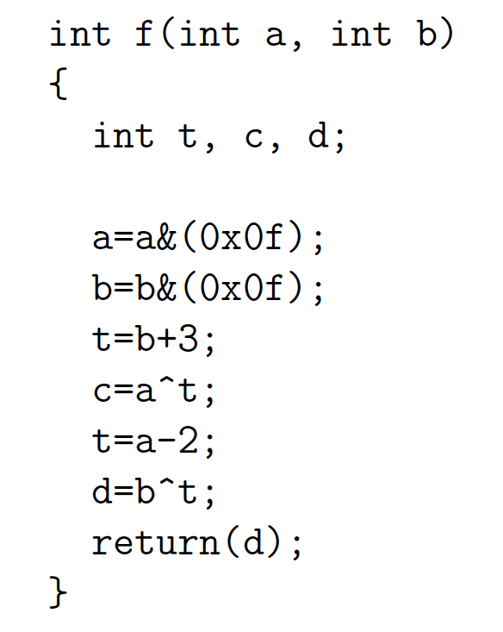
Lecture Checkpoint
Happy with ?
Straight-line code
Variables
Graph for preclass f

Slide 23
Straight Line Code
C is fine for expressing straight-line code and variables
Has limited data types
Address with tricks like masking
Address with user-defined types

Slide 24
Optimizations can probably expect compiler to do
Constant propagation: a=10; b=c[a];
Copy propagation: a=b; c=a+d; → c=b+d;
Constant folding: c[10*10+4]; → c[104];
Identity Simplification: c=1*a+0; → c=a;
Strength Reduction: c=b*2; → c=b<<1;
Dead code elimination
Common Subexpression Elimination:
C[x*100+y]=A[x*100+y]+B[x*100+y]
t=x*100+y; C[t]=A[t]+B[t];
Operator sizing: for (i=0; i<100; i++) b[i]=(a&0xff+i);

Slide 25
Conditionals
What can we do for simple conditionals?
if (a<b)
res=b-a
Else
res=a-b

Slide 26
Simple Control Flow
If (cond) { … } else { …}
Assignments become conditional
In simplest cases (no memory ops), can treat as dataflow node
cond
then
else
choose

Slide 27
Simple Conditionals
if (a>b)
c=b*c;
else
c=a*c;
a>b
b*c
a*c
c

Slide 28
Simple Conditionals
v=a;
if (b>a)
v=b;
If not assigned, value flows from before assignment
b>a
b
a
v

Slide 29
Simple Conditionals
a
max=a;
min=a;
if (a>b)
{min=b;
c=1;}
else
{max=b;
c=0;}
May (re)define many values on each branch.
a>b
b
1
0
min
max
c

Slide 30
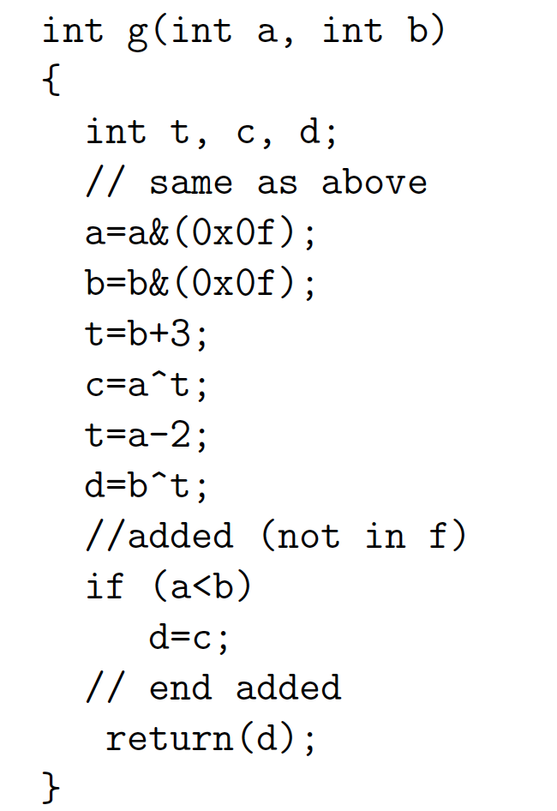
Preclass G
Graph for preclass g as mux-conversion?

Slide 31
Part 2
Functions and Globals

Slide 32
Function Call
What computation is this describing?
What role does the function call play?
int f(int a, int b)
return(sqrt(a*a+b*b));
for(i=0;i<MAX;i++)
D[i]=f(A[i],B[i]);

Slide 33
Inline Transformation
Inline a function
Copy the body of function
Into the point of call
Replacing the function arguments
With the arguments supplied in the call
int f(int a, int b)
return(sqrt(a*a+b*b));
for(i=0;i<MAX;i++)
D[i]=f(A[i],B[i]);
for(i=0;i<MAX;i++)
D[i]=sqrt(A[i]*A[i] +B[i]*B[i]);

Slide 34
Inline
int p(int a)
return(a*a+2*a-1);
for(i=0;i<MAX;i++)
D[i]=p(A[i])-p(B[i]);
for(i=0;i<MAX;i++)
D[i]=A[i]*A[i]+2*A[i]-1
- (B[i]*B[i]+2*B[i]-1);
Functions provide descriptive convenience and compactness.
…but don’t need to force implementation.

Slide 35
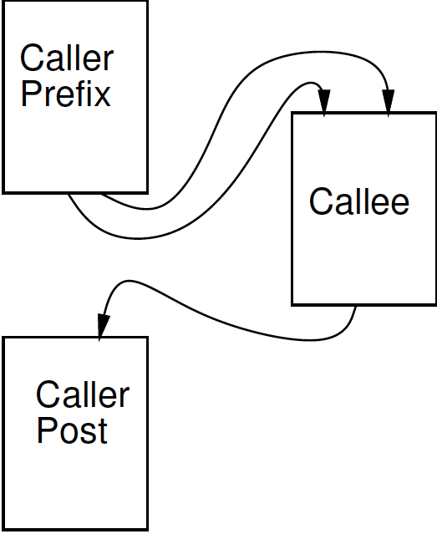
Treat as data flow
Implement function as an operation
Send arguments as input tokens
Get result back as token
Functions provide potential division between substrates?
Assign different functions to
different substrate (proc, fpga)

Slide 36
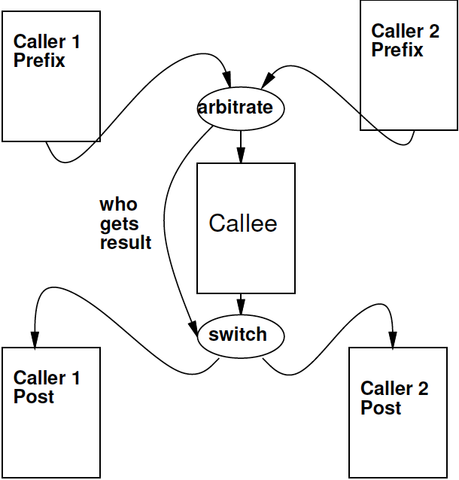
Shared Function
F1(A,B);
// Transpose(A,Aprime);
// matmul(Aprime,c1,B);
F2(B,C);
// matmul(B,c2,Cpre);
// normalize(Cpre,C);
if (A<B)
{
matmul(A,c1,B);
}
else
{
matmul(D,c3,E);
}
Functions express shared operators.

Slide 37
Recursion?
int fib(int x) {
if ((x==0) || (x==1)) return(1);
else
return(
fib(x-1) + fib(x-2));
}
In general won’t work.
Problem?
Smart compiler might be able to turn some cases into iterative loop.
…but don’t count on it.
VivadoHLS will not

Slide 38
Global Variables
int a=0;
int f1(int *A) {
for (int i=0;i<a;i++)
sum+=A[i];
return(sum); }
void f2(int *A) {
while (A[a]!=0);
a++;
}
f2(input);
isum=f1(input);
Variables not declared in a function resolve to outer context

Slide 39
Treat as data flow
Functions provide potential division between substrates.
Impact on global variables?
Run on processor
Run on FPGA
int a=0;
int f1(int *A) {
for (int i=0;i<a;i++)
sum+=A[i];
return(sum); }
void f2(int *A) {
while (A[a]!=0);
a++; }
f2(input);
isum=f1(input);

Slide 40
Treat as data flow
Functions provide potential division between substrates.
Impact on global variables?
Correct thing
Reflect change in variable between substrates
Evidence Vivado HLS
Not synchronized with host C on globals
Run on processor
Run on FPGA

Slide 41
Global Variables
int a=0;
int f1(int *A) {
for (int i=0;i<a;i++)
sum+=A[i];
return(sum); }
void f2(int *A) {
while (A[a]!=0);
a++;
}
f2(input);
isum=f1(input);
Globals generally considered bad coding practice
Obfuscate flow of data even for human
Avoid Gobals
With hardware, have extra reason avoid

Slide 42
Global Variables
Bad
Better
int a=0;
int f1(int *A) {
for (int i=0;i<a;i++)
sum+=A[i];
return(sum); }
void f2(int *A) {
while (A[a]!=0);
a++;
}
f2(input);
isum=f1(input);
int f1(int *A, int len) {
for (int i=0;i<len;i++)
sum+=A[i];
return(sum); }
int f2(int *A) {
int len=0;
while (A[len]!=0);
len++;
return(len)
}
len=f2(input);
isum=f1(input,len);

Slide 43
Part 3
Loops and Arrays

Slide 44
Loops…
From an express computation standpoint, have several roles
Compact code
Unbounded computation
From describe hardware
Compact expression of parallel hardware
Express pipelines
Express data-level parallelism
Express area-time tradeoff

Slide 45
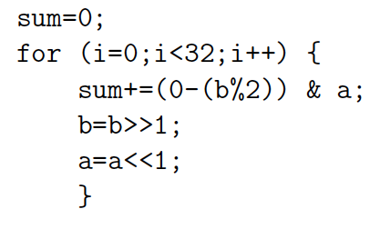
Loop Compact Expression
What express?
Sequential, fully unrolled, partially unrolled?

Slide 46
Sequential

Slide 47
Spatial = fully unrolled

Slide 48
Stream
Day 5
Logical abstraction of a persistent point-to-point communication link between operators
Has a (single) source and sink
Carries data presence / flow control
Provides in-order (FIFO) delivery of data from source to sink
stream

Slide 49
Stream
For the moment assume way to read and write to streams:
stream.read() – return next value on stream
stream.write(val); put val onto stream
stream

Slide 50
Unbounded, Pipelined Operator
What C code describe?

Slide 51
Unbounded, Pipelined Operator
What describe?
int c=12;
while(true)
{
int aval=astream.read();
int bval=bstream.read();
int res=a*b+c;
resstream.write(res);
}

Slide 52
With function call, loop in function
int c=12;
while(true)
{
int aval=astream.read();
int bval=bstream.read();
int res=multiply(a,b)+c;
resstream.write(res);
}

Slide 53
Compact Expression: Arrays
Useful to be able to refer to different values (a large number of values) with the same code.
Arrays + Loops: give us a way to do that
Useful:
general expression
hardware description

Slide 54
Compact Expression: Arrays+Logic
Vector sum:
c3=a3+b3; c2=a2+b2; c1=a1+b1; c0=a0+b0;
for(i=0;i<3;i++) c[i]=a[i]+b[i];
Chose small length to fit non-array on slide
#define K 16
for(i=0;i<K;i++) c[i]=a[i]+b[i];

Slide 55
Compact Expression: Arrays+Logic
Dot Product:
Y=a3*b3+a2*b2+a1*b1+a0*b0;
Y=0; for(i=0;i<3;i++) Y+=a[i]*b[i];

Slide 56
Compact Expression: Arrays+Logic
Vector sum:
c3=a3+b3; c2=a2+b2; c1=a1+b1; c0=a0+b0;
for(i=0;i<3;i++) c[i]=a[i]+b[i];
These array elements may be nodes in dataflow graph, just like the variables we saw for function f
Express large dataflow graphs
Make area-time choices for implementation

Slide 57
Foreshadowing: C Array Challenge
C programmers think of arrays as memory (or memory as arrays)
…and sometimes we will want to
Be careful understanding (and expressing) arrays that don’t have to be memories
…and treated with memory semantics

Slide 58
Loop Interpretations
What does a loop describe?
Sequential behavior [when to execute]
Spatial construction [when create HW]
Data Parallelism [sameness of compute]
We will want to use for all 3
Sometimes need to help the compiler understand which we want

Slide 59
Easy Loop (for contrast)
for (i=0;i<10;i++)
sum+=a[i];
How many times loop execute?
If unroll, which i for each loop instance?

Slide 60
Loop Bounds
Loops without constant bounds
while (sum+a[i]<100) {
sum+=a[i];
b[i]=a[i]>>2;
i++; }
How many times loop execute?
Typically forces sequentialization
Cannot unroll into hardware

Slide 61
Loop Increment
Loops with variable increment also force sequentialization
for (i=0;i<100;i+=f(i))
{ b[i]=a[i]; sum+=a[i]; }
What are values of i for which evaluate body?

Slide 62
Loop Interpretations
What does a loop describe?
Sequential behavior [when execute]
Spatial construction [when create HW]
Data Parallelism [sameness of compute]
We will want to use for all 3
C allows expressive loops
Some expressiveness
Not compatible with spatial hardware construction

Slide 63
Unroll
Vivado HLS has pragmas for unrolling
UG901: Vivado HLS User’s Guide
P180—229 for optimization and directives
#pragma HLS UNROLL factor=…
Use to control area-time points
Use of loop for spatial vs. temporal description

Slide 64
Big Ideas:
C (any prog lang) specifies a computation
Can describe spatial computation
Has some capabilities that don’t make sense in hardware
Shared memory pool, globals, recursion
Watch for unintended sequentialization
C for spatial is coded differently from C for processor
…but can still run on processor
Good for leaf functions (operations)
Limiting for full task

Slide 65
Admin
Feedback, incl. HW4
Midterm on Wednesday
Here at lecture time
See details on web
Previous midterms on web
Parts 1—3 today are relevant to exam
No office hour Wed.
Extended TA office hours Tuesday 5—7pm
HW5 due Wednesday 10/13
Several long compiles
Get started early

