Slide 1

ESE5320:
System-on-a-Chip Architecture
Day 1: August 31, 2022
Introduction and Overview
(lecture start target 10:20am)
Masks required in Lecture
Note: slides linked to web
www.seas.upenn.edu/~ese5320/fall2022/fall2022.html
Preclass (work now)
Feedback form (turn in end of lecture)

Slide 2
Today
Part 1: Case for Programmable SoC
Part 2
  Course Goals
  Outcomes
  Risks, Tools
Part 3: Sample Optimization
Part 4: This course
  (including policies, logistics)

Slide 3
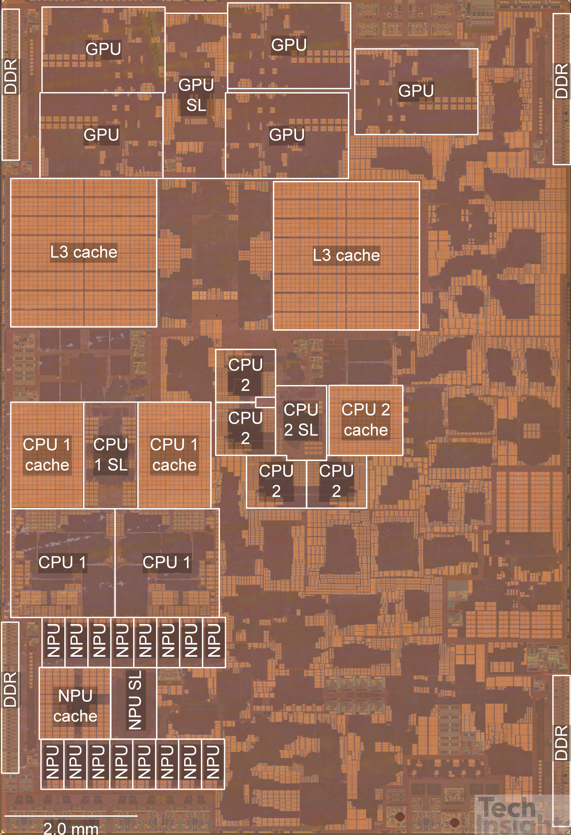
Apple A15 Bionic
108mm², 5nm
15 Billion Tr.
iPhone 13
6 ARM cores
  2 fast (3.2GHz)
  4 low energy (2GHz)
5 custom GPUs
16 Neural Engines
  11 Trillion ops/s?
Image from https://semianalysis.com/apple-a15-die-shot-and-annotation-ip-block-area-analysis/
https://www.anandtech.com/show/16983/the-apple-a15-soc-performance-review-faster-more-efficient

Slide 4
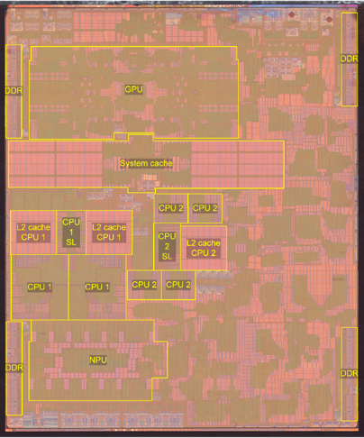
Apple A14 Bionic
88mm², 5nm
11.8 Billion Tr.
iPhone 12
6 ARM cores
  2 fast (2.9--3GHz)
  4 low energy
4 custom GPUs
16 Neural Engines
  11 Trillion ops/s?
Image from https://www.extremetech.com/computing/318715-comparison-of-apple-m1-a14-shows-differences-in-soc-design
details: https://www.tomshardware.com/news/apple-a14-bionic-revealed
https://www.anandtech.com/show/16226/apple-silicon-m1-a14-deep-dive/2

Slide 5
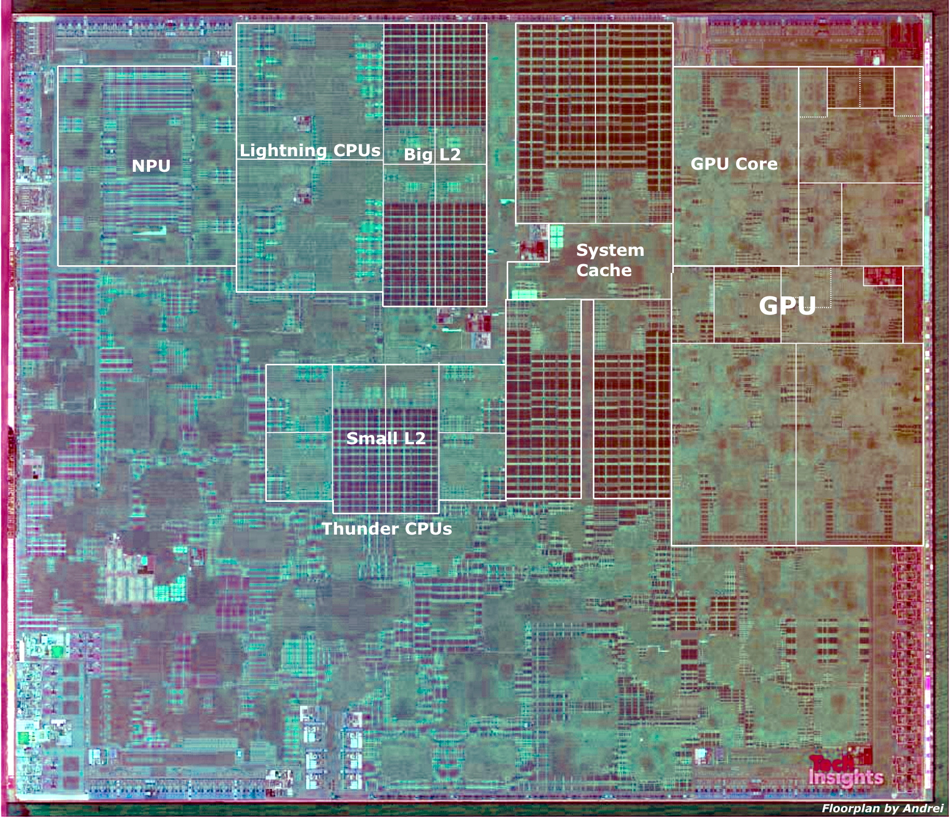
Apple A13 Bionic
98mm², 7nm
8.5 Billion Tr.
iPhone 11 +
6 ARM cores
  2 fast (2.6GHz)
  4 low energy
4 custom GPUs
Neural Engine
  5 Trillion ops/s?

Slide 6
Questions
Why do today’s SoC look like they do?
How approach programming modern SoCs?
How design a custom SoC?
When building a System-on-a-Chip (SoC)
  How much area should go into:
    Processor cores, GPUs,
    FPGA logic, memory,
    interconnect,
    custom functions (which) …. ?

Slide 7
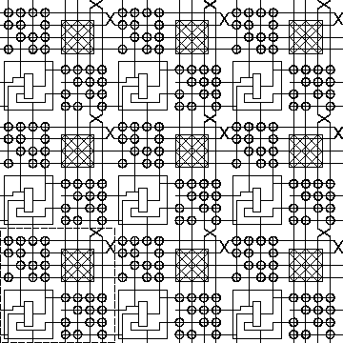
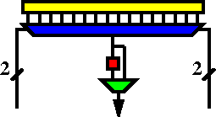
FPGA
Field-Programmable Gate Array
K-LUT (typical k=4 or 6)
Compute block
w/ optional
output Flip-Flop
ESE1500, CIS5710

Slide 8
Case for Programmable SoC

Slide 9
End of microprocessor Scaling
Old
Moore’s Law scaling delivered faster transistors
Processors rode Moore’s Law
  Turning transistors into performance
Could wait and ride technology curve
Now
Dennard’s Law kicked in
  How need to scale voltage with size
microprocessors were burning more power
Lost ability to scale down voltage
Processor performance stalled

Slide 10
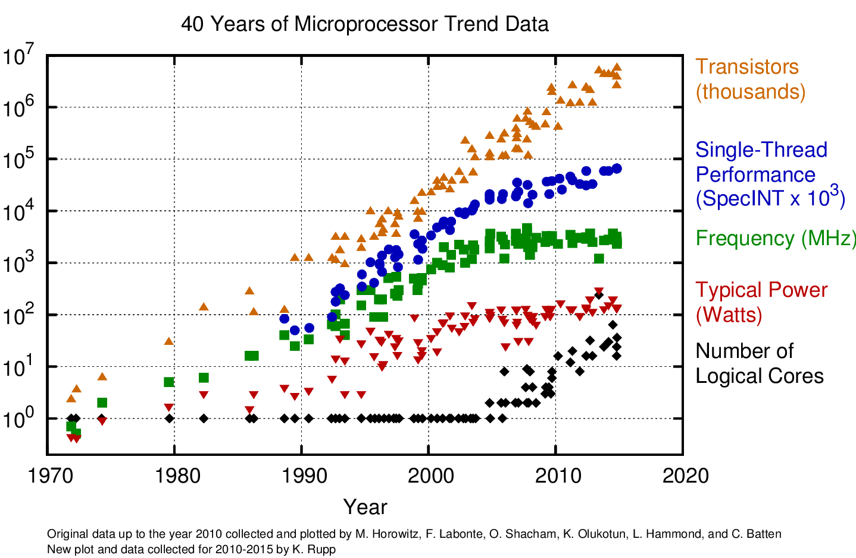

Slide 11
The Way things Were
30 years ago
Wanted programmability
  used a processor
Wanted it a little faster
  Next year’s processor would run faster…
Wanted high-throughput
  used a custom IC
Wanted product differentiation
  Got it at the board level
  Select which ICs and how wired
Build a custom IC
  It was about gates and logic

Slide 12
Today
Microprocessor may not be fast enough
  (but often it is)
  Or low enough energy
Single core processor scaling has ended
Time and Cost of a custom IC is too high
  $100M’s of dollars for development, Years
FPGAs promising
  But build everything from prog. gates?
Premium for small part count
  And avoid chip crossing
  ICs with Billions of Transistors

Slide 13
Non-Recurring Engineering (NRE) Costs
Costs spent up front on development
  Engineering Design Time
  Prototypes
  Mask costs
Recurring Engineering
  Costs to produce each chip

Slide 14
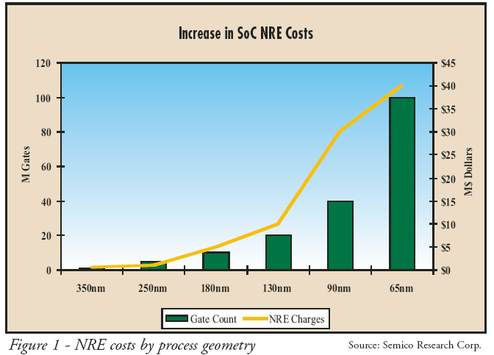
NRE Costs

Slide 15
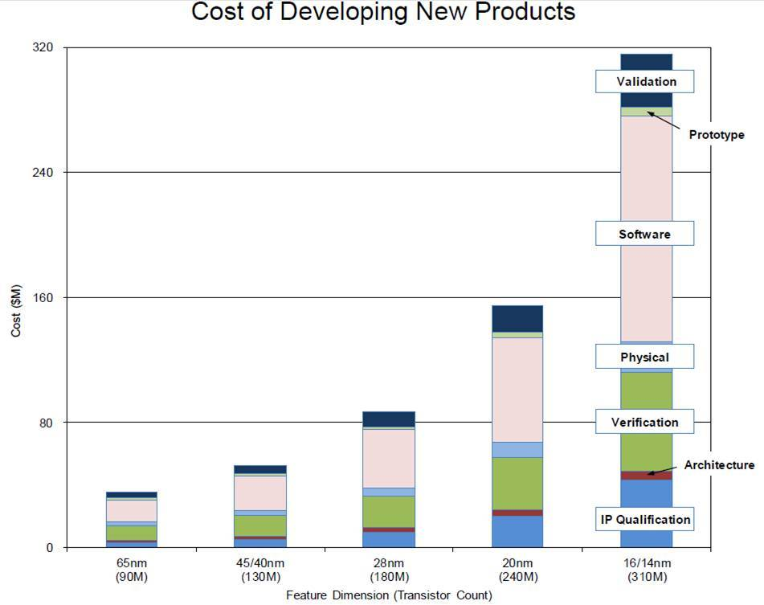
NRE Cost (continued)
https://semiengineering.com/how-much-will-that-chip-cost/

Slide 16
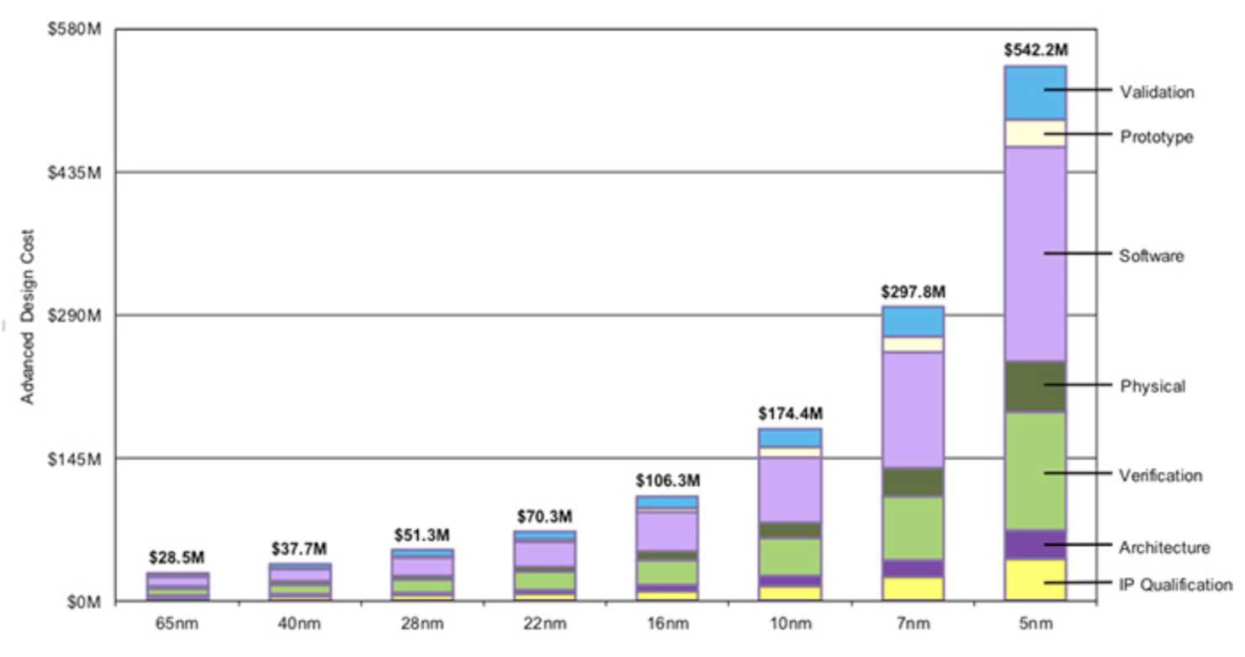
Bonus: Chip Design Costs
https://wccftech.com/apple-5nm-3nm-cost-transistors/

Slide 17
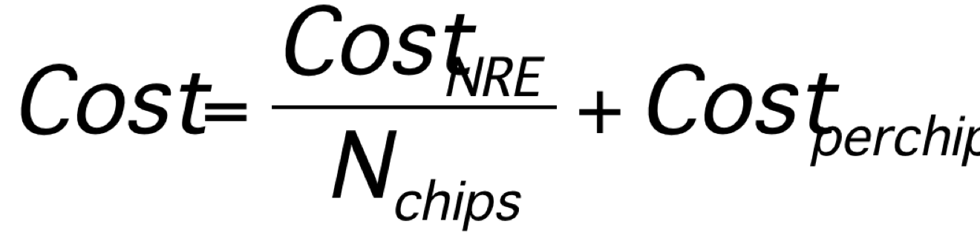
Amortize NRE with Volume

Slide 18
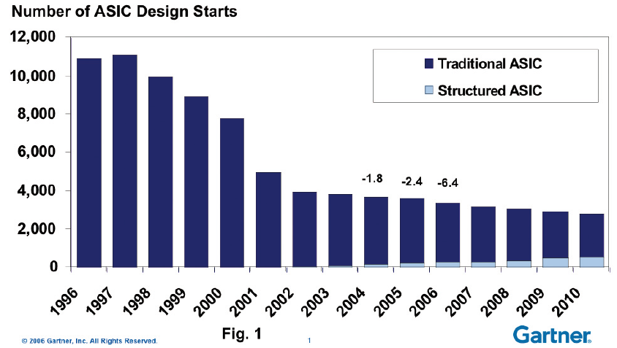
Economics
Forcing fewer,
more
customizable
chips
Economics force fewer, more customizable chips
  Mask costs in the millions of dollars
  Custom IC design NRE 100s of millions of dollars
    Need market of billions of dollars to recoup investment
    With fixed or slowly growing total IC industry revenues
    ➔ Number of unique chips must decrease
    Chips must be programmable

Slide 19
Large ICs
Now contain significant software
  Almost all have embedded processors
Must co-design SW and HW
Must solve complete computing task
  Tasks has components with variety of needs
  Some don’t need custom circuit
  90/10 Rule

Slide 20
Given Demand for Programmable
How do we get higher performance than a processor, while retaining programmability?

Slide 21
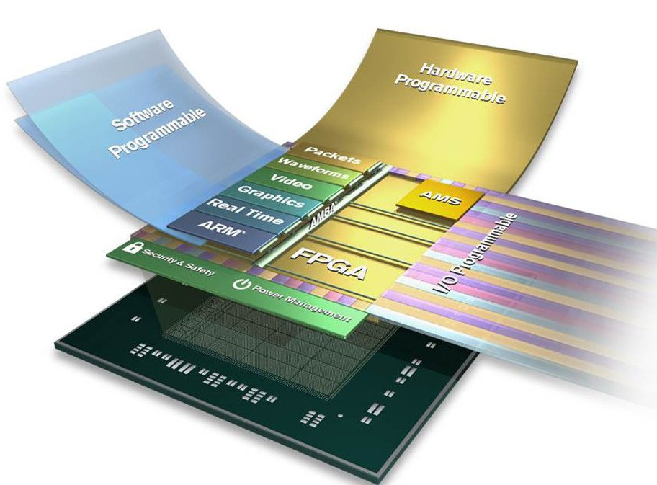
Programmable SoC
Implementation Platform for innovation
  This is what you target (avoid NRE)
  Implementation
  vehicle

Slide 22
Programmable SoC
UG1085
Xilinx
UltraScale
Zynq
TRM
(p27)

Slide 23
Then and Now
30 years ago
Programmability?
  use a processor
Faster
  Processors scaled
High-throughput
  used a custom IC
Wanted product differentiation
  board level
  Select & wired IC
Build a custom IC
  It was about gates and logic
Today
Programmability?
  uP, FPGA, GPU, PSoC
Faster
  Can’t get with single core
High-throughput
  FPGA, GPU, PSoC, custom
Wanted product differentiation
  Program FPGAs, PSoC
Build a custom IC
  System and software

Slide 24
Part 2:
Course
Goals, Outcomes

Slide 25
Goals
Create Computer Engineers
  SW/HW divide is wrong, outdated
  Computer engineers understand computation
    HW and SW are just tools and design options
  Parallelism, data movement, resource management, abstractions
  Cannot build a chip without software
SoC user – know how to exploit
SoC designer – architecture space,
hw/sw codesign
Project experience – design and optimization

Slide 26
Roles
PhD Qualifier
  One broad Computer Engineering
CMPE Concurrency Lab
Hands-on Project course

Slide 27
Outcomes
Design, optimize, and program a modern System-on-a-Chip.
Analyze, identify bottlenecks, design-space
  Modeling → write equations to estimate
Decompose into parallel components
Characterize and develop real-time solutions
Implement both hardware and software solutions
Formulate hardware/software tradeoffs, and perform hardware/software codesign

Slide 28
Outcomes
Understand the system on a chip from gates to application software, including:
  on-chip memories and communication networks, I/O interfacing, design of accelerators, processors, firmware and OS/infrastructure software.
Understand and estimate key design metrics and requirements including:
  area, latency, throughput, energy, power, predictability, and reliability.

Slide 29
Tools
Are complex
Will be challenging, but good for you to build confidence can understand and master
Tool runtimes can be long
Learning and sharing experience will be part of assignments

Slide 30
Distinction
CIS2400, 4710, 5710
ESE5320
Best Effort Computing
  Run as fast as you can
Binary compatible
ISA separation
Shared memory parallelism
Hardware-Software codesign
  Willing to recompile, maybe rewrite code
  Define/refine hardware
Real-Time
  Guarantee meet deadline
Non shared-memory parallelism models

Slide 31
Distinction
ESE5320:
ESE5390: Hardware/Software Co-Design for Machine Learning
Deep computer engineering
Broad application
Program in C
Suitable followup if want to dig deeper
Deep on Application (ML)
More accessible to CS
  Less previous experience with circuits and architecture
Won’t be as deep on understanding HW and optimization
Program in Pytorch, OpenCL

Slide 32
Abstraction Stack
Software
ESE5390 HW/SW ML
Embedded Sys:
ESE3500/5190
Systems
SoC Arch:
ESE 5320
Processors
Processor Arch:
CIS 4710/5710
(CIS2400)
Mixed Signal:
ESE 5680
ADC, DAC
Switched Capacitors
Gates, Memories
Digital:
ESE3700/5700
Analog:
ESE4190/5720
Amplifier, Compare
Voltage/Current Ref.
Circuits/VLSI
Devices: ESE5210
(ESE2180)
Transistors

Slide 33
Part 3:
Approach -- Example

Slide 34
Abstract Approach
Identify requirements, bottlenecks
Decompose Parallel Opportunities
  At extreme, how parallel could make it?
  What forms of parallelism exist?
    Thread-level, data parallel, instruction-level
Design space of mapping
  Choices of where to map, area-time tradeoffs
Map, analyze, refine
  Write equations to understand, predict

Slide 35
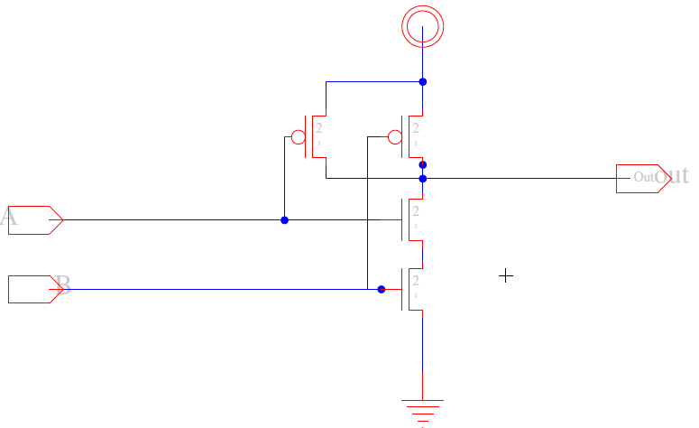
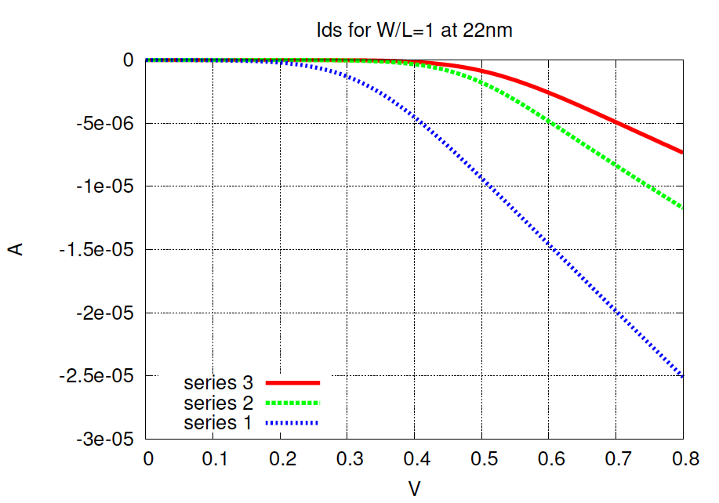
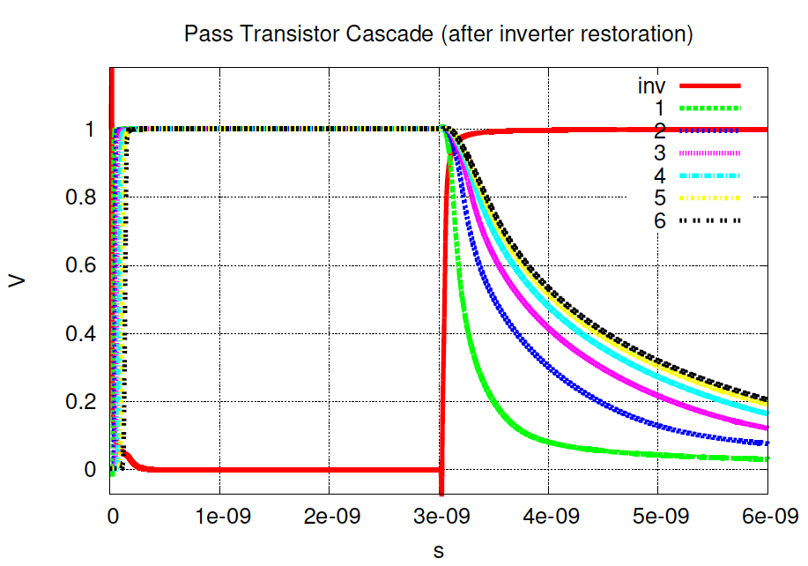
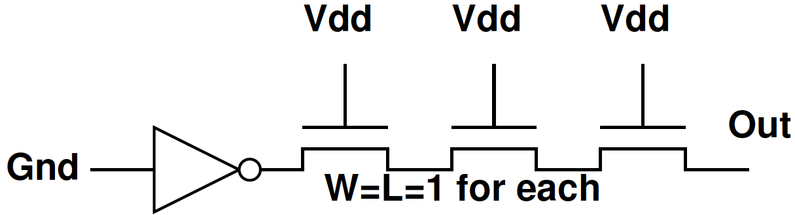
Example SPICE Circuit Simulator

Slide 36
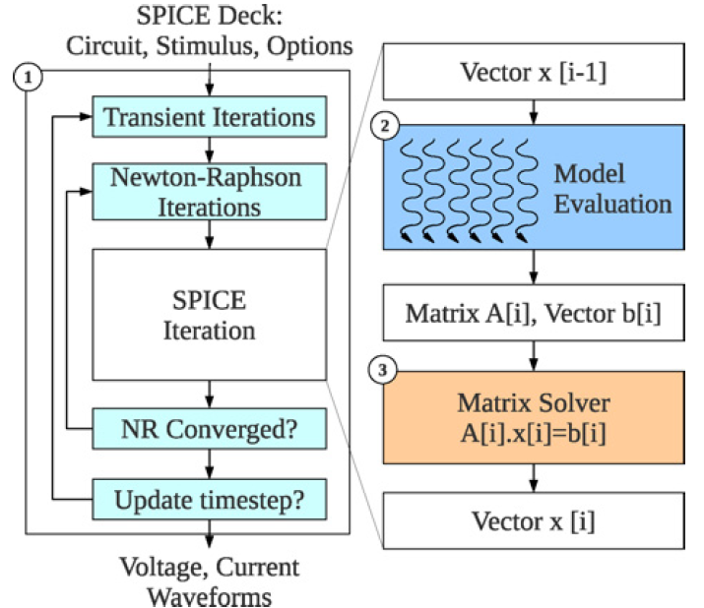
Example: SPICE Circuit Simulator
Matrix Solve
Ax=B
A matrix
B vector
x unknown vector
Solve for x
= KCL, KVL *
Linear Algebra
solving n eqns
in n unknowns.
Example: Kapre+DeHon, TRCAD 2012
* Kirchhoff {Current,Voltage} Laws

Slide 37
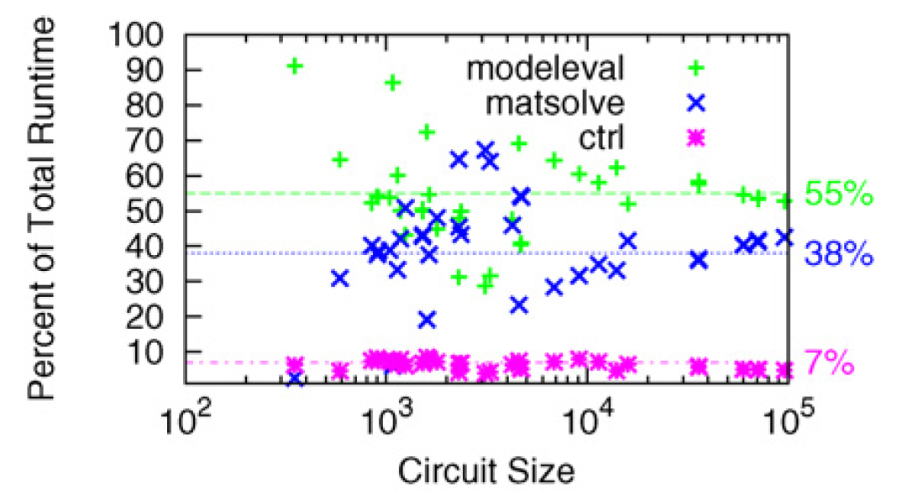
Analyze

Slide 38
Analyze
T=T_{modeleval}+T_{matsolve}+T_{ctrl}

Slide 39
Speedup
T=T_{modeleval}+T_{matsolve}+T_{ctrl}
What should we speedup first?
What happens if only speedup modeleval?
  T=T_{matsolve}+(T_{modeleval})/S+T_{ctrl}

Slide 40
Analyze
If only accelerated model evaluation
only about 2x speedup
If want better than 14x speed,
must also attack control

Slide 41
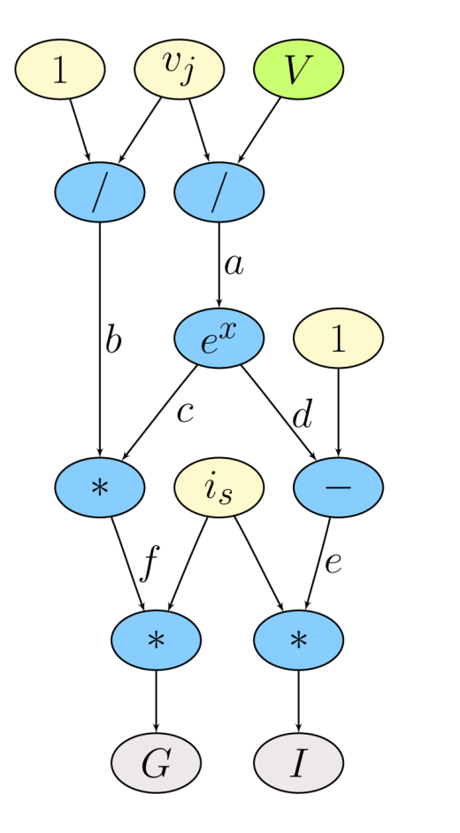
Model Evaluation: Trivial Hardware Implementation
*
*
÷
e
f
b
-
*
÷
d
c
a
e^{x}
Verilog-AMS as Domain-Specific Language

Slide 42
Spatial, Pipelined Parallelism
Every operation (*, + /) gets dedicated hardware.
Implement task in space → use additional area for each operator.
Parallel – all operations occur simultaneously.
*
*
÷
e
f
b
-
*
÷
d
c
a
e^{x}

Slide 43
Parallelism: Model Evaluation
Data Parallel
Every device independent
Many of each type of device
Can evaluate in parallel
  T=T_{seq}/N_{proc}
Build pipelined circuit for model
  T_{seq}=N_{comp}*T_{cycle}
  vs. T_{pipe}=T_{cycle}

Slide 44
Spatial Too Big?
Fully spatial circuit
Custom VLIW
*
÷
*
*
÷
b
e
f
-
*
÷
+
d
c
a
e^{x}
e^{x}
~100x Speedup
Multiple FPGAs
~10x Speedup
1 FPGA (2010)
VLIW=Very Long Instruction Word
exploits Instruction-Level Parallelism

Slide 45
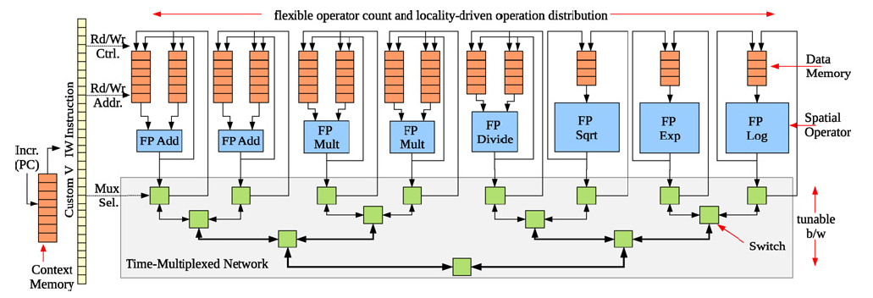
Parallelism: Model Evaluation
Spatial end up bottlenecked by other components
Use custom evaluation engines
…or GPUs

Slide 46
Parallelism: Matrix Solve
Needed direct solver?
E.g. Gaussian elimination
Data dependence on previous reduce
  Limited data parallelism
Parallelism in subtracts
Some row independence

Slide 47
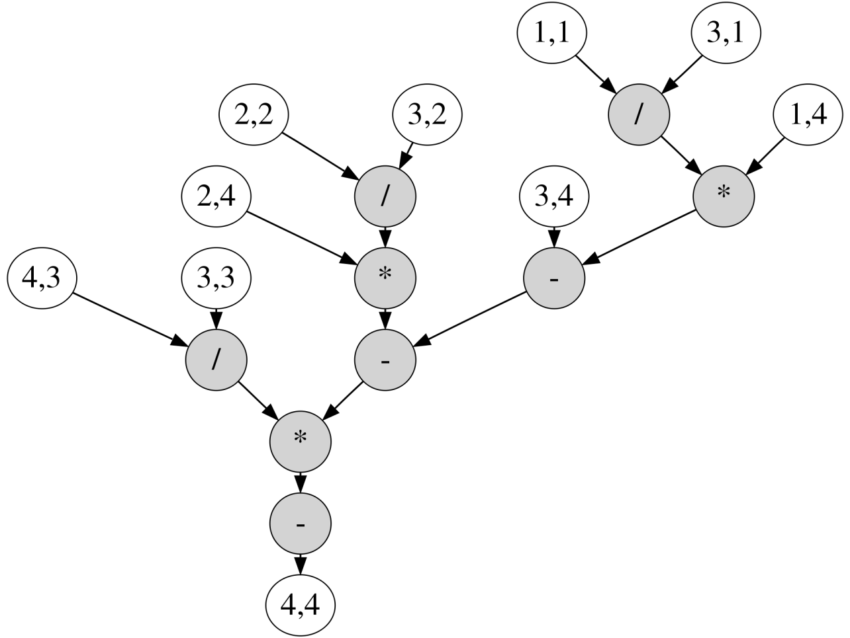
Example Matrix

Slide 48
Example Matrix

Slide 49
Example Matrix
Reduce to critical path:
from 9 sequential operations
to path of 5 operations.

Slide 50
Dataflow Processing Element (PE)
Graph
Nodes
Incoming Messages
Dataflow trigger
*
+
÷
Graph
Fanout
Outgoing Messages

Slide 51
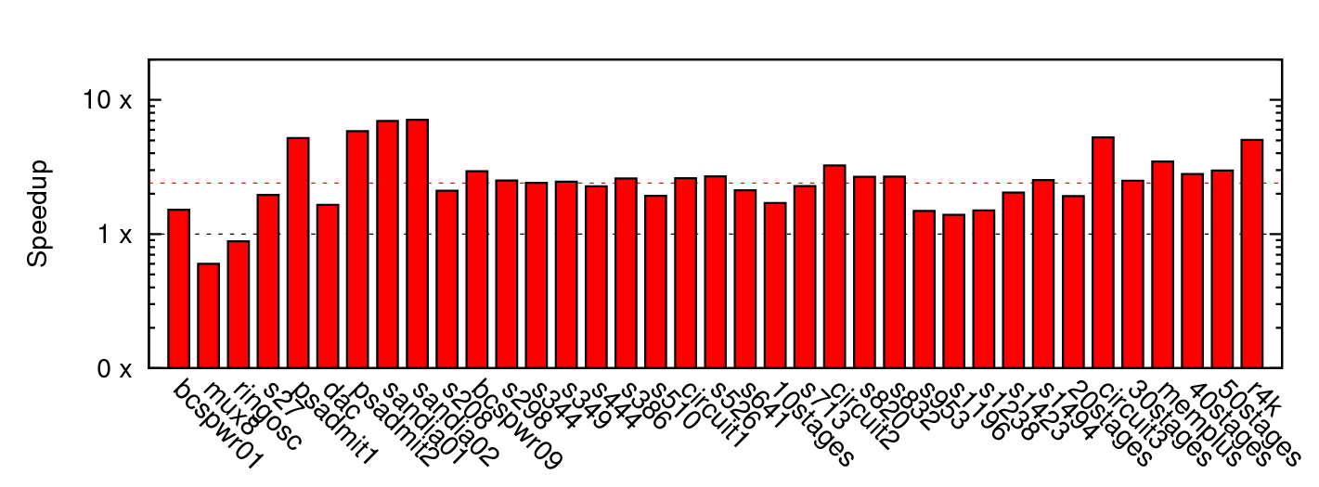
Matrix Solve Only
~2.4x mean

Slide 52
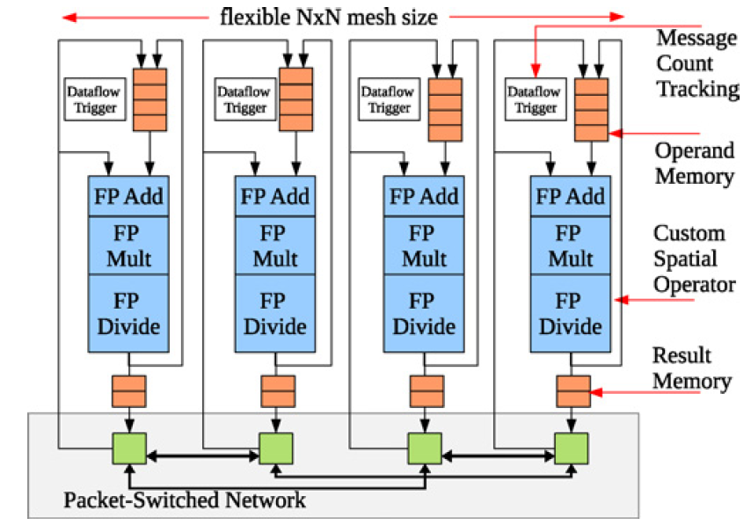
Parallelism: Matrix Solve
Settled on constructing dataflow graph
Graph can be iteration independent
  Statically scheduled
  (cheaper)
This is bottleneck to further acceleration

Slide 53
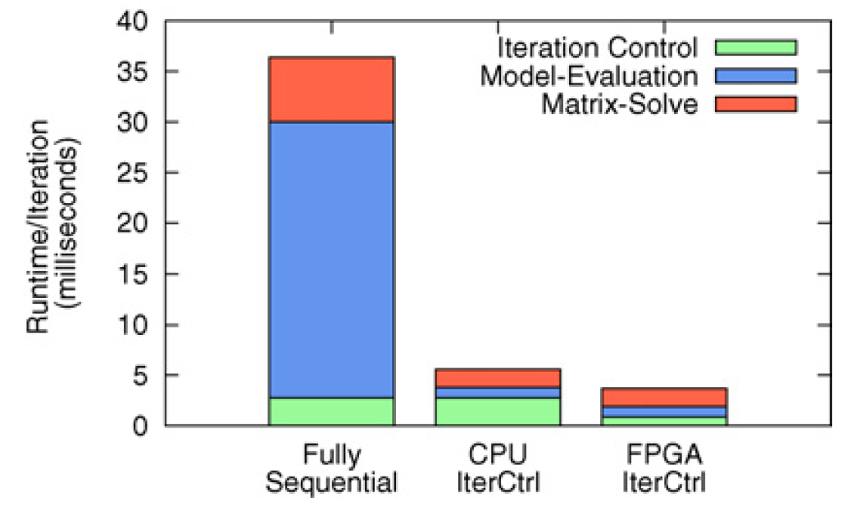
Parallelism Controller?
Could leave sequential
For some designs, becomes the bottleneck once others accelerated
Has internal parallelism in condition evaluation
  T=T_{modeleval}/S₁+(T_{matsolve})/S₂+T_{ctrl}

Slide 54
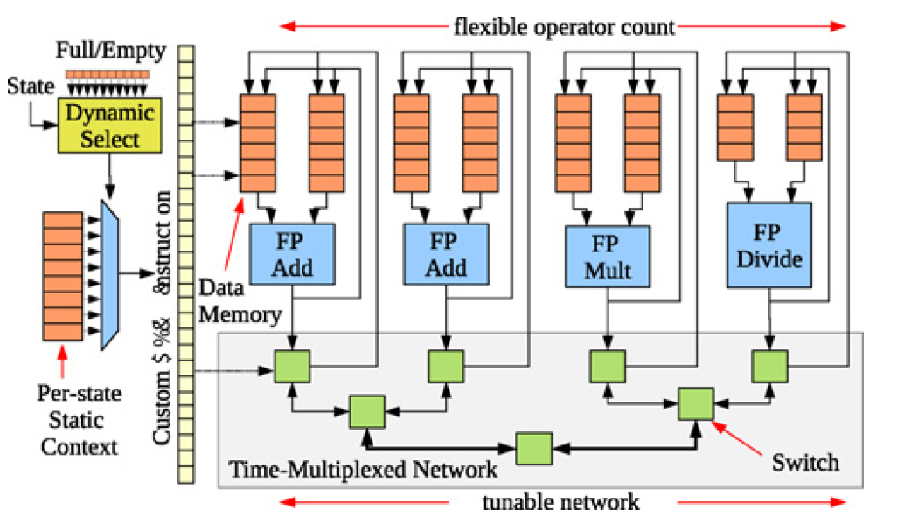
Parallelism Controller
Customized datapath controller
T_{seqctrl}=N_{add}+N_{mul}+10*N_{divide}
T_{vliwctrl}=Max(N_{add}/2,N_{mul},10*N_{divide})

Slide 55
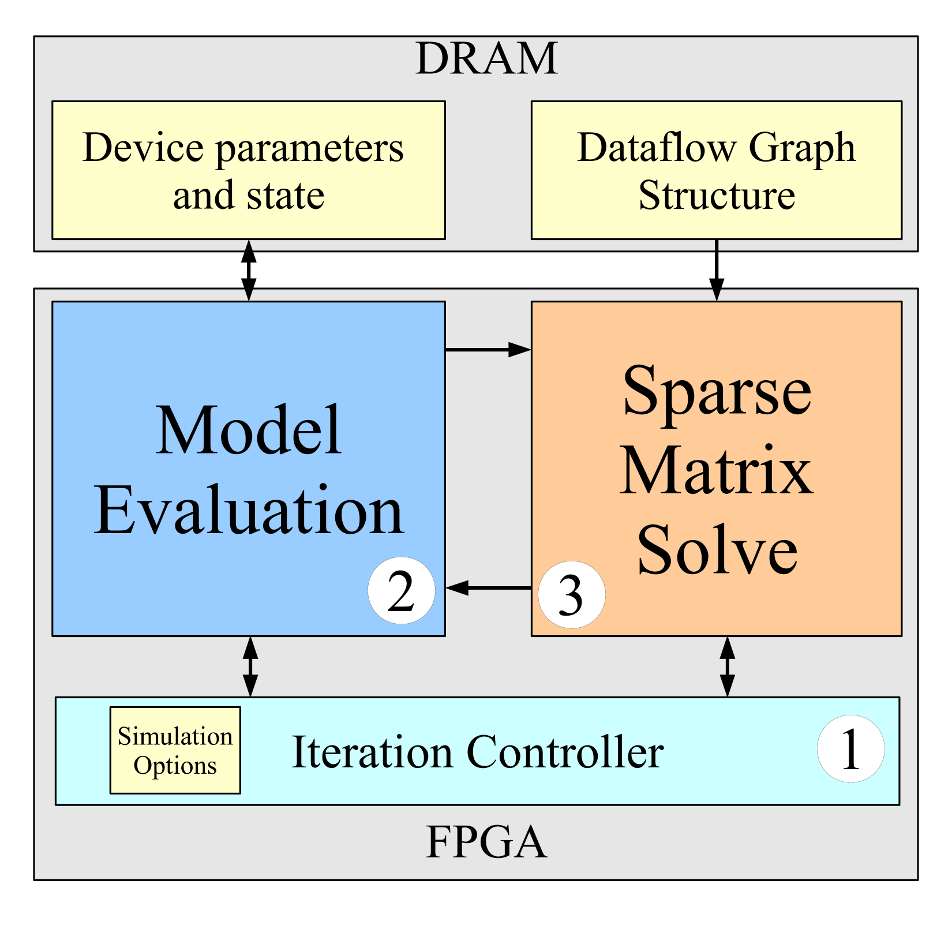
Single-Chip Solution

Slide 56
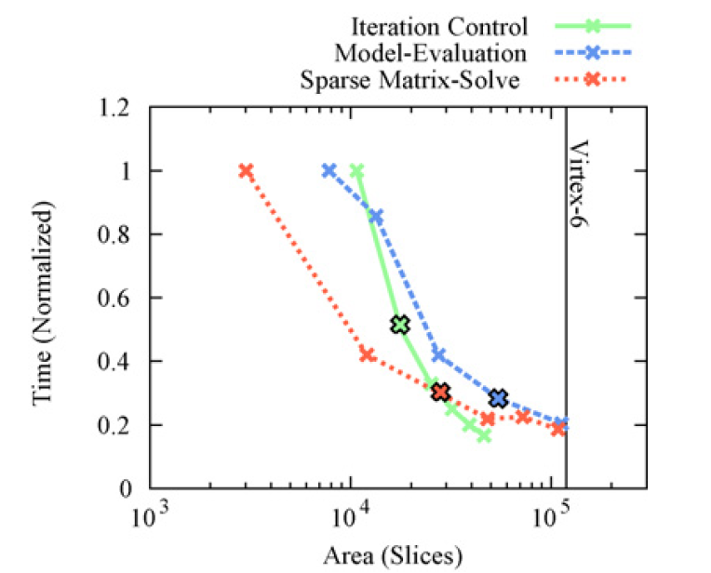
Area-Time for Each
[1 Slice = 4 LUTs]

Slide 57
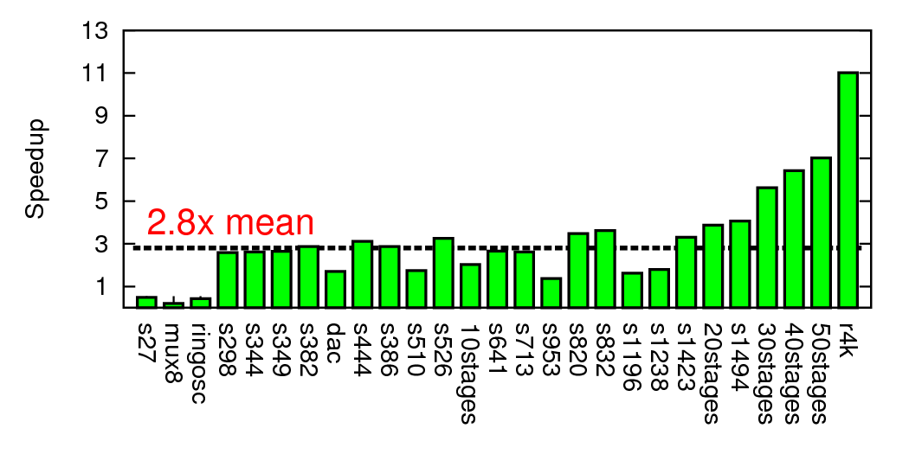
Composite Speedup

Slide 58
Modern SoC

Slide 59
Part 4:
Class Components

Slide 60
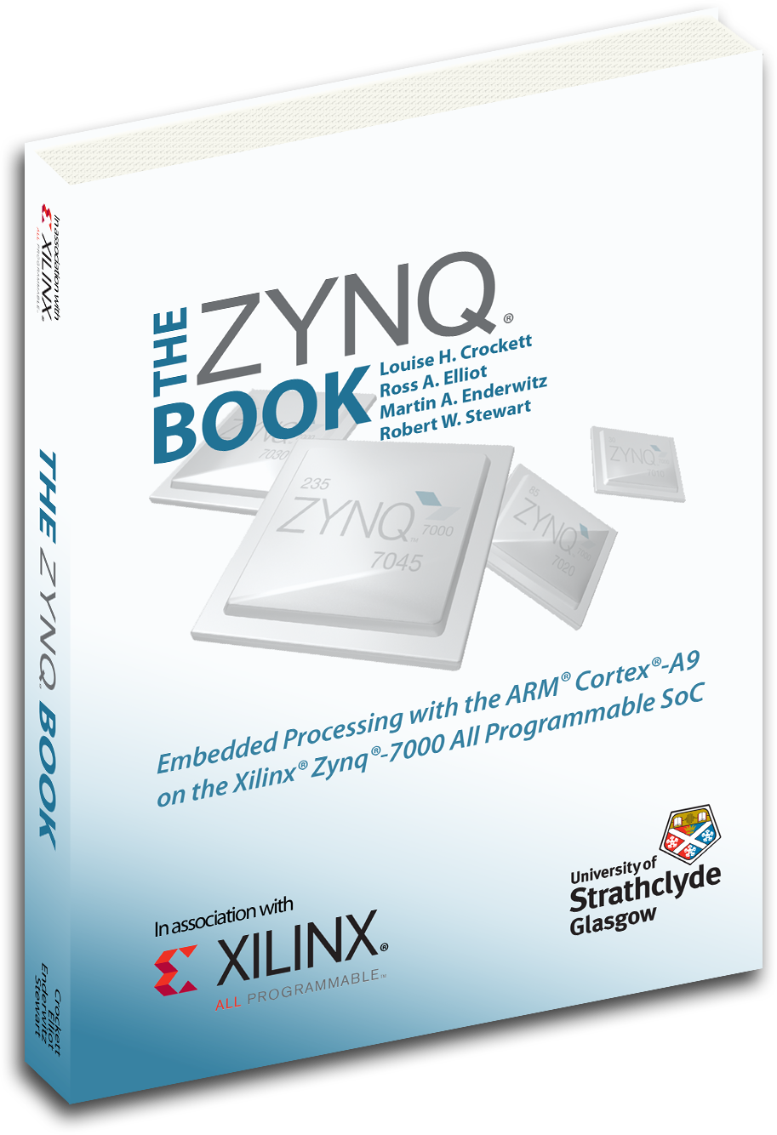
Class Components
Lecture (incl. preclass exercise)
  In-person (not hybrid, don’t expect recordings)
  Slides on web before class (print if you want)
  N.B. I encourage class participation
    In class; Questions (“warm” calls)
  Daily Quiz
Reading [~1 required paper/lecture]
  online: Canvas, IEEE, ACM, also ZynqBook,
  Parallel Programming for FPGAs
Homework
  (1 per week due F5pm Eastern)
Project – open-ended (~6 weeks)
Note syllabus, course admin online

Slide 61
First Half
Quickly cover breadth
Metrics, bottlenecks
Memory
Parallel models
SIMD/Data Parallel
Thread-level parallelism
Spatial, C-to-gates
Line up with homeworks

Slide 62
Second Half
Real-time
Reactive
Memory
Networking
Energy
Scaling
Chip Cost
Verification
VLIW
Reduce
Use everything on project
Going deeper

Slide 63
Teaming
HomeWorks (HW) in Groups of 2 (after 0, 1)
HW: we assign
Individual assignment writeup
Project in Groups of 3
Project: you propose team of 3, we review
  Most portions group writeup
  Few components individual writeup

Slide 64
Office & Lab Hours
Andre: M 4:00pm—5:00pm
  Levine 270, Zoom
  See canvas
TAs – Ketterer (plan, confirming…)
  Tuesday 7 pm
  Wednesday 7 pm (not today)
  Thursday 4-5pm, 8:15pm-9:15pm (first office hours tomorrow)

Slide 65
Diagnostic Assessment
Course will rely heavily on C
  Program both hardware and software in C
If you cannot read/write code in C,
this course will be a challenge
Diagnostic Assessment intended as a quick indication if you aren’t ready
  Should be able to complete quickly
  Better to find out now than after you’re stuck in the course
  Due next Wednesday (9/7)

Slide 66
C Review
Course will rely heavily on C
  Program both hardware and software in C
HW1 has some C warmup problems
TAs will hold C review
  on Sept. 6th, 5:00pm
  (before our next class meeting since Monday 9/5 is Labor day)

Slide 67
Preclass Exercise
Motivate the topic of the day
  Introduce a problem
  Introduce a design space, tradeoff, transform
Available before lecture (11:10am)
  Should work before lecture starts
  Won’t be available later
Do bring/use calculator
  Will be numerical examples

Slide 68
Daily Quiz
Count for Engagement Points
Only available until next lecture
Incentive to keep up with material

Slide 69
Lecture Timeline
Preclass available before class
  In class hardcopy circa 10:10am
Start lecture at 10:20am
Lecture until 11:40am
(most days) stay for remaining questions
  Pending course after us
Masks required in lecture

Slide 70
Feedback
Will have anonymous feedback for each lecture
  Clarity?
  Speed?
  Vocabulary?
  General comments
    Specificity most helpful
      X was unclear because of Y
      Subtopic Z went too fast
      Need an example for Q

Slide 71
Policies
Canvas turn-in of assignments
No handwritten work
Due on time
  Individual assignments only
    3 free late days total
Collaboration
  Tools – allowed
  Designs – limited to project teams as specified on assignments
See web page

Slide 72
Admin
Your action:
  Feedback sheet for today
  Find course web page
    Read it, including the policies
    Find Syllabus
      Find diagnostic assessment, homework 1
      Find lecture slides
        Will try to post before lecture
      Find reading assignments
  Find reading for lecture 2 on canvas and web
    …for this lecture if you haven’t already
  Find/join Ed Discussion group for course
  Signup for detkin/ketterer access
  Complete/submit diagnostic assessment

Slide 73
Big Ideas
Programmable Platforms
  Key delivery vehicle for innovative computing applications
  Reduce TTM (Time-to-Market), risk
  More than a microprocessor
  Heterogeneous, parallel
Demand hardware-software codesign
  Soft view of hardware
  Resource-aware view of parallelism

Slide 74
Questions?

