Slide 1

ESE5320:
System-on-a-Chip Architecture
Day 11: October 10, 2022
Coding HLS for Accelerators
Midterm average: 60

Slide 2
Midterm
Solutions posted
Harder midterm
  Critical Path problem for whole loop was definitely too much
Mostly diagnostic and warmup
Will take max(midterm,final) for midterm grade

Slide 3
Previously
We can describe computational operations in C
    Primitive operations (add, sub, multiply, and, or)
    Dataflow graphs primitives
    To bit level
    Conditionals and loops
    Function abstraction
    Loops, Arrays

Slide 4
Today
Arrays and Memory Sequentialization – Part 1
Controlling Parallelism in Vitis HLS C – Part 2
Controlling Memories in Vitis HLS C – Part 3
Time permitting – Part 4
  malloc, pointers,
Supplement – Part 5
  more dependencies

Slide 5
Message
Can specify HW computation in C
Vitis HLS gives control over how design mapped (area-time, streaming…)
Code may need some care and stylization to feed data efficiently
Read UG 1393 – Profiling, Optimizing, and Debugging > Optimizing C++ Kernels

Slide 6
Three Perspectives
Day 9
How express spatial/hardware computations in C
  May want to avoid some constructs in C
How express computations
  Hopefully, equally accessible to
  spatial and sequential implementations
Given C code: how could we implement in spatial hardware
  Some corner cases and technicalities make tricky

Slide 7
Arrays and Memories

Slide 8
Loop Interpretations
What does a loop describe?
  Sequential behavior [when execute]
  Spatial construction [when create HW]
  Data Parallelism [sameness of compute]
We will want to use for all 3
C allows expressive loops
  Some expressiveness
    Not compatible with spatial hardware construction

Slide 9
Arrays as Memory Banks
If single memory has only one port
  Can perform only one memory operation per cycle
  What II if a, b, c
  all in bigmem?
for (i=0;i<1024;i++)
  c[i]=a[i]*b[i];

Slide 10
Arrays as Memory Banks
Hardware expression: Sometimes we will want to describe computations with separate memory banks
int a[1024], b[1024],
c[1024];
for(i=0;i<1024;i++)
  a[i]=bigmem[offset+i];
for (i=0;i<1024;i++)
  c[i]=a[i]*b[i];

Slide 11
Physical Memory Port as Limited Shared Resource
Typically single memory port
  Must sequentialize on use of memory port
  Reason for memory banking
    Put in separate memories,
    so operations can occur simultaneously
Ultra96 DRAM 1 port
Virtex BRAM 2 ports

Slide 12
Arrays as things to put in Memory Banks
Computational expression:
  sometimes it is useful to express computation
  then decide how to pack array state into memory banks for different
    Hardware availability
    Area-Time tradeoffs

Slide 13
Arrays as Local Memory
Hardware/Computational expression: natural way of describing local state
hist(int a[SIZE], out[EVENTS]) {
int local[EVENTS];
for(i=0;i<EVENTS;i++)
local[i]=0;
for(i=0;i<SIZE;i++)
local[a[i]]++;
for(i=0;i<EVENTS;i++)
out[i]=local[i];
}

Slide 14
Arrays as Inputs and Outputs
Computational Expression: arrays are often a natural way of expressing set of inputs and outputs
int c=12;
while(true)
  {
  int aval=astream.read();
  int bval=bstream.read();
  int res=aval*bval+c;
  resstream.write(res);
    }
void op(int a[BLOCK], int b[BLOCK], int out[BLOCK]) {
for (i=0;i<BLOCK;i++)
  {
  out[i]=a[i]*b[i]+c;
    }
  }

Slide 15
Array Interpretations
What does an array describe?
  Compact expression [write less code]
  Memory banks [where place data]
    Things put in separate memory banks
  Local memory [not need to be shared]
  I/O [source and sink of data]
We will want to use for all 4
C allows expressive use of arrays/memories
  Some expressiveness will inhibit efficient hardware

Slide 16
C Memory Model
One big linear address space of locations
Most recent definition to location is value
Sequential flow of statements
New value
000
001
Addr
002
004
005
006
007
008
009
010
011
Current value

Slide 17
Challenge: C Memory Model
One big linear address space of locations
Assumes all arrays live in same memory
Assumes arrays may overlap?
New value
000
001
Addr
002
004
005
006
007
008
009
010
011
Current value

Slide 18
C Memory/Pointer Sequentialization
Must preserve ordering of memory operations
  A read cannot be moved before write to memory which may redefine the location of the read
    Conservative: any write to memory
    Sophisticated analysis may allow us to prove independence of read and write
  Writes which may redefine the same location cannot be reordered

Slide 19
C Memory/Pointer Sequentialization
Must preserve ordering of memory operations
  A read cannot be moved before write to memory which may redefine the location of the read
  Writes which may redefine the same location cannot be reordered
Challenge for single array
  Does A[B[i]] refer to same location as A[C[i]]?
  So expression issue broader than C

Slide 20
C Memory/Pointer Sequentialization
Must preserve ordering of memory operations
Challenge for single array:
  Does A[B[i]] refer to same location as A[C[i]]?
Challenge multiple arrays:
  Out-of-bounds reference for one array reference another?
  void fun(int a[100], int b[100], int c[100])
    { for (int i=0;i<100;i++) c[i]=a[b[i]]; }
  What if called: fun(a,perm,a);

Slide 21
Consequence
Expressions and operations through variables (whose address is never taken) can be executed at any time
  Just preserve the dataflow
Memory assignments must execute in strict order
  Ideally: partial order
  Conservatively: strict sequential order of C

Slide 22
More at end of lecture
More on Sequentialization and Dependencies
  Slides there to review
  Won’t cover

Slide 23
Vivado HLS Mapping Control:
Compute Parallelism
Loops, Dataflow
Part 2

Slide 24
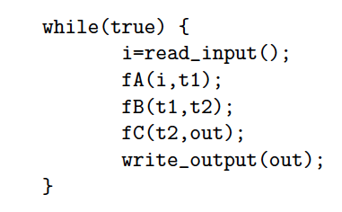
Dataflow Graph
Assume f?(in,out)
What dataflow graph does this describe?

Slide 25
Define: Pragma
Pragma – directive to compiler
  Usually compiler specific
    So ignored by compilers that don’t support
    (where not relevant)
    Gives compiler hints/direction on how to compile
    Should not change meaning of computation
      Should compute the same thing
      …but may compute differently
Use Pragmas to direct Vitis HLS on how to compile our code for FPGA

Slide 26
Vivado HLS Pragma DATAFLOW
Enables streaming data between functions and loops
  Don’t have to wait for entire array to be produced to move data and start downstream computation
Allows concurrent streaming execution
Requires data be produced/consumed sequentially
  i.e. can connect with FIFO;
  not need reorder

Slide 27
Dataflow with Arrays

Slide 28
Streamable
When process input and output in order

Slide 29
Cannot Stream Input
Why?
void fB (int in[100], int out[100])
{
for (int=0; i<100;i++)
out[i]=in[100-i];
}

Slide 30
Streamable?
Can stream input?
Can stream output?
void fC (int in[100], int out[100])
{
for (int=0; i<100;i++)
out[i]=0;
for (int=0; i<100;i++)
out[in[i]%100]++;
}

Slide 31
Vivado HLS Pragma DATAFLOW
Enables streaming data between functions and loops
Allows concurrent streaming execution
Requires data be produced/consumed sequentially
  i.e. can connect with FIFO; not need reorder
Useful to use stream data type between functions – communicates sequence
  hls::stream<TYPE>

Slide 32
Streaming Operations
Functions can have stream inputs and outputs
  Must pass as pointers
  hls::stream<Type> &strm
Vivado HLS expressiveness to define hardware streaming operation pipelines

Slide 33
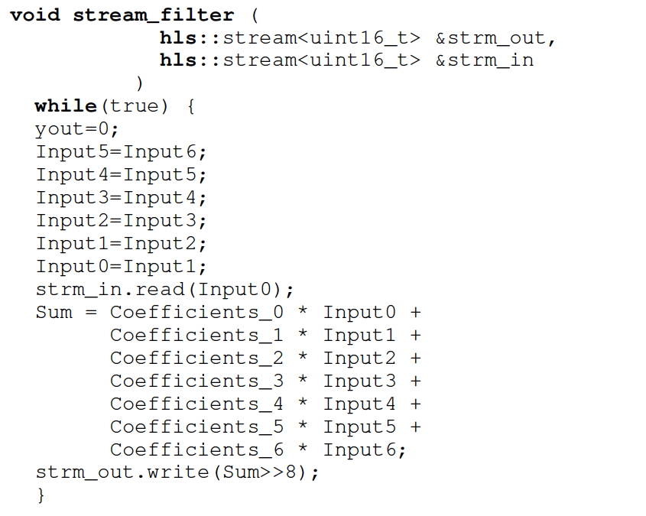

Slide 34
stream_filter Pipeline

Slide 35
Dataflow Streaming
Works between loops, as well

Slide 36
Between
Loops

Slide 37
Vivado HLS Pragma
PIPELINE
Direct a function or loop to be pipelined
Ideally start one loop or function body per cycle
  Can control II

Slide 38
for (i=0;i<N;i++)
yout=0;
for (j=0;j<K;j++)
#pragma HLS PIPELINE
yout+=in[i+j]*w[j];
y[i]=yout;
Which solution
from preclass 3?

Slide 39
Dataflow and pipelining
Dataflow allows coarse-grained pipelining among loops and functions
Pipeline causes loop bodies to be pipelined

Slide 40
Dataflow and Pipelining
Cycles for top loop unpipelined?

Slide 41
Dataflow and Pipelining
Cycles for top
loop pipelined?

Slide 42
Dataflow and Pipelining
Cycles for bottom loop unpipelined?

Slide 43
Dataflow and Pipelining
Cycles for bottom loop pipelined?

Slide 44
Dataflow and Pipelining
Composite time, no dataflow, no pipelining?

Slide 45
Dataflow and Pipelining
Composite time dataflow only?

Slide 46
Dataflow and Pipelining
Composite time pipelining only?

Slide 47
Dataflow and Pipelining
Composite
time dataflow
and pipelining?

Slide 48
Compare Cases
No Dataflow
Dataflow
Dataflow
Unpipe
Pipe

Slide 49
Compare Cases
No Dataflow
Dataflow
Dataflow
Unpipe
Pipe

Slide 50
Unroll
Vivado HLS has pragmas for unrolling
UG902: Vivado Design Suite HLS User’s Guide
  P139—142 (2020.1, 2018.3)
#pragma HLS UNROLL factor=…
Use to control area-time points
  Use of loop for spatial vs. temporal description
https://www.xilinx.com/support/documentation/sw_manuals/xilinx2018_3/ug902-vivado-high-level-synthesis.pdf
https://docs.xilinx.com/v/u/en-US/ug902-vivado-high-level-synthesis

Slide 51
Vivado HLS Pragma
UNROLL
Unroll loop into spatial hardware
  Can control level of unrolling
Any loops inside a pipelined loop gets unrolled by the PIPELINE directive

Slide 52
for (i=0;i<N;i++)
yout=0;
for (j=0;j<K;j++)
#pragma HLS UNROLL
yout+=in[i+j]*w[j];
y[i]=yout;
Which solution
from preclass 3?

Slide 53
With Pipelining
for (i=0;i<N;i++)
yout=0;
#pragma HLS PIPELINE
for (j=0;j<K;j++)
yout+=in[i+j]*w[j];
y[i]=yout;
Which solution
from preclass 3?

Slide 54
Dataflow, Unrolling, & Pipelining
Cycles unroll K-loop, dataflow, pipeline?

Slide 55
Vivado HLS Pragma
INLINE
Collapse function body into caller
  Eliminates interface code
  Allows optimization of inline code
Recursive option to inline a hierarchy
  Maybe useful when explore granularity of accelerator

Slide 56
Vivado HLS Mapping Control:
Memories
Part 3

Slide 57
Zynq BRAM
36Kb of memory
  Configurable width up to 72b
    512x72 or … 32Kx1
  Dual port
Can be operated as 2x18Kb memory banks
  Configurable width up to 36b
    512x36 or … 16Kx1
  Each memory dual port
Xilinx UG573, UltraScale Architecture Memory Resources User Guide

Slide 58
Vivado HLS Pragma
ARRAY_PARTITION
Spread out array over multiple BRAMs
  By default placed in single BRAM
    At most 2 ports
  Use to remove memory bottleneck that prevents pipelining (limits II)

Slide 59
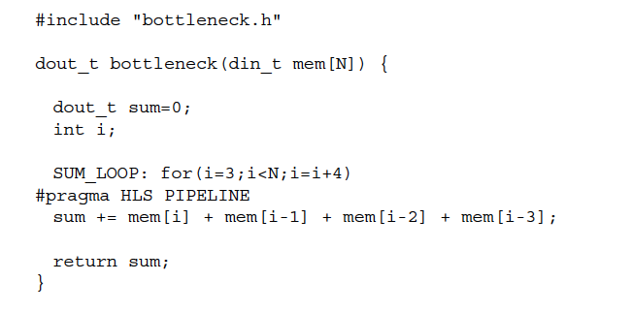
Memory Bottleneck Example
902 example p. 91-92
What problem if put mem
in single BRAM?
Xilinx UG1197 (2017.1) p. 50

Slide 60
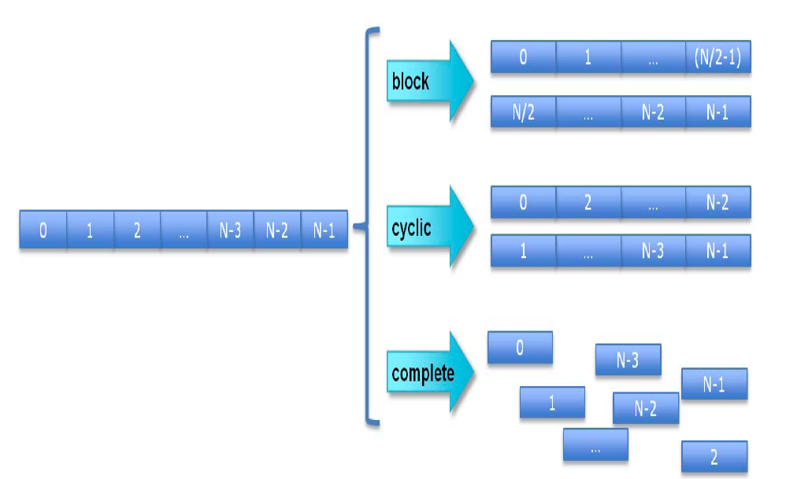
Array Partition
Xilinx UG902 p. 195 (145 in 2017.1 version)

Slide 61
Array Partition Example
#pragma ARRAY_PARTITION variable=mem cylic factor=4
Xilinx UG902 p. 91

Slide 62
Vivado HLS Pragma
ARRAY_RESHAPE
Pack data into BRAM to improve access (reduce BRAMs)
  May provide similar benefit to partitioning without using more BRAMs

Slide 63
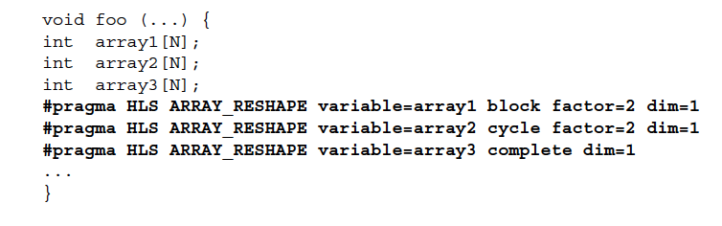
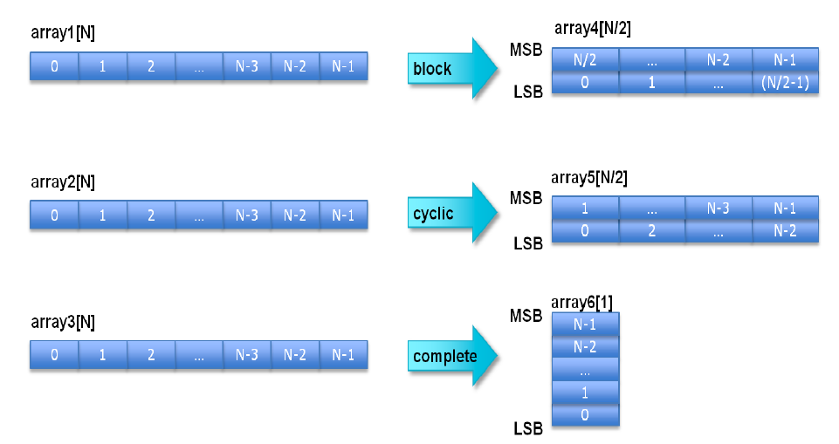
Xilinx UG902 (2017.1) p. 173

Slide 64
BRAM can be configured
for 72b wide output
902 example p. 91-92
How fix if dint_t is 16b?
Xilinx UG902 p. 91

Slide 65
Array Reshape Example
#pragma ARRAY_RESHAPE variable=mem cylic factor=4 dim=1
(if din_t 16b)
Xilinx UG902 p. 91

Slide 66
Loop Interpretations
What does a loop describe?
  Sequential behavior [when execute]
  Spatial construction [when create HW]
  Data Parallelism [sameness of compute]
We will want to use for all 3
C allows expressive loops
  Some expressiveness
    Not compatible with spatial hardware construction

Slide 67
HLS Pragma Summary
pragmas allow us to control hardware mapping
  How interpret loops (spatial hw vs. temporal)
  How arrays get mapped to memories
  How treat function calls
  Turn area-time knobs
Could have rewritten code by hand
  Unroll, separate arrays…
  Pragmas automate; we just need to provide instruction

Slide 68
Memory Allocation
Part 4
Simple answer: “Don’t do it!”
Skip to Wrapup

Slide 69
Demand for malloc()
Data-dependent object (array) size
Data-dependent number of objects

Slide 70
Hardware Memory
Typically small, fixed, local memory blocks
  E.g. 36Kb BRAMs
Reuse memory blocks
  Not allocate new blocks
  Cannot make data-dependent memory sized blocks
  Cannot hold arbitrary-sized data

Slide 71
No malloc()
Generally don’t want to use malloc with
  Hardware Accelerated functions
  Real-time computations
Vivado HLS won’t let you use malloc()
  For C running on FPGA array
Instead: statically declare arrays of maximum size data may be

Slide 72
Pointer Passing
Be careful…

Slide 73
Pointer Passing
What does it mean to pass a pointer into a function?

Slide 74
Pointer Passing Interpretations
Multiple uses we may want to express
  Specify which data to work on
    Ok to copy that data to private accelerator memory and work with it
    But, how much data to copy? (length)
  Want to mutate data and have other (parallel) tasks see it
  OR want to see data mutated by other (parallel tasks)
    Not OK to copy to private accelerator memory
    Force use from large, shared memory
    Forces sequentialization

Slide 75
Pointer Passing
What if accelerator doesn’t have access to the memory holding the data pointed to by the pointer?

Slide 76
Pointer Passing
Maybe only reading data that will not change.
What happens if we give accelerators access to common memory holding data for pointer, but
  There’s only one port into memory
  Memory is 10 cycles away
  And there are 100 accelerators that may need access
  Memory can only handle one memory op per cycle

Slide 77
Avoid Pointer Passing
Tend to copy data into / move data among hardware accelerator memories rather than passing pointers.

Slide 78
Memory Sequentialization and Data Dependencies
Part 5
(unlikely to cover in class;
Review on own)
Skip to wrapup

Slide 79

Example
Assume a, b live in same memory
Placed in sequence as shown
What happens when
  int a[16];
  int b[16];
  Read from a[17]
  Read from b[-2]
Can inhibit separation into
memory banks, parallelism

Slide 80
Memory Operation Challenge
Memory is just a set of location
But memory expressions in C can refer to variable locations
  Does A[i], B[j] refer to same location?
  A[f(i)], B[g(j)] ?
Can inhibit banking, parallelism
  Or add expensive interconnect

Slide 81
C Memory Consequence
Expressions and operations through variables (whose address is never taken) can be executed at any time
  Just preserve the dataflow
Memory assignments must execute in strict order
  Ideally: partial order
  Conservatively: strict sequential order of C

Slide 82
Forcing Sequencing
Demands we introduce some discipline for deciding when operations occur
  Could be a FSM
  Could be an explicit dataflow token
  Callahan (reading) uses control register
Other uses for timing control
  Control
  Variable delay blocks
  Looping

Slide 83
Scheduled Memory Operations
Source: Callahan

Slide 84
Hardware/Parallelism Challenge
Can we give enough information to the compiler to
  allow it to reorder?
  allow to put in separate embedded memories (separate banks)?
Is the compiler smart enough to exploit?

Slide 85
Mux Conversion and Memory
What might go wrong if we mux-converted the following:
if (cond)
  a[i]=0;
else
  b[i]=0;

Slide 86
Mux Conversion and Memory
What might go wrong if we mux-converted the following:
if (cond)
  a[i]=0;
else
  b[i]=0;
Don’t want memory operations in non-taken branch to occur.

Slide 87
Mux Conversion and Memory
if (cond)
  a[i]=0;
else
  b[i]=0;
  Don’t want memory operations in non-taken branch to occur.
Conclude: cannot mux-convert blocks with memory operations (without additional care)

Slide 88
Conditions and Memory
if (cond)
  a[i]=0;
else
  b[i]=0;

Slide 89
Dependence in Loops
for(i=0;i<K;i++)
Y[i]=a[i]*Y[i-1];
If a value needed by one instance of the loop is written by another instance, can create cyclic dependence.
→ limit parallelism (pipeline II)

Slide 90
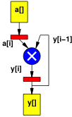
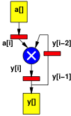
Dependence in Loops
for(i=0;i<K;i++)
Y[i]=a[i]*Y[i-1];
for(i=0;i<K;i++)
Y[i]=a[i]*Y[i-2];
Dependence distance same as
# registers in cycle.

Slide 91
Dependence Fixed/Predictable?
for(i=0;i<K;i++)
Y[i]=a[i]*Y[i-1]+Y[i-2];
for(i=0;i<K;i++)
Y[i]=a[i]*Y[b[i]];
If dependence data-dependent, forced to sequentialize.

Slide 92
Dependence Fixed/Predictable?
for(i=0;i<K;i++)
Y[i]=a[i]*Y[i-1]+Y[i-2];
for(i=0;i<K;i++)
Y[i]=a[i]*Y[2*i+3];
If dependence linear, aggressive compliers may be able to resolve.

Slide 93
Dependence Fixed/Predictable?
for(i=0;i<K;i++)
Y[i]=
a[i]*Y[ceil(sqrt(i)*sin(2i))];
If dependence too complicated, compiler not solve and will force sequential execution.

Slide 94
Big Ideas
Can specify HW computation in C
Create streaming operations
  Run on processor or FPGA
Vivado HLS gives control over how map to hardware
  Area-time point

Slide 95
Admin
Feedback
Reading for Wednesday
  on web and Zynq book
HW5 due Friday
  Start early; require slow builds

