Slide 1

ESE5320:
System-on-a-Chip Architecture
Day 14: October 19, 2022
Orchestrating Data in Memories

Slide 2
Today
DRAM (Part 1)
DRAM Implications (Part 2)
Tricks for working with DRAM and generally minimizing use of large
memories
  Data Reuse in Images (Part 3)
  Sort (time permitting) (Part 4)

Slide 3
Message
How we access data matters
Reuse data to avoid access to large memories
Think about how organize computation and data to minimize
  Use of large memory
  Data movement
…and think about what you expect,
so can diagnose unnecessary data bottlenecks

Slide 4
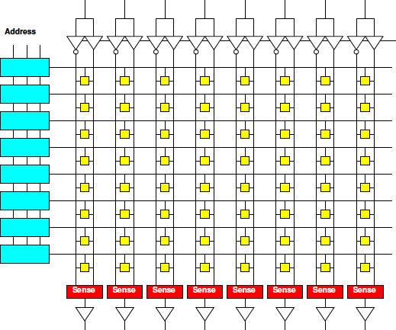
Day 3: Memory Scaling
Small memories are fast
  Large memories are slow
Small memories low energy
  Large memories high energy
Large memories dense
  Small memories cost
  more area per bit
Combining:
  Dense memories
  are slow

Slide 5
Day 3: Lesson
Cheaper to access wide/contiguous blocks memory
  In hardware
  From the architectures typically build
Can achieve higher bandwidth on large block data transfer
  Than random access of small data items

Slide 6
DRAM
Dynamic
Random Access Memory
Usually the largest memory

Slide 7
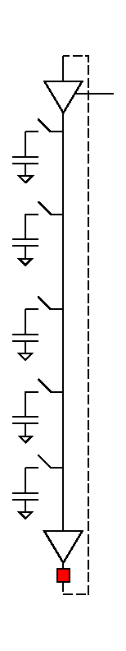
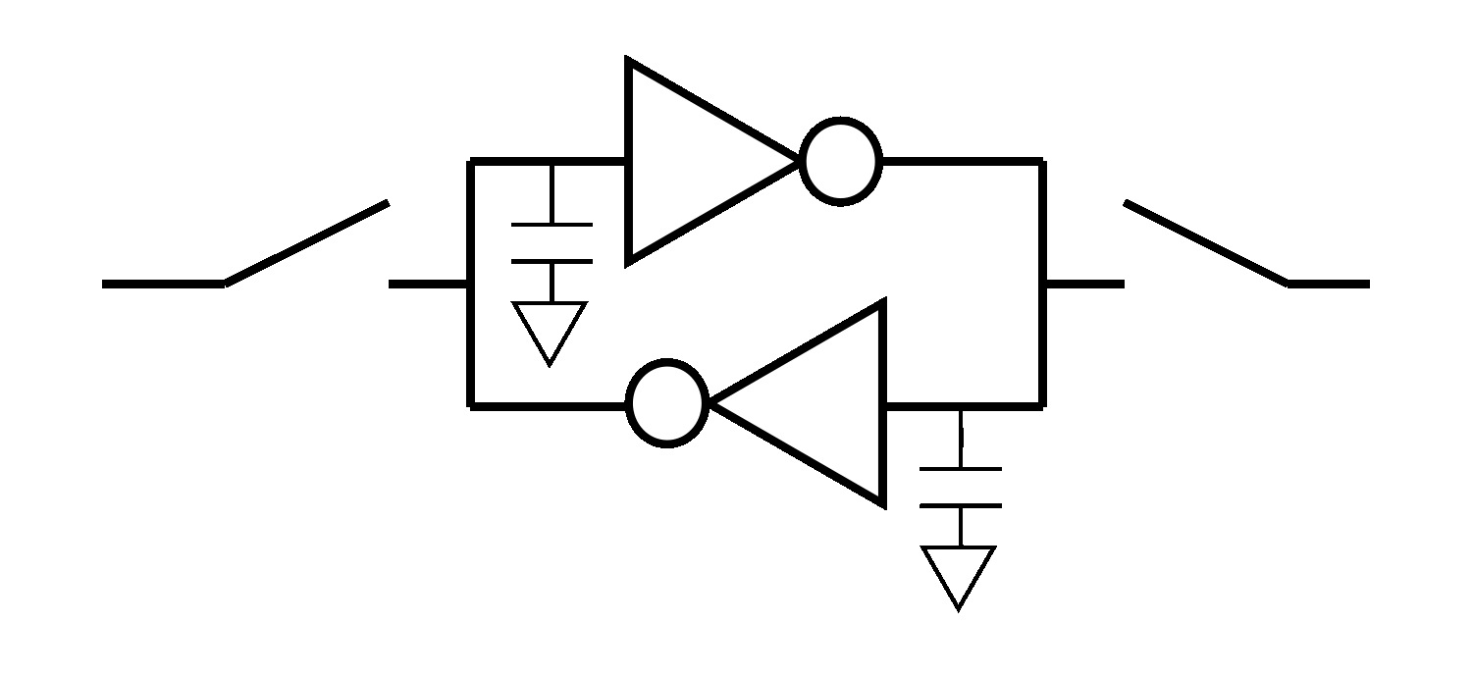
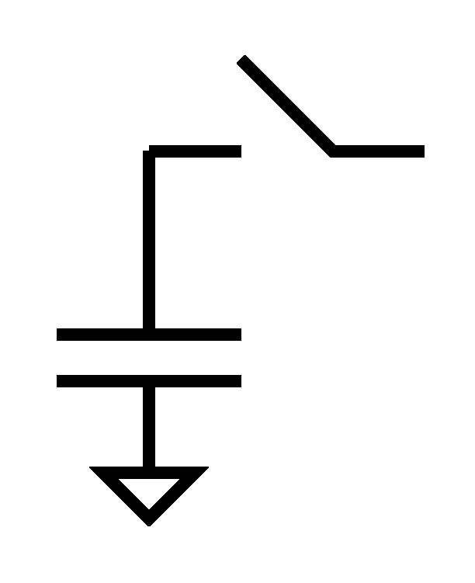
Dynamic RAM
Shares even more logic among bits
Share refresh/restoration logic as well
Minimal storage is a capacitor
“Feature” DRAM process is ability to make capacitors efficiently
Denser, but slower

Slide 8
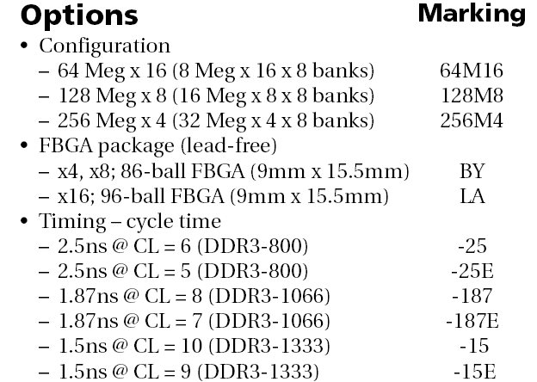
DRAM
1GB DDR3 SDRAM from Micron
  http://www.micron.com/products/dram/ddr3/
  96 pin pakage
  16b datapath IO
  Operate at 500+MHz
  37.5ns random access latency

Slide 9
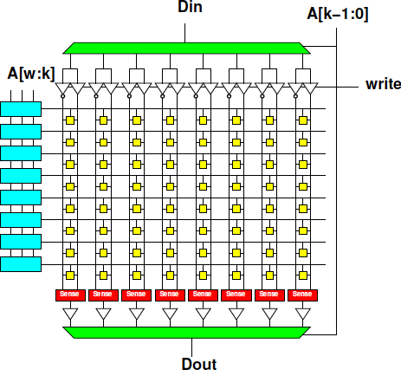
Memory Access Timing
Access:
  Address (RCD)

Slide 10
Memory Access Timing
Access:
  Address (RCD)
  Row fetch (RP)

Slide 11
Memory Access Timing
Access:
  Address (RCD)
  Row fetch (RP)
  Column select (CL)

Slide 12
Memory Access Timing
Access:
  Address (RCD)
  Row fetch (RP)
  Column select (CL)
  writeback/refresh

Slide 13
Dynamic RAM
Shares even more logic among bits
Share refresh/restoration logic as well
Minimal storage is a capacitor
“Feature” DRAM process is ability to make capacitors efficiently
Denser, but slower

Slide 14
Memory Access Timing
Access:
  Address (RCD)
  Row fetch (RP)
  Column select (CL)
  writeback/refresh

Slide 15
Memory Access Timing
Access:
  Address (RCD)
  Row fetch (RP)
  Column select (CL)
  writeback/refresh
Optimization for access within a row

Slide 16
DRAM
1GB DDR3 SDRAM from Micron
  http://www.micron.com/products/dram/ddr3/
  96 pin pakage
  16b datapath IO
  Operate at 500+MHz
  37.5ns random access latency

Slide 17
Memory Access Timing
Access
  Address (RCD)
  Row fetch (RP)
  Column select
    CL: Can repeat
  writeback/refresh
Row
1024b—8192b
Faster to access within row

Slide 18
Preclass 4
Preclass 4 toy warmup
  Reading n 16b words takes: 10+n cycles
    10 cycles for access latency (RCD, RP)
    1 cycle to select each word (CL)
      n cycles for n of them
% time in access latency
  Reading 1 word
  Reading 16 words
  Reading 128 words

Slide 19
DRAM
1GB DDR3 SDRAM from Micron
  http://www.micron.com/products/dram/ddr3/
  96 pin pakage
  16b datapath IO
  Operate at 500+MHz
  37.5ns random access latency

Slide 20
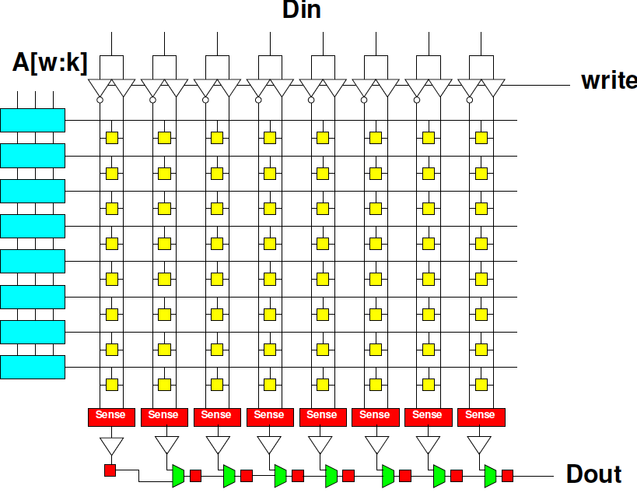
DRAM Streaming
Can design
to shift out
large data from
row

Slide 21
DRAM Streaming
Reading row
is 2x12.5ns
  (RCD,RP)
16b @ 500MHz
1024b row
1024/16
  64 words
  per row
How long (ns) to provide full row (64, 16b words) from address?

Slide 22
DRAM Streaming
Can read from wide memory, but only have 16 pins to bring off chip
But, can clock across those 16 pins at high clock rate compared to memory reference (2ns vs. 12.5ns)
So, can sequentially shift the data out the 16 pins, if grabbing all the data for the row

Slide 23
DRAM
1GB DDR3 SDRAM from Micron
  http://www.micron.com/products/dram/ddr3/
  96 pin pakage
  16b datapath IO
  Operate at 500+MHz
  37.5ns random access latency

Slide 24
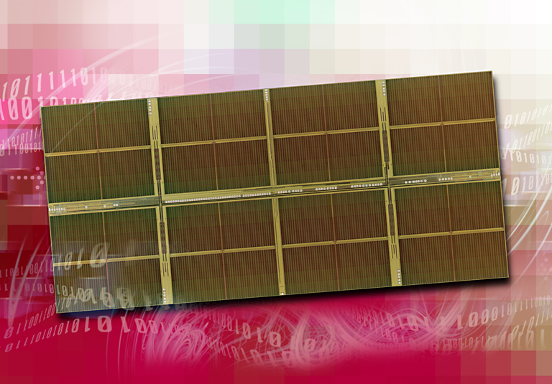
1 Gigabit DDR2 SDRAM
[Source: http://www.elpida.com/en/news/2004/11-18.html]

Slide 25
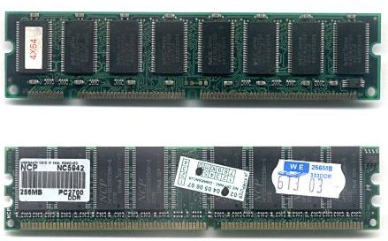
DIMMS multi-DRAM
DIMMs usually pack multiple DRAM chips, c, in parallel
  Can access c*16b per transfer
  Typically 64, 128, 256b wide
    8 chips = 128b wide
https://commons.wikimedia.org/wiki/File:DIMMs.jpg

Slide 26
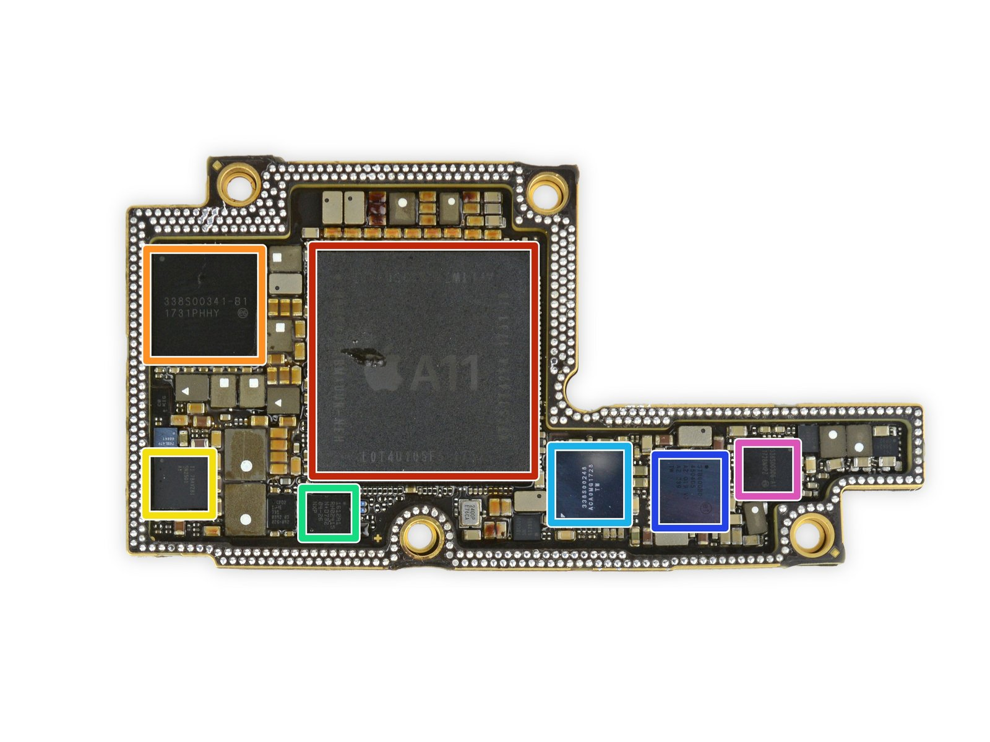
Smart Phone
Will use single DRAM chip
iPhone/iPod – flip chip in package with SoC Processor
Apple APL1W72 A11 Bionic SoC layered over SK Hynix H9HKNNNDBMAUUR 3 GB LPDDR4x RAM
Source:
https://www.ifixit.com/Teardown/iPhone+X+Teardown/98975

Slide 27
DRAM Implications
Part 2

Slide 28
Terminology Watch
Need to talk about
  DRAM Rows
  Image Rows
  Relation between DRAM and Image Rows

Slide 29
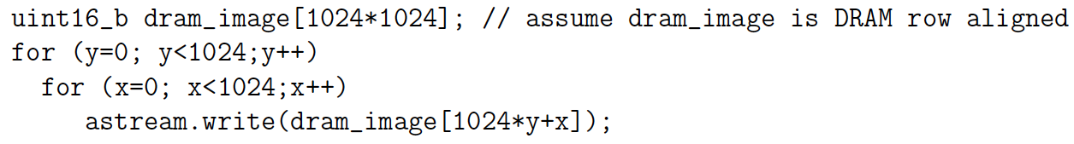
Preclass 1
How many cycles to run loop?
  10 cycle on dram row change (RCD,RP,CL)
  3 cycles same row (CL)
  128 uint16_b per DRAM row (2048b)

Slide 30
Image Row and DRAM Rows
Address | MSB -- DRAM Row Bytes -- LSB
0x027FF0 | [y-1,1023]
0x028000 | [y,127] |  |  |  |  |  |  | [y,0]
0x028100 |  |  |  |  |  |  |  | [y,128]
0x028200
0x028300
0x028400
0x028500
0x028600
0x028700 | [y,1023] |  |  |  |  |  |  | [y,896]
0x028800 |  |  |  |  |  |  |  | [y+1,0]
0x028900
0x028a00

Slide 31
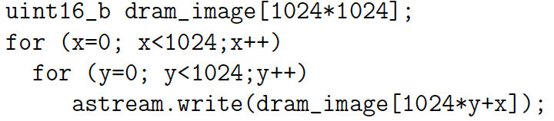
Preclass 2
Note loop
interchange
How many cycles to run loop?
  10 cycle on row change
  3 cycles same row
  128 uint16_b per DRAM row (2048b)

Slide 32
Preclass 3
How many cycles to run loop?
  10+n cycles to fetch n<=128 Half-words on row

Slide 33
DRAM
Latency is large (10s of ns)
Throughput can be high (GB/s)
  If accessed sequentially
  If exploit wide-word block transfers
Throughput low on random accesses
  As we saw for random access on wide-word memory
Integer factor – order of magnitude -- difference

Slide 34
Xilinx/Vitis DMA?
This section focused on what the DRAM can do
  What should happen with an optimized DRAM controller
  Only DRAM is contributing latency

Slide 35
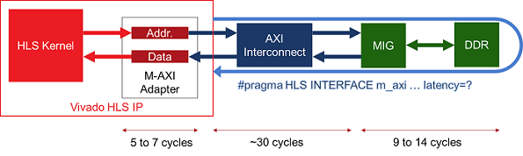
Xilinx AXI Connection to DRAM
Additional Latency from on-chip interconnect and interface
Source: https://www.xilinx.com/html_docs/xilinx2020_1/vitis_doc/programmingvitishls.html

Slide 36
Xilinx/Vitis DMA?
This section focused on what the DRAM can do
  What should happen with an optimized DRAM controller
Vitis DMA requires setup time
  Which will be in addition to DRAM access time
  High overhead [as you will see on HW6]
    Even higher premium for large block transfers

Slide 37
Day 13: Data Movement (Options)
DMA burst copy into BRAM memories
  Built on top of other with DMA copy loop

Slide 38
Maximize Reuse
Part 3
Minimize need to go to large memory

Slide 39
Data Management
Large, central memory
  Bottleneck
  High energy
Minimize need to return to it

Slide 40
Window Filter
Compute based on neighbors
  F(d[y-1][x-1],d[y-1][x],d[y-1][x+1],
  d[y][x-1],d[y][x],d[y][x+1],
  d[y+1][x-1],d[y+1][x],d[y+1][x+1])
Common idiom
  Image filtering
  CNN (Convolution stage in Deep Neural Network)
  Numerical simulation
  Cellular automata
  Search, matching

Slide 41
Window Filter
Compute based on neighbors
  F(d[y-1][x-1],d[y-1][x],d[y-1][x+1],
  d[y][x-1],d[y][x],d[y][x+1],
  d[y+1][x-1],d[y+1][x],d[y+1][x+1])
Generalize for different neighborhood sizes
  for (yoff=YMIN; yoff<YMAX;yoff++)
  for (xoff=XMIN; xoff<XMAX;xoff++)
  res=fun(res,d[y+yoff][x+xoff]);

Slide 42
Window Filter
Compute based on neighbors
for (y=0;y<YMAX;y++)
for (x=0;x<XMAX;x++)
  o[y][x]=F(d[y-1][x-1],d[y-1][x],d[y-1][x+1],
  d[y][x-1],d[y][x],d[y][x+1],
  d[y+1][x-1],d[y+1][x],d[y+1][x+1]);
How work with image in DRAM
  As written references
  Reads per row?

Slide 43
Window Filter
Compute based on neighbors
for (y=0;y<YMAX;y++)
for (x=0;x<XMAX;x++)
  o[y][x]=F(d[y-1][x-1],d[y-1][x],d[y-1][x+1],
  d[y][x-1],d[y][x],d[y][x+1],
  d[y+1][x-1],d[y+1][x],d[y+1][x+1]);
Data reused between inner loop invocations when x increments?
  How many of the 9 values are reused at x+1?

Slide 44
Window Shift x++
 | 23 | 24 | 25 | 26 | 27
17
18 |  | Y-1,X-1 | Y-1,X | Y-1,X+1
19 |  | Y,X-1 | Y,X | Y,X+1
20 |  | Y+1,X-1 | Y+1,X | Y+1,X+1
21
 | 23 | 24 | 25 | 26 | 27
17
18 |  |  | Y-1,X-1 | Y-1,X | Y-1,X+1
19 |  |  | Y,X-1 | Y,X | Y,X+1
20 |  |  | Y+1,X-1 | Y+1,X | Y+1,X+1
21

Slide 45
Window Filter
Compute based on neighbors
for (y=0;y<YMAX;y++)
for (x=0;x<XMAX;x++)
  o[y][x]=F(d[y-1][x-1],d[y-1][x],d[y-1][x+1],
  d[y][x-1],d[y][x],d[y][x+1],
  d[y+1][x-1],d[y+1][x],d[y+1][x+1]);
Data reused between y values in outer loop?
  How many of 9 values reused for y+1?
  Reuse distance [in cycles]?
    …assume II=1 pipeline inner loop

Slide 46
Window Shift y++
 | 23 | 24 | 25 | 26 | 27
17
18 |  | Y-1,X-1 | Y-1,X | Y-1,X+1
19 |  | Y,X-1 | Y,X | Y,X+1
20 |  | Y+1,X-1 | Y+1,X | Y+1,X+1
21
 | 23 | 24 | 25 | 26 | 27
17
18
19 |  | Y-1,X-1 | Y-1,X | Y-1,X+1
20 |  | Y,X-1 | Y,X | Y,X+1
21 |  | Y+1,X-1 | Y+1,X | Y+1,X+1

Slide 47
Window Filter
Compute based on neighbors
for (y=0;y<YMAX;y++)
for (x=0;x<XMAX;x++)
  o[y][x]=F(d[y-1][x-1],d[y-1][x],d[y-1][x+1],
  d[y][x-1],d[y][x],d[y][x+1],
  d[y+1][x-1],d[y+1][x],d[y+1][x+1]);
How much data need to store to hold on to d[y] values that will use again?
Where can we store?

Slide 48
Line Buffers
Only need to save last 2 rows (d[y][*])
  General case: (window_height-1) rows
Store in local buffers
  Call them dy[XMAX], dym[XMAX];
    dym for dy minus 1
  Stick value there between uses.

Slide 49
Variable Naming
 |  | +xm |  | +xp
dym |  | Y-1,X-1 | Y-1,X | Y-1,X+1
dy |  | Y,X-1 | Y,X | Y,X+1
dyp |  | Y+1,X-1 | Y+1,X | Y+1,X+1
 |  | +xm |  | +xp
dym |  | Y-1,X-1 | Y-1,X | Y-1,X+1
dy |  | Y,X-1 | Y,X | Y,X+1
dyp |  | dypxm | dypx | dnew

Slide 50
Window Filter
With line buffers dy, dym
for (y=0;y<YMAX;y++)
for (x=0;x<XMAX;x++) {
  dypxm=dypx; dypx=dnew; dnew=d[y+1][x+1];
  o[y][x]=F(dym[x-1],dym[x],dym[x+1],
  dy[x-1],dy[x],dy[x+1],
  dypxm,dypx,dnew);
  dym[x-1]=dy[x-1];
  dy[x-1]=dypxm;
  }

Slide 51
Lines in Buffers
 |  | +xm |  | +xp
dym |  | Y-1,X-1 | Y-1,X | Y-1,X+1
dy |  | Y,X-1 | Y,X | Y,X+1
dyp |  | Y+1,X-1 | Y+1,X | Y+1,X+1

Slide 52
Window Filter
With line buffers dy, dym
for (y=0;y<YMAX;y++)
for (x=0;x<XMAX;x++) {
  dypxm=dypx; dypx=dnew; dnew=d[y+1][x+1];
  o[y][x]=F(dym[x-1],dym[x],dym[x+1],
  dy[x-1],dy[x],dy[x+1],
  dypxm,dypx,dnew);
  dym[x-1]=dy[x-1];dy[x-1]=dypxm; }
Avoid multiple read dy, dym?
  Save memory ports

Slide 53
Variable Naming
 |  | +xm |  | +xp
dym |  | Y-1,X-1 | Y-1,X | Y-1,X+1
dy |  | Y,X-1 | Y,X | Y,X+1
dyp |  | Y+1,X-1 | Y+1,X | Y+1,X+1
 |  | +xm |  | +xp
dym |  | dymxm | dymx | dymxp
dy |  | dyxm | dyx | dyxp
dyp |  | dypxm | dypx | dnew

Slide 54
Window Filter
Single read and write from dym, dy
for (y=0;y<YMAX;y++)
for (x=0;x<XMAX;x++) {
  dypxm=dypx; dypx=dnew; dnew=d[y+1][x+1];
  dyxm=dyx; dyx=dyxp; dyxp=dy[x+1];
  dymxm=dymx; dymx=dymxp; dymxp=dym[x+1];
  o[y][x]=F(dymxm,dymx,dymxp,
  dyxm,dyx,dyxp,
  dypxm,dypx,dnew);
  dym[x-1]=dyxm;dy[x-1]=dypxm; }

Slide 55
Pipelined Circuit
Single sequential read
from big memory (DRAM)
per result
Shift registers
Line buffers

Slide 56
Window Filter
Convert to stream … use Preclass 3 load
for (y=0;y<YMAX;y++)
for (x=0;x<XMAX;x++) {
  dypxm=dypx; dypx=dnew; astream.read(dnew);
  dyxm=dyx; dyx=dyxp; dyxp=dy[x+1];
  dymxm=dymx; dymx=dymxp; dymxp=dym[x+1];
  o[y][x]=F(dymxm,dymx,dymxp,
  dyxm,dyx,dyxp,
  dypxm,dypx,dnew);
  dym[x-1]=dyxm;dy[x-1]=dypxm; }

Slide 57
Window Filter
Convert to stream … use Preclass 3 load
for (y=0;y<YMAX;y++)
for (x=0;x<XMAX;x++) {
  dypxm=dypx; dypx=dnew; astream.read(dnew);
  dyxm=dyx; dyx=dyxp; dyxp=dy[x+1];
  dymxm=dymx; dymx=dymxp; dymxp=dym[x+1];
  ostream.write(F(dymxm,dymx,dymxp,
  dyxm,dyx,dyxp,
  dypxm,dypx,dnew));
  dym[x-1]=dyxm;dy[x-1]=dypxm; }

Slide 58
Multiple Filters
What if want to run multiple filters?
for (f=0;f<FMAX;f++)
for (y=0;y<YMAX;y++)
for (x=0;x<XMAX;x++)
  o[f][y][x]=fun[f](d[y-1][x-1],d[y-1][x],d[y-1][x+1],
  d[y][x-1],d[y][x],d[y][x+1],
  d[y+1][x-1],d[y+1][x],d[y+1][x+1]);
Forces multiple reads through d
Avoidable?

Slide 59
Take-Away
Can process with a single, streaming read through data in large memory
  Specifically for window filters on images
  General goal to try to achieve
Careful to orchestrate data in small, local buffers
DMA/streaming transfers to achieve near peak DRAM bandwidth

Slide 60
Sort
Part 4
Cover in lecture session if time permits
Skip to wrapup

Slide 61
Sort
Order data
  7 3 4 2 1 9 8 0 → 0 1 2 3 4 7 8 9
Data movement can be challenging
  Last value may become first (vice-versa)
  Especially when not fit in small memories
Many sequential sort solutions access data irregularly
  Want to avoid with DRAM
Example illustrates can reformulate as streaming

Slide 62
Observation: Merge
Merging two sorted list is a streaming operation
int aptr; int bptr;
for (i=0;i<MCNT;i++)
  If ((aptr<ACNT) && (bptr<BCNT))
  If (a[aptr]>b[bptr])
  { o[i]=a[aptr]; aptr++; }
  Else
  { o[i]=b[bptr]; bptr++; }
  Else // copy over remaining from a or b

Slide 63
Merge Memory Access
for (i=0;i<MCNT;i++)
  If ((aptr<ACNT) && (bptr<BCNT))
  If (a[aptr]>b[bptr])
  { o[i]=a[aptr]; aptr++; }
  Else
  { o[i]=b[bptr]; bptr++; }
  Else // copy over remaining from a or b
How work with DRAM rows?

Slide 64
Merge and DRAM
May alternate between DRAM rows
Int aptr; int bptr;
For (i=0;i<MCNT;i++)
  If ((aptr<ACNT) && (bptr<BCNT))
  If (a[aptr]>b[bptr])
  { o[i]=a[aptr]; aptr++; }
  Else
  { o[i]=b[bptr]; bptr++; }
  Else // copy over remaining from a or b

Slide 65
Merge and DRAM
Want to fetch a as block into local memory (into stream), then can do this
Int aptr; int bptr;
For (i=0;i<MCNT;i++)
  If ((aptr<ACNT) && (bptr<BCNT))
  If (a[aptr]>b[bptr])
  { o[i]=a[aptr]; aptr++; }
  Else
  { o[i]=b[bptr]; bptr++; }
  Else // copy over remaining from a or b

Slide 66
Merge using Streams
Merging two sorted list is a streaming operation
int aptr; int bptr;
astream.read(ain); bstream.read(bin)
for (i=0;i<MCNT;i++)
  If ((aptr<ACNT) && (bptr<BCNT))
  If (ain>bin)
  { ostream.write(ain); aptr++; astream.read(ain);}
  Else
  { ostream.write(bin) bptr++; bstream.read(bin);}
  Else // copy over remaining from astream/bstream

Slide 67
Merge using Streams and DRAM
Streaming accomplishes if Streaming is implemented to fetch row into FIFO buffer
Int ptr; int bptr;
astream.read(ain); bstream.read(bin)
For (i=0;i<MCNT;i++)
  If ((aptr<ACNT) && (bptr<BCNT))
  If (ain>bin)
  { ostream.write(ain); aptr++; astream.read(ain);}
  Else
  { ostream.write(bin) bptr++; bstream.read(bin);}
  Else // copy over remaining from astream/bstream

Slide 68
Building from Merge
Know how to get sorted data of length N given two, independently sorted lists of length N/2
A list of length 1 is sorted.
Merging two lists of length 1 gives us?
  How many lists of what length?
Merging two lists of length 2 gives us?

Slide 69
Merge Sort
Strategy
  For i=1 to passes
    Pass over data creating merged sequences of length 2^{i} from pairs of length 2^{i-1}
  What is passes?
Can, at least, limit to passes reads through data from large memory.

Slide 70
On-chip Merge
As long as can fit sequence (2^{i}) on chip, can stream merge stages without going back to big memory (DRAM)
2^{i-1}
2^{i}
2^{i}
merge
alternate

Slide 71
On-chip Merge
As long as can fit sequence (2^{i}) on chip, can stream merge stages without going back to big memory (DRAM)
  E.g. with 36Kb BRAMs ~ first 10-12 stages
    Up to ~16 using multiple BRAMs
merge+alt
merge+alt
merge+alt

Slide 72
On-chip Merge
For sorts up to ~100K elements may be able to cover in one read/write stream to/from DRAM
Larger: ~log₂(N)-15 read/writes
merge+alt
merge+alt
merge+alt

Slide 73
Big Ideas
Must pay attention to orchestrate data movement
  How we access and reuse data
Minimize use of large memories
Regular (sequential) access to large memories higher performance
  Easier to get bandwidth on wide-word reads

Slide 74
Admin
Feedback
HW6 due Friday
Reading for Monday on web
HW7: out soon….

