Slide 1

ESE5320:
System-on-a-Chip Architecture
Day 15: October 24, 2022
Development by
Incremental Refinement

Slide 2
Today
Incremental Refinement
  Demand
  Benefits
  Simplifications (Part 2)
    Example: render
  Interfaces (Part 3)
  Defensive Programming
Source Code Repositories

Slide 3
Message
Focus on interfaces early
  Integrate first
Start with something simple that works end-to-end and incrementally refine
  May lack features
  May perform poorly
  …but it lets you resolve interfaces early

Slide 4
Project Planning
What is more likely to happen to the part of a project you leave to the end?
Why might it seem natural to leave integration of components to the end of a project?
  After fully developing components

Slide 5
Common Mistake
Build pieces, then integrate at the end
Spend most of available time on components
  Then try to integrate for first time near deadline
  Not enough time to integrate/debug at end
    Worst-case don’t have a working solution
    Spend more time fixing than if had identified incompatibilities early

Slide 6
Standard Chip Aphorism
Almost all ASICs work when first fabricated
  …until you put them on the board.
    Then maybe 50%
[usually say “first spin” – where each “spin” is a separate manufacturing run]
ASIC: Application Specific Integrated Circuit
  (custom chip)

Slide 7
Recommended Approach
Decompose problem
Focus on how components interact
Figure out simplified functionality easy to assemble
Get minimum functionality end-to-end system running early
  Even if means cut corners, solve simplified piece of problem
Chart path to refine pieces to goal

Slide 8
Benefits

Slide 9
Early Integration
What benefits might get from integrating early?

Slide 10
Benefits: Overview
Agree on interfaces up front
Supports parallel development, testing, debugging
Confidence-boosting win of having something that works
Digest problem -- supports work in small bursts

Slide 11
Interface First
Agree on interfaces up front
Each component knows interface
Can replace each component independently
Simple baseline provides scaffolding

Slide 12
Parallel Development
With interfaces defined…
Each component can be (mostly) independently developed and refined
Simple baseline provides scaffolding
  Framework to test each component independently as develop and refine
Particularly important for team
  …helpful for individual, too
    Contains what need to think about at a time

Slide 13
Confidence Boost
Get to see it working
Know you have something
  Just a question of how sophisticated can you make it?

Slide 14
Digested Problem
Easier to concentrate on what need to do for this piece
Can make tangible process in short bursts
  …time can find between lectures…

Slide 15
Continuous Integration
Pieces always fit into interface scaffold
Add pieces, functionality as available
See improvement
Identify interface problems early
  …and refine them

Slide 16
Part 2: Example
Rendering

Slide 17
Rendering Example
Create a 2D (video) image of a 3D object (set of objects)
For: computer-generated graphics
  Movies
  Video games

Slide 18
Rendering
Input:
  collection of triangles (with color)
    Each 3 (x,y,z) positions
  Viewpoint
    Another (x,y,z) point
Output
  2D raster image (what you see on screen)
    Showings what’s visible
      Some things will be hidden behind others

Slide 19
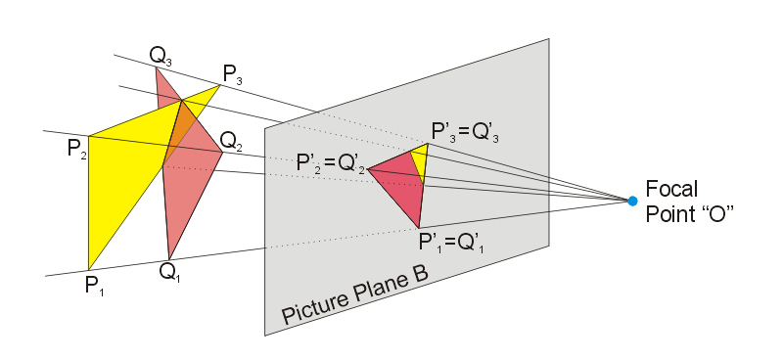
Rendering Decomposed
Pipeline of
  Projection
    Where do the points of
    this triangle end up in the viewed image?
    Matrix-multiplication to translate points
https://commons.wikimedia.org/wiki/File:Perspective_Projection_Principle.jpg

Slide 20

Rendering Decomposed
Pipeline of
  Projection
    Where do the points of
    this triangle end up in the viewed image?
    Matrix-multiplication to translate points
  Rasterization
    Turn into pixels
    Fill pixels for triangle
https://commons.wikimedia.org/wiki/File:Perspective_Projection_Principle.jpg
https://commons.wikimedia.org/wiki/File:Raster_graphic_fish_20x23squares_sdtv-example.png
de:Benutzer Diskussion:Andreas -horn- Hornig/Bildwerkstatt

Slide 21
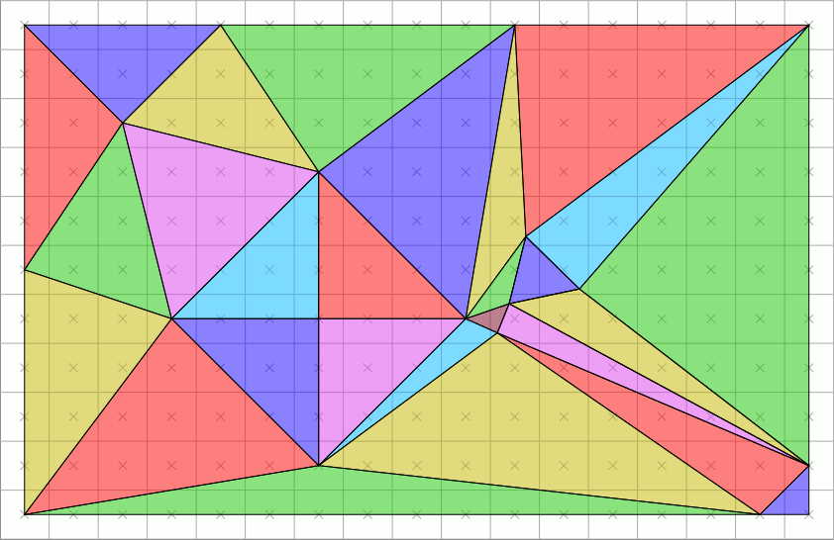
Rasterization
By Drummyfish - Own work, CC0, https://commons.wikimedia.org/w/index.php?curid=80204437

Slide 22
Rendering Decomposed
Pipeline of
  Projection
    Where do the points of
    this triangle end up in the viewed image?
    Matrix-multiplication to translate points
  Rasterization
    Turn into pixels
    Fill pixels for triangle
https://commons.wikimedia.org/wiki/File:Perspective_Projection_Principle.jpg
https://commons.wikimedia.org/wiki/File:Raster_graphic_fish_20x23squares_sdtv-example.png
de:Benutzer Diskussion:Andreas -horn- Hornig/Bildwerkstatt

Slide 23
Rendering Decomposed
Pipeline of
  Projection
    Where do the points of
    this triangle end up in the viewed image?
    Matrix-multiplication to translate points
  Rasterization
    Turn into pixels
    Fill pixels for triangle
  Z-buffer
    Keep only the ones on top (not hidden)
      2D image + Z-depth – keep smallest
https://commons.wikimedia.org/wiki/File:Perspective_Projection_Principle.jpg
https://commons.wikimedia.org/wiki/File:Raster_graphic_fish_20x23squares_sdtv-example.png
de:Benutzer Diskussion:Andreas -horn- Hornig/Bildwerkstatt

Slide 24
What’s Hard (Preclass 1)
What’s hard about each part?
  Projection?
  Rasterization?
  Z-Buffering?

Slide 25
Simplifications

Slide 26
Simplification: Overview
Solve simpler problem
Handle special subset of cases
  Avoid hard corner cases
Don’t worry about performance
Placeholder – stand in for real task
  Do minimal thing
  Use existing code

Slide 27
Simple Placeholder
Identity function work?
  Pass input to output
Get form right in simple way?
  E.g. compression
    Drop samples/images/pixels to get down?

Slide 28
Simplify (Preclass 3)
How could we simplify
  Projection?
  Rasterization?
  Z-Buffering?

Slide 29
Simplified Projection Example
Projection as identity function?
  Will definitely give wrong image
    Except when viewpoint 0,0,0….
    And all triangles at same depth…
  But the output of projection is triangles
    …so has right form for communication

Slide 30
Simplified Rasterization
Maybe: Just put output pixels for triangle corners?
  Definitely wrong
  Has right form

Slide 31
Simplified Z-Buffer Example
Intended
  Z-buffer
    Keep only the ones on top (not hidden)
      2D image + Z-depth – keep smallest
Simplified
  Just keep last value given
  If nothing overlaps → correct
    test with non-overlapping objects
  Even if overlap
    Looks wrong, but data has correct output form

Slide 32
Solve Subset
Are there cases that are easier and cases that are harder?
  Can arrange input/tests to only include easier cases first
Solve the simple cases first
  E.g. non-overlapping objects in Z-buffer
Add support for harder cases later

Slide 33
Data Parallel
How exploit data parallelism in projection?

Slide 34
Parallel Rendering Example
Exploit data parallelism in rasterization
  Cut image into pieces
    Simplest: top half, bottom half
  Separate threads to rasterize each piece

Slide 35
Parallel Rendering
Maybe ideal: rasterization sends triangle to appropriate rasterization thread
  If in top half
    send to top
  Else
    Send to bottom
What could make hard?

Slide 36
Parallel Rasterization
Simple
  Triangles exclusively in one region
    One half
  Send to appropriate half
Hard
  Triangle in both halves
    Send to all (both)
    Or compute what goes in each and send triangles to each

Slide 37
Parallel Rasterization Refinement
Start simple
  Assume only in one half, and only send there
  Use test cases split by halves
Incrementally get more sophisticated
  Sometimes send to both
Incrementally more
  Compute triangles for each region

Slide 38
What makes hard?
Can avoid that on initial pass?
  E.g. – avoid computing what part of triangle is in each region

Slide 39
Solve Small Instances?
If challenge is scale (handling large problems)
  Solve small problems first
  E.g. work on 64x64 image
    If trying to hit real time, easier with small image
    Small image may fit in BRAM (on-chip memory)
      Avoid complexities of data movement initally

Slide 40
Non-Optimized Implementation
Often complexity comes from optimized implementation
  Start with simplest, non-optimized version as placeholder
  E.g.
    Brute force solution instead of clever algorithm
      Perhaps my most common mistake
    Large, inefficient data structure
      Instead of a more complicated, compact one

Slide 41
Window Filter
Day 14
Compute based on neighbors
for (y=0;y<YMAX;y++)
for (x=0;x<XMAX;x++)
  o[y][x]=F(d[y-1][x-1],d[y-1][x],d[y-1][x+1],
  d[y][x-1],d[y][x],d[y][x+1],
  d[y+1][x-1],d[y+1][x],d[y+1][x+1]);

Slide 42
Window Filter
Day 14
Single read and write from dym, dy
for (y=0;y<YMAX;y++)
for (x=0;x<XMAX;x++) {
  dypxm=dypx; dypx=dnew; dnew=d[y+1][x+1];
  dyxm=dyx; dyx=dyxp; dyxp=dy[x+1];
  dymxm=dymx; dymx=dymxp; dymxp=dym[x+1];
  o[y][x]=F(dymxm,dymx,dymxp,
  dyxm,dyx,dyxp,
  dypxm,dypx,dnew);
  dym[x-1]=dyxm;dy[x-1]=dypxm; }

Slide 43
Software First
Functional placeholder in software first

Slide 44
Leverage Existing Solutions
Run some existing package, library to get the right answer
  E.g.
    call MATLAB to solve a matrix
    Invoke unix sort routine to get sorted data
    Invoke stand-alone image compressor or renderer

Slide 45
What components depend upon?
Can a component output any data (random data?) and be adequate to exercise components interacts with?
  E.g. if feed into an integrator/accumulator
Need to output data of a given size?
Output need to maintain some property?
  Sorted?
  Unique?
Is it ok if doesn’t do its intended job well?
  E.g. intended to compress…

Slide 46
Interfaces
Part 3

Slide 47
Division of Task
Who is expected to do what?
  E.g.,
    Which piece discards duplicates?
    Which piece removes/flags invalid input?
  E.g. Renderer
    Does Projection only send
    in-bound triangles to each region rasterizer?
    Or does each region rasterizer need to deal with out-of-bounds triangle coordinates?

Slide 48
Need to Know
What information does each component need to know?
How do we get that information to each component?

Slide 49
Rendering Interface
(Preclass 4)
What need to communicate between
  Projection → Rasterization
  Rasterization → Z-Buffering

Slide 50
3D Rendering: Need to Know
Projection
  How many triangles (int)
  Triangle points (x,y,z) triples (float)+ color (short)
  Viewpoint x,y,z (float)
Rasterization
  How many triangles for region (int)
    Or when done
  Triangle points (x,y,z) triples + color (short)
Z-buffer
  (x,y,z,color) points (short)
  How many (when done)?

Slide 51
How Communicate?
Arrays
Streams
Shared memory locations?
Variable lengths?

Slide 52
3D Rendering
All naturally streaming
All potentially variable
  Number of triangles depend on object complexity and number of objects
  Projected triangles depend on number in each region
    Not know in advance
  Pixels sent depends on size of projected triangles which changes with viewpoint
    Not know in advance

Slide 53
3D Rendering
Triangles and pixels unknown up front
How might we communicate number of triangles/pixels – communicate when done?

Slide 54
3D Rendering
Triangles and pixels unknown up front
How communicate?
  Send a record that means end-of-image?
    Extra bit?
    struct send_triangle {
    short p1x,p1y,p1z,
    p2x,p2y,p2z,
    p3x,p3y,p3z,
    color;
    Boolean last; }
    161b

Slide 55
3D Rendering
Triangles and pixels unknown up front
How communicate?
  Send a record that means end-of-image?
    Extra bit?
  Send in blocks with maximum size
    Accompany each block with a length
    Length is a separate stream from data
    For(i=0;i<TRIANGLES;i+=5)
      block_size.write(5);
      For(j=0;j<5;j++) triangles.write(t[i+j]);
    If (i!=TRIANGLES)
      block_size.write(TRIANGLES-i);
      for(j=0;j<TRIANGLES-I;j++)
        ….

Slide 56
Properties components can assume?
Sorted?
  If Z-buffer could assume sorted
    Just keep first at location (last if decreasing)
Non–duplicate?
All in-bound?
Bound on input size in a block?

Slide 57
Interfaces May Change
Interface first
  Means less surprise later
  Doesn’t mean know everything up front
Experience making simple work … and refining simple
  Often best way to understand needs of problem
Refine the interfaces incrementally, too

Slide 58
3D Rendering Start
Might start
  Projection = identity (convert short)
  Rasterization = triangle corners
  Z-buffer = save last
  Connect with streams
    Streams data has one bit for last triangle, pixel
Can put together quickly

Slide 59
Rendering Start Placeholder
for(int i=0;i<TRIANGLES;i++)
struct triangle2d t2d;
t2d.p1x=tr[i].p1x;
t2d.p1y=tr[i].p1y;
t2d.p1z=tr[i].p1z;
// same for p2, p3
t2d.color=tr[i].color;
t2d.last=(i==TRIANGLES-1);
rasterize_in.write(t2d);

Slide 60
Rendering Start Placeholder
While (true)
rt2d=rasterize_in.read();
pt.x=rt2d.p1x; pt.y=rt2d.p1y; // and z
pt.last=false; pt.color=r2d.color;
zin.write(pt);
pt.x=rt2d.p2x; pt.y=rt2d.p2y; // z
pt.last=false; pt.color=r2d.color;
zin.write(pt);
pt.x=rt2d.p3x; pt.y=rt2d.p3y; // z
pt.last=tr2d.last; pt.color=r2d.color;
zin.write(pt);
if (tr2d.last) break;

Slide 61
Rendering Start Placeholder
while (true)
zpt=zin.read()
image[zpt.y][zpt.x]=zpt.color;
if (zpt.last) break;

Slide 62
Rendering Start Refine
while (true)
zpt=zin.read()
if (z[zpt.y][zpt.x]>zpt.z) {
image[zpt.y][zpt.x]=zpt.color;
z[zpt.y][zpt.x]=zpt.z; }
if (zpt.last) break;

Slide 63
Rendering Start Refine
// initialize z[] to MAXVAL
while (true)
zpt=zin.read()
if (z[zpt.y][zpt.x]>zpt.z) {
image[zpt.y][zpt.x]=zpt.color;
z[zpt.y][zpt.x]=zpt.z; }
if (zpt.last) break;
// large image – may need to split?
// … move off chip?
// represent in clever way

Slide 64
3D Rendering Independent Refinement
Projection – actually calculate projected coordinates
Rasterization – calculate pixels per triangle
  Test just fine using identity from projection
Z-buffer – add in Z-ordering
  Also testable with placeholder results

Slide 65
3D Rendering Refinement
Put them back together and work with interface defined
Could decide to change to communicating with blocks
Could refine for parallel rasterization
  …and could do that in pieces

Slide 66
Defensive Programming

Slide 67
Validate Assumptions/Requirements
If require a property on input of a module
  Good to have (optional) code to test for it
  [add that code second]
    Adds code/complexity to check
    E.g. check actually is in-bounds if should be
  Condition it in #ifdef so can disable for production, and re-enable for debug
  Good to catch invalid assumptions early
    …rather than spend time debugging to discover
    Setup discussion about interface…which part got it wrong

Slide 68
Swap Modules
Make it easy to swap out implementations
  Swap between placeholders and refined implementations
  Swap among implementation versions
  Good to understand where problems introduced

Slide 69
Source Code Repositories
git, svn

Slide 70
Repository Message
When working on a project, especially with other people, want to use a source code repository
We’ve encouraged you to use for HWs
Start one for project group as soon as you create a project team

Slide 71
Basic Idea
Central authoritative home for code
  Everyone can access
    Even if someone gets sick, laptop crashes
Keeps track of all versions
  As iterate and refine
Maybe keep track of multiple, in-use versions at once → branches

Slide 72
Basic Benefits
Keep organized
  Common place for everything
Keep track of history
  Can go back to previous versions
    If screw up; if thought worked before
    Lowers chance of accidentally deleting
    …or losing when laptop disk crashes
Able to work on independently
  Share/integrate as stable
Branches
  Experiment without breaking main version
  E.g. change an interface…

Slide 73
Big Ideas:
Integrate first
  Focus on interfaces early
Start simple
  Something that works end-to-end
Improve incrementally and iteratively

Slide 74
Admin
Feedback
Wednesday: Project out and introduction
HW7 due Friday Sunday

