Slide 1

ESE5320:
System-on-a-Chip Architecture
Day 17: Oct. 31, 2022
LZW, Associative Maps

Slide 2
Today
LZW Compression (Part 1)
Associative Memory (Part 2)
  Custom
  FPGA
Software Maps
  Tree (Part 3)

Slide 3
Message
Can adaptively compress data using recurring substrings
Rich design space for Maps

Slide 4
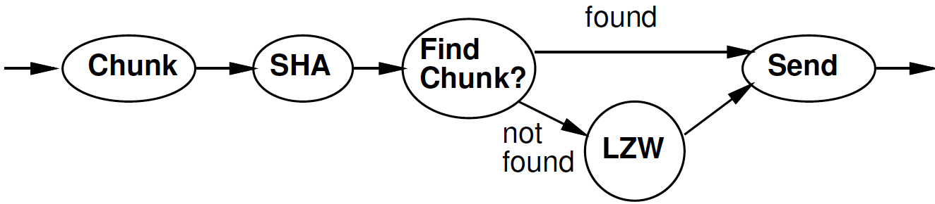
Part 1:
LZW Compression
Lempel-Ziv-Welch

Slide 5
Idea
Day 16 Reminder
Use data already sent as the dictionary
  Give short names to things in dictionary
  Don’t need to pre-arrange dictionary
  Adapt to common phrases/idioms in a particular document

Slide 6
Encoding
Day 16 Reminder
Greedy simplification
  Encode by successively selecting the longest match between the head of the remaining string to send and the current window

Slide 7
Algorithm Concept
Day 16 Reminder
While data to send
  Find largest match in window of data sent
  If length too small (length=1)
    Send character
  Else
    Send <x,y> = <match-pos,length>
    (actually, send dictionary entry)
  Add data encoded into sent window
  Expand dictionary

Slide 8
Day 16: Preclass 7
How many comparisons per invocation?

Slide 9
Idea
Avoid O(Dictionary-size) work
  Only need to match against positions that start with the character(s) in string to encode
    Separate dictionary for each?
Only check position 0 for “starts with I”

Slide 10
Idea
Avoid O(Dictionary-size) work
  Only need to match against positions that start with the character(s) in string to encode
    Separate dictionary for each?
T-dictionary:
  Tap, The, Their, Then, There, Tuesday

Slide 11
Idea
Avoid O(Dictionary-size) work
  Only need to match against positions that start with the character(s) in string to encode
    Separate dictionary for each?
T-dictionary:
  Tap, The, Their, Then, There, Tuesday
If prefix same, why check redundantly?
  Generalize: Store things with common prefix together
    Share prefix among substrings
  Represent all strings as prefix tree

Slide 12
Idea
Avoid O(Dictionary-size) work
  Only need to match against positions that start with the character(s) in string to encode
    Separate dictionary for each?
If prefix same, why check redundantly?
  Store things with common prefix together
  Share prefix among substrings
  Represent all strings as prefix tree
Follow prefix trees with fixed work per input character

Slide 13
Tree Algorithm
Tree Root for each character
Follow tree according to input until no more match
Send <name of last tree node>
  Dictionary entry
    Named sequentially by insertion
Extend tree (dictionary) with new character
Start over with this character

Slide 14
I AM SAM SAM I AM
Input | Send | Dict | Add Entry | Add What
I | <nothing>

Slide 15
I AM SAM SAM I AM
Input | Send | Dict | Add Entry | Add What
I | <nothing>
 | 73 | I | 256 | I<-spc

Slide 16
I AM SAM SAM I AM
Input | Send | Dict | Add Entry | Add What
I | <nothing>
 | 73 | I | 256 | I<-spc
A | 32 | spc | 257 | spc<-A

Slide 17
I AM SAM SAM I AM
Input | Send | Dict | Add Entry | Add What
I | <nothing>
 | 73 | I | 256 | I<-spc
A | 32 | spc | 257 | spc<-A
M | 65 | A | 258 | A<-M

Slide 18
I AM SAM SAM I AM
Input | Send | Dict | Add Entry | Add What
I | <nothing>
 | 73 | I | 256 | I<-spc
A | 32 | spc | 257 | spc<-A
M | 65 | A | 258 | A<-M
 | 77 | M | 259 | M<-spc

Slide 19
I AM SAM SAM I AM
Input | Send | Dict | Add Entry | Add What
I | <nothing>
 | 73 | I | 256 | I<-spc
A | 32 | spc | 257 | spc<-A
M | 65 | A | 258 | A<-M
 | 77 | M | 259 | M<-spc
S | 32 | spc | 260 | spc<-S

Slide 20
I AM SAM SAM I AM
Input | Send | Dict | Add Entry | Add What
I | <nothing>
 | 73 | I | 256 | I<-spc
A | 32 | spc | 257 | spc<-A
M | 65 | A | 258 | A<-M
 | 77 | M | 259 | M<-spc
S | 32 | spc | 260 | spc<-S
A | 83 | S | 261 | S<-A

Slide 21
I AM SAM SAM I AM
Input | Send | Dict | Add Entry | Add What
I | <nothing>
 | 73 | I | 256 | I<-spc
A | 32 | spc | 257 | spc<-A
M | 65 | A | 258 | A<-M
 | 77 | M | 259 | M<-spc
S | 32 | spc | 260 | spc<-S
A | 83 | S | 261 | S<-A
M | <nothing>

Slide 22
I AM SAM SAM I AM
Input | Send | Dict | Add Entry | Add What
I | <nothing>
 | 73 | I | 256 | I<-spc
A | 32 | spc | 257 | spc<-A
M | 65 | A | 258 | A<-M
 | 77 | M | 259 | M<-spc
S | 32 | spc | 260 | spc<-S
A | 83 | S | 261 | S<-A
M | <nothing>
 | 258 | AM | 262 | 258<-spc

Slide 23
I AM SAM SAM I AM
Input | Send | Dict | Add Entry | Add What
I | <nothing>
 | 73 | I | 256 | I<-spc
A | 32 | spc | 257 | spc<-A
M | 65 | A | 258 | A<-M
 | 77 | M | 259 | M<-spc
S | 32 | spc | 260 | spc<-S
A | 83 | S | 261 | S<-A
M | <nothing>
 | 258 | AM | 262 | 258<-spc
S | <nothing>

Slide 24
I AM SAM SAM I AM
Input | Send | Dict | Add Entry | Add What
I | <nothing>
 | 73 | I | 256 | I<-spc
A | 32 | spc | 257 | spc<-A
M | 65 | A | 258 | A<-M
 | 77 | M | 259 | M<-spc
S | 32 | spc | 260 | spc<-S
A | 83 | S | 261 | S<-A
M | <nothing>
 | 258 | AM | 262 | 258<-spc
S | <nothing>
A | 260 | spc S | 263 | 260<-A

Slide 25
I AM SAM SAM I AM
Input | Send | Dict | Add Entry | Add What
I | <nothing>
 | 73 | I | 256 | I<-spc
A | 32 | spc | 257 | spc<-A
M | 65 | A | 258 | A<-M
 | 77 | M | 259 | M<-spc
S | 32 | spc | 260 | spc<-S
A | 83 | S | 261 | S<-A
M | <nothing>
 | 258 | AM | 262 | 258<-spc
S | <nothing>
A | 260 | spc S | 263 | 260<-A
M | <nothing>

Slide 26
I AM SAM SAM I AM
Input | Send | Dict | Add Entry | Add What
I | <nothing>
 | 73 | I | 256 | I<-spc
A | 32 | spc | 257 | spc<-A
M | 65 | A | 258 | A<-M
 | 77 | M | 259 | M<-spc
S | 32 | spc | 260 | spc<-S
A | 83 | S | 261 | S<-A
M | <nothing>
 | 258 | AM | 262 | 258<-spc
S | <nothing>
A | 260 | spc S | 263 | 260<-A
M | <nothing>
 | <nothing>

Slide 27
I AM SAM SAM I AM
Input | Send | Dict | Add Entry | Add What
I | <nothing>
 | 73 | I | 256 | I<-spc
A | 32 | spc | 257 | spc<-A
M | 65 | A | 258 | A<-M
 | 77 | M | 259 | M<-spc
S | 32 | spc | 260 | spc<-S
A | 83 | S | 261 | S<-A
M | <nothing>
 | 258 | AM | 262 | 258<-spc
S | <nothing>
A | 260 | spc S | 263 | 260<-A
M | <nothing>
 | <nothing>
I | 262 | AM spc | 264 | 262<-I

Slide 28
Tree Example
Input | Send | Dict | Add Entry | Add What
I | <nothing>
 | 73 | I | 256 | I<-spc
A | 32 | spc | 257 | spc<-A
M | 65 | A | 258 | 2A<-M
 | 77 | M | 259 | M<-spc
S | 32 | spc | 260 | spc<-S
A | 83 | S | 261 | S<-A
M | <nothing>
 | 258 | AM | 262 | 258<-spc
S | <nothing>
A | 260 | spc S | 263 | 260<-A
M | <nothing>
 | <nothing>
S | 262 | AM spc | 264 | 262<-I
I AM SAM SAM I AM
A
65
M
258
spc
262

Slide 29
Large Memory Implementation
int encode[SIZE][256];
Name tree node by insertion order
c is a character
Encode[x][c] holds the next tree node that extends tree node x by symbol c
  Or NONE if there is no such tree node

Slide 30
Memory Tree Algorithm
curr=0; // pointer into input chunk
nextdict=NUM_SYMBOLS;
// dict[i]= symbol i for i<NUM_SYMBOLS
while (curr<chunk_size)
x=input[curr];
while(encode[x][input[curr]]!=NONE)
x=encode[x][input[curr]]; curr++;
send x
tree[nextdict].parent=x;
tree[nextdict].sym=input[curr];
encode[x][input[curr]]=nextdict++;

Slide 31
Memory Tree Algorithm
curr=0; // pointer into input chunk
nextdict=NUM_SYMBOLS;
// dict[i]= symbol i for i<NUM_SYMBOLS
while (curr<chunk_size)
x=input[curr];
while(encode[x][input[curr]]!=NONE)
x=encode[x][input[curr]]; curr++;
send x
tree[nextdict].parent=x;
tree[nextdict].sym=input[curr];
encode[x][input[curr]]=nextdict++;
Follow
Tree

Slide 32
Memory Tree Algorithm
curr=0; // pointer into input chunk
nextdict=NUM_SYMBOLS;
// dict[i]= symbol i for i<NUM_SYMBOLS
while (curr<chunk_size)
x=input[curr];
while(encode[x][input[curr]]!=NONE)
x=encode[x][input[curr]]; curr++;
send x
tree[nextdict].parent=x;
tree[nextdict].sym=input[curr];
encode[x][input[curr]]=nextdict++;
A
65
M
258
spc
262

Slide 33
I AM SAM SAM I AM
Input | Send | Dict | Add Entry | Add What
I | <nothing>
 | 73 | I | 256 | I<-spc
A | 32 | spc | 257 | spc<-A
M | 65 | A | 258 | A<-M
 | 77 | M | 259 | M<-spc
S | 32 | spc | 260 | spc<-S
A | 83 | S | 261 | S<-A
M | <nothing>
 | 258 | AM | 262 | 258<-spc
S | <nothing>
A | 260 | spc S | 263 | 260<-A
M | <nothing>
 | <nothing>
I | 262 | AM spc | 264 | 262<-I

Slide 34
Memory Tree Algorithm
curr=0; // pointer into input chunk
nextdict=NUM_SYMBOLS;
// dict[i]= symbol i for i<NUM_SYMBOLS
while (curr<chunk_size)
x=input[curr];
while(encode[x][input[curr]]!=NONE)
x=encode[x][input[curr]]; curr++;
send x
tree[nextdict].parent=x;
tree[nextdict].sym=input[curr];
encode[x][input[curr]]=nextdict++;
How much work per
character
to encode?
Hint:
always go thru
tree loop at least
once

Slide 35
Map
In Part 3 will talk about higher-level maps
Version of encode/decode in
  Geeks-for-Geeks description
  Decoder we provide
Based on Maps of strings
  Simpler to state
  Likely not O(1) per symbol
  More expensive implementation in hardware
    Version here better for simple hardware

Slide 36
Algorithm with Map
curr=0; // pointer into input chunk
nextdict=NUM_SYMBOLS;
// dict initialized symbol i for i<NUM_SYMBOLS
while (curr<chunk_size)
x=String(input[curr]);
while(dict.lookup(x+input[curr])!=NONE)
x=x+input[curr]; curr++;
send dic.lookup(x);
dict.insert(x+input[curr],nextdict++);

Slide 37
I AM SAM SAM I AM
Input | Send | Dict | Add Entry | Add What
I | <nothing>
 | 73 | I | 256 | I spc
A | 32 | spc | 257 | spc A
M | 65 | A | 258 | AM
 | 77 | M | 259 | M spc
S | 32 | spc | 260 | spc S
A | 83 | S | 261 | SA
M | <nothing>
 | 258 | AM | 262 | AM spc
S | <nothing>
A | 260 | spc S | 263 | spc SA
M | <nothing>
 | <nothing>
I | 262 | AM spc | 264 | AM spc I

Slide 38
Compact Memory
int encode[SIZE][256];
How many entries in this table are not NONE?
  Hint: SIZE is total number of positions.
  How many characters process?
  Maximum number of insertions per character processed?

Slide 39
Compact Memory
int encode[SIZE][256];
Table is very sparse
If store as associative memory
  At most SIZE entries
Look at how to implement associative memories next

Slide 40
LZW So Far – 4KB chunks
Brute Force
  Needs one byte per byte = 4KB = 1 BRAM
  DICT_SIZE=4096 comparisons per byte
Dense memory encode[SIZE][256]
  12b key (1.5B)
  Need 1.5*4096*256= 384*4KB
  = 384 BRAMs
  1 comparison and lookup per byte
  (maybe should be SIZE+256)

Slide 41
Complexity
Reminder from Day 15
  Optimized implementations tend to be more complex
  Seeing examples of that today…

Slide 42
Associative Memories
Part 2

Slide 43
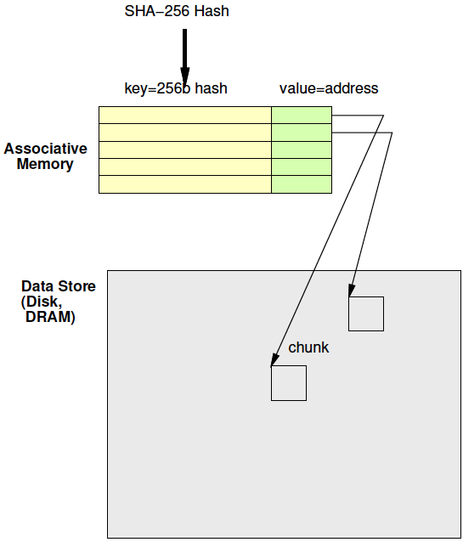
Associative Memory
Day 16 Review
Maps from a key to a value
Key not necessarily dense
  Contrast simple RAM
  Cannot afford 2²⁵⁶ word memory

Slide 44
Associative Memories
Use for deduplication
Also may use in LZW to reduce BRAMs
  Just saw
    Problem: Simple 2D tree table requires too many BRAMs
    Opportunity: Tree table sparse

Slide 45
Deduplicate
Day 16 Review
Compute chunk hash
Use chunk hash to lookup known chunks
  Data already have on disk
  Data already sent to destination, so destination will know
If lookup yields a chunk with same hash
  Check if actually equal (maybe)
If chunks equal
  Send (or save) pointer to existing chunk

Slide 46
Deduplication Architecture
Day 16 Review

Slide 47
Custom Hardware
Associative Memory

Slide 48
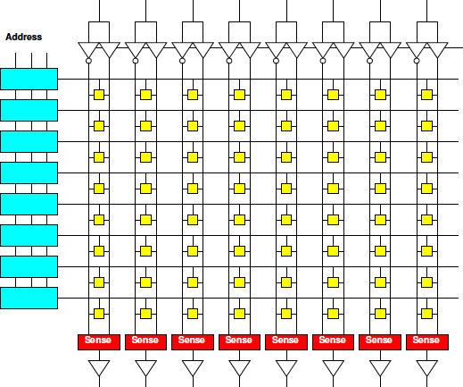
Memory Block Review
Match on address
Select wordline for a row
Reads out a word
Address dense
and hardwired
One row for
each 2^{Abits}
values
width
depth

Slide 49
Address Blocks
Each address match is AND
width
/A2&/A1&/A0
/A2&/A1&A0
depth

Slide 50
Address Blocks

Slide 51
Memory Block Associative
Want address as key
Word is value
Key sparse
Rows<2^{keybits}
Entries<2^{keybits}
Key
programmable
width
depth

Slide 52
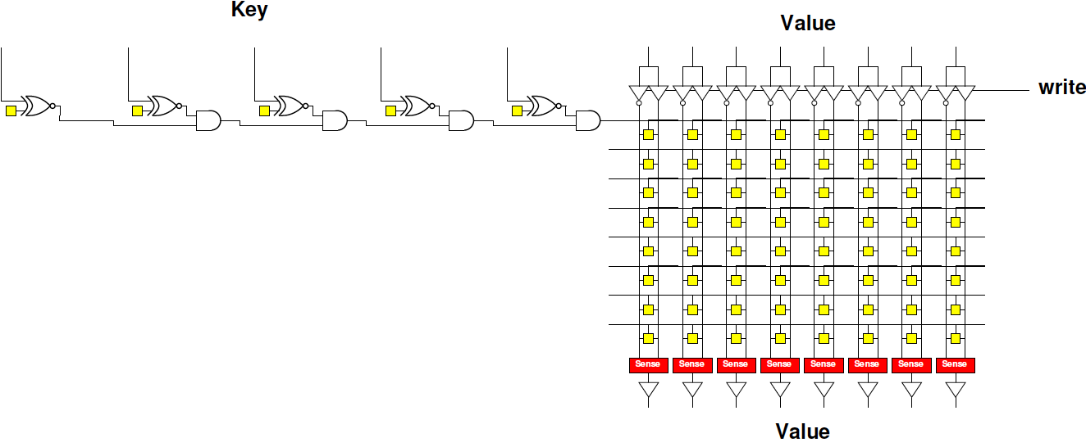
Programmable Key
Make row select programmable

Slide 53
Contrast
Assoc. and Dense Memory

Slide 54
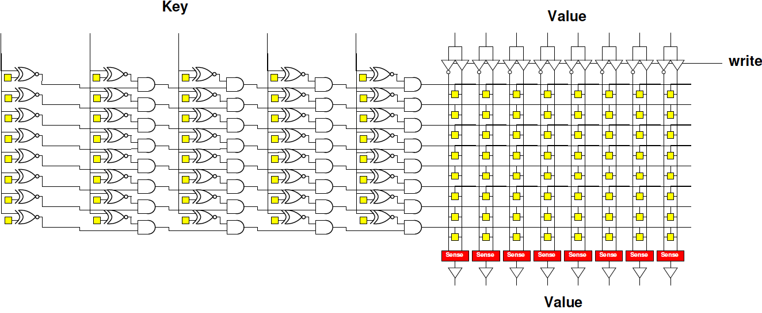
Associative Memory Bank

Slide 55
Programmable Key
Assoc: 5b key, 8 entries, 8b value
How many memory bits?
Direct: 8 entries, 8b value
How many memory bits?

Slide 56
Associative Memory Bank
Memory cells = entries*(keybits+valuebits)

Slide 57
Associative Memory Bank
Will need to be able to write into key
  Another “fixed” decoder to generate
  key-word line for programming

Slide 58
Associate Memory Cost
More expensive than equal capacity SRAM memory bank
  Memory cells in decoder
  Need to support write into key

Slide 59
Associate Memory Cost
Physical associative memory for 4KB LZW Chunk tree encode
  4K entries
  12b (pos) output
  12b (pos)+8b (char)=20b key
Memory cells assoc.?
Compare direct 4Kx12 memory (cells)?
  How much larger is assoc. for same capacity?
Compare 4096*256 with 12b result for dense LZW case (cells)?
  How much larger to solve same problem

Slide 60
FPGA
Has BRAMs – normal memories, not associative
36Kb BRAM
  512x72
Can be 9b key → 72b value assoc.
  Just using the memory sparsely
Or interpret as programmable decoder with 72 match lines

Slide 61
Assoc. Mem from BRAM
For wider match
Cover 9b of key with each BRAM
Use 72 output bits to indicate if one of 72 entries match
AND together corresponding entries
Get 72 match bits
Re-encode match
bits to lookup value

Slide 62
BRAM Associative Memory
Previous slide expands match width
How would we expand capacity?
  Hint: how get a wider word (144b word)?

Slide 63
BRAM Associative Memory

Slide 64
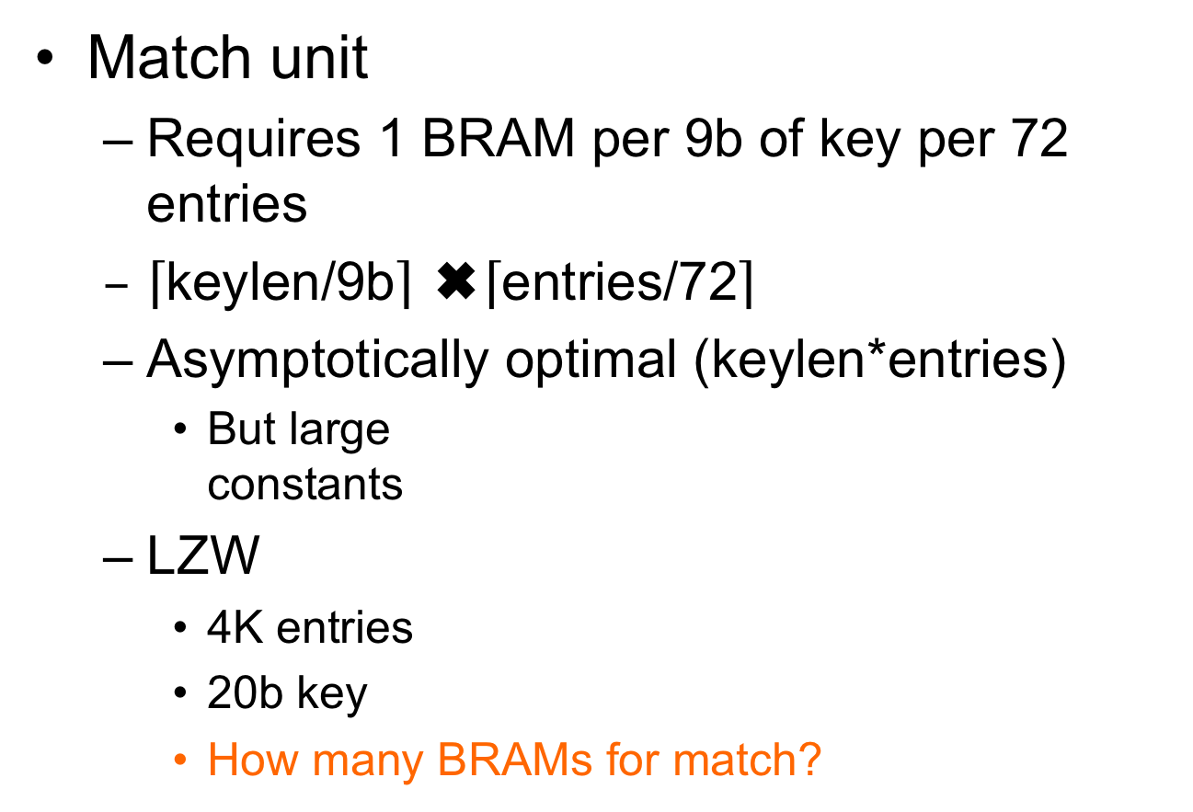
Associative Memory Cost
Match unit
  Requires 1 BRAM per 9b of key per 72 entries
  $\left\lceil \text{keylen}\text{/9}\text{b}\right\rceil$ ✖️$\left\lceil \text{entries}\text{/72}\right\rceil$
  Asymptotically optimal (keylen*entries)
    But large
    constants
  LZW
    4K entries
    20b key
    How many BRAMs for match?

Slide 65
4K LZW Chunk Search:
Fully associative
Match BRAMs:
  Match key: 20b
  Entries: 4096
Value BRAMS:
  12b (state [position])
  12b x 4096 entries
  Takes 2 BRAMs

Slide 66
Example Stored Values
Key[17:9] | Key[8:0] | Value
0x001 | 0x014 | 0x01
0x001 | 0x01 | 0x34
0x0F0 | 0x014 | 0xE3
0x0C8 | 0x113 | 0xCC

Slide 67
Memory Contents
Key[17:9] Match BRAM
Value BRAM
Addr | 7 | 6 | 5 | 4 | 3 | 2 | 1 | 0
0x001 | 0 | 0 | 0 | 0 | 0 | 0 | 1 | 1
0x014 | 0 | 0 | 0 | 0 | 0 | 0 | 0 | 0
0x0C8 | 0 | 0 | 0 | 0 | 1 | 0 | 0 | 0
0x0F0 | 0 | 0 | 0 | 0 | 0 | 1 | 0 | 0
0x113 | 0 | 0 | 0 | 0 | 0 | 0 | 0 | 0
Addr | Value
0x00 | 0x01
0x01 | 0x34
0x02 | 0xE3
0x03 | 0xCC
0x04
0x05
0x06
Key[8:0] Match BRAM
Addr | 7 | 6 | 5 | 4 | 3 | 2 | 1 | 0
0x001 | 0 | 0 | 0 | 0 | 0 | 0 | 1 | 0
0x014 | 0 | 0 | 0 | 0 | 0 | 1 | 0 | 1
0x0C8 | 0 | 0 | 0 | 0 | 0 | 0 | 0 | 0
0x0F0 | 0 | 0 | 0 | 0 | 0 | 0 | 0 | 0
0x113 | 0 | 0 | 0 | 0 | 1 | 0 | 0 | 0
(only show bottom 8 b; rest 0’s)

Slide 68
Code Snippet
ap_uint<72> key_low[512];
ap_uint<72> key_high[512];
int value[72];
match_low=key_low[key%512];
match_high=key_high[(key>>9)%512];
match=match_low & match_high;
addr=binary_encode(match);
res=value[addr];

Slide 69
How Lookup Work?
Key[17:9] | Key[8:0] | Value
0x001 | 0x014 | 0x01
0x001 | 0x01 | 0x34
0x0F0 | 0x014 | 0xE3
0x0C8 | 0x113 | 0xCC
Lookup 0x214 = 0x001 0x014

Slide 70
Code Snippet
ap_uint<72> key_low[512];
ap_uint<712> key_high[512];
int value[72];
match_low=key_low[key%512];
match_high=key_high[(key>>9)%512];
match=match_low & match_high;
addr=binary_encode(match);
res=value[addr];

Slide 71
Memory Contents
Key[17:9] Match BRAM
Addr | 7 | 6 | 5 | 4 | 3 | 2 | 1 | 0
0x001 | 0 | 0 | 0 | 0 | 0 | 0 | 1 | 1
0x014 | 0 | 0 | 0 | 0 | 0 | 0 | 0 | 0
0x0C8 | 0 | 0 | 0 | 0 | 1 | 0 | 0 | 0
0x0F0 | 0 | 0 | 0 | 0 | 0 | 1 | 0 | 0
0x113 | 0 | 0 | 0 | 0 | 0 | 0 | 0 | 0
match_low=key_low[key%512];
match_high=key_high[(key>>9)%512];
Key[8:0] Match BRAM
What match_low, match_high?
Addr | 7 | 6 | 5 | 4 | 3 | 2 | 1 | 0
0x001 | 0 | 0 | 0 | 0 | 0 | 0 | 1 | 0
0x014 | 0 | 0 | 0 | 0 | 0 | 1 | 0 | 1
0x0C8 | 0 | 0 | 0 | 0 | 0 | 0 | 0 | 0
0x0F0 | 0 | 0 | 0 | 0 | 0 | 0 | 0 | 0
0x113 | 0 | 0 | 0 | 0 | 1 | 0 | 0 | 0
(only show bottom 8 b; rest 0’s)

Slide 72
Memory Contents
Key[17:9] Match BRAM
Addr | 7 | 6 | 5 | 4 | 3 | 2 | 1 | 0
0x001 | 0 | 0 | 0 | 0 | 0 | 0 | 1 | 1
0x014 | 0 | 0 | 0 | 0 | 0 | 0 | 0 | 0
0x0C8 | 0 | 0 | 0 | 0 | 1 | 0 | 0 | 0
0x0F0 | 0 | 0 | 0 | 0 | 0 | 1 | 0 | 0
0x113 | 0 | 0 | 0 | 0 | 0 | 0 | 0 | 0
match_low=key_low[key%512];
match_high=key_high[(key>>9)%512];
match=match_low & match_high;
What match?
Key[8:0] Match BRAM
Addr | 7 | 6 | 5 | 4 | 3 | 2 | 1 | 0
0x001 | 0 | 0 | 0 | 0 | 0 | 0 | 1 | 0
0x014 | 0 | 0 | 0 | 0 | 0 | 1 | 0 | 1
0x0C8 | 0 | 0 | 0 | 0 | 0 | 0 | 0 | 0
0x0F0 | 0 | 0 | 0 | 0 | 0 | 0 | 0 | 0
0x113 | 0 | 0 | 0 | 0 | 1 | 0 | 0 | 0
(only show bottom 8 b; rest 0’s)

Slide 73
What does binary_encode do?
binary_encode(0000000…010000)=0x40
10000…0 → 71
0000…01 → 0
0000…010 → 1
for (i=0<i<72;i++)
  If (bit[i]==1) return i
Return(MISS); // if not find (i.e., all 0’s)
Technicalities – maybe check only one 1

Slide 74
Memory Contents
Key[17:9] Match BRAM
Addr | 7 | 6 | 5 | 4 | 3 | 2 | 1 | 0
0x001 | 0 | 0 | 0 | 0 | 0 | 0 | 1 | 1
0x014 | 0 | 0 | 0 | 0 | 0 | 0 | 0 | 0
0x0C8 | 0 | 0 | 0 | 0 | 1 | 0 | 0 | 0
0x0F0 | 0 | 0 | 0 | 0 | 0 | 1 | 0 | 0
0x113 | 0 | 0 | 0 | 0 | 0 | 0 | 0 | 0
match_low=key_low[key%512];
match_high=key_high[(key>>9)%512];
match=match_low & match_high;
addr=binary_encode(match);
Key[8:0] Match BRAM
What addr?
Addr | 7 | 6 | 5 | 4 | 3 | 2 | 1 | 0
0x001 | 0 | 0 | 0 | 0 | 0 | 0 | 1 | 0
0x014 | 0 | 0 | 0 | 0 | 0 | 1 | 0 | 1
0x0C8 | 0 | 0 | 0 | 0 | 0 | 0 | 0 | 0
0x0F0 | 0 | 0 | 0 | 0 | 0 | 0 | 0 | 0
0x113 | 0 | 0 | 0 | 0 | 1 | 0 | 0 | 0
(only show bottom 8 b; rest 0’s)

Slide 75
Memory Contents
Key[17:9] Match BRAM
Value BRAM
Addr | 7 | 6 | 5 | 4 | 3 | 2 | 1 | 0
0x001 | 0 | 0 | 0 | 0 | 0 | 0 | 1 | 1
0x014 | 0 | 0 | 0 | 0 | 0 | 0 | 0 | 0
0x0C8 | 0 | 0 | 0 | 0 | 1 | 0 | 0 | 0
0x0F0 | 0 | 0 | 0 | 0 | 0 | 1 | 0 | 0
0x113 | 0 | 0 | 0 | 0 | 0 | 0 | 0 | 0
Addr | Value
0x00 | 0x01
0x01 | 0x34
0x02 | 0xE3
0x03 | 0xCC
0x04
0x05
0x06
Key[8:0] Match BRAM
Addr | 7 | 6 | 5 | 4 | 3 | 2 | 1 | 0
0x001 | 0 | 0 | 0 | 0 | 0 | 0 | 1 | 0
0x014 | 0 | 0 | 0 | 0 | 0 | 1 | 0 | 1
0x0C8 | 0 | 0 | 0 | 0 | 0 | 0 | 0 | 0
0x0F0 | 0 | 0 | 0 | 0 | 0 | 0 | 0 | 0
0x113 | 0 | 0 | 0 | 0 | 1 | 0 | 0 | 0
res=value[addr];
What res?
(only show bottom 8 b; rest 0’s)

Slide 76
How Lookup Work?
Key[17:9] | Key[8:0] | Value
0x001 | 0x014 | 0x01
0x001 | 0x01 | 0x34
0x0F0 | 0x014 | 0xE3
0x0C8 | 0x113 | 0xCC
Lookup 0x214 = 0x001 0x014

Slide 77
Memory Contents
Key[17:9] Match BRAM
Value BRAM
Addr | 7 | 6 | 5 | 4 | 3 | 2 | 1 | 0
0x001 | 0 | 0 | 0 | 0 | 0 | 0 | 1 | 1
0x014 | 0 | 0 | 0 | 0 | 0 | 0 | 0 | 0
0x0C8 | 0 | 0 | 0 | 0 | 1 | 0 | 0 | 0
0x0F0 | 0 | 0 | 0 | 0 | 0 | 1 | 0 | 0
0x113 | 0 | 0 | 0 | 0 | 0 | 0 | 0 | 0
Addr | Value
0x00 | 0x01
0x01 | 0x34
0x02 | 0xE3
0x03 | 0xCC
0x04
0x05
0x06
Key[8:0] Match BRAM
Addr | 7 | 6 | 5 | 4 | 3 | 2 | 1 | 0
0x001 | 0 | 0 | 0 | 0 | 0 | 0 | 1 | 0
0x014 | 0 | 0 | 0 | 0 | 0 | 1 | 0 | 1
0x0C8 | 0 | 0 | 0 | 0 | 0 | 0 | 0 | 0
0x0F0 | 0 | 0 | 0 | 0 | 0 | 0 | 0 | 0
0x113 | 0 | 0 | 0 | 0 | 1 | 0 | 0 | 0
(only show bottom 8 b; rest 0’s)

Slide 78
Add another entry
match | Key[17:9] | Key[8:0] | Value
0 | 0x001 | 0x014 | 0x01
1 | 0x001 | 0x01 | 0x34
2 | 0x0F0 | 0x014 | 0xE3
3 | 0x0C8 | 0x113 | 0xCC
4 | 0x0C8 | 0x01 | 0x2B
How BRAM contents
change to add this entry
for 0x19001

Slide 79
Memory Contents
Key[17:9] Match BRAM
Value BRAM
Addr | 7 | 6 | 5 | 4 | 3 | 2 | 1 | 0
0x001 | 0 | 0 | 0 | 0 | 0 | 0 | 1 | 1
0x014 | 0 | 0 | 0 | 0 | 0 | 0 | 0 | 0
0x0C8 | 0 | 0 | 0 | 0 | 1 | 0 | 0 | 0
0x0F0 | 0 | 0 | 0 | 0 | 0 | 1 | 0 | 0
0x113 | 0 | 0 | 0 | 0 | 0 | 0 | 0 | 0
Addr | Value
0x00 | 0x01
0x01 | 0x34
0x02 | 0xE3
0x03 | 0xCC
0x04
0x05
0x06
Key[8:0] Match BRAM
Addr | 7 | 6 | 5 | 4 | 3 | 2 | 1 | 0
0x001 | 0 | 0 | 0 | 0 | 0 | 0 | 1 | 0
0x014 | 0 | 0 | 0 | 0 | 0 | 1 | 0 | 1
0x0C8 | 0 | 0 | 0 | 0 | 0 | 0 | 0 | 0
0x0F0 | 0 | 0 | 0 | 0 | 0 | 0 | 0 | 0
0x113 | 0 | 0 | 0 | 0 | 1 | 0 | 0 | 0
(only show bottom 8 b; rest 0’s)

Slide 80
Memory Contents
Key[17:9] Match BRAM
Value BRAM
Addr | 7 | 6 | 5 | 4 | 3 | 2 | 1 | 0
0x001 | 0 | 0 | 0 | 0 | 0 | 0 | 1 | 1
0x014 | 0 | 0 | 0 | 0 | 0 | 0 | 0 | 0
0x0C8 | 0 | 0 | 0 | 1 | 1 | 0 | 0 | 0
0x0F0 | 0 | 0 | 0 | 0 | 0 | 1 | 0 | 0
0x113 | 0 | 0 | 0 | 0 | 0 | 0 | 0 | 0
Addr | Value
0x00 | 0x01
0x01 | 0x34
0x02 | 0xE3
0x03 | 0xCC
0x04 | 0x2B
0x05
0x06
Key[8:0] Match BRAM
Addr | 7 | 6 | 5 | 4 | 3 | 2 | 1 | 0
0x001 | 0 | 0 | 0 | 1 | 0 | 0 | 1 | 0
0x014 | 0 | 0 | 0 | 0 | 0 | 1 | 0 | 1
0x0C8 | 0 | 0 | 0 | 0 | 0 | 0 | 0 | 0
0x0F0 | 0 | 0 | 0 | 0 | 0 | 0 | 0 | 0
0x113 | 0 | 0 | 0 | 0 | 1 | 0 | 0 | 0
(only show bottom 8 b; rest 0’s)

Slide 81
4K Chunk LZW Search
 | BRAMs | Operations
Brute Search | 1 | 4K
Tree with Dense RAM | 384 | 1
Tree with Full Assoc | 173 | 1
36Kb BRAMs on ZU3EG = 216

Slide 82
Checkpoint
Notice levels of mapping:
  Prefix Tree algorithm
  Formulated on a 2D memory
  Then implemented in assoc. memory
    (later with Tree … hash table)

Slide 83
Lecture Ended Here

Slide 84
Software Map
Part 3

Slide 85
Software Map
Map abstraction
  void insert(key,value);
  value lookup(key);
Will typically have many different implementations

Slide 86
Preclass 1
For a capacity of 4096
How many memory accesses needed
  When lookup fail?
  When lookup succeed (on average)?

Slide 87
Tree Map (Preclass 2)
Build search tree
Walk down tree
For a capacity of 4096,
assume balanced…
How many tree nodes visited
  When lookup fail?
  When lookup succeed (on average)?

Slide 88
Tree Map LZW
Each character requires log₂(dict) lookups
  12 for 4096
Each internal tree node hold
  Key (20b for LZW), value (12b), and 2 pointers (12b)
  7B
Total nodes 4K*2
Need 14 BRAMs for 4K chunk

Slide 89
Tree Insert
Need to maintain balance
Doable with O(log(N)) insert
  Tricky
  See Red-Black Tree
    https://en.wikipedia.org/wiki/Red–black_tree
    https://www.geeksforgeeks.org/red-black-tree-set-1-introduction-2/

Slide 90
4K Chunk LZW Search
 | BRAMs | Operations
Brute Search | 1 | 4K
Tree with Dense RAM | 384 | 1
Tree with Full Assoc | 173 | 1
Tree with Tree | 14 | 12
36Kb BRAMs on ZU3EG = 216

Slide 91
Big Ideas
Can adaptively compress data using recurring substrings
  With constant work for symbol
Rich design space for engineering associative map solutions

Slide 92
Admin
Feedback (including HW7)
Reading for Wednesday on Web
First project milestone due Friday
  Including teaming

