Slide 1

ESE5320:
System-on-a-Chip Architecture
Day 18: Nov. 2, 2022
Hash Tables
Design Space

Slide 2
Today
Software Map Trees (Part 1)
Hash Tables (Part 2)
  Software
  Hardware (FPGA) Hash Maps
Design-Space Exploration
  Generic (Part 3)
  Concrete (Part 4):
  Fast Fourier Transform (FFT)
    Time permitting

Slide 3
Message
Hash tables are useful tools
The universe of possible implementations (design space) is large
  Many dimensions to explore
Formulate carefully
Approach systematically
Use modeling along the way for guidance

Slide 4
Software Map
Part 1

Slide 5
Software Map
Map abstraction
  void insert(key,value);
  value lookup(key);
Will typically have many different implementations

Slide 6
Day 17: Preclass 1
For a capacity of 4096
How many memory accesses needed
  When lookup fail?
  When lookup succeed (on average)?

Slide 7
Tree Map (Day 17: Preclass 2)
Build search tree
Walk down tree
For a capacity of 4096,
assume balanced…
How many tree nodes visited
  When lookup fail?
  When lookup succeed (on average)?

Slide 8
Tree Map LZW
Each character requires log₂(dict) lookups
  12 for 4096
Each internal tree node hold
  Key (20b for LZW), value (12b), and 2 pointers (12b)
  7B
Total nodes 4K*2
Need 14 BRAMs for 4K chunk

Slide 9
Tree Insert
Need to maintain balance
Doable with O(log(N)) insert
  Tricky
  See Red-Black Tree
    https://en.wikipedia.org/wiki/Red–black_tree
    https://www.geeksforgeeks.org/red-black-tree-set-1-introduction-2/

Slide 10
4K Chunk LZW Search
Story so far….
 | BRAMs | Operations
Brute Search | 1 | 4K
Tree with Dense RAM | 512 | 1
Tree with Full Assoc | 175 | 1
Tree with Tree | 14 | 12
36Kb BRAMs on ZU3EG = 216

Slide 11
Hash Tables
Part 1

Slide 12
High Performance Map
Would prefer not to search
Want to do better than log₂(N) time
  log₂(N) achieved with tree
Direct lookup in arrays (memory)
is good…

Slide 13
Hash Table
lookup_key
Attempt to turn into direct lookup
Compute some function of key
  A hash
Perform lookup at that point
If hash maps a single entry
(or no entry)
  Great, got direct lookup
    Like sparse table case
hash
Mem
match_key, value
Miss =
(match_key!=lookup_key)

Slide 14
Preclass 1
Average number of entries per hash when N > HASH_CAPACITY?
  Concrete example
    N= 4096
    HASH_CAPACITY=256

Slide 15
Hash Table
lookup_key
Attempt to turn into direct lookup
Compute some function of key
  A hash
Perform lookup at that point
Typically, prepared for several keys to map to same hash → call it a bucket
  Keep list or tree of things in each bucket
hash
Mem
Bucket =
<k1,v1>,
<k2,v2>,
<k3,v3>

Slide 16
Hash Table
lookup_key
Compute some function of key
  A hash
Perform lookup at that point
Find bucket with small number of entries
  Searching that bucket easier
  …but no absolute guarantee on
  maximum bucket size
hash
Mem
Bucket =
<k1,v1>,
<k2,v2>,
<k3,v3>

Slide 17
Hardware Hash Tables

Slide 18
Hardware Hash
lookup_key
Want to avoid variable size buckets
  So can read in one lookup
    Can make wider for some fixed number of slots
  So can resolve in one cycle
hash
Mem
Bucket =
<k1,v1>,
<k2,v2>,
<k3,v3>

Slide 19
Hash Size Distribution
Look at what the distribution looks like for number of entries
N – number of entries
C – HASH_CAPACITY
m – number of items in a slot
Compute distribution for each bucket size

Slide 20
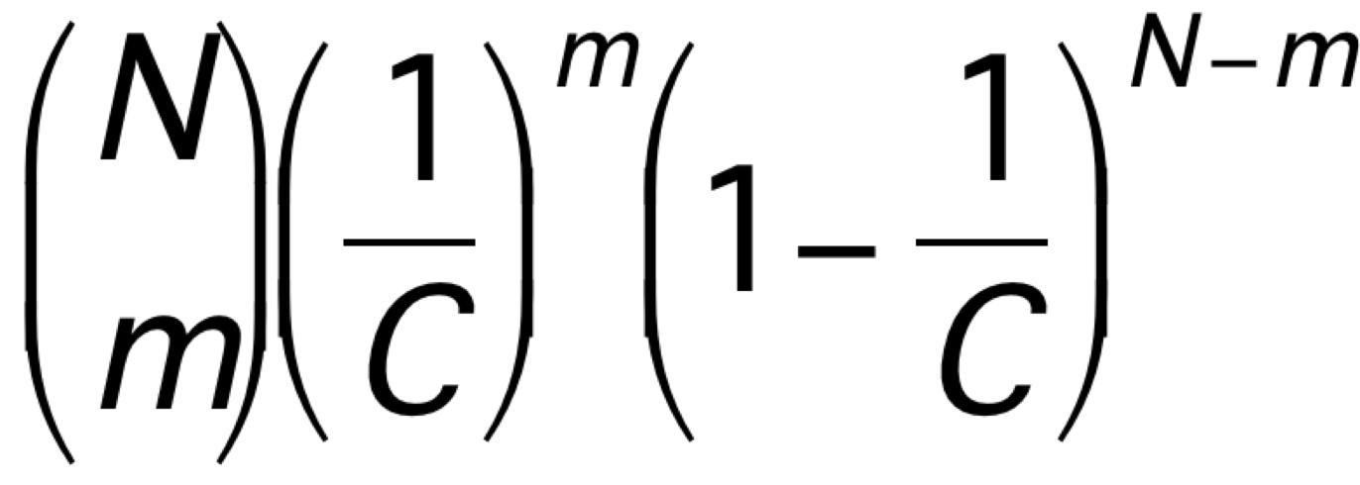
Preclass 2
N=1024
m→ | 0 | 1 | 2 | 3 | 4+
C=1024
C=2048 |  | 0.30
C=4096

Slide 21
Hash
Can tune hash parameters to control distribution
Spend more memory → smaller buckets → less work finding things in buckets
  Memory-Time tradeoff
Still have possibility of large buckets
  …but probability is low

Slide 22
Idea
Hash mostly works
Engineer hash to hold most cases
  Combination of
    sparcity (entries>N)
    Hold multiple entries per hash value
Few cases that overflow
  Store in small fully associative memory

Slide 23
Hybrid Hash+Assoc.

Slide 24
LZW 4K Chunk Hybrid
72 entry assoc. match
  needs 3 match BRAMs + 1 value BRAM
  Associative match 20b key
  72 entries (72/4096=1.7% for 4096)
So, can hold ~1% conflicts in 4K hash
Hash N=4096, C=16384, m=2, store 2
  Prob 3+: <1% (see table 1024, 4096)
  20b key+12b value=4B per entry
  16384*2*4B=4*2*4 BRAMs
32+4=36 BRAMs

Slide 25
Further Optimization
Previous example illustrative
  Not necessarily optimal (explore parameters)
    Expect not optimal
May be able to do better with multiple hashes
  See Dhawan reading paper
  May need to use that design in hybrid configuration with assoc. memory like previous example

Slide 26
Allow Imperfect?
Question: impact on compression if cannot store a few tree entries?
Some encodings will find shorter matches than optimal
Q: Impact on compression rate as a function of conflict rate?
How compare to compression rate impact of chunk size?
  Larger chunk with conflict rate vs. smaller chunk with smaller (or no) conflict rate
→ another tradeoff to explore

Slide 27
Hash Complexity
Want to compute these lookup hashes for hardware fast
  In a single cycle to keep II down for LZW
  Can xor-together a set of bits quickly in hardware
    Any 6-bits for one output bit in a single 6-LUT
    Means capacity must be power-of-2

Slide 28
4K Chunk LZW Search
 | BRAMs | Operations
Brute Search | 1 | 4K
Tree with Dense RAM | 512 | 1
Tree with Full Assoc | 175 | 1
Tree with Tree | 14 | 12
Tree with Hybrid | 36 | 1
36Kb BRAMs on ZU3EG = 216

Slide 29
Part 3
Design-Space Exploration
Generic

Slide 30
Design Space
Have many choices for implementation
  Alternatives to try
  Parameters to tune
  Mapping options
This is our freedom to impact implementation costs
  Area, delay, energy

Slide 31
Design Space
Ideally
  Each choice orthogonal axis
  in high-dimensional space
  Want to understand points in space
  Find one that best meets constraints and goals
Practice
  Seldom completely orthogonal
  Requires cleverness to identify dimensions
  Messy, cannot fully explore
  But…can understand, prioritize, guide

Slide 32
Preclass 3
What choices (design-space axes) can we explore in mapping a task to an SoC?
Hint: What showed up in homework so far?

Slide 33
Design-Space Choices
Type of parallelism
How decompose / organize parallelism
Area-time points (level exploited)
What resources we provision for what parts of computation
Where to map tasks
How schedule/order computations
How synchronize tasks
How represent data
Where place data; how manage and move
What precision use in computations

Slide 34
Generalize Continuum
Encourage to think about parameters (axes) that capture continuum to explore
Start from an idea
  Maybe can compute with 8b values
  Maybe can put matrix-mpy computation on FPGA fabric
  Maybe 1 hash + 1 fully assoc.
  Move data in 1KB chunks
Identify general knob
  Tune intermediate bits for computation
  How much of computation go on FPGA fabric
  How many hash/assoc levels?
  What is optimal data transfer size?

Slide 35
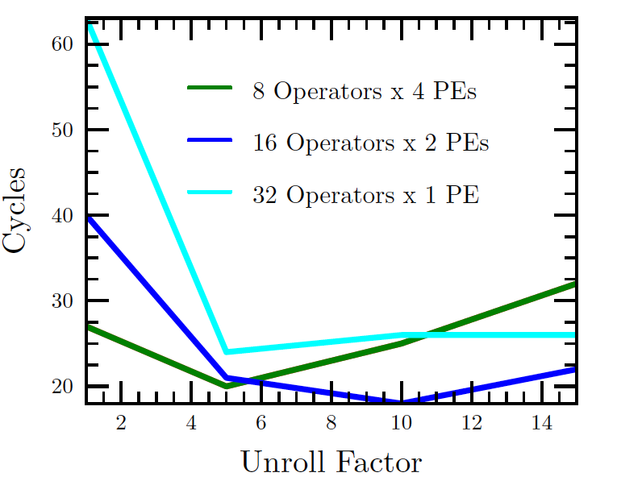
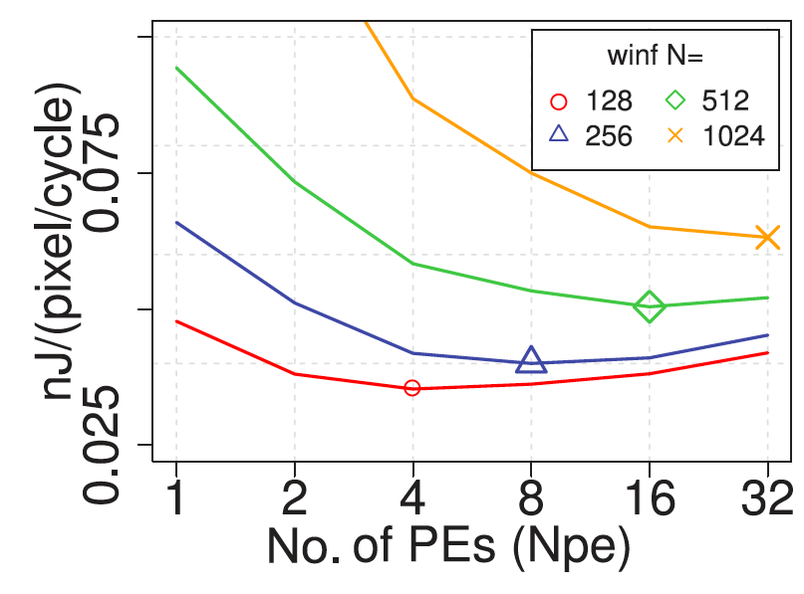
Finding Optima
Kapre, FPL 2009
Kadric, TRETS 2016

Slide 36
Design Space Explore
Think systematically about how might map the application
Avoid overlooking options
Understand tradeoffs
The larger the design space
  more opportunities to find good solutions
    Reduce bottlenecks

Slide 37
Elaborate Design Space
Refine design space as you go
Ideally identify up front
Practice bottlenecks and challenges
  will suggest new options / dimensions
    If not initially expect memory bandwidth to be a bottleneck…
Some options only make sense in particular sub-spaces
  Bitwidth optimization not a big issue on the 64b processor
    More interesting on vector, FPGA

Slide 38
Tools
Sometimes tools will directly help you explore design space
  Sometimes do it for you
    Mimimize II
  In your hands, make easy
    Unrolling, pipelining, II
    Array packing and partitioning
    Some choices for data movement
    DMA pipelining and transfer sizes
    Some loop transforms
    Granularity to place on FPGA
    ap_fixed
    Number of data parallel accelerators

Slide 39
Tools
Often tools will not help you with design space options
  Need to reshape functions and loops
  Line buffers
  Data representations and sizes
  C-slow sharing
  Communications overlap
  Picking hash function parameters

Slide 40
Code for Exploration
Can you write your code with parameters (#define) that can easily change to explore continuum?
  Unroll factor?
  Number of parallel tasks?
  Size of data to move?
Want to make it easy to explore different points in space

Slide 41
Part 4
Design-Space Exploration
Example FFT
Skip Wrapup

Slide 42
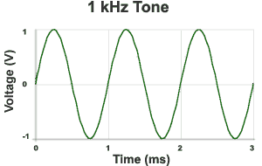


Sound Waves
Hz = 1/s
1kHz = 1000 cycles/s
Source: http://www.mediacollege.com/audio/01/sound-waves.html

Slide 43
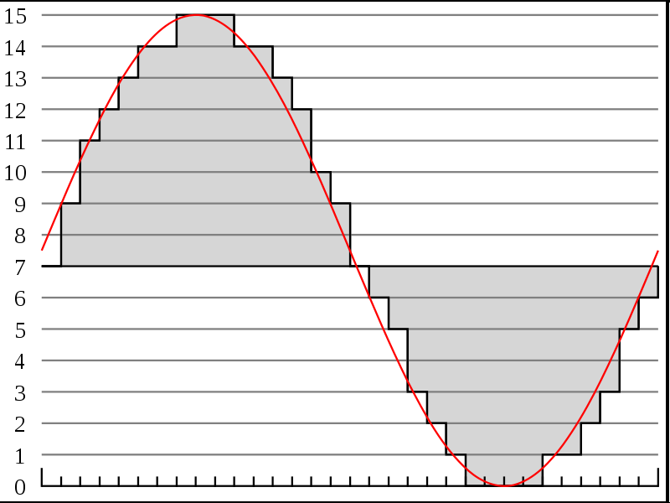
Discrete Sampling
Represent as time sequence
Discretely sample in time
What we can do directly with an Analog-to-Digital (A2D) converter
http://en.wikipedia.org/wiki/File:Pcm.svg
http://en.wikipedia.org/wiki/File:Pcm.svg

Slide 44
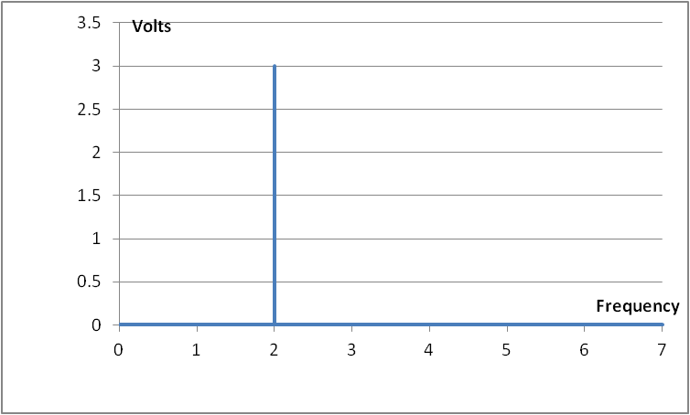


Time-Domain & Frequency-domain
example…have a pure tone
  If period: T = $1/2$ and Amplitude = 3 Volts
  $s\left(t\right)=A sin\left(2πft\right)=$
$$A sin\left(2π2t\right)$$
Time domain representation
Frequency domain representation

Slide 45

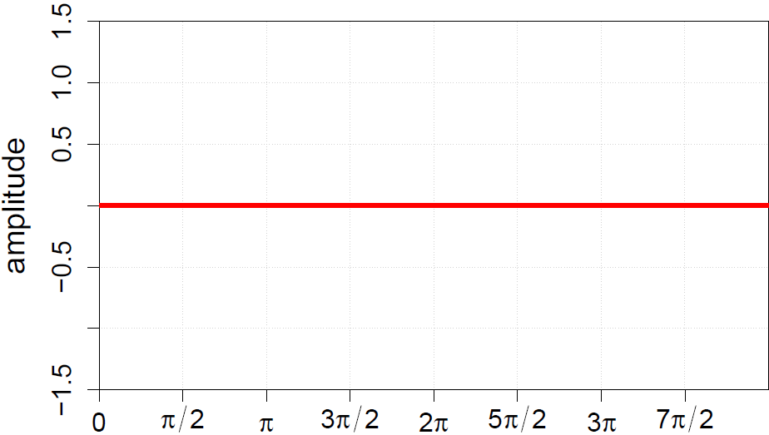
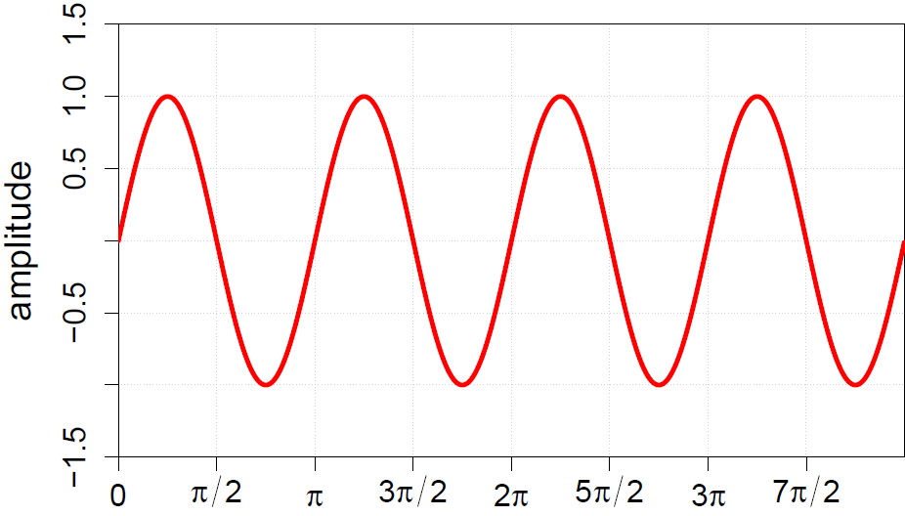
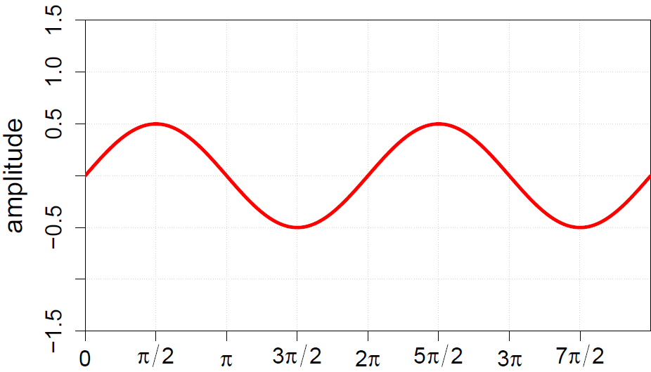
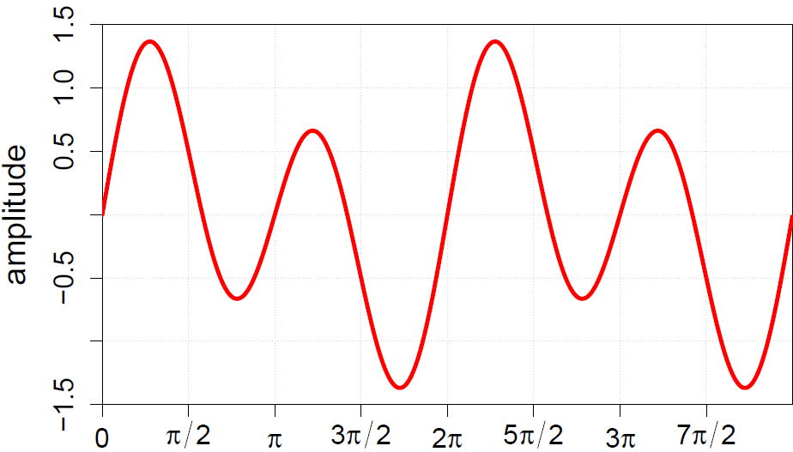
Frequency-domain
Can represent sound wave as linear sum of frequencies

Slide 46
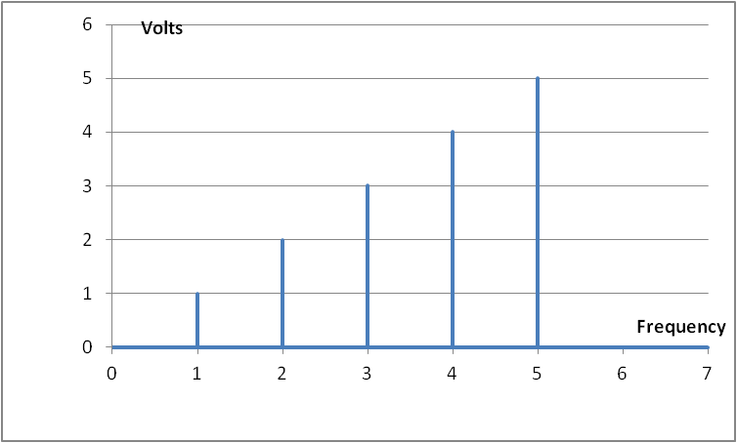
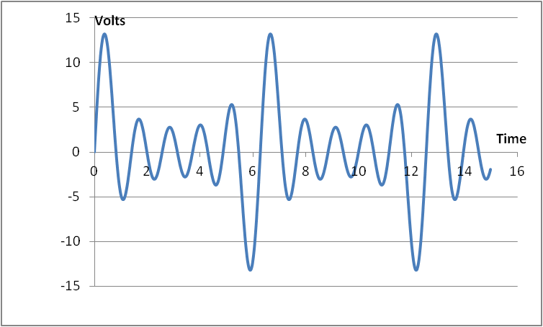
Time vs. Frequency

Slide 47
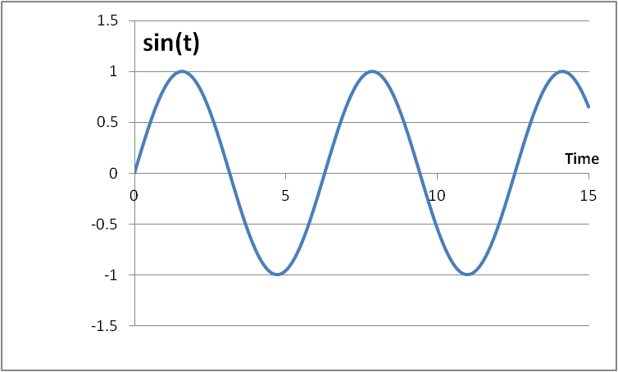
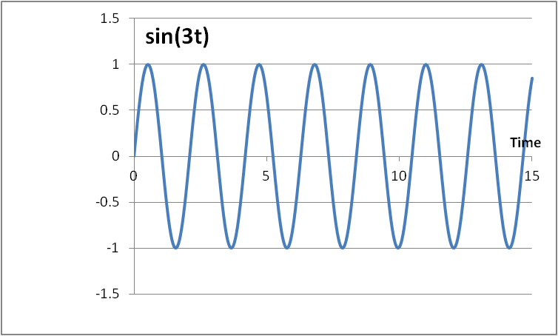
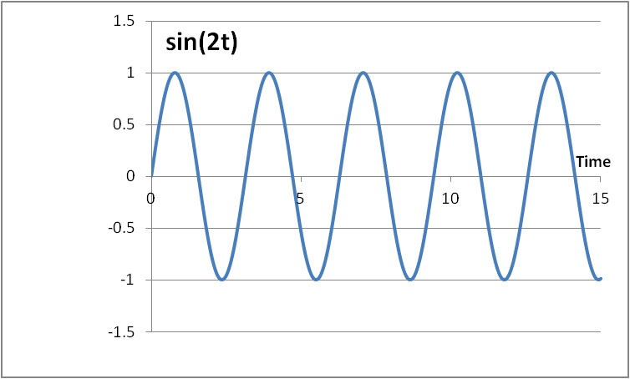
Fourier Series
  The cos(nx) and sin(nx) functions form an orthogonal basis: they allow us to represent any periodic signal by taking a linear combination of the basis components without interfering with one another

Slide 48
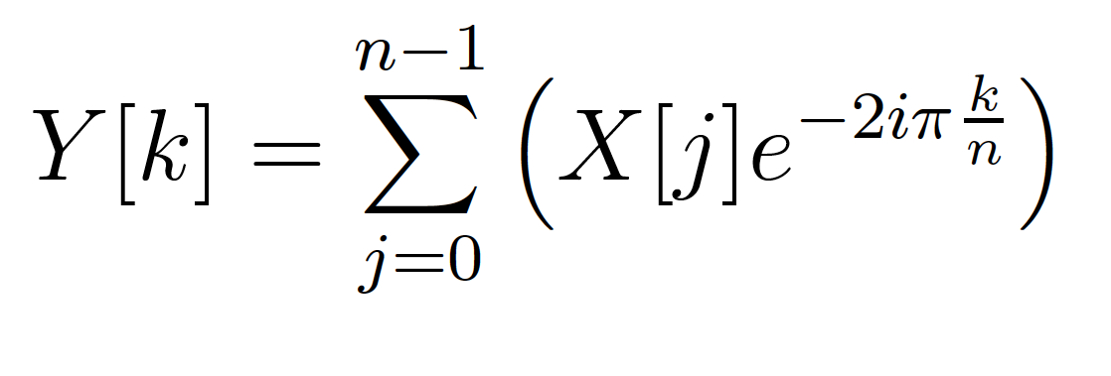
Fourier Transform
Identify spectral components (frequencies)
Convert between Time-domain to Frequency-domain
  E.g. tones from data samples
  Central to audio coding – e.g. MP3 audio

Slide 49
FT as Matching
Fourier Transform is essentially performing a dot product with a frequency
  How much like a sine wave of freq. f is this?

Slide 50
Fast-Fourier Transform (FFT)
Efficient way to compute FT
O(N*log(N)) computation
Contrast N² for direct computation
  N dot products
    Each dot product has N points (multiply-adds)

Slide 51
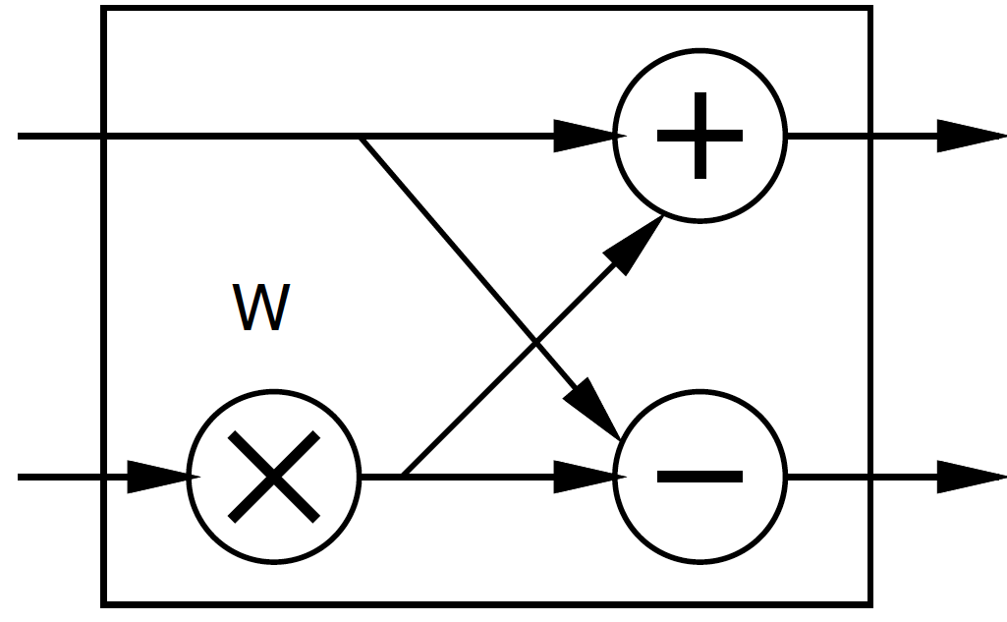
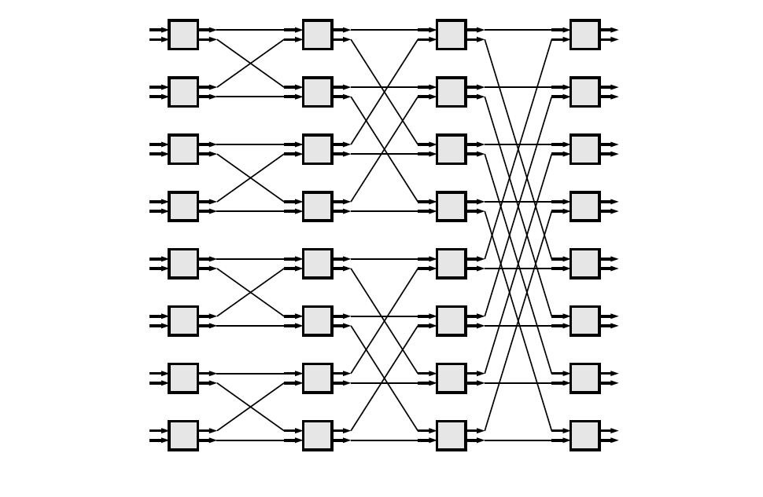
FFT
Large space of FFTs
Radix-2 FFT Butterfly
X[0]
Y[0]
X[1]
w – constant that
Differs for each instance
-- ``twiddle’’ factor
X[15]
Y[15]
X[15]

Slide 52
Basic FFT Butterfly
Y0=X0+W(stage,butterfly)*X1
Y1=X0-W(stage,butterfly)*X1
Common sub expression, compute once: W(stage,butterfly)*X1
X0
Y0
X1
Y1

Slide 53
Preclass 4
What parallelism options exist?
  Single FFT
  Sequence of FFTs

Slide 54
FFT Parallelism
Spatial
Pipeline
Streaming
By column
  Choose how many Butterflies to serialize on a PE
By subgraph
Pipeline subgraphs

Slide 55
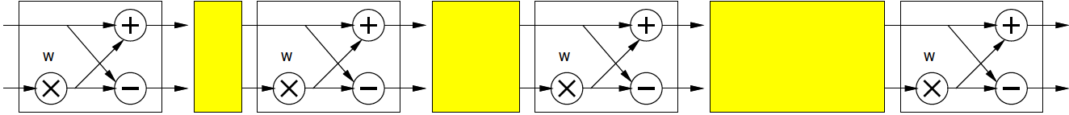
Streaming FFT

Slide 56
Preclass 5
How large of a spatial FFT can implement with 360 multipliers?
  1 multiply per butterfly
  (N/2) log₂(N) butterflies

Slide 57
Bit Serial
Could compute the add/multiply bit serially
  One full adder per adder
  W full adders per multiply
  W=16, maybe 20—30 LUTs
  70,000 LUTs
    ~= 70,000/30 ~= 2330 butterflies
      512-point FFT has 2304 butterflies
Another dimension to design space:
  How much serialize word-wide operators
  Use LUTs vs. DSPs

Slide 58
Accelerator Building Blocks
What common subgraphs exist in the FFT?

Slide 59
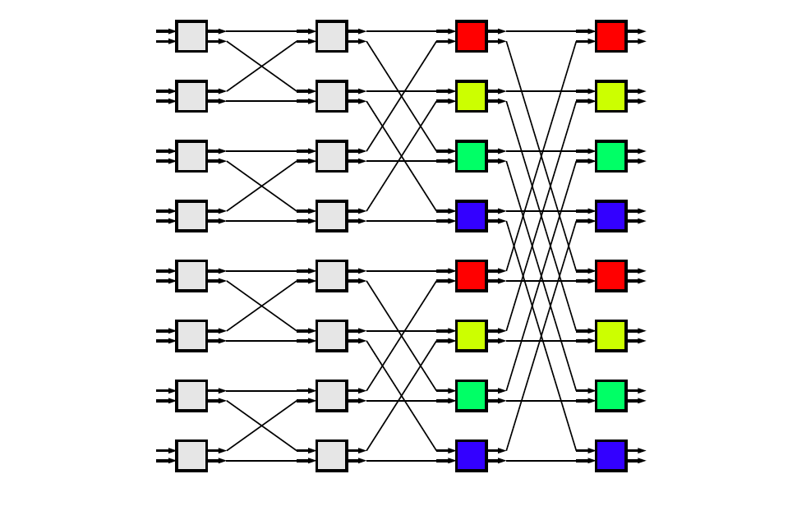
Common Subgraphs

Slide 60
Processor Mapping
How map butterfly operations to processors?
  Implications for communications?

Slide 61
Storage
How large local memory to communicate from stage to stage?

Slide 62
Evaluation Order
How change evaluation order to reduce local storage memory?

Slide 63
Evaluation Order
Evaluation order
1
3
9
2
4
10
5
7
11
6
8
12

Slide 64
Streaming FFT

Slide 65
Communication
How implement the data shuffle between processors or accelerators?
  Memories / interconnect ?
  How serial / parallel ?
  Network?

Slide 66
Data Precision
Input data from A2D likely 12b
Output data, may only want 16b
What should internal precision and representation be?

Slide 67
Number Representation
Floating-Point
  IEEE standard single (32b), double (64b)
    With mantissa and exponent
    …half, quad ….
Fixed-Point
  Select total bits and fraction
    E.g. 16.8 (16 total bits, 8 of which are fraction)
      Represent 1/256 to 256-1/256
  A(mpy) ~ W², A(add) ~ W

Slide 68
Operator Sizes
Operator | LUTs | LUTs + DSPs
Double FP Add | 712 | 681+3 DSPs
Single FP Add | 370 | 219+2 DSPs
Fixed-Point Add (32) | 16
Fixed-Point Add (n) | n/2
Double FP Multiply | 2229 | 223+10 DSPs
Single FP Multiply | 511 | 461+3 DSPs
Fixed Multiply (32x32) | 1099
Fixed Multiply (16x16) | 283 | 1 DSP
Fixed Multiply (18x25) |  | 1 DSP
Fixed Multiply (n) | ~ n²
FP (Floating Point) sizes from:
https://www.xilinx.com/support/documentation/ip_documentation/ru/floating-point.html

Slide 69
Heterogeneous Precision
May not be same in every stage
  W factors less than 1
  Non-fraction grows at most 1b per stage

Slide 70
W Coefficients
(w[stage][j])
Precompute and store in arrays
Compute as needed
  How?
    sin/cos hardware?
    CORDIC?
    Polynominal approximation?
Specialize into computation
  Many evaluate to 0, ±1, ±½, ….
  Multiplication by 0, 1 not need multiplier…

Slide 71
FFT (partial) Design Space
Parallelism
Decompose
Size/granularity of accelerator
  Area-time
Sequence/share
Communicate
Representation/precisions
Twiddle W[stage][j] coefficients

Slide 72
Big Ideas
Near O(1) Map access → Hash Table
Large design space for implementations
  Including associative maps
Worth elaborating and formulating systematically
  Make sure don’t miss opportunities
Think about continuum for design axes
Model effects for guidance and understanding

Slide 73
Admin
Feedback
Reading for Monday on web
First project milestone due Friday
  Including teaming
P2 out

