Slide 1

ESE5320:
System-on-a-Chip Architecture
Day 24: November 28, 2022
Real Time

Slide 2
Today
Real Time
Part 1: Demands
Part 2: Challenges
  Algorithms
  Architecture
Part 3: Disciplines to achieve

Slide 3
Message
Real-Time applications demand different discipline from best-effort tasks
Look more like synchronous circuits
Can sequentialize, like processor
  But must avoid/rethink typical general-purpose processor common-case optimizations

Slide 4
Real Time
“Real” – refers to physical time
  Connection to Real or Physical World
Contrast with “virtual” or “variable” time
Handles events with absolute guarantees on timing

Slide 5
Real-Time Tasks
What timing guarantees might you like for the following tasks?
  Turn steering wheel on a drive-by-wire car
    Delay to recognized and car turns
  Self-driving car detects an object in its path
    Delay from object appearing to detection
  Pacemaker stimulates your heart
  Video playback (frame to frame delay)

Slide 6
Real-Time Guarantees
Attention/processing within fixed interval
  Sample new value every XX ms
  Produce new frame every 30 ms
  Both: schedule to act and complete action
Bounded response time
  Respond to keypress within 20 ms
  Detect object within 100 ms
  Return search results within 200 ms

Slide 7


Computer Response
What do these things indicate?
  When will the computer complete the task?
https://en.wikipedia.org/wiki/File:Windows_8_%2B_10_wait_cursor.gif
https://en.wikipedia.org/wiki/File:WaitCursor-300p.gif

Slide 8
Real-Time Response
What if your car gave you a spinning wait wheel for 5 seconds when you
  Turned the wheel?
  Stepped on the brakes?

Slide 9
Synchronous Circuit Model
A simple synchronous circuit is a good “model” for real-time task
  Run at fixed clock rate
  Take input every “cycle” (application cycle)
  Produce output every “cycle” (application cycle)
  Complete computation between input and output
  Designed to run at fixed-frequency
    Critical path meets frequency requirement

Slide 10
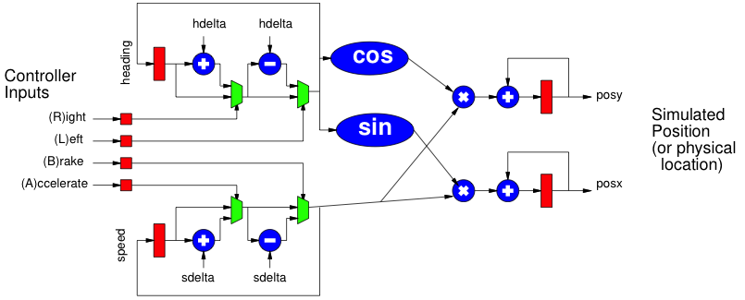
Preclass 2
(Circuit) Cycle time could operate?
Assume clocked at 100Hz (application cycle)
Worst-case delay from (L)eft press to change in heading (posx,posy)?

Slide 11
Preclass 2
Assume clocked at 100Hz (application cycle)

Slide 12
Historically
Real-Time concerns grew up in EE
  Because an analog circuit was the only way could meet frequency demands
  …later a dedicated digital circuit…
Applications
  Signal processing, video, control, …

Slide 13
Technological
Change
Area units for spatial design shown (preclass 2c)
Fraction of processor capacity required (Prelcass 2d)
Why not be satisfied with dedicating a synchronous circuit for all real-time tasks today?
  Hint: What does preclass 2c,d suggest?

Slide 14
Performance Scaling
As circuit speeds increased
  Can meet real-time performance demands with heavy sequentialization
Circuit and processor clocks
  from MHz to GHz
Many real-time task rates unchanged
  44KHz audio, 33 frames/second video
Even 100MHz processor
  Can implement audio in a small fraction of its computational throughput capacity

Slide 15
HW/SW Co-Design
Computer Engineers – know can implement anything as hardware or software
Want freedom to move between hardware and software to meet requirements
  Performance, costs, energy

Slide 16
Real-Time Challenge
Meet real-time demands / guarantees
  Economically using programmable architectures
Sequentialize and share resources with deterministic, guaranteed timing
Spatial (all hardware, HLS synthesized) implementations are good at meeting real-time guarantees, but may be bigger than necessary

Slide 17
Challenges
Part 2

Slide 18
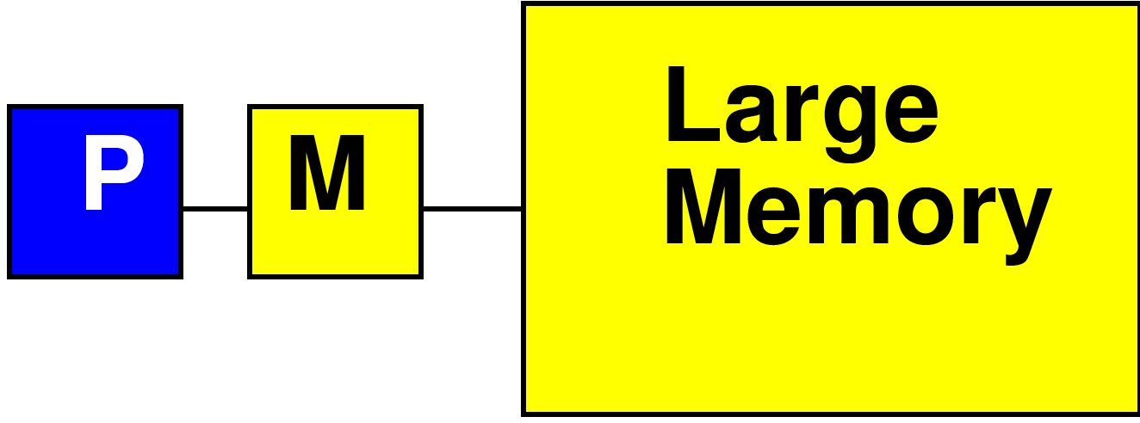
Processor Data Caches
Day 3
Traditional Processor Data Caches are a heuristic instance of this
  Add a small memory local to the processor
    It is fast, low latency
  Store anything fetched from large/remote memory in local memory
    Hoping for reuse in near future
  On every fetch, check local memory before go to large memory

Slide 19
Processor Data Caches
Day 3
Demands more than a small memory
  Need to sparsely store address/data mappings from large memory
  Makes more area/delay/energy expensive than just a simple memory of capacity
Don’t need explicit data movement
Cannot control when data moved/saved
  Bad for determinism
Limited ability to control what stays in small memory simultaneously

Slide 20
Processor Data Caches
Traditional Processor Data Caches are a heuristic instance of this
  Store anything fetched from large/remote memory in local memory
    Hoping for reuse in near future
  On every fetch, check local memory before go to large memory
  Stall processor while waiting for data

Slide 21
Preclass 3:
Processor Cache Timing
Assume
  cache miss (go to large memory) takes 10 cycles
  Cache hit (small memory) takes 1
  Start with empty cache
Due to memory delay, how long to execute:
b=a[0]+a[1];
c=a[1]+a[2];
d=a[2]+a[0];
b=a[i]+a[j];
c=a[k]+a[l];
d=a[m]+a[n];

Slide 22
Scratchpad
Recall, scratchpad memory
  Small
  Explicitly managed (not dynamic like cache)
If move (DMA) data to scratchpad memory, would be deterministic
b=a[0]+a[1];
c=a[1]+a[2];
d=a[2]+a[0];
b=a[i]+a[j];
c=a[k]+a[l];
d=a[m]+a[n];

Slide 23
Observe
Instructions on “General Purpose” processors take variable number of cycles

Slide 24
Preclass 4
How many cycles?
  sin, cos 100 cycles each
  Assignments take 1 cycle
old_sh=sh; old_ch=ch;
if (!left || !right)
{sh=old_sh;ch=old_ch;}
else
{sh=sin(heading);
ch=cos(heading);}

Slide 25
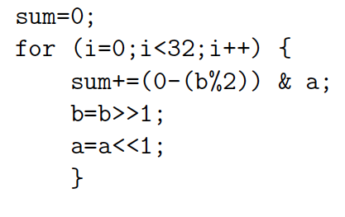
Preclass 5
How many cycles?

Slide 26
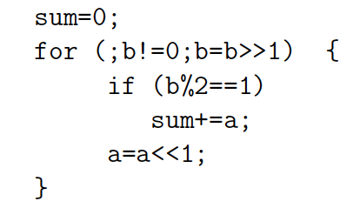
Preclass 5
How many cycles?

Slide 27
Observe
Data-dependent branching, looping
  Means variable time for operations

Slide 28
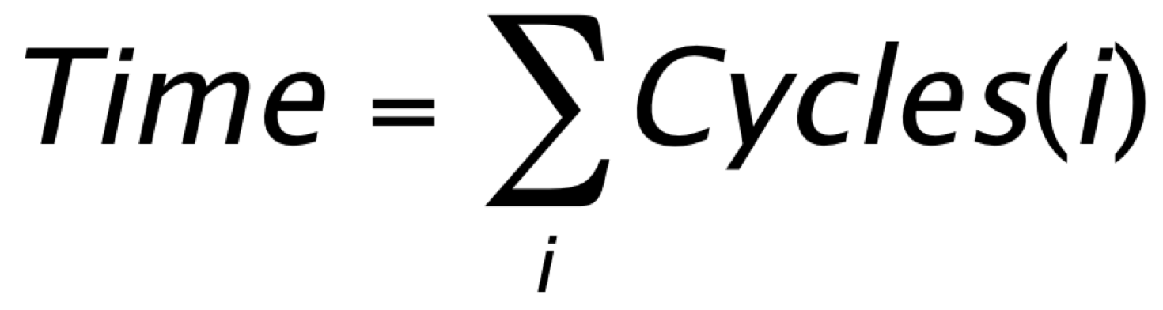
Two Challenges
Architecture – Hardware have variable (data-dependent) delay
  Esp. for General-Purpose processors
    Instructions take different number of cycles
Algorithm – computational specification have variable (data-dependent) operations
  Different number of instructions

Slide 29
Algorithm
What programming constructs are data-dependent (variable delay)?

Slide 30
Programming Constructs
Conditionals: if/then/else
Loops without compile-time determined bounds
  While with termination expressions
  For with data-dependent bounds
Data-dependent recursion
Interrupts
  I/O events, time-slice
Note: 1st three were issue for HLS
  For same reason – how did we address?

Slide 31
Programming Constructs
Dynamic Dataflow (from Day 5)
  Variable rates
  Switch/select operators

Slide 32
Hardware Architecture
Some typical (471,571) processor “optimizations” can cause variable delay
  Caches
  Branch prediction
  Common-case optimizations
  Pipeline stalls
  Speculative issue

Slide 33
Disciplines to achieve Real-Time
Part 3

Slide 34
What can we do to make architecture more deterministic?
Explicitly managed memory
Eliminate Branching (too severe?)
Unpipelined processors
Fixed-delay pipelines
  Offline-scheduled resource sharing
  Multi-threaded
Deadlines

Slide 35
Explicitly Managed Memory
Make memory hierarchy visible
  Use Scratchpad memories instead of caches
Explicitly move data between memories
  E.g. movement into local memory
Already do for Register File in Processor
  Load/store between memory and RF slot
  …but don’t do for memory hierarchy

Slide 36
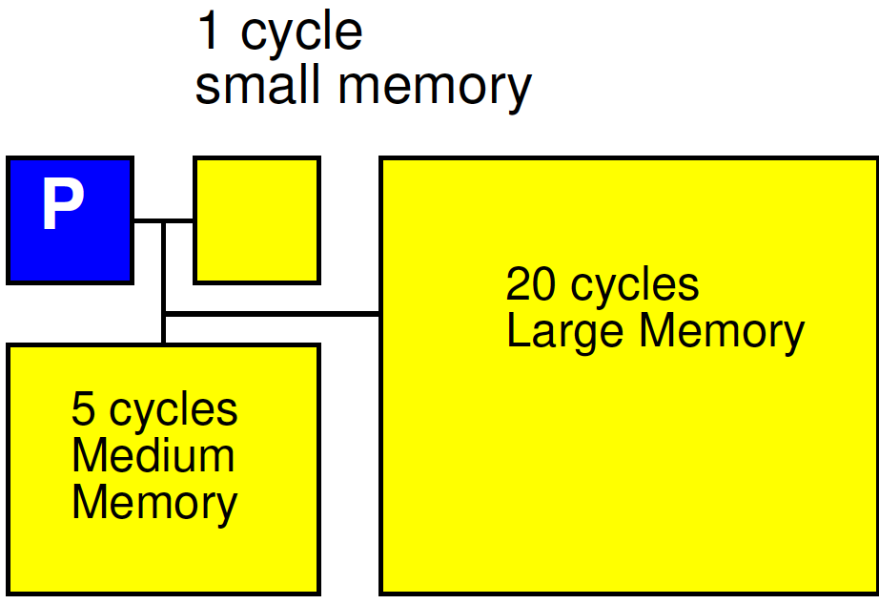
Explicitly Managed Memory

Slide 37
Offline Schedule Resource Sharing
Don’t arbitrate
Decide up-front when each shared resource can be used by each thread or processor
  Simple fixed schedule
  Detailed Schedule
What
  Memory bank, bus, I/O, network link, …

Slide 38
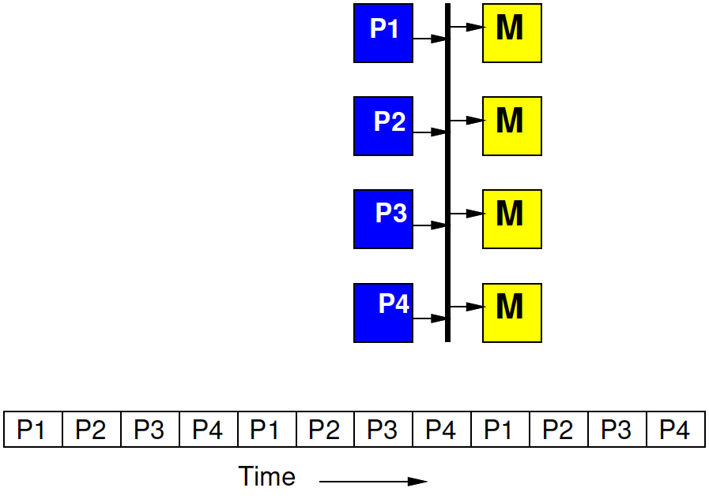
Time-Multiplexed Bus
Fixed by hardware master
4 masters share a bus
Each master gets to make a request on the bus every 4th cycle
  If doesn’t use it, goes idle

Slide 39
Time-Multiplexed Bus
Regular schedule
Fixed bus slot schedule of length N > masters
  (probably a multiple)
Assign owner for each slot
  Can assign more slots to one
E.g. N=8, for 4 masters
  Schedule (1 2 1 3 1 2 1 4)

Slide 40
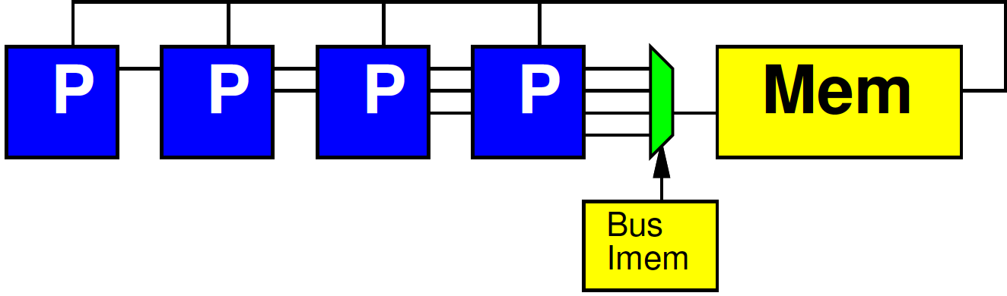
Fully Scheduled
At extreme, fully schedule which tasks gets resource on each cycle

Slide 41
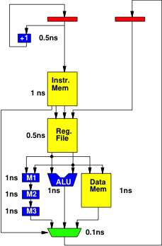
Simple Deterministic Processor with Multiplier
No branching
Unpipelined
Every operation completes in fixed time
Cycle time as shown?
Retimed cycle time?
What’s unfortunate about this?

Slide 42
Simple Deterministic Processor with some Pipelining
No branching
Every operation completes in fixed time
Retimed cycle time?
  Hint what are cycles?
How pipelines added change behavior?
  Hint: what is sequence of addresses into Instr. Mem?

Slide 43
Simple Deterministic
Pipelined Processor
No branching
Every operation completes in fixed time
How pipelines added change behavior?
  Hint R1 value

Slide 44
Simple Deterministic
Pipelined Processor
No branching
Every operation completes in fixed time
Retimed cycle time?

Slide 45
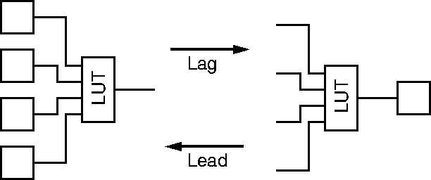
Legal Register Moves
Day 7
Retiming Lag/Lead

Slide 46

Reminder
Day 8
Able to pipeline and retime to reduce cycle time on acyclic dataflow graphs

Slide 47
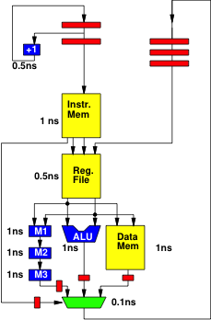
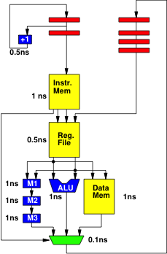
Step 1: lead Mux

Slide 48

Step 2: lead M3

Slide 49

Step 3: lead M2

Slide 50
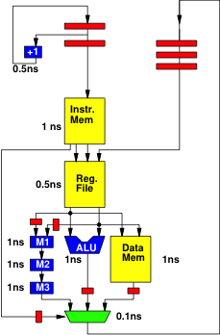
Step 4: lead M1

Slide 51
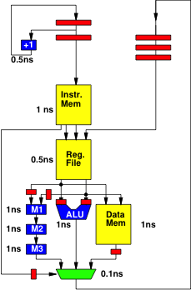
Step 5: Lead ALU

Slide 52
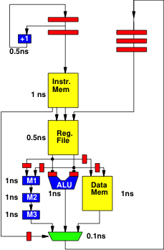
Step 6: Lead Data Mem

Slide 53
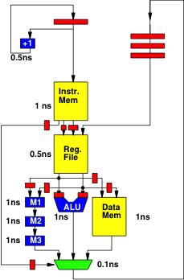
Step 7: Lag Instr. Mem

Slide 54
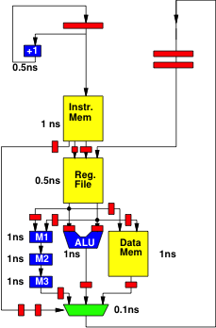
Step 8: Lead Mux

Slide 55
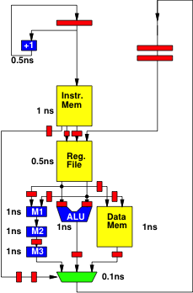
Step 9: Lead M3

Slide 56

Step 10: Lead M2

Slide 57

Step 11: Lead Mux

Slide 58
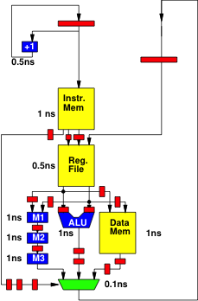
Step 12: Lead M3

Slide 59
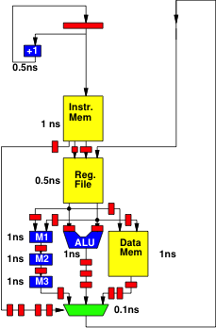
Step 13: Lead Mux

Slide 60
Retimed
Max delay between
registers 1ns
Extra slides show retiming

Slide 61
Deadline Instruction
Deal with algorithmic (branching) variability
Set a hardware counter for thread
Decrement counter on each cycle
Demand counter reach 0 before thread allowed to continue at deadline instruction
  Stall if get there early
  Similar to flip-flop on a logic path
    Wait for clock edge to change or sample value
Model: fixed execution time

Slide 62
WCET
WCET – Worst-Case Execution Time
Analysis when working with algorithms and architectures with data-dependent delay
  Need to meet real time
  Calculate the worst-case runtime of a task
    Like calculating the critical path (but harder)
    Worst-case delay of instructions
    Worst-case path through code
    Worst-case # loop iterations
  Rationale for setting Deadlines
    (like a cycle time)

Slide 63
Deterministic Pipelines
Not how ARM, Intel (471, 571) processor are pipelined
Those include operations that make timing variable
  dynamic data hazards, branch speculation
Here, data becomes available after a predictable time
Branches take effect at a fixed time
  Likely delayed
Schedule to delays to get correct data

Slide 64
Different Goals
General Purpose/Best Effort
ISA fixed
Want to run same assembly on different implementations
Tolerate different delays for different hardware
Run faster on newer, larger implementations
Real-Time
Willing to recompile to new hardware
Want time on hardware predictable
Willing to schedule for delays in particular hardware

Slide 65
SoC Opportunity
Can choose which resources are shared
Can dedicate resources to tasks
Isolate real-time tasks/portions of tasks from best-effort
  Separate hardware/processors
  Separate memories, network

Slide 66
UltraScale+ Zynq
Has 2 “Real-Time Processor”
  ARM Cortex-R5
    32b (vs. 64b for A53 APU processor)
    ARMv7-R (vs. ARMv8)
    Single ALU, dual issue
    Branch prediction
Explicitly managed scratchpads
    Tightly-Coupled Memories
    On-Chip Memory (OCM)

Slide 67
Programmable SoC
UG1085
Xilinx
UltraScale
Zynq
TRM
(p27)

Slide 68
RPU Subsystem
UG1085
Xilinx
UltraScale
Zynq
TRM
(p65)

Slide 69
Big Ideas:
Real-Time applications demand different discipline from best-effort tasks
Look more like synchronous circuits and hardware discipline
Avoid or use care with variable delay programming constructs
Can sequentialize, like processor
  But must avoid/rethink typical processor common-case optimizations
  Offline calculate static schedule for computation and sharing
    Instead of dynamic arbitration, stalls

Slide 70
Admin
Feedback
Reading for Wed. on web
Wolf Lecture Wednesday at 3pm
  Tsu-Jae King Liu
  Sustaining the Semiconductor Revolution
P4 due Friday

