Slide 1

ESE5320:
System-on-a-Chip Architecture
Day 25: November 30, 2022
Real-Time Scheduling

Slide 2
Today
Real Time
Part 1: Synchronous Reactive Model
Part 2: Interrupts and IO
  Polling alternative
  Timer?
Part 3: Resource Scheduling Graphs

Slide 3
Message
Scheduling is key to real time
  Analysis
  Guarantees

Slide 4
Synchronous Circuit Model
A simple synchronous circuit is a good “model” for real-time task
  Run at fixed clock rate
  Take input every cycle
  Produce output every cycle
  Complete computation between input and output
  Designed to run at fixed-frequency
    Critical path meets frequency requirement

Slide 5
Synchronous Reactive Model
Discipline for Real-Time tasks
Embodies “synchronous circuit model”

Slide 6
Synchronous Reactive
There is a rate for interaction with external world (like the clock)
Computation scheduled around these clock ticks (or time-slices)
  Continuously running threads
  Each thread performs action per tick
Inputs and outputs processed at this rate
Computation can “react” to events
  Reactions finite and processed before next tick

Slide 7
Thread Form
while (1) { tick(); }
tick() -- yields after doing its work
  Until next master cycle
  May be state machine
    May change state and have different behavior based on state
  May trigger actions to respond to events (inputs)

Slide 8
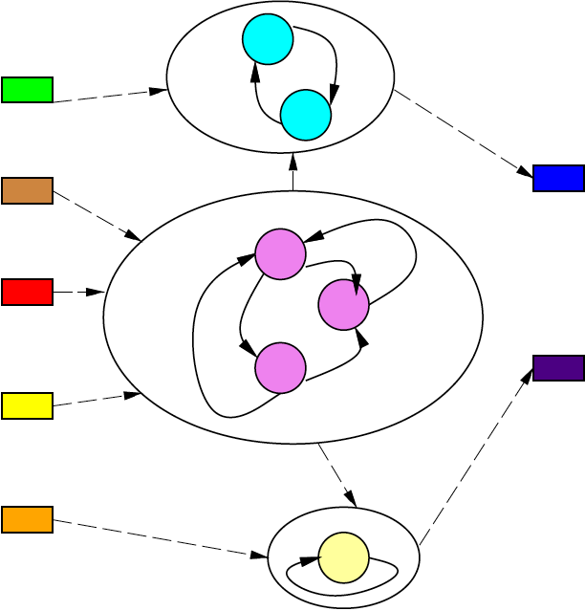
Thread Model

Slide 9
Tick Rate
Driven by application – demands of external control
  Control loop 100 Hz
    Robot, airplane, car, manufacturing plant
  Video at 33 fps
  Game with 20ms response
  Router with 1ms packet latency
    12μs

Slide 10
Tick Rate
Multiple rates
  May need master tick as least-common multiple of set of interaction rates
    …and lower freq. events scheduled less frequently
  E.g. 100Hz control loop and 33Hz video
    Master at 10ms
    Schedule video over 3 10ms time-slots
      May force decompose into tasks fit into smaller time window since must schedule events at highest frequency

Slide 11
Synchronous Reactive
Ideal model
  Per tick reaction (task processing) instantaneous
Separate function from compute time
Separate function from technology
  Feature size, processor mapped to
Like synchronous circuit
  If logic correct, works when run clock slow enough
  Works functionally when change technology
  Then focus on reducing critical path
    → making timing work

Slide 12
Timing and Function
Why want to separate function from technology and timing?
Move to slower processor(s):
  What would happen if just moved?
  What needs to happen?
Move to faster processor(s):
  What would happen if just moved?
  What want to happen?

Slide 13
Synchronous Reactive Timing
Once functional,
  need to guarantee all tasks (in all states)
    Can complete in tick time-slot
    On particular target architecture
Identify WCET (worst-case execution time)
  Like critical path in FSM circuit
  Time of task on processor target

Slide 14
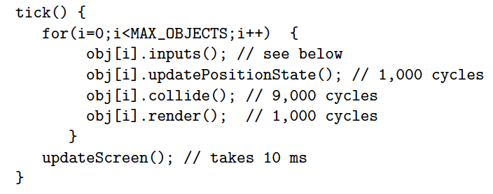
Preclass 1
Time available to process objects?

Slide 15
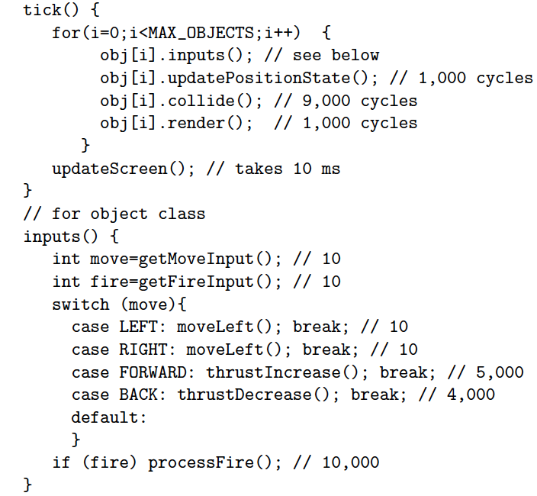
Preclass 1
Worst-case object processing time?

Slide 16
Preclass 1
Maximum number of objects on single GHz processor?

Slide 17
Synchronous Reactive Timing
Once functional,
  need to guarantee all tasks (in all states) can complete in tick time-slot
  On particular target architecture
Identify WCET
  Like critical path in FSM circuit
  Time of task on processor target
Schedule onto platform
  Threads onto processor(s)

Slide 18
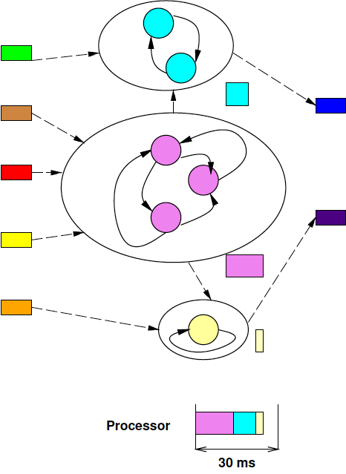
Threads Mapped to Processor

Slide 19
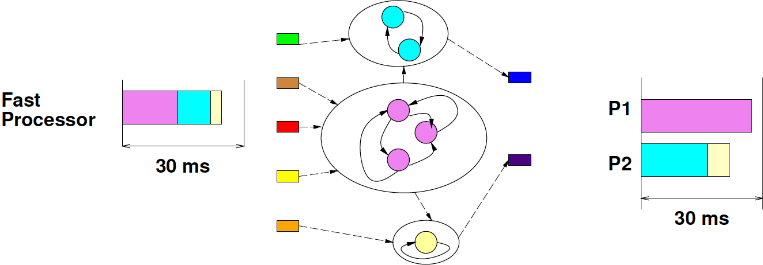
Platforms
Platform 1:
fast processor
Platform 2:
many slow processors

Slide 20
Synchronous Reactive Model
Discipline for Real-time tasks
Embodies the “synchronous circuit model”
  Master clock rate
  Computation decomposed per clock
  Functionality assuming instantaneous compute
  On platform, guarantee runs fast enough to complete critical path at “clock” rate

Slide 21
Interrupts and IO
Part 2

Slide 22
Interrupt
External event that redirects processor flow of control
Typically forces a thread switch
Common for I/O, Timers
  Indicate a need for attention

Slide 23
Interrupts
Why would we use interrupts for I/O?

Slide 24
Interrupts: Good
Allow processor to run some other work
Infrequent, irregular task service with low response service latency
  Low latency
  Ok when low throughput inputs
    So infrequent interrupts…

Slide 25
Interrupts: Bad
Time predictability
  Real-time for computing tasks interrupted
Processor usage
  Costs time to switch contexts
Concurrency management
  Must deal with tasks executing non-atomically
    Interleave of interrupted service tasks
    Perhaps interleave of any task

Slide 26
Interrupted Task
Add to list
  atmp=a
  new->next =atmp
  a=new
Remove from list
  removed=a->value
  rtmp=a->next
  a=rtmp
Running something that removes from list
Interrupt involves adding to list

Slide 27
What can happen?
Add to list
  atmp=a
  new->next =atmp
  a=new
Remove from list
  removed=a->value
  rtmp=a->next
  a=rtmp
Sequence
  removed=a->value
  rtmp=a->next
  <interrupt>
  atmp=a
  new->next=atmp
  a=new
  <return>
  a=rtmp
What goes wrong?

Slide 28
What can happen?
Sequence
  removed=a->value
  rtmp=a->next
  <interrupt>
  atmp=a
  new->next=atmp
  a=new
  <return>
  a=rtmp
What goes wrong?

Slide 29
What can happen?
Sequence
  removed=a->value
  rtmp=a->next
  <interrupt>
  atmp=a
  new->next=atmp
  a=new
  <return>
  a=rtmp
What goes wrong?

Slide 30
What can happen?
Sequence
  removed=a->value
  rtmp=a->next
  <interrupt>
  atmp=a
  new->next=atmp
  a=new
  <return>
  a=rtmp

Slide 31
What can happen?
Sequence
  removed=a->value
  rtmp=a->next
  <interrupt>
  atmp=a
  new->next=atmp
  a=new
  <return>
  a=rtmp
Got:
Intended:

Slide 32
Interrupts: Bad
Time predictability
  Real-time for computing tasks interrupted
Processor usage
  Costs time to switch contexts
Concurrency management
  Must deal with tasks executing non-atomically
    Interleave of interrupted service tasks
    Perhaps interleave of any task

Slide 33
Polling Discipline
Alternate to I/O interrupts
Every I/O task is a thread
Budget time and rate it needs to run
  E.g. 10,000 cycles every 5ms
  Likely tied to
    Buffer sizes
    Response latency
Schedule I/O threads as real-time tasks
  Some can be DMA channels

Slide 34
IO Thread
while (1) { process_input(); }
Like tick() -- yields after doing its work
  Wait for next master cycle

Slide 35
Preclass 2
Input at 100KB/s
30ms time-slot window
Size of buffer?
100 cycles/byte, GHz processor – runtime of service routine?
  Fraction of processor capacity?

Slide 36
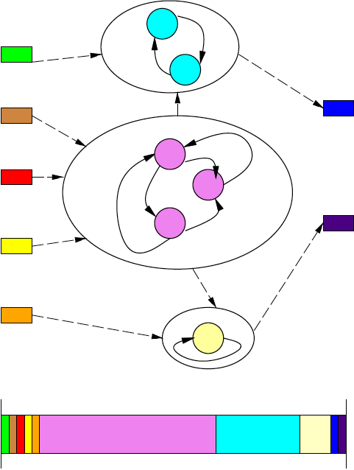
Scheduling I/O Tasks

Slide 37
Timer Interrupts
Why do we have timer interrupts in conventional operating systems?
  E.g. in linux?

Slide 38
Timer Interrupts
Best effort tasks (i.e. non-real-time tasks)
  Have no guarantee to finish in bounded time
  Timer interrupts necessary
    to allow other threads to run
    fairness
    to switch to real-time service tasks
Need timer interrupts if need to share processor with best-effort and real-time threads
  Alternate: Easier to segregate real-time and best-effort threads onto different processors

Slide 39
Timer Interrupts?
Bounded-time tasks
  E.g. reactive tasks in real-time
  Task has guarantee to release processor within time window
  Not need timer interrupts to regain control from task
  (Maybe use deadline operations [Day24] for timer)

Slide 40
Greedy Strategy
Schedule real-time tasks
  Scheduled based on worst-case, so may not use all time allocated
Run best-effort tasks at end of time-slice after complete real-time tasks
  Timer-interrupt to recover processor in time for start of next scheduling time slot
(adds complexity)

Slide 41
Real-Time Tasks
Interrupts less attractive
  More disruptive
Scheduled polling better predictability
Fits with Synchronous Reactive Model

Slide 42
Resource Scheduling Graphs
Part 3

Slide 43
Scheduling
Useful to think about scheduling a processor by task usage
Useful to budget and co-schedule required resources
  Bus
  Memory port
  DMA channel

Slide 44
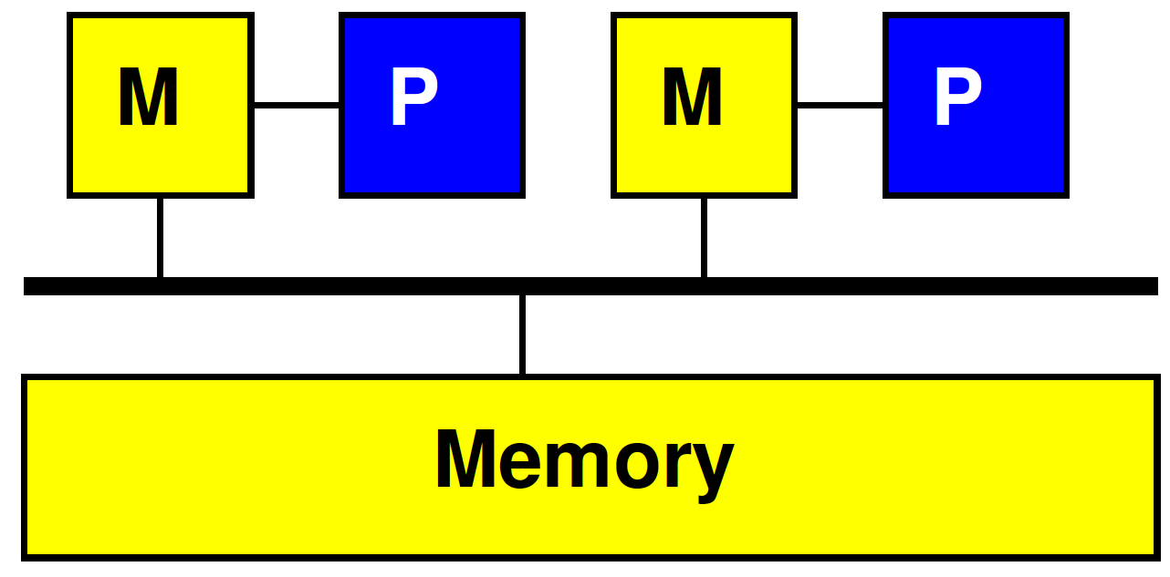
Simple Task Model
Task requires
  Data to be transferred
  Local storage state
  Computational cycles
  (Result data to be transferred)
Uses resources
  Bus/channel to transfer data
    (in and out)
  Space in memory on accelerator
  Cycles on accelerator

Slide 45
One Task
P1
P2
Bus
Mem

Slide 46
Several Tasks
Resource | 0 | 1 | 2 | 3 | 4 | 5 | 6 | 7 | 8
P1
P2
Bus
Mem

Slide 47
Resource Schedule Graph
Extend as necessary to capture potentially limiting resources and usage
  Regions in memories
  Memory ports
  I/O channels

Slide 48
Extended Details
Resource | 0 | 1 | 2 | 3 | 4 | 5 | 6 | 7 | 8
P1
P1 M0
P1 M1
P2
P2 M0
P2 M1
Bus1
Bus2
OCM
DRAM

Slide 49
Several Tasks
Resource | 0 | 1 | 2 | 3 | 4 | 5 | 6 | 7 | 8
P1
P1 M0
P1 M1
P2
P2 M0
P2 M1
Bus1
Bus2
OCM
DRAM

Slide 50
Approach
Ideal/initial – look at processing requirements
  Resource bound on processing
Look for bottlenecks / limits with Resource Bounds independently
  Add buses, memories, etc.
Plan/schedule with Resource Schedule Graph

Slide 51
Preclass 3a
Resource Bound
  Data movement over bus?
  Compute on 2 processors?
  Compute on 2 processors when processor must wait while local memory is written?
Task | Data (bytes) | Compute cycles | Data+Compute Work
A | 1600 | 1600
B | 200 | 600
C | 800 | 3200
D | 200 | 600
E | 400 | 400

Slide 52
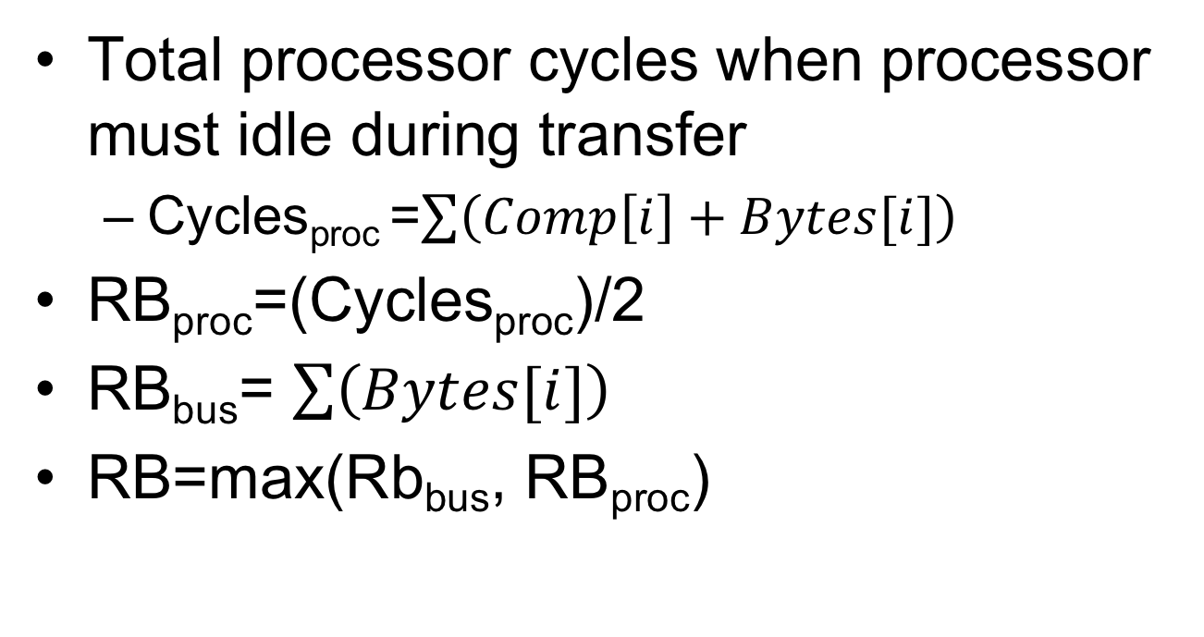
Resource Bound wait Transfer
Total processor cycles when processor must idle during transfer
  Cycles_{proc} =$\sum{\left(Comp\left[i\right]+Bytes[i]\right)}$
RB_{proc}=(Cycles_{proc})/2
RB_{bus}= $\sum{\left(Bytes[i]\right)}$
RB=max(Rb_{bus}, RB_{proc})

Slide 53
Preclass 3b Schedule
Processor wait for data load
200 cycle intervals
 | 1 | 2 | 3 | 4 | 5 | 6 | 7 | 8 | 9 | 10 | 11 | 12 | 13 | 14 | 15 | 16 | 17 | 18 | 19 | 20 | 21 | 22 | 23 | 24 | 25 | 26 | 27 | 28 | 29 | 30 | 31 | 32
P1
P2
B

Slide 54
Double Buffering
Common trick to overlap compute and communication
Reserve two buffers input (output)
Alternate buffer use for input
Producer fills one buffer while consumer working from the other
Swap between tasks
Tradeoff memory for concurrency
Sub-buffers in Vitis clEnqueueMigrateObjects

Slide 55
Double Buffer

Slide 56
Double Buffer Schedule
How impact schedule?
  When can move data into buffer?
    Hint: think about how impact preclass 3b schedule? What new freedom have?
  Impact on use of processor?

Slide 57
Preclass 3c Schedule
Double Buffer
200 cycle intervals
 | 1 | 2 | 3 | 4 | 5 | 6 | 7 | 8 | 9 | 10 | 11 | 12 | 13 | 14 | 15 | 16 | 17 | 18 | 19 | 20 | 21 | 22 | 23 | 24 | 25 | 26 | 27 | 28 | 29 | 30 | 31 | 32
P1
P2
B
Minimum local memory space required?

Slide 58
Resource Schedule Graphs
Useful to plan/visualize resource sharing and bottlenecks in SoC
Supports scheduling
Necessary for real-time scheduling

Slide 59
Big Ideas:
Scheduling is key to real time
  Analysis, Guarantees
Synchronous Reactive
  Scheduling worst-case tasks “reactions” into master time-slice matching rate
  Separate function from timing
Schedule I/O with polling threads
  Avoid interrupts
Schedule dependent resources
  Buses, memory ports, memory regions…

Slide 60
Admin
Feedback
Wolf Lecture Wednesday at 3pm
  Tsu-Jae King Liu
  Sustaining the Semiconductor Revolution
Reading for Monday online
P4 due Friday

