Slide 1

ESE5320:
System-on-a-Chip Architecture
Day 26: December 5, 2022
VLIW
(Very Long Instruction Word Processors)

Slide 2
Today
VLIW (Very Large Instruction Word)
Exploiting Instruction-Level Parallelism (ILP)
Part 1:
  Demand, Basic Model
Part 2:
  Tuning, Unrollling
Part 3:
  Data Movement
Part 4 (bonus, probably not cover):
  Zero-Overhead Loops, Pipelined Operators

Slide 3
Message
VLIW as a Model for
  Instruction-Level Parallelism (ILP)
  Customizing Datapaths
  Area-Time Tradeoffs
  Real-Time, Scheduled Sequentialization

Slide 4
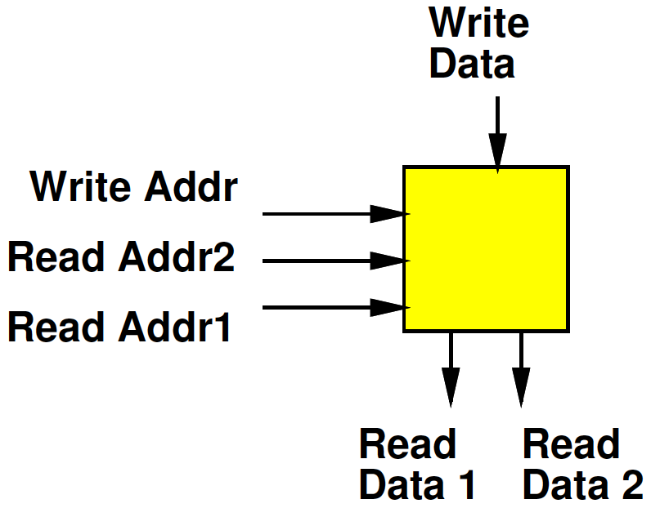
Register File
Day 6
Small Memory
Usually with multiple ports
  Ability to perform multiple reads and writes simultaneously
Small
  To make it fast
  (small memories fast)
  Multiple ports are expensive

Slide 5
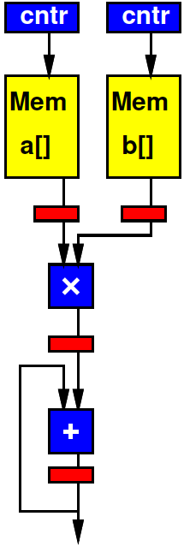
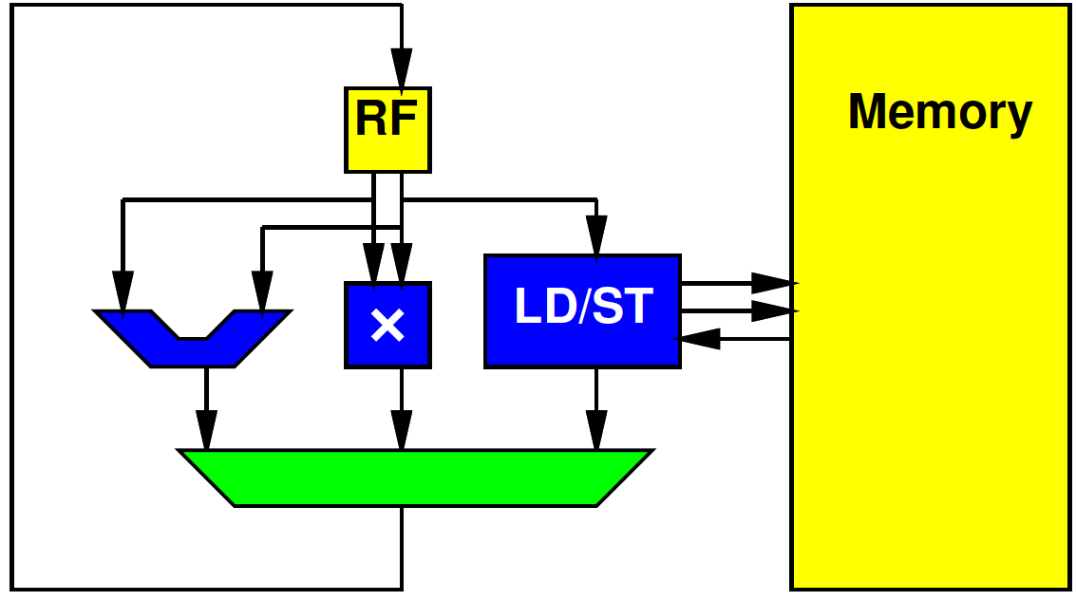
Preclass 1
Cycles per multiply-accumulate
(throughput question, not latency)
  Spatial Pipeline
  Processor

Slide 6
Preclass 1
How different?
  Resources
    Number of units can perform adds
    Number of simultaneous memory reads
  Ability to use resources
    What resources can use in same cycle

Slide 7
Computing Forms
Processor – does one thing at a time
Spatial Pipeline – can do many things, but always the same
Vector – can do the same things on many pieces of data

Slide 8
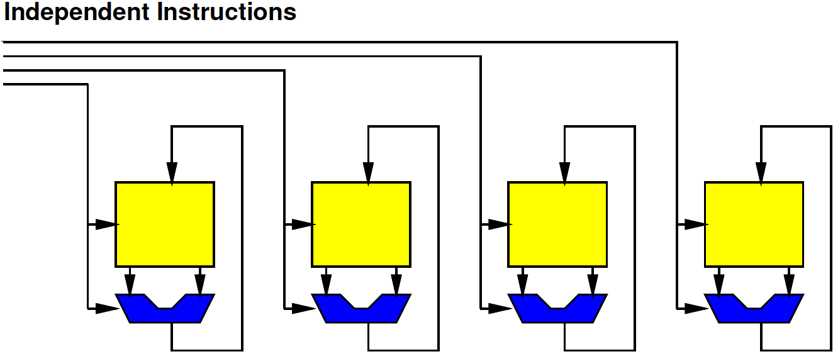
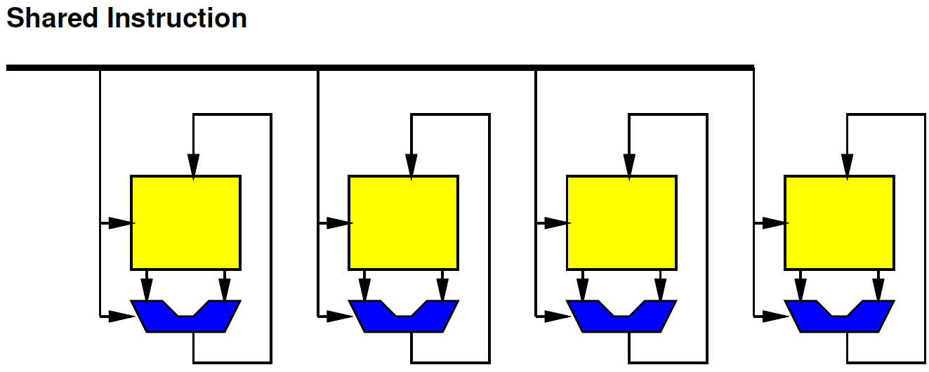
In Between
VLIW
What if…
Want to
  Do many things at a time (ILP)
  But not the same (DLP)
SIMD

Slide 9
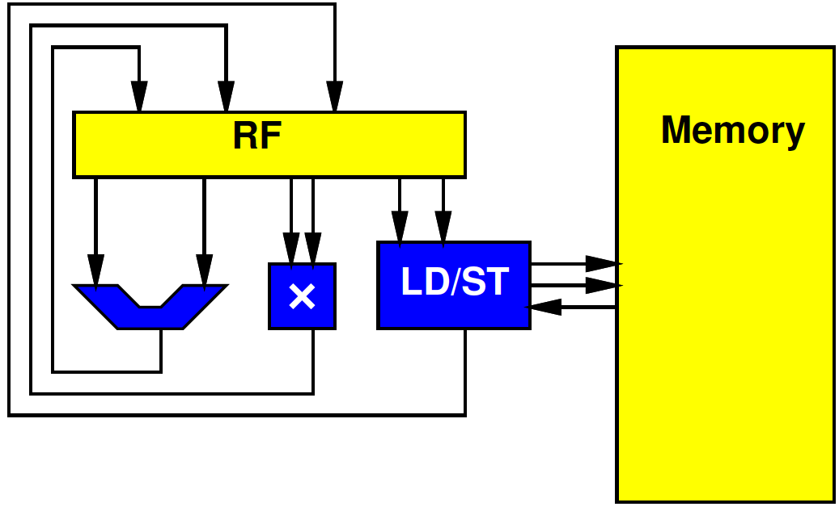
In Between
What if…
Want to
  Do many things at a time (ILP)
  But not the same (DLP)
Want to use resources concurrently

Slide 10
In Between
What if…
Want to
  Do many things at a time (ILP)
  But not the same (DLP)
Want to use resources concurrently
Want to
  Accelerate specific task
  But not go to spatial pipeline extreme

Slide 11
VLIW Feature:
Supply Independent Instructions
Provide instruction per ALU (resource)
Instructions more expensive than Vector
  But more flexible

Slide 12
VLIW
The “instruction”
  The bits controlling the datapath
…becomes long
Hence:
  Very Long Instruction Word (VLIW)
long
instruction

Slide 13
Control Heterogeneous Units
Control each unit simultaneously and independently
  More expensive than processor
    Memory ports and/or interconnect
  But more parallelism

Slide 14
VLIW
Very Long Instruction Word
Set of operators
  Parameterize number, distribution (X, +, sqrt…)
    More operators→ less time, more area
    Fewer operators→ more time, less area
Memories for intermediate state
X
X
+

Slide 15
VLIW
Very Long Instruction Word
Set of operators
  Parameterize number, distribution (X, +, sqrt…)
    More operators→ less time, more area
    Fewer operators→ more time, less area
Memories for intermediate state
Memory for “long” instructions
Instruction
Memory
Address
X
X
+

Slide 16
VLIW
Instruction
Memory
Address
X
X
+

Slide 17
VLIW
Very Long Instruction Word
Set of operators
  Parameterize number, distribution (X, +, sqrt…)
    More operators→ less time, more area
    Fewer operators→ more time, less area
    Continuum for operator allocation
Memories for intermediate state
Memory for “long” instructions
General framework for specializing to problem
  Wiring, memories get expensive
  Opportunity for further optimizations
General way to tradeoff area and time

Slide 18
VLIW
Instruction
Memory
Address
X
X
+

Slide 19
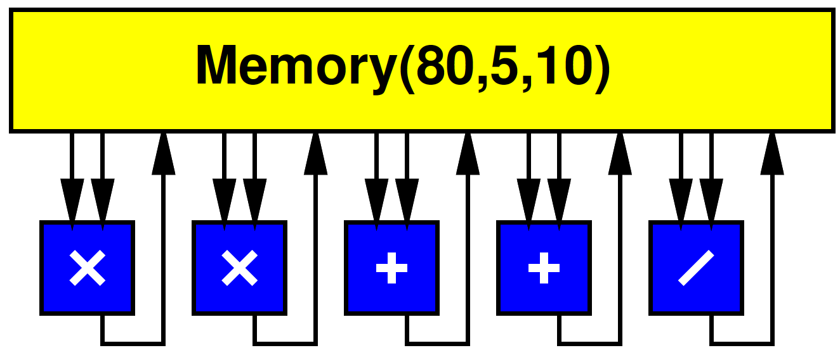
VLIW w/ Multiport RF
Simple, full-featured model use common Register File
  Memory(Words, WritePorts, ReadPorts)

Slide 20
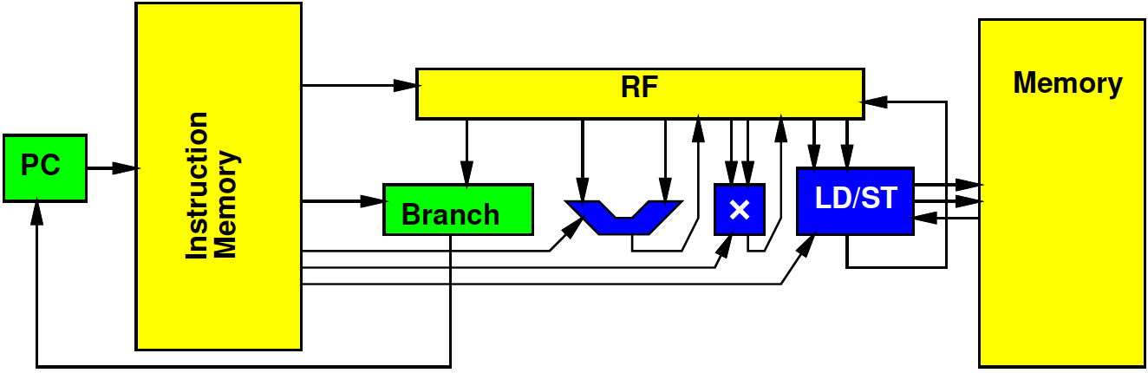
Processor Unbound
Can (design to) use all operators at once

Slide 21
Processor Unbound
Schedule Preclass 1 on this VLIW
(next slide)

Slide 22
Schedule Preclass 1
Cycle | Branch | ALU | Multiply | LD/ST
0
1
2
3
4
5

Slide 23
Schedule
Cycle | Branch | ALU | Multiply | LD/ST
0 |  | Sub r2,r1,r3
1 | Bzneq r3,end | Add r4
2 |  | Add r5 |  | Ld r4,r6
3 |  |  |  | Ld r5,r7
4 |  | Add r1,#1,r1 | Mpy r7,r8,r8
5 | B top | Add r7,r8,r8

Slide 24
Tuning, Unrolling
Part 2

Slide 25
VLIW Operator Knobs
(Design Space Axes)
Choose collection of operators and the numbers of each
  Match task
  Tune resources

Slide 26
Schedule
Choose collection of operators and the numbers of each
  Match task
  Tune resources
What operator might we add
to accelerate this loop?
Cycle | Branch | ALU | Multiply | LD/ST
0 |  | Sub r2,r1,r3
1 | Bzneq r3,end | Add r4
2 |  | Add r5 |  | Ld r4,r6
3 |  |  |  | Ld r5,r7
4 |  | Add r1,#1,r1 | Mpy r7,r8,r8
5 | B top | Add r7,r8,r8

Slide 27
Preclass 2a
res[i]=sqrt(x[i]*x[i]+y[i]*y[i]+z[i]*z[i]);
II with one operator of each?

Slide 28
Schedule
Cycle | LD | ST | Multiply | Add | incr | sqrt
0 |  |  |  | i<MAX | &X[i]
1 | X[i] |  |  |  | &Y[i]
2 | Y[i] |  | X[i]*X[i] |  | &Z[i]
3 | Z[i] |  | Y[i]*Y[i]
4 |  |  | Z[i]*Z[i] | X²+Y²
5 |  |  |  | (X²+Y²)+Z²
6 |  |  |  |  |  | Sqrt()
7 |  | Res[i] |  |  | i

Slide 29
Preclass 2b
res[i]=sqrt(x[i]*x[i]+y[i]*y[i]+z[i]*z[i]);
Minimum II achievable?
  Latency lower bound

Slide 30
Critical Path
(Increment pointers / branch)
Load
Multiplies
Add
Add
Squareroot
Writeback

Slide 31
Resource Bound
Can tune VLIW to directly target resource bound
  Add operators to target a particular resource bound

Slide 32
Preclass 2c
res[i]=sqrt(x[i]*x[i]+y[i]*y[i]+z[i]*z[i]);
How many operators of each type to achieve minimum II (latency lower bound)?

Slide 33
Schedule w/ 2c Resources
 | LD | LD | ST | * | * | + | i | i | sqrt
0 |  |  |  |  |  | < | &x | &y
1 | X[i] | Y[i] |  |  |  |  | &z
2 | Z[i] |  |  | x | y
3 |  |  |  | z |  | x+y
4 |  |  |  |  |  | +z
5 |  |  |  |  |  |  |  |  | sqrt
6 |  |  | Res[i] |  |  |  | i

Slide 34
Schedule w/ 2d Resources
What is disappointing about this schedule?
 | LD | LD | LD | ST | * | * | * | + | i | i | i | sqrt
0 |  |  |  |  |  |  |  | < | &x | &y | &z
1 | X[i] | Y[i] | Z[i]
2 |  |  |  |  | x | y | z
3 |  |  |  |  |  |  |  | X+y
4 |  |  |  |  |  |  |  | +z
5 |  |  |  |  |  |  |  |  |  |  |  | sqrt
6 |  |  |  | Res[i] |  |  |  |  | i

Slide 35
Preclass 2d
res[i]=sqrt(x[i]*x[i]+y[i]*y[i]+z[i]*z[i]);
res[i+1]=sqrt(x[i+1]*x[i+1]+y[i+1]*y[i+1]+z[i+1]*z[i+1]);
res[i+2]=sqrt(x[i+2]*x[i+2]+y[i+2]*y[i+2]+z[i+2]*z[i+2]);
res[i+3]=sqrt(x[i+3]*x[i+3]+y[i+3]*y[i+3]+z[i+3]*z[i+3]);
Schedule (next slide)

Slide 36
Unroll 4 Schedule
 | LD | LD | LD | ST | * | * | * | + | + | i | i | i | sqrt
0
1
2
3
4
5
6
7
8
9

Slide 37
Time Points
4 iterations in 10 cycles = 2.5 cycles/iter
Compared to 1 iteration in 7
Compared to 1 iteration in 8

Slide 38
Unroll 4
 | LD | LD | LD | ST | * | * | * | + | + | i | i | i | sqrt
0 |  |  |  |  |  |  |  | < |  | x0 | y0 | z0
1 | x0 | y0 | z0 |  |  |  |  |  |  | x1 | y1 | z1
2 | x1 | y1 | z1 |  | x0 | y0 | z0 |  |  | x2 | y2 | z2
3 | x2 | y2 | z2 |  | x1 | y1 | z1 | xy0 |  | x3 | y2 | z3
4 | x3 | y2 | z3 |  | x2 | y2 | z2 | xy1 | +z0
5 |  |  |  |  | x3 | y2 | z3 | xy2 | +z1 |  |  |  | 0
6 |  |  |  | 0 |  |  |  | xy3 | +z2 |  |  |  | 1
7 |  |  |  | 1 |  |  |  |  | +z3 |  |  |  | 2
8 |  |  |  | 2 |  |  |  |  |  |  |  |  | 3
9 |  |  |  | 3 |  |  |  |  |  | i
What happens to II (cycle/iter) as unroll more?

Slide 39
Observation
With no data dependencies
  Unroll gets closer to resource bound

Slide 40
Preclass 2e
res[i]=sqrt(x[i]*x[i]+y[i]*y[i]+z[i]*z[i]);
Area comparison?
Op | read | write | * | + | incr | sqrt | Area | II
A | 20 | 30 | 10 | 2 | 1 | 25
2a | 1 | 1 | 1 | 1 | 1 | 1 |  | 8
2c |  |  |  |  |  |  |  | 7
2d | 3 | 1 | 3 | 2 | 3 | 1 |  | 2.5

Slide 41
Take Aways
VLIW: Tune Operators to select
Area-Time point
Running single iteration of loop to completion before start next
  Inefficient
  Latency bound for loop
  Benefit schedule multiple loop bodies
    Can get closer to resource bound

Slide 42
Data Storage and Movement
Part 3

Slide 43
Multiport RF
Multiported memories are expensive
  Need input/output lines for each port
  Makes large, slow
Simplified preclass model:
  Area(Memory(n,w,r))=n*(w+r+1)/2

Slide 44
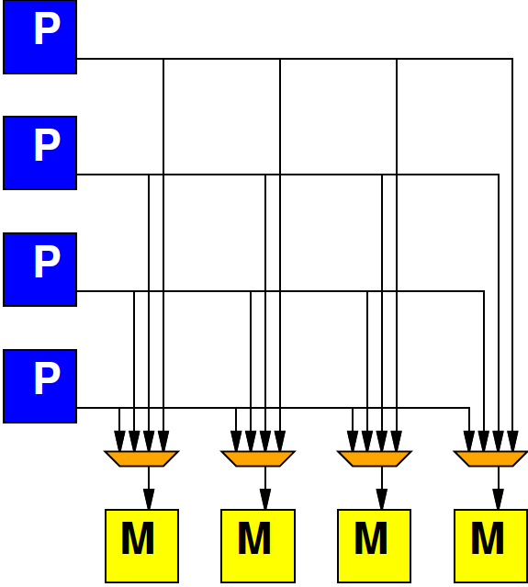
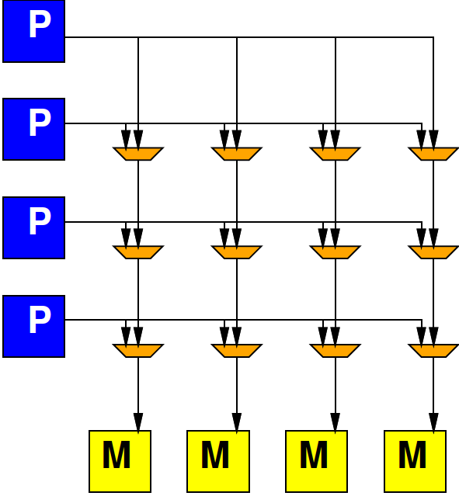
Alternate: Crossbar (Xbar)
Day 12
Provide programmable connection between all sources and destinations
Any destination can be connected to any single source

Slide 45
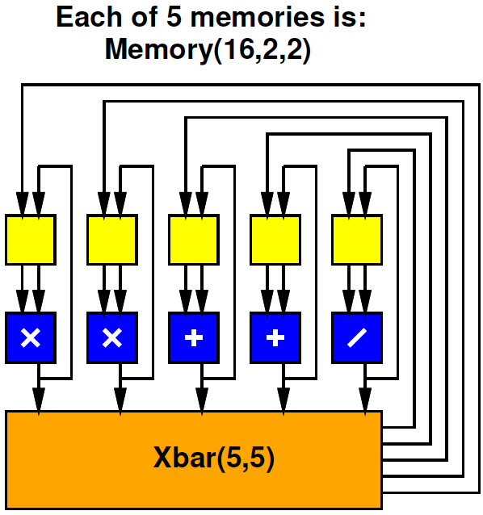
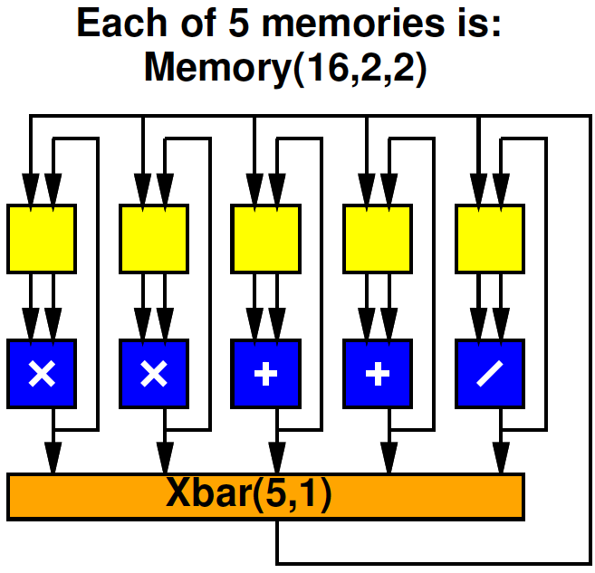
Preclass 3
Areas? (table)
How does area of memories,
xbar compare to datapath
operators in each case?
 | Multiport RF | Split RF Xbar(5,5) | Split RF Xbar(5,1)
Memory
Operators
Xbar
Total

Slide 46
Split RF Cheaper
At same capacity, split register file cheaper
  2W+2R → 2.5 per word
  5W+10R → 8 per word

Slide 47
Split RF Full Crossbar
Cycles each for computing: (A*B+C)/(D*E+F)
  Assume A..F start as shown
A,B
D,E
C
F

Slide 48
Split RF Full Crossbar
Specialize connections to avoid bottleneck
A,B
D,E
C
F

Slide 49
VLIW Memory Tuning
Can select how much sharing or independence in local memories

Slide 50
Split RF, Limited Crossbar
What limitation does the one crossbar output pose?
  Cycles for same task: (A*B+C)/(D*E+F)
A,B
D,E
C
F
A,B
D,E
C
F

Slide 51
Split RF, Limited Crossbar
Could specialize connections for computation
A,B
D,E
C
F
A,B
D,E
F
C

Slide 52
VLIW Schedule
Need to schedule Xbar output(s) as well as operators.
cycle | * | * | + | + | / | Xbar
0
1
2
3
4

Slide 53
VLIW Interconnect Tuning
Can decide how rich to make the interconnect
  Number of outputs to support
  How to depopulate (restrict) crossbar
  Use more restricted network

Slide 54
Commercial: Xilinx AI Engine
6-way VLIW Vector
https://www.xilinx.com/support/documentation/white_papers/wp506-ai-engine.pdf
Xilinx WP506

Slide 55
VLIW vs. SuperScalar
Modern, high-end proc. (incl. ARM on Zynq)
  Do support ILP
  Issue multiple instructions per cycle
  …but, from a single, sequential instruction stream
SuperScalar – dynamic issue and interlock on data hazards – hide # operators
  Must have shared, multiport RF
VLIW – offline scheduled (like done today)
  No interlocks, allow split RF
  Lower area/operator – need to recompile code

Slide 56
Big Ideas:
VLIW as a Model for
  Instruction-Level Parallelism (ILP)
  Customizing Datapaths
  Area-Time Tradeoffs
  Real-Time, Scheduled Sequentialization
Customize VLIW
  Operator selection
  Memory/register file setup
  Inter-functional unit communication network

Slide 57
Admin
Feedback (including P4)
Reading for Wednesday online
Project final reports due next Monday
  Collect boards
Final on Friday, Dec. 16th
  Week from Friday

Slide 58
Loop Overhead
Part 4: Bonus slides:
not expect to cover in lecture

Slide 59
Loop Overhead
Can handle loop overhead in ILP on VLIW
  Increment counters, branches as independent functional units

Slide 60
VLIW Loop Overhead
Can handle loop overhead in ILP on VLIW
…but paying a full issue unit and instruction costs overhead

Slide 61
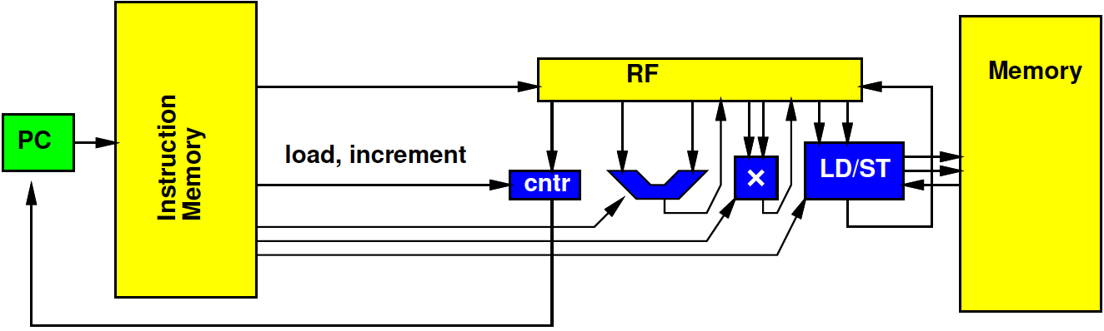
Zero-Overhead Loops
Specialize the instructions, state, branching for loops
  Counter rather than RF
  One bit to indicate if counter decrement
  Exit loop when decrement to 0

Slide 62
Simplification

Slide 63
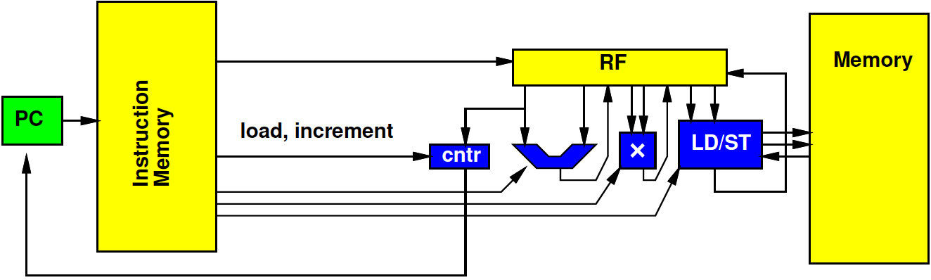
Zero-Overhead Loop Simplify
Share port – simplify further

Slide 64
Zero-Overhead Loop Example
(preclass 1)
repeat r3:
addi r4,#4,r4;
addi r5,#4,r5; ld r4,r6
ld r5,r7
mul r6,r7,r7
add r7,r8,r8

Slide 65
Zero-Overhead Loop
Potentially generalize to multiple loop nests and counters
Common in highly optimized DSPs, Vector units
Can think about design space options within this VLIW model framework

Slide 66
Pipelined VLIW Operators

Slide 67
Pipelined Operators
Often will have pipelined operators
  E.g. 3 cycles multiply
How complicate?

Slide 68
Accommodating Pipeline
Schedule for when data becomes available
  Dependencies
  Use of resources
cycle | * | * | + | + | / | Xbar
0 | X*X
1 | Y*Y
2 |  |  |  |  |  | X*X
3 |  |  |  |  |  | Y*Y
4 |  |  | X²+Y² |  |  | X²+Y²
5 |  |  |  |  | X²+Y²/Z
6

Slide 69
Accommodating Pipeline
Schedule for when data becomes available
  Dependencies
  Use of resources
Impossible
schedule;
Conflict on
single Xbar
output
cycle | * | * | + | + | / | Xbar
0 | X*X
1 | Y*Y
2 |  |  |  |  |  | X*X
3 |  |  | Q+R |  |  | Y*Y,Q+R
4 |  |  | X²+Y² |  |  | X²+Y²
5 |  |  |  |  | X²+Y²/Z
6

Slide 70
Pipelined Operators
Instance of what we saw last time
Need to schedule use on all resources
Including
  Memory port
  Communications (busses, crossbars ports)
  I/O

