Slide 1

ESE5320:
System-on-a-Chip Architecture
Day 7: September 26, 2022
Pipelining
Notes:
Background from: https://www.adhesivesmag.com/articles/97744-north-american-printed-circuit-board-industry-sees-spike-in-shipments-due-to-pandemic

Slide 2
Previously
Pipelining in the large
  Not just for gate-level circuits
Throughput and Latency
Pipelining as a form of parallelism

Slide 3
Today
Pipelining details (for gates, primitive ops)
Systematic Approach (Part 1)
Justify Operator and Interconnect Pipelining (Part 2)
Loop Bodies
Cycles in the Dataflow Graph (Part 3)
C-slow [supplemental recording] (Part 4)

Slide 4
Message
Pipelining is an efficient way to reuse hardware to perform the same set of operations at high throughput

Slide 5

Multiplexer Gate
MUX
  When S=0, output=i0
  When S=1, output=i1
S | i0 | i1 | Mux2(S,i0,i1)
0 | 0 | 0 | 0
0 | 0 | 1 | 0
0 | 1 | 0 | 1
0 | 1 | 1 | 1
1 | 0 | 0 | 0
1 | 0 | 1 | 1
1 | 1 | 0 | 0
1 | 1 | 1 | 1

Slide 6
Cycle
Two uses of term in this lecture:
Repetitive waveform
  E.g. sine wave or square wave
Graph cycle

Slide 7
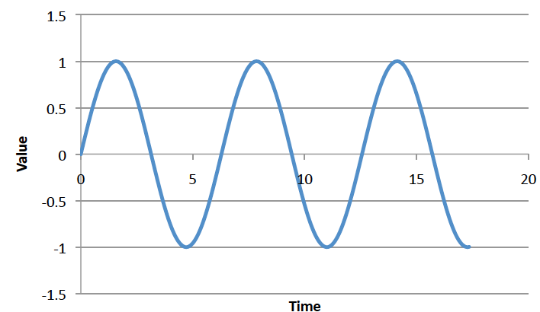
Waveform Cycles
How many cycles showing of sine wave?
How many cycles of square wave?

Slide 8
Waveform Cycles
How many cycles showing of sine wave?
How many cycles of square wave?
Note: clock on which we pipeline is a square wave
  Talk about what happens in a clock cycle
  Talk about number of clock cycles

Slide 9
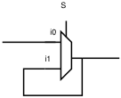

Latch
Element that can hold a
previous value of an input

Slide 10
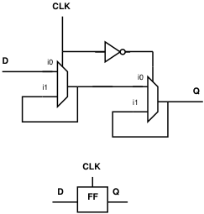
Register
Use a pair to create a flip-flop
  Also call register
What happens when
  CLK is low (0) ?
  CLK is high (1) ?
  CLK transitions from 0 to 1?
What output Q until next 0 to 1 CLK transition?
Internal

Slide 11
Register
Use a pair to create a flip-flop
  Also call register
Sample D input on 0→1
transition of clock (CLK)
Never an open path from
D→Q
  One of the mux latches always
  in hold state

Slide 12
Synchronous Circuit Discipline
Registers that sample inputs at clock edge and hold value throughout clock period
Compute from registers-to-registers
Clock Cycle time large enough for longest logic path between registers
Min cycle = Max path delay between registers
Comb
logic

Slide 13
Preclass 1
Delay between registers as shown?

Slide 14
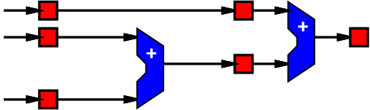
Preclass 1
Move registers so can clock at adder delay?
(which is of choices at bottom is correct = same behavior)
A
B
C

Slide 15
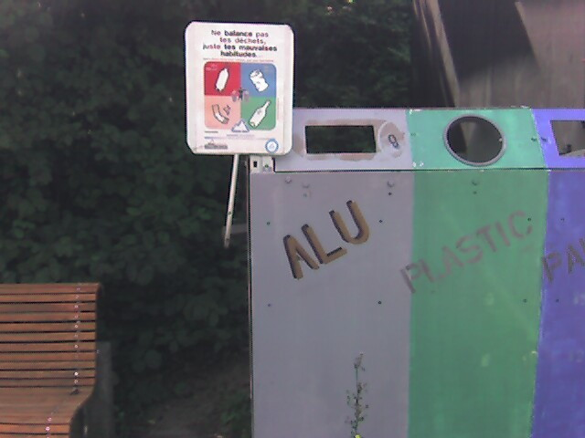
Pipeline Reuse
Lower delay between clocks
  Higher clock rate
  Higher potential throughput
  Faster we reuse our logic
  More capacity get out of design
    Assuming registers cheap in area and time overhead
      T_{setup}, T_{clk->q} ~ 20ps, T_{add} ~ 500ps
      Registers ~ 10 transistors/bit
      Adder ~ 40—50 transistors/bit

Slide 16
Preclass 2: What Happens?
What would be wrong with this pipelining?
For this initial design:

Slide 17
Behavior

Slide 18
Equations

Slide 19
Behavior
Add Register

Slide 20
Equations

Slide 21
Note Registers on Links
Some links end up with multiple registers.
Why?

Slide 22
Consistent Pipelining
Makes sure a consistent input set arrives at each gate/operator
  Don’t get mixing between input sets

Slide 23
Legal Register Moves
Retiming Lag/Lead
Lag: remove register every input
add register every output
Lead: remove register every output
add register every input

Slide 24
Preclass 1
Retime using Lead/Lag

Slide 25
Preclass 1 (revisited)

Slide 26
Add Registers and Move
If we’re willing to add pipeline delay
  Add any number of pipeline registers at input
  Move registers into circuit to reduce cycle time
    Reduce max delay between registers

Slide 27
Add Registers at Input

Slide 28
Add Registers at Input and Retime

Slide 29
Add Register and Retime
Add chain of registers on every input
Retime registers into circuit
  Minimizing delay between registers

Slide 30
Add Registers and Retime
Lets us think about behavior
  What the pipelining is doing to cycles of delay
Separate from details of how redistribute registers
Behavioral equivalence between the registers-at-front and properly retimed version of circuit

Slide 31
Justify Pipelining
(or composing pipelined operators)
Part 2

Slide 32
Handling Pipelined Operators
Given a pipelined operator
  (or a pipelined interconnect)
Discipline of picking a frequency target and designing everything for that
  May be necessary to pipeline operator since its delay is too high
Due to hierarchy
  Pipelined this operator and now want to use it as a building block

Slide 33
Examples
Run at 500MHz
Floating-point unit that takes 9ns
  Can pipeline into 5, 2ns stages
Multiplier that takes 6ns
Memory can access in 2ns
  Only if registers on address/inputs and output
  i.e. exist in own clock stage

Slide 34
Interconnect Delay
Chips >> Clock Cycles
May have chip 100s of Operators wide
May only be able to reach across 10 operators in a 2ns cycle
Must pipeline long interconnect links

Slide 35
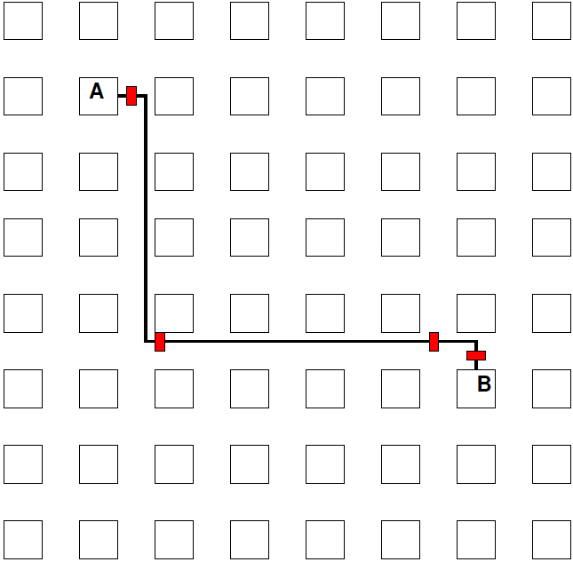
Interconnect Example

Slide 36
Methodology:
Pipelined Operator Graph
Start with logical, unpipelined graph
Treat each pipelined operator as a set of unit-delay operators of mandatory depth
Treat each interconnect pipeline stage as a unit-delay buffer
Add registers at input
Retime into graph

Slide 37
Model
3-stage Multiplier
Interconnect Delay
A
I1
M1
I2
M2
I3
M3
B

Slide 38
Pipeline Loop
(and use for justify pipeline example)

Slide 39
Preclass 4
Logical (unpipelined) dataflow graph for loop body

Slide 40
Example Operators
Operator and Interconnect delays
  Multiplier 3 cycles
  Reading from Input array
    Memory op is cycle after computing address
    Takes one cycle delay bring data back to multiplier (or adder)

Slide 41
Illustrate Need
What happens if just use graph as is (with operators pipelined as required)?

Slide 42
Model Graph
Revised graph for modeling

Slide 43
Pipeline Graph
Result after first retime (top register)

Slide 44
Pipeline Graph
Result after first retime

Slide 45
Pipeline Graph
Result after next retime (top register)?

Slide 46
Pipeline Graph
Result after next retime

Slide 47
Pipeline Graph
Result after next retime (top register)?

Slide 48
Pipeline Graph
Result after next retime

Slide 49
Pipeline Graph
Result after next retime (top register)?

Slide 50
Pipeline Graph
Result after next retime

Slide 51
Pipeline Graph
Result after next retime (top register)?

Slide 52
Pipeline Graph
Result after next retime

Slide 53
Pipeline Graph
Result after next retime (top register)?

Slide 54
Pipeline Graph
Result after next retime

Slide 55
Pipeline Graph
Result after pipelining

Slide 56
Pipelining Lesson
Can always pipeline an acyclic graph
(no graph cycles)
to fixed frequency target
  fixed pipelining of primitive operators
  Pipeline interconnect delays
Need to keep track of registers to balance paths
  So see consistent delays to operators

Slide 57
Graph Cycles
Watch: Clock cycle
Cycle time
Cycle in Graph
Part 3

Slide 58
Preclass 3
Can we retime to reduce clock cycle time?

Slide 59
Retiming Limits?
What prevents us from retiming?

Slide 60
(Graph) Cycle Observation
Retiming does not allow us to change the number of registers inside a graph cycle.
Limit to clock cycle time
  Max delay in graph cycle / Registers in graph cycle
Pipelining doesn’t help inside graph cycle
  Cannot push registers into graph cycle

Slide 61
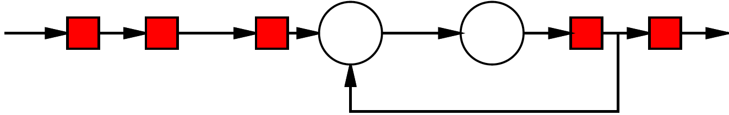
Simple Graph Cycle
Delay of graph cycle?
Registers in graph cycle?
What happens to graph cycle if try to apply lead/lag?

Slide 62
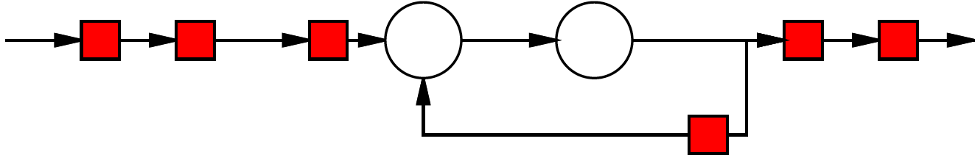
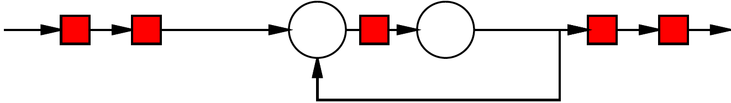
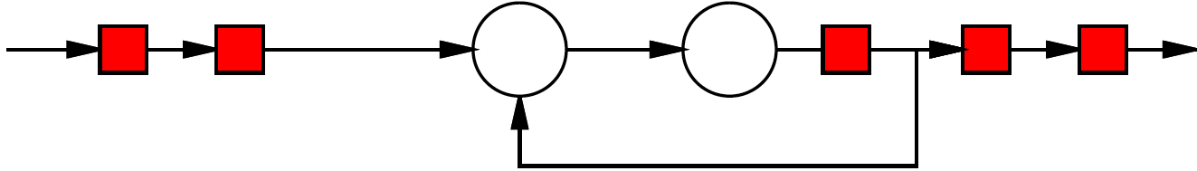
Retiming

Slide 63
Initiation Interval (II)
Cyclic dependencies in a dataflow graph can limit throughput
Due to data-dependent cycles in graph,
  May not be able to initiate a new computation on every clock cycle
II – clock cycles (delay) before can initiate
Throughput = 1/II

Slide 64
Loop
Consider
  [multiply and mod each take 3 cycles]
For (i=0;i<N;i++)
  C[i]=(C[i-1]*A[i])%N;

Slide 65
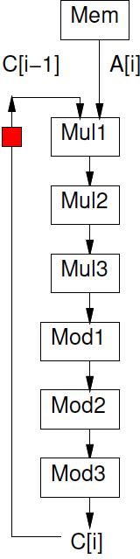
Loop
For (i=0;i<N;i++)
  C[i]=(C[i-1]*A[i])%N;

Slide 66
Loop
For (i=0;i<N;i++)
  C[i]=(C[i-1]*A[i])%N;
Initiation Interval?

Slide 67
Initiation Interval
Delay Around graph cycle?
  Assume multiply 3, add 1
Registers in graph cycle?
Retiming clock cycle bound = II ?
Achievable?

Slide 68
Retimed

Slide 69
II and Latency
Actually is a cycle
  II?
  Latency?

Slide 70
II and Latency
II? (assume willing to pipeline inputs)
Latency?

Slide 71
II and Latency

Slide 72
Lesson
Cyclic dependencies limit throughput on single task or data stream
  Cycle-length / registers-in-cycle

Slide 73
Vector Pipelines
Data Parallel Vector Operations are interesting even when
Vector Lanes<Vector Length
Within Vector operation, data parallel so no cyclic dependencies
  So get an II=1 issuing Vector Lane operations
  May have data dependences between Vector operations

Slide 74
Vector Pipeline Example
for (int i=0;i<32; i++)
  c[i]+=a[i]*b[i]

Slide 75
Dependence between
Vector Operations
for (int i=0;i<32; i++)
  c[i]+=a[i]*b[i]
for (int i=0;i<32; i++)
  e[i]+=c[i]*e[i]

Slide 76
Big Ideas
Pipeline computations to reuse hardware and maximize computational capacity
Can compose pipelined operators and accommodate fixed-frequency target
  Be careful with data retiming
Graph cycles limit pipelining on single stream – II (Initiation Interval)
C-slow to share hardware among multiple, data-parallel streams (part 4)

Slide 77
Admin
Remember Feedback form
  Including HW3
Reading for Day 8 on web
HW4 due Friday

Slide 78
C-Slow
(See uploaded recording)
Part 4

Slide 79
Problem
Pipelining cannot push registers into a graph cycle
Graph cycles can prevent running at full pipeline target (maximum clock frequency)
If not reusing operators at full pipeline target are underutilizing resources
Can we use the resources for something?

Slide 80
C-Slow
Observation: if we have data-level parallelism, can use to solve independent problems on same hardware
Transformation: make C copies of each register
Guarantee: C computations operate independently
  Do not interact with each other

Slide 81
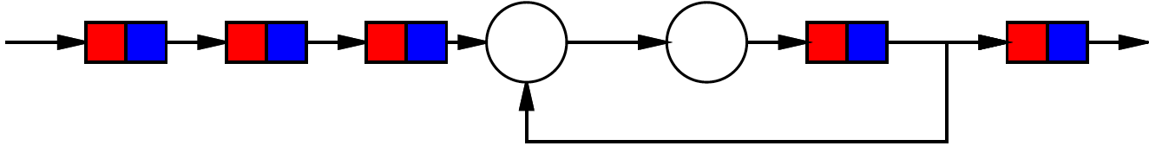
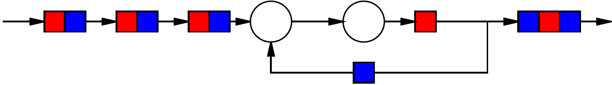
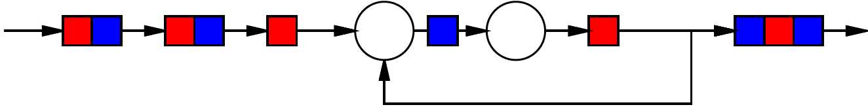
2-Slow Simple Cycle
Replace register with pair
Retime

Slide 82
2-Slow Simple Cycle
Replace register with pair
Retime
Observe independence of red/blue computations

Slide 83
Equivalence
The 2-slow operator is equivalent to two data parallel operators running at half the speed
  E.g. processing separate audio channels

Slide 84
Automation
No mainstream tool today will perform C-slow transformation for you automatically
Synthesis tools will retime registers

Slide 85
Lesson
Cyclic dependencies limit throughput on single task or data stream
  II=Cycle-length / registers-in-cycle
Can use on C (C<=II) independent (data parallel) tasks

Slide 86
Big Ideas
Pipeline computations to reuse hardware and maximize computational capacity
Can compose pipelined operators and accommodate fixed-frequency target
  Be careful with data retiming
Graph cycles limit pipelining on single stream -- II
C-slow (C<=II) to share hardware among multiple, data-parallel streams (part 4)

