Slide 1

ESE5320:
System-on-a-Chip Architecture
Day 18: Nov. 1, 2023
Maps, Associative Memories, Hash Tables

Slide 2
Today
Associative Memories on FPGAs (Part 1)
Software Map Trees (Part 2)
Hash Tables (Part 3)
  Software
  Hardware (FPGA) Hash Maps

Slide 3
Message
Many options for Maps
Hash tables are useful tools

Slide 4
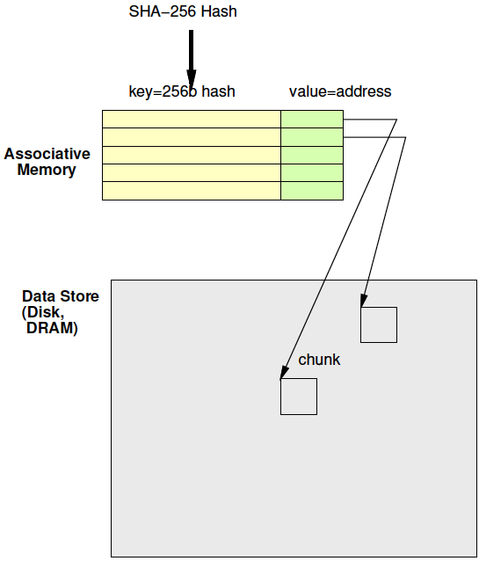
Associative Memory
Day 16 Review
Maps from a key to a value
  associates a value with a key
Key not necessarily dense
  Contrast simple RAM
  Cannot afford 2²⁵⁶ word memory

Slide 5
Associative Memories
Use for deduplication
Also may use in LZW to reduce BRAMs
  Just saw
    Problem: Simple 2D tree table requires too many BRAMs
    Opportunity: Tree table sparse

Slide 6
Associative Memories
FPGA
Part 1

Slide 7
FPGA
Has BRAMs – normal memories, not associative
36Kb BRAM
  512x72
Can be 9b key → 72b value assoc.
  Just using the memory sparsely
Or interpret as programmable decoder with 72 match lines

Slide 8
Assoc. Mem from BRAM
For wider match
Cover 9b of key with each BRAM
Use 72 output bits to indicate if one of 72 entries match
AND together corresponding entries
Get 72 match bits
Re-encode match
bits to lookup value

Slide 9
BRAM Associative Memory
Previous slide expands match width
How would we expand capacity?
  Hint: how get a wider word (144b word)?

Slide 10
BRAM Associative Memory

Slide 11
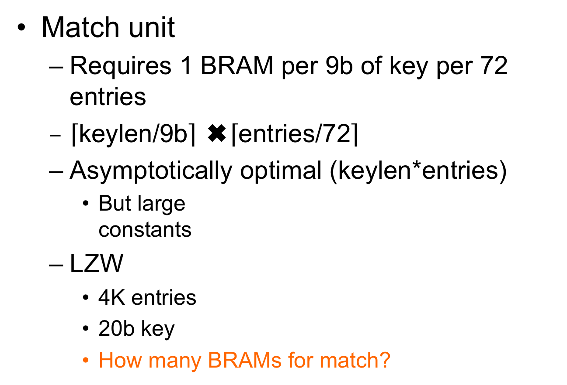
Associative Memory Cost
Match unit
  Requires 1 BRAM per 9b of key per 72 entries
  $\left\lceil \text{keylen}\text{/9}\text{b}\right\rceil$ ✖️$\left\lceil \text{entries}\text{/72}\right\rceil$
  Asymptotically optimal (keylen*entries)
    But large
    constants
  LZW
    4K entries
    20b key
    How many BRAMs for match?

Slide 12
4K LZW Chunk Search:
Fully associative
Match BRAMs:
  Match key: 20b
  Entries: 4096
Value BRAMS:
  12b (state [position])
  12b x 4096 entries
  Takes 2 BRAMs

Slide 13
Example Stored Values
Key[17:9] | Key[8:0] | Value
0x001 | 0x014 | 0x01
0x001 | 0x01 | 0x34
0x0F0 | 0x014 | 0xE3
0x0C8 | 0x113 | 0xCC

Slide 14
Memory Contents
Key[17:9] Match BRAM
Value BRAM
Addr | 7 | 6 | 5 | 4 | 3 | 2 | 1 | 0
0x001 | 0 | 0 | 0 | 0 | 0 | 0 | 1 | 1
0x014 | 0 | 0 | 0 | 0 | 0 | 0 | 0 | 0
0x0C8 | 0 | 0 | 0 | 0 | 1 | 0 | 0 | 0
0x0F0 | 0 | 0 | 0 | 0 | 0 | 1 | 0 | 0
0x113 | 0 | 0 | 0 | 0 | 0 | 0 | 0 | 0
Addr | Value
0x00 | 0x01
0x01 | 0x34
0x02 | 0xE3
0x03 | 0xCC
0x04
0x05
0x06
Key[8:0] Match BRAM
Addr | 7 | 6 | 5 | 4 | 3 | 2 | 1 | 0
0x001 | 0 | 0 | 0 | 0 | 0 | 0 | 1 | 0
0x014 | 0 | 0 | 0 | 0 | 0 | 1 | 0 | 1
0x0C8 | 0 | 0 | 0 | 0 | 0 | 0 | 0 | 0
0x0F0 | 0 | 0 | 0 | 0 | 0 | 0 | 0 | 0
0x113 | 0 | 0 | 0 | 0 | 1 | 0 | 0 | 0
(only show bottom 8 b; rest 0’s)

Slide 15
Code Snippet
ap_uint<72> key_low[512];
ap_uint<72> key_high[512];
int value[72];
match_low=key_low[key%512];
match_high=key_high[(key>>9)%512];
match=match_low & match_high;
addr=binary_encode(match);
res=value[addr];

Slide 16
How Lookup Work?
Key[17:9] | Key[8:0] | Value
0x001 | 0x014 | 0x01
0x001 | 0x01 | 0x34
0x0F0 | 0x014 | 0xE3
0x0C8 | 0x113 | 0xCC
Lookup 0x214 = 0x001 0x014

Slide 17
Code Snippet
ap_uint<72> key_low[512];
ap_uint<712> key_high[512];
int value[72];
match_low=key_low[key%512];
match_high=key_high[(key>>9)%512];
match=match_low & match_high;
addr=binary_encode(match);
res=value[addr];

Slide 18
Memory Contents
Key[17:9] Match BRAM
Addr | 7 | 6 | 5 | 4 | 3 | 2 | 1 | 0
0x001 | 0 | 0 | 0 | 0 | 0 | 0 | 1 | 1
0x014 | 0 | 0 | 0 | 0 | 0 | 0 | 0 | 0
0x0C8 | 0 | 0 | 0 | 0 | 1 | 0 | 0 | 0
0x0F0 | 0 | 0 | 0 | 0 | 0 | 1 | 0 | 0
0x113 | 0 | 0 | 0 | 0 | 0 | 0 | 0 | 0
match_low=key_low[key%512];
match_high=key_high[(key>>9)%512];
Key[8:0] Match BRAM
What match_low, match_high?
Addr | 7 | 6 | 5 | 4 | 3 | 2 | 1 | 0
0x001 | 0 | 0 | 0 | 0 | 0 | 0 | 1 | 0
0x014 | 0 | 0 | 0 | 0 | 0 | 1 | 0 | 1
0x0C8 | 0 | 0 | 0 | 0 | 0 | 0 | 0 | 0
0x0F0 | 0 | 0 | 0 | 0 | 0 | 0 | 0 | 0
0x113 | 0 | 0 | 0 | 0 | 1 | 0 | 0 | 0
(only show bottom 8 b; rest 0’s)

Slide 19
Memory Contents
Key[17:9] Match BRAM
Addr | 7 | 6 | 5 | 4 | 3 | 2 | 1 | 0
0x001 | 0 | 0 | 0 | 0 | 0 | 0 | 1 | 1
0x014 | 0 | 0 | 0 | 0 | 0 | 0 | 0 | 0
0x0C8 | 0 | 0 | 0 | 0 | 1 | 0 | 0 | 0
0x0F0 | 0 | 0 | 0 | 0 | 0 | 1 | 0 | 0
0x113 | 0 | 0 | 0 | 0 | 0 | 0 | 0 | 0
match_low=key_low[key%512];
match_high=key_high[(key>>9)%512];
match=match_low & match_high;
What match?
Key[8:0] Match BRAM
Addr | 7 | 6 | 5 | 4 | 3 | 2 | 1 | 0
0x001 | 0 | 0 | 0 | 0 | 0 | 0 | 1 | 0
0x014 | 0 | 0 | 0 | 0 | 0 | 1 | 0 | 1
0x0C8 | 0 | 0 | 0 | 0 | 0 | 0 | 0 | 0
0x0F0 | 0 | 0 | 0 | 0 | 0 | 0 | 0 | 0
0x113 | 0 | 0 | 0 | 0 | 1 | 0 | 0 | 0
(only show bottom 8 b; rest 0’s)

Slide 20
What does binary_encode do?
binary_encode(0000000…010000)=0x40
10000…0 → 71
0000…01 → 0
0000…010 → 1
for (i=0<i<72;i++)
  If (bit[i]==1) return i
Return(MISS); // if not find (i.e., all 0’s)
Technicalities – maybe check only one 1

Slide 21
Memory Contents
Key[17:9] Match BRAM
Addr | 7 | 6 | 5 | 4 | 3 | 2 | 1 | 0
0x001 | 0 | 0 | 0 | 0 | 0 | 0 | 1 | 1
0x014 | 0 | 0 | 0 | 0 | 0 | 0 | 0 | 0
0x0C8 | 0 | 0 | 0 | 0 | 1 | 0 | 0 | 0
0x0F0 | 0 | 0 | 0 | 0 | 0 | 1 | 0 | 0
0x113 | 0 | 0 | 0 | 0 | 0 | 0 | 0 | 0
match_low=key_low[key%512];
match_high=key_high[(key>>9)%512];
match=match_low & match_high;
addr=binary_encode(match);
Key[8:0] Match BRAM
What addr?
Addr | 7 | 6 | 5 | 4 | 3 | 2 | 1 | 0
0x001 | 0 | 0 | 0 | 0 | 0 | 0 | 1 | 0
0x014 | 0 | 0 | 0 | 0 | 0 | 1 | 0 | 1
0x0C8 | 0 | 0 | 0 | 0 | 0 | 0 | 0 | 0
0x0F0 | 0 | 0 | 0 | 0 | 0 | 0 | 0 | 0
0x113 | 0 | 0 | 0 | 0 | 1 | 0 | 0 | 0
(only show bottom 8 b; rest 0’s)

Slide 22
Memory Contents
Key[17:9] Match BRAM
Value BRAM
Addr | 7 | 6 | 5 | 4 | 3 | 2 | 1 | 0
0x001 | 0 | 0 | 0 | 0 | 0 | 0 | 1 | 1
0x014 | 0 | 0 | 0 | 0 | 0 | 0 | 0 | 0
0x0C8 | 0 | 0 | 0 | 0 | 1 | 0 | 0 | 0
0x0F0 | 0 | 0 | 0 | 0 | 0 | 1 | 0 | 0
0x113 | 0 | 0 | 0 | 0 | 0 | 0 | 0 | 0
Addr | Value
0x00 | 0x01
0x01 | 0x34
0x02 | 0xE3
0x03 | 0xCC
0x04
0x05
0x06
Key[8:0] Match BRAM
Addr | 7 | 6 | 5 | 4 | 3 | 2 | 1 | 0
0x001 | 0 | 0 | 0 | 0 | 0 | 0 | 1 | 0
0x014 | 0 | 0 | 0 | 0 | 0 | 1 | 0 | 1
0x0C8 | 0 | 0 | 0 | 0 | 0 | 0 | 0 | 0
0x0F0 | 0 | 0 | 0 | 0 | 0 | 0 | 0 | 0
0x113 | 0 | 0 | 0 | 0 | 1 | 0 | 0 | 0
res=value[addr];
What res?
(only show bottom 8 b; rest 0’s)

Slide 23
How Lookup Work?
Key[17:9] | Key[8:0] | Value
0x001 | 0x014 | 0x01
0x001 | 0x01 | 0x34
0x0F0 | 0x014 | 0xE3
0x0C8 | 0x113 | 0xCC
Lookup 0x1E14 = 0x0F0 0x014

Slide 24
Memory Contents
Key[17:9] Match BRAM
Value BRAM
Addr | 7 | 6 | 5 | 4 | 3 | 2 | 1 | 0
0x001 | 0 | 0 | 0 | 0 | 0 | 0 | 1 | 1
0x014 | 0 | 0 | 0 | 0 | 0 | 0 | 0 | 0
0x0C8 | 0 | 0 | 0 | 0 | 1 | 0 | 0 | 0
0x0F0 | 0 | 0 | 0 | 0 | 0 | 1 | 0 | 0
0x113 | 0 | 0 | 0 | 0 | 0 | 0 | 0 | 0
Addr | Value
0x00 | 0x01
0x01 | 0x34
0x02 | 0xE3
0x03 | 0xCC
0x04
0x05
0x06
Key[8:0] Match BRAM
Addr | 7 | 6 | 5 | 4 | 3 | 2 | 1 | 0
0x001 | 0 | 0 | 0 | 0 | 0 | 0 | 1 | 0
0x014 | 0 | 0 | 0 | 0 | 0 | 1 | 0 | 1
0x0C8 | 0 | 0 | 0 | 0 | 0 | 0 | 0 | 0
0x0F0 | 0 | 0 | 0 | 0 | 0 | 0 | 0 | 0
0x113 | 0 | 0 | 0 | 0 | 1 | 0 | 0 | 0
(only show bottom 8 b; rest 0’s)

Slide 25
Add another entry
match | Key[17:9] | Key[8:0] | Value
0 | 0x001 | 0x014 | 0x01
1 | 0x001 | 0x01 | 0x34
2 | 0x0F0 | 0x014 | 0xE3
3 | 0x0C8 | 0x113 | 0xCC
4 | 0x0C8 | 0x01 | 0x2B
How BRAM contents
change to add this entry
for 0x19001

Slide 26
Memory Contents
Key[17:9] Match BRAM
Value BRAM
Addr | 7 | 6 | 5 | 4 | 3 | 2 | 1 | 0
0x001 | 0 | 0 | 0 | 0 | 0 | 0 | 1 | 1
0x014 | 0 | 0 | 0 | 0 | 0 | 0 | 0 | 0
0x0C8 | 0 | 0 | 0 | 0 | 1 | 0 | 0 | 0
0x0F0 | 0 | 0 | 0 | 0 | 0 | 1 | 0 | 0
0x113 | 0 | 0 | 0 | 0 | 0 | 0 | 0 | 0
Addr | Value
0x00 | 0x01
0x01 | 0x34
0x02 | 0xE3
0x03 | 0xCC
0x04
0x05
0x06
Key[8:0] Match BRAM
Addr | 7 | 6 | 5 | 4 | 3 | 2 | 1 | 0
0x001 | 0 | 0 | 0 | 0 | 0 | 0 | 1 | 0
0x014 | 0 | 0 | 0 | 0 | 0 | 1 | 0 | 1
0x0C8 | 0 | 0 | 0 | 0 | 0 | 0 | 0 | 0
0x0F0 | 0 | 0 | 0 | 0 | 0 | 0 | 0 | 0
0x113 | 0 | 0 | 0 | 0 | 1 | 0 | 0 | 0
(only show bottom 8 b; rest 0’s)

Slide 27
Memory Contents
Key[17:9] Match BRAM
Value BRAM
Addr | 7 | 6 | 5 | 4 | 3 | 2 | 1 | 0
0x001 | 0 | 0 | 0 | 0 | 0 | 0 | 1 | 1
0x014 | 0 | 0 | 0 | 0 | 0 | 0 | 0 | 0
0x0C8 | 0 | 0 | 0 | 1 | 1 | 0 | 0 | 0
0x0F0 | 0 | 0 | 0 | 0 | 0 | 1 | 0 | 0
0x113 | 0 | 0 | 0 | 0 | 0 | 0 | 0 | 0
Addr | Value
0x00 | 0x01
0x01 | 0x34
0x02 | 0xE3
0x03 | 0xCC
0x04 | 0x2B
0x05
0x06
Key[8:0] Match BRAM
Addr | 7 | 6 | 5 | 4 | 3 | 2 | 1 | 0
0x001 | 0 | 0 | 0 | 1 | 0 | 0 | 1 | 0
0x014 | 0 | 0 | 0 | 0 | 0 | 1 | 0 | 1
0x0C8 | 0 | 0 | 0 | 0 | 0 | 0 | 0 | 0
0x0F0 | 0 | 0 | 0 | 0 | 0 | 0 | 0 | 0
0x113 | 0 | 0 | 0 | 0 | 1 | 0 | 0 | 0
(only show bottom 8 b; rest 0’s)

Slide 28
4K Chunk LZW Search
 | BRAMs | Operations/byte
Brute Search | 1 | 4K
Tree with Dense RAM | 384 | 1
Tree with Full Assoc | 173 | 1
36Kb BRAMs on ZU3EG = 216

Slide 29
Checkpoint
Notice levels of mapping:
  Prefix Tree algorithm
  Formulated on a 2D memory
  Then implemented in assoc. memory
    (later with Tree … hash table)

Slide 30
Software Map
Part 2

Slide 31
Software Map
Map abstraction
  void insert(key,value);
  value lookup(key);
Will typically have many different implementations

Slide 32
Preclass 2
For a capacity of 4096
How many memory accesses needed
  When lookup fail?
  When lookup succeed (on average)?

Slide 33
Tree Map (Preclass 4)
Build search tree
Walk down tree
For a capacity of 4096,
assume balanced…
How many tree nodes visited
  When lookup fail?
  When lookup succeed (on average)?

Slide 34
Tree Map LZW
Each character requires log₂(dict) lookups
  12 for 4096
Each internal tree node hold
  Key (20b for LZW), value (12b), and 2 pointers (12b)
  7B
Total nodes 4K*2
Need 14 BRAMs for 4K chunk

Slide 35
Tree Insert
Need to maintain balance
Doable with O(log(N)) insert
  Tricky
  See Red-Black Tree
    https://en.wikipedia.org/wiki/Red–black_tree
    https://www.geeksforgeeks.org/red-black-tree-set-1-introduction-2/

Slide 36
4K Chunk LZW Search
Story so far….
 | BRAMs | Operations/byte
Brute Search | 1 | 4K
Tree with Dense RAM | 384 | 1
Tree with Full Assoc | 173 | 1
Tree with Tree | 14 | 12
36Kb BRAMs on ZU3EG = 216

Slide 37
Hash Tables
Part 3

Slide 38
High Performance Map
Would prefer not to search
Want to do better than log₂(N) time
  log₂(N) achieved with tree
Direct lookup in arrays (memory)
is good…

Slide 39
Hash Table
lookup_key
Attempt to turn into direct lookup
Compute some function of key
  A hash
Perform lookup at that point
If hash maps a single entry
(or no entry)
  Great, got direct lookup
    Like sparse table case
hash
Mem
match_key, value
Miss =
(match_key!=lookup_key)

Slide 40
Hash Entries
Average number of entries per hash when N > HASH_CAPACITY?
  Concrete example
    N= 4096
    HASH_CAPACITY=256

Slide 41
Hash Table
lookup_key
Attempt to turn into direct lookup
Compute some function of key
  A hash
Perform lookup at that point
Typically, prepared for several keys to map to same hash → call it a bucket
  Keep list or tree of things in each bucket
hash
Mem
Bucket =
<k1,v1>,
<k2,v2>,
<k3,v3>

Slide 42
Hash Table
lookup_key
Compute some function of key
  A hash
Perform lookup at that point
Find bucket with small number of entries
  Searching that bucket easier
  …but no absolute guarantee on
  maximum bucket size
hash
Mem
Bucket =
<k1,v1>,
<k2,v2>,
<k3,v3>

Slide 43
Hardware Hash Tables

Slide 44
Hardware Hash
lookup_key
Want to avoid variable size buckets
  So can read in one lookup
    Can make wider for some fixed number of slots
  So can resolve in one cycle
hash
Mem
Bucket =
<k1,v1>,
<k2,v2>,
<k3,v3>

Slide 45
Hash Size Distribution
Look at what the distribution looks like for number of entries
N – number of entries
C – HASH_CAPACITY (N<C) [buckets]
m – number of items mapped to a bucket
Compute distribution for each bucket size (m)

Slide 46
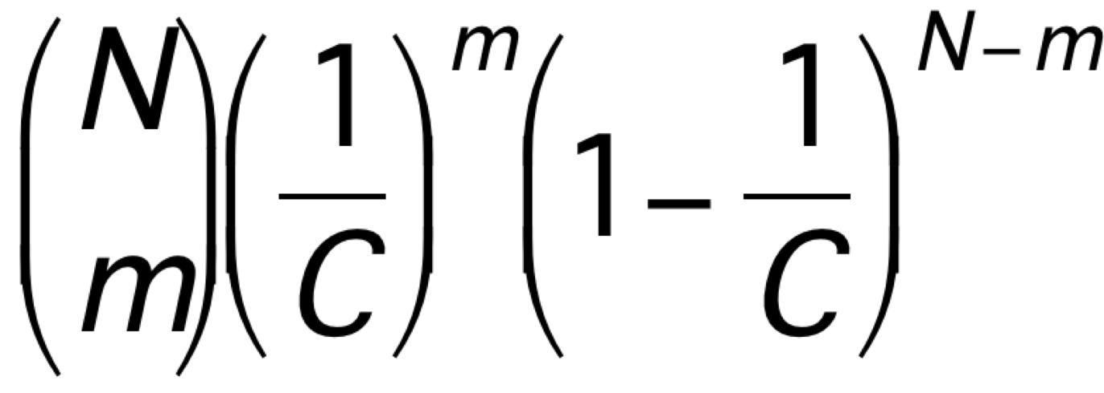
Preclass 3
N=1024
m→ | 0 | 1 | 2 | 3 | 4+
C=1024
C=2048 |  | 0.30
C=4096

Slide 47
Hash
Can tune hash parameters to control distribution
Spend more memory → smaller buckets → less work finding things in buckets
  Memory-Time tradeoff
Still have possibility of large buckets
  …but probability is low

Slide 48
Idea
Hash mostly works
Engineer hash to hold most cases
  Combination of
    sparcity (entries>N)
    Hold multiple entries per hash value
Few cases that overflow
  Store in small fully associative memory

Slide 49
Hybrid Hash+Assoc.

Slide 50
LZW 4K Chunk Hybrid
72 entry assoc. match
  needs 3 match BRAMs + 1 value BRAM
  Associative match 20b key
  72 entries (72/4096=1.7% for 4096)
So, can hold ~1% conflicts in 4K hash
Hash N=4096, C=16384, m=2, store 2
  Prob 3+: <1% (see table 1024, 4096)
  20b key+12b value=4B per entry
  16384*2*4B=4*2*4 BRAMs
32+4=36 BRAMs

Slide 51
Further Optimization
Previous example illustrative
  Not necessarily optimal (explore parameters)
    Expect not optimal
May be able to do better with multiple hashes
  See Dhawan reading paper
  May need to use that design in hybrid configuration with assoc. memory like previous example

Slide 52
Allow Imperfect?
Question: impact on compression if cannot store a few tree entries?
Some encodings will find shorter matches than optimal
Q: Impact on compression rate as a function of conflict rate?
How compare to compression rate impact of chunk size?
  Larger chunk with conflict rate vs. smaller chunk with smaller (or no) conflict rate
→ another tradeoff to explore

Slide 53
Hash Complexity
Want to compute these lookup hashes for hardware fast
  In a single cycle to keep II down for LZW
  Can xor-together a set of bits quickly in hardware
    Any 6-bits for one output bit in a single 6-LUT
    Means capacity must be power-of-2

Slide 54
4K Chunk LZW Search
 | BRAMs | Operations/byte
Brute Search | 1 | 4K
Tree with Dense RAM | 384 | 1
Tree with Full Assoc | 173 | 1
Tree with Tree | 14 | 12
Tree with Hybrid Hash | 36 | 1
36Kb BRAMs on ZU3EG = 216

Slide 55
Big Ideas
Many ways to implement maps
Near O(1) Map access → Hash Table

Slide 56
Admin
Feedback
Reading for Monday on web
First project milestone due Friday
  Including teaming
P2 out

