Slide 1

ESE5320:
System-on-a-Chip Architecture
Day 23: November 20, 2023
(was Day 21: November 14, 2022)
Reduce

Slide 2
Today
Part 1
  Reduce
  Associative Operations
  Model
Part 2
  Latency Bound Implications
  and Implementations
Part 3
  Parallel Prefix
  Broad Application
Part 4: Binary Arithmetic

Slide 3
Message
Aggregation is a common need that is not strictly data parallel
…but admits to parallel computation with a slightly different pattern that is worth knowing

Slide 4
Reduce
Reduce – combining a collection of data into a single value
  Converting a vector into a scalar
    E.g. sum elements

Slide 5
Sum Reduce
Simplest and most common
  Add up all the values in a vector or array
  int sum=0;
  for (int i=0;i<N; i++)
  sum+=a[i];

Slide 6
Sum Reduce
What’s II? (unit delay add)
  int sum=0;
  for (int i=0;i<N; i++)
  sum+=a[i];

Slide 7
Sum Reduce
What’s latency bound?
  Assuming associativity holds for addition
  int sum=0;
  for (int i=0;i<N; i++)
  sum+=a[i];

Slide 8
Associative Operations
Associativity means can group together operations in any way
Addition is associative for
  Natural numbers
  Real Numbers
  Modulo Arithmetic

Slide 9
Associative Operations
Associativity means can group together operations in any way
Normal sequential:
  (((a[0]+a[1])+a[2])+a[3])+…
Associative regroup:
  (a[0]+((((a[1]+(a[2]+a[3]))+a[4])+(…)))

Slide 10
Associative Operations
Associativity means can group together operations in any way
Normal sequential:
  (((a[0]+a[1])+a[2])+a[3])+…
Regroup parallelism:
  (((a[0]+a[1])+(a[2]+a[3]))+((a[4]+a[5])+(a[6]+a[7])))

Slide 11
Associative Tree Reduce
Add pairs – cut numbers in half
Repeat adding pairs until single value
How deep?

Slide 12
Associative Tree Reduce
Add pairs – cut numbers in half
Repeat adding pairs until single value
How deep?
N*(1/2)^{k}=1
N=2^{k}
k=log₂(N)

Slide 13
Latency Bounds
Associative reduces typically contribute log terms to latency bounds
  …as you’ve seen on many previous midterms and finals

Slide 14
Sum Reduce
Data Parallel?
  int sum=0;
  for (int i=0;i<N; i++)
  sum+=a[i];

Slide 15
Sum Reduce
How exploit 4 cores to compute?
  (assume a very large, like 1 million)
  int sum=0;
  for (int i=0;i<N; i++)
  sum+=a[i];

Slide 16
Model: Data Parallel+Reduce
Data Parallel + Reduce
  Very common to perform a data parallel operation then a reduce on results
Example: dot product
  (core in DNN, Matrix-Multiply)
  int sum=0;
  for (int i=0;i<N; i++)
  sum+=a[i]*b[i];

Slide 17
Dot Product
Latency bound for dot product
  Assume 1 cycle add, 3 cycle multiply
Example: dot product
  int sum=0;
  for (int i=0;i<N; i++)
  sum+=a[i]*b[i];

Slide 18
Model: Data Parallel+Reduce
Data Parallel + Reduce
  Very common to perform a data parallel operation then a reduce on results
General form
  int res=0;
  for (int i=0;i<N; i++)
  res=assoc_op(res,f(a[i],b[i], …))

Slide 19
What else Associative?
Beyond modulo addition, what other associative operations do we often see as reductions?

Slide 20
Associative Operations
Add
Multiply
Max
Min
AND
OR
Max/min
  And keep associated position
Find First

Slide 21
Optimization Loop
int minval=f(0);
int min=0;
for (i=1;i<N;i++) {
int val=f(i);
if (val<minval) {
minval=val; min=i;
}
}

Slide 22
Min keeping Position
if (val<minval) {
minval=val; min=i;
}
Each operation:
min1,val1,min2,val2 → min,val
if(val1<=val2) // keep first position found
// if equal, should be first
{min=min1; val=val1;}
else
{min=min2; val=val2;}

Slide 23
Optimization Loop
int minval=f(0);
int min=0;
for (i=1;i<N;i++) {
int val=f(i);
if (val<minval) {
minval=val; min=i;
}
}

Slide 24
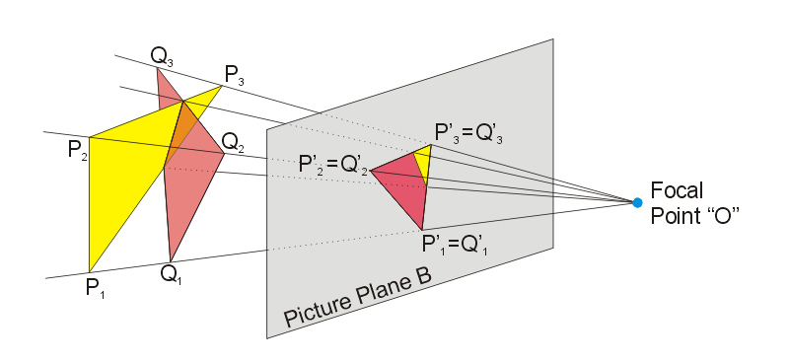

Rendering Decomposed
Day 15
Pipeline of
  Projection
    Where do the points of
    this triangle end up in the viewed image?
    Matrix-multiplication to translate points
  Rasterization
    Turn into pixels
    Fill pixels for triangle
  Z-buffer
    Keep only the ones on top (not hidden)
      2D image + Z-depth – keep smallest
Figures from: https://commons.wikimedia.org/wiki/File:Perspective_Projection_Principle.jpg
https://en.wikipedia.org/wiki/Rasterisation#/media/File:Raster_graphic_fish_20x23squares_sdtv-example.png

Slide 25
Z-Buffering
Storing into Z–buffer is an associative reduce operation
  Min reduce (keep nearest pixel) on depth with an associated value
Parallel strategy
  Split triangles into sets
  Project, rasterize, Z-buffer in parallel
  Assoc. reduce Z-buffer pixels across parallel Z-buffers

Slide 26
Not Associative: Floating Point
Floating-Point Addition
  Due to rounding
  (1+1E100)-1E100 = 0
  1+(1E100-1E100) = 1

Slide 27
Not Associative: Saturated Addition
Saturated Addition
  tmp=a+b;
  if (tmp>MAXVAL) sum=MAXVAL;
  else sum=tmp;
MAXVAL=255
  254+(20-3) = 255
  (254+20)-3 = 252

Slide 28
Majority Associative?
Carry=MAJ=majority
= A&&B || B&&C || A&&C
Is Majority Associative ?
Hint: What are each of following?
  MAJ(1,1,MAJ(1,1,MAJ(1,0,0)))
  MAJ(MAJ(MAJ(1,1,1),1,1),0,0)

Slide 29
Teaser
Can recast into associative operations
  saturated add
  Majority (Section 4)
Can still use ideas with Floating Point

Slide 30
Implementations
Part 2: Data Parallel+Reduce

Slide 31
Threaded:
Data Parallel+Reduce
Break into P threads
  0 to N/P-1, N/P to 2N/P-1, …
Run fraction of data and reduce on each
Then bring results together to sum
  P small, on one processor
  P large, as tree

Slide 32
Vector:
Data Parallel + Reduce
Some vector/SIMD machines will have dedicated reduce hardware
E.g. vector-add operator
NEON
  Not have vector reduce
  Does have VPADAL
    Pairwise adds
Use VL adds for coarse-grained reduce (data parallel)
for (i=0;i<N;i+=VL) {
avl=a[i]…a[i+VL-1]
VADD(res,avl, res);
}
Use VPADAL to complete
Cycles?

Slide 33
Unrolled Pipeline:
Data Parallel + Reduce
Unroll computation
Perform f ops in parallel pipelines
Pipelined tree reduce
Latency?
  N f ops
  Delay f – 3
  Delay assoc -- 2

Slide 34
Model: Data Parallel+Reduce
What’s cycle → what’s II?
  (concrete: assoc_op delay=2)
General form
  int res=0;
  for (int i=0;i<N; i++)
  res=assoc_op(res,f(a[i],b[i], …))

Slide 35
Pipeline:
Data Parallel + Reduce
Pipeline f
Cycle on assoc_op

Slide 36
Pipeline:
Data Parallel + Reduce
Pipeline f
Cycle on assoc_op
  Cannot take input on every cycle
Shown
II=2

Slide 37
Pipeline:
Data Parallel + Reduce
Pipeline f
Cycle on assoc_op
  Cannot take input on every cycle
Can use assoc. reduce to combine groups of original II
  Allow cycle to run at lower frequency
Shown
II=2

Slide 38
Pipeline:
Data Parallel + Reduce
Pipeline f
Cycle on assoc_op
Avoid cycle, II=1 for associative
  Gather up II values
  Run through pipelined assoc. reduce tree
  Drop into assoc_op cycle every II cycles
Shown
II=2

Slide 39
Pipeline:
Data Parallel + Reduce
Pipeline f
Cycle on assoc_op
Avoid cycle, II=1 for associative
  Gather up II values
  Run through pipelined assoc. reduce tree
  Drop into assoc_op cycle every II cycles
Solves, but underutilizes at ¼ clock
Shown
II=4

Slide 40
Model: Data Parallel+Reduce
Conclude: associative reduce can achieve II of 1
General form
  int res=0;
  for (int i=0;i<N; i++)
  res=assoc_op(res,f(a[i],b[i], …))

Slide 41
Pipeline:
Data Parallel
+ Reduce
Alternate, less efficient
  …but setting up next

Slide 42
Pipeline:
Data Parallel
+ Reduce
C-slow uses
Front-end
Full speed

Slide 43
Pipeline:
Data Parallel
+ Reduce
Continue
To use
C-slow
For final

Slide 44
Implement Reduce
Can exploit with all of our parallel implementation forms
  Multi-thread (multi-processor)
  SIMD/Vector
  Instruction
  Pipeline
  Spatial (unrolled)

Slide 45
Parallel Prefix
Part 3

Slide 46
What if want Prefix?
Sum Reduce
  int sum=0;
  for (int i=0;i<N; i++)
  sum+=a[i];
Sum Prefix
  int sum[N];
  sum[0]=a[0];
  for (int i=1;i<N; i++)
  sum[i]=a[i]+sum[i-1];

Slide 47
Integers 1--5
Sum Reduce
  int sum=0;
  for (int i=0;i<N; i++)
  sum+=a[i];
  → sum=1+2+3+4+5=15

Slide 48
Integers 1--5
Sum Reduce = 15
Sum Prefix
  int sum[N];
  sum[0]=a[0];
  for (int i=1;i<N; i++)
  sum[i]=a[i]+sum[i-1];
  → {1, 3, 6, 10, 15}

Slide 49
Prefix
Aggregate (vector) output
where item i is the reduce of the input vector 0 through i
  prefix[0]=a[0];
  for (int i=1;i<N; i++)
  prefix[i]=op(prefix[i-1],f(a[i]…));
``Prefix’’ because given reduce of each prefix subset 0 to i

Slide 50
Latency Bound
What’s the latency bound for the prefix when op is associative?
  Assume op is 1 cycle
  prefix[0]=a[0];
  for (int i=1;i<N; i++)
  prefix[i]=op(prefix[i-1],f(a[i]…));

Slide 51
Latency Bound
Simple (not area efficient) answer:
  Compute reduce for each prefix[i] in parallel
  Latency bound? (single cycle op)
  prefix[0]=a[0];
  for (int i=1;i<N; i++)
  prefix[i]=op(prefix[i-1],f(a[i]…));

Slide 52
Resources?
How much hardware to achieve within 2x latency bound?
  Hint: can do better than simple case previous slide
  prefix[0]=a[0];
  for (int i=1;i<N; i++)
  prefix[i]=op(prefix[i-1],f(a[i]…));

Slide 53
Reduce Tree
While computing Sum[0,N-1]
compute many Sum[0,j]’s
  Sum[0,1], Sum[0,3], Sum[0,7] ….

Slide 54
Prefix Tree
While computing Sum[0,N-1] only get
  PG[0,2^{n}-1]
How fillin holes?
– e.g. how get Sum[0,11]?

Slide 55
Prefix Tree
Look at Symmetric stage (with respect to middle=Sum[0,N-1] stage) and combine to fill in

Slide 56
Prefix Tree

Slide 57
Prefix Tree

Slide 58
Prefix Tree
Note: prefix-tree is same size as reduce tree

Slide 59
Parallel Prefix
Area and Delay?
Roughly twice the area/delay
Area= 2N
Delay = 2log₂(N)
Conclude:
can compute prefix
in log time
with linear area.

Slide 60
Latency Bound
What’s the latency bound
for the prefix when op is associative?
  When cycles(op)>1?
  prefix[0]=a[0];
  for (int i=1;i<N; i++)
  prefix[i]=op(prefix[i-1],f(a[i]…));

Slide 61
Parallel Prefix
Important Pattern
Applicable any time operation is associative
  Or can be made associative
Function Composition is always associative
  (Section 4)
Logarithmic delay
Linear area
Notes:
Non-associative example: nor2 ? (strictly if start with nors…but of course nor-n is associative in terms of the Ors)

Slide 62
Parallel Prefix Sum
  prefix[0]=a[0];
  for (int i=1;i<N; i++)
  prefix[i]=op(prefix[i-1],f(a[i]…));

Slide 63
Broader Application

Slide 64
Cast Associative
If you can cast it into an associative operation, you can apply
  Associative Reduce
  Parallel Prefix

Slide 65
Examples
Saturated Addition
  Not associative
Floating-Point Addition
Finite Automata Evaluation
(papers in supplemental reading)

Slide 66
Categorization
To minimize confusion, will typically ask you to characterize:
  Data parallel
  Reduce
  Sequential

Slide 67
Binary Addition
Part 4

Slide 68
Majority Associative?
Carry=MAJ=majority
= A&&B || B&&C || A&&C
Is Majority Associative ?
Hint: What are each of following?
  MAJ(1,1,MAJ(1,1,MAJ(1,0,0)))
  MAJ(MAJ(MAJ(1,1,1),1,1),0,0)

Slide 69
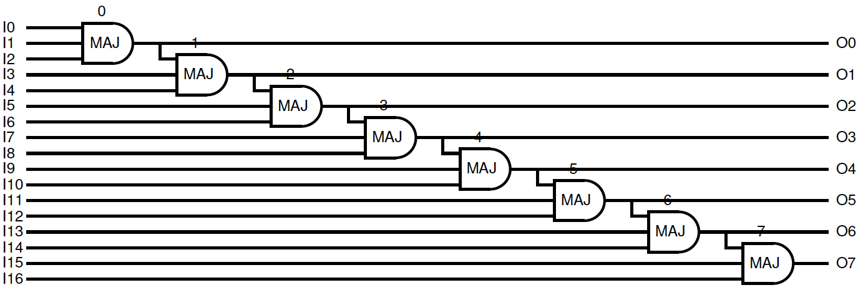
Binary Addition
Binary addition needs parallel prefix on majority
Adding 2 W-bit numbers
  What’s the latency bound?
  Area to achieve?
boolean a[i],b[i],s[i]
for (i=0;i<W;i++) {
  cn=(a[i]&&b[i])||
  (a[i]&&c)||
  (b[i]&&c);
  s[i]=a[i] ^ b[i] ^ c;
  c=cn;
  }

Slide 70
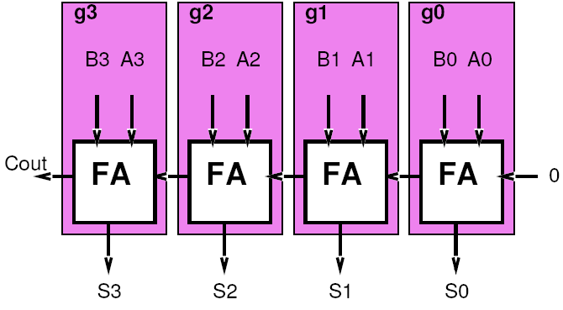
Carry Computation
Think about each adder bit as a computing a function on the carry in
  C[i]=g(c[i-1])
  Particular function f will depend on a[i], b[i]
  g=f(a,b)

Slide 71
Functions
Carry=MAJ=majority
= A&&B || B&&C || A&&C
What are the functions g(c[i-1])?
  g(c)=carry(a=0,b=0,c)
  g(c)=carry(a=1,b=0,c)
  g(c)=carry(a=0,b=1,c)
  g(c)=carry(a=1,b=1,c)

Slide 72
Functions
What are the functions g(c[i-1])?
  g(x)=1 Generate
    a[i]=b[i]=1
  g(x)=x Propagate
    a[i] xor b[i]=1
  g(x)=0 Squash
    a[i]=b[i]=0

Slide 73
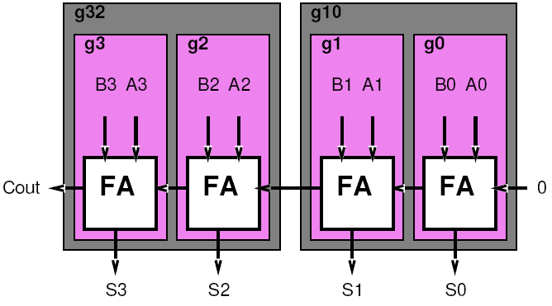
Combining
Want to combine functions
  Compute c[i]=g_{i}(g_{i-1}(c[i-2]))
  Compute compose of two functions
What functions will the compose of two of these functions be?
  Same as before
    Propagate, generate, squash

Slide 74
Compose Rules
(LSB MSB)
GG
GP
GS
PG
PP
PS
SG
SP
SS
[work on board]

Slide 75
Compose Rules
(LSB MSB)
GG = G
GP = G
GS = S
PG = G
PP = P
PS = S
SG = G
SP = S
SS = S

Slide 76
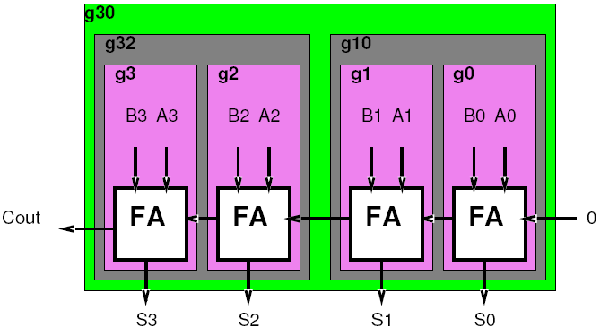
Combining
Do it again…
Combine g[i-3,i-2] and g[i-1,i]
What do we get?

Slide 77
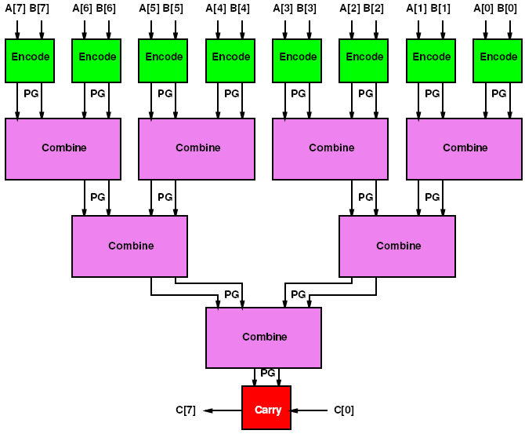
Associative Reduce Tree

Slide 78
Reduce Tree
Sq=/A*/B
Gen=A*B
Sq_{out}=Sq₁+/Gen₁*Sq₀
Gen_{out}=Gen₁+/Sq₁*Gen₀

Slide 79
Reduce Tree
Sq=/A*/B
Gen=A*B
Sq_{out}=Sq₁+/Gen₁*Sq₀
Gen_{out}=Gen₁+/Sq₁*Gen₀
Delay and Area? (work next few slides)

Slide 80
Reduce Tree
A(Encode)=2
D(Encode)=1
A(Combine)=4
D(Combine)=2
A(Carry)=2
D(Carry)=1
Sq=/A*/B
Gen=A*B
Sq_{out}=Sq₁+/Gen₁*Sq₀
Gen_{out}=Gen₁+/Sq₁*Gen₀

Slide 81
Reduce Tree: Delay?
D(Encode)=1
D(Combine)=2
D(Carry)=1
Delay = 1+2log₂(N)+1

Slide 82
Reduce Tree: Area?
A(Encode)=2
A(Combine)=4
A(Carry)=2
Area= 2N+4(N-1)+2

Slide 83
Reduce Tree: Area & Delay
Area(N) = 6N-2
Delay(N) = 2log₂(N)+2

Slide 84
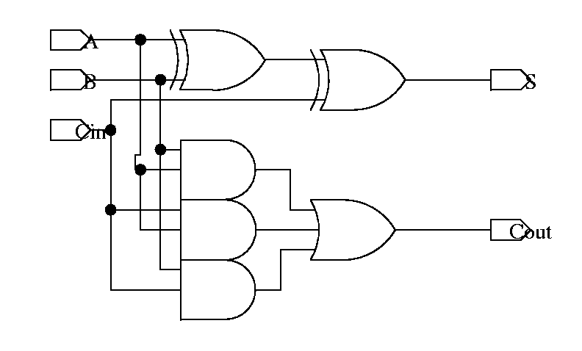
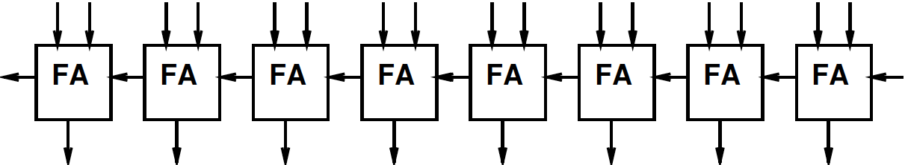
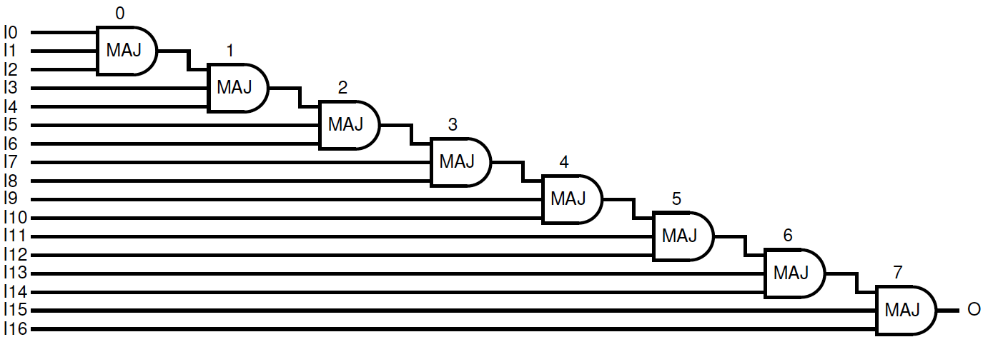
Compute Carry[N]

Slide 85
Need Prefix
Need PG[i:0] forall i

Slide 86
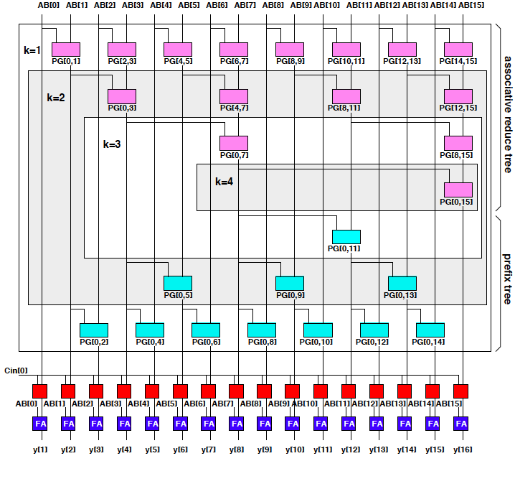
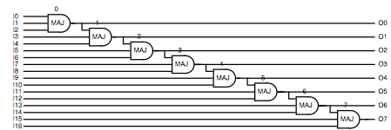
Prefix Tree
Bring in Carry and compute each intermediate carry-in

Slide 87
Parallel Prefix
Area and Delay?
Roughly twice the area/delay
Area= 2N+4N+4N+2N
= 12N
Delay = 4log₂(N)+2
Conclude:
can add in log time
with linear area.

Slide 88
Big Ideas:
Reduce from aggregate to scalar
  is a common operation
  not strictly data parallel
  Associative reduce admits to parallelism
    log(N) latency bound
    II=1
    Linear area
Prefix when want reduce of all prefixes
  Also log(N) latency bound
  Linear area

Slide 89
Admin
Wednesday is a virtual Friday – no lecture

