Slide 1

ESE5320:
System-on-a-Chip Architecture
Day 1: August 28, 2024
Introduction and Overview
(lecture start target 10:20am)
Note: slides, preclass linked to web
www.seas.upenn.edu/~ese5320/fall2024/fall2024.html
Work/finish preclass while waiting for lecture start
Feedback form (turn in end of lecture)

Slide 2
Today
Part 1: Case for Programmable SoC (motivation)
Part 2: Course Goals, Outcomes, Tools (philosophy?)
Part 3: Sample Optimization (fast, flavor)
Part 4: This course (operational details)
  (including policies, logistics)

Slide 3
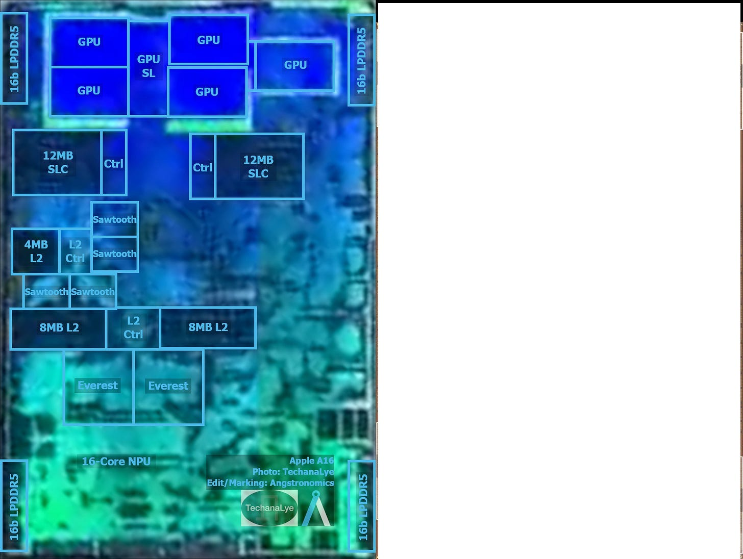
Apple A16 Bionic
? 110+mm², 4nm
16 Billion Tr.
iPhone 14
6 ARM cores
  2 fast (3.5GHz)
  4 low energy (2GHz)
5 custom GPUs (1.4GHz)
16 Neural Engines
  17 Trillion ops/s?
https://en.wikipedia.org/wiki/Apple_A16

Slide 4
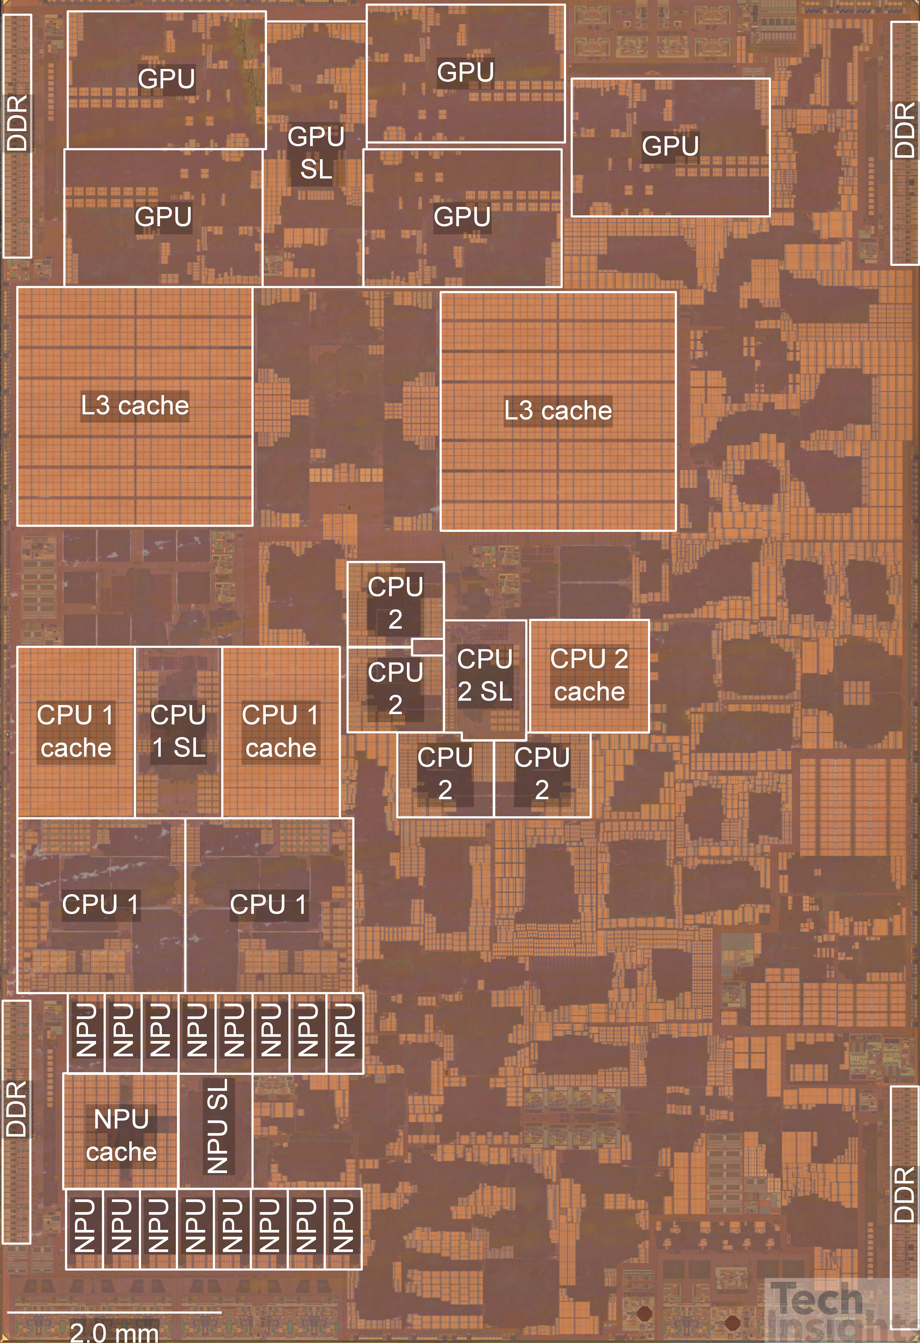
Apple A15 Bionic
108mm², 5nm
15 Billion Tr.
iPhone 13
6 ARM cores
  2 fast (3.2GHz)
  4 low energy (2GHz)
5 custom GPUs
16 Neural Engines
  11 Trillion ops/s?
Image from https://semianalysis.com/apple-a15-die-shot-and-annotation-ip-block-area-analysis/
https://www.anandtech.com/show/16983/the-apple-a15-soc-performance-review-faster-more-efficient

Slide 5
Questions
Why do today’s SoC look like they do?
How approach programming modern SoCs?
How design a custom SoC?
When building a System-on-a-Chip (SoC)
  How much area should go into:
    Processor cores, GPUs,
    FPGA logic, memory,
    interconnect,
    custom functions (which) …. ?

Slide 6
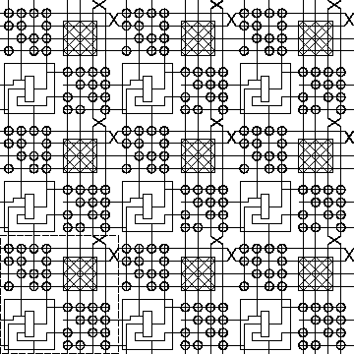
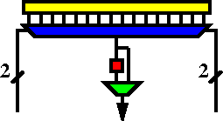
FPGA
Field-Programmable Gate Array
K-LUT (typical k=4 or 6)
Compute block
w/ optional
output Flip-Flop
(LUT = LookUp Table)
ESE1500, CIS5710

Slide 7
Case for Programmable SoC

Slide 8
End of Microprocessor Scaling
Old
Moore’s Law scaling delivered faster transistors
Processors rode Moore’s Law
  Turning transistors into performance
Could wait and ride technology curve
Now
Dennard’s Law kicked in
  How need to scale voltage with size
Microprocessors were burning more power
Lost ability to scale down voltage
Processor performance stalled

Slide 9
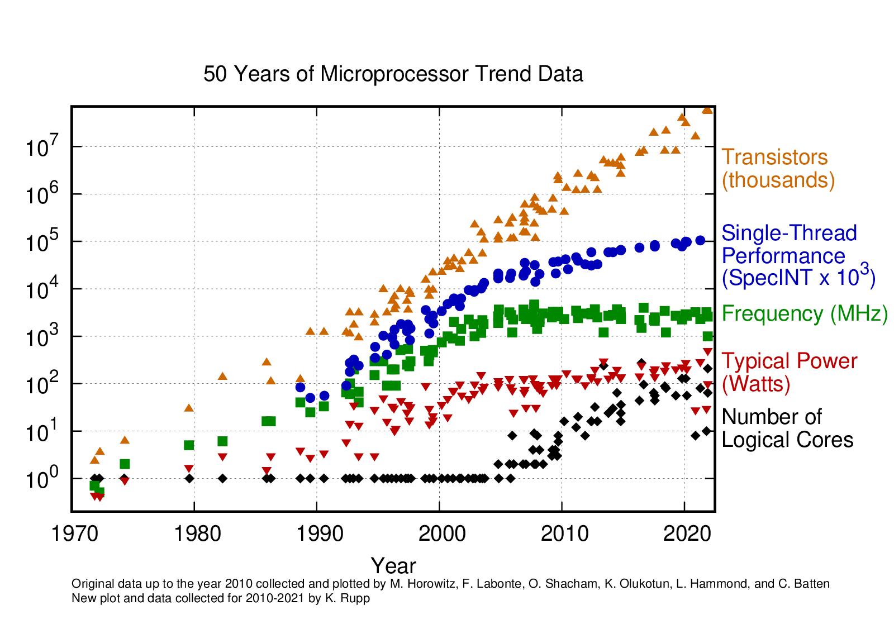

Slide 10
The Way things Were
30 years ago
Wanted programmability
  used a processor
Wanted it a little faster
  Next year’s processor would run faster…
Wanted high-throughput
  used a custom Integrated Circuit (IC) -- chip
Wanted product differentiation
  Got it at the board level
  Select which ICs and how wired
Build a custom IC (chip)
  It was about gates and logic

Slide 11
Today
Microprocessor may not be fast enough
  (but often it is)
  Or low enough energy
Single core processor scaling has ended
Time and Cost of a custom IC is too high
  $100M’s of dollars for development, Years
FPGAs promising
  But build everything from prog. gates?
Premium for small part count
  And avoid chip crossing
  ICs with 10—100 Billions of Transistors

Slide 12
Non-Recurring Engineering (NRE) Costs
Costs spent up front on development
  Engineering Design Time
  Design Verification
  Prototypes
  Mask costs
Recurring Engineering
  Costs to produce each chip

Slide 13
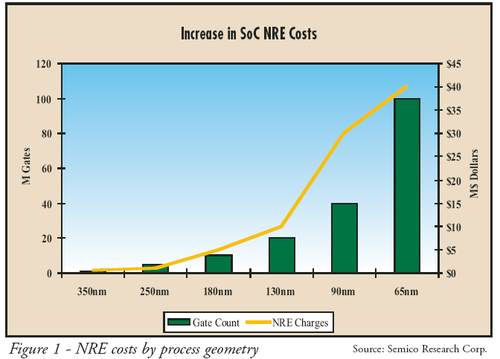
NRE Costs

Slide 14
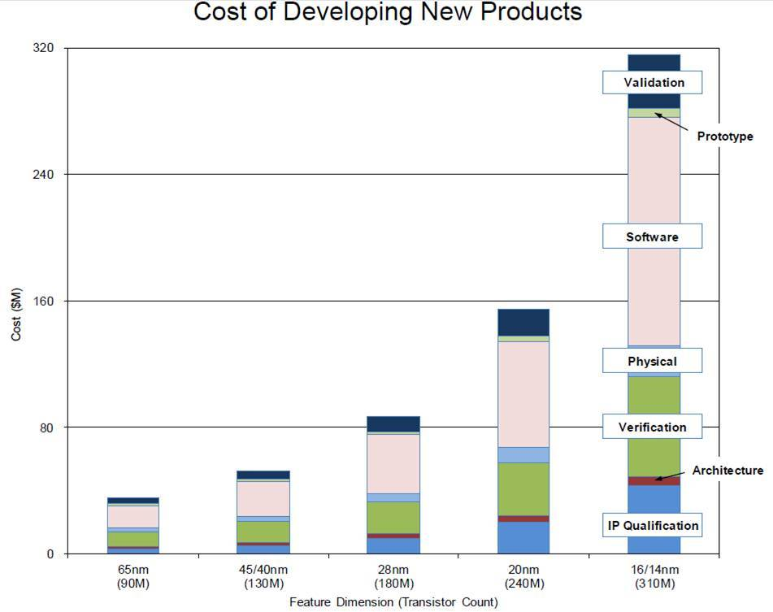
NRE Cost (continued)
https://semiengineering.com/how-much-will-that-chip-cost/

Slide 15
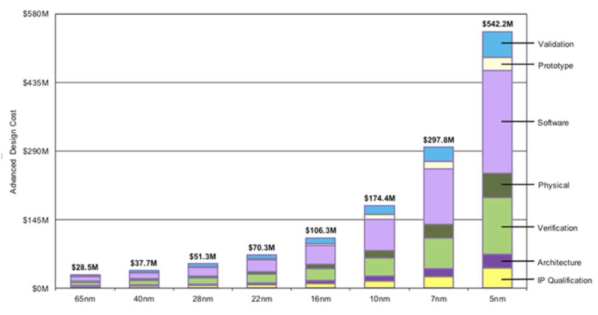
Bonus: Chip Design Costs
https://wccftech.com/apple-5nm-3nm-cost-transistors/

Slide 16
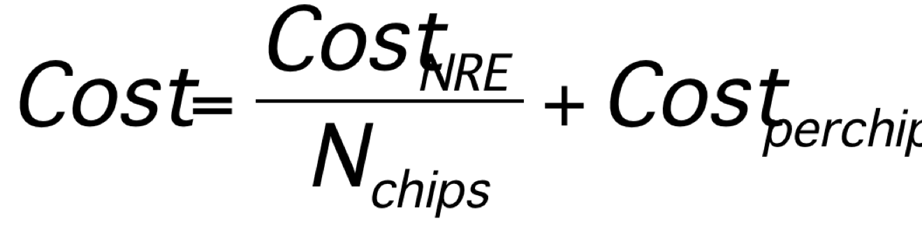
Amortize NRE with Volume

Slide 17
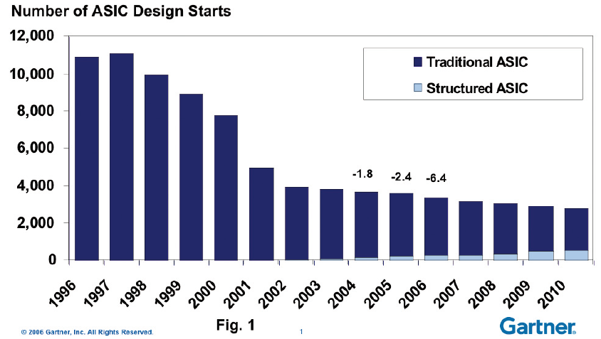
Economics
Forcing fewer,
more
customizable
chips
Economics force fewer, more customizable chips
  Mask costs in the millions of dollars
  Custom IC design NRE 100s of millions of dollars
    Need market of billions of dollars to recoup investment
    With fixed or slowly growing total IC industry revenues
    ➔ Number of unique chips must decrease
    Chips must be programmable

Slide 18
Large ICs (Chips)
Now contain significant software
  Almost all have embedded processors
Must co-design SW and HW
Must solve complete computing task
  Tasks has components with variety of needs
  Some don’t need custom circuit
  90/10 Rule

Slide 19
Given Demand for Programmable
How do we get higher performance than a processor, while retaining programmability?
  Programmability – don’t have to spend 100s of millions of dollars and months for fabrication?

Slide 20
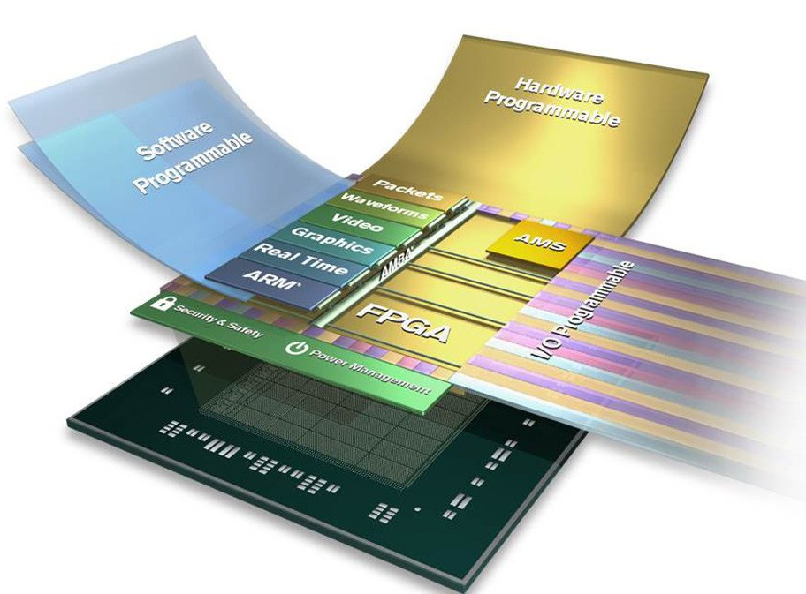
Programmable SoC
Implementation Platform for innovation
  This is what you target (avoid NRE)
  Implementation
  vehicle

Slide 21
Programmable SoC
UG1085
Xilinx
UltraScale
Zynq
TRM
(p27)

Slide 22
Then and Now
30 years ago
Programmability?
  use a processor
Faster
  Processors scaled
High-throughput
  used a custom IC
Wanted product differentiation
  board level
  Select & wired IC
Build a custom IC (Chip)
  It was about gates and logic
Today
Programmability?
  uP, FPGA, GPU, PSoC
Faster
  Can’t get with single core
High-throughput
  FPGA, GPU, PSoC, custom IC
Wanted product differentiation
  Program FPGAs, PSoC
Build a custom IC (Chip)
  System and software

Slide 23
Part 2:
Course
Goals, Outcomes

Slide 24
Goals
Create Computer Engineers
  SW/HW divide is wrong, outdated
  Computer engineers understand computation
    HW and SW are just tools and design options
  Parallelism, data movement, resource management, abstractions
  Cannot build a chip without software
SoC user – know how to exploit
SoC designer – architecture space,
hw/sw codesign
Project experience – design and optimization

Slide 25
Roles
PhD Qualifier
  One broad Computer Engineering
CMPE Concurrency Lab
Hands-on Project course

Slide 26
Outcomes
Design, optimize, and program a modern System-on-a-Chip.
Analyze, identify bottlenecks, design-space
  Modeling → write equations to estimate
Decompose into parallel components
Characterize and develop real-time solutions
Implement both hardware and software solutions
Formulate hardware/software tradeoffs, and perform hardware/software codesign

Slide 27
Outcomes
Understand the system on a chip from gates to application software, including:
  on-chip memories and communication networks, I/O interfacing, design of accelerators, processors, firmware and OS/infrastructure software.
Understand and estimate key design metrics and requirements including:
  area, latency, throughput, energy, power, predictability, and reliability.

Slide 28
Course Programming
Write everything in C
  including for hardware (FPGA, spatial) operators
Avoid learning separate language
  Don’t require or teach Verilog/VHDL
Do focus on how tailor C for hardware
  Focus on what’s unique about specifying and guiding hardware
Code → CHIPS

Slide 29
Tools
Are complex
Will be challenging, but good for you to build confidence can understand and master
Tool runtimes can be long
Learning and sharing experience will be part of assignments

Slide 30
Distinction
CIS2400, 4710, 5710
ESE5320
Best Effort Computing
  Run as fast as you can
Binary compatible
ISA separation
Shared memory parallelism
Real-Time
  Guarantee meet deadline
Hardware-Software codesign
  Willing to recompile, maybe rewrite code
  Define/refine hardware
Non shared-memory parallelism models

Slide 31
Distinction
ESE5320:
ESE5390: Hardware/Software Co-Design for Machine Learning
Deep computer engineering
Broad application
Program in C
Suitable followup if want to dig deeper
Deep on Application (ML)
More accessible to CS
  Less previous experience with circuits and architecture
Won’t be as deep on understanding HW and optimization
Program in Pytorch, OpenCL

Slide 32
Abstraction Stack
Software
ESE5390 HW/SW ML
Embedded Sys:
ESE3500/5190
CHIPS
Systems
SoC Arch:
ESE 5320
Processors
Processor Arch:
CIS 4710/5710
(CIS2400)
Mixed Signal:
ESE 5680
ADC, DAC
Switched Capacitors
Gates, Memories
Digital:
ESE3700/5700
Analog:
ESE4190/5720
Amplifier, Compare
Voltage/Current Ref.
Circuits/VLSI
Devices: ESE5210
(ESE2180)
Transistors

Slide 33
Part 3:
Approach -- Example

Slide 34
Abstract Approach
Identify requirements, bottlenecks
Decompose Parallel Opportunities
  At extreme, how parallel could make it?
  What forms of parallelism exist?
    Thread-level, data parallel, instruction-level
Design space of mapping
  Choices of where to map, area-time tradeoffs
Map, analyze, refine
  Write equations to understand, predict

Slide 35
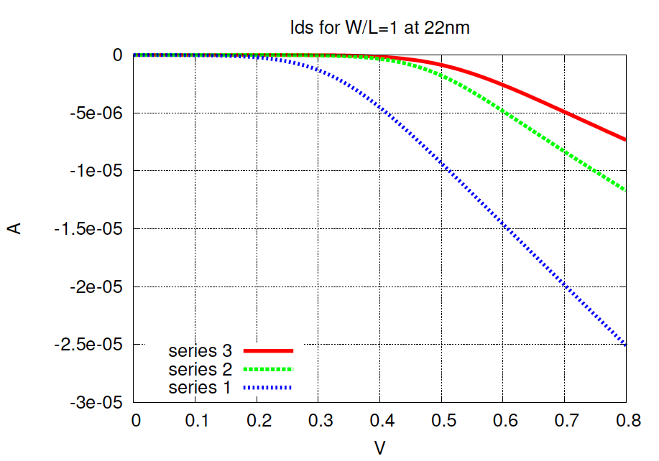
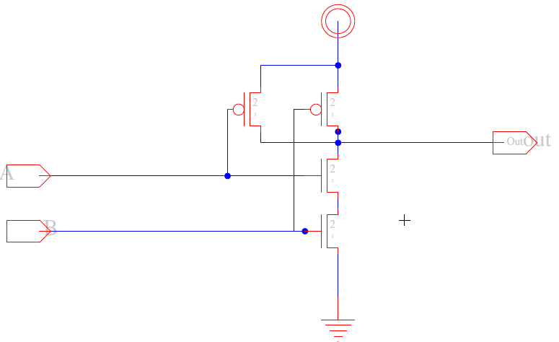
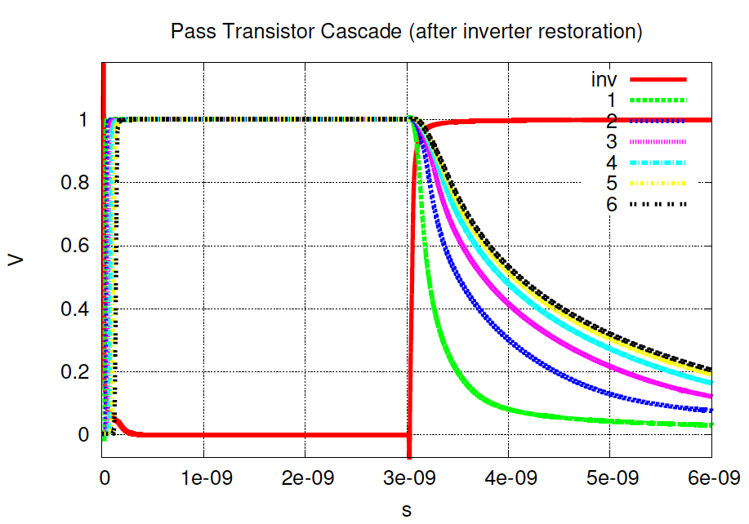
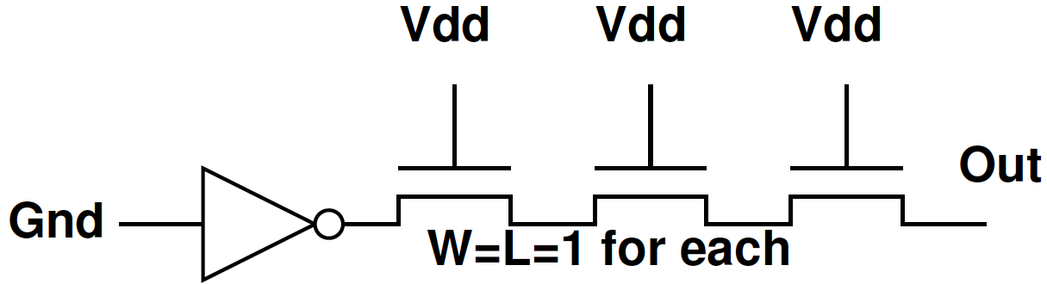
Example SPICE Circuit Simulator
SPICE – Simulate and
validate chip performance
at transistor level (ESE3700,5700)
  Specialized Differential
  Equation simulator for circuits (chips)

Slide 36
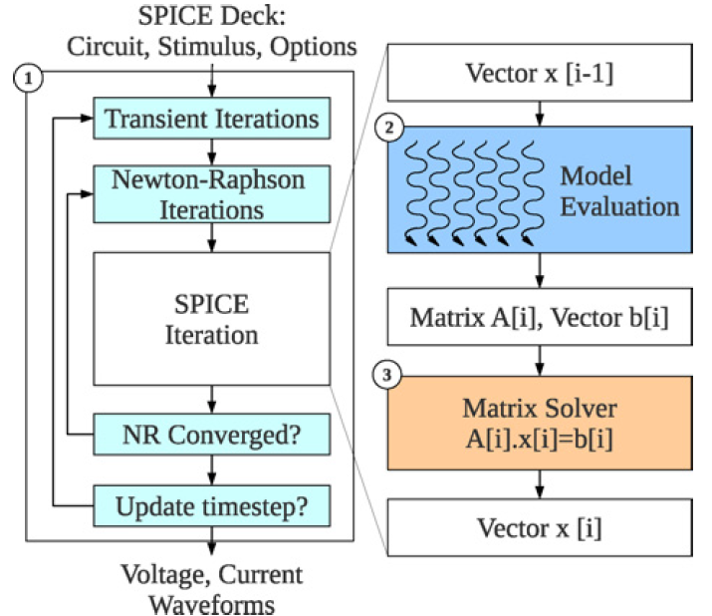
Example: SPICE Circuit Simulator
Matrix Solve
Ax=B
A matrix
B vector
x unknown vector
Solve for x
= KCL, KVL *
Linear Algebra
solving n eqns
in n unknowns.
Example: Kapre+DeHon, TRCAD 2012
* Kirchhoff {Current,Voltage} Laws

Slide 37
Abstract Approach
Identify requirements, bottlenecks
Decompose Parallel Opportunities
  At extreme, how parallel could make it?
  What forms of parallelism exist?
    Thread-level, data parallel, instruction-level
Design space of mapping
  Choices of where to map, area-time tradeoffs
Map, analyze, refine
  Write equations to understand, predict

Slide 38
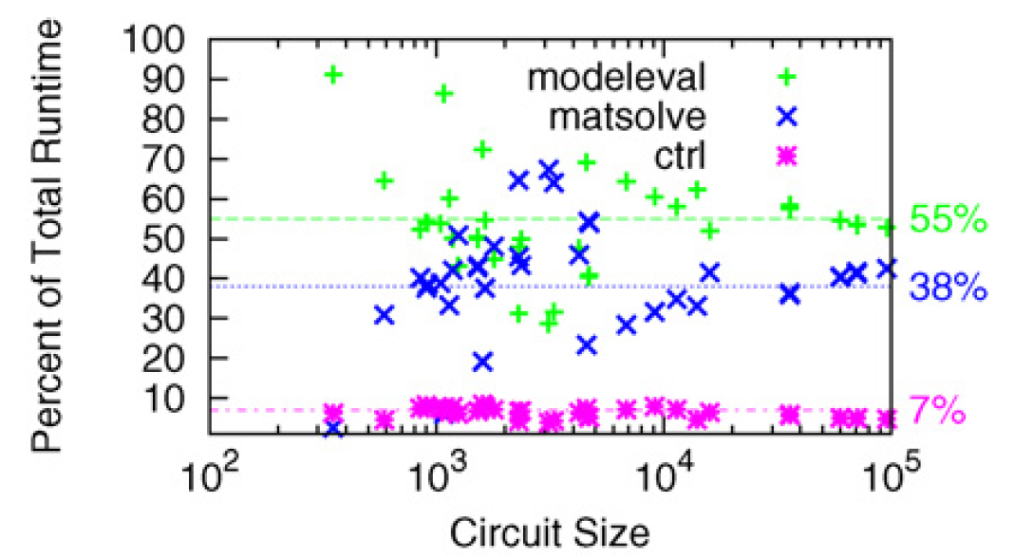
Analyze

Slide 39
Analyze
T=T_{modeleval}+T_{matsolve}+T_{ctrl}

Slide 40
Speedup
T=T_{modeleval}+T_{matsolve}+T_{ctrl}
What should we speedup first?
What happens if only speedup modeleval?
  T=T_{matsolve}+(T_{modeleval})/S+T_{ctrl}

Slide 41
Analyze
If only accelerated model evaluation
only about 2x speedup
If want better than 14x speed,
must also attack control

Slide 42
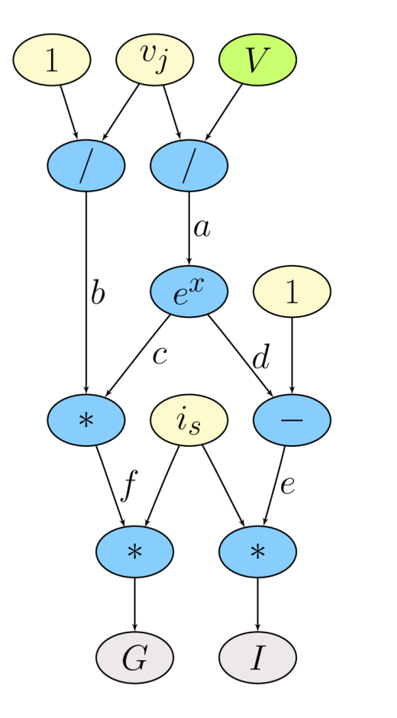
Model Evaluation: Trivial Hardware Implementation
*
*
÷
e
f
b
-
*
÷
d
c
a
e^{x}
Verilog-AMS as Domain-Specific Language

Slide 43
Spatial, Pipelined Parallelism
Every operation (*, + /) gets dedicated hardware.
Implement task in space → use additional area for each operator.
Parallel – all operations occur simultaneously.
*
*
÷
e
f
b
-
*
÷
d
c
a
e^{x}

Slide 44
Parallelism: Model Evaluation
Data Parallel
Every device independent
Many of each type of device
Can evaluate in parallel
  T=T_{seq}/N_{proc}
Build pipelined circuit for model
  T_{seq}=N_{comp}*T_{cycle}
  vs. T_{pipe}=T_{cycle}

Slide 45
Spatial Too Big?
Fully spatial circuit
Custom VLIW
*
÷
*
*
÷
b
e
f
-
*
÷
+
d
c
a
e^{x}
e^{x}
~100x Speedup
Multiple FPGAs
~10x Speedup
1 FPGA (2010)
VLIW=Very Long Instruction Word
exploits Instruction-Level Parallelism

Slide 46
VLIW
Very Long Instruction Word
Supports Instruction/Operator-Level Parallelism
Perform many primitive operations in parallel
  Can parameterize and customize set of operations
Using “long” instructions
Instruction
Memory
Address
X
X
+

Slide 47
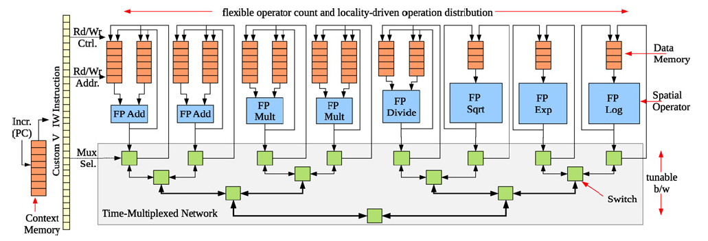
Parallelism: Model Evaluation
Spatial end up bottlenecked by other components
Use custom evaluation engines
…or GPUs

Slide 48
Parallelism: Matrix Solve
Needed direct solver?
E.g. Gaussian elimination
Data dependence on previous reduce
  Limited data parallelism
Parallelism in subtracts
Some row independence

Slide 49
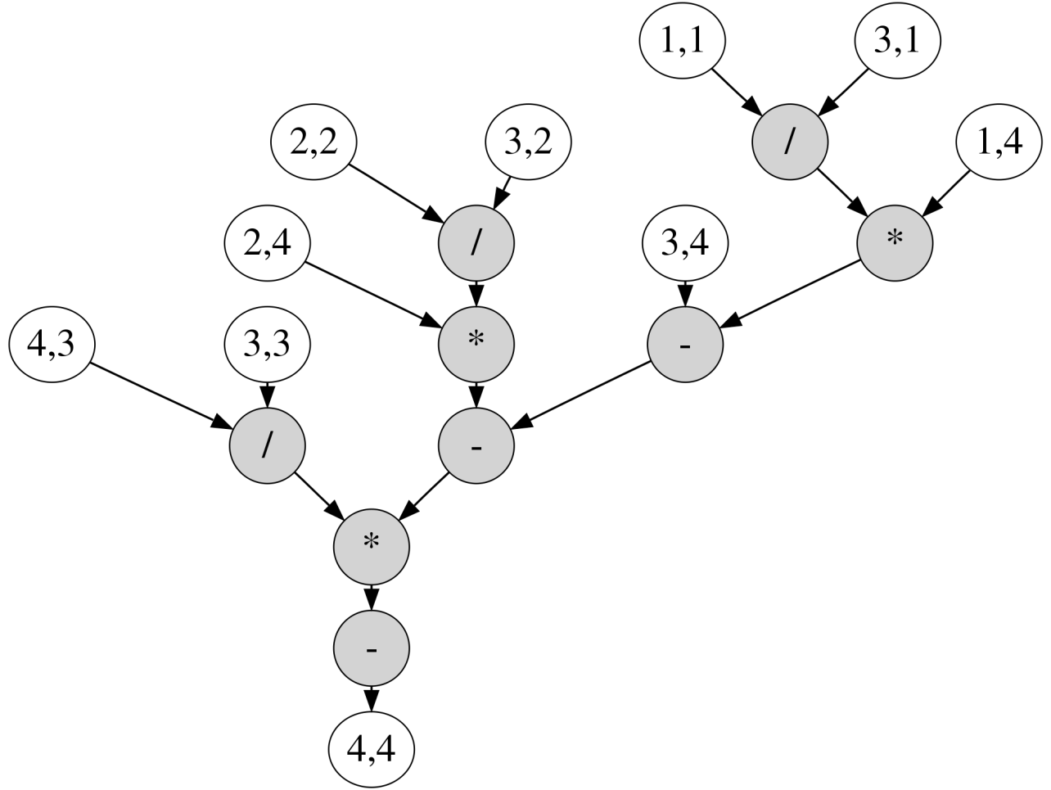
Example Matrix

Slide 50
Example Matrix

Slide 51
Example Matrix
Reduce to critical path:
from 9 sequential operations
to path of 5 operations.

Slide 52
Dataflow Processing Element (PE)
Graph
Nodes
Incoming Messages
Dataflow trigger
*
+
÷
Graph
Fanout
Outgoing Messages

Slide 53
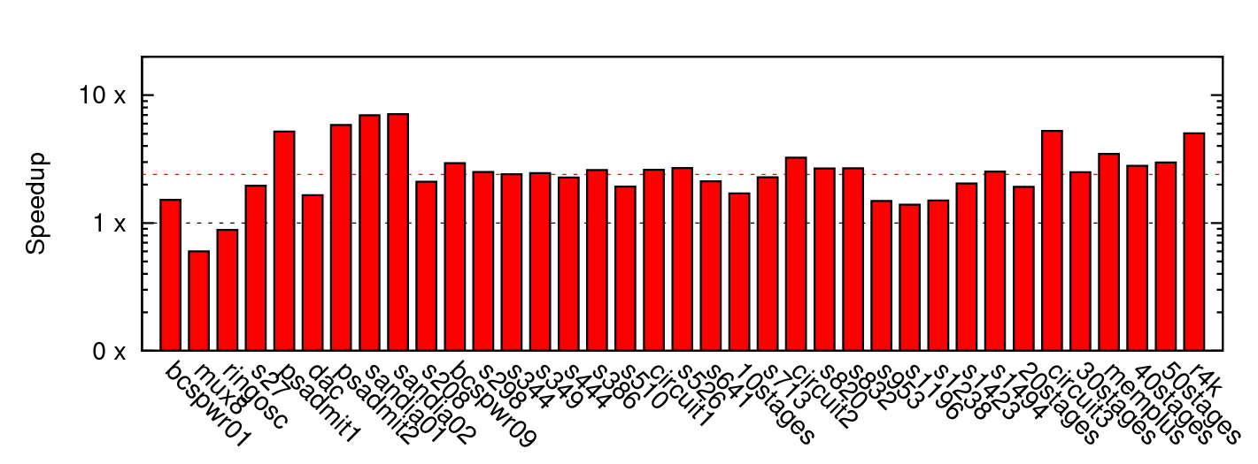
Matrix Solve Only
~2.4x mean

Slide 54
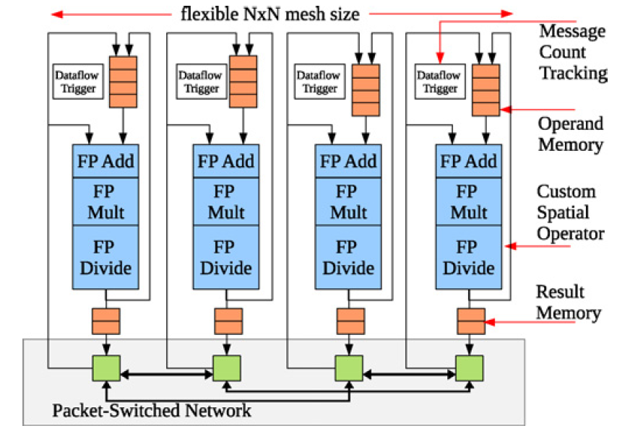
Parallelism: Matrix Solve
Settled on constructing dataflow graph
Graph can be iteration independent
  Statically scheduled
  (cheaper)
This is bottleneck to further acceleration

Slide 55
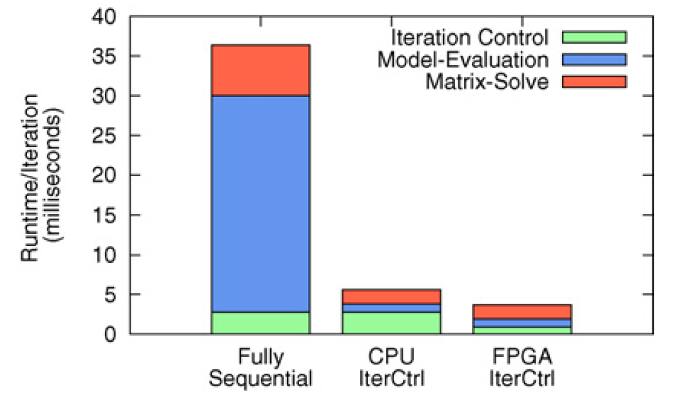
Parallelism Controller?
Could leave sequential
For some designs, becomes the bottleneck once others accelerated
Has internal parallelism in condition evaluation
  T=T_{modeleval}/S₁+(T_{matsolve})/S₂+T_{ctrl}

Slide 56
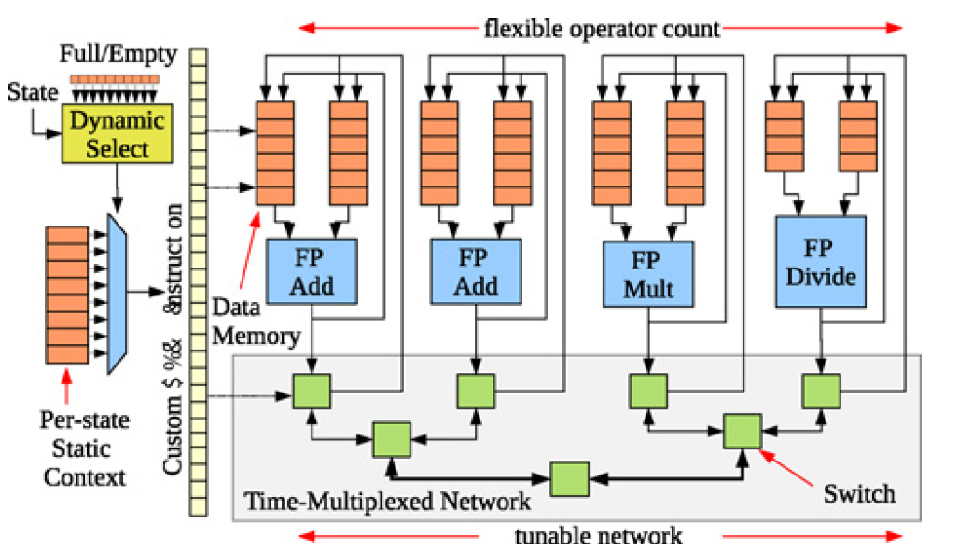
Parallelism Controller
Customized datapath controller
T_{seqctrl}=N_{add}+N_{mul}+10*N_{divide}
T_{vliwctrl}=Max(N_{add}/2,N_{mul},10*N_{divide})

Slide 57
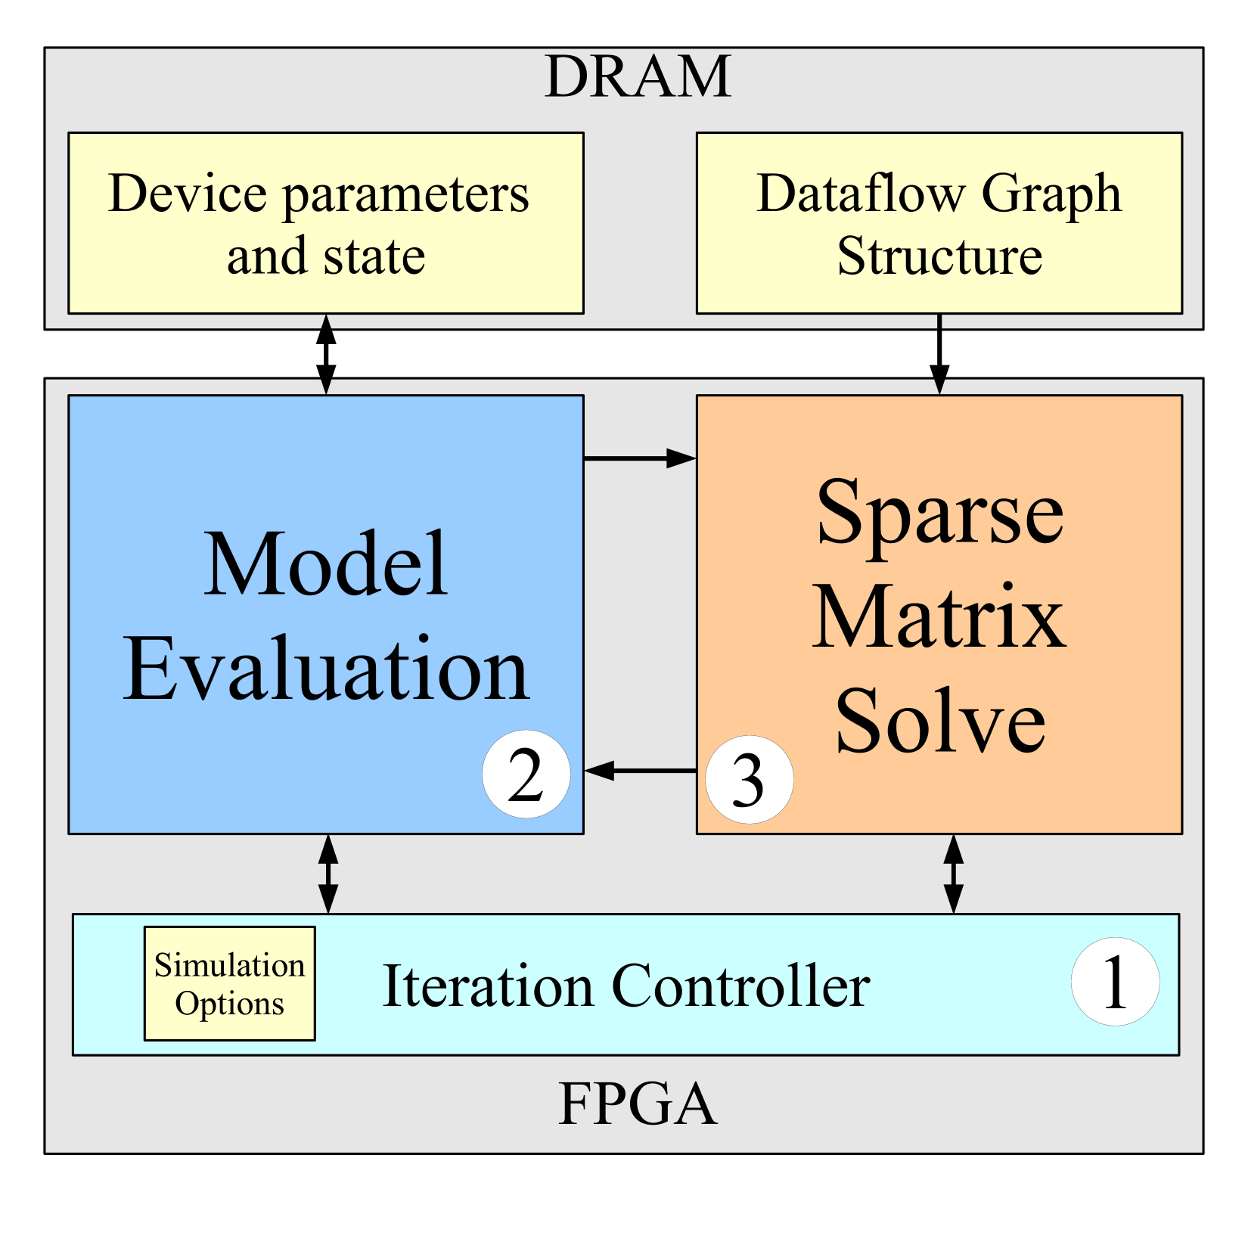
Single-Chip Solution

Slide 58
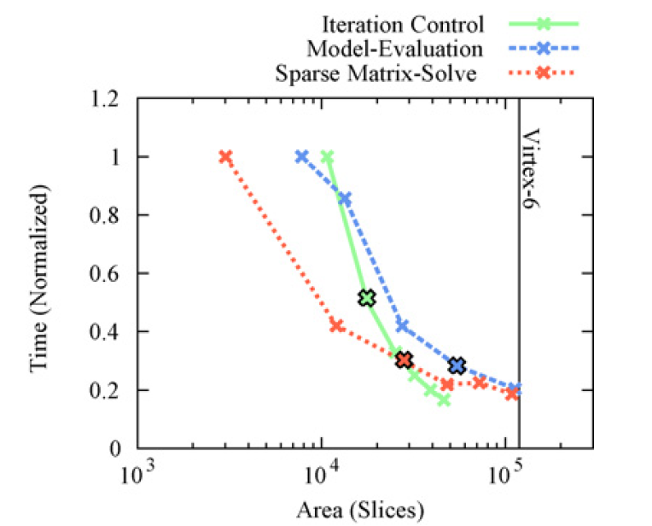
Area-Time for Each
[1 Slice = 4 LUTs]

Slide 59
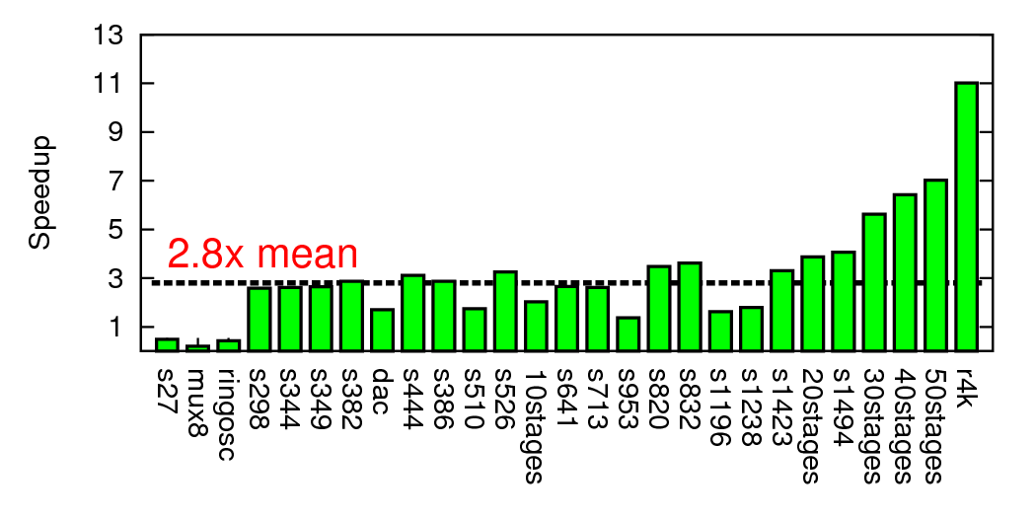
Composite Speedup

Slide 60
Modern SoC

Slide 61
Part 4:
Class Components

Slide 62

Class Components
Lecture (incl. preclass exercise)
  In-person (not hybrid, don’t expect recordings)
  Slides, preclass on web before class (print if you want)
  N.B. I encourage class participation
    In class; Questions (“warm” calls)
  Daily Quiz
Reading [~1 required paper/lecture]
  online: Canvas, IEEE, ACM, also ZynqBook,
  Parallel Programming for FPGAs
Homework (1 per week due 5pm)
Project – open-ended (~6 weeks)
  Oct. 23 – Dec. 9th (~ weekly milestones, details syllabus)
Note syllabus, course admin online

Slide 63
First Half
Quickly cover breadth
Metrics, bottlenecks
Memory
Parallel models
SIMD/Data Parallel
Thread-level parallelism
Spatial, C-to-gates
Line up with homeworks

Slide 64
Second Half
Memory
Verification
VLIW
Reduce
Energy
Chip Cost
Real-time
Reactive
Use everything on project
Going deeper

Slide 65
Teaming
HomeWorks (HW) in Groups of 2 (after 0, 1)
HW: we assign
Individual assignment writeup
Project in Groups of 3
Project: you propose team of 3, we review
  Most portions group writeup
  Maybe few components individual writeup

Slide 66
Office & Lab Hours
Andre: TBD
  Levine 270, Zoom
TAs – Ketterer (starting next week)
  Tuesday 8:30-9:30 pm
  Wednesday 4:00-5:00 pm (not today)
  Thursday 8:30pm-10:30pm (not tomorrow)

Slide 67
Diagnostic Assessment
Course will rely heavily on C
  Program both hardware and software in C
If you cannot read/write code in C,
this course will be a challenge
Diagnostic Assessment intended as a quick indication if you aren’t ready
  Should be able to complete quickly
  Better to find out now than after you’re stuck in the course
  Due next Wednesday (9/4)

Slide 68
C Review
Course will rely heavily on C
  Program both hardware and software in C
HW1 has some C warmup problems
TA will hold C review
  on Sept. 4th, TBD (probably office hours)
  (before our next class meeting since Monday 9/2 is Labor day)
  See Ed Discuss for details

Slide 69
Preclass Exercise
Motivate the topic of the day
  Introduce a problem
  Introduce a design space, tradeoff, transform
Available on syllabus before lecture
  May want to print a copy to bring to class
Should work before lecture starts
  Won’t be available later
Do bring/use calculator
  Will be numerical examples

Slide 70
Daily Quiz
Count for Engagement Points
Only available until next lecture
Incentive to keep up with material

Slide 71
Lecture Timeline
Work on preclass before lecture start
Start lecture at 10:20am
Lecture until 11:40am
(most days) stay for remaining questions
  Pending course after us
  Typically take questions in hall after clearing out for next course
  [not today → CMPE Meet-and-Greet]

Slide 72
Feedback
Will have anonymous feedback for each lecture
  Clarity?
  Speed?
  Vocabulary?
  General comments
    Specificity most helpful
      X was unclear because of Y
      Subtopic Z went too fast
      Need an example for Q

Slide 73
Policies
Canvas turn-in of assignments
No handwritten work
Due on time
  Individual assignments only
    3 free late days total
Collaboration
  Tools – allowed
  Designs – limited to project teams as specified on assignments
See web page

Slide 74
Admin
Your action:
  Feedback sheet for today
  Find course web page
    Read it, including the policies
    Find Syllabus
      Find diagnostic assessment, homework 1
      Find lecture slides
        Will try to post before lecture
      Find reading assignments
  Find reading for lecture 2 on canvas and web
    …for this lecture if you haven’t already
  Find/join Ed Discussion group for course
  Signup for detkin/ketterer access
  Complete/submit diagnostic assessment

Slide 75
Big Ideas
Programmable Platforms
  Key delivery vehicle for innovative computing applications
  Reduce TTM (Time-to-Market), risk
  More than a microprocessor
  Heterogeneous, parallel
Demand hardware-software codesign
  Soft view of hardware
  Resource-aware view of parallelism

Slide 76
Questions?

