Slide 1

ESE5320:
System-on-a-Chip Architecture
Day 17: Oct. 28, 2024
LZW, Associative Maps

Slide 2
Today
LZW Compression Algorithm (Part 1)
Associative Memory
  Custom (part 2)
  FPGA (Part 3, time permitting)

Slide 3
Message
Can adaptively compress data using recurring substrings
Rich design space for Maps

Slide 4
Idea
Use data already sent as the dictionary
  Give short names to things in dictionary
  Don’t need to pre-arrange dictionary
  Adapt to common phrases/idioms in a particular document

Slide 5
Encoding
Greedy simplification
  Encode by successively selecting the longest match between the head of the remaining string to send and the current window

Slide 6
Algorithm Concept
While data to send
  Find largest match in window of data sent
  If length too small (length=1)
    Send character
  Else
    Send <x,y> = <match-pos,length>
  Add data encoded into sent window

Slide 7
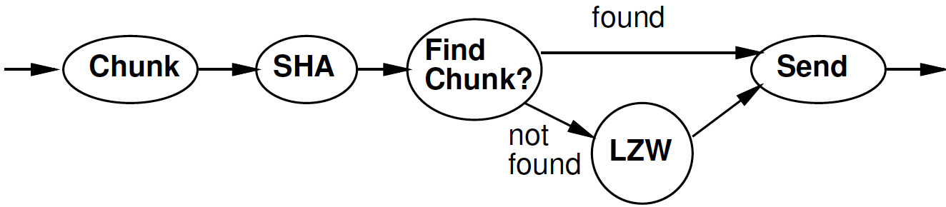
Part 1:
LZW Compression
Lempel-Ziv-Welch

Slide 8
Idea
Avoid O(Dictionary-size) work
  Only need to match against positions that start with the character(s) in string to encode
    Separate dictionary for each?
Only check position 0 for “starts with I”

Slide 9
Idea
Avoid O(Dictionary-size) work
  Only need to match against positions that start with the character(s) in string to encode
    Separate dictionary for each?
T-dictionary:
  Tap, The, Their, Then, There, Tuesday

Slide 10
Idea
Avoid O(Dictionary-size) work
  Only need to match against positions that start with the character(s) in string to encode
    Separate dictionary for each?
T-dictionary:
  Tap, The, Their, Then, There, Tuesday
If prefix same, why check redundantly?
  Generalize: Store things with common prefix together
    Share prefix among substrings
  Represent all strings as prefix tree

Slide 11
Idea
Avoid O(Dictionary-size) work
  Only need to match against positions that start with the character(s) in string to encode
    Separate dictionary for each?
If prefix same, why check redundantly?
  Store things with common prefix together
  Share prefix among substrings
  Represent all strings as prefix tree
Follow prefix trees with fixed work per input character

Slide 12
Tree Algorithm
Tree Root for each character
Follow tree according to input until no more match
Send <name of last tree node>
  Dictionary entry
    Named sequentially by insertion
Extend tree (dictionary) with new character
Start over with this character

Slide 13
I AM SAM SAM I AM
Input | Send | Dict | Add Entry | Add What
I | <nothing>

Slide 14
I AM SAM SAM I AM
Input | Send | Dict | Add Entry | Add What
I | <nothing>
 | ??? | I | ??? | ???

Slide 15
Note: the “Add What” arrows are shown
  the way we would backtrack to recover the string
  rather than the way trace forward for matching
  (may change for lecture)

Slide 16
I AM SAM SAM I AM
Input | Send | Dict | Add Entry | Add What
I | <nothing>
 | 73 | I | 256 | I<-spc
I
<spc>
256

Slide 17
I AM SAM SAM I AM
Input | Send | Dict | Add Entry | Add What
I | <nothing>
 | 73 | I | 256 | I<-spc
A | ??? | spc | ??? | ???
I
<spc>
256

Slide 18
I AM SAM SAM I AM
Input | Send | Dict | Add Entry | Add What
I | <nothing>
 | 73 | I | 256 | I<-spc
A | 32 | spc | 257 | spc<-A
I
<spc>
<spc>
A
256
257

Slide 19
I AM SAM SAM I AM
Input | Send | Dict | Add Entry | Add What
I | <nothing>
 | 73 | I | 256 | I<-spc
A | 32 | spc | 257 | spc<-A
M | ?? | A | ??? | ???
I
<spc>
<spc>
A
256
257

Slide 20
I AM SAM SAM I AM
Input | Send | Dict | Add Entry | Add What
I | <nothing>
 | 73 | I | 256 | I<-spc
A | 32 | spc | 257 | spc<-A
M | 65 | A | 258 | A<-M
I
<spc>
<spc>
A
256
257
A
M
258

Slide 21
I AM SAM SAM I AM
Input | Send | Dict | Add Entry | Add What
I | <nothing>
 | 73 | I | 256 | I<-spc
A | 32 | spc | 257 | spc<-A
M | 65 | A | 258 | A<-M
 | ??? | M | ??? | ???
I
A
<spc>
M
256
258
<spc>
A
257

Slide 22
I AM SAM SAM I AM
Input | Send | Dict | Add Entry | Add What
I | <nothing>
 | 73 | I | 256 | I<-spc
A | 32 | spc | 257 | spc<-A
M | 65 | A | 258 | A<-M
 | 77 | M | 259 | M<-spc
I
A
<spc>
M
256
258
<spc>
M
A
<spc>
257
259

Slide 23
I AM SAM SAM I AM
Input | Send | Dict | Add Entry | Add What
I | <nothing>
 | 73 | I | 256 | I<-spc
A | 32 | spc | 257 | spc<-A
M | 65 | A | 258 | A<-M
 | 77 | M | 259 | M<-spc
S | ??? | spc | ??? | ???
I
A
<spc>
M
256
258
<spc>
A
257
M
<spc>
260

Slide 24
I AM SAM SAM I AM
Input | Send | Dict | Add Entry | Add What
I | <nothing>
 | 73 | I | 256 | I<-spc
A | 32 | spc | 257 | spc<-A
M | 65 | A | 258 | A<-M
 | 77 | M | 259 | M<-spc
S | 32 | spc | 260 | spc<-S
I
A
<spc>
M
256
258
<spc>
A
S
257
260
M
<spc>
259

Slide 25
I AM SAM SAM I AM
Input | Send | Dict | Add Entry | Add What
I | <nothing>
 | 73 | I | 256 | I<-spc
A | 32 | spc | 257 | spc<-A
M | 65 | A | 258 | A<-M
 | 77 | M | 259 | M<-spc
S | 32 | spc | 260 | spc<-S
A | ??? | S | ??? | ???
I
A
<spc>
M
256
258
<spc>
A
S
257
260
M
<spc>
259

Slide 26
I AM SAM SAM I AM
Input | Send | Dict | Add Entry | Add What
I | <nothing>
 | 73 | I | 256 | I<-spc
A | 32 | spc | 257 | spc<-A
M | 65 | A | 258 | A<-M
 | 77 | M | 259 | M<-spc
S | 32 | spc | 260 | spc<-S
A | 83 | S | 261 | S<-A
I
A
<spc>
M
256
258
<spc>
A
S
257
260
S
M
A
<spc>
261
259

Slide 27
I AM SAM SAM I AM
Input | Send | Dict | Add Entry | Add What
I | <nothing>
 | 73 | I | 256 | I<-spc
A | 32 | spc | 257 | spc<-A
M | 65 | A | 258 | A<-M
 | 77 | M | 259 | M<-spc
S | 32 | spc | 260 | spc<-S
A | 83 | S | 261 | S<-A
M | ??? (different) | A | ??? | ???
I
A
<spc>
M
256
258
<spc>
A
S
257
260
S
M
A
<spc>
261
259

Slide 28
I AM SAM SAM I AM
Input | Send | Dict | Add Entry | Add What
I | <nothing>
 | 73 | I | 256 | I<-spc
A | 32 | spc | 257 | spc<-A
M | 65 | A | 258 | A<-M
 | 77 | M | 259 | M<-spc
S | 32 | spc | 260 | spc<-S
A | 83 | S | 261 | S<-A
M | <nothing> | A
I
A
<spc>
M
256
258
<spc>
A
S
257
260
S
M
A
<spc>
261
259

Slide 29
I AM SAM SAM I AM
Input | Send | Dict | Add Entry | Add What
I | <nothing>
 | 73 | I | 256 | I<-spc
A | 32 | spc | 257 | spc<-A
M | 65 | A | 258 | A<-M
 | 77 | M | 259 | M<-spc
S | 32 | spc | 260 | spc<-S
A | 83 | S | 261 | S<-A
M | <nothing> | A
 | ??? | AM (258) | ??? | ???
I
A
<spc>
M
256
258
<spc>
A
S
257
260
S
M
A
<spc>
261
259

Slide 30
I AM SAM SAM I AM
Input | Send | Dict | Add Entry | Add What
I | <nothing>
 | 73 | I | 256 | I<-spc
A | 32 | spc | 257 | spc<-A
M | 65 | A | 258 | A<-M
 | 77 | M | 259 | M<-spc
S | 32 | spc | 260 | spc<-S
A | 83 | S | 261 | S<-A
M | <nothing> | A
 | 258 | AM (258) | 262 | 258<-spc
I
A
<spc>
M
256
258
<spc>
A
S
257
260
S
M
A
<spc>
261
259

Slide 31
I AM SAM SAM I AM
Input | Send | Dict | Add Entry | Add What
I | <nothing>
 | 73 | I | 256 | I<-spc
A | 32 | spc | 257 | spc<-A
M | 65 | A | 258 | A<-M
 | 77 | M | 259 | M<-spc
S | 32 | spc | 260 | spc<-S
A | 83 | S | 261 | S<-A
M | <nothing> | A
 | 258 | AM (258) | 262 | 258<-spc
I
A
<spc>
M
256
258
<spc>
262
<spc>
A
S
257
260
S
M
A
<spc>
261
259

Slide 32
I AM SAM SAM I AM
Input | Send | Dict | Add Entry | Add What
I | <nothing>
 | 73 | I | 256 | I<-spc
A | 32 | spc | 257 | spc<-A
M | 65 | A | 258 | A<-M
 | 77 | M | 259 | M<-spc
S | 32 | spc | 260 | spc<-S
A | 83 | S | 261 | S<-A
M | <nothing> | A
 | 258 | AM | 262 | 258<-spc
S | ??? | spc | ??? | ???
I
A
<spc>
M
256
258
<spc>
262
<spc>
A
S
257
260
S
M
A
<spc>
261
259

Slide 33
I AM SAM SAM I AM
Input | Send | Dict | Add Entry | Add What
I | <nothing>
 | 73 | I | 256 | I<-spc
A | 32 | spc | 257 | spc<-A
M | 65 | A | 258 | A<-M
 | 77 | M | 259 | M<-spc
S | 32 | spc | 260 | spc<-S
A | 83 | S | 261 | S<-A
M | <nothing> | A
 | 258 | AM (258) | 262 | 258<-spc
S | <nothing> | spc
I
A
<spc>
M
256
258
<spc>
262
<spc>
A
S
257
260
S
M
A
<spc>
261
259

Slide 34
I AM SAM SAM I AM
Input | Send | Dict | Add Entry | Add What
I | <nothing>
 | 73 | I | 256 | I<-spc
A | 32 | spc | 257 | spc<-A
M | 65 | A | 258 | A<-M
 | 77 | M | 259 | M<-spc
S | 32 | spc | 260 | spc<-S
A | 83 | S | 261 | S<-A
M | <nothing> | A
 | 258 | AM | 262 | 258<-spc
S | <nothing> | spc
A | ??? | spc S (260) | ??? | ???
I
A
<spc>
M
256
258
<spc>
262
<spc>
A
S
257
260
S
M
A
<spc>
261
259

Slide 35
I AM SAM SAM I AM
I
A
<spc>
M
Input | Send | Dict | Add Entry | Add What
I | <nothing>
 | 73 | I | 256 | I<-spc
A | 32 | spc | 257 | spc<-A
M | 65 | A | 258 | A<-M
 | 77 | M | 259 | M<-spc
S | 32 | spc | 260 | spc<-S
A | 83 | S | 261 | S<-A
M | <nothing> | A
 | 258 | AM | 262 | 258<-spc
S | <nothing> | spc
A | 260 | spc S | 263 | 260<-A
256
258
<spc>
262
<spc>
A
S
257
260
A
263
S
M
A
<spc>
261
259

Slide 36
I AM SAM SAM I AM
I
A
<spc>
M
Input | Send | Dict | Add Entry | Add What
I | <nothing>
 | 73 | I | 256 | I<-spc
A | 32 | spc | 257 | spc<-A
M | 65 | A | 258 | A<-M
 | 77 | M | 259 | M<-spc
S | 32 | spc | 260 | spc<-S
A | 83 | S | 261 | S<-A
M | <nothing> | A
 | 258 | AM | 262 | 258<-spc
S | <nothing> | spc
A | 260 | spc S | 263 | 260<-A
M | ??? | A | ??? | ???
256
258
<spc>
262
<spc>
A
S
257
260
A
263
S
M
A
<spc>
261
259

Slide 37
I AM SAM SAM I AM
I
A
<spc>
M
Input | Send | Dict | Add Entry | Add What
I | <nothing>
 | 73 | I | 256 | I<-spc
A | 32 | spc | 257 | spc<-A
M | 65 | A | 258 | A<-M
 | 77 | M | 259 | M<-spc
S | 32 | spc | 260 | spc<-S
A | 83 | S | 261 | S<-A
M | <nothing> | A
 | 258 | AM (258) | 262 | 258<-spc
S | <nothing> | spc
A | 260 | spc S (260) | 263 | 260<-A
M | <nothing> | A
256
258
<spc>
262
<spc>
A
S
257
260
A
263
S
M
A
<spc>
261
259

Slide 38
I AM SAM SAM I AM
I
A
<spc>
M
Input | Send | Dict | Add Entry | Add What
I | <nothing>
 | 73 | I | 256 | I<-spc
A | 32 | spc | 257 | spc<-A
M | 65 | A | 258 | A<-M
 | 77 | M | 259 | M<-spc
S | 32 | spc | 260 | spc<-S
A | 83 | S | 261 | S<-A
M | <nothing> | A
 | 258 | AM (258) | 262 | 258<-spc
S | <nothing> | spc
A | 260 | spc S (260) | 263 | 260<-A
M | <nothing> | A
 | ??? | AM (258) | ??? | ???
256
258
<spc>
262
<spc>
A
S
257
260
A
263
S
M
A
<spc>
261
259

Slide 39
I AM SAM SAM I AM
I
A
<spc>
M
Input | Send | Dict | Add Entry | Add What
I | <nothing>
 | 73 | I | 256 | I<-spc
A | 32 | spc | 257 | spc<-A
M | 65 | A | 258 | A<-M
 | 77 | M | 259 | M<-spc
S | 32 | spc | 260 | spc<-S
A | 83 | S | 261 | S<-A
M | <nothing> | A
 | 258 | AM (258) | 262 | 258<-spc
S | <nothing> | spc
A | 260 | spc S (260) | 263 | 260<-A
M | <nothing> | A
 | <nothing> | AM (252)
256
258
<spc>
262
<spc>
A
S
257
260
A
263
S
M
A
<spc>
261
259

Slide 40
I AM SAM SAM I AM
I
A
<spc>
M
Input | Send | Dict | Add Entry | Add What
I | <nothing>
 | 73 | I | 256 | I<-spc
A | 32 | spc | 257 | spc<-A
M | 65 | A | 258 | A<-M
 | 77 | M | 259 | M<-spc
S | 32 | spc | 260 | spc<-S
A | 83 | S | 261 | S<-A
M | <nothing>
 | 258 | AM (258) | 262 | 258<-spc
S | <nothing>
A | 260 | spc S (260) | 263 | 260<-A
M | <nothing> | A
 | <nothing> | AM (258)
I | ??? | AM spc (262) | ??? | ???
256
258
<spc>
262
<spc>
A
S
257
260
A
263
S
M
A
<spc>
261
259

Slide 41
I AM SAM SAM I AM
I
A
<spc>
M
Input | Send | Dict | Add Entry | Add What
I | <nothing>
 | 73 | I | 256 | I<-spc
A | 32 | spc | 257 | spc<-A
M | 65 | A | 258 | A<-M
 | 77 | M | 259 | M<-spc
S | 32 | spc | 260 | spc<-S
A | 83 | S | 261 | S<-A
M | <nothing>
 | 258 | AM (258) | 262 | 258<-spc
S | <nothing>
A | 260 | spc S (260) | 263 | 260<-A
M | <nothing> | A
 | <nothing> | AM (258)
I | 262 | AM spc (262) | 264 | 262<-I
256
258
<spc>
262
<spc>
A
S
257
260
A
263
S
M
A
<spc>
261
259

Slide 42
I AM SAM SAM I AM
I
A
<spc>
M
Input | Send | Dict | Add Entry | Add What
I | <nothing>
 | 73 | I | 256 | I<-spc
A | 32 | spc | 257 | spc<-A
M | 65 | A | 258 | A<-M
 | 77 | M | 259 | M<-spc
S | 32 | spc | 260 | spc<-S
A | 83 | S | 261 | S<-A
M | <nothing>
 | 258 | AM (258) | 262 | 258<-spc
S | <nothing>
A | 260 | spc S (260) | 263 | 260<-A
M | <nothing> | A
 | <nothing> | AM (258)
I | 262 | AM spc (262) | 264 | 262<-I
256
258
<spc>
262
I
264
<spc>
A
S
257
260
A
263
S
M
A
<spc>
261
259

Slide 43
Large Memory Implementation
int encode[SIZE][256];
Name tree node by insertion order
c is a character
Encode[x][c] holds the next tree node that extends tree node x by symbol c
  Or NONE if there is no such tree node

Slide 44
Memory Tree Algorithm
curr=0; // pointer into input chunk
nextdict=NUM_SYMBOLS;
// dict[i]= symbol i for i<NUM_SYMBOLS
while (curr<chunk_size)
while(encode[x][input[curr]]!=NONE)
x=encode[x][input[curr]]; curr++;
send x
tree[nextdict].parent=x;
tree[nextdict].sym=input[curr];
encode[x][input[curr]]=nextdict++;
x=input[curr]; curr++;

Slide 45
Memory Tree Algorithm
curr=0; // pointer into input chunk
nextdict=NUM_SYMBOLS;
// dict[i]= symbol i for i<NUM_SYMBOLS
while (curr<chunk_size)
while(encode[x][input[curr]]!=NONE)
x=encode[x][input[curr]]; curr++;
send x
tree[nextdict].parent=x;
tree[nextdict].sym=input[curr];
encode[x][input[curr]]=nextdict++;
x=input[curr]; curr++;
Follow
Tree

Slide 46
Memory Tree Algorithm
curr=0; // pointer into input chunk
nextdict=NUM_SYMBOLS;
// dict[i]= symbol i for i<NUM_SYMBOLS
while (curr<chunk_size)
while(encode[x][input[curr]]!=NONE)
x=encode[x][input[curr]]; curr++;
send x
tree[nextdict].parent=x;
tree[nextdict].sym=input[curr];
encode[x][input[curr]]=nextdict++;
x=input[curr]; curr++;
A
M
258
<spc>
262
I
264

Slide 47
I AM SAM SAM I AM
I
A
<spc>
M
Input | Send | Dict | Add Entry | Add What
I | <nothing>
 | 73 | I | 256 | I<-spc
A | 32 | spc | 257 | spc<-A
M | 65 | A | 258 | A<-M
 | 77 | M | 259 | M<-spc
S | 32 | spc | 260 | spc<-S
A | 83 | S | 261 | S<-A
M | <nothing>
 | 258 | AM (258) | 262 | 258<-spc
S | <nothing>
A | 260 | spc S (260) | 263 | 260<-A
M | <nothing> | A
 | <nothing> | AM (258)
I | 262 | AM spc (262) | 264 | 262<-I
256
258
<spc>
262
I
264
<spc>
A
S
257
260
A
263
S
M
A
<spc>
261
259

Slide 48
Memory Tree Algorithm
curr=0; // pointer into input chunk
nextdict=NUM_SYMBOLS;
// dict[i]= symbol i for i<NUM_SYMBOLS
while (curr<chunk_size)
while(encode[x][input[curr]]!=NONE)
x=encode[x][input[curr]]; curr++;
send x
tree[nextdict].parent=x;
tree[nextdict].sym=input[curr];
encode[x][input[curr]]=nextdict++;
x=input[curr]; curr++;
How much work per
character
to encode?
Hint: between curr++
executions?

Slide 49
Map
Later today or Wednesday will talk about higher-level maps
Version of encode/decode in
  Geeks-for-Geeks description
  Decoder we provide
Based on Maps of strings
  Simpler to state
  Likely not O(1) per symbol
  More expensive implementation in hardware
    Version here better for hardware (keeps simple)

Slide 50
Algorithm with Map
curr=0; // pointer into input chunk
nextdict=NUM_SYMBOLS;
// dict initialized symbol i for i<NUM_SYMBOLS
while (curr<chunk_size)
while(dict.lookup(x+input[curr])!=NONE)
x=x+input[curr]; curr++;
send dic.lookup(x);
dict.insert(x+input[curr],nextdict++);
x=String(input[curr]); curr++;

Slide 51
I AM SAM SAM I AM
I
A
<spc>
M
Input | Send | Dict | Add Entry | Add What
I | <nothing>
 | 73 | I | 256 | I<-spc
A | 32 | spc | 257 | spc<-A
M | 65 | A | 258 | A<-M
 | 77 | M | 259 | M<-spc
S | 32 | spc | 260 | spc<-S
A | 83 | S | 261 | S<-A
M | <nothing>
 | 258 | AM (258) | 262 | 258<-spc
S | <nothing>
A | 260 | spc S (260) | 263 | 260<-A
M | <nothing> | A
 | <nothing> | AM (258)
I | 262 | AM spc (262) | 264 | 262<-I
256
258
<spc>
262
I
264
<spc>
A
S
257
260
A
263
S
M
A
<spc>
261
259

Slide 52
Compact Memory
int encode[SIZE][256];
How many entries in this table are not NONE?
  Maximum number of times execute:
  encode[x][input[curr]]=nextdict++;
  Maximum number of entries added to encode?
  Maximum number of NONE entries in encode?

Slide 53
Compact Memory
int encode[SIZE][256];
Table is very sparse
If store as associative memory
  At most SIZE entries
    (SIZE+256 with first 256 entries for each byte value)
Look at how to implement associative memories next

Slide 54
LZW So Far – 4KB chunks
Brute Force
  Needs one byte per byte = 4KB = 1 BRAM
  DICT_SIZE=4096 comparisons per byte
Dense memory encode[SIZE][256]
  12b node id (1.5B)
  Need 1.5*4096*256= 384*4KB
  = 384 BRAMs
  1 comparison and lookup per byte
  (maybe should be SIZE+256)

Slide 55
4K Chunk LZW Search
 | BRAMs | Operations/byte
Brute Search | 1 | 4K
Tree with Dense RAM | 384 | 1
36Kb BRAMs on ZU3EG = 216

Slide 56
Complexity
Reminder from Day 15
  Optimized implementations tend to be more complex
  Large problems may force more complexity
    (e.g. Large window, deal with limited BRAMs on chip)
  Seeing examples of that today…

Slide 57
Associative Memories
Part 3

Slide 58
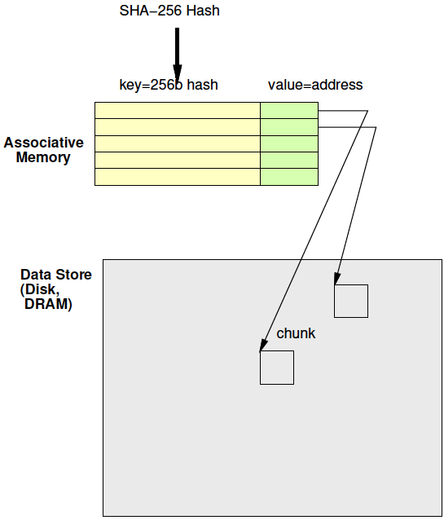
Associative Memory
Day 16 Review
Maps from a key to a value
Key not necessarily dense
  Contrast simple RAM
  Cannot afford 2²⁵⁶ word memory

Slide 59
Associative Memories
Use for deduplication
Also may use in LZW to reduce BRAMs
  Just saw
    Problem: Simple 2D tree table requires too many BRAMs
    Opportunity: Tree table sparse

Slide 60
Custom Hardware
Associative Memory

Slide 61
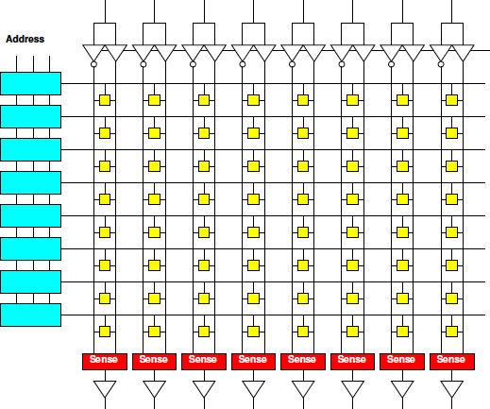
Memory Block Review
Match on address
Select wordline for a row
Reads out a word
Address dense
and hardwired
One row for
each 2^{Abits}
values
width
depth

Slide 62
Address Blocks
Each address match is AND
width
/A2&/A1&/A0
/A2&/A1&A0
depth

Slide 63
Address Blocks

Slide 64
Memory Block Associative
Want address as key
Word is value
Key sparse
Rows<2^{keybits}
Entries<2^{keybits}
Key
programmable
width
depth

Slide 65
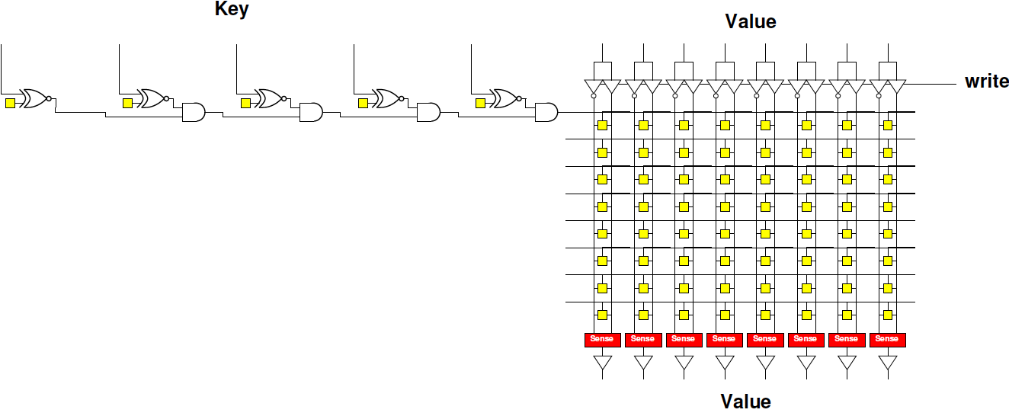
Programmable Key
Make row select programmable

Slide 66
Contrast
Assoc. and Dense Memory

Slide 67
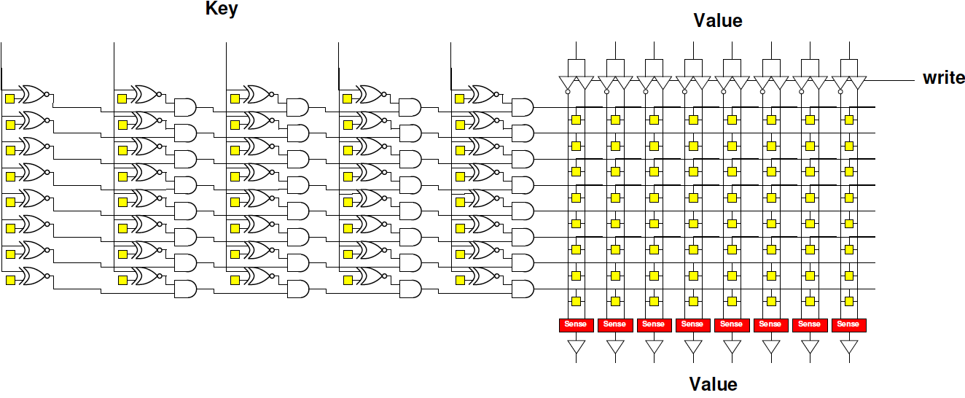
Associative Memory Bank

Slide 68
Programmable Key
Assoc: 5b key, 8 entries, 8b value
How many memory bits?
Direct: 8 entries, 8b value
How many memory bits?

Slide 69
Associative Memory Bank
Memory cells = entries*(keybits+valuebits)

Slide 70
Associative Memory Bank
Will need to be able to write into key
  Another “fixed” decoder to generate
  key-word line for programming

Slide 71
Associate Memory Cost
More expensive than equal capacity SRAM memory bank
  Memory cells in decoder
  Need to support write into key

Slide 72
Associate Memory Cost
Physical associative memory for 4KB LZW Chunk tree encode
  4K entries
  12b (pos) output
  12b (pos)+8b (char)=20b key
Memory cells assoc.?
Compare direct 4Kx12 memory (cells)?
  How much larger is assoc. for same capacity?
Compare 4096*256 with 12b result for dense LZW case (cells)?
  How much larger to solve same problem

Slide 73
Associative Memories
FPGA
Part 4
(probably for Day 18)
Skip wrapup

Slide 74
FPGA
Has BRAMs – normal memories, not associative
36Kb BRAM
  512x72
Can be 9b key → 72b value assoc.
  Just using the memory sparsely
Or interpret as programmable decoder with 72 match lines

Slide 75
Assoc. Mem from BRAM
For wider match
Cover 9b of key with each BRAM
Use 72 output bits to indicate if one of 72 entries match
AND together corresponding entries
Get 72 match bits
Re-encode match
bits to lookup value

Slide 76
BRAM Associative Memory
Previous slide expands match width
How would we expand capacity?
  Hint: how get a wider word (144b word)?

Slide 77
BRAM Associative Memory

Slide 78
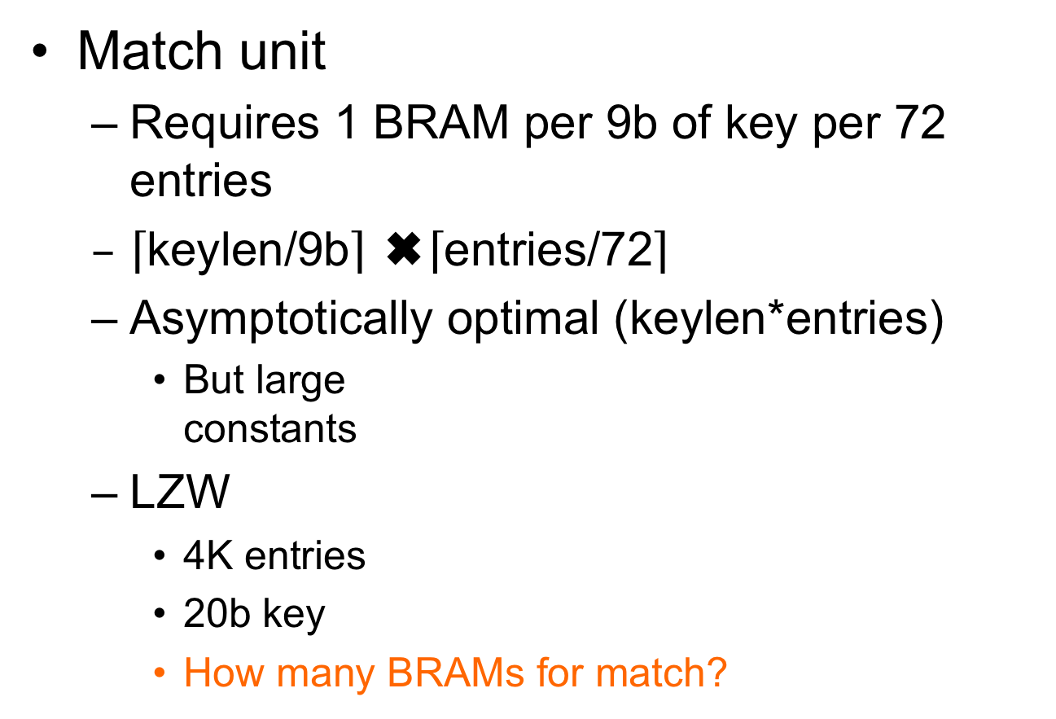
Associative Memory Cost
Match unit
  Requires 1 BRAM per 9b of key per 72 entries
  $\left\lceil \text{keylen}\text{/9}\text{b}\right\rceil$ ✖️$\left\lceil \text{entries}\text{/72}\right\rceil$
  Asymptotically optimal (keylen*entries)
    But large
    constants
  LZW
    4K entries
    20b key
    How many BRAMs for match?

Slide 79
4K LZW Chunk Search:
Fully associative
Match BRAMs:
  Match key: 20b
  Entries: 4096
Value BRAMS:
  12b (state [position])
  12b x 4096 entries
  Takes 2 BRAMs

Slide 80
Example Stored Values
Key[17:9] | Key[8:0] | Value
0x001 | 0x014 | 0x01
0x001 | 0x01 | 0x34
0x0F0 | 0x014 | 0xE3
0x0C8 | 0x113 | 0xCC

Slide 81
Memory Contents
Key[17:9] Match BRAM
Value BRAM
Addr | 7 | 6 | 5 | 4 | 3 | 2 | 1 | 0
0x001 | 0 | 0 | 0 | 0 | 0 | 0 | 1 | 1
0x014 | 0 | 0 | 0 | 0 | 0 | 0 | 0 | 0
0x0C8 | 0 | 0 | 0 | 0 | 1 | 0 | 0 | 0
0x0F0 | 0 | 0 | 0 | 0 | 0 | 1 | 0 | 0
0x113 | 0 | 0 | 0 | 0 | 0 | 0 | 0 | 0
Addr | Value
0x00 | 0x01
0x01 | 0x34
0x02 | 0xE3
0x03 | 0xCC
0x04
0x05
0x06
Key[8:0] Match BRAM
Addr | 7 | 6 | 5 | 4 | 3 | 2 | 1 | 0
0x001 | 0 | 0 | 0 | 0 | 0 | 0 | 1 | 0
0x014 | 0 | 0 | 0 | 0 | 0 | 1 | 0 | 1
0x0C8 | 0 | 0 | 0 | 0 | 0 | 0 | 0 | 0
0x0F0 | 0 | 0 | 0 | 0 | 0 | 0 | 0 | 0
0x113 | 0 | 0 | 0 | 0 | 1 | 0 | 0 | 0
(only show bottom 8 b; rest 0’s)

Slide 82
Code Snippet
ap_uint<72> key_low[512];
ap_uint<72> key_high[512];
int value[72];
match_low=key_low[key%512];
match_high=key_high[(key>>9)%512];
match=match_low & match_high;
addr=binary_encode(match);
res=value[addr];

Slide 83
How Lookup Work?
Key[17:9] | Key[8:0] | Value
0x001 | 0x014 | 0x01
0x001 | 0x01 | 0x34
0x0F0 | 0x014 | 0xE3
0x0C8 | 0x113 | 0xCC
Lookup 0x214 = 0x001 0x014

Slide 84
Code Snippet
ap_uint<72> key_low[512];
ap_uint<712> key_high[512];
int value[72];
match_low=key_low[key%512];
match_high=key_high[(key>>9)%512];
match=match_low & match_high;
addr=binary_encode(match);
res=value[addr];

Slide 85
Memory Contents
Key[17:9] Match BRAM
Addr | 7 | 6 | 5 | 4 | 3 | 2 | 1 | 0
0x001 | 0 | 0 | 0 | 0 | 0 | 0 | 1 | 1
0x014 | 0 | 0 | 0 | 0 | 0 | 0 | 0 | 0
0x0C8 | 0 | 0 | 0 | 0 | 1 | 0 | 0 | 0
0x0F0 | 0 | 0 | 0 | 0 | 0 | 1 | 0 | 0
0x113 | 0 | 0 | 0 | 0 | 0 | 0 | 0 | 0
match_low=key_low[key%512];
match_high=key_high[(key>>9)%512];
Key[8:0] Match BRAM
What match_low, match_high?
Addr | 7 | 6 | 5 | 4 | 3 | 2 | 1 | 0
0x001 | 0 | 0 | 0 | 0 | 0 | 0 | 1 | 0
0x014 | 0 | 0 | 0 | 0 | 0 | 1 | 0 | 1
0x0C8 | 0 | 0 | 0 | 0 | 0 | 0 | 0 | 0
0x0F0 | 0 | 0 | 0 | 0 | 0 | 0 | 0 | 0
0x113 | 0 | 0 | 0 | 0 | 1 | 0 | 0 | 0
(only show bottom 8 b; rest 0’s)

Slide 86
Memory Contents
Key[17:9] Match BRAM
Addr | 7 | 6 | 5 | 4 | 3 | 2 | 1 | 0
0x001 | 0 | 0 | 0 | 0 | 0 | 0 | 1 | 1
0x014 | 0 | 0 | 0 | 0 | 0 | 0 | 0 | 0
0x0C8 | 0 | 0 | 0 | 0 | 1 | 0 | 0 | 0
0x0F0 | 0 | 0 | 0 | 0 | 0 | 1 | 0 | 0
0x113 | 0 | 0 | 0 | 0 | 0 | 0 | 0 | 0
match_low=key_low[key%512];
match_high=key_high[(key>>9)%512];
match=match_low & match_high;
What match?
Key[8:0] Match BRAM
Addr | 7 | 6 | 5 | 4 | 3 | 2 | 1 | 0
0x001 | 0 | 0 | 0 | 0 | 0 | 0 | 1 | 0
0x014 | 0 | 0 | 0 | 0 | 0 | 1 | 0 | 1
0x0C8 | 0 | 0 | 0 | 0 | 0 | 0 | 0 | 0
0x0F0 | 0 | 0 | 0 | 0 | 0 | 0 | 0 | 0
0x113 | 0 | 0 | 0 | 0 | 1 | 0 | 0 | 0
(only show bottom 8 b; rest 0’s)

Slide 87
What does binary_encode do?
binary_encode(0000000…010000)=0x40
10000…0 → 71
0000…01 → 0
0000…010 → 1
for (i=0<i<72;i++)
  If (bit[i]==1) return i
Return(MISS); // if not find (i.e., all 0’s)
Technicalities – maybe check only one 1

Slide 88
Memory Contents
Key[17:9] Match BRAM
Addr | 7 | 6 | 5 | 4 | 3 | 2 | 1 | 0
0x001 | 0 | 0 | 0 | 0 | 0 | 0 | 1 | 1
0x014 | 0 | 0 | 0 | 0 | 0 | 0 | 0 | 0
0x0C8 | 0 | 0 | 0 | 0 | 1 | 0 | 0 | 0
0x0F0 | 0 | 0 | 0 | 0 | 0 | 1 | 0 | 0
0x113 | 0 | 0 | 0 | 0 | 0 | 0 | 0 | 0
match_low=key_low[key%512];
match_high=key_high[(key>>9)%512];
match=match_low & match_high;
addr=binary_encode(match);
Key[8:0] Match BRAM
What addr?
Addr | 7 | 6 | 5 | 4 | 3 | 2 | 1 | 0
0x001 | 0 | 0 | 0 | 0 | 0 | 0 | 1 | 0
0x014 | 0 | 0 | 0 | 0 | 0 | 1 | 0 | 1
0x0C8 | 0 | 0 | 0 | 0 | 0 | 0 | 0 | 0
0x0F0 | 0 | 0 | 0 | 0 | 0 | 0 | 0 | 0
0x113 | 0 | 0 | 0 | 0 | 1 | 0 | 0 | 0
(only show bottom 8 b; rest 0’s)

Slide 89
Memory Contents
Key[17:9] Match BRAM
Value BRAM
Addr | 7 | 6 | 5 | 4 | 3 | 2 | 1 | 0
0x001 | 0 | 0 | 0 | 0 | 0 | 0 | 1 | 1
0x014 | 0 | 0 | 0 | 0 | 0 | 0 | 0 | 0
0x0C8 | 0 | 0 | 0 | 0 | 1 | 0 | 0 | 0
0x0F0 | 0 | 0 | 0 | 0 | 0 | 1 | 0 | 0
0x113 | 0 | 0 | 0 | 0 | 0 | 0 | 0 | 0
Addr | Value
0x00 | 0x01
0x01 | 0x34
0x02 | 0xE3
0x03 | 0xCC
0x04
0x05
0x06
Key[8:0] Match BRAM
Addr | 7 | 6 | 5 | 4 | 3 | 2 | 1 | 0
0x001 | 0 | 0 | 0 | 0 | 0 | 0 | 1 | 0
0x014 | 0 | 0 | 0 | 0 | 0 | 1 | 0 | 1
0x0C8 | 0 | 0 | 0 | 0 | 0 | 0 | 0 | 0
0x0F0 | 0 | 0 | 0 | 0 | 0 | 0 | 0 | 0
0x113 | 0 | 0 | 0 | 0 | 1 | 0 | 0 | 0
res=value[addr];
What res?
(only show bottom 8 b; rest 0’s)

Slide 90
How Lookup Work?
Key[17:9] | Key[8:0] | Value
0x001 | 0x014 | 0x01
0x001 | 0x01 | 0x34
0x0F0 | 0x014 | 0xE3
0x0C8 | 0x113 | 0xCC
Lookup 0x214 = 0x001 0x014

Slide 91
Memory Contents
Key[17:9] Match BRAM
Value BRAM
Addr | 7 | 6 | 5 | 4 | 3 | 2 | 1 | 0
0x001 | 0 | 0 | 0 | 0 | 0 | 0 | 1 | 1
0x014 | 0 | 0 | 0 | 0 | 0 | 0 | 0 | 0
0x0C8 | 0 | 0 | 0 | 0 | 1 | 0 | 0 | 0
0x0F0 | 0 | 0 | 0 | 0 | 0 | 1 | 0 | 0
0x113 | 0 | 0 | 0 | 0 | 0 | 0 | 0 | 0
Addr | Value
0x00 | 0x01
0x01 | 0x34
0x02 | 0xE3
0x03 | 0xCC
0x04
0x05
0x06
Key[8:0] Match BRAM
Addr | 7 | 6 | 5 | 4 | 3 | 2 | 1 | 0
0x001 | 0 | 0 | 0 | 0 | 0 | 0 | 1 | 0
0x014 | 0 | 0 | 0 | 0 | 0 | 1 | 0 | 1
0x0C8 | 0 | 0 | 0 | 0 | 0 | 0 | 0 | 0
0x0F0 | 0 | 0 | 0 | 0 | 0 | 0 | 0 | 0
0x113 | 0 | 0 | 0 | 0 | 1 | 0 | 0 | 0
(only show bottom 8 b; rest 0’s)

Slide 92
Add another entry
match | Key[17:9] | Key[8:0] | Value
0 | 0x001 | 0x014 | 0x01
1 | 0x001 | 0x01 | 0x34
2 | 0x0F0 | 0x014 | 0xE3
3 | 0x0C8 | 0x113 | 0xCC
4 | 0x0C8 | 0x01 | 0x2B
How BRAM contents
change to add this entry
for 0x19001

Slide 93
Memory Contents
Key[17:9] Match BRAM
Value BRAM
Addr | 7 | 6 | 5 | 4 | 3 | 2 | 1 | 0
0x001 | 0 | 0 | 0 | 0 | 0 | 0 | 1 | 1
0x014 | 0 | 0 | 0 | 0 | 0 | 0 | 0 | 0
0x0C8 | 0 | 0 | 0 | 0 | 1 | 0 | 0 | 0
0x0F0 | 0 | 0 | 0 | 0 | 0 | 1 | 0 | 0
0x113 | 0 | 0 | 0 | 0 | 0 | 0 | 0 | 0
Addr | Value
0x00 | 0x01
0x01 | 0x34
0x02 | 0xE3
0x03 | 0xCC
0x04
0x05
0x06
Key[8:0] Match BRAM
Addr | 7 | 6 | 5 | 4 | 3 | 2 | 1 | 0
0x001 | 0 | 0 | 0 | 0 | 0 | 0 | 1 | 0
0x014 | 0 | 0 | 0 | 0 | 0 | 1 | 0 | 1
0x0C8 | 0 | 0 | 0 | 0 | 0 | 0 | 0 | 0
0x0F0 | 0 | 0 | 0 | 0 | 0 | 0 | 0 | 0
0x113 | 0 | 0 | 0 | 0 | 1 | 0 | 0 | 0
(only show bottom 8 b; rest 0’s)

Slide 94
Memory Contents
Key[17:9] Match BRAM
Value BRAM
Addr | 7 | 6 | 5 | 4 | 3 | 2 | 1 | 0
0x001 | 0 | 0 | 0 | 0 | 0 | 0 | 1 | 1
0x014 | 0 | 0 | 0 | 0 | 0 | 0 | 0 | 0
0x0C8 | 0 | 0 | 0 | 1 | 1 | 0 | 0 | 0
0x0F0 | 0 | 0 | 0 | 0 | 0 | 1 | 0 | 0
0x113 | 0 | 0 | 0 | 0 | 0 | 0 | 0 | 0
Addr | Value
0x00 | 0x01
0x01 | 0x34
0x02 | 0xE3
0x03 | 0xCC
0x04 | 0x2B
0x05
0x06
Key[8:0] Match BRAM
Addr | 7 | 6 | 5 | 4 | 3 | 2 | 1 | 0
0x001 | 0 | 0 | 0 | 1 | 0 | 0 | 1 | 0
0x014 | 0 | 0 | 0 | 0 | 0 | 1 | 0 | 1
0x0C8 | 0 | 0 | 0 | 0 | 0 | 0 | 0 | 0
0x0F0 | 0 | 0 | 0 | 0 | 0 | 0 | 0 | 0
0x113 | 0 | 0 | 0 | 0 | 1 | 0 | 0 | 0
(only show bottom 8 b; rest 0’s)

Slide 95
4K Chunk LZW Search
 | BRAMs | Operations/byte
Brute Search | 1 | 4K
Tree with Dense RAM | 384 | 1
Tree with Full Assoc | 173 | 1
36Kb BRAMs on ZU3EG = 216

Slide 96
Checkpoint
Notice levels of mapping:
  Prefix Tree algorithm
  Formulated on a 2D memory
  Then implemented in assoc. memory
    (later with Tree … hash table)

Slide 97
Big Ideas
Can adaptively compress data using recurring substrings
  With constant work for symbol
Rich design space for engineering associative map solutions

Slide 98
Admin
Feedback (including HW7)
Reading for Wednesday on Web
First project milestone due Friday
  Including teaming

