Slide 1

ESE5320:
System-on-a-Chip Architecture
Day 19: November 4, 2024
Design-Space Exploration

Slide 2
Today
Design-Space Exploration
  Generic (Part 1)
  Concrete example: (Part 2)
    Fast Fourier Transform (FFT)

Slide 3
Message
The universe of possible implementations (design space) is large
  Many dimensions to explore
Formulate carefully
Approach systematically
Use modeling along the way for guidance

Slide 4
Design-Space Exploration
Generic

Slide 5
Design Space
Have many choices for implementation
  Alternatives to try
  Parameters to tune
  Mapping options
This is our freedom to impact implementation costs
  Area, delay, energy

Slide 6
Design Space
Ideally
  Each choice orthogonal axis
  in high-dimensional space
  Want to understand points in space
  Find one that bests meets constraints and goals
Practice
  Seldom completely orthogonal
  Requires cleverness to identify dimensions
  Messy, cannot fully explore
  But…can understand, prioritize, guide

Slide 7
Preclass 1
What choices (design-space axes) can we explore in mapping a task to an SoC?
What showed up in homework so far?

Slide 8
From Homework?
Types of parallelism
Mapping to different fabrics / hardware
How manage memory, move data
  DMA, streaming
  Data access patterns
Levels of parallelism
Pipelining, unrolling, II, array partitioning
Data size (precision)

Slide 9
Design-Space Choices
Type of parallelism
How decompose / organize parallelism
Area-time points (level exploited)
What resources we provision for what parts of computation
Where to map tasks
How schedule/order computations
How synchronize tasks
How represent data
Where place data; how manage and move
What precision use in computations

Slide 10
Generalize Continuum
Encourage to think about parameters (axes) that capture continuum to explore
Start from an idea
  Maybe can compute with 8b values
  Maybe can put matrix-mpy computation on FPGA fabric
  Move data in 1KB chunks
Identify general knob
  Tune intermediate bits for computation
  How much of computation go on FPGA fabric
  What is optimal data transfer size?

Slide 11
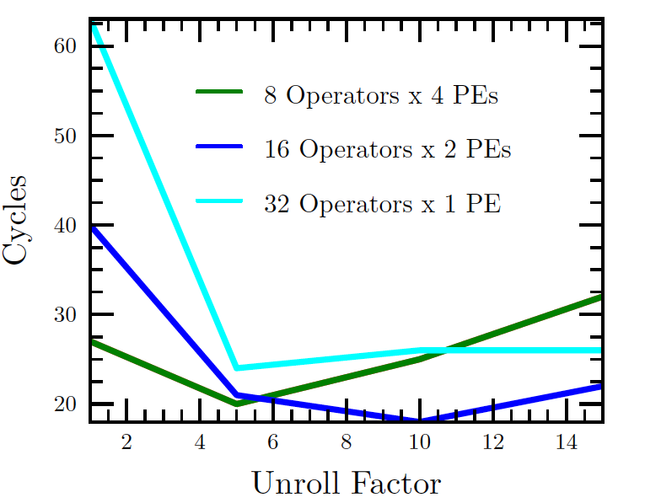
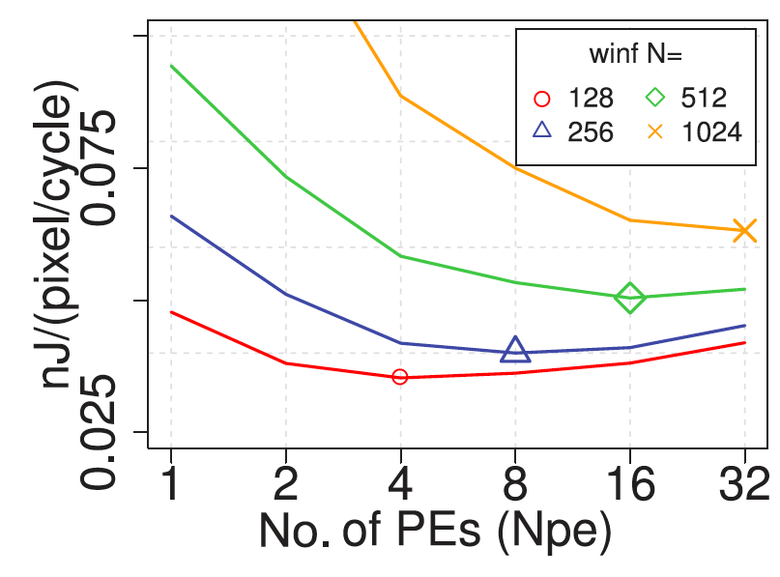
Finding Optima
Kapre, FPL 2009
Kadric, TRETS 2016
PE = Processing Element

Slide 12
Design Space Explore
Think systematically about how might map the application
Avoid overlooking options
Understand tradeoffs
The larger the design space
  more opportunities to find good solutions
    Reduce bottlenecks

Slide 13
Elaborate Design Space
Refine design space as you go
Ideally identify up front
Practice bottlenecks and challenges
  will suggest new options / dimensions
    If not initially expect memory bandwidth to be a bottleneck…
Some options only make sense in particular sub-spaces
  Bitwidth optimization not a big issue on the 64b processor
    More interesting on vector, FPGA

Slide 14
Tools
Sometimes tools will directly help you explore design space
  Unrolling, pipelining, II
  Array packing and partitioning
  Some choices for data movement
  DMA pipelining and transfer sizes
  Some loop transforms
  Granularity to place on FPGA

Slide 15
Tools
Often tools will not help you with design space options
  Need to reshape functions and loops
  Line buffers
  Data representations and sizes
  C-slow sharing
  Communications overlap
  Picking hash function parameters

Slide 16
Code for Exploration
Can you write your code with parameters (#define) that can easily change to explore continuum?
  Unroll factor?
  Number of parallel tasks?
  Size of data to move?
Want to make it easy to explore different points in space

Slide 17
Part 2:
Design-Space Exploration
Example FFT

Slide 18
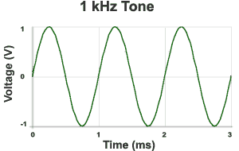


Sound Waves
Hz = 1/s
1kHz = 1000 cycles/s
Source: http://www.mediacollege.com/audio/01/sound-waves.html

Slide 19
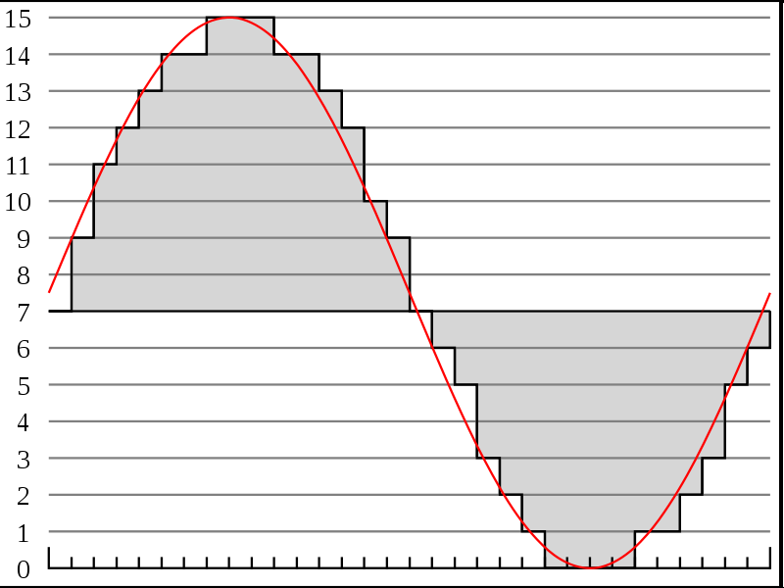
Discrete Sampling
Represent as time sequence
Discretely sample in time
What we can do directly with an Analog-to-Digital (A2D) converter
http://en.wikipedia.org/wiki/File:Pcm.svg
http://en.wikipedia.org/wiki/File:Pcm.svg

Slide 20
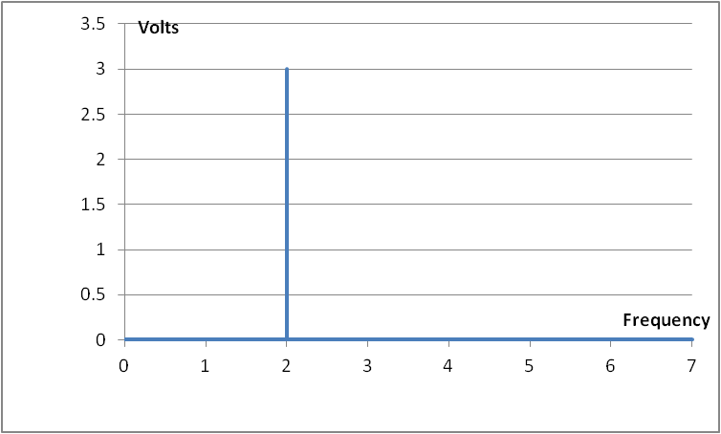


Time-Domain & Frequency-domain
example…have a pure tone
  If period: T = $1/2$ and Amplitude = 3 Volts
  $s\left(t\right)=A sin\left(2πft\right)=$
$$A sin\left(2π2t\right)$$
Time domain representation
Frequency domain representation

Slide 21

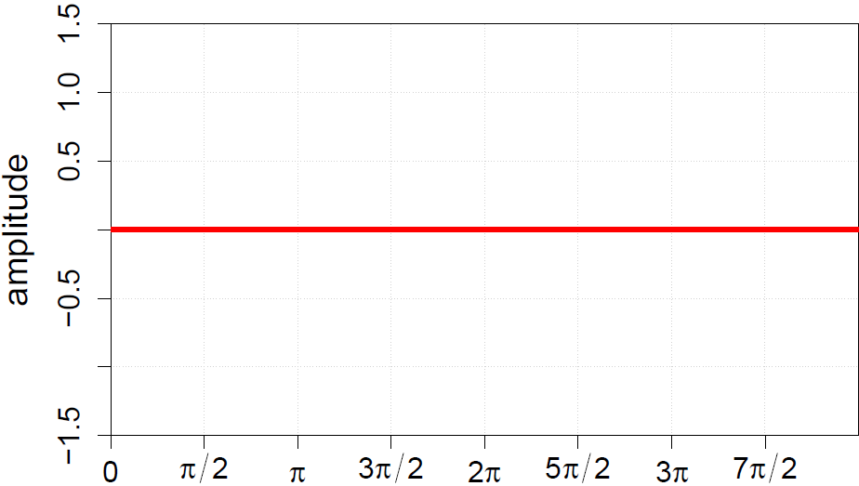
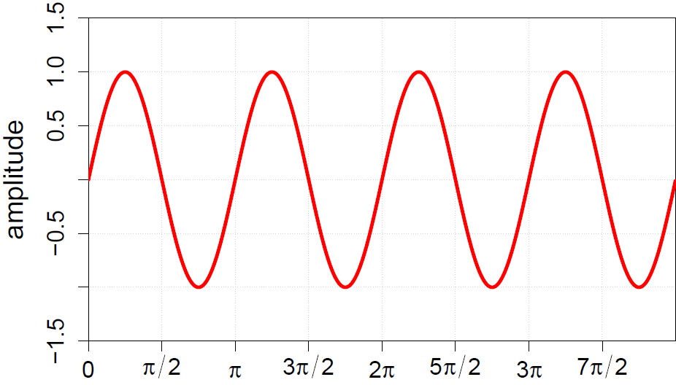
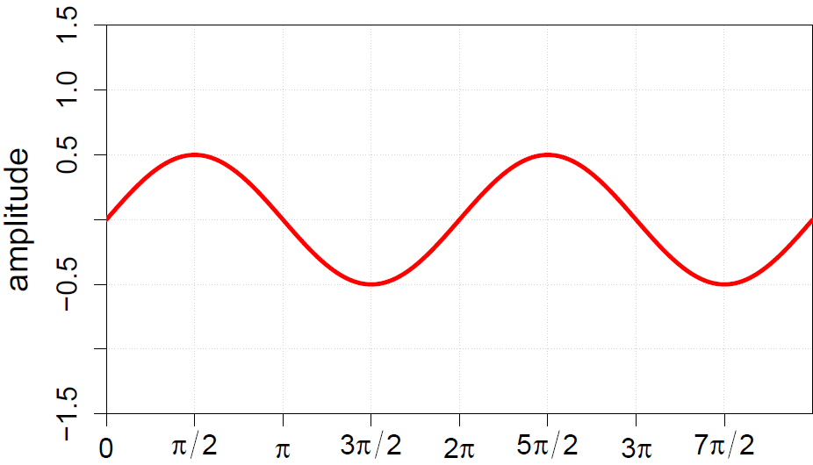
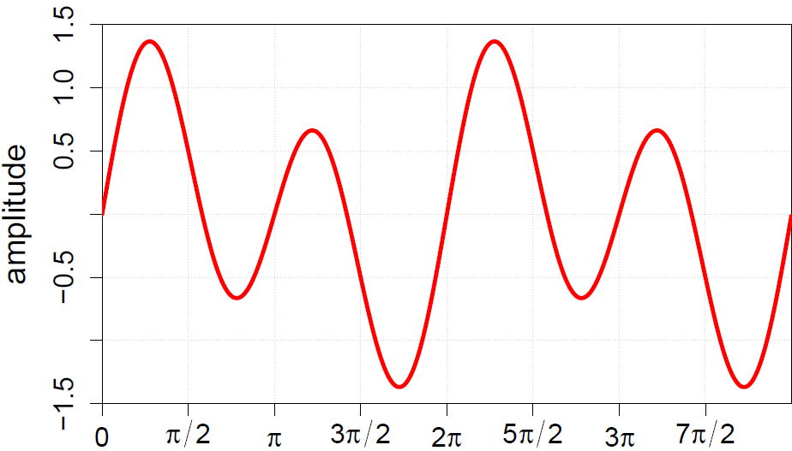
Frequency-domain
Can represent sound wave as linear sum of frequencies

Slide 22
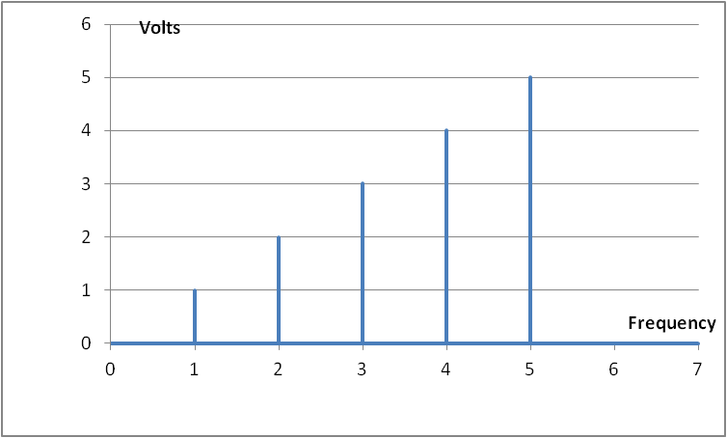
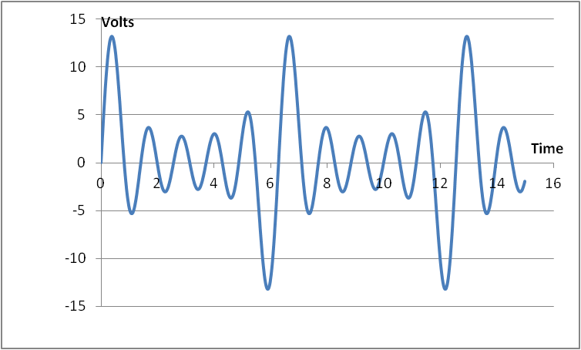
Time vs. Frequency

Slide 23
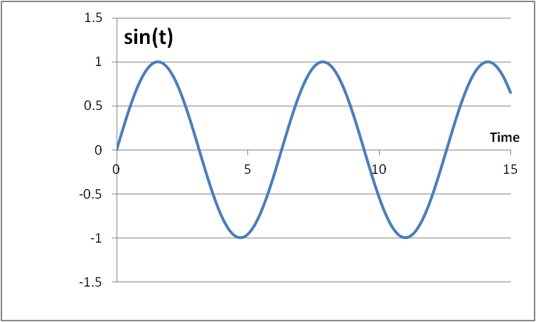
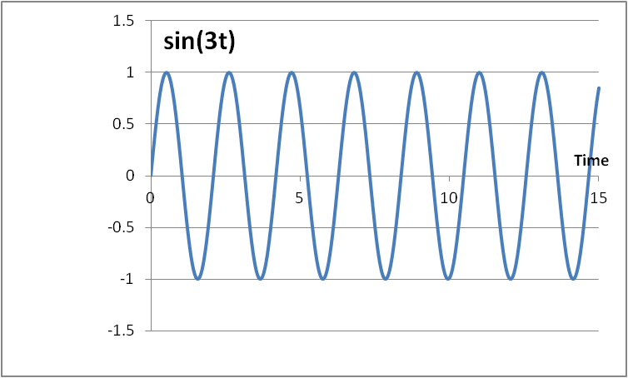
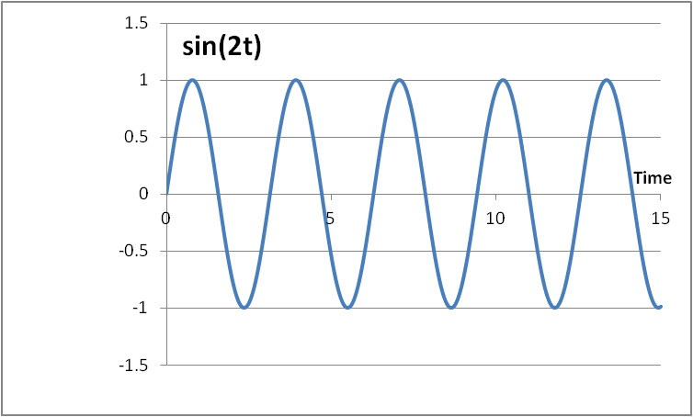
Fourier Series
  The cos(nx) and sin(nx) functions form an orthogonal basis: they allow us to represent any periodic signal by taking a linear combination of the basis components without interfering with one another

Slide 24
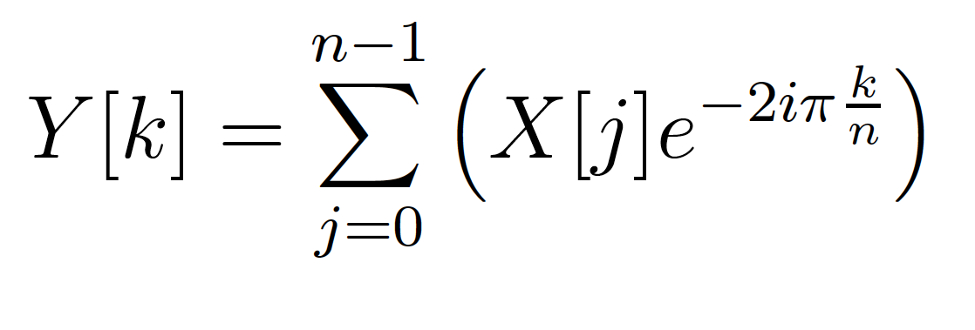
Fourier Transform
Identify spectral components (frequencies)
Convert between Time-domain to Frequency-domain
  E.g. tones from data samples
  Central to audio coding – e.g. MP3 audio
Constant

Slide 25
FT as Matching
Fourier Transform is essentially performing a dot product with a frequency
  How much like a sine wave of freq. f is this?
Constant

Slide 26
Fast-Fourier Transform (FFT)
Efficient way to compute FT
O(N*log(N)) computation
Contrast N² for direct computation
  N dot products
    Each dot product has N points (multiply-adds)
Constant

Slide 27
FFT
Large space of FFTs
Radix-2 FFT Butterfly
T

Slide 28
Basic FFT Butterfly
Y0=X0+T(stage,butterfly)*X1
Y1=X0-T(stage,butterfly)*X1
Common sub expression, compute once: T(stage,butterfly)*X1
X0
Y0
X1
Y1

Slide 29
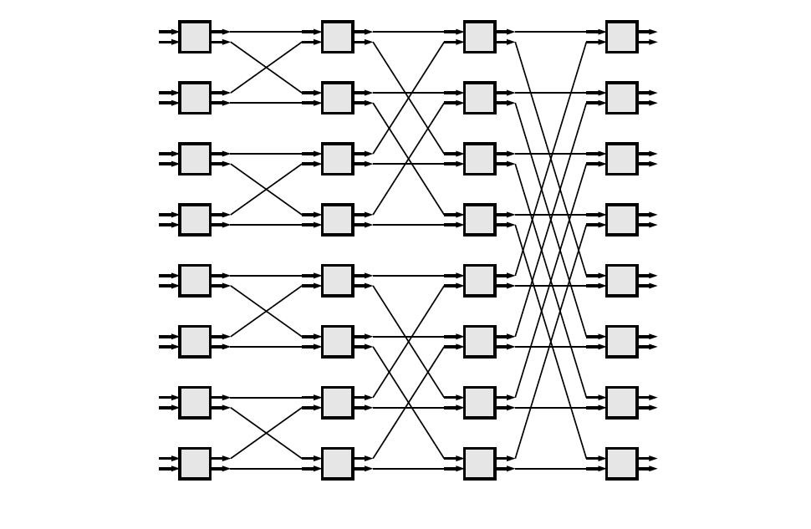
Preclass 2
What parallelism options exist?
  Single FFT
  Sequence of FFTs

Slide 30
FFT Parallelism
Spatial
Pipeline
Streaming
By column
  Choose how many Butterflies to serialize on a PE (processing element)
By subgraph
Pipeline subgraphs

Slide 31
Preclass 3
How large of a spatial FFT can implement with 360 multipliers?

Slide 32
Bit Serial
Could compute the add/multiply bit serially
  One full adder per adder
  W full adders per multiply
  W=16, maybe 20—30 LUTs
  70,000 LUTs
    ~= 70,000/30 ~= 2330 butterflies
      512-point FFT has 2304 butterflies
Another dimension to design space:
  How much serialize word-wide operators
  Use LUTs vs. DSPs

Slide 33
Accelerator Building Blocks
What common subgraphs exist in the FFT?

Slide 34
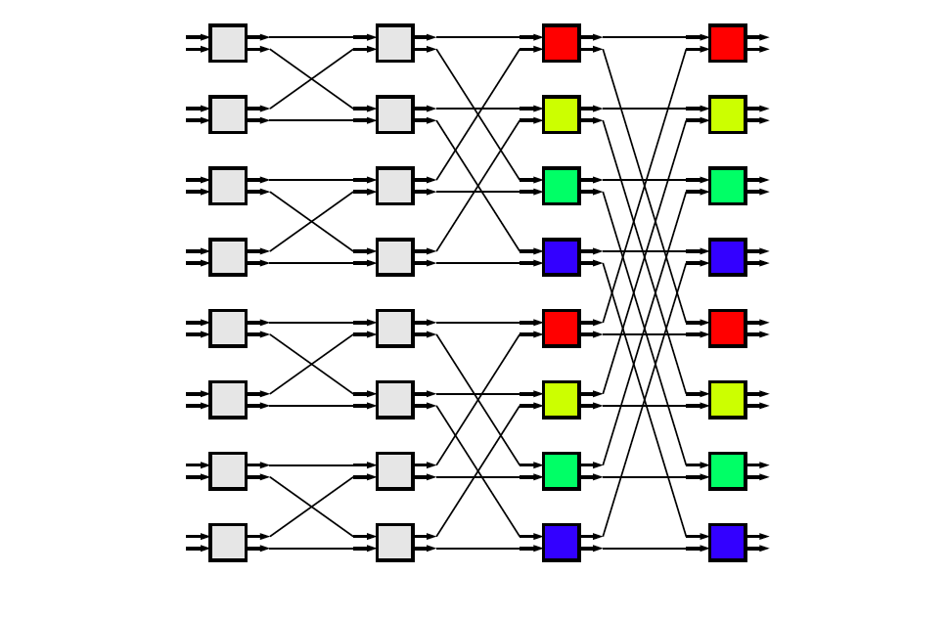
Common Subgraphs

Slide 35
Processor Mapping
How map butterfly operations to processors?
  Implications for communications?

Slide 36
Preclass 4a
How large local memory to communicate from stage to stage?

Slide 37
Preclass 4b
How change evaluation order to reduce local storage memory?

Slide 38
Preclass 4b
Evaluation order
1
3
9
2
4
10
5
7
11
6
8
12

Slide 39
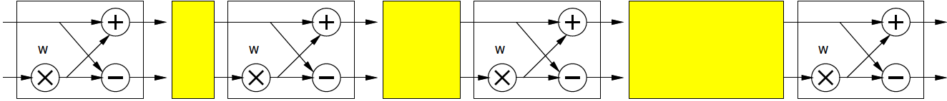
Streaming FFT

Slide 40
Communication
How implement the data shuffle between processors or accelerators?
  Memories / interconnect ?
  How serial / parallel ?
  Network?

Slide 41
Data Precision
Input data from A2D likely 12b
Output data, may only want 16b
What should internal precision and representation be?

Slide 42
Number Representation
Floating-Point
  IEEE standard single (32b), double (64b)
    With mantissa and exponent
    …half, quad ….
Fixed-Point
  Select total bits and fraction
    E.g. 16.8 (16 total bits, 8 of which are fraction)
      Represent 1/256 to 256-1/256
  A(mpy) ~ W², A(add) ~ W
    W here width – not FFT weight value

Slide 43
Operator Sizes
Operator | LUTs | LUTs + DSPs
Double FP Add | 712 | 681+3 DSPs
Single FP Add | 370 | 219+2 DSPs
Fixed-Point Add (32) | 16
Fixed-Point Add (n) | n/2
Double FP Multiply | 2229 | 223+10 DSPs
Single FP Multiply | 511 | 461+3 DSPs
Fixed Multiply (32x32) | 1099
Fixed Multiply (16x16) | 283 | 1 DSP
Fixed Multiply (18x25) |  | 1 DSP
Fixed Multiply (n) | ~ n²
FP (Floating Point) sizes from:
https://www.xilinx.com/support/documentation/ip_documentation/ru/floating-point.html

Slide 44
Heterogeneous Precision
May not be same in every stage
  W factors less than 1
  Non-fraction grows at most 1b per stage

Slide 45
T Coefficients
Precompute and store in arrays
Compute as needed
  How?
    sin/cos hardware?
    CORDIC?
    Polynominal approximation?
Specialize into computation
  Many evaluate to 0, ±1, ±½, ….
  Multiplication by 0, 1 not need multiplier…
T

Slide 46
FFT (partial) Design Space
Parallelism
Decompose
Size/granularity of accelerator
  Area-time
Sequence/share
Communicate
Representation/precisions
W coefficients (precompute, store, specialize…)

Slide 47
Big Ideas:
Large design space for implementations
Worth elaborating and formulating systematically
  Make sure don’t miss opportunities
Think about continuum for design axes
Model effects for guidance and understanding

Slide 48
Admin
Feedback, including P1
P2 due Friday
  Asks you to identify design space

