Slide 1

ESE5320:
System-on-a-Chip Architecture
Day 26: December 2, 2024
Wrapup

Slide 2
Today
Part 1:
  What was course about
  Final
Part 2: Review w/ Simple Models
Part 3
  Other Courses
  Questions/Discussion

Slide 3
Goal
How to design/select/map to SoC to reduce Energy/Area/Delay.

Slide 4
Outcomes
Day 1
Design, optimize, and program a modern System-on-a-Chip.
Analyze, identify bottlenecks, design-space
Decompose into parallel components
Characterize and develop real-time solutions
Implement both hardware and software solutions
Formulate hardware/software tradeoffs, and perform hardware/software codesign

Slide 5
Outcomes
Day 1
Understand the system on a chip from gates to application software, including:
  on-chip memories and communication networks, I/O interfacing, RTL design of accelerators, processors, firmware and OS/infrastructure software.
Understand and estimate key design metrics and requirements including:
  area, latency, throughput, energy, power, predictability, and reliability.

Slide 6
Message for Day
Day 2
Identify the Bottleneck
  May be in compute, I/O, memory, data movement
Focus and reduce/remove bottleneck
  More efficient use of resources
  More resources
Repeat

Slide 7
Abstract Approach
Day 1
Identify requirements, bottlenecks
Decompose Parallel Opportunities
  At extreme, how parallel could make it?
  What forms of parallelism exist?
    Thread-level, data parallel, instruction-level
Design space of mapping
  Choices of where to map, area-time tradeoffs
Map, analyze, refine

Slide 8
SoC Designer
Hardware Building Blocks
Communication blocks
  Busses
  Multiplexers, Crossbars
  DMA Engines
Processors
I/O blocks
  Ethernet, USB, PCI, DDR, Gigabit serial links
Computational blocks
  Adders, multipliers, dividers, ALUs
Data Storage
  Registers
  Memory blocks

Slide 9
Final

Slide 10
Final
From Code
Forms of Parallelism
Dataflow, SIMD, VLIW, hardware pipeline, threads, reduce
Map/schedule task graph to (multiple) target substrates
Memory assignment and movement
Area-time points
Analysis
  Bottleneck
  Amdhal’s Law Speedup
  Computational requirements
  Resource Bounds
  Critical Path
  Latency/throughput/II
Model/estimate speedup

Slide 11
Final
Like midterm
  Content
  Style
  No book, notes
  Calculators allowed (encouraged)
Previous years final and solutions
Friday, December 13, 3-5pm, DRLB 4
2 hours (standard final exam period)

Slide 12
Review
Part 2

Slide 13
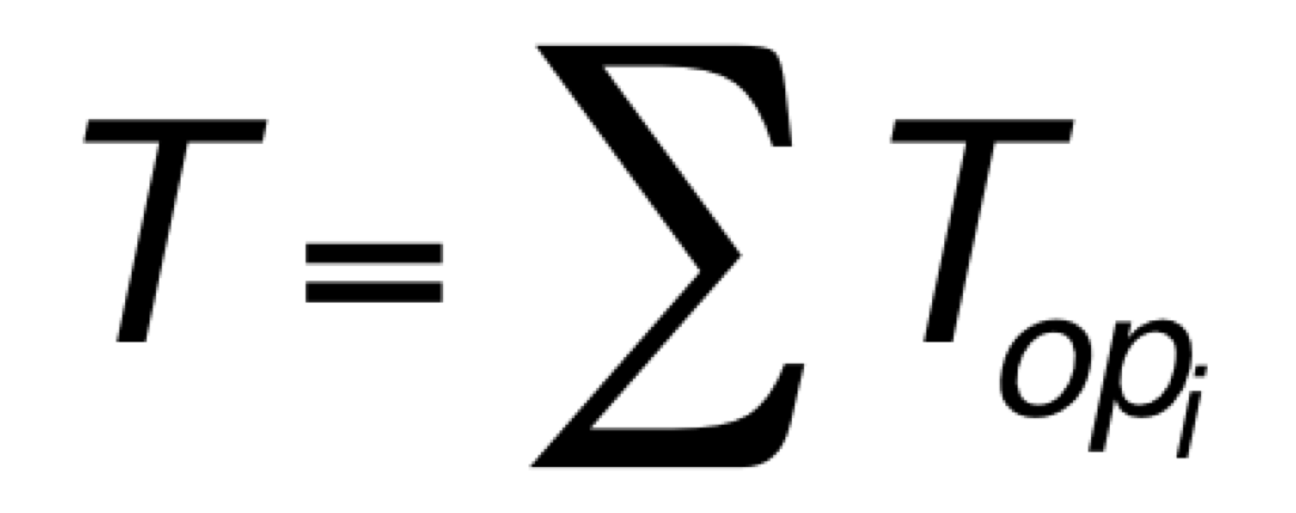
Sequential Computation
Computation requires a collection of operations
  Arithmetic
  Logical
  Data storage/retrieval

Slide 14
Computations in C
Express computations in a programming language, such as C
Can execute computation in many different ways
  Sequential, parallel, spatial hardware
while(true) {
for (i=0;i<16;i++)
y[i]=a[i]*b[i];
z[0]=y[0];
for (i=1;i<16;i++)
z[i]=z[i-1]+y[i];
}

Slide 15
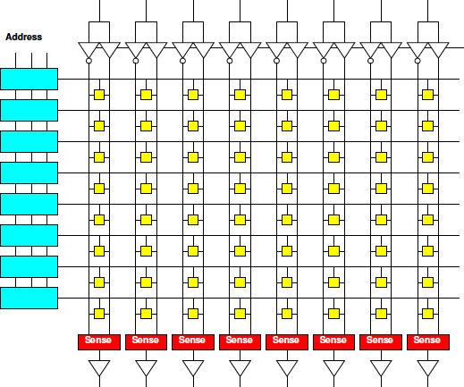
Memory Characteristics
Small memories
  Fast
  Low energy
  Not dense
    (high area per bit)
Large memories
  Slow
  High energy
  Dense (less area per bit)

Slide 16
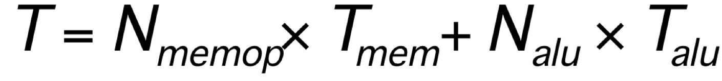
Memory and Compute
Computation involves both arith/logical ops and memory ops

Slide 17
Memory and Compute
Computation involves both arith/logical ops and memory ops
Either can dominate
  Be bottleneck

Slide 18
Memory and Compute
Timing
  T_{mem}=10
  T_{alu}=1
N_{mpy}=
N_{add}=
N_{mem}=
Total Time, T?
while(true) {
for (i=0;i<16;i++)
y[i]=a[i]*b[i];
z[0]=y[0];
for (i=1;i<16;i++)
z[i]=z[i-1]+y[i];
}
(not count loop, indexing costs in this sequence)

Slide 19
Memory and Compute
Where bottleneck?
  T_{mem}=10
  T_{alu}=1
N_{mpy}=16
N_{add}=15
N_{mem}=95
while(true) {
for (i=0;i<16;i++)
y[i]=a[i]*b[i];
z[0]=y[0];
for (i=1;i<16;i++)
z[i]=z[i-1]+y[i];
}

Slide 20
Data Reuse
Reduce memory operations to large memory by storing in
  Registers
  Small memories
T_{lmem}>T_{smem}

Slide 21
Memory and Compute
a,b in large mem
y,z in small mem
  T_{lmem}=10
  T_{smem}=1
  T_{alu}=1
N_{mpy}=16
N_{add}=15
N_{lmem}=?
N_{smem}=?
while(true) {
for (i=0;i<16;i++)
y[i]=a[i]*b[i];
z[0]=y[0];
for (i=1;i<16;i++)
z[i]=z[i-1]+y[i];
}

Slide 22
Memory and Compute
a,b in large mem
y,z in small mem
  T_{lem}=10
  T_{sem}=1
  T_{alu}=1
N_{mpy}=16
N_{add}=15
N_{lmem}=32
N_{smem}=63
while(true) {
for (i=0;i<16;i++)
y[i]=a[i]*b[i];
z[0]=y[0];
for (i=1;i<16;i++)
z[i]=z[i-1]+y[i];
}
Performance impact?

Slide 23
Task Parallel
Can run unrelated tasks concurrently
Ideal: T(p) = T(1)/p

Slide 24
Data Parallel
Can run same task on independent data in parallel
Ideal: T(p) = T(1)/p

Slide 25
Data Parallel
Classify loops?
  Sequential
  Data parallel
  Reduce
  Parallel prefix
while(true) {
for (i=0;i<16;i++)
y[i]=a[i]*b[i];
z[0]=y[0];
for (i=1;i<16;i++)
z[i]=z[i-1]+y[i];
}

Slide 26
Reduce
(note slightly different second loop)
Common pattern is a reduce operation
  Combine a set of data into a single value
Latency bound for second loop?
while(true) {
for (i=0;i<16;i++)
y[i]=a[i]*b[i];
z=0;
for (i=0;i<16;i++)
z+=y[i];
}

Slide 27
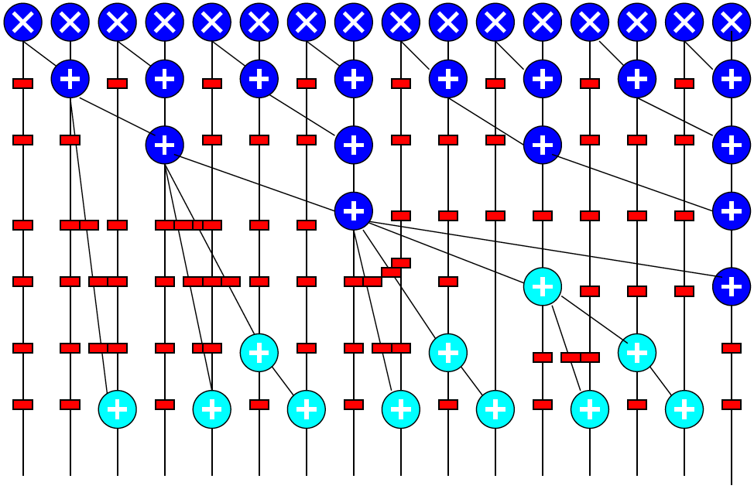
Log-Depth Associative Reduce

Slide 28
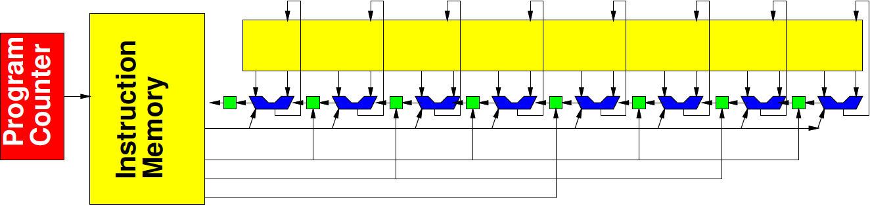
Vector/SIMD
Can perform same operation on a set of data items
Ideal: T(VL) = T(1)/VL
(Vector Length)

Slide 29
Vector/SIMD
Can perform same operation on a set of data items
  Not everything vectorizable

Slide 30
Vector/SIMD
414 total cycles
First loop: 352
Second loop: 62
What’s vectorizable?
Speedup vector piece VL=4
  (assume both memory and compute speedup)
Overall speedup
Amdahl’s Law speedup for VL→infintiy?
while(true) {
for (i=0;i<16;i++)
y[i]=a[i]*b[i];
z[0]=y[0];
for (i=1;i<16;i++)
z[i]=z[i-1]+y[i];
}

Slide 31
Dataflow Pipeline
Prod
Consume
With no cycles in flowgraph
  (no feedback)
  (no loop carried dependencies)
Producer and consumer can operate concurrently

Slide 32
Data Flow Pipeline
Producer/consumer here?
Time each
  Assuming T_{mem}=1
Granularity of dataflow pipeline
Size of buffer needed to allow concurrent operation?
Time on 2 processors dataflow
while(true) {
for (i=0;i<16;i++)
y[i]=a[i]*b[i];
z[0]=y[0];
for (i=1;i<16;i++)
z[i]=z[i-1]+y[i];
}

Slide 33
Data Flow Pipeline
(note changed loops)
Granularity of dataflow pipeline
Size of buffer needed to allow concurrent operation?
for (j=0;j<MAX;j++) {
for (i=0;i<16;i++)
y[i]=a[j,i]*b[j,i];
z[j,15]=y[j,15];
for (i=14;i>=0;i--)
z[j,i]=z[j,i+1]+y[i];
}

Slide 34
Spatial Pipeline
Can build spatial pipeline of hardware operators to compute a dataflow graph
With no feedback: T_{loop}=1
With feedback limit II: T_{loop}=II_{cycle}

Slide 35
Initiation Interval
What’s II?
  a, b now Tmem=1
  Separate memory banks for a,b,z
  y in local registers
  z[i-1] communicated through local register
while(true) {
for (i=0;i<16;i++)
y[i]=a[i]*b[i];
z[0]=y[0];
for (i=1;i<16;i++)
z[i]=z[i-1]+y[i];
}

Slide 36
Initiation Interval
What’s II?
  a, b, c Tmem=1
  Separate memory banks for a,b,c,z
  y in local registers
  z[i-1] communicated through local register
while(true) {
for (i=0;i<16;i++)
y[i]=a[i]*b[i]+c[i];
z[0]=y[0];
for (i=1;i<16;i++)
z[i]=z[i-1]+y[i];
}

Slide 37
Initiation Interval
First loop (Tmem=1)
  Latency of loop body?
  II?
while(true) {
g=0;
for (i=0;i<16;i++) {
t=a[i]*b[i]+c[g];
y[i]=t;
g=t%16; }
z[0]=y[0];
for (i=1;i<16;i++)
z[i]=z[i-1]+y[i];
}

Slide 38
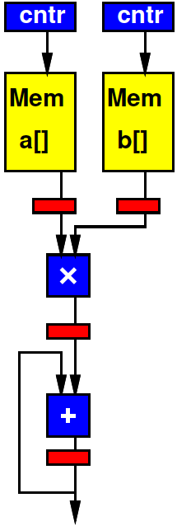
Spatial Pipeline
Back to original code
Pipeline taking one a[i], b[i] per cycle
  Tmem=1
Cycles to complete?
while(true) {
for (i=0;i<16;i++)
y[i]=a[i]*b[i];
z[0]=y[0];
for (i=1;i<16;i++)
z[i]=z[i-1]+y[i];
}

Slide 39
Critical Path
Critical Path assuming associativity holds?
while(true) {
for (i=0;i<16;i++)
y[i]=a[i]*b[i];
z[0]=y[0];
for (i=1;i<16;i++)
z[i]=z[i-1]+y[i];
}

Slide 40
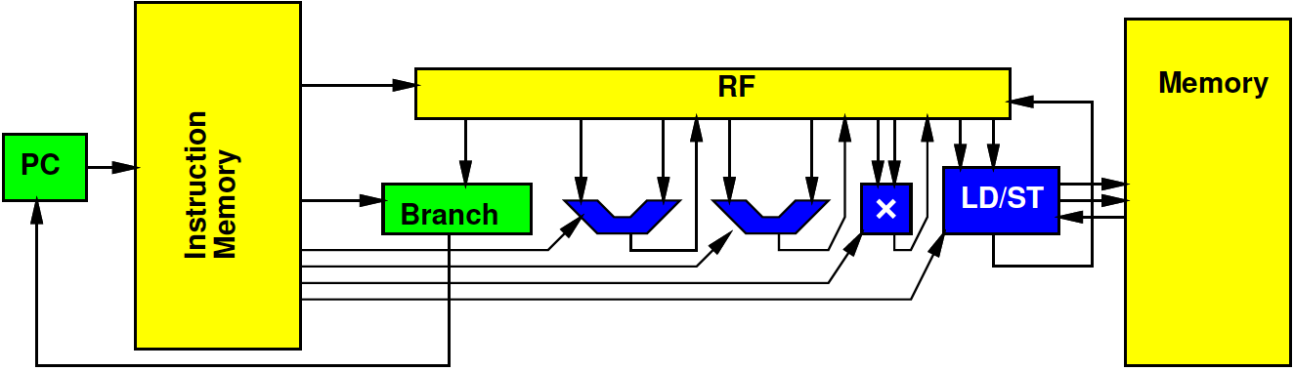
VLIW
Can control datapath to perform multiple, heterogeneous operations per cycle
  Tune parallelism
Op types: A, B, C
  Ops N_{A}, N_{B}, N_{C}
  Number of Hardware Units H_{A}, H_{B}, H_{C}
T_{RB}=max(N_{A}/H_{A}, N_{B}/H_{B}, N_{C}/H_{C},…)≤T_{VLIW}
T_{CP}≤T_{VLIW}

Slide 41
VLIW
VLIW
  1 load/store (a,b,z)
    Assume single cycle
  1 mpy
  1 add
  (ignoring increment for simplicity/consistency)
  y/z[i-1] in registers
RB
CP
while(true) {
for (i=0;i<16;i++)
y[i]=a[i]*b[i];
z[0]=y[0];
for (i=1;i<16;i++)
z[i]=z[i-1]+y[i];
}

Slide 42
VLIW
VLIW
  1 load/store (a,b,z)
    Assume single cycle
  1 mpy
  1 add
  1 incr
while(true) {
for (i=0;i<16;i++)
y[i]=a[i]*b[i];
z[0]=y[0];
for (i=1;i<16;i++)
z[i]=z[i-1]+y[i];
}
Cycle | mpy | add | Ld/st
0 | a*b 0 |  | a1
1 |  | +y[i] 0 | b1
2 |  |  | Z0

Slide 43
VLIW
VLIW
  4 load/store (a,b,z)
    Assume single cycle
  2 mpy
  2 add
RB
CP
while(true) {
for (i=0;i<16;i++)
y[i]=a[i]*b[i];
z[0]=y[0];
for (i=1;i<16;i++)
z[i]=z[i-1]+y[i];
}

Slide 44
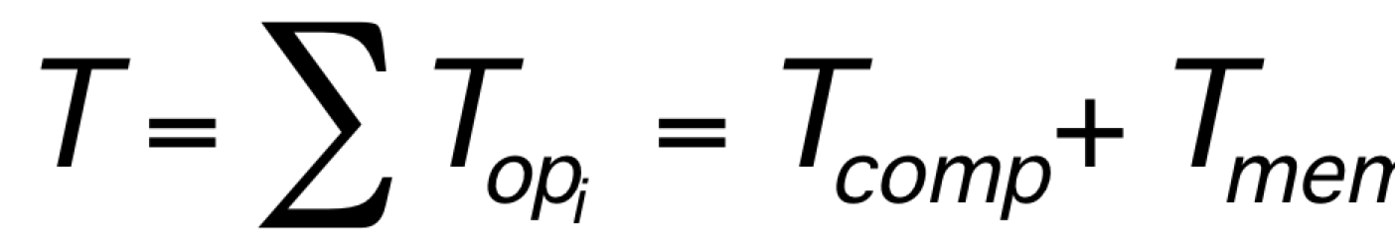
Memory Bottleneck
Memory can end up being bottleneck
Ideal: T(p) = T_{comp}(1)/p+T_{mem}

Slide 45
Memory Bottleneck
Pipeline to perform one multiply per cycle
Memory supplies one data item from large memory (a,b) every 10 cycles
Performance?
  (number of cycles)
while(true) {
for (i=0;i<16;i++)
y[i]=a[i]*b[i];
z[0]=y[0];
for (i=1;i<16;i++)
z[i]=z[i-1]+y[i];
}

Slide 46
Memory Bottleneck
Memory can end up being bottleneck
Ideal: T(p) = T_{comp}(1)/p+T_{mem}/Membw

Slide 47
Memory Bottleneck
Invest in higher bandwidth
  Wider memory
  More memory banks
Exploit data reuse
  Smaller memories may have more bandwidth
  Smaller memories are additional banks
    More bandwidth

Slide 48
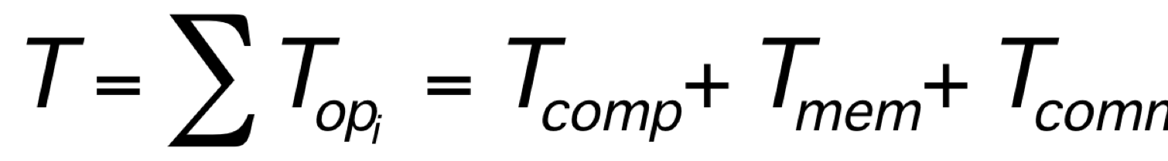
Communication
Once parallel, communication may be bottleneck
Ideal (like VLIW):
  T≤max(T_{comp}/p,T_{mem}/membw,T_{comm}/netbw)

Slide 49
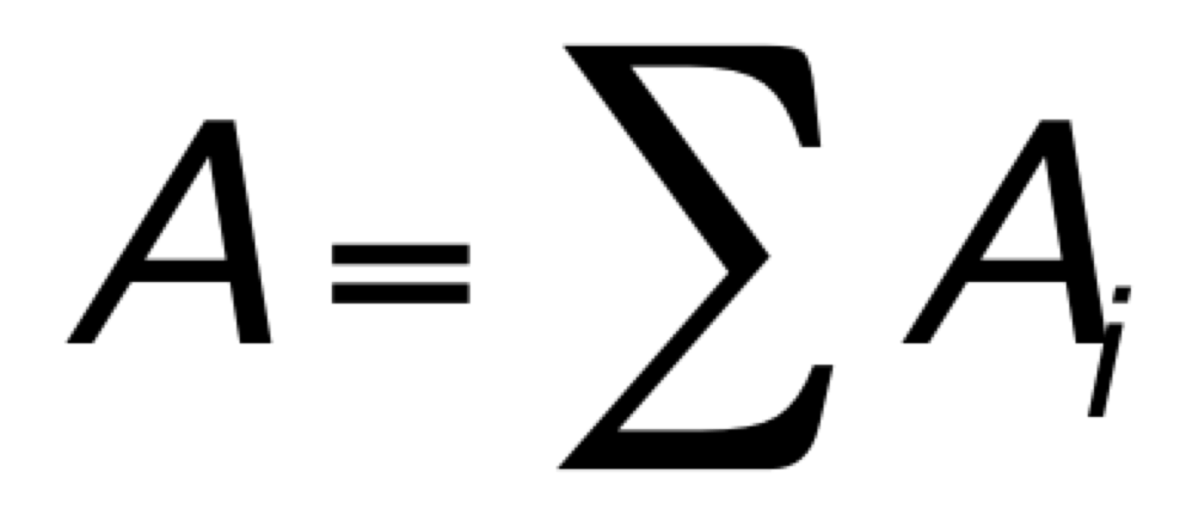
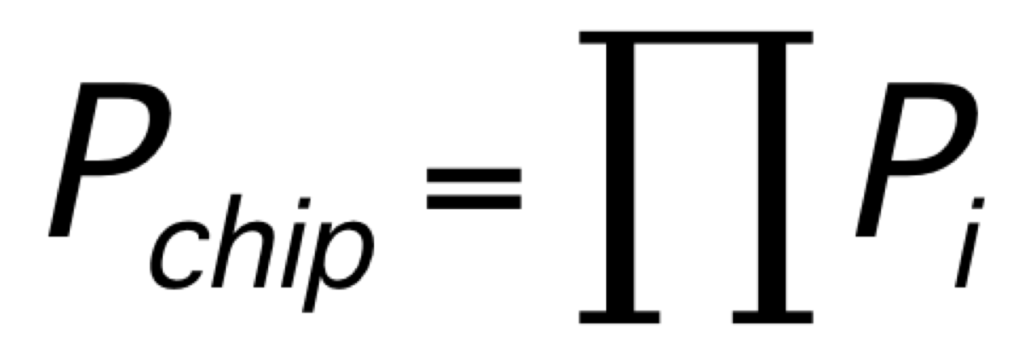
Area
Skipped 2023
Can model area of various solutions
  Sum of component areas
  (watch interconnect)
Cost proportional A/P_{chip}
Without sparing
  P_{chip} = (P_{mm})^{A}
Sparing (did not cover this year)
  Pmofn

Slide 50
Multi-Objective Optimization
Many forms of parallelism
Given fixed area (resources, energy)
  Maximize performance
  Select best architecture
Given fixed performance goal (Real Time)
  Find architecture that achieves
  With minimum area (energy, cost)

Slide 51
Other Courses
Wrapup, Questions
Part 3

Slide 52
Distinction
CIS2400, 5710(4710)
ESE5320
Best Effort Computing
  Run as fast as you can
Binary compatible
ISA separation
Shared memory parallelism
Caching – automatic memory management
Superscalar
Pipelined processor
Hardware-Software codesign
  Willing to recompile, maybe rewrite code
  Define/refine hardware
Real-Time
  Guarantee meet deadline
Non shared-memory models
Explicit memory management
VLIW

Slide 53
Abstraction Stack
Software
ESE5390 HW/SW ML
Embedded Sys:
ESE3500/5190
Systems
SoC Arch:
ESE 5320
Processors
Processor Arch:
CIS 4710/5710
(CIS2400)
Mixed Signal:
ESE 5680
ADC, DAC
Switched Capacitors
Gates, Memories
Digital:
ESE3700/5700
Analog:
ESE4190/5720
Amplifier, Compare
Voltage/Current Ref.
Circuits/VLSI
Devices: ESE5210
(ESE2180)
Transistors
All about CHIPS, ICs

Slide 54
Circuits and Computer Engineering
ESE3500
Embedded Systems
μ-controller architectures, Interfacing, ADC, sensor and actuator control, ROS, network protocols
ESE3700
Circuit Level Modeling & Optimization of Dig. Systems
Transistor models, CMOS logic, delay, scaling, energy, interconnects, flip-flops, noise, T-lines, RAM design
ESE3190
Electronics
Diode & Transistor Circuits, Single Stage & Diff. Amplifiers, Filters, Oscillators
ESE5190
Real-Time &
Embedded Systems
μ-controller architectures, Interfacing, ADC, sensor and actuator control, ROS, network protocols
or
ESE4190 (5720)
Analog Integrated Circuits
MOSFET circuits, Ampl. Stages, I-Mirrors, Op-Amps, Feedback, Stability, Root Locus, Cascode Ampl.
ESE5320
SoC Architecture
Hardware/Software
Codesign,
Parallelism, Analysis, Real-Time
ESE5700
Digital Integrated Circuits
MOSFET Trans Models, Inverter switching, MOS Logic, Memories, Implementation methods, Layout.
or
or
ESE5680 (Fall)
Mixed-Signal Circuits
A/D, D/A, sampling…
CIS5410
Embedded Cyber Physical Systems
Life-Critical, Real-Time,
Analysis,
Implementations
Validation/verification
ESE5780
RF Integrated
Circuits Design
μ-wave Eng overview, T-line, Smith-chart, S-parameters, matching, passive devices, small signal amplifier, LNA and PA, mixed signal on chip
ESE6720
Integrated Communication Circuits
Receivers, Low-noise amplifiers, mixers, oscillators, phase lock loops, power amplifiers
Digital
Embedded
(uP/uC)
Analog
Notes:
Simple Story

Slide 55
Other Courses
Security: CIS3310, CIS5510
  ESE5370 (this Spring): Hardware Security
Networking: ESE4070, CIS5530
GPGPU (graphics focus): CIS5650
Machine Learning: ESE5390
Power Electronics: ESE5800

Slide 56
Message
Any interesting, challenging computation will require both
hardware and software
SoC powerful implementation platform
  Target pre-existing
  Design customized for problem
  Exploit heterogeneous parallelism
Understand and systematically remove bottlenecks
  Compute, memory, communicate, I/O

Slide 57
Admin
Feedback
Project
  Demo Day Monday, Dec. 9th
    With board return
    Signup for slot
  Reports due Dec. 9th
No DQ today
Review: watch Ed Discuss
Final: Friday, Dec. 13, 3pm, DRLB A4

Slide 58
Question/Discussion

