Slide 1

ESE5320:
System-on-a-Chip Architecture
Day 3: September 9, 2024
Memory
Preclass

Slide 2
Today
Memory
Memory (part 1)
  Bottleneck
  Scaling
Latency Engineering (part 2)
  Scheduling
  Data Reuse: Scratchpad and cache
Throughput [Bandwidth] Engineering (part 3)
  Wide word

Slide 3
Message
Memory throughput and latency can be bottlenecks
Minimize data movement
Exploit small, local memories
Exploit data reuse

Slide 4
Memory Scaling

Slide 5
On-Chip Delay
Delay is proportional to distance travelled
Make a wire twice the length
  Takes twice the latency to traverse
  (can pipeline—keep throughput)
Modern chips
  Run at GHz speeds
    (1ns, sub 1ns cycle times)
  Take 10s of ns to cross the chip
  Takes 100s of ns to reference off-chip data
What does this say about placement of computations and memories?

Slide 6
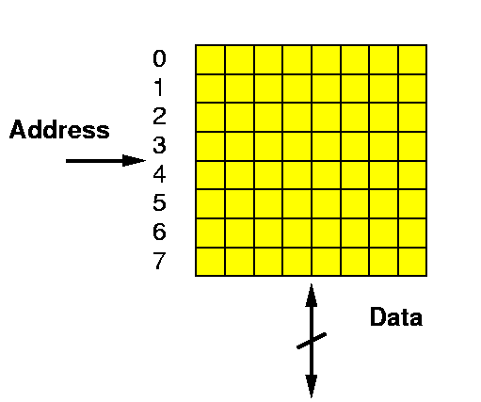
Random Access Memory
A Memory:
  Series of locations (slots)
  Can write values to a slot (specified by address)
  Read values from (by address)
  Return last value written
Notation:
slash on wire
means multiple bits wide

Slide 7
Terminology Word
Word
  set of bits act on together in our computer system
    E.g. In our 64b processors, work on 64b words
  Often bits used to represent a value
    64b to represent at double-precision float or 64b integer
    32b to represent a single-precision float or 32b integer

Slide 8
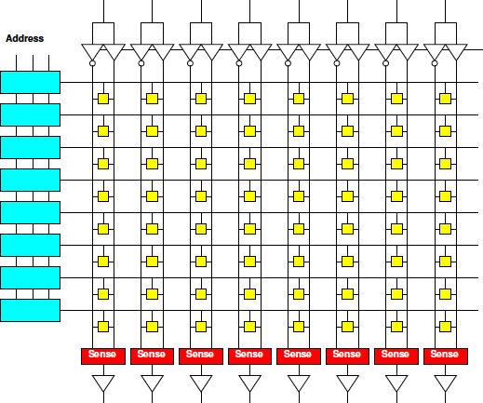
Memory Operation
Memory Read
  Present Address
  Decoder Matches
  Charge word line
  Enables Memory Cell
  to charge bitlines
  (column)
  SenseAmp
  detects
  bitline swing
  Buffered for output
Cartoon memory
illustrative of physical layout
1
2
3
4
5
6

Slide 9
Memory Block
Linear wire delay with distance
Assume constant area/memory bit
N-bit memory, arranged in square
  As shown N=64,
  width=depth=8
  N=width*depth
  (since square)
4x capacity (N)
delay change?
  (e.g. 1Gbit
  to 4Gbit)
width
depth

Slide 10
Memory Block
Linear wire delay with distance
Assume constant area/memory bit
N-bit memory, arranged in square
Width relate
to N?
Depth?
Delay
scale N?
width
depth

Slide 11
Terminology Bandwidth
Bandwidth – throughput for data movement
  How many bits per second can we transfer

Slide 12
Memory Block Bandwidth
Bandwidth: data movement throughput
  How many bits per second can we transfer
N-bit memory, arranged in square
Bits/cycle
scale with N?
  (not quite
  bandwidth)

Slide 13
Memory Block Energy
Assume read full width,
  Energy scales with N
    Activate sqrt(N) wires
    Each wire sqrt(N)
    long
  Or, energy/bit
  scales as sqrt(N)
Larger memories
cost more energy

Slide 14
Memory Block Density
Address, sense amplifies are large
How do address bits scale with N?
Scale slower than bit area
  Bits scale N
  Address sqrt(N)*log(N)
  Sense amps sqrt(N)
Large memories
pay less per bit
  denser

Slide 15
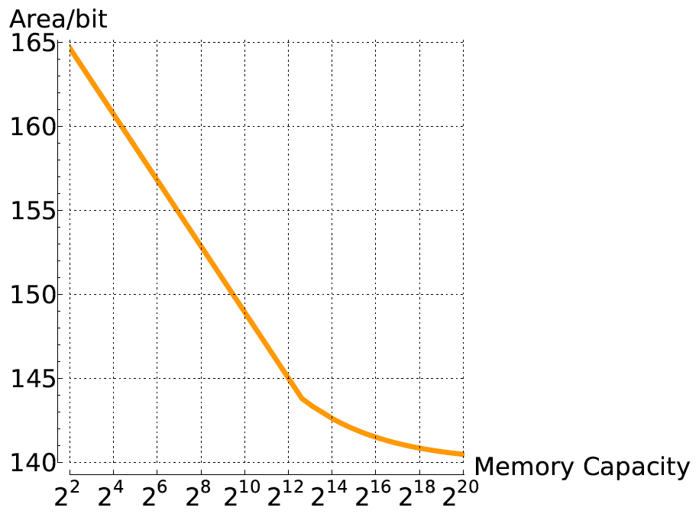
Compactness vs. Memory Size
(F² units)

Slide 16
Memory Scaling
Small memories are fast
  Large memories are slow
Small memories low energy
  Large memories high energy
Large memories dense
  Small memories cost
  more area per bit
Combining:
  Dense memories
  are slow

Slide 17
Latency Engineering
Scheduling
Part 2

Slide 18
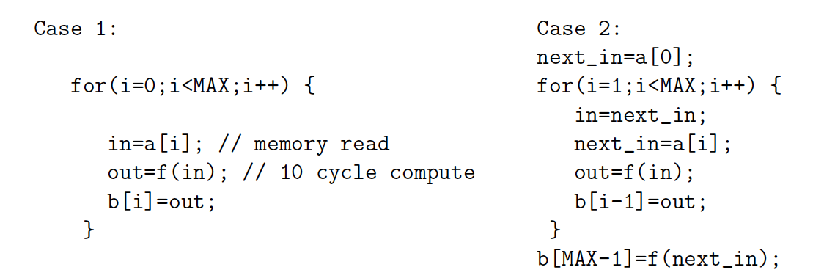
Preclass 2
Issue one read/write per cycle
10 cycle latency to memory
Memory read concurrent with compute
  only wait for memory when need value
Throughput (iters/cycle) in each case?

Slide 19
Preclass 2
Throughput (iters/cycle) in each case?
21 cycles
Read a[i]
f(in)
Issue
b[i]
write

Slide 20
Preclass 2
Throughput (iters/cycle) in each case?
21 cycles
13 cycles
Read a[i]
Read a[i]
f(in)
Issue
b[i]
write
In
next_in
f(in)
Issue
b[i]
write

Slide 21
Lesson
Long memory latency can impact throughput
  When must wait on it
  When part of a cyclic dependency
Overlap memory access with computations when possible
  exploit parallelism between compute and memory access

Slide 22
Latency Engineering
Data Reuse

Slide 23
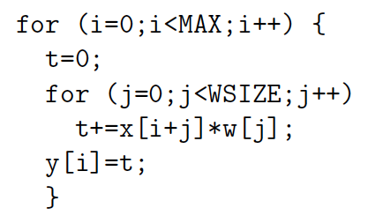
Preclass 3abc
MAX=10⁶ WSIZE=5
How many times execute t+=x[]*w[] ?
How many reads to x[] and w[]?
Runtime
read x,w 20
t+=… 5

Slide 24
Preclass 3c
T=MAX*WSIZE(T_{comp}+T_{x}+T_{w})
T=10⁶*5*(5+20+20)
T=2.25*10⁸

Slide 25
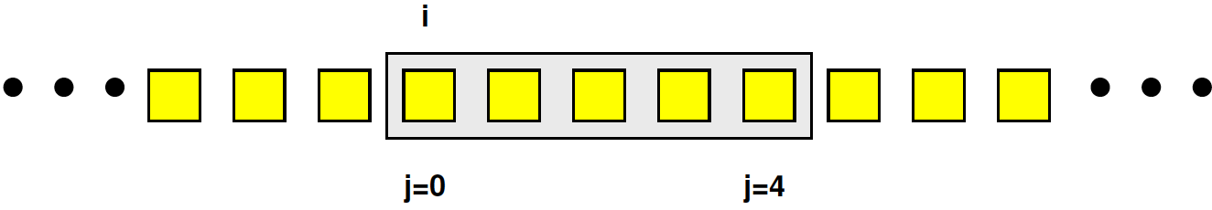
Preclass 3d
How many distinct x[], w[] read?

Slide 26
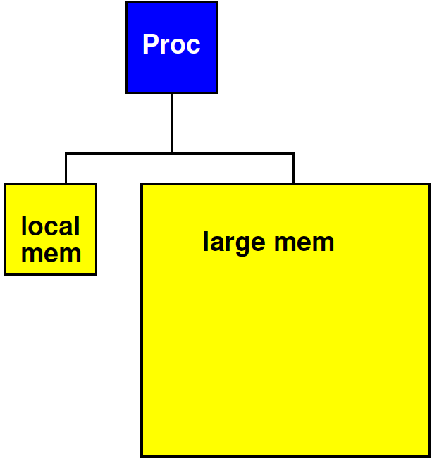
Strategy
Add small, local memory bank
  Small memories are faster

Slide 27
Preclass 3e
How use local memory to reduce large memory reads to 3d?
How much local memory need?

Slide 28
Preclass 3d
Which w’s read in each iteration of j loop?
Which x’s?
  i=0,
  i=1,
  Same i=0, i=1?
When never read x[0] again? x[4]?

Slide 29
Recall from earlier in lecture: Memory Block
Linear wire delay with distance
Assume constant area/memory bit
N-bit memory, arranged in square
Width relate
to N?
Depth?
Delay
scale N?
width
depth

Slide 30
Impact Small Memory
Remember how delay scales with N
How much faster might small [10 element] memory be? [compare 10⁶]
  as powers of 2: 2⁴ vs. 2²⁰

Slide 31
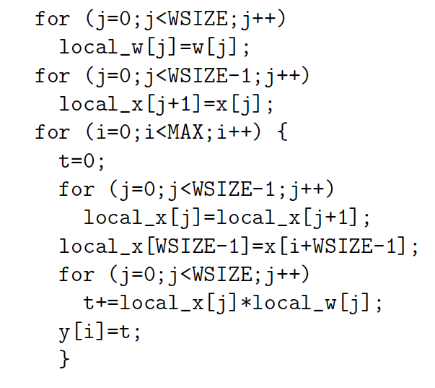
Preclass 3e
Load in w’s
Load first x’s
Shift x’s
Load
new x

Slide 32
Preclass 3e
WSIZE*T_{w}
WSIZE*T_{x}
WSIZE*MAX*T_{local}
MAX*T_{x}
WSIZE*MAX*T_{comp}
WSIZE*MAX*2*T_{local}

Slide 33
Preclass 3e iii
WSIZE*MAX*(T_{comp}+3*T_{local})
+WSIZE*(T_{w}+T_{x})
+MAX*T_{x}
5*10⁶*(5+3)
+5*(20+20)
+10⁶*20
6*10⁷

Slide 34
Preclass 3e iii
2.25*10⁸ 6*10⁷
3.75x

Slide 35
Lesson
Data can often be reused
  Keep data needed for computation in
    Closer, smaller (faster, less energy) memories
  Reduces latency costs
  Reduces bandwidth required from large memories
Reuse hint: value used multiple times
  Or value produced/consumed

Slide 36
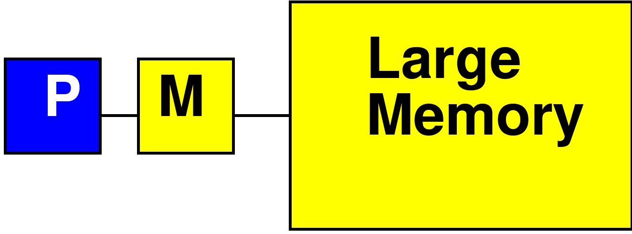
Processor Data Caches
Traditional Processor Data Caches are a heuristic instance of this
  Add a small memory local to the processor
    It is fast, low latency
  Store anything fetched from large/remote memory in local memory
    Hoping for reuse in near future
  On every fetch, check local memory before go to large memory

Slide 37
Cache
Goal: performance of small memory with density of large memory

Slide 38
Processor Data Caches
Demands more than a small memory
  Need to sparsely store address/data mappings from large memory
  Makes more area/delay/energy expensive than just a simple memory of capacity
Don’t need explicit data movement
Cannot control when data moved/saved
  Bad for determinism
Limited ability to control what stays in small memory simultaneously

Slide 39
Terminology
Cache
  Hardware-managed small memory in front of larger memory
Scratchpad
  Small memory
  Software (or logic) managed
  Explicit reference to scratchpad vs. large (other) memories
  Explicit movement of data

Slide 40
Bandwidth Engineering
Part 3

Slide 41
Terminology: Unroll Loop
Replace loop with instantiations of body
For WSIZE=5

Slide 42
Terminology: Unroll Loop
Replace loop with instantiations of body
For WSIZE=5

Slide 43
Terminology: Unroll Loop
Can unroll partially
For WSIZE even

Slide 44
Throughput Engineering
(Bandwidth Engineering)

Slide 45
Bandwidth Engineering
High bandwidth is easier to engineer than low latency
  Wide-word
  Banking (not today→come back to later)
    Decompose memory into independent banks
    Route requests to appropriate bank

Slide 46
Wide Memory
Can make memory wider (less square)
  Get more bits out per cycle
As long as we share the address
  One address to select
  wide word of bits
Efficient if all read
together

Slide 47
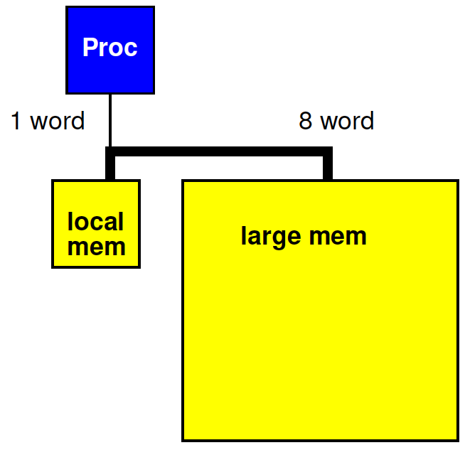
Revisit Preclass 3
Use wide memory access to move 8 words (x[]) between large and small memory in a single cycle

Slide 48
Preclass 3 + wide
Impact of 8 word datapath between
large and local memory?
WSIZE*MAX*(T_{comp}+3*T_{local})
+WSIZE*(T_{w}+T_{x})
+MAX*T_{x}
5*10⁶*(5+3)
+5*(20+20)
+10⁶*20
6*10⁷
What term(s) impacted?

Slide 49
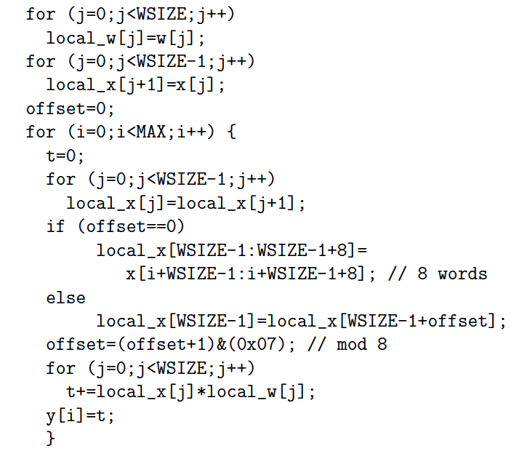
Preclass 3 + wide
WSIZE*MAX*(T_{comp}+3*T_{local})
+WSIZE*(T_{w}+T_{x})
+MAX/8*T_{x}
+MAX*(T_{local}+2T_{comp})
5*10⁶*(5+3)
+5*(20+20)
+10⁶*20/8
+10⁶*3
4.55*10⁷

Slide 50
Amdahl’s Law

Slide 51
Amdahl’s Law
If you only speedup Y(%) of the code, the most you can accelerate your application is 1/(1-Y)
T_{before} = 1*Y + 1*(1-Y) = 1
Speedup by factor of S
T_{after}=(1/S)*Y+1*(1-Y)
Limit S→infinity T_{before}/T_{after}=1/(1-Y)

Slide 52
Amdahl’s Law
T_{before} = 1*Y + 1*(1-Y) = 1
Speedup by factor of S
T_{after}=(1/S)*Y+1*(1-Y)
Y=70%
  Possible speedup (S→infinity) ?
  Speedup if S=10?

Slide 53
Amdahl’s Law
If you only speedup Y(%) of the code, the most you can accelerate your application is 1/(1-Y)
Implications
  Amdhal: good to have a fast sequential processor
  Keep optimizing
    T_{after}=(1/S)*Y+1*(1-Y)
    For large S, bottleneck now in the 1-Y

Slide 54
Memory Organization
Architecture contains
  Large memories
    For density, necessary sharing
  Small memories local to compute
    For high bandwidth, low latency, low energy
Need to move data
  Among memories
    Large to small and back
    Among small

Slide 55
Big Ideas
Memory bandwidth and latency can be bottlenecks
Exploit small, local memories
  Easy bandwidth, low latency, energy
Exploit data reuse
  Keep in small memories
Minimize data movement
  Small, local memories keep distance short
  Minimally move into small memories

Slide 56
Admin
Reading for Wednesday on canvas
If never seen a Lego
  Plan to watch short (<3min) video before preclass for Wednesday
Board distribution on Wednesday
  10:05am to lecture start
HW2 due Friday

