Slide 1

ESE5320:
System-on-a-Chip Architecture
Day 4: September 11, 2024
Parallelism Overview
Board holders pickup boards
Preclass

Slide 2
Today
Compute Models (Part 1)
  How do we express and reason about parallel execution freedom
Types of Parallelism (Part 2)
  How can we slice up and think about parallelism?
  How exploit parallelism

Slide 3
Message
Many useful models for parallelism
  Help conceptualize
One-size does not fill all
  Match to problem
  Will want to exploit all of them

Slide 4
Parallel Compute Models
Control Flow, Dataflow
Combining
Explicit, Implicit Parallelism

Slide 5
Term: Operation
Operation – logic computation to be performed

Slide 6
Sequential Control Flow
Control flow
Program is a sequence of operations
Operation reads inputs and writes outputs into common store (memory)
One operation runs at a time
  defines successor
Model of correctness is sequential execution
Examples
C (Java, …)
Finite-State Machine (FSM)
Finite Automata (FA)
assembly code (ISA)

Slide 7
Parallelism can be explicit
State which operations occur on a cycle
Multiply, add for quadratic equation
cycle | mpy | add
1 | B,x
2 | x,x | (Bx)+C
3 | A,x²
4 |  | Ax²+(Bx+C)

Slide 8
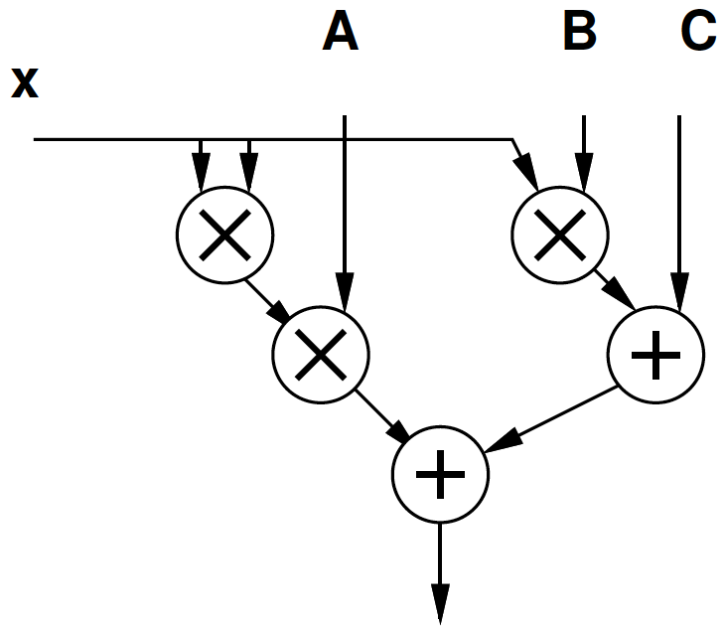
Parallelism can be implicit
Sequential expression
Infer data dependencies
T1=x*x
T2=A*T1
T3=B*x
T4=T2+T3
Y=C+T4
Or
Y=A*x*x+B*x+C

Slide 9
Implicit Parallelism
d=(x1-x2)*(x1-x2) + (y1-y2)*(y1-y2)
What parallelism exists here?

Slide 10
Parallelism can be implicit
Sequential expression
Infer data dependencies
for (i=0;i<100;i++)
y[i]=A*x[i]*x[i]+B*x[i]+C
Why can these operations be performed in parallel?

Slide 11
Dataflow / Control Flow
Dataflow
Program is a graph of operations
Operation consumes tokens and produces tokens
All operations run concurrently
Control flow (e.g. C)
Program is a sequence of operations
Operation reads inputs and writes outputs into common store
One operation runs at a time
  defines successor

Slide 12
Token
Data value with presence indication
  May be conceptual
    Only exist in high-level model
    Not kept around at runtime
  Or may be physically represented
    One bit represents presence/absence of data

Slide 13
FIFO
Hardware Block
Outputs data in order received
  First-In, First-Out
Tell it when you are providing data
  Write
  May choose not to insert on a cycle
    Need to signal
Tell it when you are consuming data
  Read
Tells you when it’s empty and has no data to provide
Tells you when it’s full and can hold nothing else
What are data presence indicators here?

Slide 14
Token Examples?
How signal miss in processor data cache and processor needs to wait for data?

Slide 15

Operation
Takes in one or more inputs
Computes on the inputs
Produces results
Logically self-timed
  “Fires” only when input set present
  Signals availability of output

Slide 16
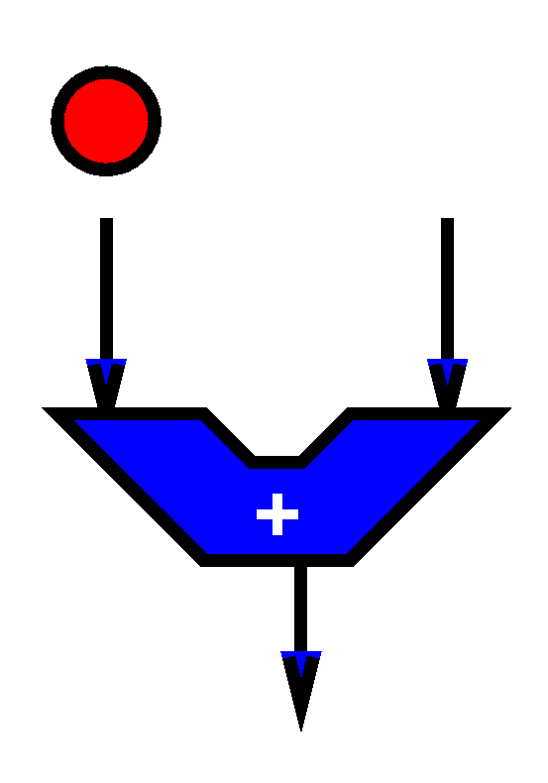
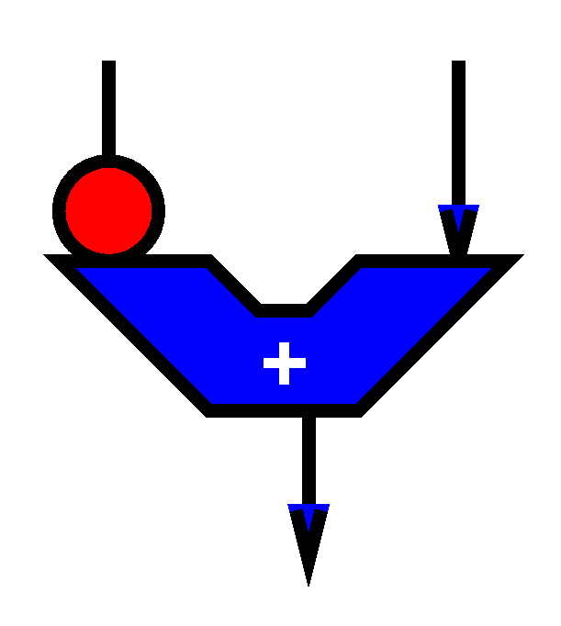
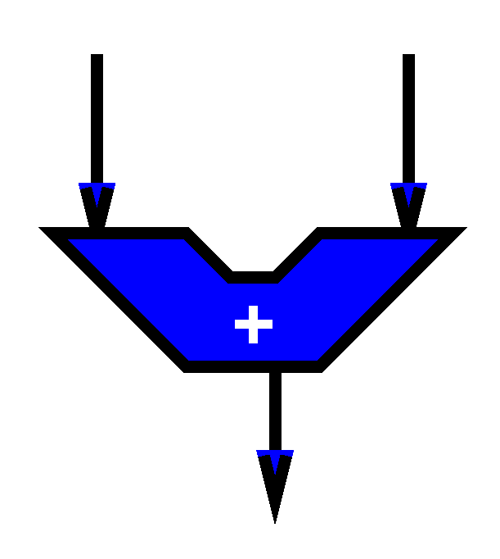
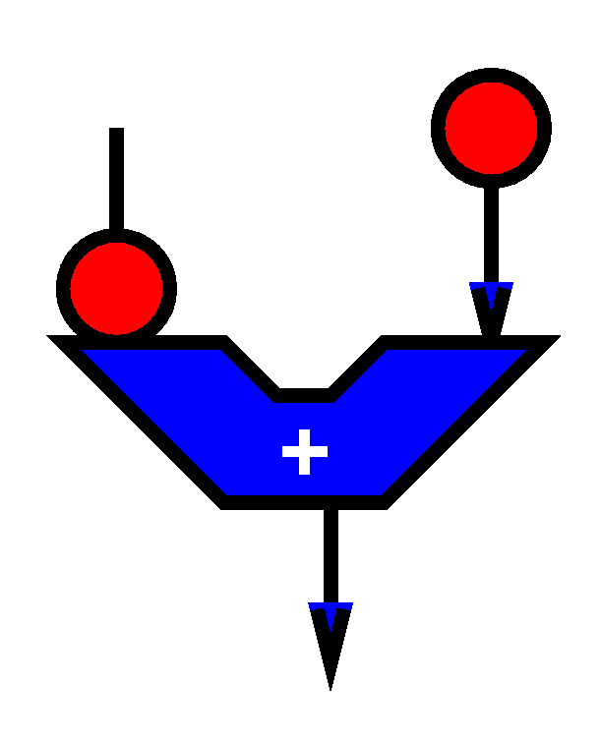
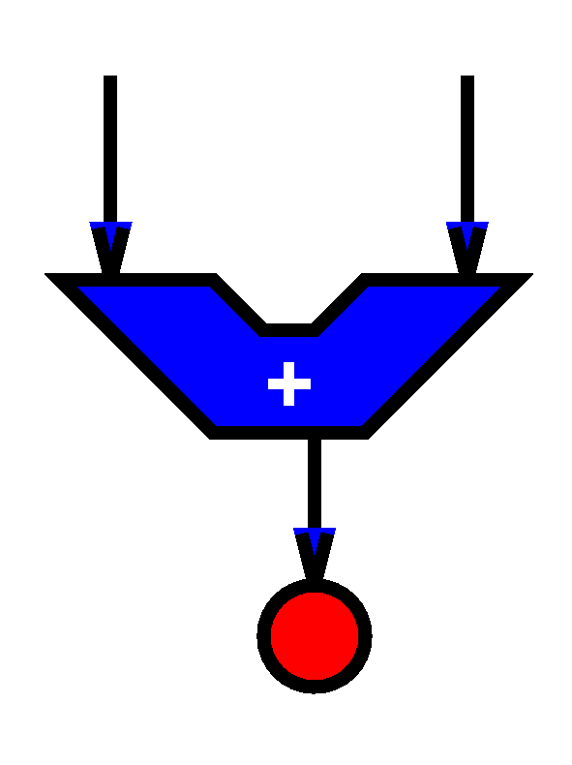

Slide 17
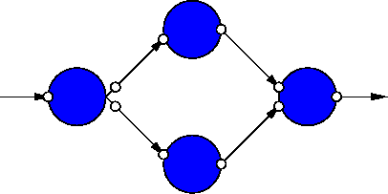
Dataflow Graph
Represents
  computation sub-blocks
  linkage
Abstractly
  controlled by data presence

Slide 18
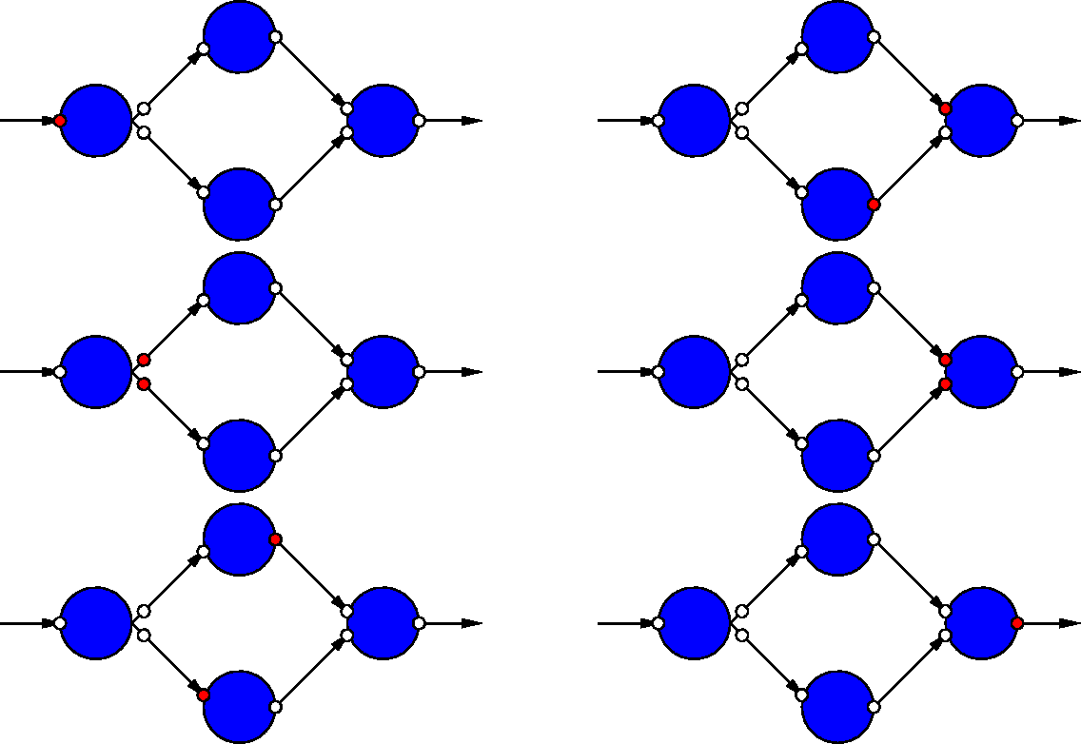
Dataflow Graph Example

Slide 19
Dataflow / Control Flow
Dataflow
Program is a graph of operations
Operation consumes tokens and produces tokens
All operations run concurrently
Control flow (e.g. C)
Program is a sequence of operations
Operation reads inputs and writes outputs into common store
One operation runs at a time
  defines successor

Slide 20
Communicating Threads
Computation is a collection of sequential/control-flow “threads”
Threads may communicate
  Through dataflow I/O
  (Through shared variables)
View as hybrid or generalization
  Of control flow and dataflow
CSP – Communicating Sequential Processes → canonical model example

Slide 21
Video Decode
Audio
Sync to HDMI
Parse
Video
Why might need to synchronize to send to HDMI?

Slide 22
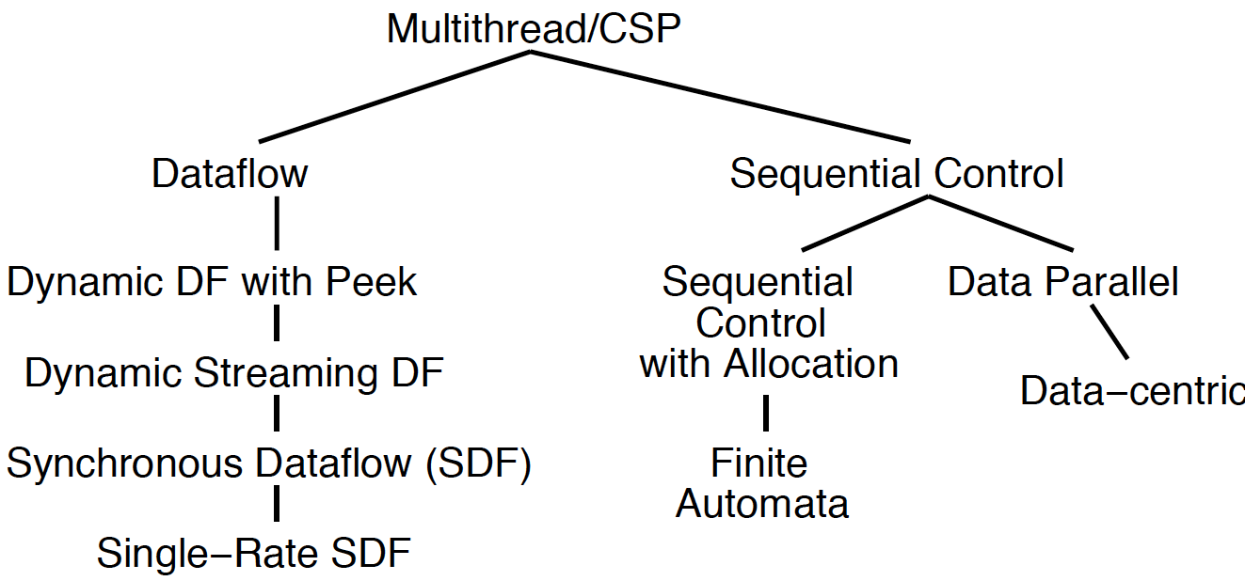
Compute Models

Slide 23
All Used
All of these things get used in modern CPUs and SoCs
  Sequential control flow
  Operation parallelism
  Data presence and data-driven flow
  Multiple threads
  Data Parallel

Slide 24

Value of Multiple Models
When you have a big enough
hammer, everything looks like
a nail.
Many stuck on single model
  Try to make all problems look like their nail
Value to diversity / heterogeneity
  One size does not fit all

Slide 25
Types of Parallelism
Part 2

Slide 26
Types of Parallelism
Data Level – Perform same computation on different data items
Thread or Task Level – Perform separable (perhaps heterogeneous) tasks independently
Instruction Level – Within a single sequential thread, perform multiple operations on each cycle.

Slide 27
Pipeline Parallelism
Pipeline – organize computation as a spatial sequence of concurrent operations
  Can introduce new inputs before finishing
  Instruction- or thread-level
  Use for data-level parallelism
  Can be directed graph

Slide 28

Sequential
Single person build E
Latency?
Throughput?

Slide 29
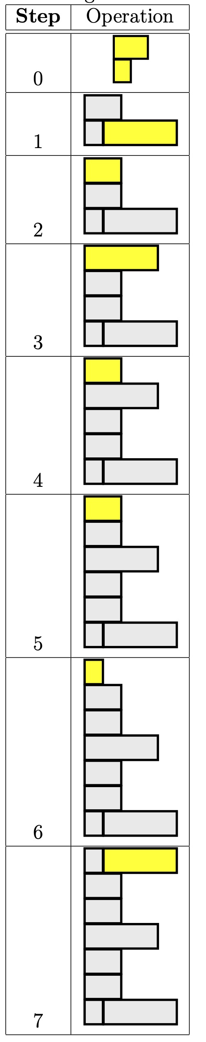
Data Parallel
Everyone with Legos build own E

Slide 30
Data Parallel
Everyone in class build own E
Latency?
Throughput?
Ideal speedup?
Resource Bound?
  100 Es, 12 people
When useful?

Slide 31
Data-Level Parallelism
Data Level – Perform same computation on different data items
Resource Bound: T_{dp} = T_{seq}/P
(with enough independent problems, match our resource bound computation)

Slide 32
Thread Parallel
Each person build distinct letter or number (e.g. E, S, 5, 3, 2, 0)

Slide 33
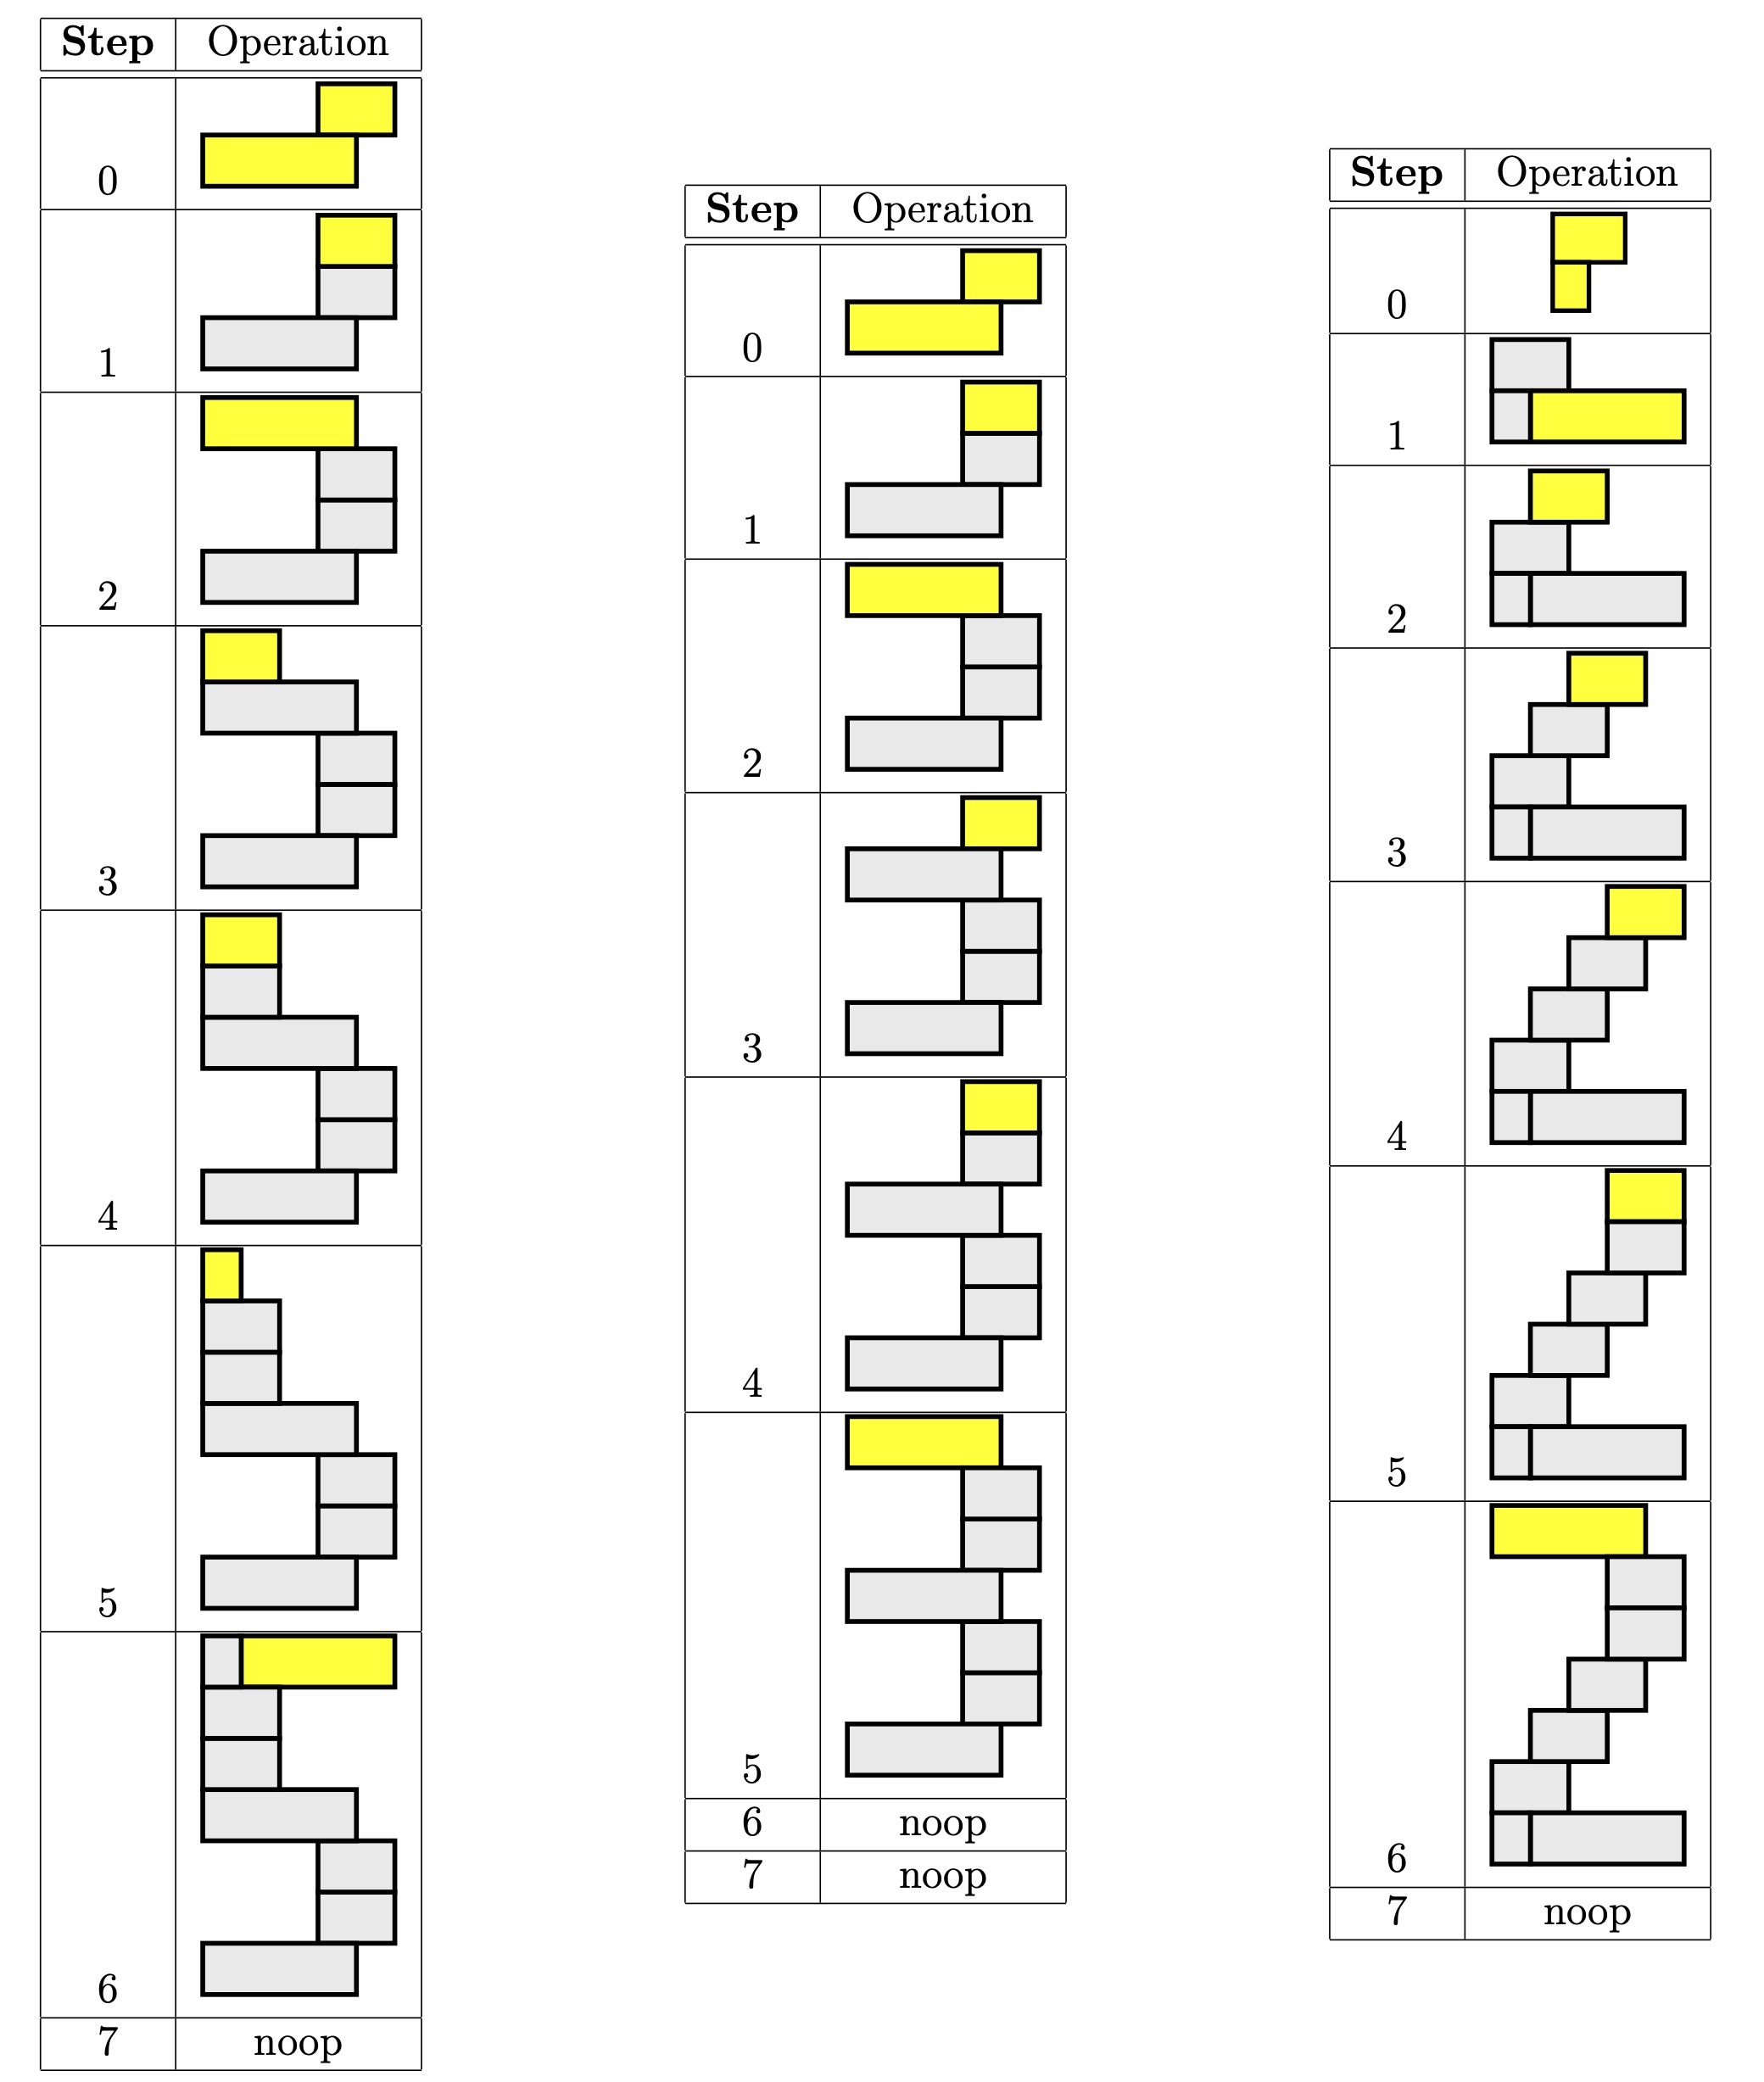
Thread Parallel
Likely get
3 volunteers
to help demo.

Slide 34
Thread Parallel
Each person build distinct letter or number (e.g. E, S, 5, 3, 2, 0)
Latency? (assume each has <=9 bricks)
Throughput?
  Build 6 distinct letters
  Using 6 people
  (distinct letters/time-unit)
Speedup over sequential build of 6 letters?

Slide 35
Thread-Level Parallelism
Thread or Task Level – Perform separable (perhaps heterogeneous) tasks independently
Resource Bound: T_{tp} = T_{seq}/P
T_{tp}=max(T_{t1},T_{t2},T_{t3},…)
  Less speedup than ideal if not balanced
Can produce a diversity of calculations
  Useful if have limited need for the same calculation

Slide 36
Instruction-Level Parallelism
Build single letter in lock step
Group of 3
  [3 volunteers; steps up front]
Resource Bound for 3 people building 9-brick letter?
Announce steps from slide
  Stay in step with slides

Slide 37
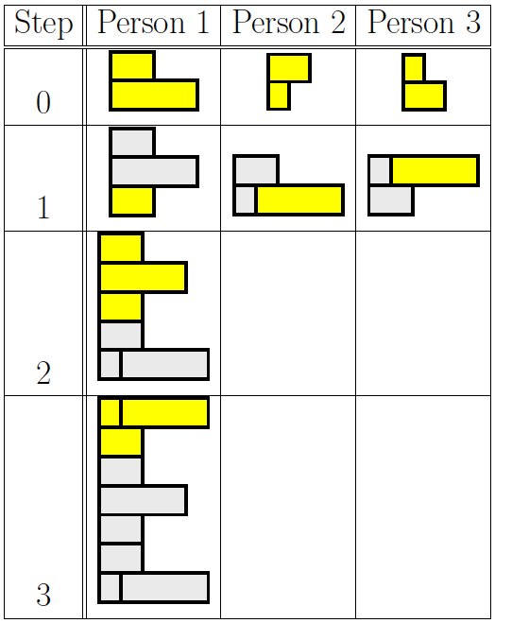
Group Communication
Groups of 3
Note who was person 1 task
2, 3 will need to pass completed substructures

Slide 38
Step 0

Slide 39
Step 1

Slide 40
Step 2

Slide 41
Step 3

Slide 42
Instruction-Level Parallelism (ILP)
Latency?
Throughput?
Can reduce latency for single letter
Resource Bound: T_{latency} = T_{seqlatency}/P
  Remember critical path bound applies; dependencies may limit

Slide 43
Instruction-Level Pipeline
Each person adds one brick to build
Resources? (people in pipeline?)
Run pipeline once alone
Latency? (brick-adds to build letter)
Then run pipeline with 5 inputs
Throughput? (letters/brick-add-time)

Slide 44
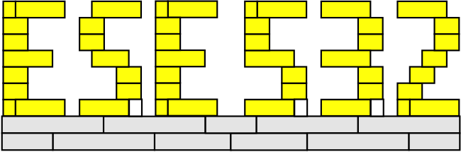
Thread Graph
How would we build with task level parallelism?
  Tasks?
  Dependencies?

Slide 45
Types of Parallelism
Data Level – Perform same computation on different data items
Thread or Task Level – Perform separable (perhaps heterogeneous) tasks independently
Instruction Level – Within a single sequential thread, perform multiple operations on each cycle.

Slide 46
Pipeline Parallelism
Pipeline – organize computation as a spatial sequence of concurrent operations
  Can introduce new inputs before finishing
  Instruction- or thread-level
  Use for data-level parallelism
  Can be directed graph

Slide 47
Big Ideas
Many parallel compute models
  Sequential, Dataflow, CSP
Find natural parallelism in problem
Mix-and-match
Likely to need all of them at some point

Slide 48
Admin
Reading Day 5 on web
HW2 due Friday
HW3 out
  Including partner assignments on canvas
  Board Holder reach out to partner ASAP

