Slide 1

ESE5320:
System-on-a-Chip Architecture
Day 6: September 18, 2024
Data-Level Parallelism
Preclass

Slide 2
Today
Data-level Parallelism
For Parallel Decomposition (Part 1)
Architectures (Part 2)
Concepts (Part 3)
NEON

Slide 3
Message
Data Parallelism easy basis for decomposition
  When things are data parallel, exploiting for parallelism relatively easy
Data Parallel architectures can be compact
  pack more computations onto a fixed-size Integrated Circuit chip
  OR perform computation in less area

Slide 4
Preclass 1
500 news articles
  3000 words each
Count total occurrences of a string
How can we exploit data-level parallelism on task?
How much parallelism can we exploit?
  If don’t exploit parallelism within article?
  If do exploit parallelism within article?

Slide 5
Parallel Decomposition

Slide 6
Data Parallel
Data-level parallelism can serve as an organizing principle for parallel task decomposition
Run computation on independent data in parallel

Slide 7
Exploit
Can exploit with
  Threads
  Pipeline Parallelism
  Instruction-level Parallelism
  Fine-grained Data-Level Parallelism

Slide 8
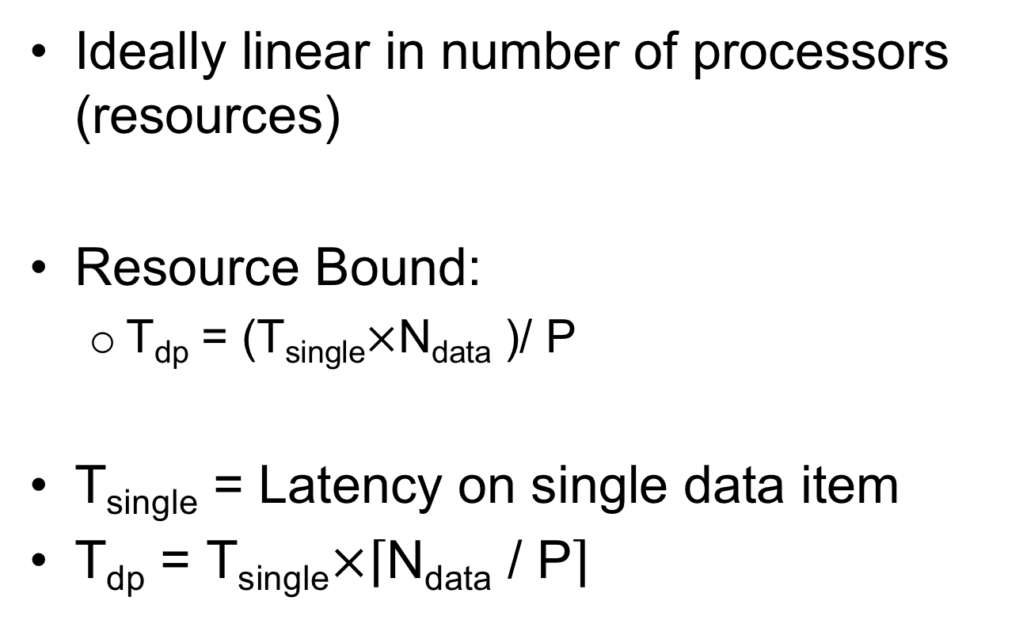
Performance Benefit
Ideally linear in number of processors (resources)
Resource Bound:
  T_{dp} = (T_{single}$×$N_{data} )/ P
T_{single} = Latency on single data item
T_{dp} = T_{single}$×\left\lceil \text{N}\text{data}\text{ / }\text{P}\right\rceil$

Slide 9
Vector
In Math – 1D array of numbers
Vector A = [2, 3, 5, 7]
Vector B = [4, 6, 8, 9]
A+B = [6, 9, 13,16]

Slide 10
Preclass 2
Common Examples
What are common examples of DLP?
  Numerical Linear Algebra
    E.g. Vector Add, Matrix-Vector Multiplication
  Simulation
  Signal or Image Processing
  Optimization

Slide 11
Hardware Architectures
Part 2

Slide 12
Idea
If we’re going to perform the same operations on different data,
exploit that to reduce area, energy
Reduced area means can have more computation on a fixed-size IC chip.

Slide 13
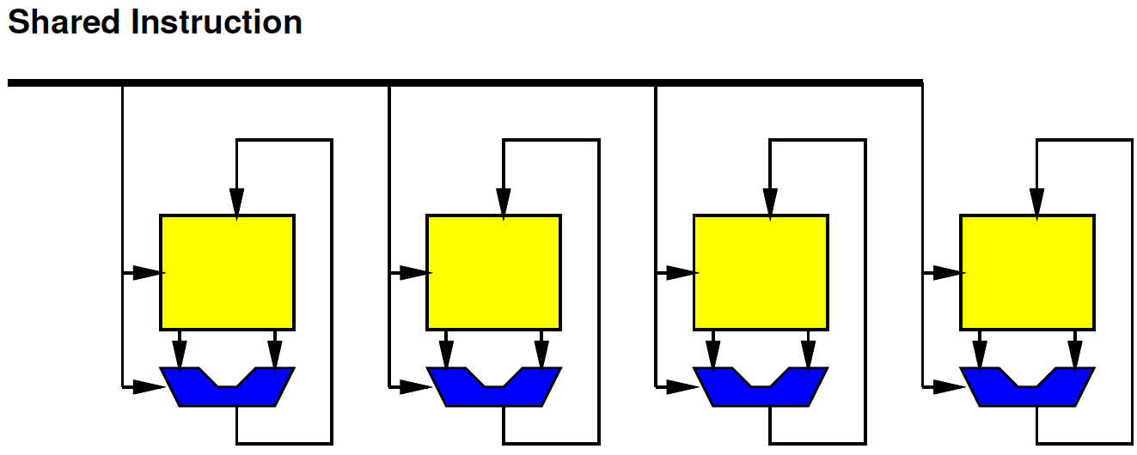
SIMD
Single Instruction Multiple Data

Slide 14
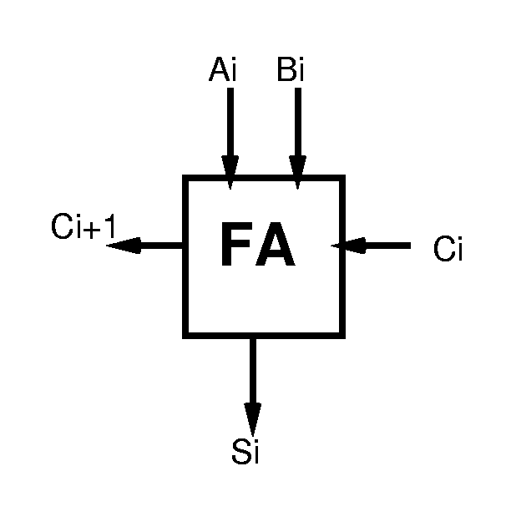
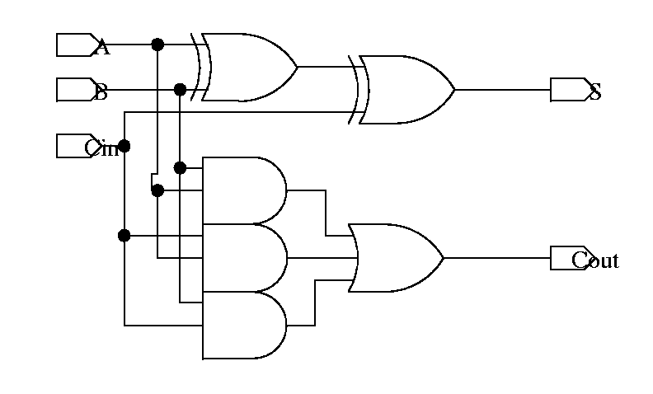
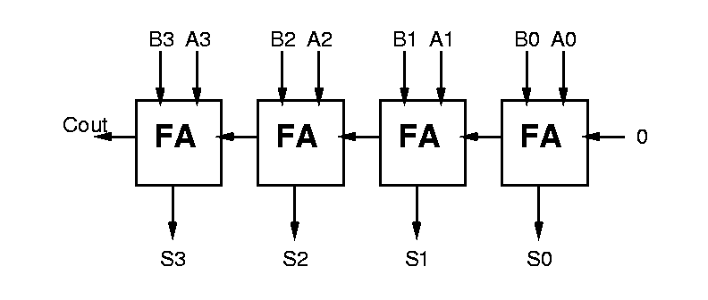
Ripple Carry Addition
Can define logic for each bit, then assemble:
  bit slice

Slide 15
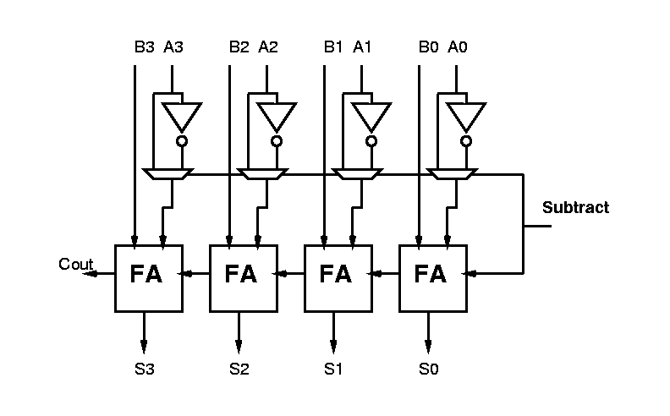
Arithmetic Logic Unit (ALU)
Observe:
  with small tweaks can get many functions with basic adder components

Slide 16

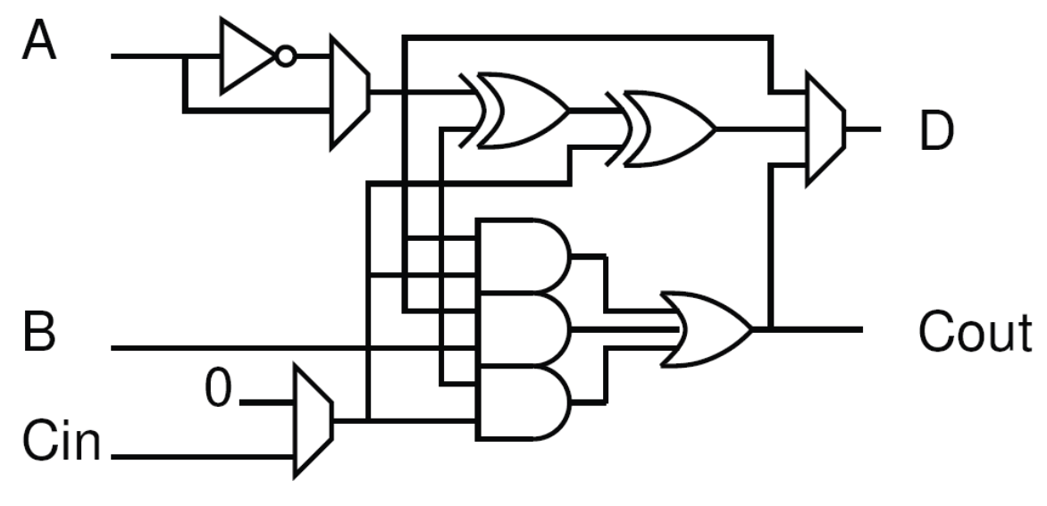
Arithmetic and Logic Unit

Slide 17
ALU Functions
A+B w/ Carry
B-A
A xor B (squash carry)
A*B (squash carry)
/A
Key observation: every ALU bit does the same thing
on different bits of the data word(s).

Slide 18
ARM v7 Core
ALU is Key compute operator in a processor

Slide 19
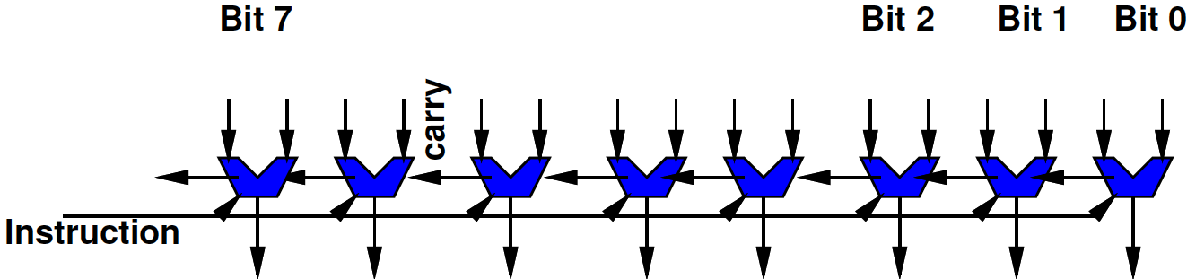
W-bit ALU as SIMD
Familiar idea
A W-bit ALU (W=8, 16, 32, 64, …) is SIMD
Each bit of ALU works on separate bits
  Performing the same operation on it
    Trivial to see bitwise AND, OR, XOR
    Also true for ADD (each bit performing Full Adder)
Share one instruction across all ALU bits

Slide 20
ALU Bit Slice

Slide 21
Preclass 4
What do we get when add 65280 to 257
  32b unsigned add?
  16b unsigned add?

Slide 22
ALU vs. SIMD ?
What’s different between
  128b wide ALU
  SIMD datapath supporting eight 16b ALU operations

Slide 23
ALU vs. SIMD Example
Concretely show:
  16b wide ALU
  SIMD datapath with two 8b wide ALUs

Slide 24
ALU vs. SIMD ?
How could we get both operations from the same hardware?
  128b wide ALU
  SIMD datapath supporting eight 16b ALU operations

Slide 25
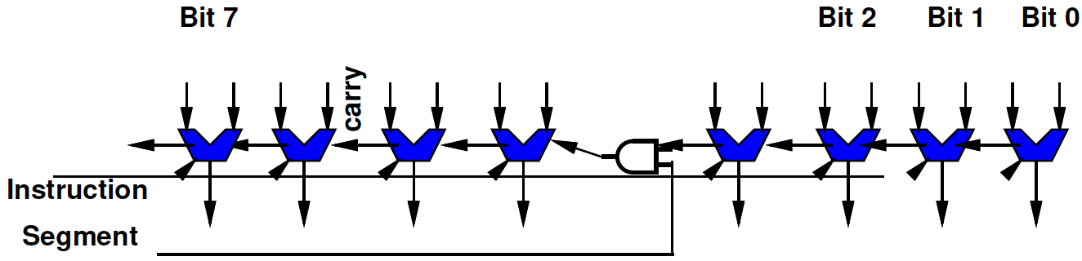
Segmented Datapath
Add a few gates to convert a wide datapath into one supporting a set of smaller operations
  Just need to squash the carry at points

Slide 26
Segmented Datapath
Add a few gates to convert a wide datapath into one supporting a set of smaller operations
  Just need to squash the carry at points
But need to keep instructions (description) small
  So typically have limited, homogeneous widths supported

Slide 27
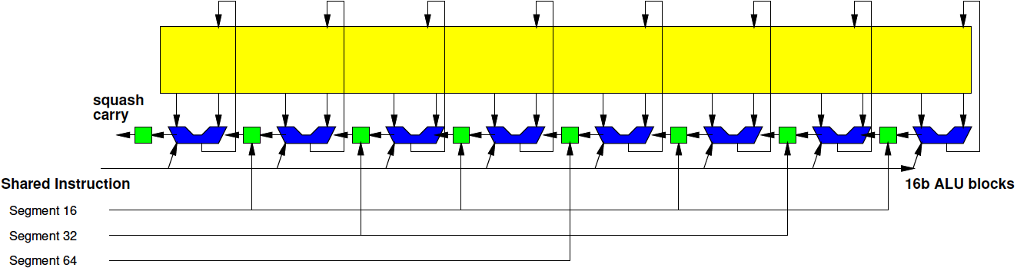
Segmented 128b Datapath
1x128b, 2x64b, 4x32b, 8x16b
(only 4 cases, so can decode from 2b)

Slide 28
Vector
In Math – 1D array of numbers
Here – 1D array of numbers that we operate upon with SIMD operations
  Perform the same operations on
Vector A = [2, 3, 5, 7]
Vector B = [4, 6, 8, 9]
A+B = [6, 9, 13,16]

Slide 29
Terminology: Vector Lane
Each of the separate segments called a Vector Lane
  Length of vector hardware natively supports
For 16b data on 128b datapath, this provides 8 vector lanes

Slide 30
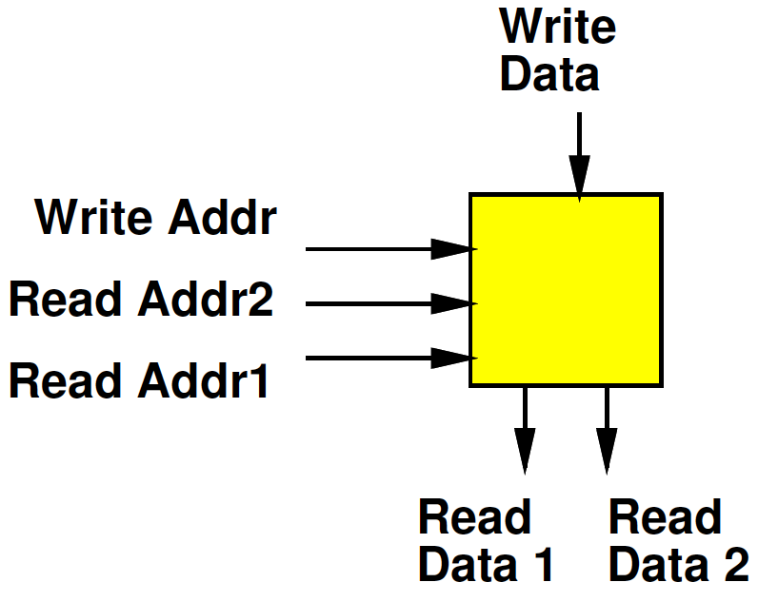
Register File
Small Memory
Usually with multiple ports
  Ability to perform multiple reads and writes simultaneously
Small
  To make it fast (small memories fast)
  Multiple ports are expensive

Slide 31
SIMD Datapath
Logical View:
Layout View:

Slide 32
Preclass 3:
Opportunity
Don’t need 64b variables for lots of things
Natural data sizes?
  Audio samples?
  Input from A/D?
  Video Pixels?
  X, Y coordinates for 4K x 4K image?

Slide 33
Preclass 5
Look at Area of datapath
Imagine filling an IC die with copies (instances) of datapath
  If datapath smaller, can fit more of them into fixed die area
Look at computation this provides

Slide 34
Preclass 5
W | A(W) | % datapath | Instances | Peak 16b ops
16
64
128
256

Slide 35
Preclass 5
W | A(W) | % datapath | Instances | Peak 16b ops | Ratio
16 | 1.1 | 9 | 91 | 91 | 1.0
64
128 | 1.8 | 43 | 56 | 448 | 4.9
256
Complete: 64, 256

Slide 36
Preclass 5
W | A(W) | % datapath | Instances | Peak 16b ops | Ratio
16 | 1.1 | 9 | 91 | 91 | 1.0
64
128 | 1.8 | 43 | 56 | 448 | 4.9
256
Complete: 64, 256

Slide 37
Preclass 5
Why?
W | A(W) x10^6 | % datapath | Instances | Peak 16b ops | Ratio
16 | 1.1 | 9 | 91 | 91 | 1.00
64 | 1.4 | 28 | 71 | 284 | 3.16
128 | 1.8 | 43 | 56 | 448 | 4.90
256 | 2.5 | 60 | 39 | 640 | 6.85
(c)

Slide 38
To Scale Comparison

Slide 39
To Scale W=1024

Slide 40
Preclass 5
W | A(W) x10⁶ | % datapath | Instances | Peak 16b ops | Ratio
16 | 1.1 | 9 | 91 | 91 | 1.00
64 | 1.4 | 28 | 71 | 284 | 3.16
128 | 1.8 | 43 | 56 | 448 | 4.90
256 | 2.5 | 60 | 39 | 640 | 6.85
(c) | 100
What get for 5c?

Slide 41
Preclass 5
W | A(W) x10⁶ | % datapath | Instances | Peak 16b ops | Ratio
16 | 1.1 | 9 | 91 | 91 | 1.00
64 | 1.4 | 28 | 71 | 284 | 3.16
128 | 1.8 | 43 | 56 | 448 | 4.90
256 | 2.5 | 60 | 39 | 640 | 6.85
(c) 16,500 | 100 | 100-epsilon | 1 | 1031 | 11.32

Slide 42
Take Away
Wider SIMD → greater potential density
  More compute per cm² of silicon
There is a point of diminishing return
  Once over half the area in datapath
Wider SIMD may be inefficient if do not have enough data-level parallelism

Slide 43
Preclass 6: Vector Length
May not match physical hardware length
  Logical (application need): Vector Length
  Physical (hardware provide): Vector Lanes
vadd(int *a, int *b, int *res,
int vector_length) {
for (int i=0;i<vector_length;i++)
    res[i]=a[i]+b[i];
    }

Slide 44
Preclass 6:
Vector Length
May not match physical hardware length
  Logical (application need): Vector Length
  Physical (hardware provide): Vector Lanes
Efficiency (utilization) when
  Vector length < Vector Lanes? (5, 8)
  Vector length > Vector Lanes? (24, 8)
  Vector length % (Vector Lanes) !=0 (13, 8)
    E.g. vector length 13, for 8 vector lanes

Slide 45

Performance
Resource Bound
  T_{vector} = $\left\lceil \text{N}\text{op}\text{/}\text{VL}\right\rceil ×$T_{cycle}

Slide 46
Vector Computation
Easy to map to SIMD flow if can express computation as operation on vectors
  Vector Add
  Vector Multiply
  Dot Product

Slide 47
Concepts
Part 3

Slide 48
Terminology: Scalar
Simple: non-vector
When we have a vector unit controlled by a normal (non-vector) processor core often need to distinguish:
  Vector operations that are performed on the vector unit
  Normal=non-vector=scalar operations performed on the base processor core

Slide 49
Vector Register File
Need to be able to feed the SIMD compute units
  Not be bottlenecked on data movement to the SIMD ALU
Wide RF (register file) to supply
With wide path to memory

Slide 50
Point-wise Vector Operations
Easy – just like wide-word operations
(now with segmentation)

Slide 51
Point-wise Vector Operations
…but alignment matters.
If not aligned, need to perform data movement operations to get aligned
  E.g. a[0]…a[7] + b[1]…b[8]

Slide 52
Ideal
for (i=0;i<64;i=i++)
  c[i]=a[i]+b[i]
No data dependencies
Access every element
Number of operations is a
multiple of number of vector lanes

Slide 53
Skipping Elements?
How does this work with datapath?
  Assume loaded a[0], a[1], …a[63] and b[0], b[1], …b[63] into vector register file
for (i=0;i<64;i=i+2)
  c[i/2]=a[i]+b[i]

Slide 54
Stride
Stride: the distance between vector elements used
for (i=0;i<64;i=i+2)
  c[i/2]=a[i]+b[i]
Accessing data with stride=2

Slide 55
Load/Store
Strided load/stores
  Some architectures will provide strided memory access that compact when read into register file
Scatter/gather
  Some architectures will provide memory operations to grab data from different places to construct a dense vector

Slide 56
Neon
ARM Vector Accelerator

Slide 57
Programmable SoC
UG1085
Xilinx
UltraScale
Zynq
TRM
(p27)

Slide 58
APU MPcore
UG1085
Xilinx
UltraScale
Zynq
TRM
(p53)

Slide 59
Neon Vector
128b wide register file, 16 registers
Support
  2x64b
  4x32b (also Single-Precision Float)
  8x16b
  16x8b

Slide 60
Sample Instructions
VADD – basic vector
VCEQ – compare equal
  Sets to all 0s or 1s, useful for masking
VMIN – avoid using if’s
VMLA – accumulating multiply
VPADAL – maybe useful for reduce
  Vector pair-wise add
VEXT – for “shifting” vector alignment
VLDn – deinterleaving load

Slide 61
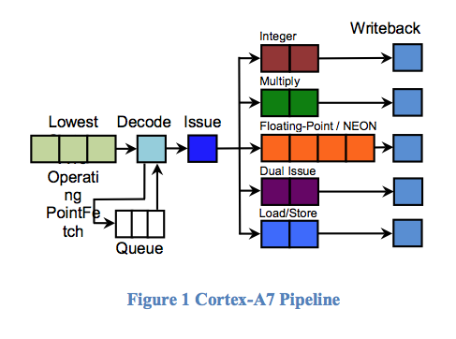
ARM Cortex A53 (Ultra96)
(similar to A-7 Pipeline)
2-issue
In-order
1 NEON pipe
128b wide
8-stage pipe
https://www.anandtech.com/show/8718/the-samsung-galaxy-note-4-exynos-review/3
https://arstechnica.com/gadgets/2011/10/arms-new-cortex-a7-is-tailor-made-for-android-superphones/

Slide 62
Big Ideas
Data Parallelism easy basis for decomposition
Data Parallel architectures can be compact – pack more computations onto a chip
  SIMD, Pipelined
  Benefit by sharing (instructions)
  Performance can be brittle
    Drop from peak as mismatch

Slide 63
Admin
Remember feedback
Reading for Day 7 online
HW3 due Friday
HW4 out
  Including partner assignments
    Board holders – contact partner soon

