Slide 1

ESE5320:
System-on-a-Chip Architecture
Day 9: September 30, 2024
High-Level Synthesis (HLS)
C-to-gates
More accurate: C-for-gates

Slide 2
Today
Motivation
Spatial Computations from C specification
  Variables and expression (pre-lecture)
  Simple Conditionals (Part 1)
  Functions (part 2)
  Globals
  Loops and Arrays (Part 3)

Slide 3
Message
C (or any programming language) specifies a computation
C can describe spatial computation
  A dataflow graph with physical operators for each operation
Underlying semantics is sequential
  Watch for unintended sequentialization
  Write C for spatial differently than write C for processors

Slide 4
Coding Accelerators
Want to exploit FPGA logic on Zynq to accelerate computations
Traditionally has meant develop accelerators in
  Hardware Description Language (HDL)
    E.g. Verilog → see in CIS4710, CIS5710
  Directly in schematics

Slide 5
Course “Hypothesis”
C-to-gates synthesis mature enough to use to specify hardware
  Leverage fact everyone knows C
    (must, at least, know C to develop embedded code)
  Avoid taking time to teach Verilog or VHDL
    Or making Verilog a pre-req.
  Focus on teaching how to craft hardware
    Using the C already know
    …may require thinking about the C differently

Slide 6
Discussion [open]
Is it obvious we can write C to describe hardware?
What parts of C translate naturally to hardware?
What parts of C might be problematic?
What parts of hardware design might be hard to describe in C?

Slide 7
Three Perspectives
How express spatial/hardware computations in C
  May want to avoid some constructs in C
How express computations
  Hopefully, equally accessible to
  spatial and sequential implementations
Given C code: how could we implement in spatial hardware
  Some corner cases and technicalities make tricky
[copy to board]

Slide 8
Advantage
Use C for hardware and software
  Test out functionality entirely in software
    Debug code before put on hardware
      where harder to observe what’s happening
    …without spending time in place and route
      …which you soon see is slow…
  Explore hardware/software tradeoffs by targeting same code to either hardware or software

Slide 9
C Hardware
Hardware accelerator must fit into fixed space
  E.g. the 70K LUTs on the Zynq
  Computations that go on accelerator must be of bounded size
Must decide that space at compile time (when run place and route)
  Pay attention to what’s data dependent

Slide 10
Context
C most useful for describing behavior of operators
C alone doesn’t naturally capture task parallelism

Slide 11
Preclass F
Ready for preclass f?
Skip to preclass f

Slide 12
C Primitives
Arithmetic Operators
Unary Minus (Negation) -a
Addition (Sum) a + b
Subtraction (Difference) a - b
Multiplication (Product) a * b
Division (Quotient) a / b
Modulus (Remainder) a % b
Things might have a hardware operator for…

Slide 13
C Primitives
Bitwise Operators
Bitwise Left Shift a << b
Bitwise Right Shift a >> b
Bitwise One's Complement ~a
Bitwise AND a & b
Bitwise OR a | b
Bitwise XOR a ^ b
Things might have a hardware operator for…

Slide 14
C Primitives
Comparison Operators
Less Than a < b
Less Than or Equal To a <= b
Greater Than a > b
Greater Than or Equal To a >= b
Not Equal To a != b
Equal To a == b
Logical Negation !a
Logical AND a && b
Logical OR a || b
Things might have a hardware operator for…

Slide 15
Expressions: combine operators
a*x+b
a
x
b
*
+
A connected set of operators
→ Graph of operators

Slide 16
Expressions: combine operators
a*x+b
a*x*x+b*x+c
a*(x+b)*x+c
((a+10)*b < 100)
A connected set of operators
→ Graph of operators

Slide 17
C Assignment
Basic assignment statement is:
Location = expression
f=a*x+b
a
x
b
*
+
f

Slide 18
Straight-line code
a sequence of assignments
What does this mean?
  g=a*x;
  h=b+g;
  i=h*x;
  j=i+c;
a
x
b
c
*
g
+
h
*
i
+
j

Slide 19
Variable Reuse
Variables (locations) define flow between computations
Locations (variables) are reusable
  t=a*x;
  r=t*x;
  t=b*x;
  r=r+t;
  r=r+c;

Slide 20
Variable Reuse
Variables (locations) define flow between computations
Locations (variables) are reusable
  t=a*x; t=a*x;
  r=t*x; r=t*x;
  t=b*x; t=b*x;
  r=r+t; r=r+t;
  r=r+c; r=r+c;
Sequential assignment semantics tell us which definition goes with which use.
  Use gets most recent preceding definition.

Slide 21
Dataflow
Can turn sequential assignments into dataflow graph through def→use connections
  t=a*x; t=a*x;
  r=t*x; r=t*x;
  t=b*x; t=b*x;
  r=r+t; r=r+t;
  r=r+c; r=r+c;
a
x
b
c
*
*
*
+
+

Slide 22
Dataflow Height
t=a*x; t=a*x;
  r=t*x; r=t*x;
  t=b*x; t=b*x;
  r=r+t; r=r+t;
  r=r+c; r=r+c;
Height (delay) of DF graph may be less than # sequential instructions.
a
x
b
c
*
*
*
+
+

Slide 23
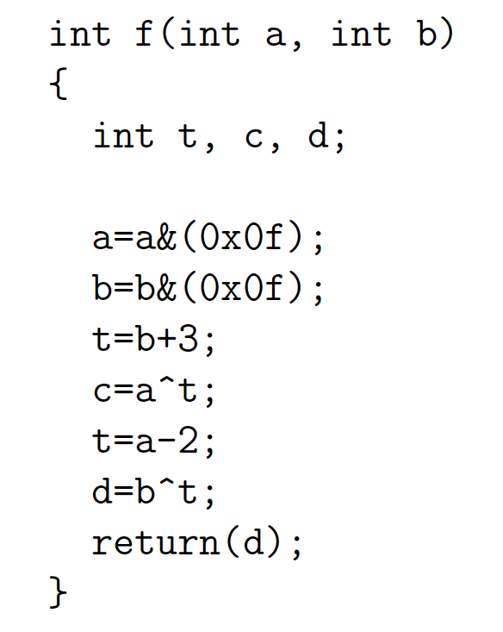
Lecture Checkpoint
Happy with ?
  Straight-line code
  Variables
Graph for preclass f

Slide 24
Straight Line Code
C is fine for expressing straight-line code and variables
  Has limited data types
    Address with tricks like masking
    Address with user-defined types

Slide 25
Optimizations can probably expect compiler to do
Constant propagation: a=10; b=c[a];
Copy propagation: a=b; c=a+d; → c=b+d;
Constant folding: c[10*10+4]; → c[104];
Identity Simplification: c=1*a+0; → c=a;
Strength Reduction: c=b*2; → c=b<<1;
Dead code elimination
Common Subexpression Elimination:
  C[x*100+y]=A[x*100+y]+B[x*100+y]
  t=x*100+y; C[t]=A[t]+B[t];
Operator sizing: for (i=0; i<100; i++) b[i]=(a&0xff+i);

Slide 26
Conditionals
What can we do for simple conditionals?
if (a>b)
c=b*c;
else
c=a*c;

Slide 27
Simple Control Flow
If (cond) { … } else { …}
Assignments become conditional
In simplest cases (no memory ops),
can treat as dataflow node
cond
then
else
choose

Slide 28
Simple Conditionals:
Mux Conversion
if (a>b)
c=b*c;
else
c=a*c;
a>b
b*c
a*c
c

Slide 29
Simple Conditionals
v=a;
if (b>a)
v=b;
If not assigned, value flows from before assignment
b>a
b
a
v

Slide 30
Simple Conditionals
a
max=a;
min=a;
if (a>b)
{min=b;
c=1;}
else
{max=b;
c=0;}
May (re)define many values on each branch.
a>b
b
1
0
min
max
c

Slide 31
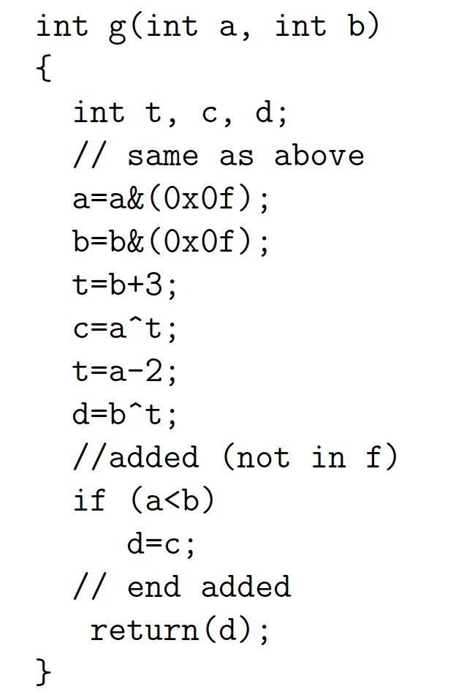
Preclass G
Graph for preclass g
as mux-conversion?

Slide 32
Part 2
Functions and Globals

Slide 33
Function Call
What computation is this describing?
What role does the function call play?
int f(int a, int b)
  return(sqrt(a*a+b*b));
for(i=0;i<MAX;i++)
  D[i]=f(A[i],B[i]);

Slide 34
Inline Transformation
Inline a function
  Copy the body of function
  Into the point of call
  Replacing the function arguments
  With the arguments supplied in the call
int f(int a, int b)
  return(sqrt(a*a+b*b));
for(i=0;i<MAX;i++)
  D[i]=f(A[i],B[i]);
for(i=0;i<MAX;i++)
  D[i]=sqrt(A[i]*A[i]
  +B[i]*B[i]);

Slide 35
Inline
int p(int a)
  return(a*a+2*a-1);
for(i=0;i<MAX;i++)
  D[i]=p(A[i])-p(B[i]);
for(i=0;i<MAX;i++)
  D[i]=p(A[i]-B[i]);
for(i=0;i<MAX;i++)
D[i]=A[i]*A[i]+2*A[i]-1
  - (B[i]*B[i]+2*B[i]-1);
for(i=0;i<MAX;i++)
D[i]=(A[i]-B[i])
*(A[i]-B[i])
+2*((A[i]-B[i])-1
Functions provide descriptive convenience and compactness.
…but don’t need to force implementation.

Slide 36
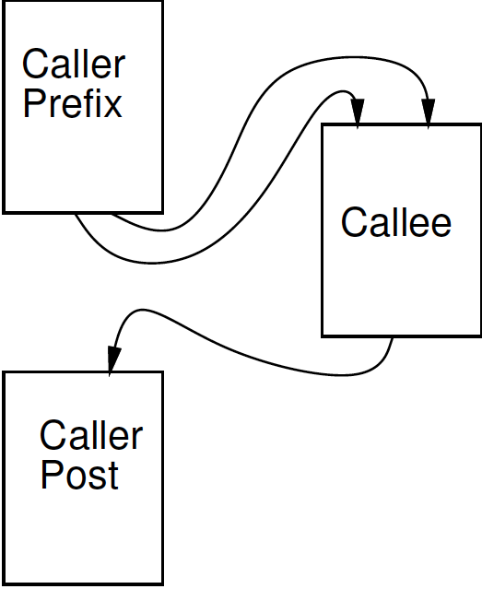
Treat as data flow
Implement function as an operation
Send arguments as input tokens
Get result back as token
Functions provide potential division between substrates?
Assign different functions to
different substrate (proc, fpga)

Slide 37
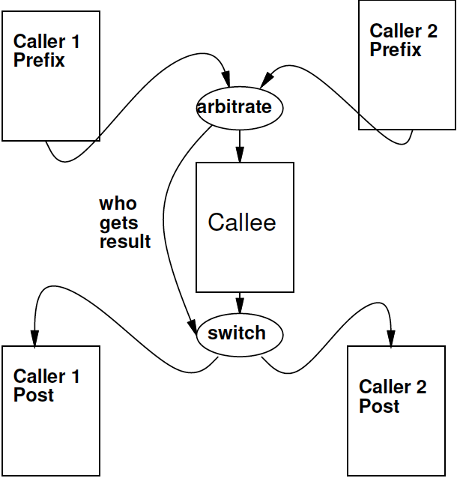
Shared Function
F1(A,B);
// Transpose(A,Aprime);
// matmul(Aprime,c1,B);
F2(B,C);
// matmul(B,c2,Cpre);
// normalize(Cpre,C);
if (A<B)
{
matmul(A,c1,B);
}
else
{
matmul(D,c3,E);
}
Functions express shared operators.

Slide 38
Recursion?
int fib(int x) {
if ((x==0) ||
(x==1))
return(1);
else
return(
fib(x-1) +
fib(x-2));
}
In general won’t work.
  Problem?
    Try Inline?
    How much hardware do we build?
Smart compiler might be able to turn some cases into iterative loop.
…but don’t count on it.
  Vitis HLS will not

Slide 39
Global Variables
int a=0;
int f1(int *A) {
for (int i=0;i<a;i++)
sum+=A[i];
return(sum); }
void f2(int *A) {
while (A[a]!=0);
a++;
}
f2(input);
isum=f1(input);
Variables not declared in a function
resolve to outer
context

Slide 40
Treat as data flow
Functions provide potential division between substrates.
Impact on global variables?
Run on processor
Run on FPGA
int a=0;
int f1(int *A) {
for (int i=0;i<a;i++)
sum+=A[i];
return(sum); }
void f2(int *A) {
while (A[a]!=0);
a++; }
f2(input);
isum=f1(input);

Slide 41
Treat as data flow
Functions provide potential division between substrates.
Impact on global variables?
Correct thing
  Reflect change in variable between
  substrates
Evidence Vitis HLS
  Not synchronized with host C on globals
Run on processor
Run on FPGA

Slide 42
Global Variables
int a=0;
int f1(int *A) {
for (int i=0;i<a;i++)
sum+=A[i];
return(sum); }
void f2(int *A) {
while (A[a]!=0);
a++;
}
f2(input);
isum=f1(input);
Globals generally considered bad coding practice
  Obfuscate flow of data even for human
Avoid Gobals
With hardware, have extra reason avoid

Slide 43
Global Variables
Bad
Better
int a=0;
int f1(int *A) {
for (int i=0;i<a;i++)
sum+=A[i];
return(sum); }
void f2(int *A) {
while (A[a]!=0);
a++;
}
f2(input);
isum=f1(input);
int f1(int *A, int len) {
for (int i=0;i<len;i++)
sum+=A[i];
return(sum); }
int f2(int *A) {
int len=0;
while (A[len]!=0);
len++;
return(len)
}
len=f2(input);
isum=f1(input,len);

Slide 44
Part 3
Loops and Arrays

Slide 45
C Hardware (reminder)
Hardware accelerator must fit into fixed space
  E.g. the 70K LUTs on the Zynq
  Computations that go on accelerator must be of bounded size
Must decide that space at compile time (when run place and route)
  Pay attention to what’s data dependent

Slide 46
Loops…
From an express computation standpoint, have several roles
  Compact code
  Unbounded computation
From describe hardware
  Compact expression of parallel hardware
  Express pipelines
  Express data-level parallelism
  Express area-time tradeoff

Slide 47
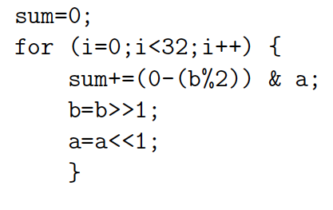
Loop Compact Expression
What express?
  Sequential, fully unrolled, partially unrolled?

Slide 48
Sequential

Slide 49
Spatial = fully unrolled

Slide 50
Stream
Day 5
Logical abstraction of a persistent point-to-point communication link between operators
  Has a (single) source and sink
  Carries data presence / flow control
  Provides in-order (FIFO) delivery of data from source to sink
stream

Slide 51
Stream
For the moment assume way to read and write to streams:
  stream.read() – return next value on stream
  stream.write(val); put val onto stream
stream

Slide 52
Unbounded, Pipelined Operator
What C code describe?

Slide 53
Unbounded, Pipelined Operator
What describe?
int c=12;
while(true)
  {
  int aval=astream.read();
  int bval=bstream.read();
  int res=aval*bval+c;
  resstream.write(res);
    }

Slide 54
With function call, loop in function
int c=12;
while(true)
  {
  int aval=astream.read();
  int bval=bstream.read();
  int res=multiply(aval,bval)+c;
  resstream.write(res);
    }

Slide 55
Compact Expression: Arrays
Useful to be able to refer to different values (a large number of values) with the same code.
Arrays + Loops: give us a way to do that
Useful:
  general expression
  hardware description

Slide 56
Compact Expression: Arrays+Logic
Vector sum:
  c3=a3+b3; c2=a2+b2; c1=a1+b1; c0=a0+b0;
  for(i=0;i<3;i++) c[i]=a[i]+b[i];
Chose small length to fit non-array on slide
  #define K 16
  for(i=0;i<K;i++) c[i]=a[i]+b[i];

Slide 57
Compact Expression: Arrays+Logic
Dot Product:
  Y=a3*b3+a2*b2+a1*b1+a0*b0;
  Y=0; for(i=0;i<3;i++) Y+=a[i]*b[i];

Slide 58
Compact Expression: Arrays+Logic
Vector sum:
  c3=a3+b3; c2=a2+b2; c1=a1+b1; c0=a0+b0;
  for(i=0;i<3;i++) c[i]=a[i]+b[i];
These array elements may be nodes in dataflow graph, just like the variables we saw for function f
  Express large dataflow graphs
  Make area-time choices for implementation

Slide 59
Foreshadowing:
C Array Challenge
C programmers think of arrays as memory (or memory as arrays)
  …and sometimes we will want to
Be careful understanding (and expressing) arrays that don’t have to be memories
  …and treated with memory semantics

Slide 60
Loop Interpretations
What does a loop describe?
  Sequential behavior [when to execute]
  Spatial construction [when create HW]
  Data Parallelism [sameness of compute]
We will want to use for all 3
Sometimes need to help the compiler understand which we want

Slide 61
Easy Loop (for contrast)
for (i=0;i<10;i++)
sum+=a[i];
How many times loop execute?
If unroll, which i for each loop instance?

Slide 62
Easy Loop (for contrast)
for (i=0;i<10;i++)
sum+=a[i];
Unroll
  Sum+=a[0]
  Sum+=a[1]
  Sum+=a[2]
  …
--> Sum=a[0]+a[1]+a[2]+a[3]…a[9]

Slide 63
Loop Bounds
Loops without constant bounds
  while (sum+a[i]<100) {
  sum+=a[i];
  i++; }
How many times loop execute?
Typically forces sequentialization
  Cannot unroll into hardware

Slide 64
Loop Increment
Loops with variable increment also force sequentialization
  for (i=0;i<100;i+=f[i])
  { b[i]=a[i]; sum+=a[i]; }
What are values of i for which evaluate body?

Slide 65
Loop Interpretations
What does a loop describe?
  Sequential behavior [when execute]
  Spatial construction [when create HW]
  Data Parallelism [sameness of compute]
We will want to use for all 3
C allows expressive loops
  Some expressiveness
    Not compatible with spatial hardware construction

Slide 66
Unroll
Vitis HLS has pragmas for unrolling
UG1399: Vitis HLS User’s Guide
#pragma HLS UNROLL factor=…
Use to control area-time points
  Use of loop for spatial vs. temporal description
In general – pragmas – directives to the compiler telling how to compile; does not change meaning of program

Slide 67
Unroll Factor
Unroll by factor is a way of providing bounded hardware, even if loop unbounded.

Slide 68
Big Ideas:
C (any prog lang) specifies a computation
Can describe spatial computation
  Has some capabilities that don’t make sense in hardware
    Shared memory pool, globals, recursion
  Watch for unintended sequentialization
C for spatial is coded differently from C for processor
  …but can still run on processor
Good for leaf functions (operations)
  Limiting for full task

Slide 69
Admin
Feedback, incl. HW4
Reading for Wednesday online
Fall Break this Thursday/Friday
Midterm next Wednesday (10/9)
HW5 due next Friday (10/11)
  Several long compiles; start early

