Slide 1
ESE532: System-on-a-Chip Architecture
Day 1: January 11, 2017
Introduction and Overview

Slide 2
Today
Case for Programmable SoC
Goals
Outcomes
New Course, Risks, Tools
Sample Optimization
This course (incl. policies, logistics)
Zed Boards

Slide 3
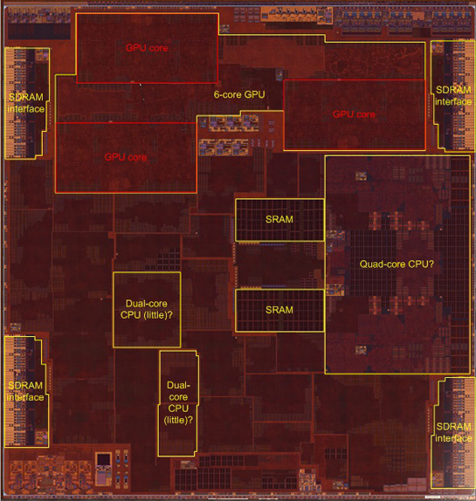
Today SoC: Apple A10
Quad=Dual Dual Core
Dual 64-bit ARM 2.3GHz
Dual 64-bit ARM low energy
3MB L2 cache
6 GPU cores
Custom accelerators
Image Processor?
125mm² 16nm FinFET
3.3B transistors
Chipworks Die Photo

Slide 4
Questions
Why do today’s SoC look like they do?
How approach programming modern SoCs?
How design a custom SoC?
When building a System-on-a-Chip (SoC)
How much area should go into:
Processor cores, GPUs, FPGA logic, memory, interconnect, custom functions (which) …. ?

Slide 5
Case for Programmable SoC

Slide 6
The Way things Were
20 years ago
Wanted programmability
used a processor
Wanted high-throughput
used a custom IC
Wanted product differentiation
Got it at the board level
Select which ICs and how wired
Build a custom IC
It was about gates and logic

Slide 7
Today
Microprocessor may not be fast enough
(but often it is)
Or low enough energy
Time and Cost of a custom IC is too high
$100M’s of dollars for development, Years
FPGAs promising
But build everything from prog. gates?
Premium for small part count
And avoid chip crossing
ICs with Billions of Transistors

Slide 8
Non-Recurring Engineering (NRE) Costs
Costs spent up front on development
Engineering Design Time
Prototypes
Mask costs
Recurring Engineering
Costs to produce each chip

Slide 9
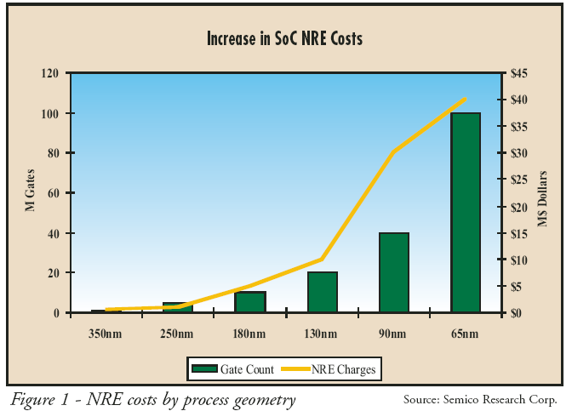
NRE Costs
28-nm SoC development costs doubled over previous node – EE Times 2013
28nm+78%, 20nm+48%, 14nm+31%, 10nm+35%

Slide 10
Amortize NRE with Volume

Slide 11
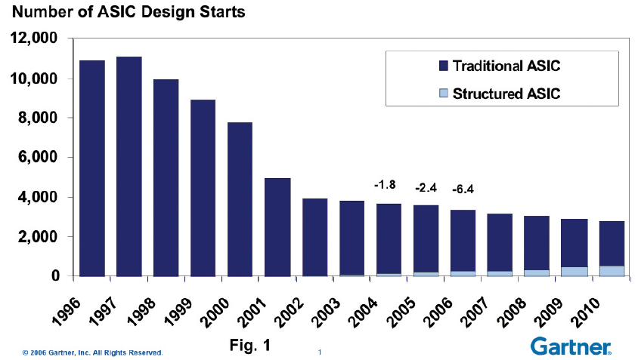
Economics
Forcing fewer,
more customizable
chips
Economics force fewer, more customizable chips
Mask costs in the millions of dollars
Custom IC design NRE 10s—100s of millions of dollars
Need market of billions of dollars to recoup investment
With fixed or slowly growing total IC industry revenues
➔ Number of unique chips must decrease

Slide 12
Large ICs
Now contain significant software
Almost all have embedded processors
Must co-design SW and HW
Must solve complete computing task
Tasks has components with variety of needs
Some don’t need custom circuit
90/10 Rule

Slide 13
Given Demand for Programmable
How get beyond processors?
Multiple processors?
Integrate common board functionality?
Memory, communications, I/O, peripherals
Accelerators?
Generalized
Specialized (for what?)

Slide 14
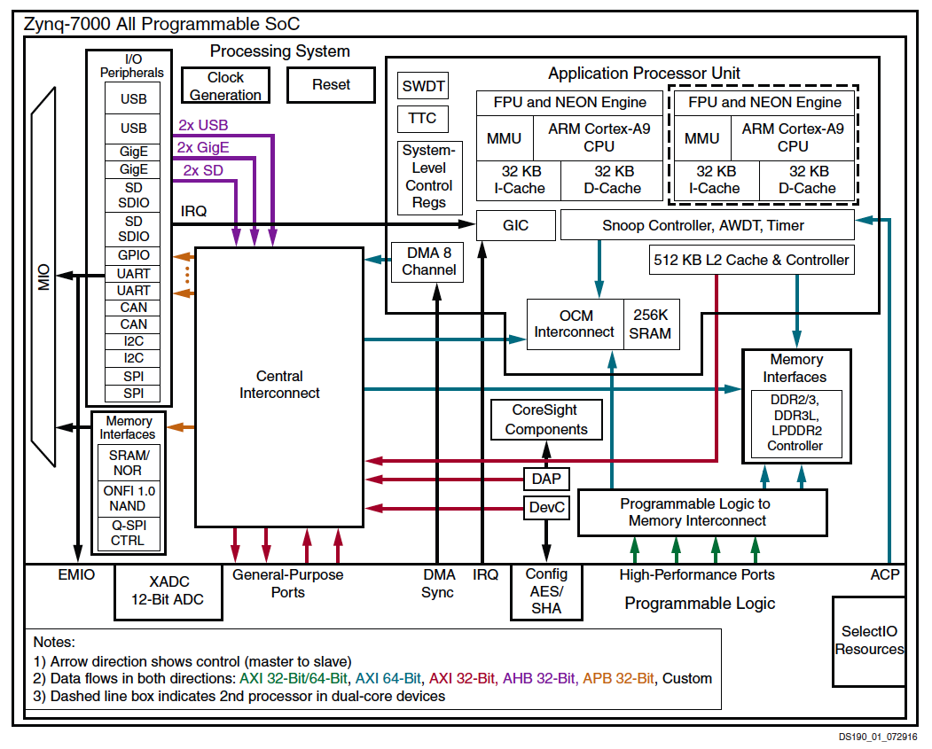
Programmable SoC
Implementation Platform for innovation
Implementation vehicle
This is what you target (avoid NRE)

Slide 15
Goals, Outcomes

Slide 16
Goals
Create Computer Engineers
SW/HW divide is wrong, outdated
Parallelism, data movement, resource management, abstractions
Cannot build a chip without software
SoC user – know how to exploit
SoC designer – architecture space, hw/sw codesign
Project experience – design and optimization

Slide 17
Roles
PhD Qualifier
One broad Computer Engineering
CMPE Concurrency
Hands-on Project course

Slide 18
Outcomes
Design, optimize, and program a modern System-on-a-Chip.
Analyze, identify bottlenecks, design-space
Decompose into parallel components
Characterize and develop real-time solutions
Implement both hardware and software solutions
Formulate hardware/software tradeoffs, and perform hardware/software codesign

Slide 19
Outcomes
Understand the system on a chip from gates to application software, including:
on-chip memories and communication networks, I/O interfacing, RTL design of accelerators, processors, firmware and OS/infrastructure software.
Understand and estimate key design metrics and requirements including:
area, latency, throughput, energy, power, predictability, and reliability.

Slide 20
New Course
We’ll be making it up as we go along…
You’ll be first to perform assignments
We may estimate difficulty of assignments incorrectly
Too easy, too hard
Lectures will be less polished
Intellectual excitement of trying to figure it out…and currency

Slide 21
Risks
Tools tricky to get working
New SDSoC
New try use HLS (C-to-gates) throughout
Tool runtimes can be long
Choosing problems with
Reasonable scope
Interesting/rich opportunities for optimization

Slide 22
Tools
Are complex
We’ll be figuring them out together
View as collaboratively figuring out how to use them this term
Will be challenging, but good for you to build confidence can understand and master
Learning and sharing experience will be part of assignments
Bonus points for tutorials

Slide 23
Relation to ESE532
534 – (last term)
532 – System-on-a-Chip Architecture
Deep into design space and continuum
How to build compute, interconnect, memory
Analysis
Fundamentals
Theory
Why X better than Y
More relevant substrate designers
Both Real-Time and Best-effort
New course
Probably 33% overlap
Broader (all CMPE)
HW/SW codesign
More Hands-on
Code in C
Map to Zynq
Accelerate an application
More relevant to (P)SoC user
Real-time focus

Slide 24
Distinction
CIS240, 371 ,501
ESE532
Best Effort Computing
Run as fast as you can
Binary compatible
ISA separation
Shared memory parallelism
Hardware-Software codesign
Willing to recompile, maybe rewrite code
Define/refine hardware
Real-Time
Guarantee meet deadline
Non shared-memory models

Slide 25
Approach -- Example

Slide 26
Abstract Approach
Identify requirements, bottlenecks
Decompose Parallel Opportunities
At extreme, how parallel could make it?
What forms of parallelism exist?
Thread-level, data parallel, instruction-level
Design space of mapping
Choices of where to map, area-time tradeoffs
Map, analyze, refine

Slide 27
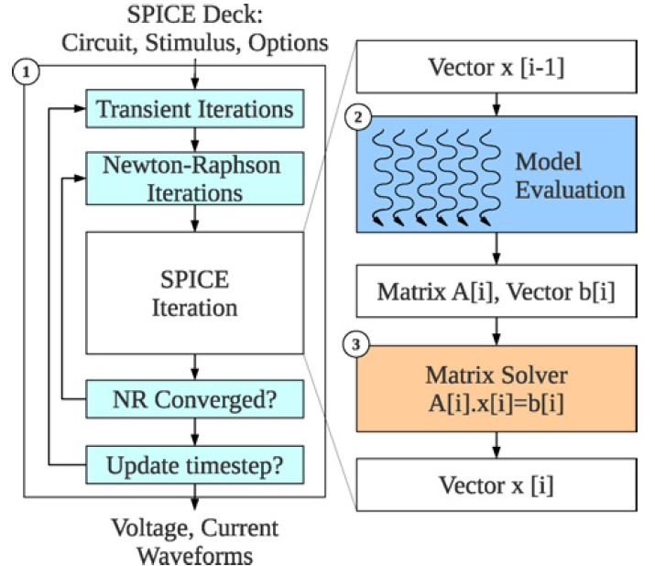
SPICE Circuit Simulator
Example: Kapre+DeHon, TRCAD 2012

Slide 28
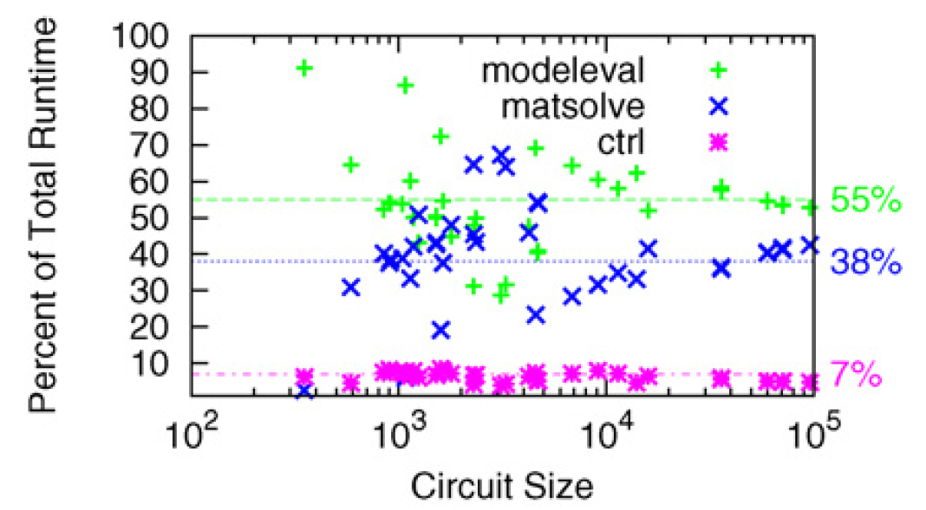
Analyze

Slide 29
Analyze
If only accelerated model evaluation only about 2x speedup
If want better than 14x speed, must also attack control

Slide 30
Model Evaluation: Trivial Hardware Implementation
*
*
÷
e
f
b
-
*
÷
d
c
a
e^{x}
Verilog-AMS as Domain-Specific Language

Slide 31
Parallelism: Model Evaluation
Every device independent
Many of each type of device
Can evaluate in parallel
Could build a pipelined circuit for each model
Multiple if merited

Slide 32
Single FPGA Mapping
Fully spatial circuit
Custom VLIW
*
÷
*
*
÷
b
e
f
-
*
÷
+
d
c
a
e^{x}
e^{x}
~100x Speedup
Multiple FPGAs
1-10x Speedup
1 FPGA

Slide 33
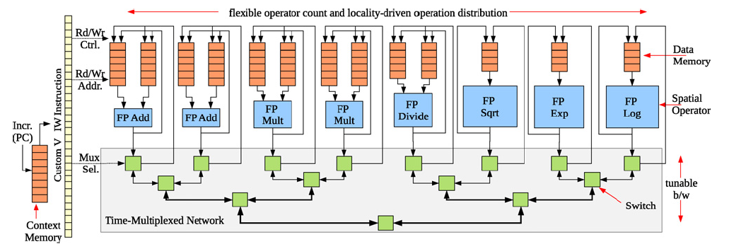
Parallelism: Model Evaluation
Spatial end up bottlenecked by other components
Use custom evaluation engines
…or GPUs

Slide 34
Parallelism: Matrix Solve
Needed direct solver?
E.g. Gaussian elimination
Data dependence on previous reduce
Parallelism in subtracts
Some row independence

Slide 35
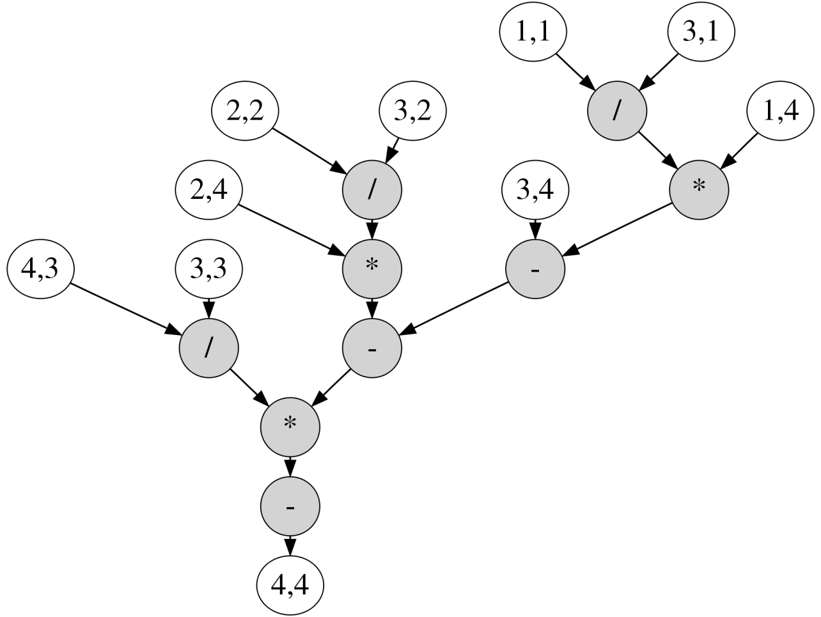
Example Matrix

Slide 36
Example Matrix

Slide 37
Dataflow PE
Graph
Nodes
Incoming Messages
Dataflow trigger
*
+
÷
Graph
Fanout
Outgoing Messages

Slide 38
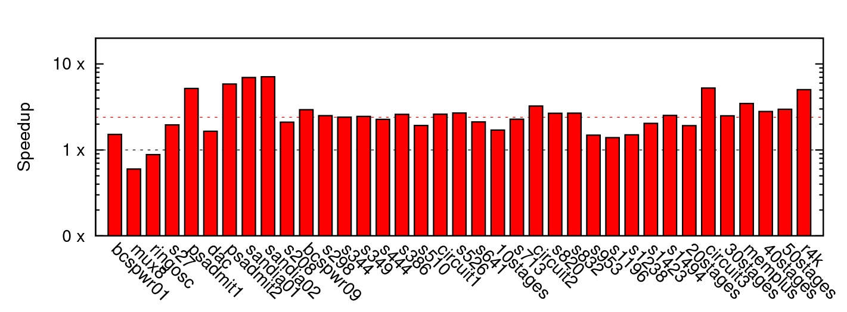
Matrix Solve Only
~2.4x mean

Slide 39
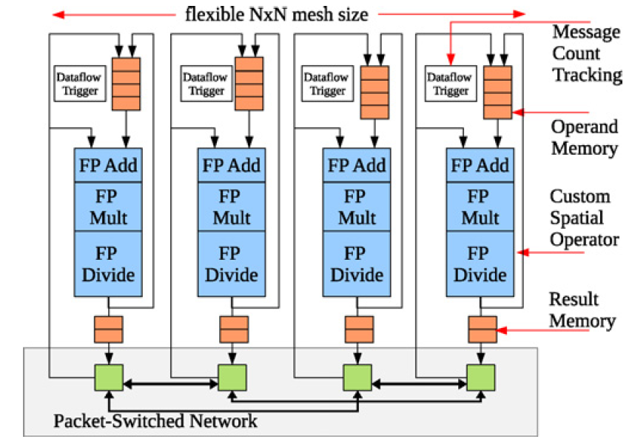
Parallelism: Matrix Solve
Settled on constructing dataflow graph
Graph can be iteration independent
Statically scheduled
(cheaper)
This is bottleneck to further acceleration

Slide 40
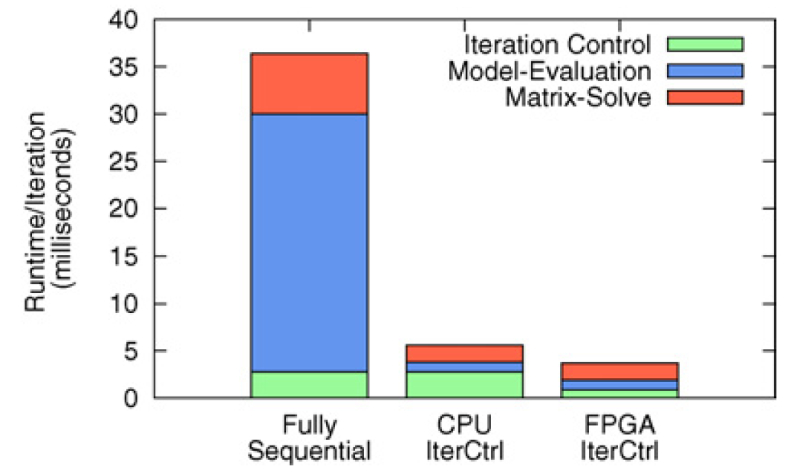
Parallelism Controller?
Could leave sequential
For some designs, becomes the bottleneck once others accelerated
Has internal parallelism in condition evaluation

Slide 41
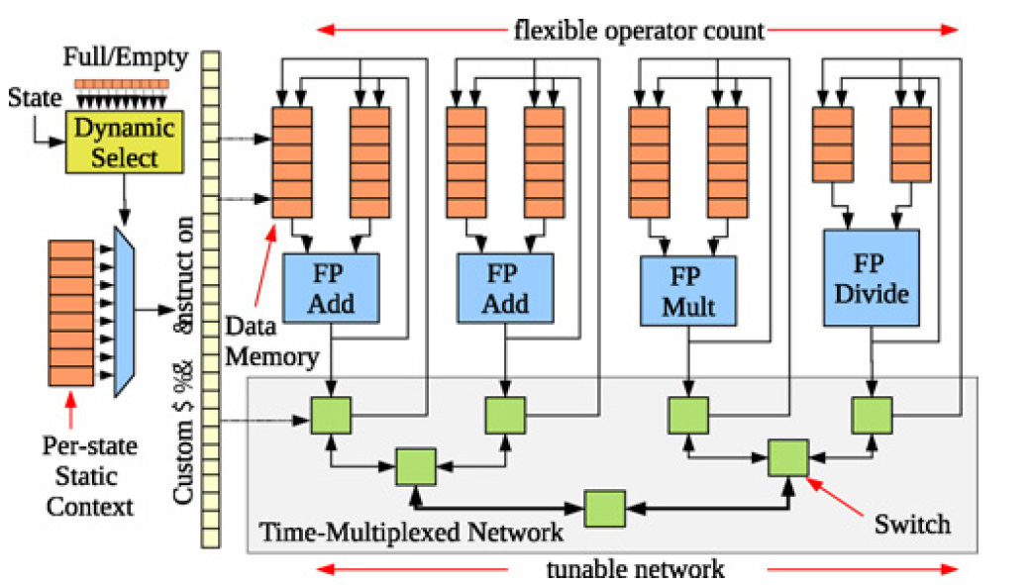
Parallelism Controller
Customized datapath controller

Slide 42
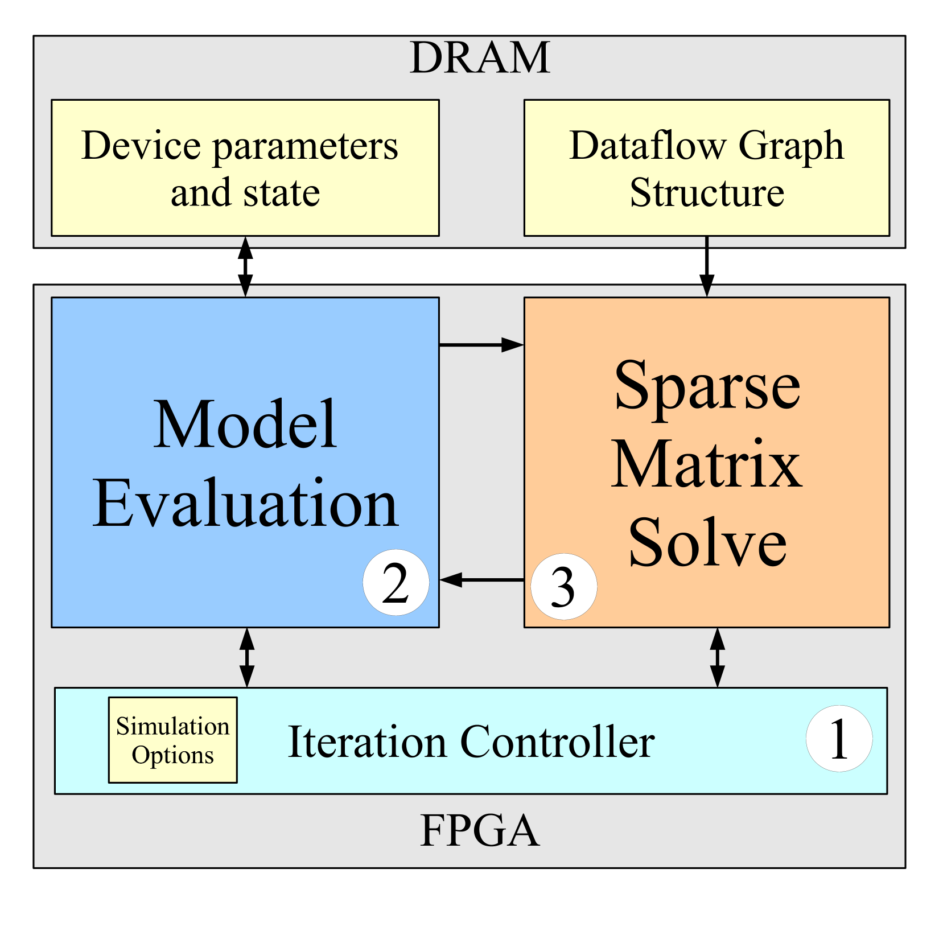

Slide 43
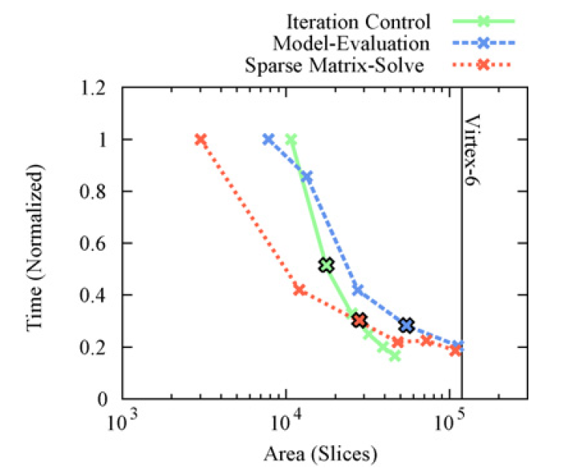
Area-Time for Each

Slide 44
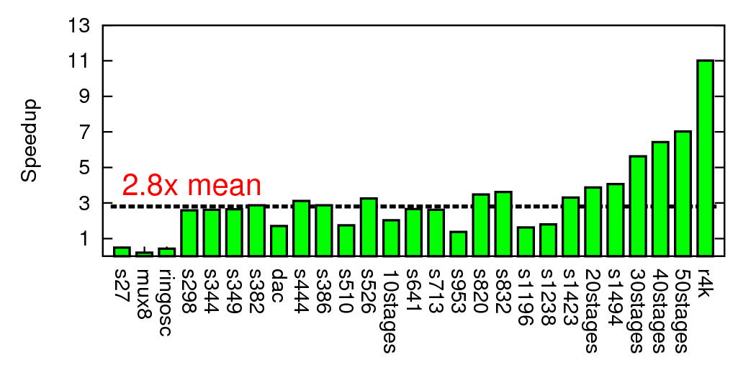
Composite Speedup

Slide 45
Modern SoC

Slide 46
Class Components

Slide 47
Class Components
Lecture (incl. preclass exercise)
Slides on web before class
(you can print if want a follow-along copy)
N.B. I will encourage (force) class participation
Reading [~1 required paper/lecture]
online: Canvas, IEEE, ACM, also ZynqBook
Homework
(1 per week up to Spring Break, due F5pm)
Project – open-ended
(~6 weeks)
Note syllabus, course admin online

Slide 48
First Half
Quickly cover breadth
Metrics, bottlenecks
Parallel models
SIMD/Data Parallel
Thread-level parallelism
DMA, Memory
Spatial, C-to-gates
Real-time
Reactive
Line up with homeworks

Slide 49
Second Half
Use everything on project
Schedule more tentative
Adjust as experience and project demands
Going deeper
Memory
Networking
Energy
Scaling
Chip Cost
Defect + Fault tolerance

Slide 50
Teaming
HW and Project in Groups of 2
First assignment
You choose, optionally individual
HW2-7: we assign
Project: you propose, we review
Individual assignment turnin
See assignment details if individual pieces

Slide 51
Office & Lab Hours
Andre: T 4:15pm—5:30pm Levine 270
Hans: TR 6—7pm in Ketterer
Start tomorrow 1/12

Slide 52
Preclass Exercise
Motivate the topic of the day
Introduce a problem
Introduce a design space, tradeoff, transform
Work for ~5 minutes before start lecturing

Slide 53
Feedback
Will have anonymous feedback sheets for each lecture
Clarity?
Speed?
Vocabulary?
General comments

Slide 54
Policies
Canvas turn-in of assignments
No handwritten work
Due on time (3 free late days total)
Collaboration
Tools – allowed
Designs – limited to project teams as specified on assignments
See web page

Slide 55
Admin
Your action:
Find course web page
Read it, including the policies
Find Syllabus
Find homework 1
Find lecture slides
Will try to post before lecture
Find reading assignments
Find reading for lecture 2 on canvas and web
…for this lecture if you haven’t already

Slide 56
Big Ideas
Programmable Platforms
Key delivery vehicle for innovative computing applications
Reduce TTM, risk
More than a microprocessor
Heterogeneous, parallel
Demand hardware-software codesign
Soft view of hardware
Resource-aware view of parallelism

Slide 57
Zedboard Checkout
Ketterer Combo
Lockers: EOS, B13, 8a-3.30p
strongly recommending Masterlock combination lock (with black dial) available at Amazonhttp://a.co/5YfVLJt

