Slide 1
ESE532: System-on-a-Chip Architecture
Day 12: February 27, 2017
Real Time Scheduling

Slide 2
Today
Real Time
Synchronous Reactive Model
Interrupts
Polling alternative
Timer?
Resource Scheduling Graphs

Slide 3
Message
Scheduling is key to real time
Analysis
Guarantees

Slide 4
Synchronous Circuit Model
A simple synchronous circuit is a good “model” for real-time task
Run at fixed clock rate
Take input every cycle
Produce output every cycle
Complete computation between input and output
Designed to run at fixed-frequency
Critical path meets frequency requirement

Slide 5
Synchronous Reactive Model
Discipline for Real-Time tasks
Embodies the “synchronous circuit model”

Slide 6
Synchronous Reactive
There is a rate for interaction with external world (like the clock)
Computation scheduled around these clock ticks (or time-slices)
Continuously running threads
Each thread performs action per tick
Inputs and outputs processed at this rate
Computation can “react” to events
Reactions finite and processed before next tick

Slide 7
Thread Form
while (1) { tick(); }
tick() -- yields after doing its work
May be state machine
May trigger actions to respond to events (inputs)

Slide 8
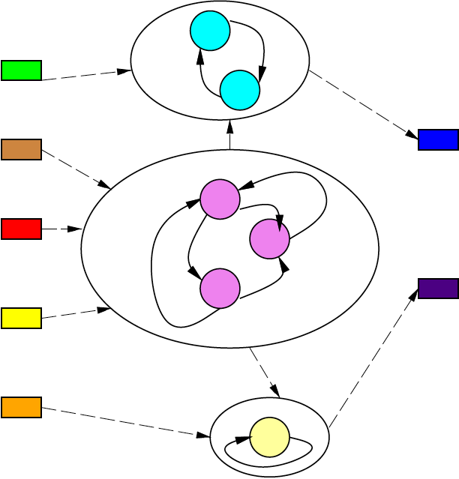
Thread Model

Slide 9
Tick Rate
Driven by application – demands of external control
Control loop 100 Hz
Robot, airplane, car, manufacturing plant
Video at 33 fps
Game with 20ms response
Router with 1ms packet latency

Slide 10
Tick Rate
Multiple rates
May need master tick as least-common multiple of set of interaction rates
…and lower freq. events scheduled less frequently
E.g. 100Hz control loop at 33Hz video
Master at 10ms
Schedule video over 3 10ms time-slots
May force decompose into tasks fit into smaller time window since must schedule events at highest frequency

Slide 11
Synchronous Reactive
Ideal model
Per tick reaction (task processing) instantaneous
Separate function from compute time
Separate function from technology
Feature size, processor mapped to
Like synchronous circuit
If logic correct, works when run clock slow enough
Works functionally when change technology
Then focus on reducing critical path

Slide 12
Synchronous Reactive Timing
Once functional,
need to guarantee all tasks (in all states)
can complete in tick time-slot
On particular target architecture
Identify WCET
Like critical path in FSM circuit
Time of task on processor target

Slide 13
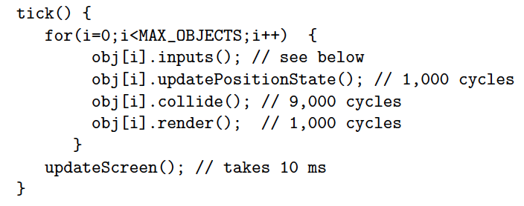
Preclass 1
Time available to process objects?

Slide 14
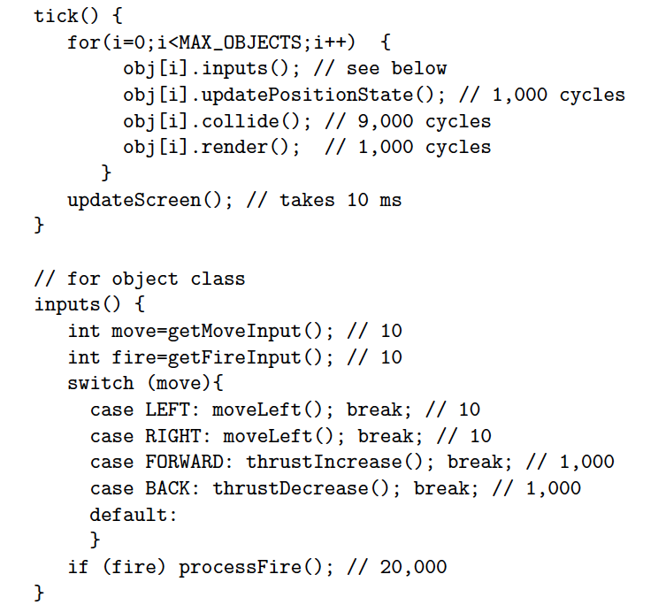
Preclass 1
Worst-case object processing time?

Slide 15
Preclass 1
Maximum number of objects on single GHz processor?

Slide 16
Synchronous Reactive Timing
Once functional,
need to guarantee all tasks (in all states) can complete in tick time-slot
On particular target architecture
Identify WCET
Like critical path in FSM circuit
Time of task on processor target
Schedule onto platform
Threads onto processor(s)

Slide 17
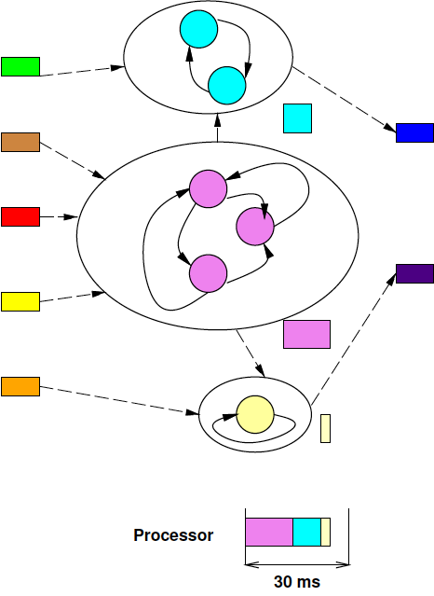
Threads Mapped to Processor

Slide 18
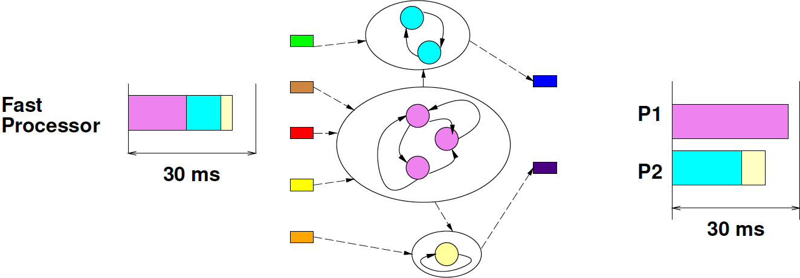
Platforms
Platform 1: fast processor
Platform 2: many slow processors

Slide 19
Synchronous Reactive Model
Discipline for Real-time tasks
Embodies the “synchronous circuit model”
Master clock rate
Computation decomposed per clock
Functionality assuming instantaneous compute
On platform, guarantee runs fast enough to complete critical path at “clock” rate

Slide 20
Midterm

Slide 21
Midterm
From Code
Forms of Parallelism
Dataflow, SIMD, hardware pipeline, threads
Map/schedule task graph to (multiple) target substrates
Memory assignment and movement
Area-time points
Analysis
Bottleneck
Amdhal’s Law Speedup
Computational requirements
Resource Bounds
Critical Path
Latency/throughput

Slide 22
Interrupts

Slide 23
Interrupt
External event that redirects processor flow of control
Typically forces a thread switch
Common for I/O, Timers
Indicate a need for attention

Slide 24
Interrupts: Good
Allow processor to run some other work
Infrequent, irregular task service with low response service latency
Low latency
Low throughput

Slide 25
Interrupts: Bad
Time predictability
Real-time for computing tasks interrupted
Processor usage
Costs time to switch contexts
Concurrency management
Must deal with tasks executing non-atomically
Interleave of interrupted service tasks
Perhaps interleave of any task

Slide 26
Polling Discipline
Alternate to I/O interrupts
Every I/O task is a thread
Budget time and rate it needs to run
E.g. 10,000 cycles every 5ms
Likely tied to
Buffer sizes
Response latency
Schedule I/O threads as real-time tasks
Some can be DMA channels

Slide 27
IO Thread
while (1) { process_input(); }
Like tick() -- yields after doing its work

Slide 28
Preclass 2
Input at 100KB/s
30ms time-slot window
Size of buffer?
100 cycles/byte, GHz processor – runtime of service routine?
Fraction of processor capacity?

Slide 29
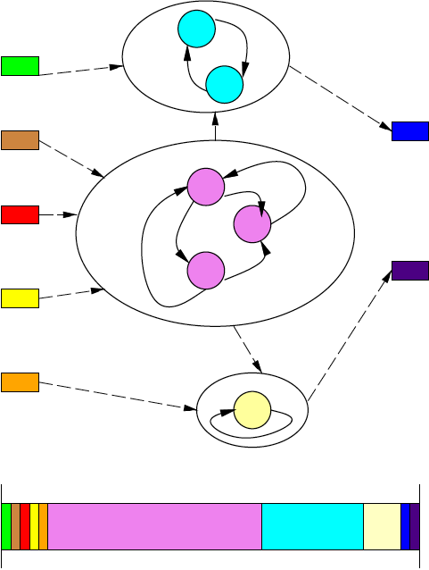
Scheduling I/O Tasks

Slide 30
Timer Interrupts
Bounded-time tasks
E.g. reactive tasks in real-time
Task has guarantee to release processor within time window
Not need timer interrupts to regain control from task
(Maybe use deadline operations for timer)

Slide 31
Timer Interrupts
Best effort tasks
Have no guarantee to finish in bounded time
Timer interrupts necessary
to allow other threads to run
fairness
to switch to real-time service tasks
Need timer interrupts if need to share processor with real-time threads
Easier to segregate real-time and best-effort threads onto different processors

Slide 32
Greedy Strategy
Schedule real-time tasks
Scheduled based on worst-case, so may not use all time allocated
Run best-effort tasks at end of time-slice after complete real-time tasks
Timer-interrupt to recover processor in time for start of next scheduling time slot
(adds complexity)

Slide 33
Real-Time Tasks
Interrupts less attractive
More disruptive
Scheduled polling better predictability
Fits with Synchronous Reactive Model

Slide 34
Resource Scheduling Graphs

Slide 35
Scheduling
Useful to think about scheduling a processor by task usage
Useful to budget and co-schedule required resources
Bus
Memory port
DMA channel

Slide 36
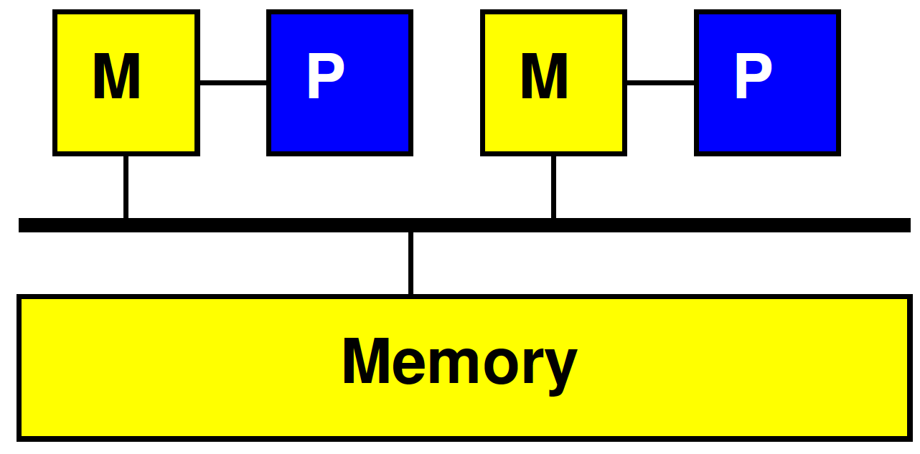
Simple Task Model
Task requires
Data to be transferred
Local storage state
Computational cycles
(Result data to be transferred)
Uses resources
Bus/channel to transfer data
(in and out)
Space in memory on accelerator
Cycles on accelerator

Slide 37
One Task
P1
P2
Bus
Mem

Slide 38
Several Tasks
Resource | 0 | 1 | 2 | 3 | 4 | 5 | 6 | 7 | 8
P1
P2
Bus
Mem

Slide 39
Resource Schedule Graph
Extend as necessary to capture potentially limiting resources and usage
Regions in memories
Memory ports
I/O channels

Slide 40
Extended Details
Resource | 0 | 1 | 2 | 3 | 4 | 5 | 6 | 7 | 8
P1
P1 M0
P1 M1
P2
P2 M0
P2 M1
Bus1
Bus2
OCM
DRAM

Slide 41
Several Tasks
Resource | 0 | 1 | 2 | 3 | 4 | 5 | 6 | 7 | 8
P1
P1 M0
P1 M1
P2
P2 M0
P2 M1
Bus1
Bus2
OCM
DRAM

Slide 42
Approach
Ideal/initial – look at processing requirements
Resource bound on processing
Look for bottlenecks / limits with Resource Bounds independently
Add buses, memories, etc.
Plan/schedule with Resource Schedule Graph

Slide 43
Preclass 3a
Resource Bound
Data movement over bus?
Compute on 2 processors?
Compute on 2 processors when processor must wait while local memory is written?

Slide 44
Preclass 3b Schedule
Processor wait for data load

Slide 45
Double Buffering
Common trick to overlap compute and communication
Reserve two buffers input (output)
Alternate buffer use for input
Producer fills one buffer while consumer working from the other
Swap between tasks
Trade memory for concurrency

Slide 46
Preclass 3c Schedule
Double Buffer
Minimum local memory space required?

Slide 47
Resource Schedule Graphs
Useful to plan/visualize resource sharing and bottlenecks in SoC
Supports scheduling
Necessary for real-time scheduling

Slide 48
Big Ideas:
Scheduling is key to real time
Analysis, Guarantees
Synchronous reactive
Scheduling worst-case tasks “reactions” into master time-slice matching rate
Schedule I/O with polling threads
Avoid interrupts
Schedule dependent resources
Buses, memory ports, memory regions…

Slide 49
Admin
Exam Wednesday
HW6 due Friday
<Enjoy Spring Break>

