Slide 1
ESE532: System-on-a-Chip Architecture
Day 14: March 13, 2017
Design Space Exploration

Slide 2
Today
Midterm
Design-Space Exploration

Slide 3
Message
The universe of possible implementations (design space) is large
Many dimensions to explore
Formulate carefully
Approach systematically
Use modeling along the way for guidance

Slide 4
Midterm

Slide 5
Mea Culpa
Too long
Too time constrained

Slide 6
Mismatch?
What I think I’m teaching
What you think you are learning
Midterm focused on performance modeling

Slide 7
Agree?
How to design/select/map to SoC to reduce Energy/Area/Delay?

Slide 8
Outcomes
Day 1
Design, optimize, and program a modern System-on-a-Chip.
Analyze, identify bottlenecks, design-space
Decompose into parallel components
Characterize and develop real-time solutions
Implement both hardware and software solutions
Formulate hardware/software tradeoffs, and perform hardware/software codesign

Slide 9
Outcomes
Day 1
Understand the system on a chip from gates to application software, including:
on-chip memories and communication networks, I/O interfacing, RTL design of accelerators, processors, firmware and OS/infrastructure software.
Understand and estimate key design metrics and requirements including:
area, latency, throughput, energy, power, predictability, and reliability.

Slide 10
Agree?
How to design/select/map to SoC to reduce Energy/Area/Delay?
Haven’t touched Area/Energy much, yet, so initial focus on Delay, Performance

Slide 11
Reduce Delay
What can we do to reduce delay?
How know when we succeed?
Compile and run
How know what’s wrong and how to fix if we don’t get a speedup?
Need to be able to model, estimate, and reason about performance.

Slide 12
Model to Select Design
Homework shows you that implementing a design is expensive
Goal: have a model to drive you to select good implementations to try

Slide 13
Model to Understand
If not get the performance you expect, what went wrong?
Need an expectation
Need to drill down into components
Model expectations wrong?
Which part?
Refine?
Something went wrong in implementations?
What?
How fix to match model?

Slide 14
Model to Understand
If not get the performance you expect, what went wrong?
Very Powerful
Not match → something I need to understand
Bugs in implementation, understanding
Does match → Tells me
where to look
what to try to fix
when to give up (on a particular approach)

Slide 15
Expect
Kinds of analysis on the exam underlies all design exploration and experiments

Slide 16
Message for Day
Day 2
Identify the Bottleneck
May be in compute, I/O, memory, data movement
Focus and reduce/remove bottleneck
More efficient use of resources
More resources
Repeat

Slide 17
Second Half
How to design/select/map to SoC to reduce Energy/Area/Delay
Spend some more time understanding
Area
Started as we look at accelerators
…worry about fit in fixed array
Cost for custom design
Energy

Slide 18
Design-Space Exploration
Generic

Slide 19
Design Space
Have many choices for implementation
Alternatives to try
Parameters to tune
Mapping options
Our freedom to impact implementation costs
Area, delay, energy

Slide 20
Design Space
Ideally
Each choice orthogonal axis in high-dimensional space
Want to understand points in space
Find one that bests meets constraints and goals
Practice
Seldom completely orthogonal
Requires cleverness to identify dimensions
Messy, cannot fully explore
But…can understand, priorities, guide

Slide 21
Preclass 1
What choices (design-space axes) can we explore in mapping a task to an SoC?
What showed up in homework so far?

Slide 22
From Homework?
Types of parallelism
Mapping to different fabrics / hardware
How manage memory, move data
Levels of parallelism
Pipelining, unrolling, II

Slide 23
Design-Space Choices
Type of parallelism
How decompose / organize parallelism
Area-time points (level exploited)
What resources we provision for what parts of computation
Where to map tasks
How schedule/order computations
How synchronize tasks
How represent data
Where place data; how manage and move
What precision use in computations

Slide 24
Generalize Continuum
Encourage to think about parameters (axes) that capture continuum to explore
Start from an idea
Maybe can compute with 8b values
Maybe can put dist computation on FPGA fabric
Move data in 1KB chunks
Identify general knob
Tune intermediate bits for computation
How much of computation go on FPGA fabric
What is optimal data transfer size?

Slide 25
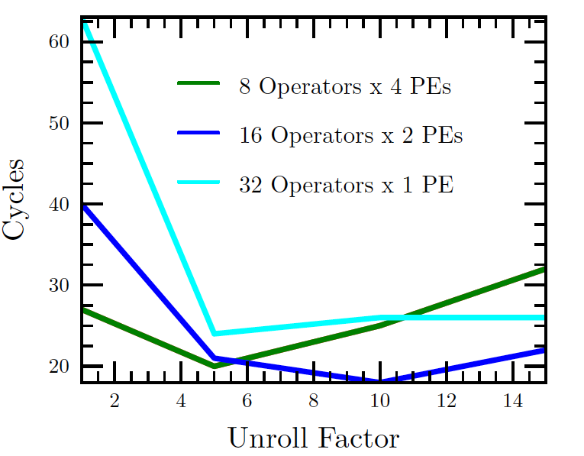
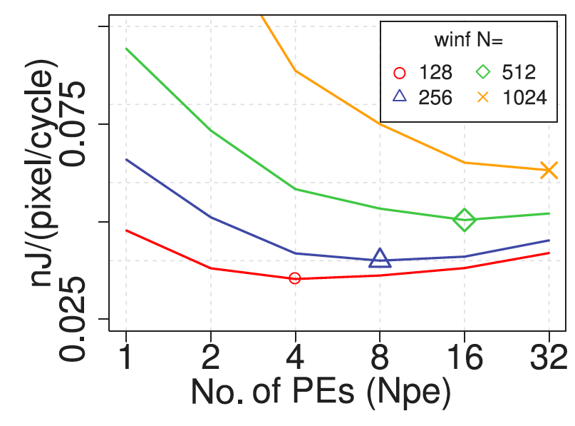
Finding Optima
Kapre, FPL 2009
Kadric, TRETS 2016

Slide 26
Design Space Explore
Think systematically about how might map the application
Avoid overlooking options
Understand tradeoffs
Large design space
more opportunities to find good solutions
Reduce bottlenecks

Slide 27
Elaborate Design Space
Refine design space as you go
Ideally identify up front
Practice bottlenecks and challenges
will suggest new options / dimensions
If not initially expect memory bandwidth to be a bottleneck…
Some options only make sense in particular sub-spaces
Bitwidth optimization not a big issue on the 64b processor
More interesting on vector, FPGA

Slide 28
Tools
Sometimes tools will directly help you explore design space
What SDSoC/Vivado HLS support?
Often they will not
What might you want that does not support?

Slide 29
Tools
Sometimes tools will directly help you explore design space
Unrolling, pipelining, II
Some choices for data movement
Some loop transforms
Granularity to place on FPGA
Often they will not
Need to reshape functions and loops
Data representations and sizes

Slide 30
Design-Space Exploration
Example FFT

Slide 31
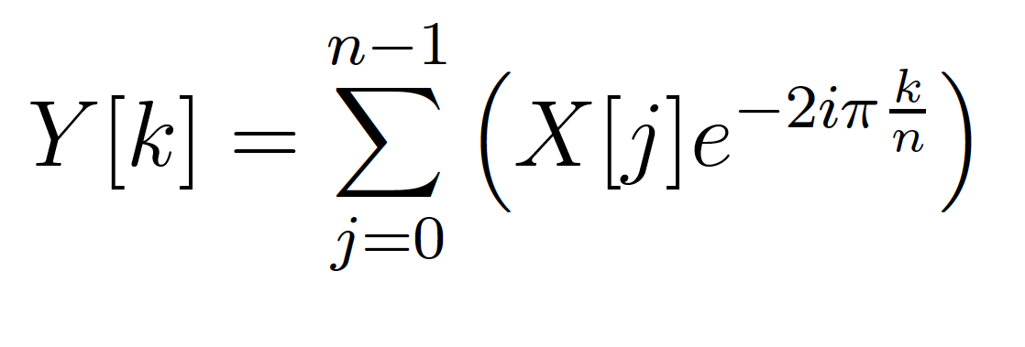
Fourier Transform
Identify spectral components
Convert between Time-domain to Frequency-domain
E.g. tones from data samples
Central to audio coding – e.g. MP3 audio

Slide 32
Fast-Fourier Transform (FFT)
Efficient way to compute FT
O(N*log(N)) computation

Slide 33
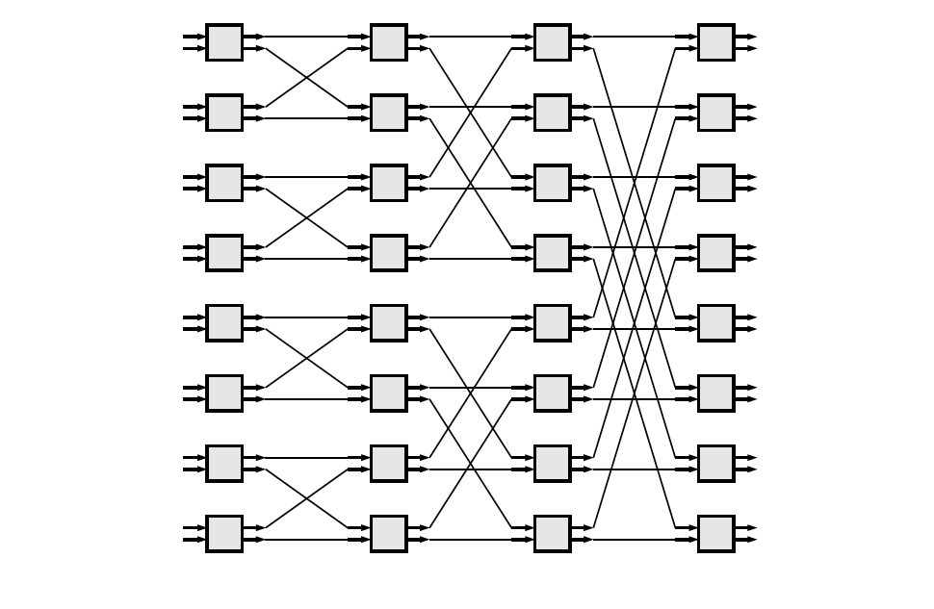
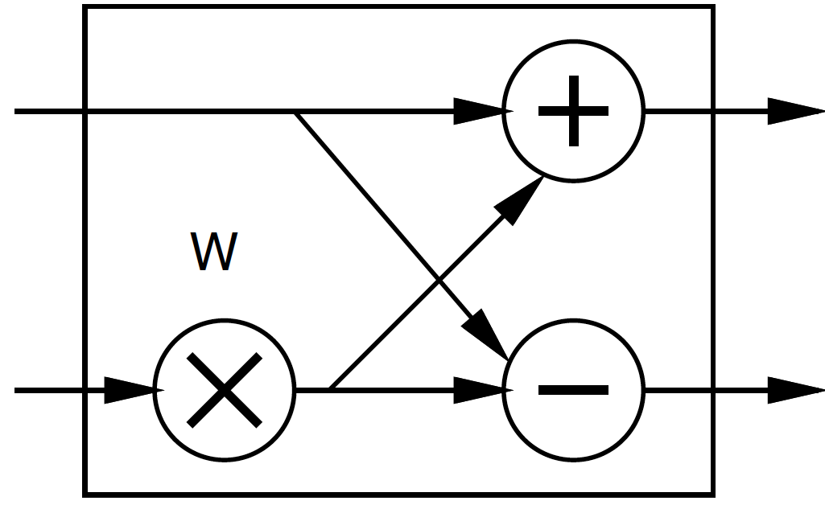
FFT
Large space of FFTs
Radix-2 FFT Butterfly

Slide 34
Basic FFT Butterfly
Y0=X0+W(stage,butterfly)*X1
Y1=X0-W(stage,butterfly)*X1
Common sub expression, compute once: W(stage,butterfly)*X1
X0
Y0
X1
Y1

Slide 35
Preclass 2
What parallelism options exist?
Single FFT
Sequence of FFTs

Slide 36
FFT Parallelism
Spatial
Pipeline
Streaming
By column
Choose how many Butterflies to serialize on a PE
By subgraph
Pipeline subgraphs

Slide 37
Streaming FFT

Slide 38
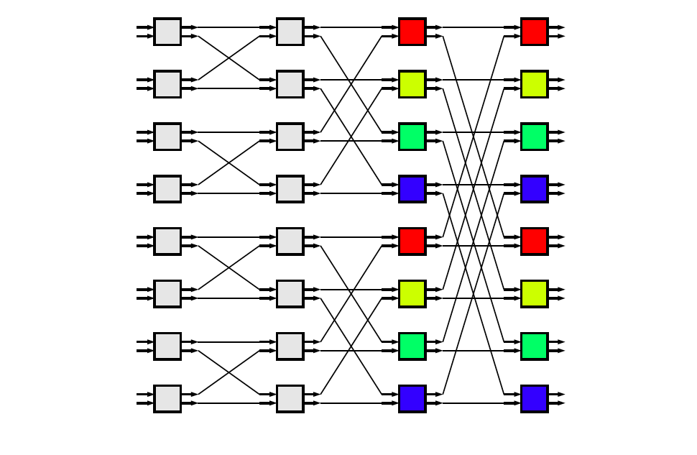
Common Subgraphs

Slide 39
Preclass 3
How large of a spatial FFT can implement with 220 multipliers?

Slide 40
Bit Serial
Could compute the add/multiply bit serially
One full adder per adder
W full adders per multiply
50,000 LUTs
~= 2500 bit-serial butterflies for W=16?
Maybe 512-point FFT?
Another dimension:
How much serialize word-wide operators

Slide 41
Accelerator Building Blocks
What might we use as primitive, FFT-specific building blocks?

Slide 42
Processor Mapping
How map butterfly operations to processors?
Implications for communications?

Slide 43
Preclass 4a
How large local memory to communicate from stage to stage?

Slide 44
Preclass 4b
How change evaluation order to reduce local storage memory?

Slide 45
Communication
How implement the data shuffle between processors or accelerators?
Memories / interconnect ?
How serial / parallel ?
Network?

Slide 46
Data Precision
Input data from A/D likely 12b
Output data, may only want 16b
What should internal precision and representation be?

Slide 47
Number Representation
Floating-Point
IEEE standard single (32b), double (64b)
With mantissa and exponent
…half, quad ….
Fixed-Point
Select total bits and fraction
E.g. 16.8 (16 total bits, 8 of which are fraction)
Represent 1/256 to 256-1/256

Slide 48
Heterogeneous Precision
May not be same in every stage
W factors less than 1
Non-fraction grows at most 1b per stage

Slide 49
W/Twiddle factors
Precompute and store in arrays
Compute as needed
How? sin/cos hardware? CORDIC? Polynominal approximation?
Specialize into computation
Many evaluate to 0, ±1, ±½, ….

Slide 50
FFT (partial) Design Space
Parallelism
Decompose
Size/granularity of accelerator
Area-time
Sequence/share
Communicate
Representation/precisions
Twiddle

Slide 51
Big Ideas:
Large design space for implementations
Worth elaborating and formulating systematically
Make sure don’t miss opportunities
Think about continuum for design axes
Model effects for guidance and understanding

Slide 52
Admin
HW7 out → due Friday
Individual
Working on getting Project ready

