Slide 1
ESE532: System-on-a-Chip Architecture
Day 15: March 15, 2017
VLIW
(Very Long Instruction Word Processors)

Slide 2
Today
VLIW (Very Large Instruction Word)
Demand
Basic Model
Costs
Tuning

Slide 3
Message
VLIW as a Model for
Instruction-Level Parallelism (ILP)
Customizing Datapaths
Area-Time Tradeoffs

Slide 4
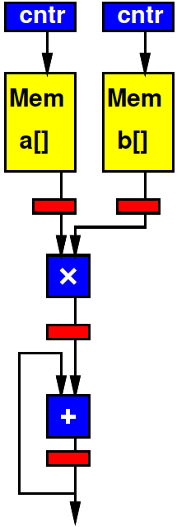
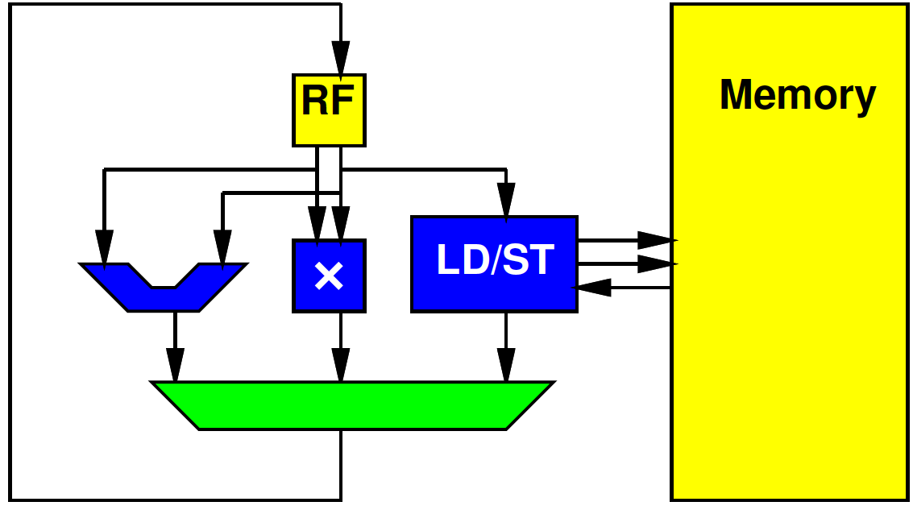
Preclass 1
Cycles per multiply-accumulate
Spatial Pipeline
Processor

Slide 5
Preclass 1
How different?

Slide 6
Computing Forms
Processor – does one thing at a time
Spatial Pipeline – can do many things, but always the same
Vector – can do the same things on many pieces of data

Slide 7
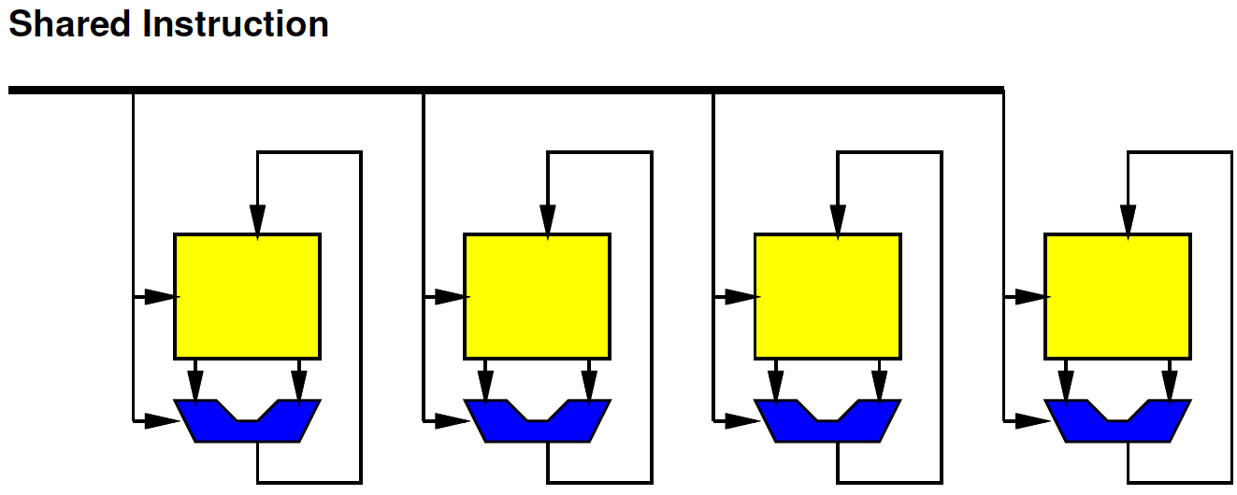
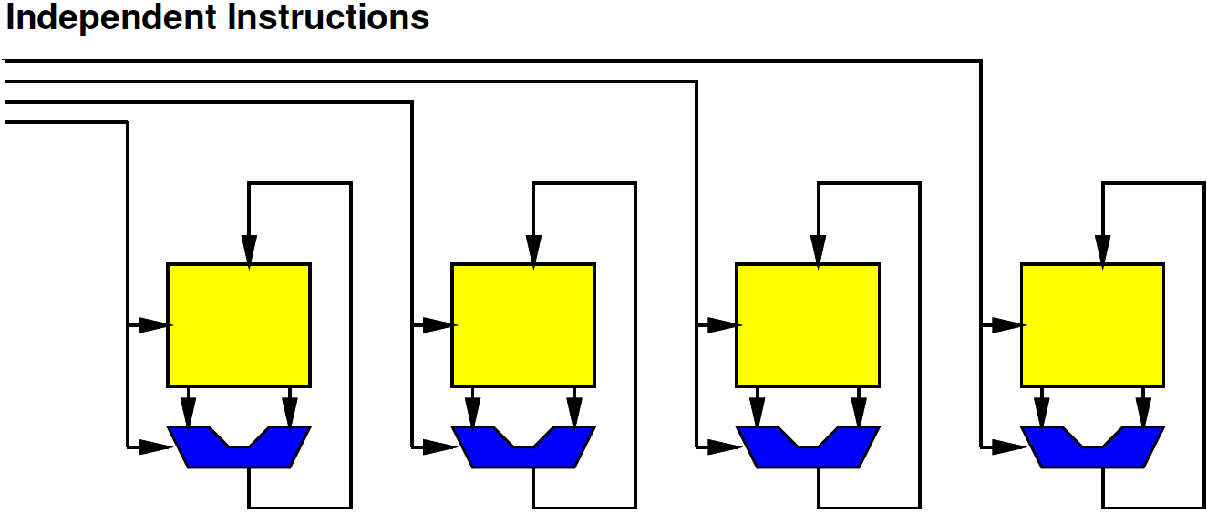
In Between
What if…
Want to
Do many things at a time (ILP)
But not the same (DLP)

Slide 8
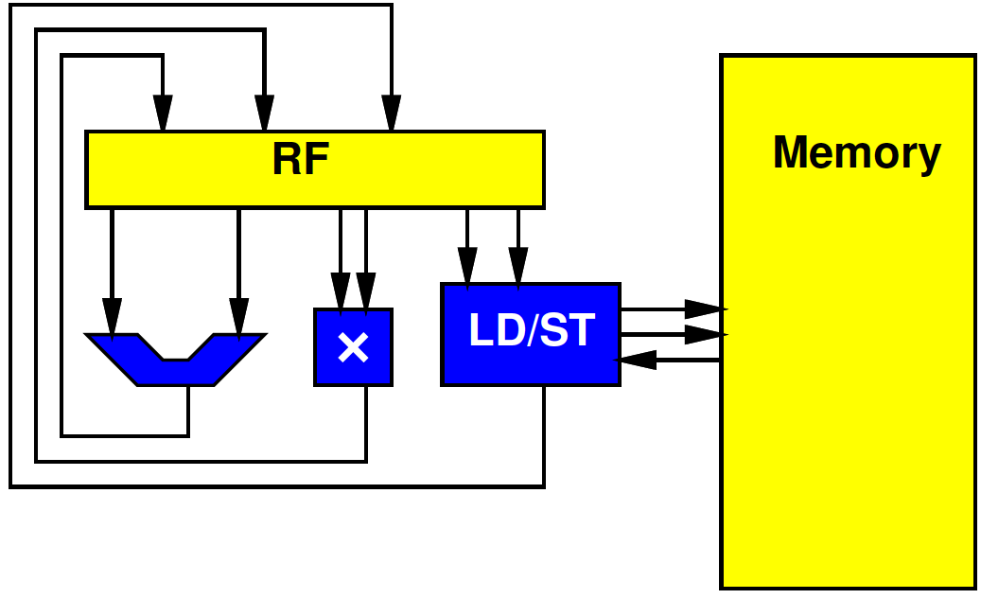
In between
What if…
Want to
Do many things at a time (ILP)
But not the same (DLP)
Want to use resources concurrently

Slide 9
In between
What if…
Want to
Do many things at a time (ILP)
But not the same (DLP)
Want to use resources concurrently
Want to
Accelerate specific task
But not go to spatial pipeline extreme

Slide 10
Supply Independent Instructions
Provide instruction per ALU
Instructions more expensive than Vector
But more flexible

Slide 11
Control Heterogeneous Units
Control each unit simultaneously and independently
More expensive memory/interconnect than processor
But more parallelism

Slide 12
VLIW
The “instruction”
The bits controlling the datapath
…becomes long
Hence:
Very Long Instruction Word (VLIW)

Slide 13
VLIW
Very Long Instruction Word
Set of operators
Parameterize number, distribution (X, +, sqrt…)
More operators→ less time, more area
Fewer operators→ more time, less area
Memories for intermediate state
X
X
+

Slide 14
VLIW
Very Long Instruction Word
Set of operators
Parameterize number, distribution (X, +, sqrt…)
More operators→ less time, more area
Fewer operators→ more time, less area
Memories for intermediate state
Memory for “long” instructions
Instruction
Memory
Address
X
X
+

Slide 15
VLIW
Instruction
Memory
Address
X
X
+

Slide 16
VLIW
Very Long Instruction Word
Set of operators
Parameterize number, distribution (X, +, sqrt…)
More operators→ less time, more area
Fewer operators→ more time, less area
Memories for intermediate state
Memory for “long” instructions
General framework for specializing to problem
Wiring, memories get expensive
Opportunity for further optimizations
General way to tradeoff area and time

Slide 17
VLIW
Instruction
Memory
Address
X
X
+

Slide 18
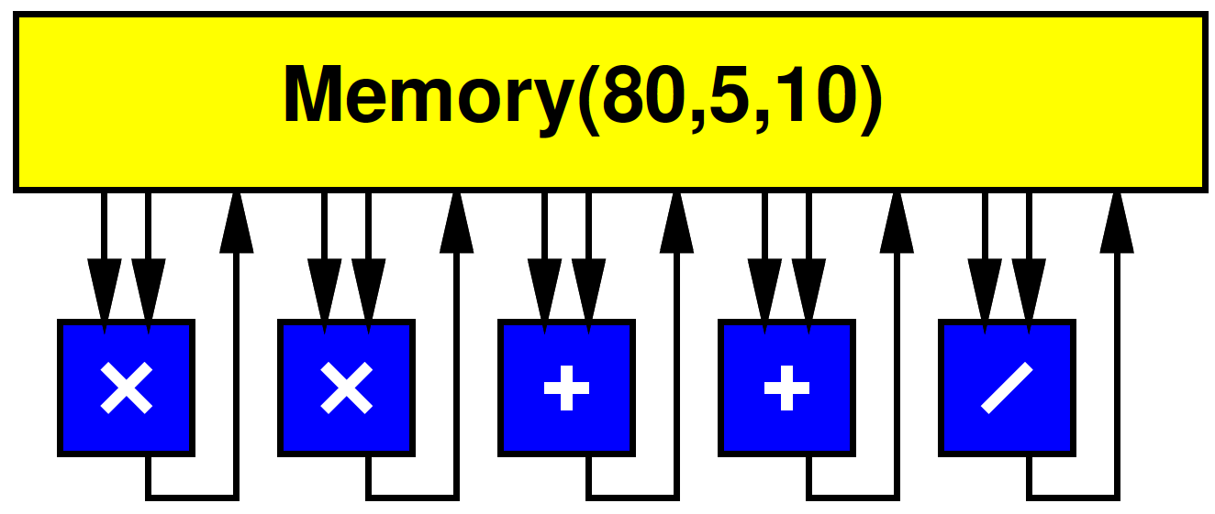
VLIW w/ Multiport RF
Simple, full-featured model use common Register File

Slide 19
Processor Unbound
Can (design to) use all operators at once

Slide 20
Processor Unbound
Implement Preclass 1

Slide 21
Software Pipelined Version
for (i=0;i<MAX;i++)
{ c=c+prod; prod=la*lb; la=a[i]; lb=b[i];}
Use this to compact schedule

Slide 22
VLIW Operator Knobs
Choose collection of operators and the numbers of each
Match task
Tune resources

Slide 23
Preclass 2
res[i]=sqrt(x[i]*x[i]+y[i]*y[i]+z[i]*z[i]);
How many operators need for each II? Datapath Area?

Slide 24
Multiport RF
Multiported memories are expensive
Need input/output lines for each port
Makes large, slow
Simplified preclass model:
Area(Memory(n,w,r))=n*(w+r+1)/2

Slide 25
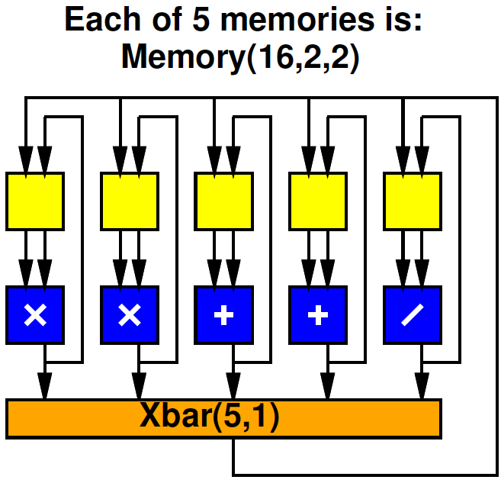
Preclass 3
Compare total area
Multiport 5, 10
5 x Multiport 2, 2 with 5x1 Xbar
How does area of memories, xbar compare to datapath operators in each case?

Slide 26
Split RF Cheaper
At same capacity, split register file cheaper
2R+1W → 2 per word
5R+10W → 8 per word

Slide 27
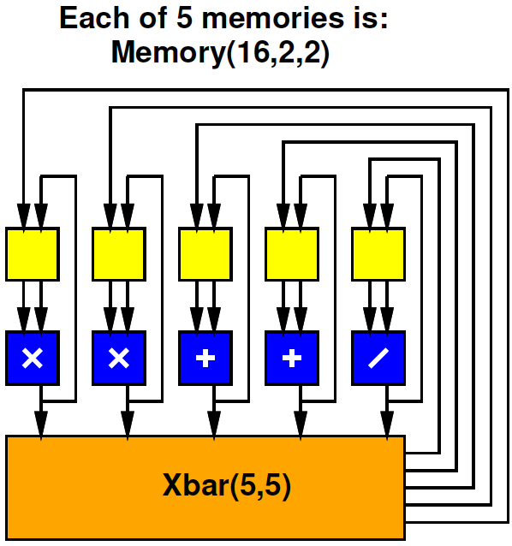
Split RF
Split RF with Full (5, 5) Crossbar
Cost?

Slide 28
Split RF Full Crossbar
What restriction/limitation might this have versus multiported RF version?

Slide 29
VLIW Memory Tuning
Can select how much sharing or independence in local memories

Slide 30
Split RF, Limited Crossbar
What limitation does the one crossbar output pose?

Slide 31
VLIW Schedule
Need to schedule Xbar output(s) as well as operators.
(as seen Day 12)
Cycle | 0 | 1 | 2 | 3 | 4 | 5 | 6 | 7 | 8 | 9
X 1
X 2
+ 1
+ 2
/
Xbar

Slide 32
Pipelined Operators
Often seen, will have pipelined operators
E.g. 3 cycles multiply
How complicate?

Slide 33
Accommodating Pipeline
Schedule for when data becomes available
Dependencies
Use of resources
Cycle | 0 | 1 | 2 | 3 | 4 | 5 | 6 | 7 | 8 | 9
X 1
X 2 | OP
+ 1 |  |  | AOP
+ 2
/
Xbar |  |  | AOP | OP

Slide 34
VLIW Interconnect Tuning
Can decide how rich to make the interconnect
Number of outputs to support
How to depopulate crossbar
Use more restricted network

Slide 35
Compare
Compare processor and unbound-VLIW processor under preclass 3 model.
32 registers, Mux 3x1 crossbar
Branch=10, LD/ST=200, ALU=10
Assume Imem, Memcomparable

Slide 36
Compare
Vector and VLIW under preclass 3 model
LD/ST=200 (only charge 1 across vector)
Charge per multiplier/adder/Multiport 16,1,2 RF
(hint: 1 same as proc, 3 same – ld/st)

Slide 37
Compare Vector VLIW
Instructions for dot product (preclass 1)
10 instructions for 4 multiply-adds (VL=4)
top: sub r1,r2,r3 // r3=MAX-i
bzneq r3, end
addi r4,#16,r4
addi r5,#16,r5
vld r4,v6 // a[i]…a[i+3]
vld 56,v7 // b[i]…b[i+3]
vmul v6,v7,v7 // a[i]*b[i]
vadd v7,v8,v8 // c+=a[i]*b[i]
addi r1,#4,r1 // i+=4
end: vreduce v8,r8

Slide 38
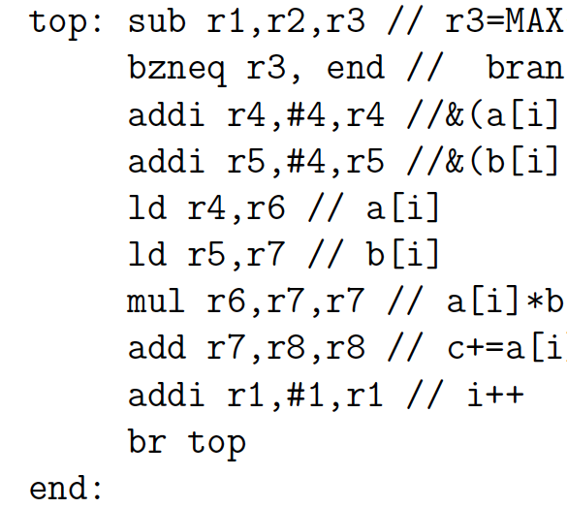
Loop Overhead
Looping, incrementing pointers costs a few instructions
Can be large overhead in tight loops
Most/all of non-vector operations in previous example

Slide 39
Loop Overhead
Can handle loop overhead in ILP on VLIW
Increment counters, branches as independent functional units

Slide 40
VLIW Loop Overhead
Can handle loop overhead in ILP on VLIW
…but paying a full issue unit and instruction costs overhead

Slide 41
Zero-Overhead Loops
Specialize the instructions, state, branching for loops
Counter rather than RF
One bit to indicate if counter decrement
Exit loop when decrement to 0

Slide 42
Simplification

Slide 43
Zero-Overhead Loop Simplify
Share port – simplify further

Slide 44
Zero-Overhead Loop Example (preclass 1)
repeat r3:
addi r5,#4,r5; ld r4,r5
addi r4,#4,r4; ld r6,r7
add r9,r8,r8; mul r6,r7,r9

Slide 45
Zero-Overhead Loop
Potentially generalize to multiple loop nests and counters
Common in highly optimized DSPs, Vector units

Slide 46
VLIW vs. SuperScalar
Modern, high-end processors
Do support ILP
Issue multiple instructions per cycle
…but, from a single, sequential instruction stream
SuperScalar – dynamic issue and interlock on data hazards – hide # operators
Must have shared, multiport RF
VLIW – offline scheduled
No interlocks, allow distributed RF
Lower area/operator – need to recompile code

Slide 47
Big Ideas:
VLIW as a Model for
Instruction-Level Parallelism (ILP)
Customizing Datapaths
Area-Time Tradeoffs
Customize VLIW
Operator selection
Memory/register file setup
Inter-functional unit communication network

Slide 48
Admin
HW7 due Friday
Individual

