Slide 1
ESE532: System-on-a-Chip Architecture
Day 16: March 20, 2017
MPEG Encoding

Slide 2
Today
MPEG Encoding
Project
Motion Estimation
DCT
Entropy Encoding

Slide 3
Message
Compression is about exploiting (eliminating)
Redundancy (lossless)
Things humans don’t notice much (lossy)
Redundancy in video
Temporal: data repeated frame-to-frame
Spatial: frequency patterns
Quantize: high frequencies
Entropy encode values (e.g. frequencies)

Slide 4
Project
Continue to work with MPEG Encoder
Speed up as much as possible on Zynq
Estimate custom design to achieve real-time for 1080p30: 1920x1080 at 30 fps
Groups of 2 – you select partners
Next 5 weeks: project report 4/21
Weekly milestones

Slide 5
Why MPEG Encode?
Original intent: different problem
Experience:
MPEG harder than intended for first half warmup
Probably right complexity for project
Avoid giving you a project too complex
Want you to succeed at accelerating

Slide 6
Expect
You will need to rewrite more of the code than you have so far
C written for reference not organized or written correctly for acceleration

Slide 7
Why not do this before?
Expected
wouldn’t need to get this deep into it for the homework series.
Could focus on bottleneck pieces and small snippets
…as we did for HW3
was familiar

Slide 8
MPEG Encode

Slide 9
MPEG Encoder

Slide 10
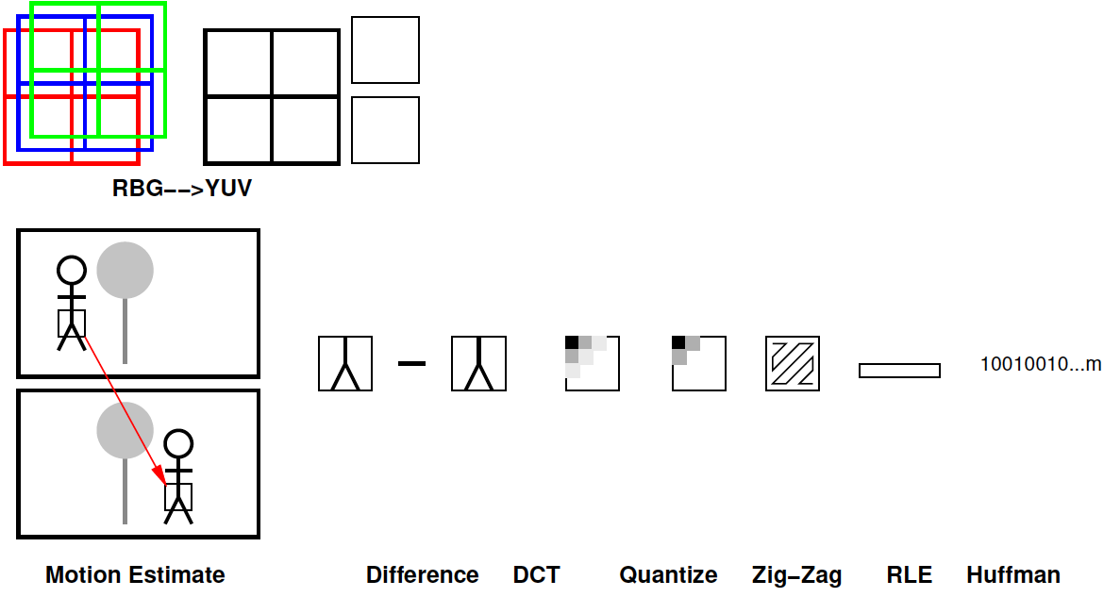
MPEG Encoder

Slide 11
Temporal Redundancy

Slide 12
Frame-to-Frame
How are two immediately adjacent video frames likely to be related?
Common cases
Fixed camera (e.g. security camera)
Panning camera
Object moving left to right

Slide 13
Idea: Temporal Coding
If part of frame not change
Avoid resending
If something moves in frame
Avoid resending
Identify where to find in previous frame

Slide 14
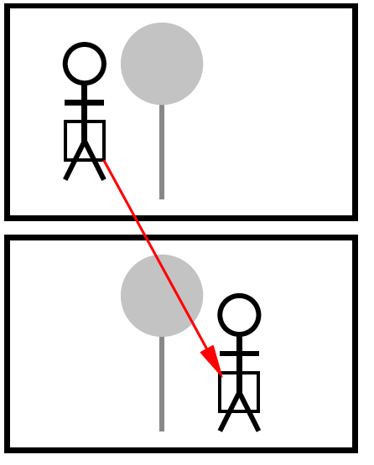
MPEG Simplification
Break image into 16x16 macroblocks
Try to find macroblock in previous frame
(or subsequent frame)
Ideal
Find perfect match
Only send location of match

Slide 15
Preclass 1
How big is pointer for 1920x1080 frame?
How much cheaper than sending 16x16 macroblock with 8b pixels?

Slide 16
Macroblock Match
Finding “identical” macroblock:
Where is this likely to work?
What complicates?

Slide 17
Challenge
May not be exactly identical
Shadows change
Something moves over part of macroblock
Thing in macroblock distorts
Person talks, turns, rotates
Object moves toward/away from camera

Slide 18
Not Identical
Send difference
Maybe less information than new macroblock
E.g.
background occluded (exposed) on side
Eye opens (closes)

Slide 19
Finding
Find matching macroblock
Or best matching (hence dist)
How go about finding?

Slide 20
Local Search
Hypothesize that the macroblock is nearby in previous image.
Why might be good hypothesis?
Simple
Exhaustively search within some distance
Why expensive?

Slide 21
Limited Motion
After a number of frames, less likely to find in previous frame
New objects, turns, rotation, scale…
Send new, non-motion coded reference

Slide 22
MPEG Frames
Interleave I, P, and B frames
I – not motion coded
P – forward prediction frames
Predict from previous frame
B – backward prediction frames
Predict from future frames
E.g. (IBBPBBPBBPBB)*

Slide 23
MPEG Encoder

Slide 24
Spatial Redundancy
Can code more efficiently in frequency domain
Humans notice low frequency components more than high frequency
Can use fewer bits for high frequency components

Slide 25
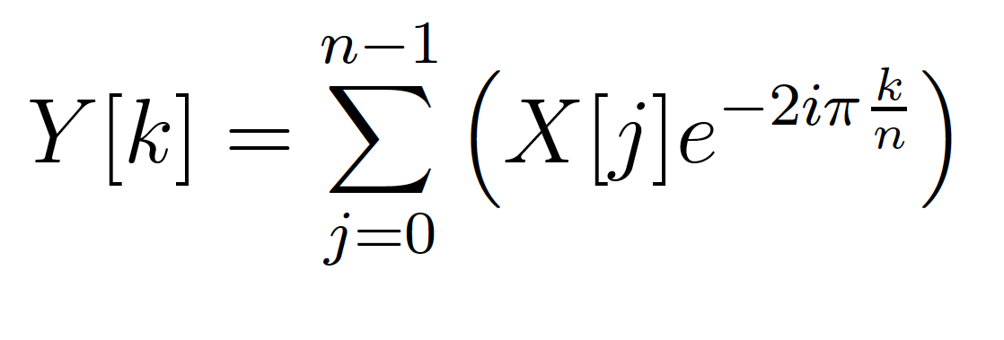
Fourier Transform
Day 14
Identify spectral components
Convert between Time-domain to Frequency-domain
E.g. tones from data samples
Central to audio coding – e.g. MP3 audio

Slide 26
Discrete Cosine Transform
Similar to FFT
Only uses Cosine (real part)
(boundary condition)

Slide 27
2D-DCT Basis
Actually compute 2D-DCT
DCT in each spatial dimension
On 8x8 blocks
Can be viewed as a basis transform
Re-expressing the 8x8 block in terms of 8x8 selection of x and y frequencies

Slide 28
2D-DCT Basis
Basis vectors, so all 64 components are orthogonal
Any 8x8 spatial is a weighted sum of these 64 components

Slide 29
Preclass 2
Represent all 23 pixel block?
Non-zeros for horizontal stripes?
Non-zeros for vertical stripes?

Slide 30
DCT Benefits
Concentrates weight in low frequency components (upper left)
High frequency components can be dropped or represented with few bits
Not matter so much to human perception

Slide 31
DCT Example
Source: http://img.tomshardware.com/us/1999/09/24/video_guide_part_3/dct.gif

Slide 32
2D DCT Calculation
Brute force like this
O(n⁴)
n² entries
Each require n² terms

Slide 33
2D DCT Calculation
fdct
Decompose, like FFT
Perform 1D DCT across rows O(n³)
n² results, each O(n)
Perform 1D DCT across columns O(n³)

Slide 34
MPEG Encoder

Slide 35
Quantize
EXTERN unsigned char default_intra_quantizer_matrix[64]
#ifdef GLOBAL
=
{
8, 16, 19, 22, 26, 27, 29, 34,
16, 16, 22, 24, 27, 29, 34, 37,
19, 22, 26, 27, 29, 34, 34, 38,
22, 22, 26, 27, 29, 34, 37, 40,
22, 26, 27, 29, 32, 35, 40, 48,
26, 27, 29, 32, 35, 40, 48, 58,
26, 27, 29, 34, 38, 46, 56, 69,
27, 29, 35, 38, 46, 56, 69, 83
}
#endif

Slide 36
Quantize
EXTERN unsigned char default_intra_quantizer_matrix[64]
#ifdef GLOBAL
=
{
8, 16, 19, 22, 26, 27, 29, 34,
16, 16, 22, 24, 27, 29, 34, 37,
19, 22, 26, 27, 29, 34, 34, 38,
22, 22, 26, 27, 29, 34, 37, 40,
22, 26, 27, 29, 32, 35, 40, 48,
26, 27, 29, 32, 35, 40, 48, 58,
26, 27, 29, 34, 38, 46, 56, 69,
27, 29, 35, 38, 46, 56, 69, 83
}
#endif
Divide by entry in quantizer matrix before change to integer
Most bits to upper left
Few bits to lower right
More things threshold to zero

Slide 37
Quantize and Precision
EXTERN unsigned char default_intra_quantizer_matrix[64]
#ifdef GLOBAL
=
{
8, 16, 19, 22, 26, 27, 29, 34,
16, 16, 22, 24, 27, 29, 34, 37,
19, 22, 26, 27, 29, 34, 34, 38,
22, 22, 26, 27, 29, 34, 37, 40,
22, 26, 27, 29, 32, 35, 40, 48,
26, 27, 29, 32, 35, 40, 48, 58,
26, 27, 29, 34, 38, 46, 56, 69,
27, 29, 35, 38, 46, 56, 69, 83
}
#endif
What does quantization mean for DCT precisions?

Slide 38
MPEG Encoder

Slide 39
Value Diminish to Lower Right
Source: http://img.tomshardware.com/us/1999/09/24/video_guide_part_3/dct.gif

Slide 40
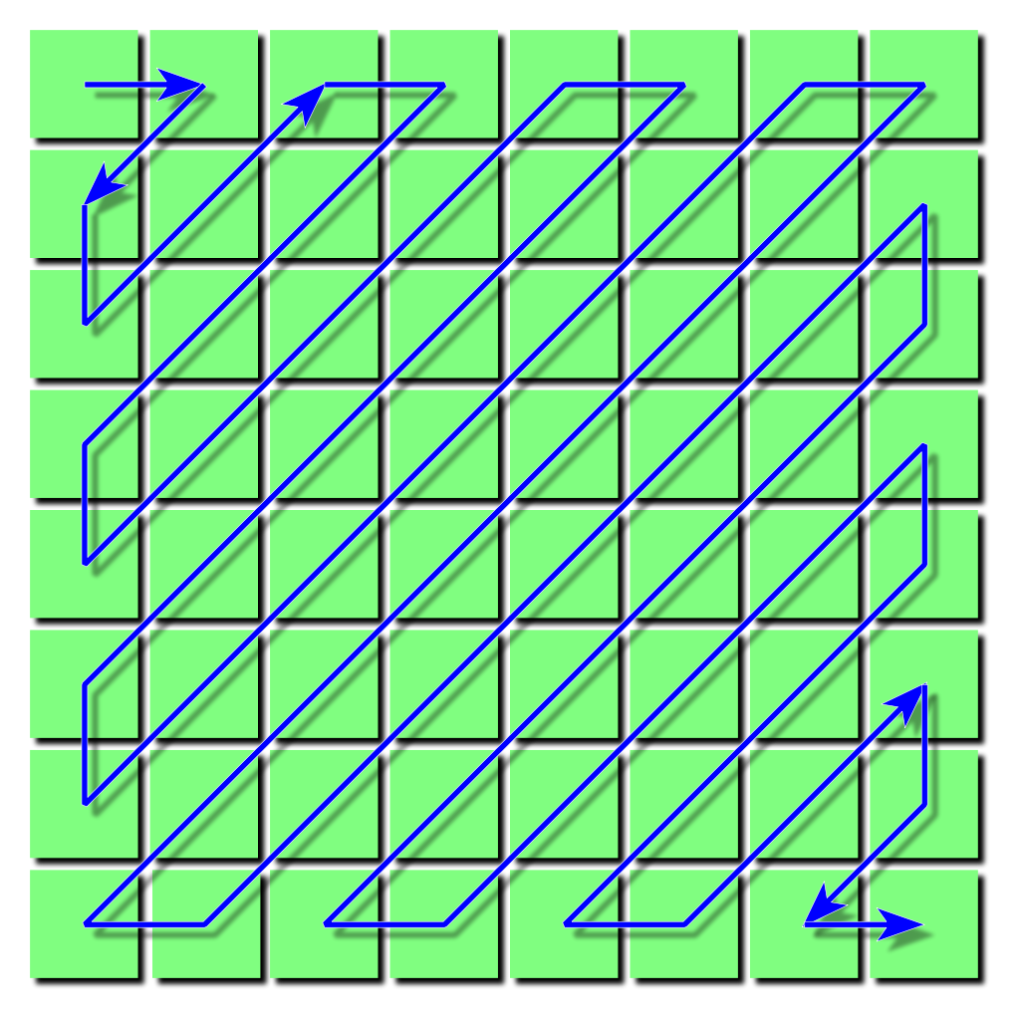
Zig-Zag Order
Groups zeros (and small constants) together at end
Source: https://en.wikipedia.org/wiki/JPEG#/media/File:JPEG_ZigZag.svg

Slide 41
Value Diminish to Lower Right
Source: http://img.tomshardware.com/us/1999/09/24/video_guide_part_3/dct.gif
Source: https://en.wikipedia.org/wiki/JPEG#/media/File:JPEG_ZigZag.svg

Slide 42
Value Diminish to Lower Right
45 -5 12 0 0 0 -4 -3 0 0 0 0 0 0 0 -1 0 0 0 0 0 0 0 0 0 0 0 0 0 0 0 0 ….
Source: http://img.tomshardware.com/us/1999/09/24/video_guide_part_3/dct.gif
Source: https://en.wikipedia.org/wiki/JPEG#/media/File:JPEG_ZigZag.svg

Slide 43
MPEG Encoder

Slide 44
Preclass 3
How many numbers in the Run-Length encoding?
45 -5 12 0 0 0 -4 -3 0 0 0 0 0 0 0 -1 0 0 0 0 0 0 0 0 0 0 0 0 0 0 0 0 ….

Slide 45
MPEG Encoder

Slide 46
Preclass 4
How many bits to Huffman encode?
Compare to 8b encoding of RLE?

Slide 47
Huffman
void putbits(val,n)
{
mask = 1 << (n-1); /* selects first (leftmost) bit */
for (i=0; i<n; i++)
{
outbfr <<= 1;
if (val & mask)
outbfr|= 1;
mask >>= 1; /* select next bit */
outcnt--;
if (outcnt==0) /* 8 bit buffer full */
{
output_buf[bytecnt] = outbfr;
outcnt = 8;
bytecnt++;
if (bytecnt == OUTPUT_BUF_SIZE)
error("Output buffer too small.");
}
}
}
Bit twiddling for Huffman coding inefficient on word-wide processor

Slide 48
MPEG Encoder

Slide 49
MPEG Encoder

Slide 50
Big Ideas
Compression is about exploiting (eliminating)
Redundancy (lossless)
Things humans don’t notice much (lossy)
Redundancy in video
Temporal: data repeat frame-to-frame
Spatial: frequency patterns
Quantize: high frequencies
Entropy encode values (e.g. frequencies)

Slide 51
Admin
Project and Project Analysis Milestone out
Project Analysis Milestone due Friday
Including teaming

