Slide 1
ESE532: System-on-a-Chip Architecture
Day 18: March 27, 2017
Representation and Precision

Slide 2
Today
Fixed Point
Errors from Limited Precision
Precision Analysis / Interval Arithmetic
Floating Point

Slide 3
Message
We must always calculate with limited precision
Precision costs area (and energy)
Can economize area (and energy) by judiciously using just the precision we need
Precision-cost tradeoff
Can perform analysis on precision

Slide 4
Fixed Point
Integer which interpret as a fraction
Fixed-Point N.F
N bits
F bits below fraction (typically N<F)
Equivalently: meaning is Integer-value/2^{F}

Slide 5
Operator Sizes
Operator | LUTs | LUTs + DSPs
Double FP Add | 712 | 681+3 DSPs
Single FP Add | 370 | 219+2 DSPs
Fixed-Point Add (32) | 16
Fixed-Point Add (n) | n/2
Double FP Multiply | 2229 | 223+10 DSPs
Single FP Multiply | 511 | 461+3 DSPs
Fixed Multiply (32x32) | 1099
Fixed Multiply (16x16) | 283 | 1 DSP
Fixed Multiply (18x25) |  | 1 DSP
Fixed Multiply (n) | ~ n²
FP sizes from: https://www.xilinx.com/support/documentation/ip_documentation/ru/floating-point.html

Slide 6
Observe
Floating-Point operators are large compared to Fixed-Point
For similar precision
712 vs. 32 for addition
Double-precision Floating point operators are large
2229 Multiply, 712 Add
Can quickly fill 50,000 LUT programmable logic

Slide 7
Fixed-Point Economy
Can fit more logic (more parallelism) using modest fixed-point
At 16b: Multiply 283, Add 16
Vs. Double: 2229, 712
But
How much precision do we need?
How do we determine?

Slide 8
Perfect Representation
Start with Fixed-Point 16.8
What do we need to
represent the result of an addition? (3a)
represent the result of a multiplication? (3b)

Slide 9
Sequence
Across a sequence of operations
A, B, C, D, E start Fixed-Point 16.8
Y=((A+B)*C+D)*E;
Perfect representation for partial results up to Y?

Slide 10
Looping: Bound loop
res=0;
for(i=0;i<4;i++)
res=res*x+a[i]
Assume a[i], x start Fixed-Point 16.8
Final precision needed for res?

Slide 11
Looping: Unbound
res=0;
for(i=0;i<len;i++)
res=res*x+a[i]
Assume a[i], x start Fixed-Point 16.8, len starts Integer 16
Final precision needed for res?

Slide 12
Perfect Representation
Start with Fixed-Point 16.8
What do we need to
represent the result of a division? (3e)
E.g. 00000001.00000000/00000011.00000000

Slide 13
Conclude
Cannot generally keep perfect precision
Will typically need to decide how much precision we need and where

Slide 14
Errors from Limited Precision

Slide 15
What error introduce?
Absolute Error – what level of error do we have in approximated value or a result
Might be all we care about
Get answer to 1mV accuracy
…or 1 pixel accuracy
4.13742 – assume full
4.1374 – 0.00002
10⁻⁵
4.137 – 0.00042
10⁻⁴
4.14 – 0.00256
10⁻³
4.1 – 0.03742
10⁻²

Slide 16
What error introduce?
Relative Error – error as percentage of intended result
May be more relevant, particularly if trying to identify small values
4.13742 – assume full
4.1374 – 4.8E-6
10⁻⁶
4.137 – 1.02E-4
10⁻⁴
4.14 – 6.2E-4
10⁻⁴
4.1 – 9.0E-3
10⁻³

Slide 17
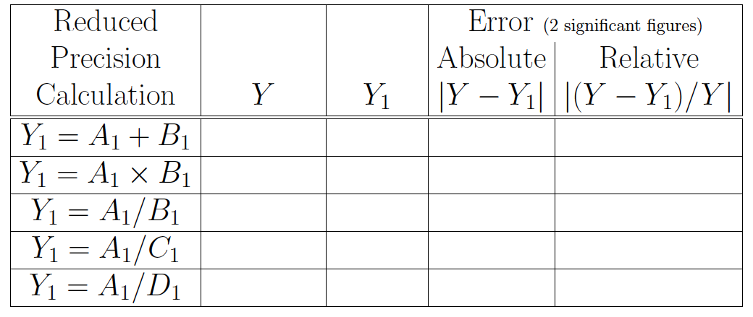
Preclass 1
Complete Table

Slide 18
Observe
Add/Multiply relatively well behaved
Must be very careful when
Division involved
Divisors can be small
Get approximated near zero

Slide 19
Precision Allocation
Full precision can be too expensive
Non-sensical
Limited precision introduces errors
May be smaller than we care about
Determine minimal precision needed
…or where to spend precision…

Slide 20
Empirical Analysis
Make guess at precisions
Set precisions in calculation
Simulate on data
Evaluate results (absolute, relative error) compared to gold standard
Unlimited precision…or, at least, higher precision
Often standard is double-precision float
…but, as we’ll, even that’s a compromise
Update precision guess and repeat

Slide 21
Empirical Analysis
Make guess at precisions
Set precisions in calculation
Simulate on data
Evaluate results compared to gold standard
Care
Adequate set of test data to trigger worst-case errors?
Requires some understanding of calculation
Shouldn’t be entirely black box

Slide 22
Vivado HLS Support
Has libraries to support
Arbitrary precision integers
Arbitrary precision fixed point
For
Simulation
Synthesis
UG902 – Vivado HLS User Guide
Chapter 2: Abritrary Precision Data Type Library

Slide 23
Precision Analysis

Slide 24
Precision Analysis
Can analyze worst-case error impacts from limited precision
Give results not sensitive to test set
Give guidance on where to allocate precision
…can be automated

Slide 25
Limit Precision Inputs
Typically start with limited precision
A/D only sample to 12b
Real-world had more precise value, but didn’t capture
Quantized data stored in representation
Sound samples, DCT frequency coefficients
We start with error
What does that mean about values we calculate?

Slide 26
Interval Analysis
Treat every value as an interval arrange
Model effects of operations on range of results
A=(A.H, A.L)
A+B=(A.H+B.H,A.L+B.L)
Positive A, B and B interval not cross 0
A*B=(A.H*B.H,A.L*B.L)
A/B=(A.H/B.L,A.L/B.H)

Slide 27
Interval Analysis
A*B=(max(A.H*B.H,A.H*B.L,A.L*B.H,A.L*B.L), min(A.H*B.H,A.H*B.L,A.L*B.H,A.L*B.L))
A/B … more complicated
If B.H positive, B.L negative, can become infinity

Slide 28
Limited Precision
A=(A.H,A.L)=(A+ε,A-ε)=A±ε
E.g. if rounded to Fixed Point 16.8
ε may be 2⁻⁹

Slide 29
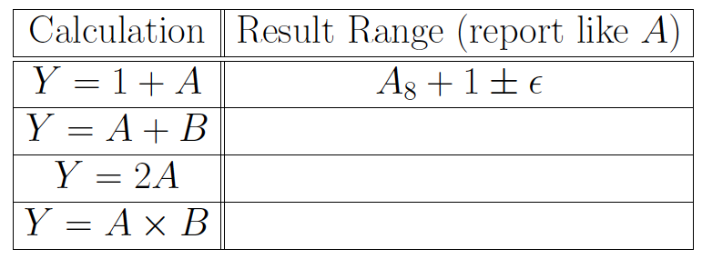
Preclass 2
Complete Table

Slide 30
Multiplication
(A±ε)(B±ε)
A*B ± ( (A+B) ε + ε² )
A and B can be MAXVAL, MINVAL
Assume symmetric (MAXVAL=-MINVAL)
A*B ± ( 2*MAXVAL* ε + ε² )
Probably reasonable to drop ε²
A*B ± 2*MAXVAL* ε

Slide 31
Preclass 3c
Recall: Fixed-Point 16.8 multiply
Full precision result: 32.16
What is error interval for result of 16.8 multiply?

Slide 32
Preclass 3c
For 16.8, ε₀=1/512, maxval=256
From answer multiply in preclass 2
A*B ± 2*MAXVAL* ε
So, get A*B ± 2*256*(1/512)
Or A*B±1

Slide 33
Observe
Full precision may keep bits well below the error in the calculation

Slide 34
Rounding
Rounding introduces an error
Round Nearest A to Fixed-Point N.8
ε=2⁻⁹
As does truncation, floor, ceil…
But asymetric interval

Slide 35
Preclass 3d
Error range if round 32.16 result to 18.2?
(from 16.8 multiply)

Slide 36
Preclass 3d
Rounding 32.16 to 18.2 introduces a quantization error of 2⁻³
Our 32.16 multiply result was ±1
Add an addition ±1/8
Total error: ±9/8

Slide 37
Result
Dropping (rounding) bits may not increase error range (much)

Slide 38
Symbolic
If work through computation symbolically, can generate equation for error
Each rounding (precision drop) adds some ε_{i} precision

Slide 39
Symbolic Example (start)
Start A, B, C, D, E with maxval₀, ε₀
Y=((A+B)*C+D)*E;
A+B maxval₁=2maxval₀ , ε₂=2ε₀+ε₁
ε₁ for round after this operation
(A+B)*C
maxval2=maxval₁*maxval₀
ε₄=ε₂*maxval0+ε₀*maxval1+ε₃
ε₃ for round at this operation

Slide 40
Result Precision
After series of operations, may have expression like:
Y±(3ε₂+ε₁+1024*ε₀)
If looking for result with precision ±ε_{res}
ε_{res}≥ (3ε₂+ε₁+1024*ε₀)

Slide 41
Result Precision
Fixed Precision12.0 = Round(val)
E.g. A/D output
Only need to know val to ε=1/2
Fixed Precision 12.0 = Round(val/4)
E.g. Quantized value stored in file
Only need to know val to ε=2
ε_{res}≥ (3ε₂+ε₁+1024*ε₀)
Maybe: ε₀=1/1024, ε₁=1/2, ε₂=1/8

Slide 42
Optimize Precision Allocation
ε_{res}≥ (3ε₂+ε₁+1024*ε₀)
Maybe: ε₀=1/1024, ε₁=1/2, ε₂=1/8
More generally
Combine with area model and look at expense of providing each ε_{i}
Try pick ε_{i} to meet ε_{res} while minimizing area

Slide 43
Tools
Tools can automate interval calculations to verify precision
E.g. Gappa++
https://bitbucket.org/mlinderm/gappa

Slide 44
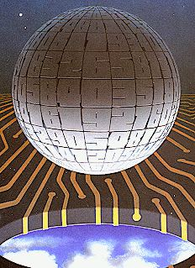
Floating Point
Robert Tinney
(Byte circa 1980)

Slide 45
Floating Point
Leading 0s aren’t that useful
Can represent more compactly by counting them
Only need log bits to count
Represent value as
Mantissa
Exponent
Like Scientific Notation

Slide 46
Floating Point
Floating Point means
Move the datapath to the interesting/significant part of computation
Don’t represent leading zeros
Don’t represent less significant bits
Even if they are well above 1
In the integer portion

Slide 47
Revisit Divisions Preclass 1
C=0.14378 → 1.4x2⁻¹
D=0.00192 → 1.9x2⁻³
Float A/C = 4.1/0.14
Absolute error 0.5
Relative error 0.018
Float A/D = 4.1/0.0019
Absolute error 3.0
Relative error 0.0014

Slide 48
Standard Floating Point
Double Precision (64b)
1 bit sign
11 bit exponent
Offset 1023 represents 1023 to -1022
53 bit mantissa (52b + implicit 1)
Single Precision (32b)
1 bit sign
8 bit exponent (offset 127)
24 bit mantissa (23b + implicit 1)

Slide 49
Expensive Add
Recall Double=712, Single=370
A=(A.m,A.e), B=(B.m,B.e)
By e, sort to large, small
Small.m>>(large.e-small.e)
Perform mantissa addition
Large.m+small.m>>(large.e-small.e)
Possibly shift to normalize result
Update exponent
Round

Slide 50
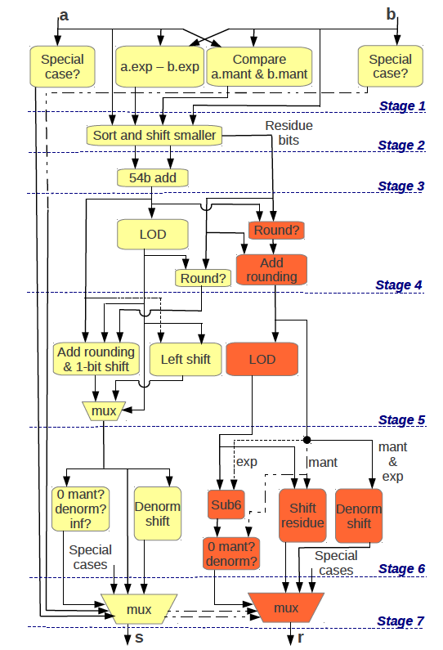
FP Add
54b add one stage of 7 in pipeline
Done in 27 6-LUTs
[Kadric, Arith 2013]

Slide 51
Floating Point Multiply
Double 2229, Single 461
Don’t need to sort, pre-shift
m=A.m*B.m (53x53 multiply dominates)
e=A.e+B.e
Still have shifting, rounding at end

Slide 52
Dynamic Range
Floating Point has very wide dynamic range
Can deal with significant piece being anywhere in 1023 to -1022
For fixed-point to cover same range
Fixed Point 2046.1022
Add 1024 LUTs
Multiply ~ 4M LUTs
When need dynamic range, FP economical

Slide 53
Customization
Can customize on FPGA or custom silicon
Mantissa bits
Exponent bits
Fewer bits when need less precision or range to save area
More bits if need greater precision or range

Slide 54
Floating Point
Not free of precision problems
((1+2¹⁰⁰)-2⁹⁹)-2⁹⁹=0
1+(2¹⁰⁰+(-2⁹⁹-2⁹⁹))=1

Slide 55
Floating-Point Analysis
Can do similar analysis on floating point
…and there are tools to help
Including Gappa++

Slide 56
Floating-Point vs. Fixed-Point
Floating-Point (esp. double-precision) is a big hammer solution
Trades hardware/energy for programmer attention to needs
Standards have been well thought out so works over wide range
Most cases it is more than needed
Cost/energy sensitive designs will ask what’s necessary and tune accordingly

Slide 57
Economizing Precision
FPGAs
Get fined-grained selection of precision
GPUs
Often provide single-precision
Enough, allow pack more parallelism
DSP
Fixed-Point DSPs cheaper, lower energy

Slide 58
Big Ideas
We must always calculate with limited precision
Precision costs area (and energy)
Can economize area (and energy) by judiciously using just the precision we need
Precision-cost tradeoff
Can perform analysis on precision

Slide 59
Admin
Project Design Space Milestone
Out
Due Friday

