Slide 1

ESE532:
System-on-a-Chip Architecture
Day 19: March 29, 2017
Network-on-a-Chip (NoC)

Slide 2
Today
Ring
2D Mesh Networks
Design Issues
Buffering and deflection
Dynamic and static routing

Slide 3
Message
Scalable interconnect for locality
  has rich design space
Customize to compute and application
Support real-time with static scheduled communication

Slide 4
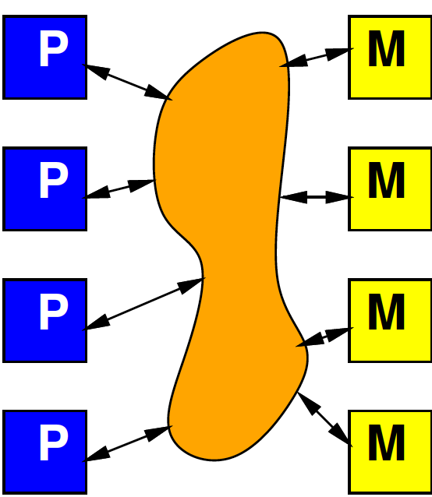
Interconnect
Day 8
Will need an infrastructure for programmable connections
Rich design space to tune
area-bandwidth-locality
  Will explore more
  later in course

Slide 5
Interconnect Concerns
Avoid being a bottleneck
  Bandwidth
  Latency
Competes for area and energy
  against compute and memory

Slide 6
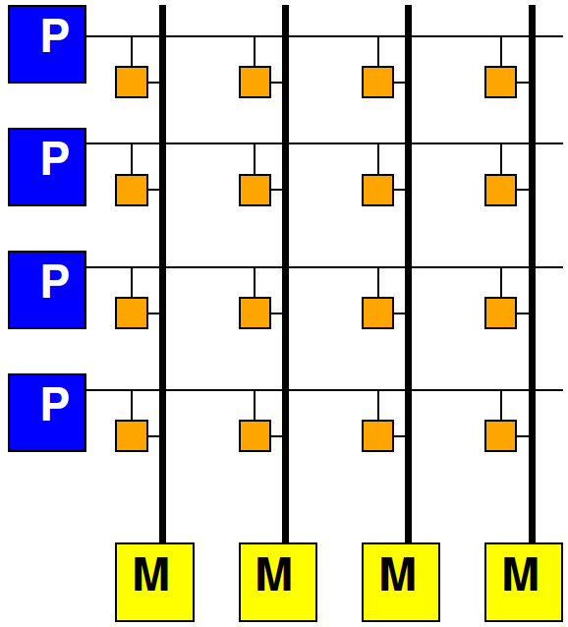
Crossbar
Connect any I inputs, O outputs
Area ~ I×O
For N PEs
scale as N²

Slide 7
Today’s SoC Large
At 1mm² per A9, can put 100 on 1cm² chip
120 core MIPS on Stratix V FPGA
  FPGA 2017
1680 core RISC-V on Xilinx Ultrascale
  http://fpga.org/2017/01/12/grvi-phalanx-joins-the-kilocore-club/
Scaling to 100s and 1000s of processing elements (PEs) that need interconnect

Slide 8
Locality
Delay and energy proportional to distance
Want to keep communications short
  Data near compute
  From compute block to compute block
How build network?
  Scalable (Area ~ N = things connected?)
  Supports locality

Slide 9
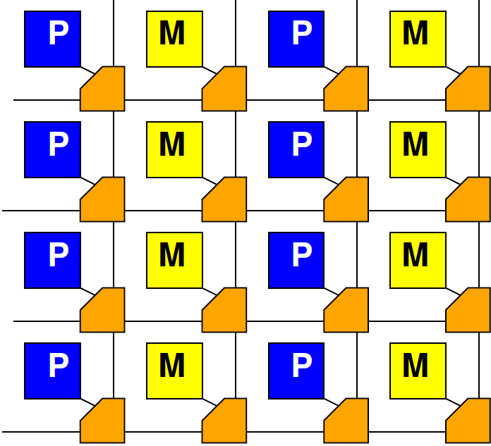
Mesh
Day 8

Slide 10
Bus to Ring

Slide 11
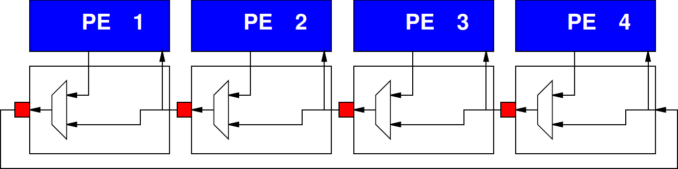
Ring

Slide 12
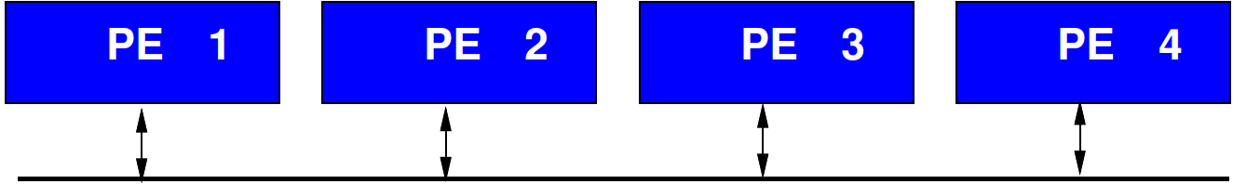
Preclass 1
Traffic pattern
  Similar bandwidth?
  One has higher bandwidth?

Slide 13
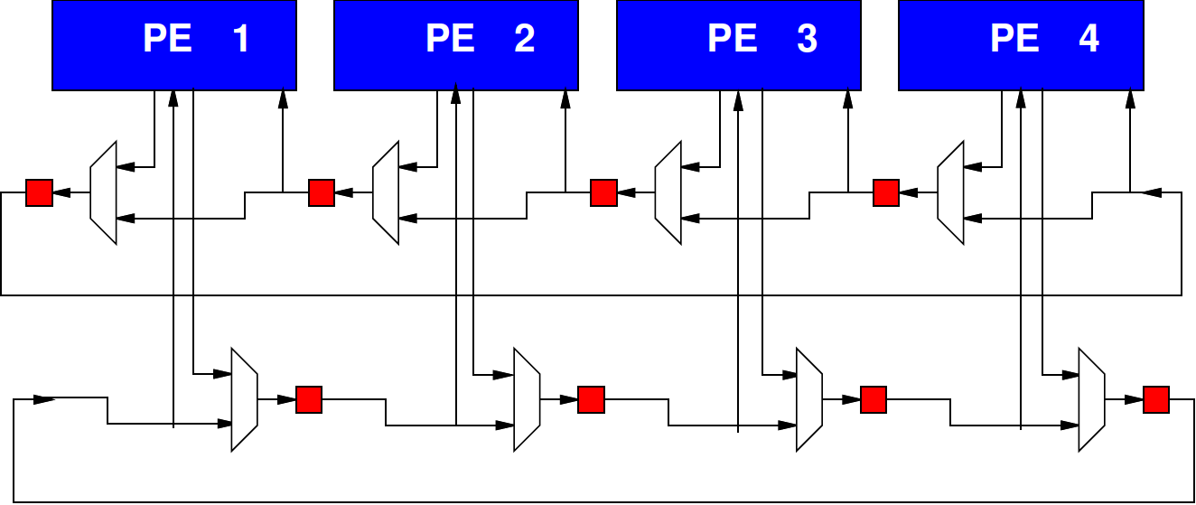
Bidirectional Ring

Slide 14
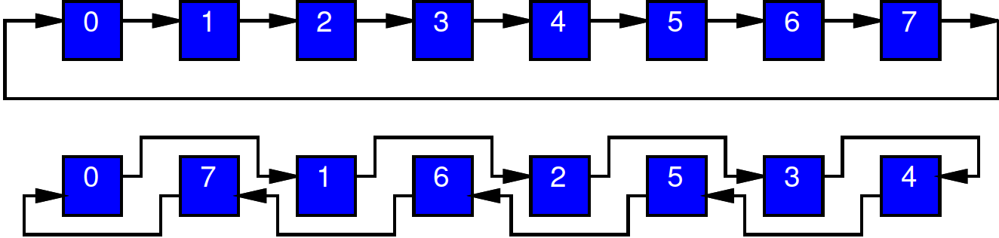
Interleaved Layout
What problem does this layout solve?

Slide 15
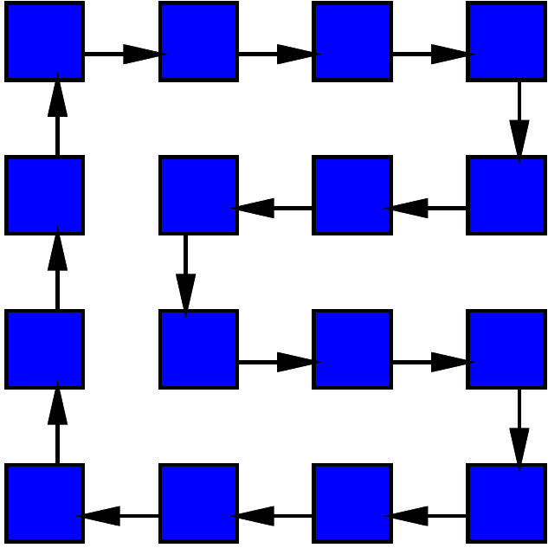
2D Layout

Slide 16
Scaling
How does area scale with N?
How does neighbor distance scale with N?
  Unidirectional
  bidirectional
How does worst-case distance in ring scale with N?
  Unidirectional
  bidirectional

Slide 17
1D to 2D

Slide 18
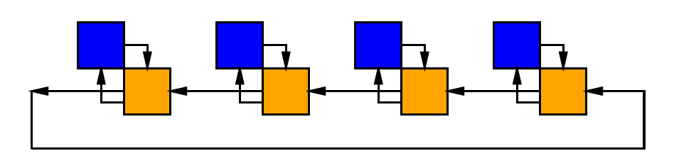
Ring Abstract

Slide 19
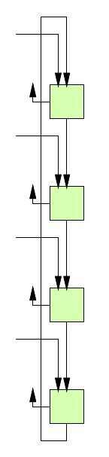
Row and Column Rings

Slide 20
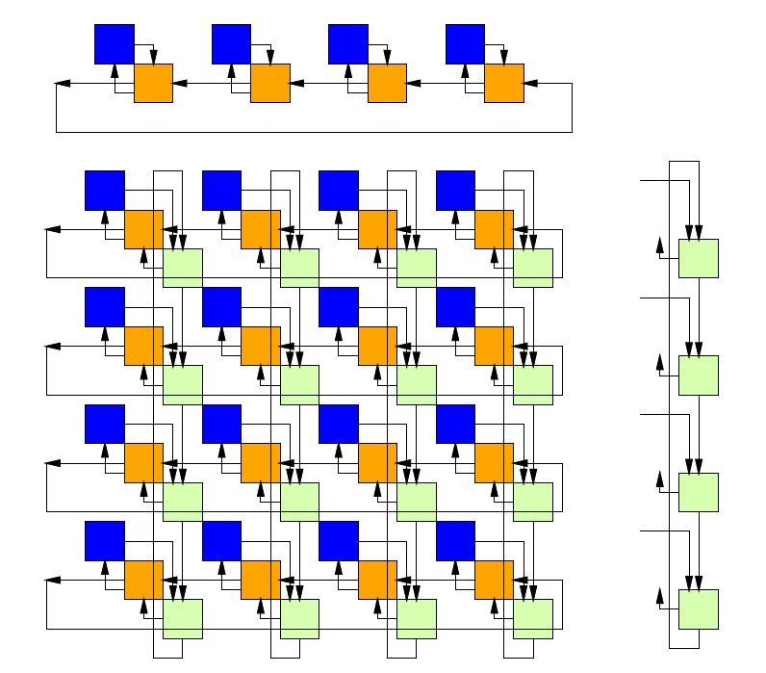
Mesh as Row & Column Rings

Slide 21
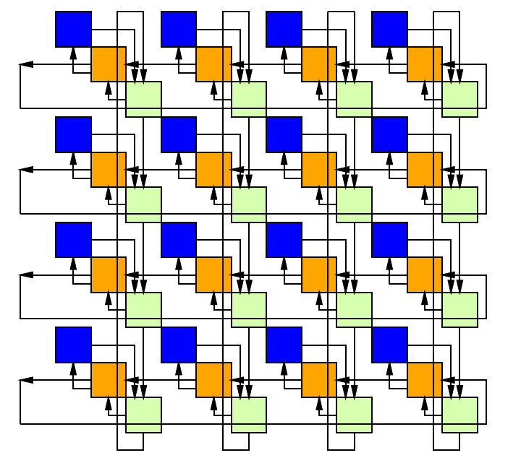
Directional Mesh (Torus)

Slide 22
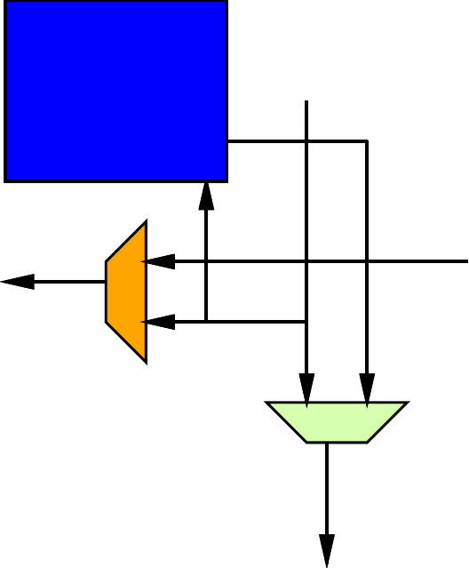
Mesh Datapath

Slide 23
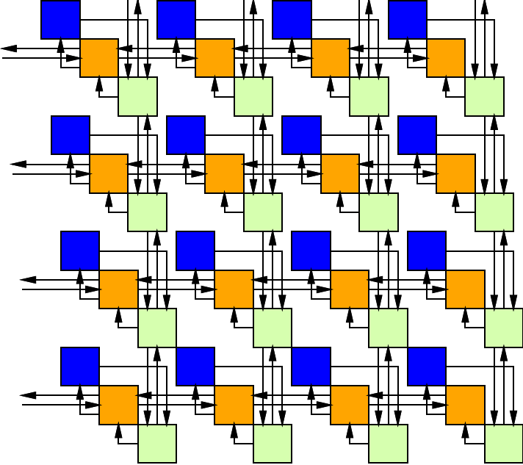
Bidirectional Mesh

Slide 24
2D Mesh Scaling
How does area scale with N?
How does neighbor distance scale with N?
How does worst-case distance in mesh scale with N?

Slide 25
Specifying Destination
Simple: add destination address
Ring or Mesh wires carry:
  Valid bit + Address + Payload (Data)

Slide 26
Mesh Routing
Route in Y until reach row
Then route in X until reach column
Consume from PE when arrives

Slide 27
Mesh Routing
Yin
Xin
Xout
Yout=Yin.valid & row(Yin.address)!=row & Yin
+ Pin.valid & P
Xout=Xin.valid & column(Xin.address)!=column & Xin
+ Yin.valid & row(Yin.address==row)
Not deal with congestion
Yout

Slide 28
Mesh Routing
Yout=Yin.valid & row(Yin.address)!=row & Yin + Pin.valid & P
Xout=Xin.valid & column(Xin.address)!=column & Xin + Yin.valid & row(Yin.address==row)
Complexity of route function can impact
  Area, cycle time, route latency

Slide 29
Mesh Congestion

Slide 30
Mesh Congest
What happens when inputs from 2 sides want to travel out same output?
  (here Xin, Yin)

Slide 31
Dealing with Congestion
Don’t let it happen (offline/static)
  Schedule to avoid
Online/dynamic
  Store in place -- Buffer
  Misroute -- Deflect

Slide 32
Congestion 1D
For simplicity, we look at congestion in 1D case (Preclass 2)

Slide 33
Preclass 2a
Complete table – identify uncongested latencies

Slide 34
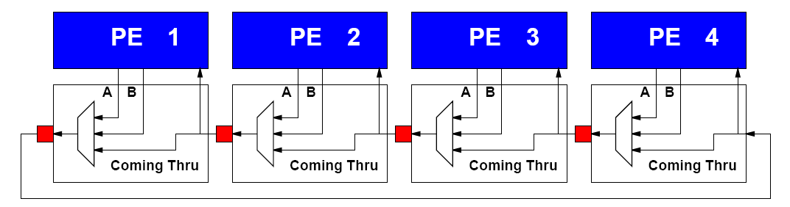
Preclass 2b
Cycles from simulation?

Slide 35
Observe
Did have congestion
  Ran slower than the single-link case
How we make decisions matters
  Who gets to route, which is stalled
Best, global decision can be better than local decisions

Slide 36
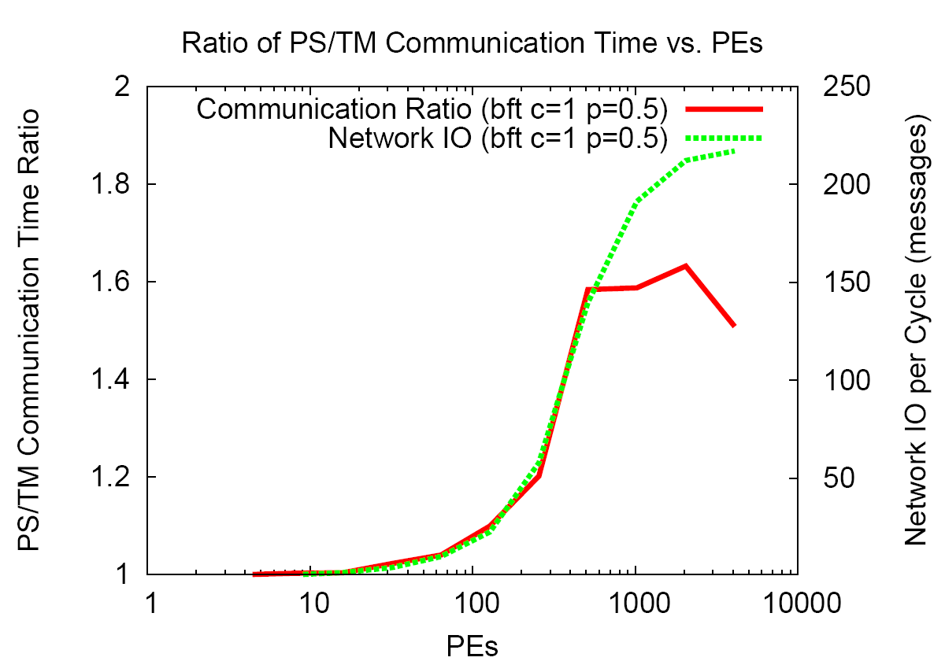
Offline vs. Online
[Kapre et al., FCCM 200]

Slide 37
Dealing with Congestion
Don’t let it happen (offline/static)
  Schedule to avoid
Online/dynamic
  Store in place -- Buffer
  Misroute -- Deflect

Slide 38
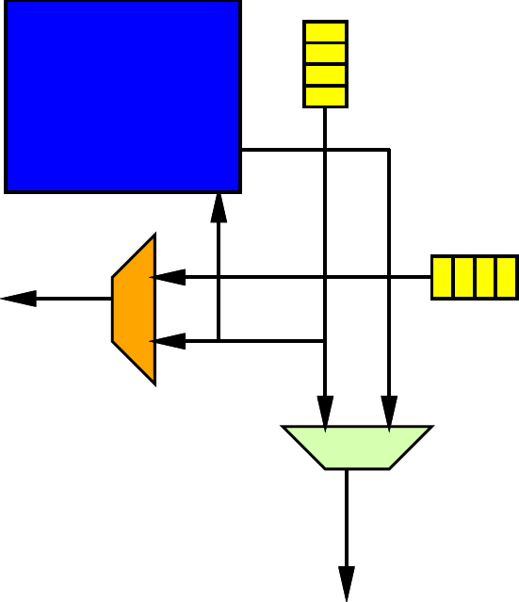
Congestion: Buffer
Store inputs that must wait until path available
  Typically store in FIFO buffer
  How big do we make the FIFO?
  FIFO Buffers cost space
    Often more than
    multiplexers

Slide 39
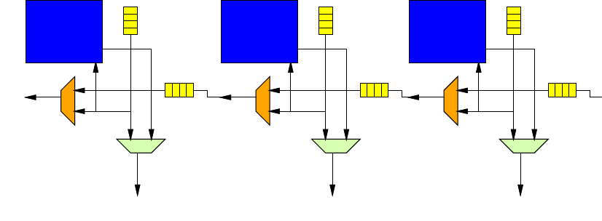
Congestion: Buffer
Store inputs that must wait until path available
  Typically store in FIFO buffer
  How big do we make the FIFO?
  What if FIFO full?

Slide 40
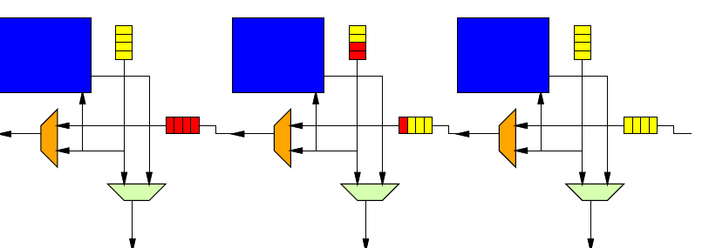
Congestion: Buffer
Store inputs that must wait until path available
  Typically store in FIFO buffer
  How big do we make the FIFO?
  What if FIFO full?

Slide 41
Congestion: Deflect
Misroute: (deflection routing)
  Send in to an available (wrong) direction
  Avoid Buffer
  Requires balance of ins and outs
    Can make work on mesh
  How much more traffic do we create misrouting?

Slide 42
Mesh Routing:
Yout=Yin.valid & row(Yin.address)!=row & Yin + Pin.valid & P
+row(Yin.address)==row & (column.Xin.address)!=column) & Y.in
Xout=Xin.valid & column(Xin.address)!=column & Xin + Yin.valid & row(Yin.address==row)
Gives Preference to X

Slide 43
Mesh Routing:
Alternates:
random selection
preference based on aging
(keep track of # of times
misrouted)
Yout=Yin.valid & row(Yin.address)!=row & Yin + Pin.valid & P
+row(Yin.address)==row & (column.Xin.address)!=column) & Y.in
Xout=Xin.valid & column(Xin.address)!=column & Xin + Yin.valid & row(Yin.address==row)

Slide 44
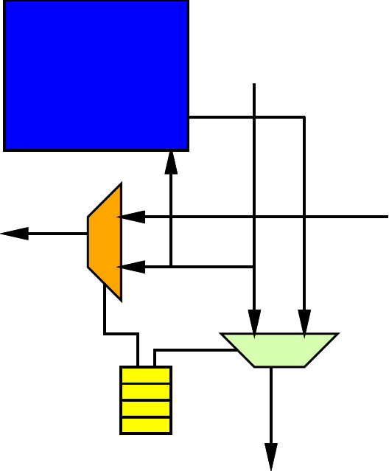
Static Schedule
Store per-cycle instruction for switch
  Doesn’t need
  address header
  on route
  Static, local
  memories
  control destination

Slide 45
Alternate Static Schedule
Control injection cycle from processor so never have conflict
Simple datapath logic to select available data
  Needs address header
  on routed data

Slide 46
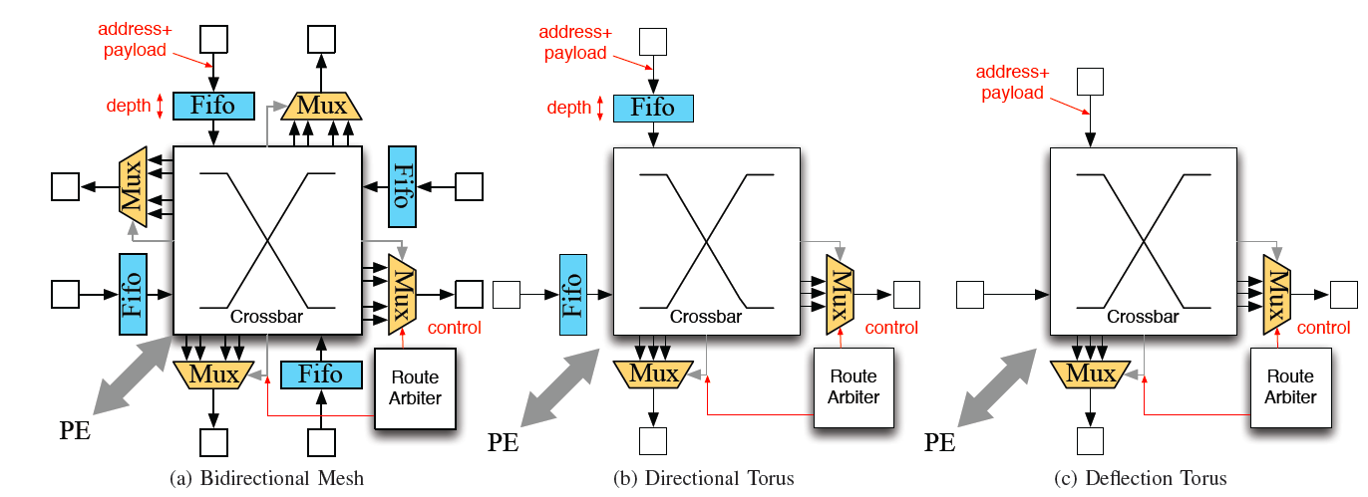
Mesh Packet Switched 32b
Split-Merge FIFO
  bidrectional
  1800 LUTs
Hoplite Deflection
  undirectional
  60 LUTs
Big difference in area costs.
Need to look at area and benefits.
[Kapre+Gray, FPL 2015]

Slide 47
Deflection Route
What concerns might we have about deflection route?

Slide 48
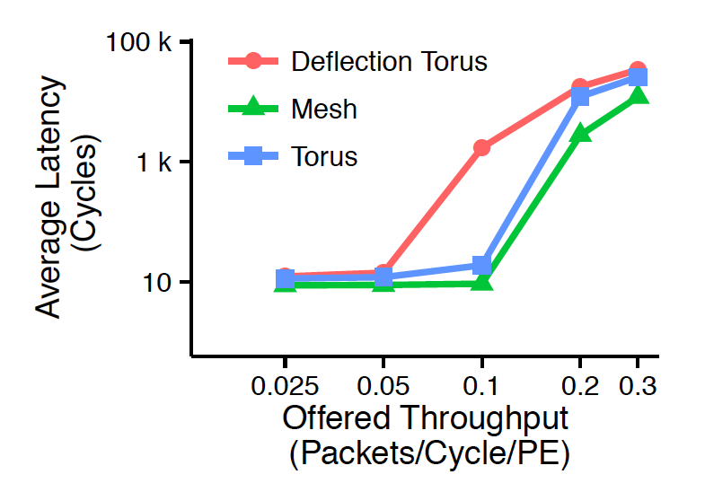
Buffer vs. Deflection
[Kapre+Gray, FPL 2015]

Slide 49
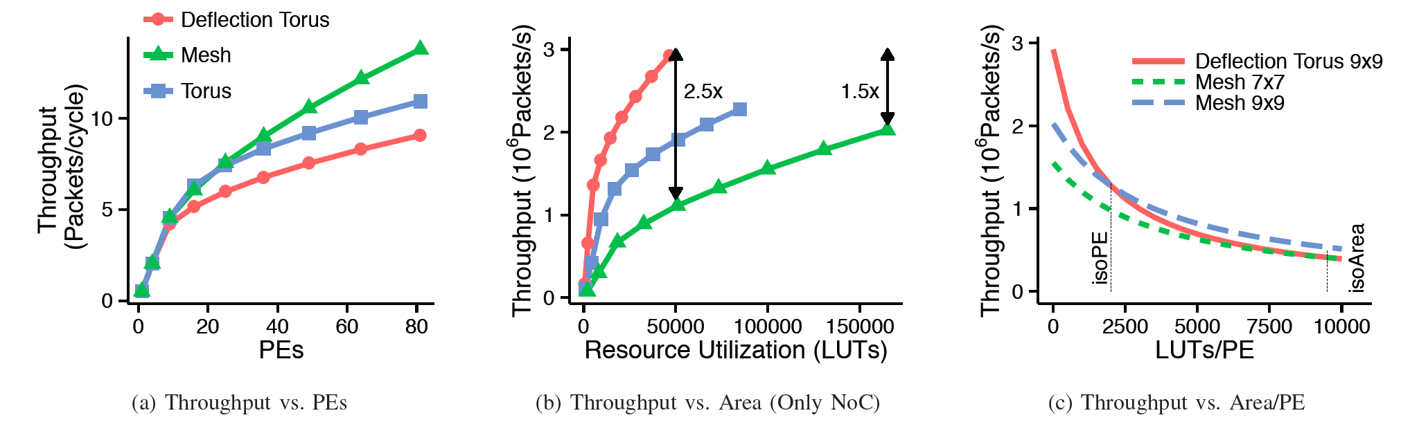
Take 2, they are small
[Kapre+Gray, FPL 2015]

Slide 50
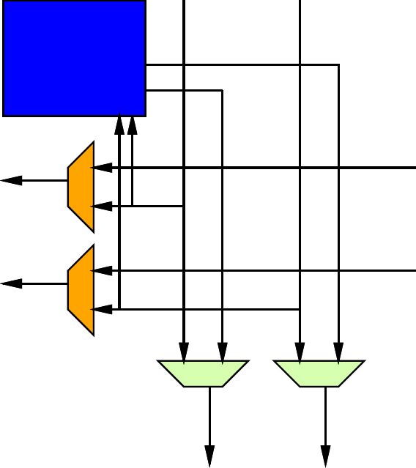
Tune Bandwidth
Add channels to tune bandwidth
  Rings per row, column
  Single Hoplite channel ~60
    …two around 120 … still << 1800

Slide 51
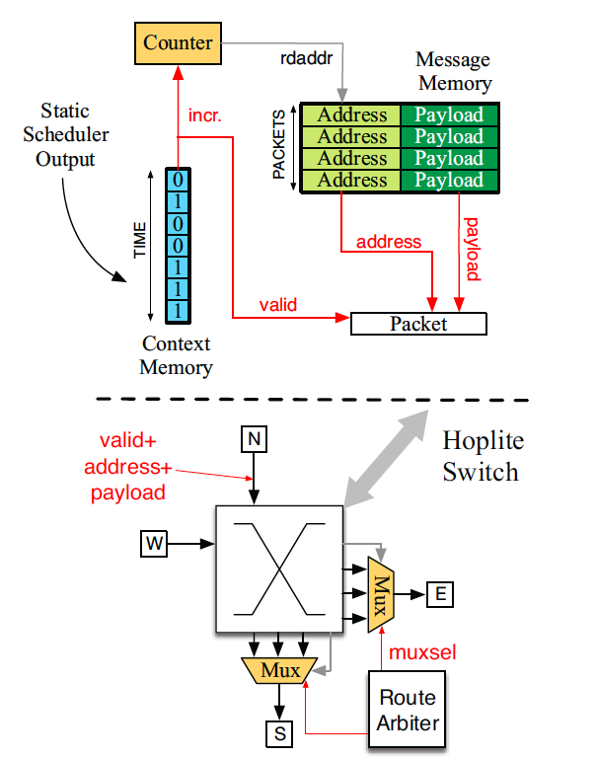
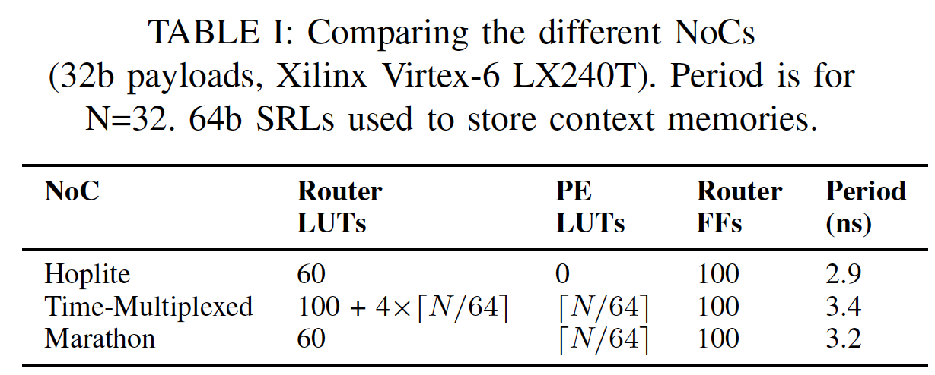
Mesh Area Deflection PS/TM
[Kapre FCCM 2015]

Slide 52
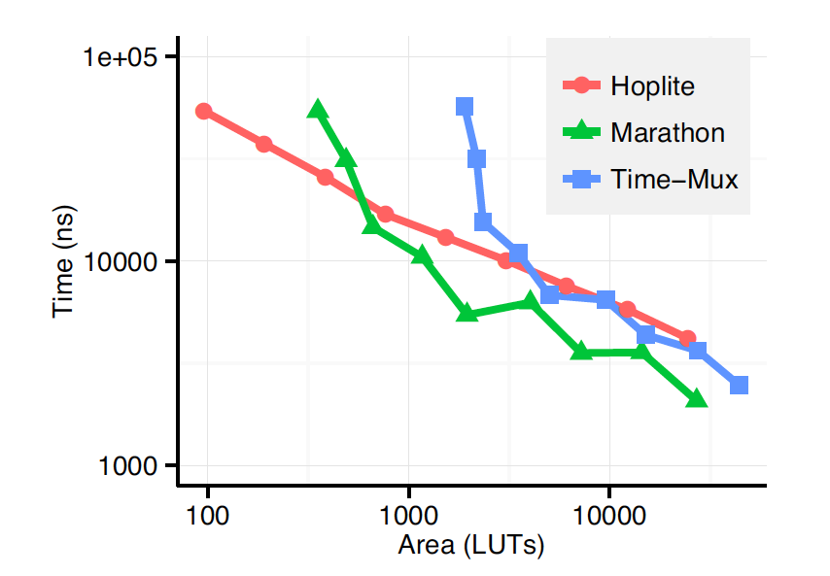
Static Schedule vs. Deflection
[Kapre FCCM 2015]

Slide 53
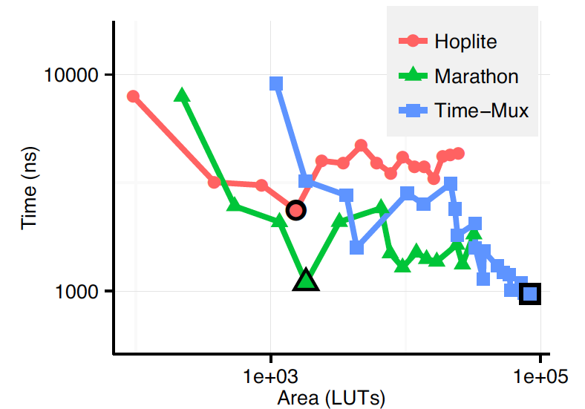
Static Schedule vs. Deflection
Routing
142K
message
add20
benchmark
Marathon
statically
schedule
PS
[Kapre FCCM 2015]

Slide 54
Mesh Customization

Slide 55
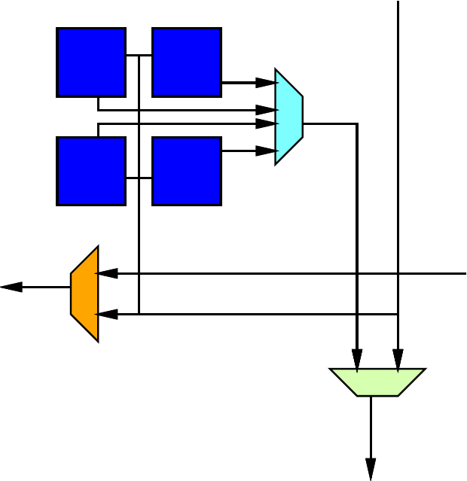
Tuning Down Bandwidth
If need less bandwidth, cluster multiple PEs to share a router.

Slide 56
Simple Bandwidth/Area Control
Width of channels
  Like SIMD
  All bits going to same destination

Slide 57
Packets
Simple story is, each “word” routed on mesh is: address+payload
Alternately:
  Multiword packet with single address
  Share “address” across larger payload
  Control width of datapath separate from size of payload
Additional control issues to route packet together and buffer

Slide 58
Customization
Bandwidth
  Width, clustering, channels
Directional/Bidirectional
Online dynamic/offline static
Buffer/deflect
  Buffer depth
Route function sophistication

Slide 59
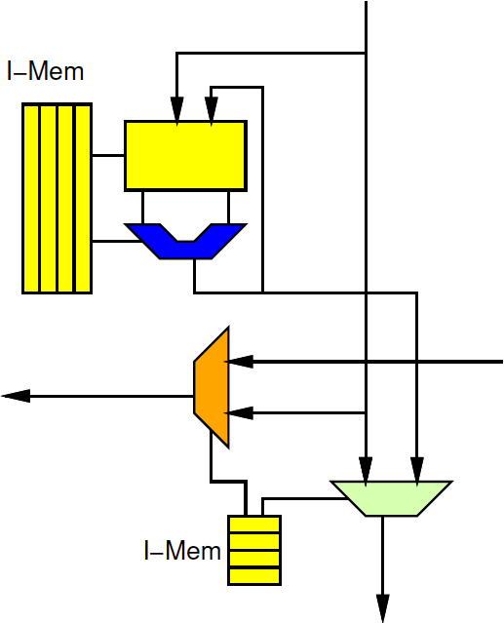
Large VLIW
Natural to use static network with VLIW clusters
  Network routing becomes part of
  long instruction word
Extreme one operator per mesh PE
Tune bandwidth by clustering

Slide 60
Big Ideas
Scalable interconnect for locality
  Has rich design space
Customize to compute and application
Support real-time with static scheduled communication

Slide 61
Admin
Project Design Space Milestone
  Due Friday
Next milestone out by Friday
  4x, area estimate

