Slide 1
ESE532: System-on-a-Chip Architecture
Day 20: April 3, 2017
Pipelining, Frequency, Dataflow

Slide 2
Today
What drives cycle times
Pipelining in Vivado HLS C
Avoiding bottlenecks feeding data in Vivado HLS C

Slide 3
Message
Should be able to run at high clock rates (e.g. 400—550MHz)
Vivado HLS gives control over pipelining
Code may need some care and stylization to feed data efficiently
Read Vivado HLS Users Guide (902)
Methodology, Design Optimization

Slide 4
Clock Cycle

Slide 5
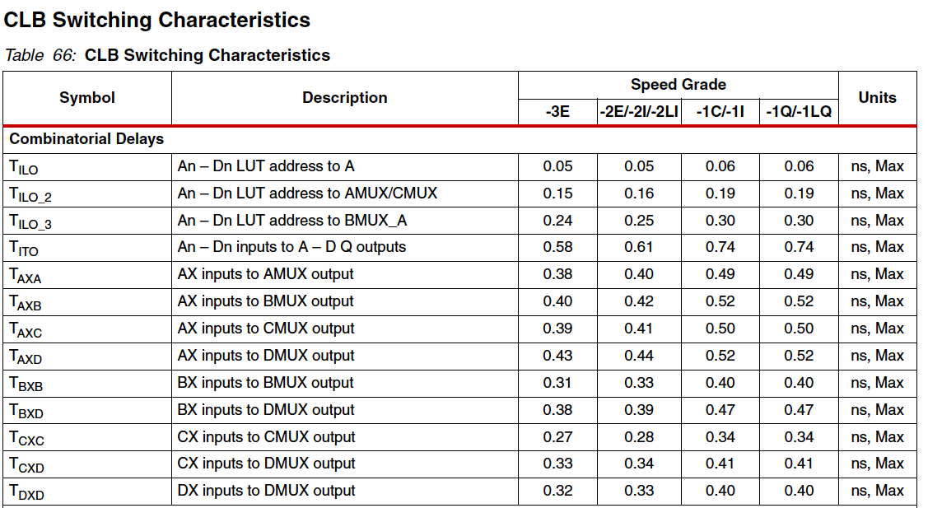
Xilinx DS191 p. 54

Slide 6
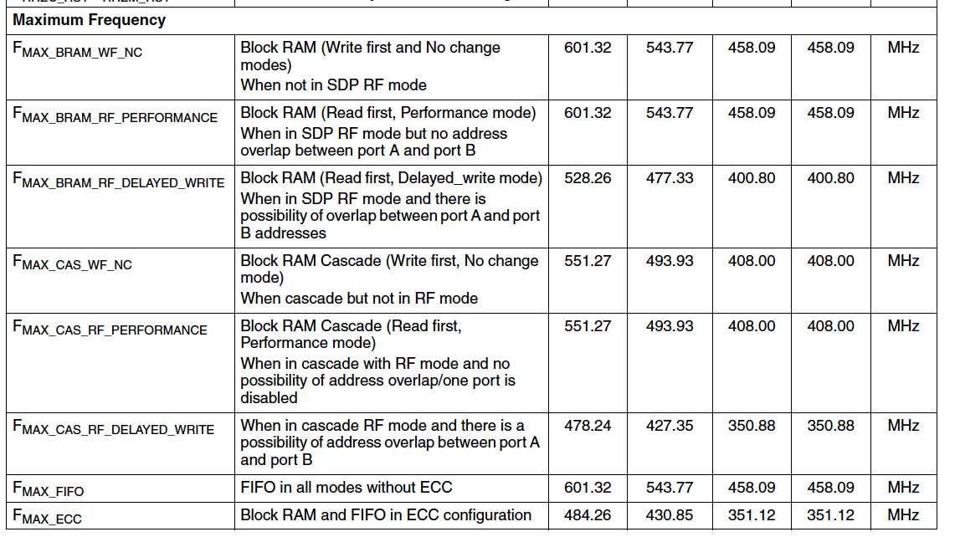
BRAM
Xilinx DS191 p. 57

Slide 7
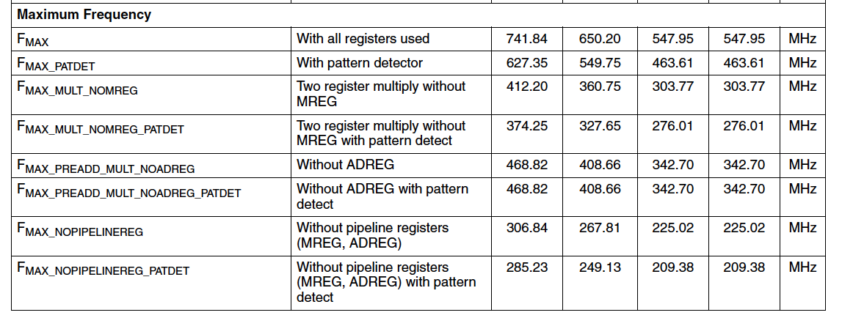
DSP

Slide 8
Zynq Primitives
DSP block – run around 550MHz
BRAM – run around 400—460MHz
CLB – latency around 0.5ns
Carry cascade around 9ps

Slide 9
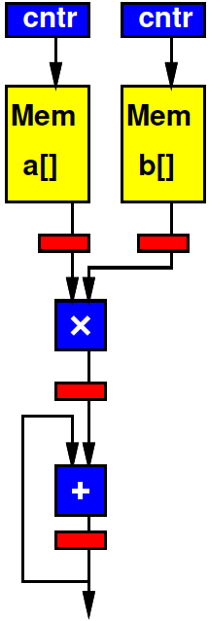
Preclass 1
How fast can pipeline?

Slide 10
Acyclic Datapath
With no feedback cycles
Should be able to pipeline datapath down to level of operators
Slowest operator
May need to add more pipeline levels
Takes more clocks to get from input to output

Slide 11
Interconnect
If we pipeline operators ignoring interconnect delays, what can happen?

Slide 12
Interconnect Delays
How would we fix?
What does it cost us?

Slide 13
Typical Synthesis Flow
HLS→RTL→gates/mem/dsp→place→route
High-level doesn’t know exactly what happens at lower level
What might it not know?

Slide 14
Typical Synthesis Flow
HLS→RTL→gates/mem/dsp→place→route
High-level doesn’t know exactly what happens at lower level
How many gates some logic takes
Where blocks are placed (how far apart)
Which routes taken between blocks
Take minimum delay path? Forced to take longer?

Slide 15
Vivado Synthesis
Targets a clock cycle
Optimization is open ended
…and it takes longer to get a lower delay result
Stops when it thinks things are “fast enough”
Meets target

Slide 16
Consequence
HLS not know exactly what will happen downstream
HLS optimize for target clock
Result: HLS may produce design that fails to meet timing during place&route

Slide 17
Another Consequence
Delay achieved
May not be what you ask for
Can be a function of what you ask for
Asking it to for a tighter cycle
Often gives a tighter result
Not 100%
Not always by same amount / predictable

Slide 18
Compensation
How might HLS compensate?

Slide 19
Compensating
Add margin for downstream
How much?
Iterate
If downstream margin inadequate, increase margin and try again
Try at multiple targets to explore possible frequencies

Slide 20
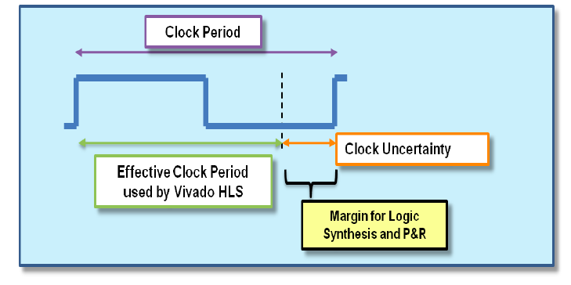
Compensating
Add margin for downstream
How much?
Vivado HLS – allows specification of “clock uncertainty”
Xilinx UG902 p. 184

Slide 21
Compensating
Add margin for downstream
How much?
Vivado HLS – allows specification of “clock uncertainty”
Iterate
If downstream margin inadequate, increase margin and try again
Vivado HLS – doesn’t do this automatically,
But you can…

Slide 22
Vivado HLS Pipelining

Slide 23
Design Mapping
Streaming operators
Area-Time tuning
Initiation Intervals for loop for streaming operator
Unrolling
Benefits and tradeoffs of each?

Slide 24
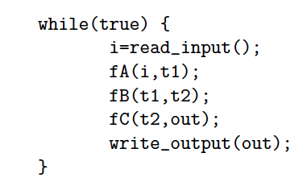
Preclass 2
What dataflow graph does this describe?

Slide 25
Vivado HLS Pragma DATAFLOW
Enables streaming data between functions and loops
Allows concurrent streaming execution
Requires data be produced/consumed sequentially
Useful to use stream data type (upcoming) or specify FIFO depth between functions

Slide 26
Vivado HLS Pragma STREAM
Specify that array will be accessed sequentially
Allows efficient implementation as FIFO

Slide 27
Vivado HLS Pragma PIPELINE
Direct a function or loop to be pipelined
Ideally start one loop or function body per cycle
Can control II

Slide 28
for (i=0;i<N;i++)
yout=0;
#pragma HLS PIPELINE
for (j=0;j<K;j++)
yout+=in[i+j]*w[j];
y[i]=yout;
Which solution
from preclass 3?

Slide 29
Vivado HLS Pragma UNROLL
Unroll loop into spatial hardware
Can control level of unrolling
Any loops inside a pipelined loop gets unrolled by the PIPELINE directive

Slide 30
for (i=0;i<N;i++)
yout=0;
#pragma HLS UNROLL
for (j=0;j<K;j++)
yout+=in[i+j]*w[j];
y[i]=yout;
Which solution
from preclass 3?

Slide 31
Vivado HLS Pragma INLINE
Collapse function body into caller
Eliminates interface code
Allows optimization of inline code
recursive option to inline a hierarchy
Maybe useful when explore granularity of accelerator

Slide 32
Vivado HLS Pragma ARRAY_PARTITION
Spread out array over multiple BRAMs
By default placed in single BRAM
Use to remove memory bottleneck that prevents pipelining (limits II)

Slide 33
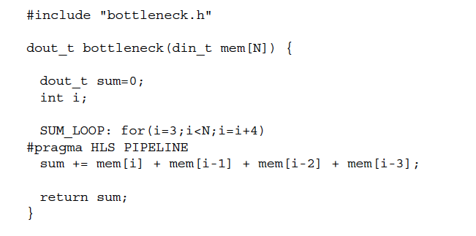
Memory Bottleneck Example
902 example p. 91-92
What problem if put mem
in single BRAM?
Xilinx UG902 p. 91

Slide 34
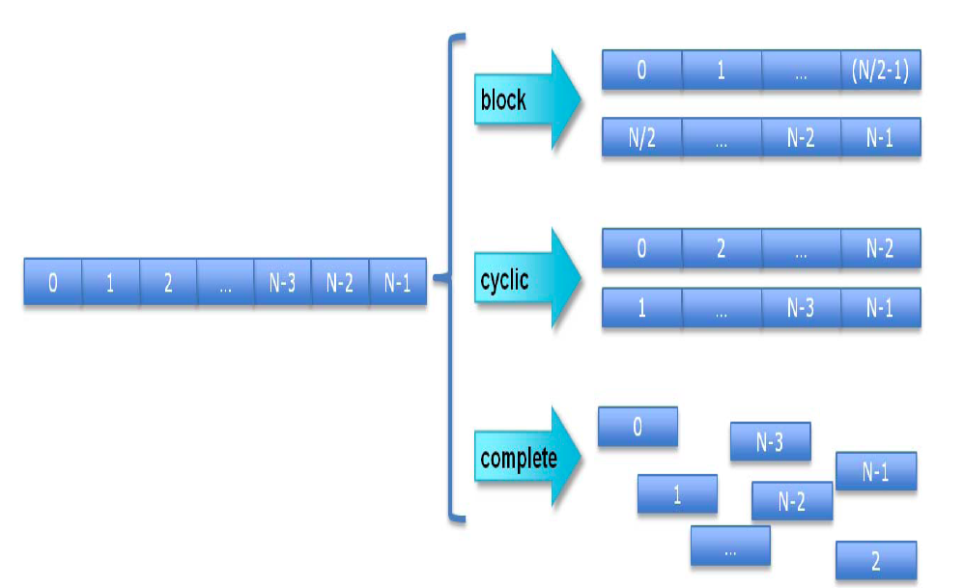
Array Partition
Xilinx UG902 p. 195

Slide 35
Array Partition Example
#pragma ARRAY_PARTITION variable=mem cylic factor=4
Xilinx UG902 p. 91

Slide 36
Vivado HLS Pragma ARRAY_RESHAPE
Pack data into BRAM to improve access (reduce BRAMs)
May provide similar benefit to partitioning without using more BRAMs

Slide 37
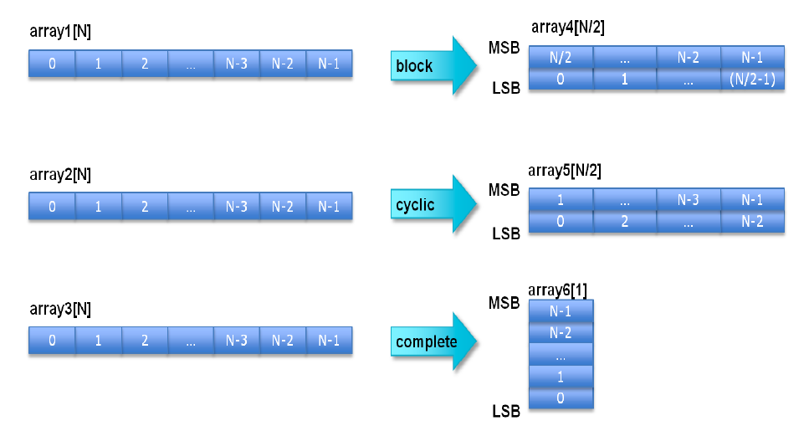
Xilinx UG902 p. 218

Slide 38
902 example p. 91-92
How fix if dint_t is 16b?
Xilinx UG902 p. 91

Slide 39
Array Reshape Example
#pragma ARRAY_RESHAPE variable=mem cylic factor=4 dim=1
(if din_t 16b)
Xilinx UG902 p. 91

Slide 40
Vivado HLS Pragma LOOP_MERGE
Combine loops to reduce delay

Slide 41
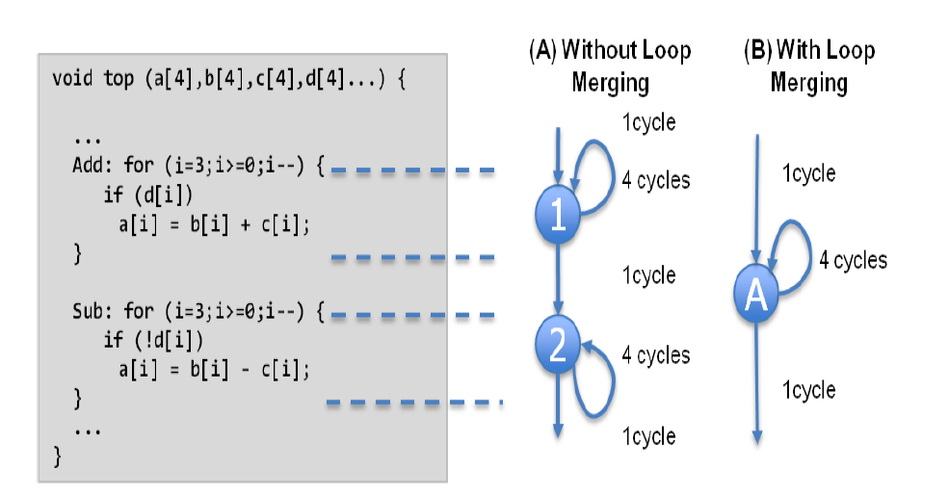
Loop Merge
P208 1-73
Xilinx UG902 p. 208

Slide 42
Feeding Data

Slide 43
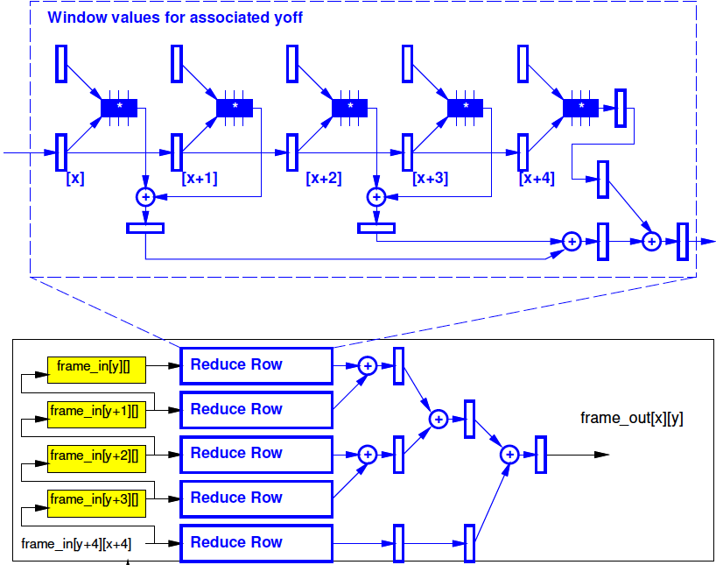
Challenge
How get Vivado HLS to provide a streaming, fully unrolled version like midterm 2f?

Slide 44
Midterm 2f
Each pixel needed WSIZE² times
Only want to read once from big memory
(move once to array)

Slide 45
Three Coding Tricks
Setup input for streaming
Setup local window for X shift register
Setup linebuffer for Y
Use Vivado HLS convolution example (pp. 104—121)
…likely need for efficient full search…

Slide 46
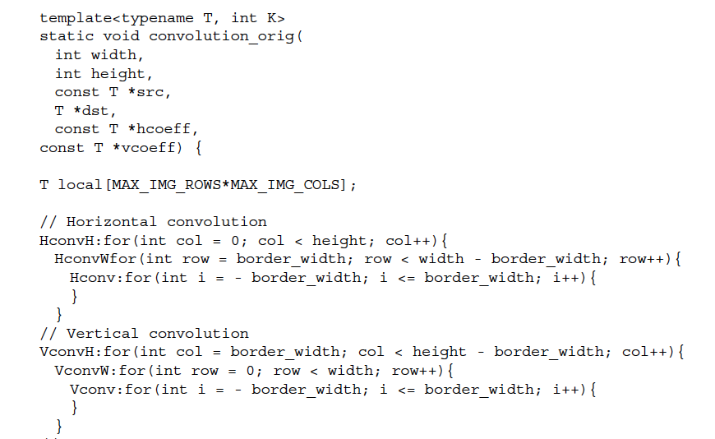
Unoptimized Convolution
Xilinx UG902 p. 104

Slide 47
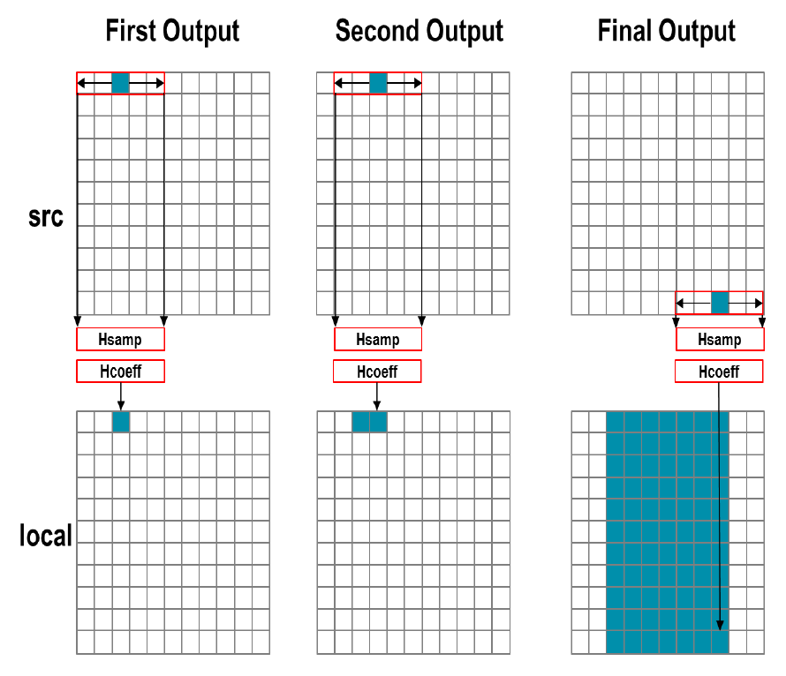
Xilinx UG902 p. 105

Slide 48
Unoptimized Horizontal Conv.
What’s inefficient here with src?
Xilinx UG902 p. 106

Slide 49
Unoptimized Horizontal Conv.
Forces src data to be reread within window
Doesn’t automatically figure out and localize
Xilinx UG902 p. 106

Slide 50
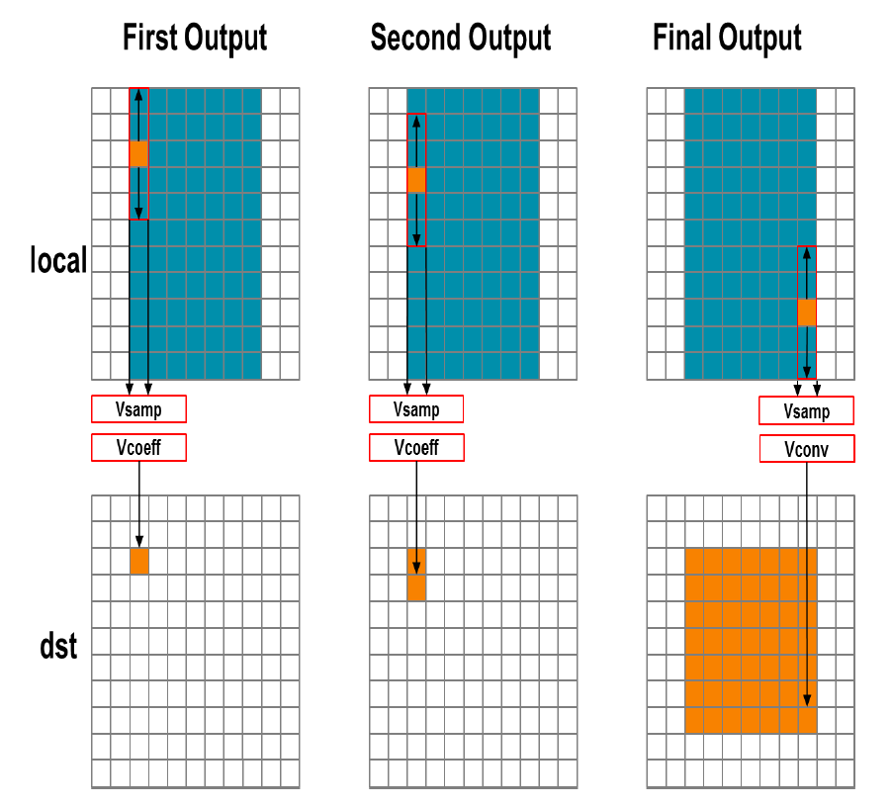
Xilinx UG902 p. 108

Slide 51
Unoptimized Vertical
Also forces multiple reads of pixel data
Xilinx UG902 p. 109

Slide 52
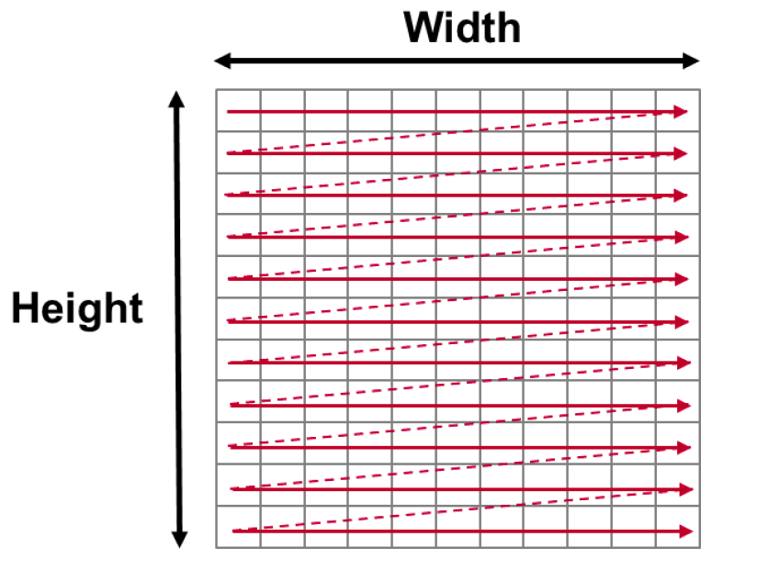
Optimizing I/O
Want to read each pixel exactly once in scan order
Store locally

Slide 53
hls::stream
Data accessed sequentially
Can only read data item once
Forces discipline for optimal I/O
Tells compiler that is what you are doing so it can optimize implementation
Infers a FIFO of depth 1
Useful with function dataflow streams

Slide 54
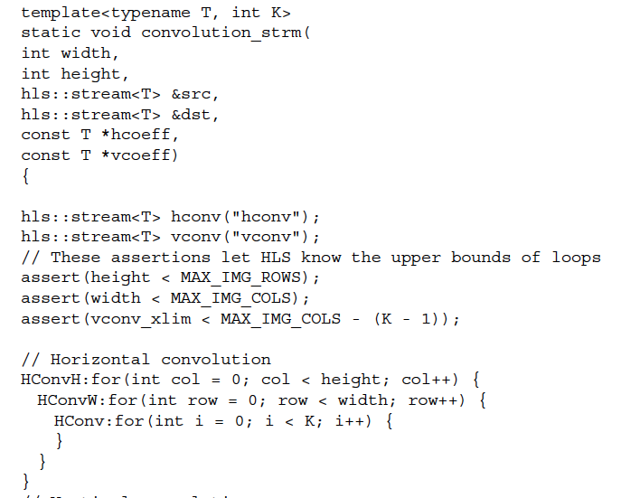
Xilinx UG902 p. 114

Slide 55
Unoptimized Horizontal Conv.
What do we need to do to make sure we only read src once?
Xilinx UG902 p. 106

Slide 56
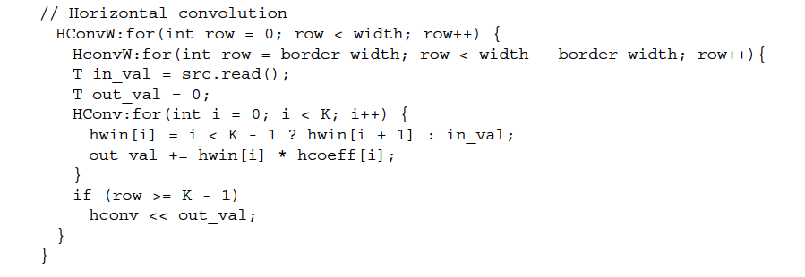
Partially Optimized Hconv
hwin shift register
Xilinx UG902 p. 116

Slide 57
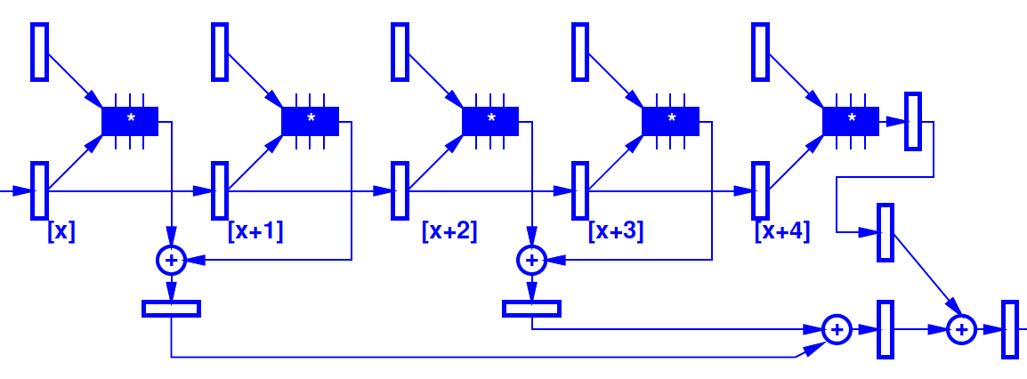
Partially Optimized Hconv
hwin shift register
Xilinx UG902 p. 116

Slide 58
Partially Optimized Hconv
What’s missing?
(not yet give figure on right)
Xilinx UG902 p. 116

Slide 59
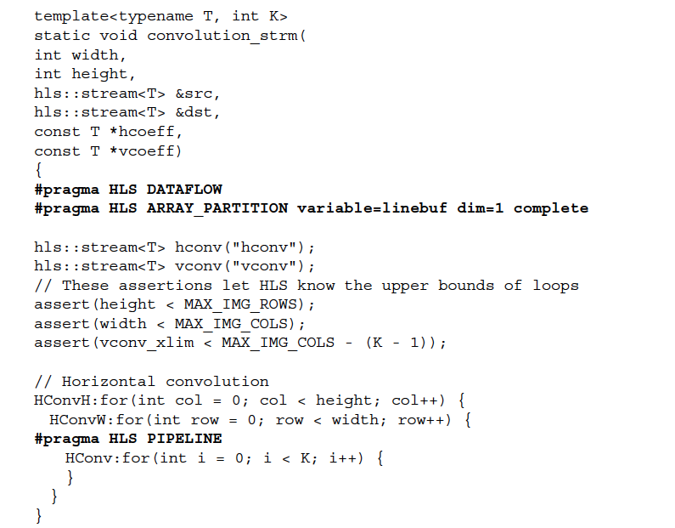
Xilinx UG902 p. 120

Slide 60
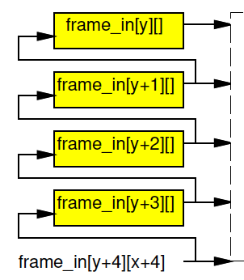
Xilinx UG902 p. 120

Slide 61
Unoptimized Vertical
What do we need to do to only read from local once?
Xilinx UG902 p. 109

Slide 62
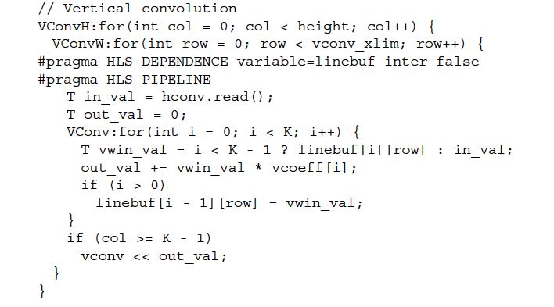
Xilinx UG902 p. 118

Slide 63
Three Coding Tricks
Setup input for streaming
Setup local window for X shift register
Setup linebuffer for Y
…likely need for efficient full search…

Slide 64
Big Ideas
Should be able to run at high clock rates (e.g. 400—550MHz)
Vivado HLS gives control over pipelining
Code may need some care and stylization to feed data efficiently
Read Vivado HLS Users Guide (902)
Methodology, Design Optimization

Slide 65
Admin
Project 4x and area Milestone
Due Friday

