Slide 1
ESE532: System-on-a-Chip Architecture
Day 21: April 5, 2017
VLSI Scaling

Slide 2
Today
VLSI Scaling Rules
Effects
Historical/predicted scaling
Variations (cheating)
Limits
Note: gory equations
→ goal is to understand trends
Give equations … then push through scaling implications together

Slide 3
Message
Technology advances rapidly
Must account for in understanding
…platform will be available
…platforms will be inexpensive
…what our competitors can build
…new challenges and opportunities

Slide 4
Why Care?
In this game, we must be able to predict the future
Technology advances rapidly
Reason about changes and trends
Re-evaluate prior solutions given technology at time X.
Make direct comparison across technologies
E.g. to understand older designs
What comes from process vs. architecture

Slide 5
Why Care: Custom SoC
Cannot compare against what competitor does today
but what they can do at time you can ship
Development time > Technology generation
Careful not to fall off curve
lose out to someone who can stay on curve

Slide 6
Scaling
Old Premise: features scale “uniformly”
everything gets better in a predictable manner
Parameters:
λ (lambda) -- Mead and Conway
F -- Half pitch – ITRS (F=2λ)
S – scale factor – Rabaey
F’=S×F

Slide 7
ITRS Roadmap
Semiconductor Industry rides this scaling curve
Try to predict where industry going
(requirements…self fulfilling prophecy)
http://public.itrs.net
http://www.semiconductors.org/main/2015_international_technology_roadmap_for_semiconductors_itrs/

Slide 8
Preclass
Scale factor S from 28nm → 20nm?

Slide 9
MOS Transistor Scaling (1974 to present)
S=0.7
[0.5x per 2 nodes]
Pitch
Gate
Source: 2001 ITRS - Exec. Summary, ORTC Figure
[from Andrew Kahng]

Slide 10
Half Pitch (= Pitch/2) Definition
Metal
Pitch
Poly
Pitch
(Typical
DRAM)
(Typical
MPU/ASIC)
Source: 2001 ITRS - Exec. Summary, ORTC Figure
[from Andrew Kahng]

Slide 11
Scaling Calculator + Node Cycle Time:
1994 NTRS - .7x/3yrs
Log Half-Pitch
Actual - .7x/2yrs
0.7x
0.7x
Linear Time
250 -> 180 -> 130 -> 90 -> 65 -> 45 -> 32 -> 22 -> 16
0.5x
Node Cycle Time (T yrs):
*CARR(T) =
[(0.5)^(1/2T yrs)] - 1
CARR(3 yrs) = -10.9%
CARR(2 yrs) = -15.9%
N
N+1
N+2
* CARR(T) = Compound Annual Reduction Rate (@ cycle time period, T)
Source: 2001 ITRS - Exec. Summary, ORTC Figure
[from Andrew Kahng]

Slide 12
Warning
Dive into detail equations
Not expect you necessarily know before
Unless took 370, 570, 534…
Won’t expect you use later
…but, you want to have an idea of the implications (area, performance, energy)
If I just showed you results
I think would be hard to follow
Not engaged
So, we will do calculations together

Slide 13
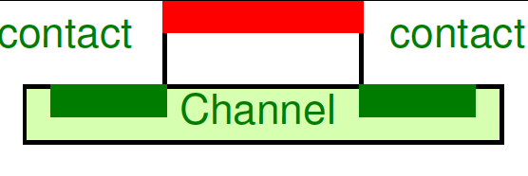
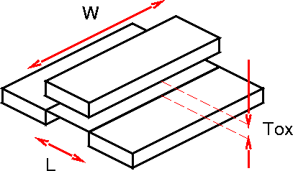
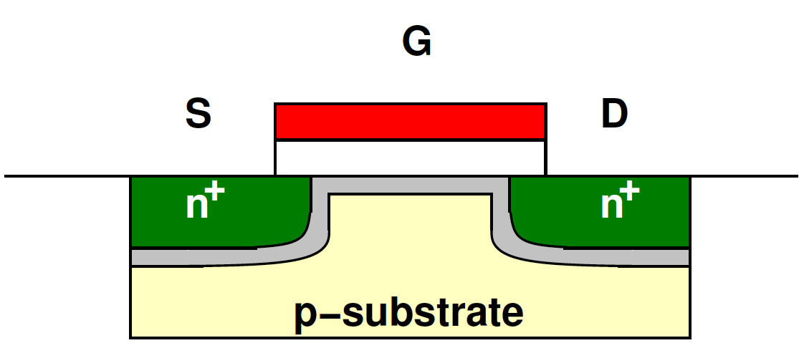
Dimensions
Channel Length (L)
Channel Width (W)
Oxide Thickness (T_{ox})

Slide 14
Scaling
Channel Length (L)
Channel Width (W)
Oxide Thickness (T_{ox})
Doping (N_{a})
Voltage (V)

Slide 15
Full Scaling (Ideal Scaling, Dennard Scaling)
Channel Length (L) S
Channel Width (W) S
Oxide Thickness (T_{ox}) S
Doping (N_{a}) 1/S
Voltage (V) S

Slide 16
Effects on Physical Properties?
Area
Capacitance
Resistance
Threshold (V_{th})
Current (I_{d})
Gate Delay (τ_{gd})
Wire Delay (τ_{wire})
Energy
Power
Go through full (ideal)
…then come back and ask what still makes sense today
These are more the take-aways

Slide 17
Area
F➔ FS
Area impact?
Α = L × W
Α ➔ ΑS²
28nm ➔ 20nm
50% area
2× capacity same area
L
S=0.7
[0.5x per 2 nodes]
W
Pitch
Gate

Slide 18
Preclass
When will have 100-core processor
What feature size?
What time frame?

Slide 19
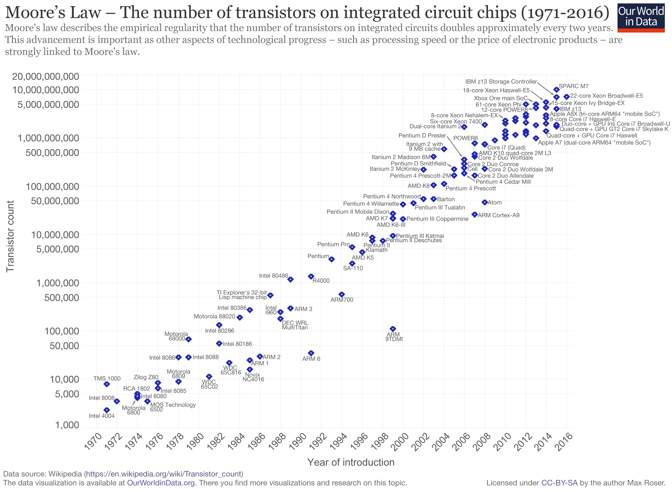
Capacity Scaling from Wikipedia

Slide 20
Capacitance
Capacitance per unit area scaling:
C_{ox}= ε_{SiO2}/T_{ox}
T_{ox}➔ S×T_{ox}
C_{ox} ➔ C_{ox}/S

Slide 21
Capacitance
Gate Capacitance scaling?
C_{gate}= A×C_{ox}
Α ➔ Α×S²
C_{ox} ➔ C_{ox}/S
C_{gate} ➔ S×C_{gate}

Slide 22
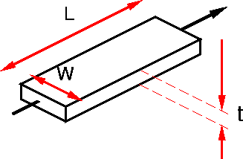
Resistance
Resistance scaling?
R=ρL/(W*t)
W→ S×W
L, t similar
R → R/S

Slide 23
Threshold Voltage
V_{TH}➔ S×V_{TH}

Slide 24
Current
Saturation Current scaling?
I_{d}=(μC_{OX}/2)(W/L)(V_{gs}-V_{TH})²
V_{gs=}V→ S×V
V_{TH}→ S×V_{TH}
W→ S×W
L→ S×L
C_{ox} → C_{ox}/S
I_{d}→ S×I_{d}

Slide 25
Current
Velocity Saturation Current scaling:
V_{gs=}V→ S×V
V_{TH}→ S×V_{TH}
L→ S×L
V_{DSAT} → S×V_{DSAT}
W→ S×W
C_{ox} → C_{ox}/S
I_{d}→ S×I_{d}

Slide 26
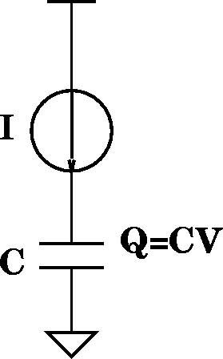
Gate Delay
Gate Delay scaling?
τ_{gd}=Q/I=(CV)/I
V→ S×V
I_{d} → S×I_{d}
C → S×C
τ_{gd} → S×τ_{gd}

Slide 27
Overall Scaling Results, Transistor Speed and Leakage. Preliminary Data from 2005 ITRS.
HP = High-Performance Logic
LOP = Low Operating Power Logic
LSTP = Low Standby Power Logic
Intrinsic Transistor Delay, τ = CV/I
(lower delay = higher speed)
Leakage Current
(HP: standby power dissipation issues)
HP
LOP
LSTP
LOP
LSTP➔ Target:
Isd,leak ~ 10 pA/um
HP➔ Target:
17%/yr, historical rate
17%/yr rate
Planar Bulk MOSFETs
Advanced MOSFETs

Slide 28
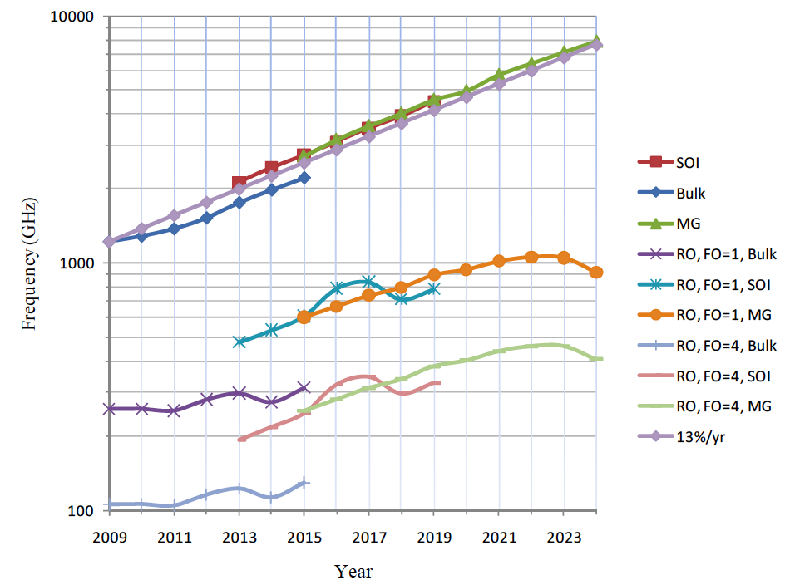
ITRS 2009 Transistor Speed
RO=Ring
Oscillator

Slide 29
Wire Delay
Wire delay scaling?
τ_{wire}=R×C
R → R/S
C → S×C
τ_{wire} → τ_{wire}
…assuming (logical) wire lengths remain constant...

Slide 30
Impact of Wire and Gate Delay Scaling
If gate delay scales down but wire delay does not scale, what does that suggest about the relative contribution of gate and wire delays to overall delay as we scale?

Slide 31
Energy
Switching Energy per operation scaling?
E=1/2 CV²
V→ S×V
C → S×C
E → S³×E

Slide 32
Power Dissipation (Dynamic)
Capacitive (Dis)charging scaling?
P=(1/2)CV²f
V→ S×V
C → S×C
P→ S³×P
Increase Frequency?
τ_{gd} → S×τ_{gd}
So: f → f/S ?
P → S²×P

Slide 33
Effects?
Area S²
Capacitance S
Resistance 1/S
Threshold (V_{th}) S
Current (I_{d}) S
Gate Delay (τ_{gd}) S
Wire Delay (τ_{wire}) 1
Energy S³
Power S²→S³

Slide 34
Power Density
P➔ S²P (increase frequency)
P➔ S³P (dynamic, same freq.)
A ➔ S²A
Power Density: P/A two cases?
P/A ➔ P/A increase freq.
P/A ➔ S×P/A same freq.

Slide 35
Power Density
P/A → P/A very important
Says, it doesn’t get any harder to cool as we scale exponentially to
More gates switching
Higher clock rates
Don’t create an cooling bottleneck

Slide 36
Cheating…
Don’t like some of the implications
High resistance wires
Higher capacitance
Atomic-scale dimensions
…. Quantum tunneling
Not scale speed fast enough

Slide 37
Improving Resistance
R=ρL/(W×t)
W→ S×W
L, t similar
R → R/S
What might we do?
Don’t scale t quite as fast → now taller than wide.
Decrease ρ (copper) – introduced 1997
http://www.ibm.com/ibm100/us/en/icons/copperchip/

Slide 38
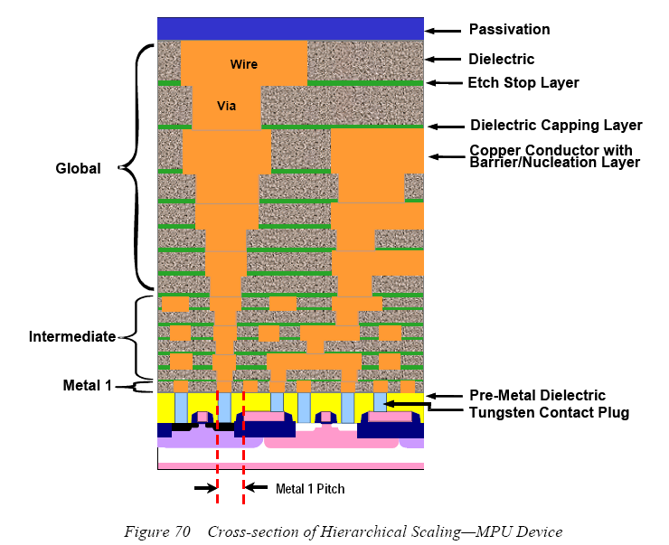

Slide 39
3D View
Source: https://en.wikipedia.org/wiki/File:Silicon_chip_3d.PNG

Slide 40
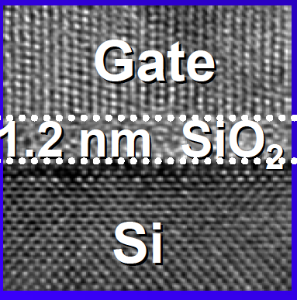
Capacitance and Leakage
Capacitance per unit area
C_{ox}= ε_{SiO2}/T_{ox}
T_{ox}➔ S×T_{ox}
C_{ox} ➔ C_{ox}/S
What’s wrong with Tox = 1.2nm?
source: Borkar/Micro 2004

Slide 41
Capacitance and Leakage
Capacitance per unit area
C_{ox}= ε_{SiO2}/T_{ox}
T_{ox}➔ S×T_{ox}
C_{ox} ➔ C_{ox}/S
What might we do?
Reduce Dielectric Constant ε (interconnect)
and Increase Dielectric to substitute for scaling T_{ox}
(gate quantum tunneling)

Slide 42
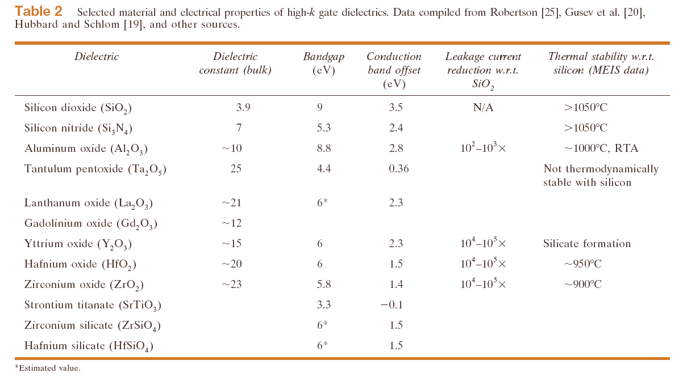
High-K dielectric Survey
Wong/IBM J. of R&D, V46N2/3P133—168, 2002

Slide 43
Improving Gate Delay
Normal scale
τ_{gd}=Q/I=(CV)/I
V→ S×V
I_{d}=(μC_{OX}/2)(W/L)(V_{gs}-V_{TH})²
I_{d} → S×I_{d}
C → S×C
τ_{gd} → S×τ_{gd}
What happens
if don’t scale V?
(note V impacts I)
Don’t scale V:
V→V
I→I/S
τ_{gd} → S²×τ_{gd}

Slide 44
…But Power Dissipation (Dynamic)
Capacitive (Dis)charging
P=(1/2)CV²f
V→ V
C → S×C
Increase Frequency?
f → f/S² ?
P → P/S
If not scale V, power dissipation not scale down.

Slide 45
…And Power Density
P→ P/S (increase frequency)
But… Α → S²×Α
What happens to power density?
P/A → (1/S³)P/A
Power Density Increases
…this is where some companies have gotten into trouble…

Slide 46
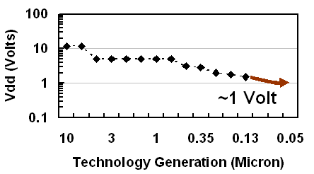
Historical Voltage Scaling
http://software.intel.com/en-us/articles/gigascale-integration-challenges-and-opportunities/
…and, we’re running into limits prevent voltage scaling going forward.

Slide 47
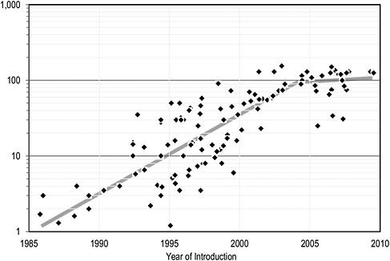
uP Power Density
Watts
The Future of Computing Performance: Game Over or Next Level?
National Academy Press, 2011
http://www.nap.edu/catalog.php?record_id=12980

Slide 48
Power Density
Has become the new bottleneck
Can put more transistors on a chip than we can afford to turn on
Can afford to operate at the frequency at which they are capable of switching
Energy and Power, not capacity, limits performance

Slide 49
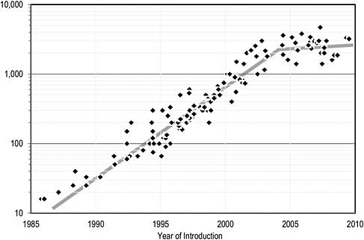
uProc Clock Frequency
MHz
The Future of Computing Performance: Game Over or Next Level?
National Academy Press, 2011
http://www.nap.edu/catalog.php?record_id=12980

Slide 50
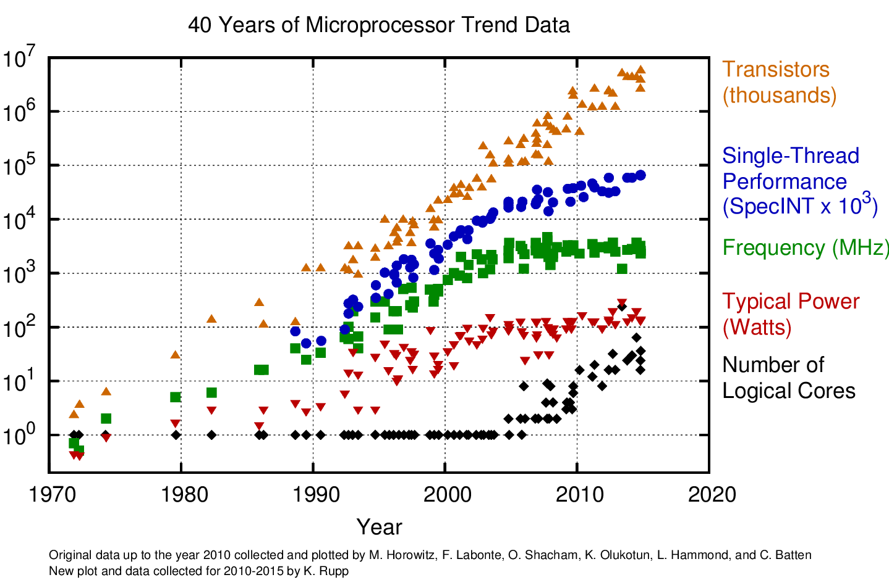

Slide 51
Physical Limits
Doping?
Features?

Slide 52
Physical Limits
Depended on
bulk effects
doping
current (many electrons)
mean free path in conductor
localized to conductors
Eventually
single electrons, atoms
distances close enough to allow tunneling

Slide 53
Dopants/Transistor
10000
1000
Mean Number of Dopant Atoms
100
10
1000
500
250
130
65
32
16
Technology Node (nm)
Notes:
Starting at the beginning…
As our devices scale to the atomic scale, we must deal with the fact that the low level physics of the placement and behavior of atoms and electrons is statistical in nature.
Note on graphs:
The left graphs shows how the number of dopants decreases as we scale to smaller technology nodes. Around the 65nm node, we are already down to roughly 100 dopants per device.
Since dopants are placed statistically, we always see a range of actual dopants. As the total number of dopants (N) decreases, the variance among devices increases. Very roughly, the variance in the number of dopants in a device goes as N^{-0.5} (i.e. 1/sqrt(N) ). So, at 100 dopants, we have a variance of 10%. The graph on the right plots this variance.
The effective variance is actually larger than this because, at these small numbers, actual placement of the dopants matters as well as the number.
This underscores the fact that increased variance is arising directly from these small number effects.

Slide 54
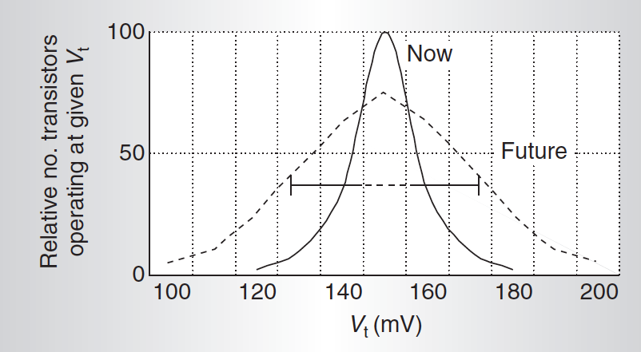
Leads to Variation
[Borkar, IEEE Micro Nov.-Dec. 2005]

Slide 55
Conventional Scaling
Ends in your lifetime
Perhaps already has:
"Basically, this is the end of scaling.”
May 2005, Bernard Meyerson, V.P. and chief technologist for IBM's systems and technology group

Slide 56
Bob Colwell
March 2013

Slide 57
Feature Size Scaling ITRS
IEEE Spectrum, Sep. 2016

Slide 58
Intel says they’ve got 10nm covered

Slide 59
Conventional Scaling
Ends in your lifetime
Perhaps already:
"Basically, this is the end of scaling.”
May 2005, Bernard Meyerson, V.P. and chief technologist for IBM's systems and technology group
Dennard Scaling ended
Feature scaling end at 10nm?
Transistor count integration may continue…
E.g. 3D

Slide 60
Finishing Up...

Slide 61
Big Ideas [MSB Ideas]
Moderately predictable VLSI Scaling
unprecedented capacities/capability growth for engineered systems
change
be prepared to exploit
account for in comparing across time
…but not for much longer

Slide 62
Big Ideas [MSB-1 Ideas]
Uniform scaling reasonably accurate for past couple of decades
Area increase 1/S²
Real capacity maybe a little less?
Gate delay decreases (S)
…maybe a little less
Wire delay not decrease, maybe increase
Overall delay decrease less than (S)
Lack of V scale → Power density limit

Slide 63
Admin
Project 4x and area Milestone
Due Friday

