Slide 1

ESE532:
System-on-a-Chip Architecture
Day 22: April 10, 2017
Energy

Slide 2
Today
Energy
Today’s bottleneck
What drives
Efficiency of
  Processors, FPGAs, accelerators

Slide 3
Message
Energy dominates
  Including limiting performance
Make memories small and wires short
  Small memories cost less energy per read
Accelerators reduce energy
  Compared to processors

Slide 4

Energy
Growing domain of portables
  Less energy/op → longer battery life
Global Energy Crisis
Power-envelope at key limit
  E reduce → increase compute in P-envelope
  Scaling
    Power density not transistors limit sustained ops/s
  Server rooms
    Cost-of-ownership not dominated by Silicon
      Cooling, Power bill

Slide 5
Preclass 1--4
20,000 gates/mm²
2.5*10⁻¹⁵ J/gate switch
Gates on 1cm²
Energy to switch all?
Power at 1GHz?
Fraction can switch with 1W/cm² power budget?

Slide 6
Challenge: Power

Slide 7
Origin of Power Challenge
Limited capacity to remove heat
  ~100W/cm² force air
  1-10W/cm² ambient
Transistors per chip grow at Moore’s Law rate = (1/F)²
Energy/transistor must decrease at this rate to keep constant power density
P/tr ∝ CV²f
E/tr ∝ CV²
  …but V scaling more slowly than F

Slide 8
ITRS V_{dd} Scaling:
More slowly than F

Slide 9
ITRS CV² Scaling:
More slowly than (1/F)²

Slide 10
Origin of Power Challenge
Transistors per chip grow at Moore’s Law rate = (1/F)²
Energy/transistor must decrease at this rate to keep constant
E/tr ∝ CV²

Slide 11
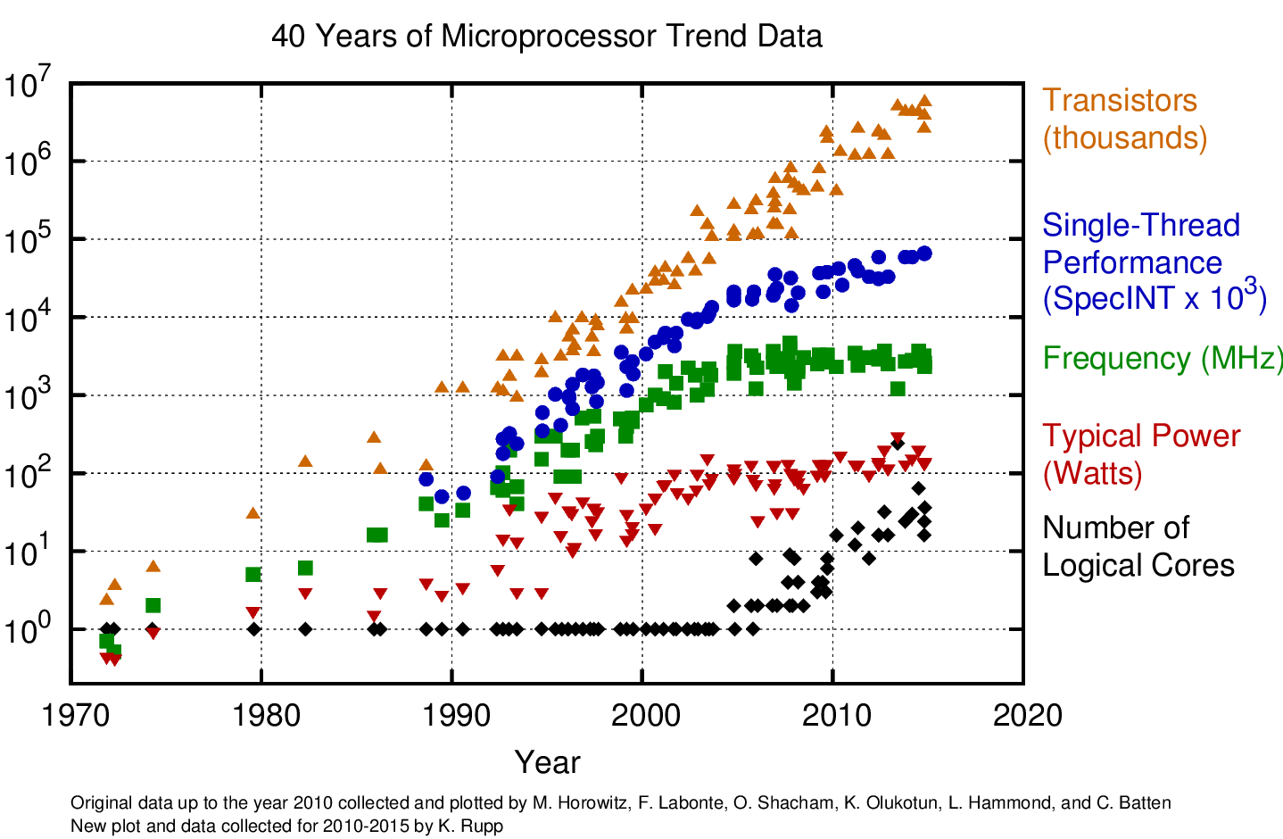

Slide 12
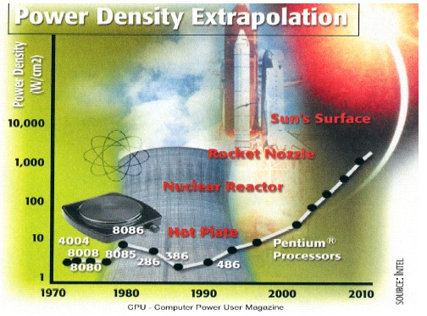
Intel Power Density

Slide 13
Impact
Power Limits Integration
Source: Carter/Intel
13

Slide 14
Impact
Power density is limiting scaling
  Can already place more transistors on a chip than we can afford to turn on!
Power is potential challenge/limiter for all future chips.
  Only turn on small percentage of transistors?
  Operate those transistors as much slower frequency?
  Find a way to drop V_{dd}?

Slide 15
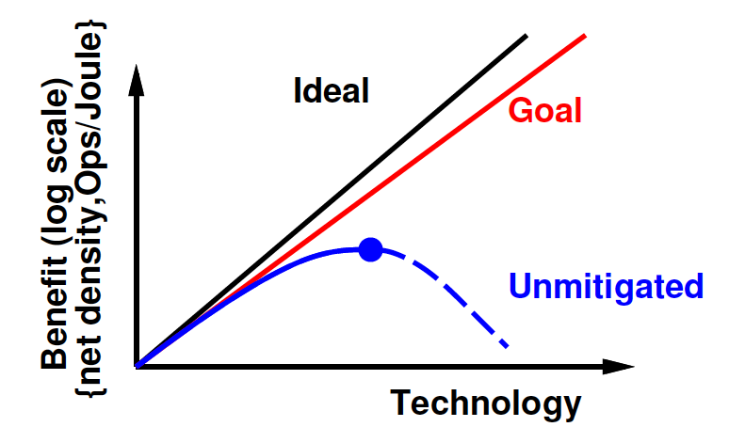
Variation threatens
E/Op reduction
Black nominal
Grey with variation
Min-Energy for multiplication (typically subthreshold)
[Bol et al., IEEE TR VLSI Sys 17(10):1508—1519]

Slide 16
Energy Limited
It is Energy that defines
  Ops/s can extract from a power-limited chip
  Ops/battery-hour can extract from a portable
If a technology makes E/op worse
  That technology is worse
  End-of-scaling

Slide 17
Energy

Slide 18
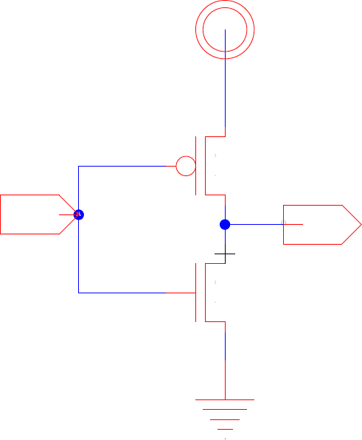
Leakage Energy
I_{leak}
  Subthreshold leakage
  (possibly) Gate-Drain leakage

Slide 19
Switching Energy
C – driven by architecture
  Also impacted by variation, aging
V – today, driven by variation, aging
α – driven by architecture, coding/information

Slide 20
Energy

Slide 21
Preclass 6
Memory bank
Leaks at 8μW
Switches 24pJ/read
At what rate of reads does E_{switch}>E_{leak}?

Slide 22
Voltage
We can set voltages
  V_{TH} – threshold voltage
  V_{dd} – switching/operating voltage
Typically need
  V_{dd}>V_{TH}>0
  (can have V_{dd} ~= V_{TH}, maybe even below)

Slide 23
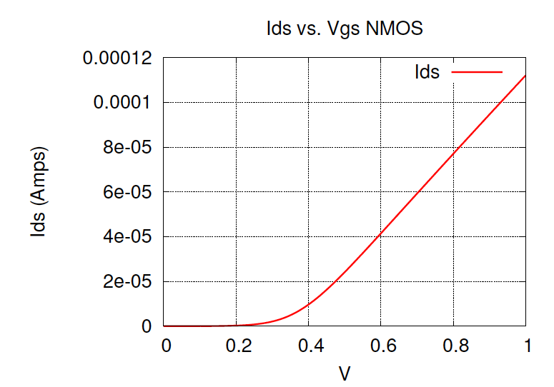
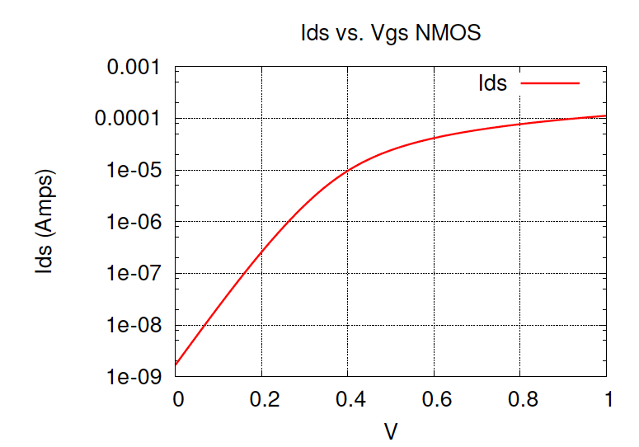
I_{DS} vs. V_{GS}

Slide 24
Voltage
What happens to T if V set low? [T=CV/I]
  E.g. V→ 400mV, 300mV, 200mV ?

Slide 25
Operating a Transistor
Concerned about I_{on} and I_{off}
I_{on} drive (saturation) current for charging
  Determines speed (latency): T_{gd} = CV/I
I_{off} leakage current
  Determines leakage power/energy:
    P_{leak} = V×I_{leak}
    E_{leak} = V×I_{leak}×T_{cycle}

Slide 26
Leakage
To avoid leakage want I_{off} very small
Switch V from V_{dd} to 0
V_{gs} in off state is 0 (V_{gs}<V_{TH})

Slide 27
Leakage
S≈90mV for single gate
S≈70mV for double gate (FinFET)
For lowest leakage, want S small, V_{TH} large
4 orders of magnitude I_{VT}/I_{off}➔V_{TH}>280mV
Leakage limits V_{TH} in turn limits V_{dd}

Slide 28
Statistical Dopant
Count and Placement
[Bernstein et al, IBM JRD 2006]

Slide 29
V_{th} Variability @ 65nm
[Bernstein et al, IBM JRD 2006]

Slide 30
Variation
Fewer dopants, atoms → increasing Variation
How do we deal with variation?
% variation in V_{TH}
(From ITRS prediction)
30
Notes:
30

Slide 31
Variation
Increasing variation forces higher voltages
  On top of our leakage limits
31
Notes:
31

Slide 32
Variations
Old
Probability Distribution
New
Margins growing due to
increasing variation
Margined value may be worse than older technology?
Delay
Notes:
One key issue showing up today is increased variation.
(We noted on slide 2 that decreasing number of dopants directly leads to increased variance in device characterstics.)
As the variation increases, so must our margins. This diminishes the benefit we see from advanced technology.
The diagram shows that the mean device behavior for a smaller feature size technology gets better (i.e. lower delay) as expected. This is what we’re tracking on the ideal (black) curve.
However, the variance for the advanced (smaller feature size) technology is larger. This means that after we apply margining for yield and worst-case path effects, the chip-level benefit is lower. …and so, the larger variance means we do not see the full, ideal scaling in device performance (hence the purple curve).
For DoD system, we often require greater margins to accommodate wider operating scenarios and/or as part of derating for harsh environment operation. This greater margining leads to even a greater degradation of performance. In the extreme, this might lead to inversion where the new technology, with margining, is actually worse than the older technology with lower variation.
In practice, it’s unlikely that this inversion will arise entirely based on this effect alone, but this effect is composed with the earlier effects of defect and fault mitigation and the composite effect can likely lead to this inversion.
The solution here is to go away from worst-case margined designs. With the methodologies proposed here, we make the designs tolerant to failures-in-the-middle. That allows us to detect the uncommon cases where the device fails to meet timing and recover. This allows us to achieve performance on the red curve.

Slide 33
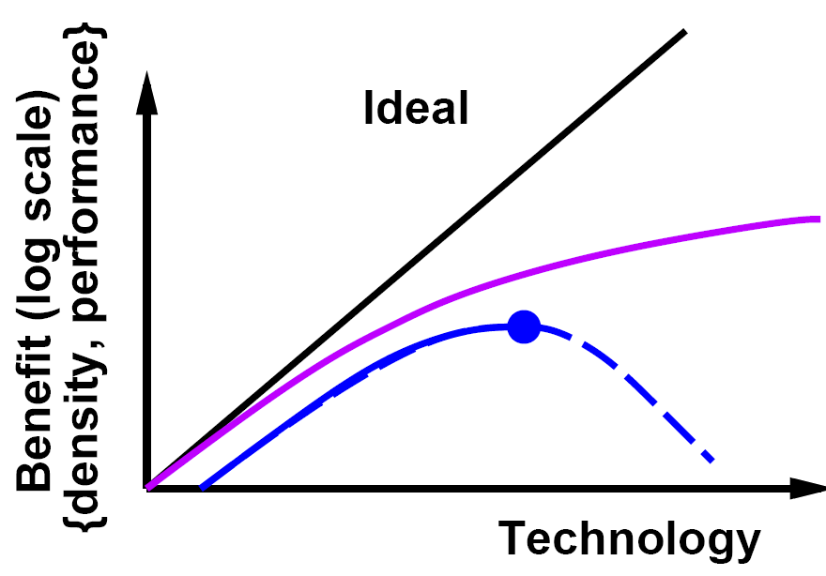
End of Energy Scaling?
Black nominal
Grey with variation
[Bol et al., IEEE TR VLSI Sys 17(10):1508—1519]

Slide 34
Scaling
Voltage scaling mostly over
  Need ~300mV for Ion/Ioff
  Plus variation and noise margin

Slide 35
Extending Preclass 6 @ 22nm
Low Power process
Higher V_{TH} to reduce leakage
(Higher V_{dd})
Memory Bank
Leaks at 21μW
Switches 7.4pJ/read
High Performance process
Lower V_{TH}
  So V_{dd}-V_{TH} larger
  Runs faster
(Lower V_{dd})
Memory Bank
Leaks at 5mW
Switches 7.1pJ/read
Crossover for each? When HP preferred?

Slide 36
Switching Energy
C – driven by architecture
  Also impacted by variation, aging
V – today, driven by variation, aging
α – driven by architecture, information

Slide 37
Data Dependent Activity
Consider an 8b counter
  How often do each of the following switch?
    Low bit?
    High bit?
  Average switching across all 8 output bits?
Assuming random inputs
  Activity at output of nand4?
  Activity at output of xor4?

Slide 38
Gate Output Switching
(random inputs)
Prev.
Next
0
Pswitch=P(0@i)*P(1@i+1)
+P(1@i)*P(0@i+1)
1

Slide 39
Switching Energy
C_{i} == capacitance driven by each gate (including wire)

Slide 40
Switching Rate (α_{i}) Varies
Different logic (low/high bits, gate type)
Different usage
  Gate off unused functional units
Data coded
Entropy in data
Average α 5--15% plausible

Slide 41
Switching Energy
C – driven by architecture
  Also impacted by variation, aging
V – today, driven by variation, aging
α – driven by architecture, information

Slide 42
Wire Driven
Gates drive
  Self
  Inputs to other gates
  Wire routing between self and other gates
Typically:

Slide 43
Wire Capacitance
How does wire capacitance relate to wire length?

Slide 44
Wire Capacitance
C=εA/d = εW*L_{wire}/d = C_{unit} * L_{wire}
Wire capacitance is linear in wire length
E.g. 1.7pF/cm (preclass)
Remains true if buffer wire
  Add buffered segment at fixed lengths

Slide 45
Wire Driven Implications
Care about locality
  Long wires are higher energy
  Producers near consumers
  Memories near compute
  Esp. for large α_{i}’s
Care about size/area
  Reduce (worst-case) distance must cross
Care about minimizing data movement
  Less data, less often, smaller distances
Care about size of memories

Slide 46
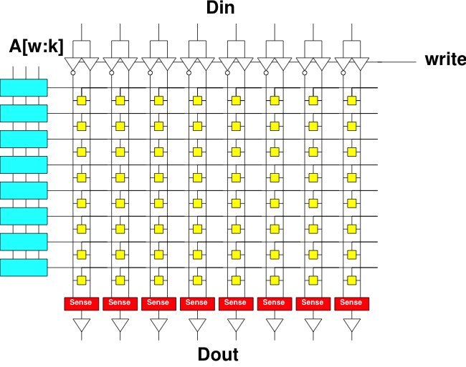
Preclass 5
Primary switching capacitance in wires
How does energy of a ready grow with capacity (N) of a memory bank?
Energy per bit?

Slide 47
Memory Implications
Memory energy can be expensive
Small memories cost less energy than large memories
  Use data from small memories as much as possible
Cheaper to re-use data item from register than re-reading from memory

Slide 48
Architectural Implications

Slide 49
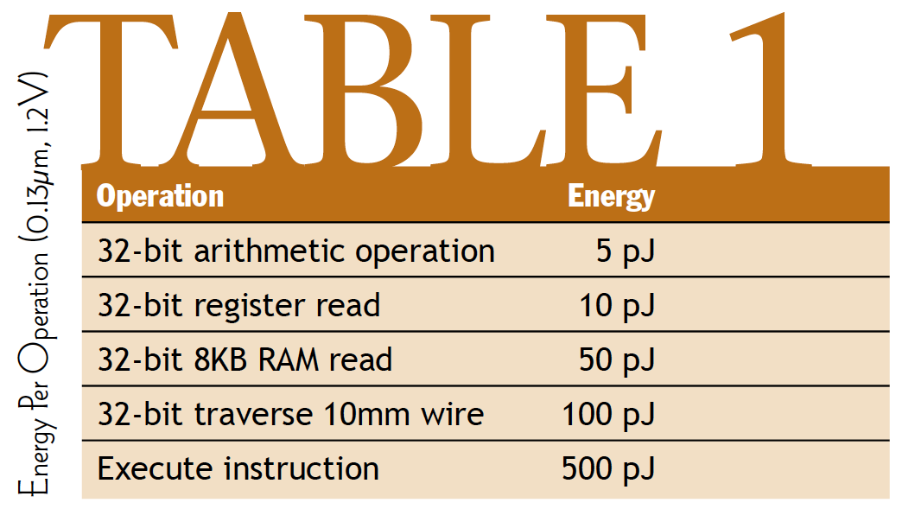
Component Numbers
[Dally, March 2004 ACM Queue]

Slide 50
Component Numbers
Processor instruction 100x more than arithmetic
Register read 2x
RAM read 10x
Why processor instruction > arith operation?
[Dally, March 2004 ACM Queue]

Slide 51
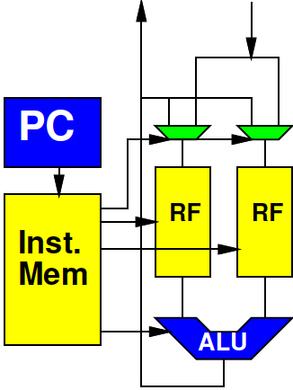
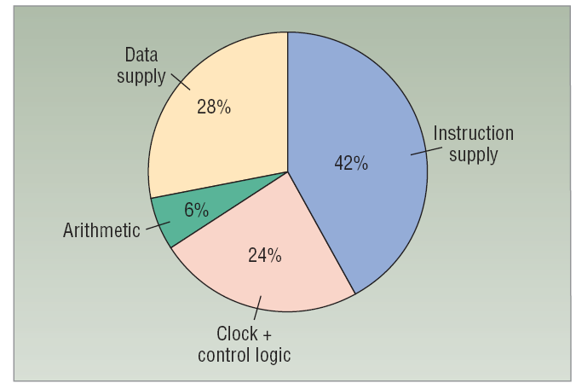
Processors and Energy
Very little into actual computation
Determine and Fetch Instruction
Read and Write data from memories
[Dally et al. /
Computer 2008]

Slide 52
ARM Cortex A9
Estimate find: 0.5W at 800MHz in 40nm
0.5/0.8 x 10⁻⁹ J/instr
~600pJ/instr
Scale to 28nm
  maybe 0.7*600—0.5*600
  300—400pJ/instr ?
Is superscalar w/ neon, so not as simple a processor as previous example

Slide 53
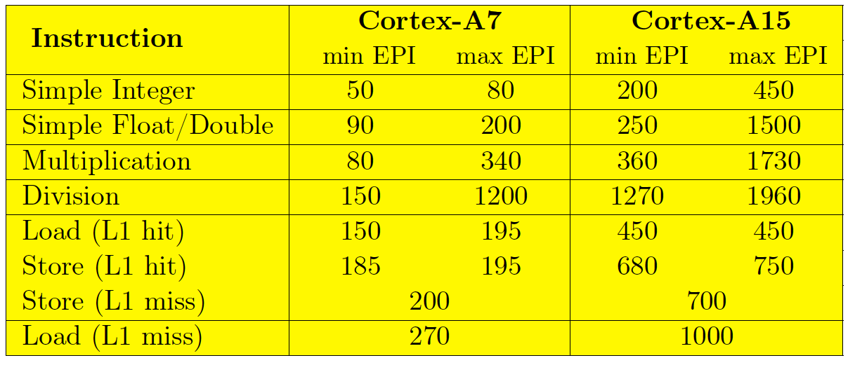
ARM Cortex A7, A15
(Samsung 28nm)
[Evangelos Vasilakis, Technical Report FORTH-ICS/TR-450, March 2015]
http://www.ics.forth.gr/carv/greenvm/files/tr450.pdf

Slide 54
Processor Differences
What different among A7, A9, A15?

Slide 55
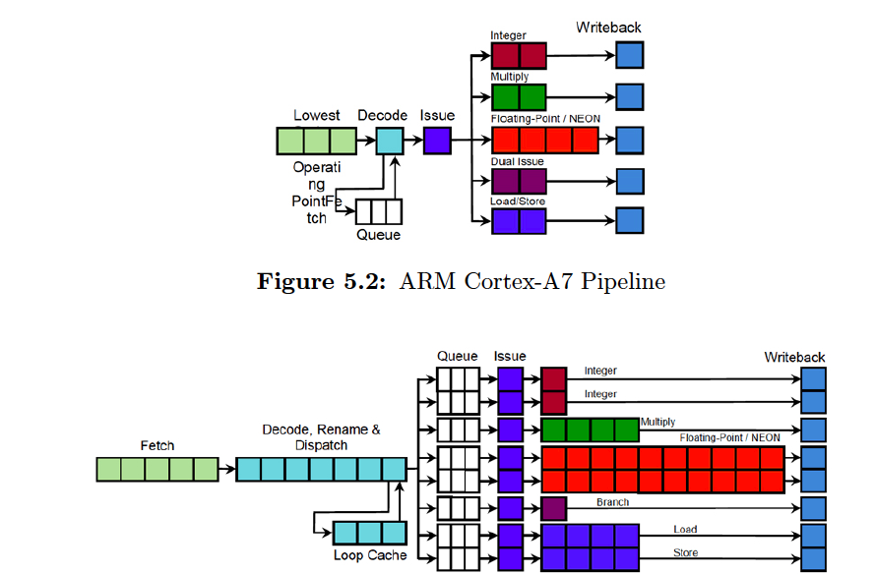
ARM Cortex A7, A15
(Samsung 28nm)
[Evangelos Vasilakis, Technical Report FORTH-ICS/TR-450, March 2015]
http://www.ics.forth.gr/carv/greenvm/files/tr450.pdf

Slide 56
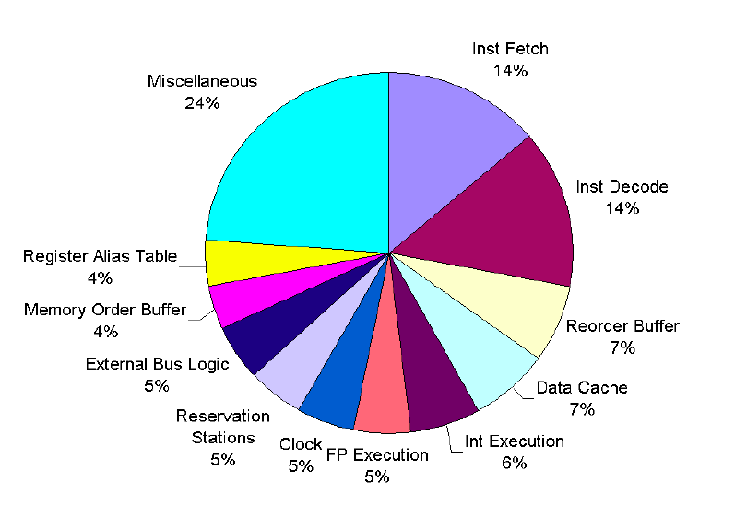
Pentium Pro Energy Breakdown
[Bose, Martonosi, Brooks / Sigmetrics 2001]

Slide 57
Implications
Complex, multi-issue superscalars
  Cost more energy per operation
  Spend energy on issue logic, etc.
  that does not go into computation for the task
Even if can get performance from superscalar processors
  For energy reasons, benefit getting it elsewhere

Slide 58
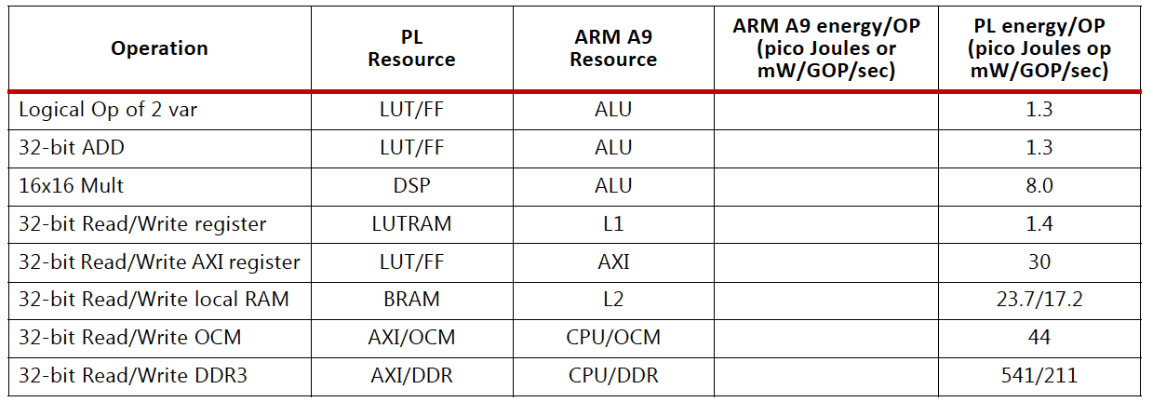
Zynq
ARM A9 instruction 300—400pJ
ARM A9 L1 cache read 23pJ
Xilinx UG585 – Zynq TRM

Slide 59
Compare
Assume ARM Cortex A9 executes 4x32b Neon vector add instruction for 300pJ
Compare to 32b adds on FPGA?

Slide 60
Compare
Assume ARM Cortex A9 executes 8x16b Neon vector multiply instruction for 300pJ
Compare to 16x16 multiplies on FPGA?

Slide 61
Programmable Datapath
Performing an operation in a pipelined datapath can be orders of magnitude less energy than on a processor
  ARM 300pJ vs. 1.3pJ 32b add
  Even neon 300pJ vs. 4x1.3pJ for 4x32b add
  300pJ vs. 8x8pJ for 8 16x16b multiplies

Slide 62
Zynq
Reading from OCM order of magnitude less than from DRAM
…and BRAM half that
Xilinx UG585 – Zynq TRM

Slide 63
Energy
Pleiades includes
hardwire multiply
accumulator
[Abnous et al, The Application of Programmable DSPs in
Mobile Communications, Wiley, 2002, pp. 327-360 ]

Slide 64
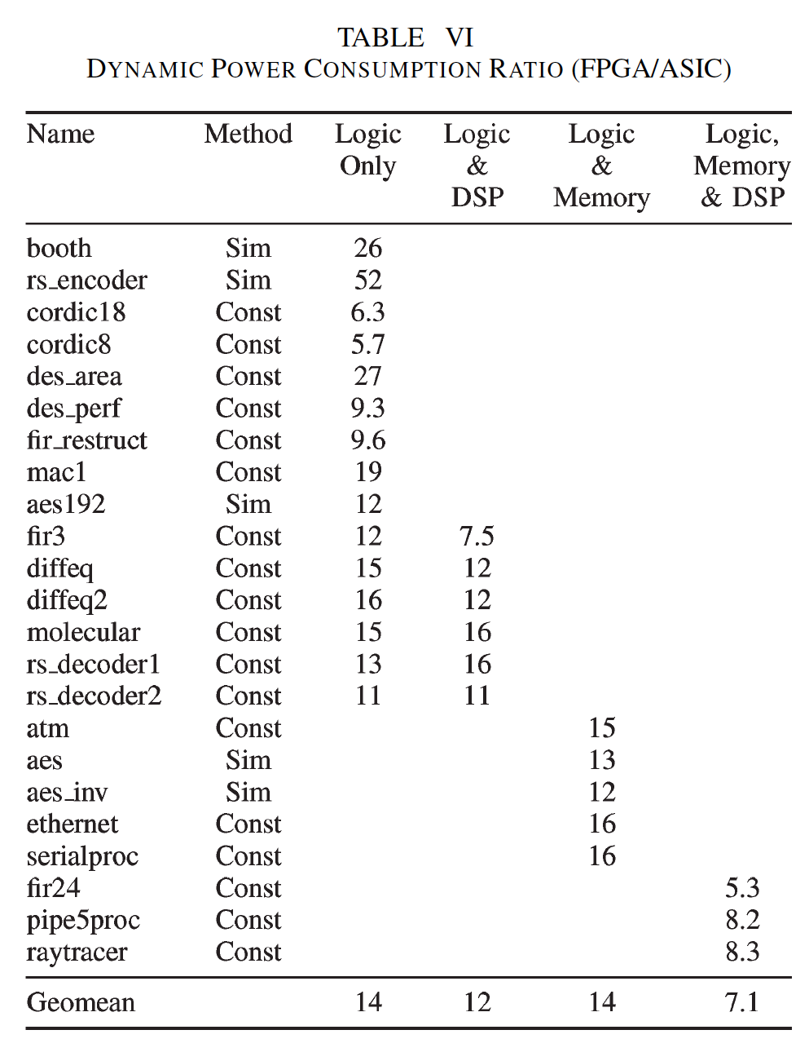
FPGA vs. Std Cell
Energy
90nm
FPGA: Stratix II
STMicro CMOS090
eASIC (MPGA) claim
  20% of FPGA power
  (best case)
[Kuon/Rose TRCADv26n2p203--215 2007]

Slide 65
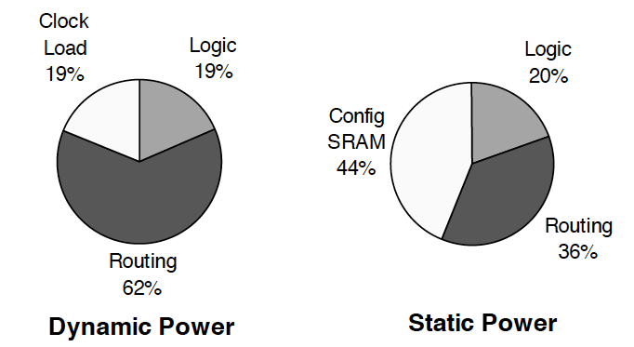
FPGA Disadvantage to Custom
Interconnect Energy
  Long wires → more capacitance → more E
  Switch Energy is an overhead
[Tuan et al./FPGA 2006]

Slide 66
Energy
Pleiades includes
hardwire multiply
accumulator
[Abnous et al, The Application of Programmable DSPs in
Mobile Communications, Wiley, 2002, pp. 327-360 ]

Slide 67
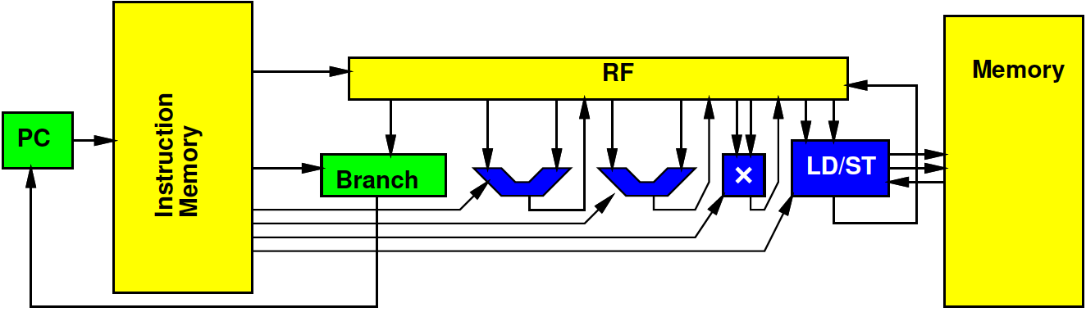
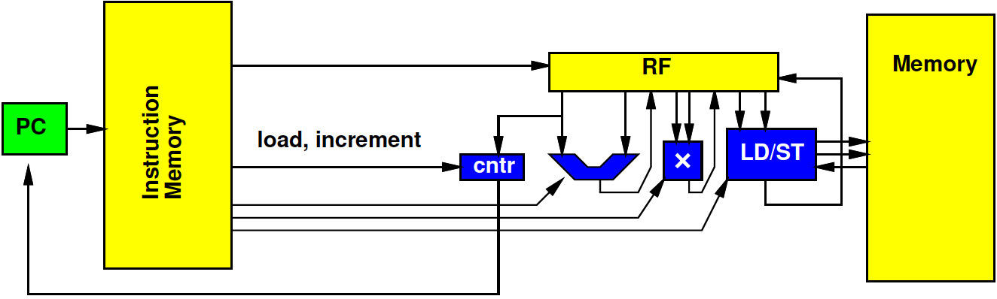
Zero-Overhead Loop Simplify
TI DSPs specialized w/ tricks like ZOL…
  Fewer instructions, less energy/instruction

Slide 68
Energy
Pleiades includes
hardwire multiply
accumulator
[Abnous et al, The Application of Programmable DSPs in
Mobile Communications, Wiley, 2002, pp. 327-360 ]

Slide 69
Simplified Comparison
Processor two orders of magnitude higher energy than custom accelerator
FPGA accelerator in between
  Order of magnitude lower than processor
  Order of magnitude higher than custom

Slide 70
Big Ideas
Energy dominance
With power-density budget
  The most energy efficient architecture delivers the most performance
Make memories small and wires short
SoC, accelerators reduce energy by reducing processor instruction execution overhead

Slide 71
Admin
Project energy Milestone
  Due Friday

