Slide 1
ESE532: System-on-a-Chip Architecture
Day 23: April 12, 2017
Parallelism and Energy

Slide 2
Today
How does parallelism impact energy?
Refine
Locality?
Problem size?

Slide 3
Message
Can tune parallelism to minimize energy
Typically, the more parallel implementation costs less energy

Slide 4
Energy
Day 22
Growing domain of portables
Less energy/op → longer battery life
Global Energy Crisis
Power-envelope at key limit
E reduce → increase compute in P-envelope
Scaling
Power density not transistors limit sustained ops/s
Server rooms
Cost-of-ownership not dominated by Silicon
Cooling, Power bill

Slide 5
Memory Energy
Memory operations cost energy
Must move data for memory bit to outside of array
Wires of length Sqrt(N)
Energy Sqrt(N)

Slide 6
Memory Energy
Energy Sqrt(N)
Large memories cost more energy than small memories

Slide 7
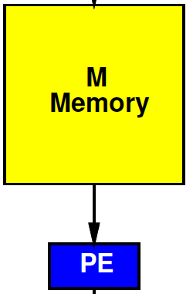
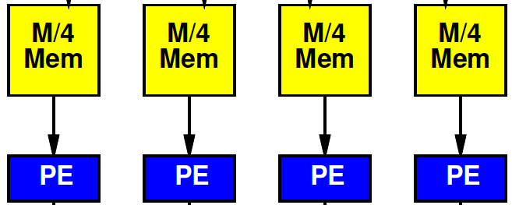
Preclass 1
Energy
Per read from M=10⁶ memory?
Per read from 10⁶/4 memory?

Slide 8
Local Consumption
To exploit, we must consume the data local to the memory.

Slide 9
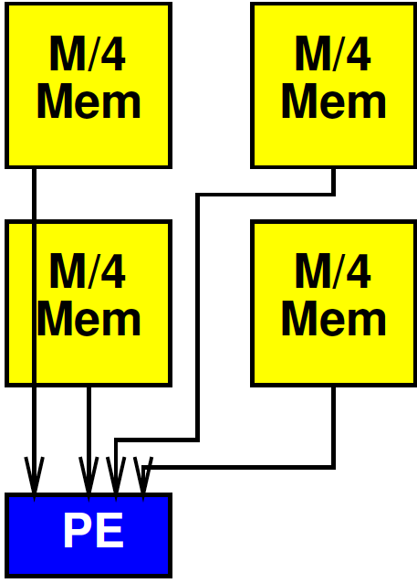
Cheat?
What if we broke the memory into 4 blocks, but still routed to a single processor?

Slide 10
Exploit Locality
Must consume data near computation

Slide 11
Inter PE Communication
May need to communicate between parallel processing units (and memories)
Must pay for energy to move data between PEs

Slide 12
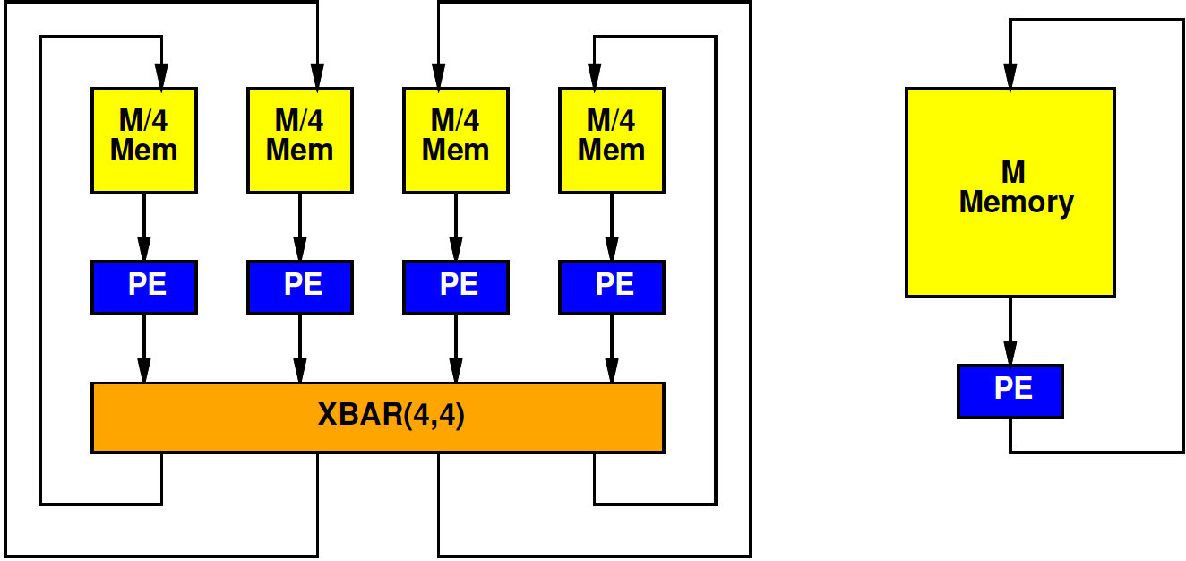
Preclass 2
Energy: Read 4 memories 10⁶/4, route 4x4 crossbar, write 4 10⁶/4 memories?
Energy: 4 reads from 10⁶ memory, 4 writes from 10⁶ memory?

Slide 13
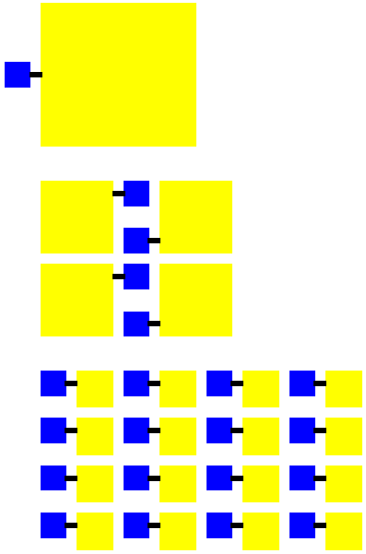
Parallel Larger
More parallel design
Has more PEs
Adds interconnect
Total area > less parallel design
More area → longer wires → more energy in communication between PEs
Could increase energy!

Slide 14
Continuum Question
Where do we minimize total energy?
Both memory and communication
Design axis P – number of PEs
What P minimizes energy?

Slide 15
Simple Model
E_{mem}=sqrt(M)
Communication = E_{xbar}(I,O)=4*I*O
P Processors
N total data
Possibly communicate each result to other PEs

Slide 16
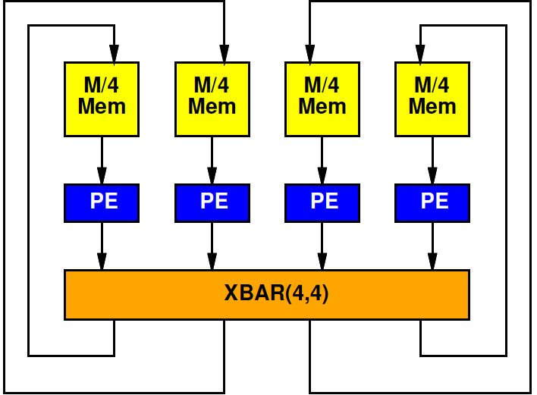
Simple Model: Memory
Divide N data over P memories
E_{mem}=sqrt(N/P)
N total memory operations
Memory energy: N*sqrt(N/P)
Memory energy decrease with P

Slide 17
Simple Model: Communication
Crossbar with P inputs and P outputs
E_{xbar}=4*P*P
Crossbar used N/P times
Crossbar energy: 4*N*P
Communication energy increase with P

Slide 18
Simple Model

Slide 19
Preclass 3
For N=10⁶
Per operation becomes:

Slide 20
Preclass 3
Energy for:
P=1
P=4
P=100
Energy minimizing P?
Energy?

Slide 21
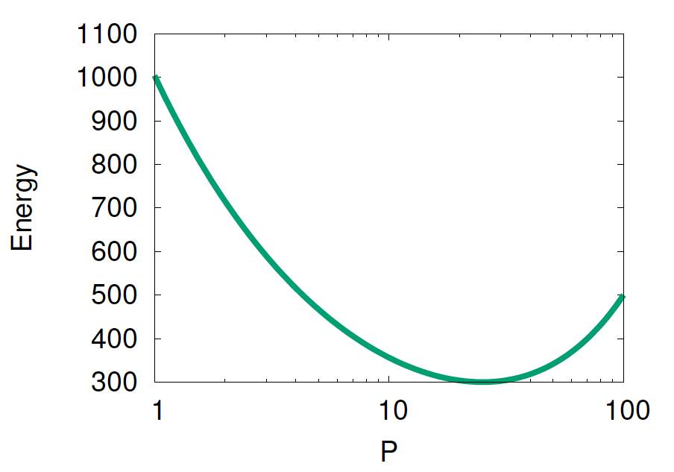
Graph

Slide 22
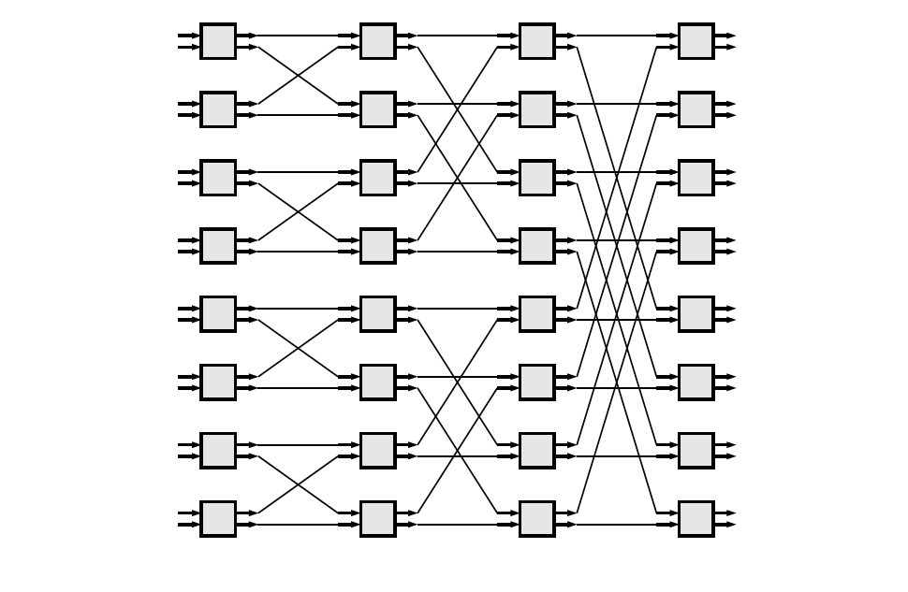
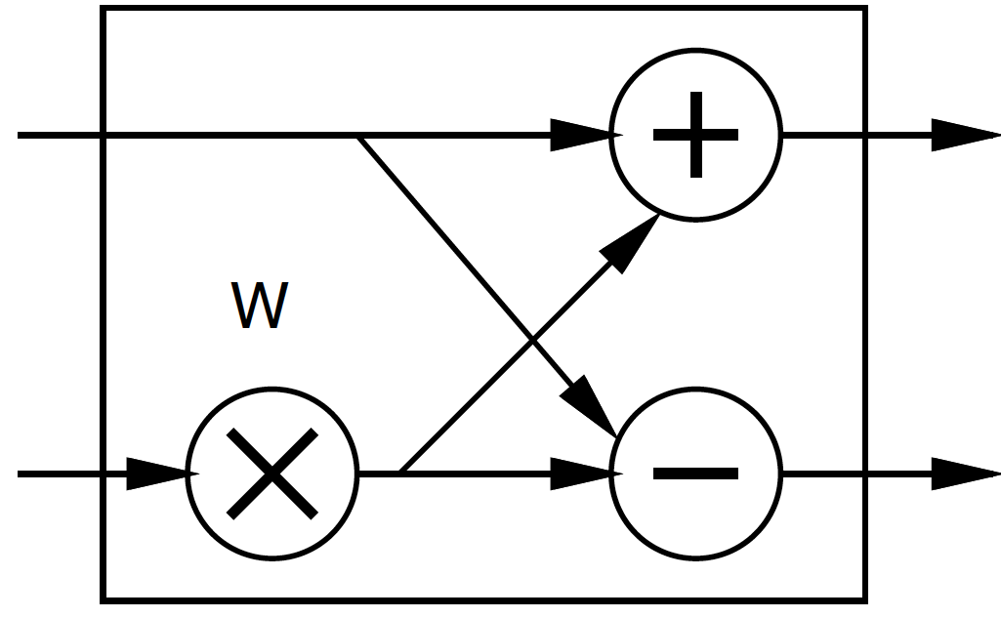
FFT
Day 14
Large space of FFTs
Radix-2 FFT Butterfly

Slide 23
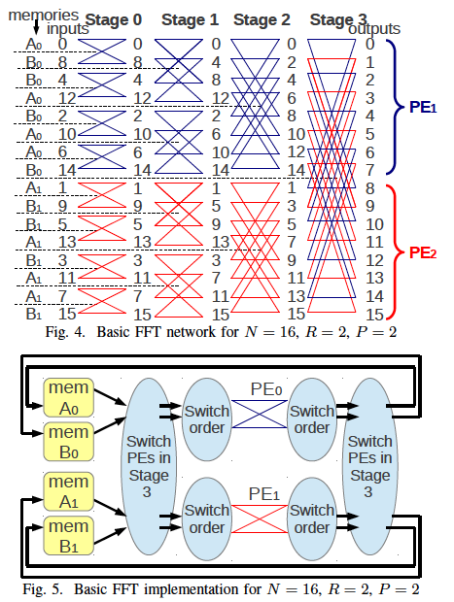
FFT Example
Tune number of PEs, P
[Kadric, FCCM 2014]

Slide 24
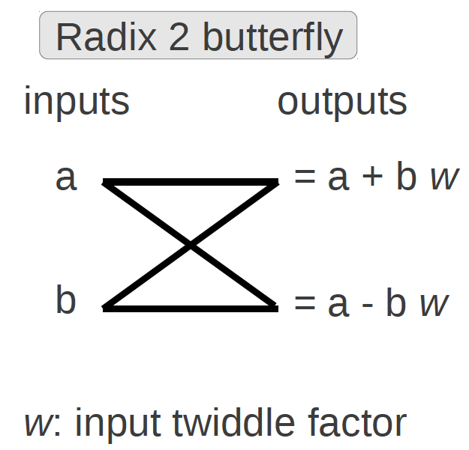
FFT on Stratix-IV
PE is Radix 2 Butterfly
PEs | Hier | Mem | Components (per point) |  |  |  | Total
 |  | Type | Mem | route | comp | route | pJ/pt
1 | 1 | M144K | 2300 | 140 | 900 | 1300 | 4700
1 | 16 | M144K | 1300 | 210 | 920 | 1400 | 3800
4 | 4 | M9K | 880 | 75 | 1000 | 1500 | 3500
16 | 1 | M9K | 420 | 85 | 900 | 1200 | 2600
32 | 1 | M9K | 210 | 85 | 910 | 1200 | 2400
[Kadric, FCCM 2014]

Slide 25
FFT
PE is Radix 2 Butterfly
PEs | Hier | Mem | Components (per point) |  |  |  | Total
 |  | Type | Mem | route | comp | route | pJ/pt
1 | 1 | M144K | 2300 | 140 | 900 | 1300 | 4700
1 | 16 | M144K | 1300 | 210 | 920 | 1400 | 3800
4 | 4 | M9K | 880 | 75 | 1000 | 1500 | 3500
16 | 1 | M9K | 420 | 85 | 900 | 1200 | 2600
32 | 1 | M9K | 210 | 85 | 910 | 1200 | 2400
[Kadric, FCCM 2014]

Slide 26
FFT
PE is Radix 2 Butterfly
PEs | Hier | Mem | Components (per point) |  |  |  | Total
 |  | Type | Mem | route | comp | route | pJ/pt
1 | 1 | M144K | 2300 | 140 | 900 | 1300 | 4700
1 | 16 | M144K | 1300 | 210 | 920 | 1400 | 3800
4 | 4 | M9K | 880 | 75 | 1000 | 1500 | 3500
16 | 1 | M9K | 420 | 85 | 900 | 1200 | 2600
32 | 1 | M9K | 210 | 85 | 910 | 1200 | 2400
[Kadric, FCCM 2014]

Slide 27
FFT
PE is Radix 2 Butterfly
PEs | Hier | Mem | Components (per point) |  |  |  | Total
 |  | Type | Mem | route | comp | route | pJ/pt
1 | 1 | M144K | 2300 | 140 | 900 | 1300 | 4700
1 | 16 | M144K | 1300 | 210 | 920 | 1400 | 3800
4 | 4 | M9K | 880 | 75 | 1000 | 1500 | 3500
16 | 1 | M9K | 420 | 85 | 900 | 1200 | 2600
32 | 1 | M9K | 210 | 85 | 910 | 1200 | 2400
[Kadric, FCCM 2014]

Slide 28
FFT
PE is Radix 2 Butterfly
PEs | Hier | Mem | Components (per point) |  |  |  | Total
 |  | Type | Mem | route | comp | route | pJ/pt
1 | 1 | M144K | 2300 | 140 | 900 | 1300 | 4700
1 | 16 | M144K | 1300 | 210 | 920 | 1400 | 3800
4 | 4 | M9K | 880 | 75 | 1000 | 1500 | 3500
16 | 1 | M9K | 420 | 85 | 900 | 1200 | 2600
32 | 1 | M9K | 210 | 85 | 910 | 1200 | 2400
[Kadric, FCCM 2014]

Slide 29
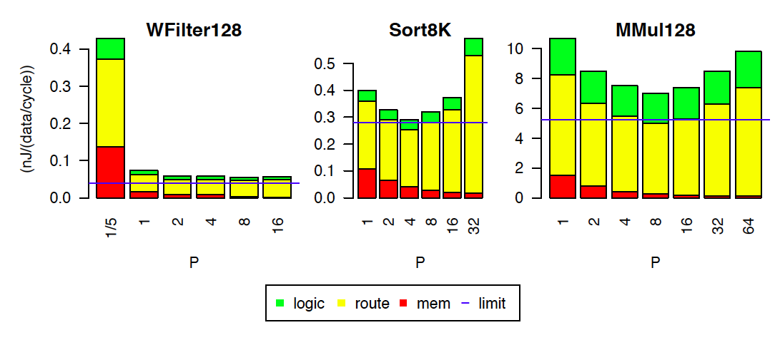
Tune Parallelism: Stratix-IV
[Kadric, FPGA 2015]

Slide 30
GMM
Compute Gaussian model of pixel background for every pixel
Reference case at 50MHz
PEs | Mem | Components (per PE) |  |  |  | Total
 | Type | Mem | route | Comp | route | mW/PE
1 | M144K | 29 | 4.4 | 9.8 | 28 | 71
2 | M144K | 27 | 6.8 | 9.5 | 16 | 59
4 | M9K | 12 | 1.3 | 9.9 | 19 | 42
8 | M9K | 4.7 | 1.0 | 10 | 17 | 33
16 | M9K | 4.6 | 1.0 | 9.8 | 13 | 29
32 | M9K | 5.7 | 3.7 | 9.3 | 8 | 27
[Kadric, FCCM 2014]

Slide 31
GMM
Compute Gaussian model of pixel background for every pixel
Reference case at 50MHz
PEs | Mem | Components (per PE) |  |  |  | Total
 | Type | Mem | route | Comp | route | mW/PE
1 | M144K | 29 | 4.4 | 9.8 | 28 | 71
2 | M144K | 27 | 6.8 | 9.5 | 16 | 59
4 | M9K | 12 | 1.3 | 9.9 | 19 | 42
8 | M9K | 4.7 | 1.0 | 10 | 17 | 33
16 | M9K | 4.6 | 1.0 | 9.8 | 13 | 29
32 | M9K | 5.7 | 3.7 | 9.3 | 8 | 27
[Kadric, FCCM 2014]

Slide 32
GMM
Compute Gaussian model of pixel background for every pixel
Reference case at 50MHz
PEs | Mem | Components (per PE) |  |  |  | Total
 | Type | Mem | route | Comp | route | mW/PE
1 | M144K | 29 | 4.4 | 9.8 | 28 | 71
2 | M144K | 27 | 6.8 | 9.5 | 16 | 59
4 | M9K | 12 | 1.3 | 9.9 | 19 | 42
8 | M9K | 4.7 | 1.0 | 10 | 17 | 33
16 | M9K | 4.6 | 1.0 | 9.8 | 13 | 29
32 | M9K | 5.7 | 3.7 | 9.3 | 8 | 27
[Kadric, FCCM 2014]

Slide 33
GMM
Compute Gaussian model of pixel background for every pixel
Reference case at 50MHz
PEs | Mem | Components (per PE) |  |  |  | Total
 | Type | Mem | route | Comp | route | mW/PE
1 | M144K | 29 | 4.4 | 9.8 | 28 | 71
2 | M144K | 27 | 6.8 | 9.5 | 16 | 59
4 | M9K | 12 | 1.3 | 9.9 | 19 | 42
8 | M9K | 4.7 | 1.0 | 10 | 17 | 33
16 | M9K | 4.6 | 1.0 | 9.8 | 13 | 29
32 | M9K | 5.7 | 3.7 | 9.3 | 8 | 27
[Kadric, FCCM 2014]

Slide 34
GMM
Compute Gaussian model of pixel background for every pixel
Reference case at 50MHz
PEs | Mem | Components (per PE) |  |  |  | Total
 | Type | Mem | route | Comp | route | mW/PE
1 | M144K | 29 | 4.4 | 9.8 | 28 | 71
2 | M144K | 27 | 6.8 | 9.5 | 16 | 59
4 | M9K | 12 | 1.3 | 9.9 | 19 | 42
8 | M9K | 4.7 | 1.0 | 10 | 17 | 33
16 | M9K | 4.6 | 1.0 | 9.8 | 13 | 29
32 | M9K | 5.7 | 3.7 | 9.3 | 8 | 27
[Kadric, FCCM 2014]

Slide 35
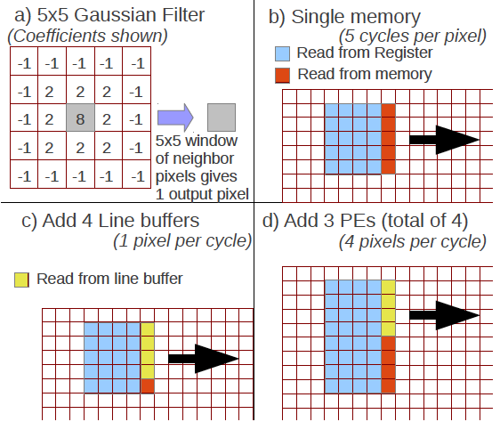
Window Filter
PEs | Line | Bits | Mem | Components (per pixel) |  |  |  | Total
 | Buff | /pixel | Type | Mem | route | comp | route | pJ/PE
1 | N | 1 | M144K | 400 | 50 | 130 | 280 | 850
1 | Y | 1 | M9K | 110 | 11 | 81 | 120 | 320
2 | Y | 1 | M9K | 45 | 6 | 67 | 84 | 200
4 | Y | 1 | M9K | 24 | 3 | 61 | 75 | 160
4 | Y | 2 | M9K | 15 | 3 | 59 | 63 | 140
4 | Y | 4 | M9K | 15 | 3 | 57 | 60 | 135
[Kadric, FCCM 2014]

Slide 36
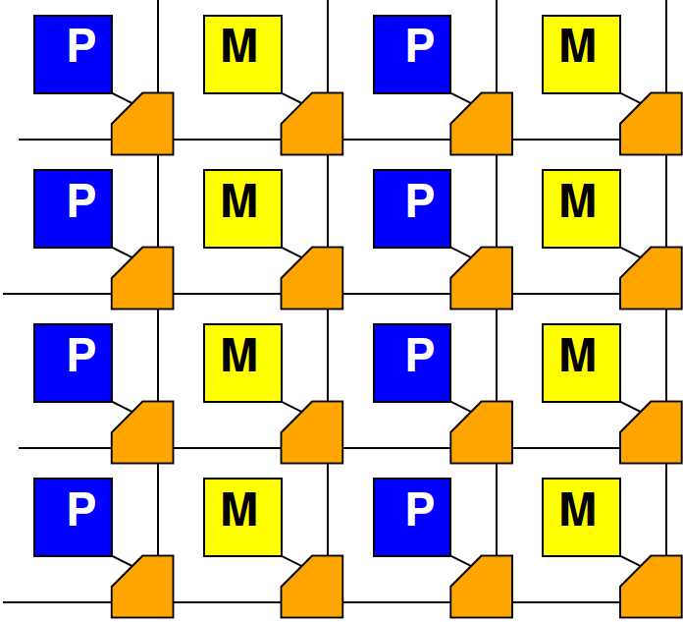
High Locality
If communication is local, don’t need crossbar
Communication energy scales less than P²
Can scale as low as P
As see GMM, WinF

Slide 37
Model for High Locality
E_{comm}=constant
E_{comm}=10
Total comm:
N*10

Slide 38
Preclass 4
What is energy minimizing P?

Slide 39
Task Locality Matters
Optimal P depends on communication locality
Very local problems always benefit from parallelism
Highly interconnected problems must balance energies → intermediate parallelism

Slide 40
Impact of Problem Size
Optimal P changes with problem size
Changes N
Changes cost of memories

Slide 41
Preclass 5
For N=6.4×10⁷
Per operation becomes:

Slide 42
Preclass 5
Energy minimizing P?

Slide 43
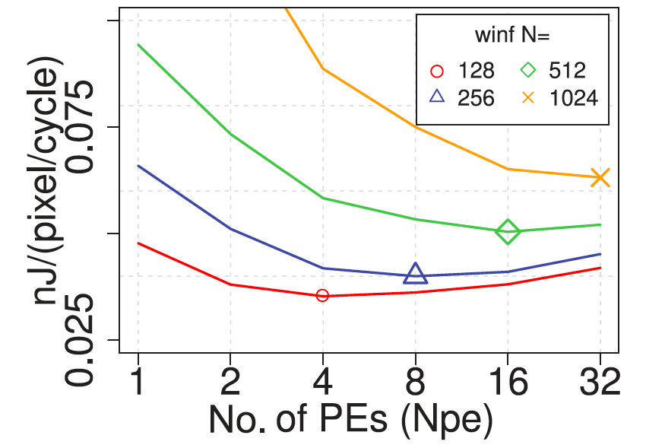
Window Filter
[Kadric, TRETS 2016]

Slide 44
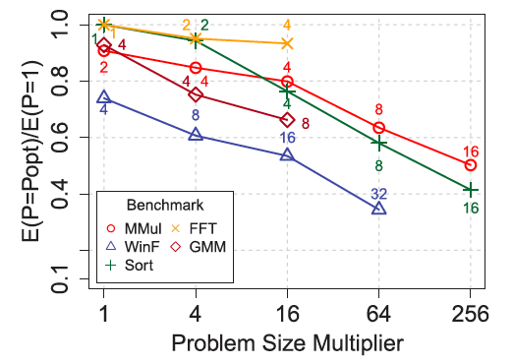
PE Scaling with Problem Size
[Kadric, TRETS 2016]

Slide 45
P Scaling Trends
[Kadric, TRETS 2016]

Slide 46
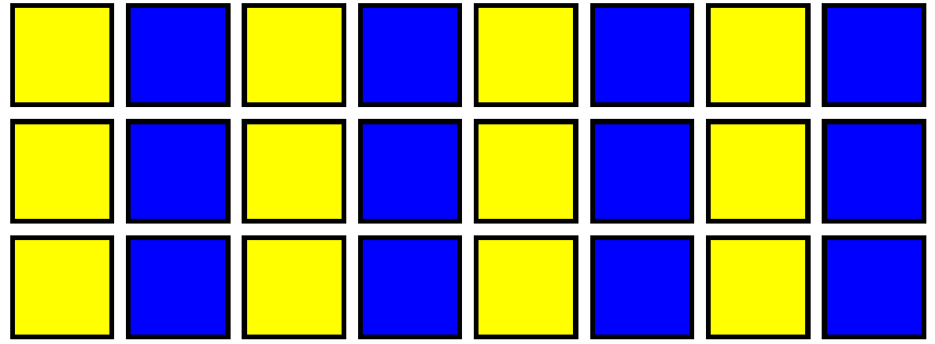
Balanced Memory and Compute
In general
Want memory to be about the size of the PE
Then replicate that to handle larger problems
Rather than making memory larger

Slide 47
Balanced Memory and Compute
Memory ~= Compute size
E_{mem} comparable to E_{route}
Doesn’t make local computation much larger
If does need distant memory
Not much worse than one large memory

Slide 48
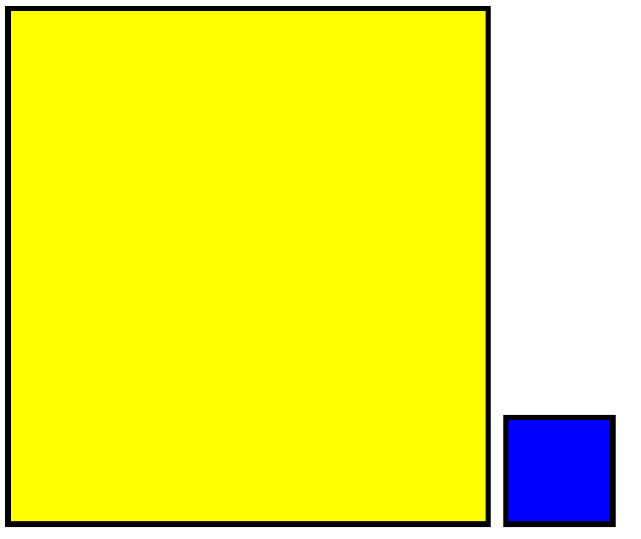
Balanced Memory and Compute
Memory >> PE size
Not exploiting locality

Slide 49
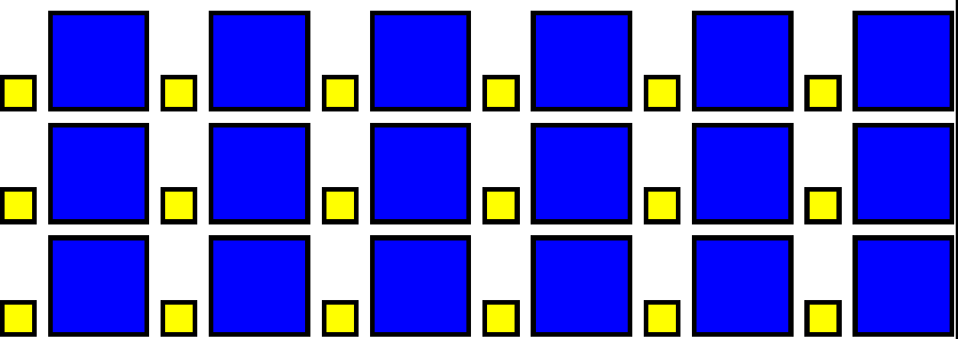
Balanced Memory and Compute
Memory >> PE size
Not exploiting locality
Memory << PE size
Energy routing to distant memory can be much larger than if each memory bank was larger

Slide 50
Balanced Memory and Compute
In general
Want memory to be about the size of the PE
Then replicate that to handle larger problems
Rather than making memory larger
P α Problem Size

Slide 51
Big Ideas
Large memories are energy expensive
Force large data movement
Small memories with local compute
Reduce data movement, save energy
Parallel design exploiting locality can reduce energy
Optimal parallelism for problem
Driven by communication structure
Depends on problem size

Slide 52
Admin
Project energy Milestone
Due Friday

