Slide 1

ESE532:
System-on-a-Chip Architecture
Day 24: April 17, 2017
Defect Tolerance

Slide 2
Today
Reliability Challenges
Defect Tolerance
  Memories
  Interconnect
  FPGA
FPGA Variation and Energy

Slide 3
Message
At small feature sizes, not viable to demand perfect fabrication of billions of transistors on a chip
Modern ICs are like snowflakes
  Everyone is different, changes over time
Reconfiguration allows repair
  Finer grain → higher defect rates
  Tolerate variation → lower energy

Slide 4
Intel Xeon Phi Offerings
Part # | Cores
7290F | 72
7250F | 68
7230F | 64
http://www.intel.com/content/www/us/en/products/processors/xeon-phi/xeon-phi-processors.html

Slide 5
Intel Xeon Phi Offerings
Part # | Cores
7290F | 72
7250F | 68
7230F | 64
Is Intel producing 3 separate chips?

Slide 6
Preclass 1 and
Intel Xeon Phi Offerings
Part # | Cores
7290F | 72
7250F | 68
7230F | 64
Cost ratio between 72 and 64 processor
assuming fixed mm² per core?

Slide 7

Intel Xeon Phi Pricing

Slide 8
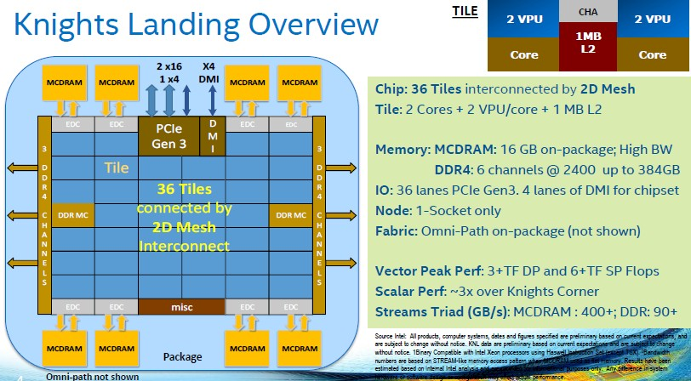
Intel Knights Landing
https://www.nextplatform.com/2016/06/20/intel-knights-landing-yields-big-bang-buck-jump/
[Intel, Micro 2016]

Slide 9
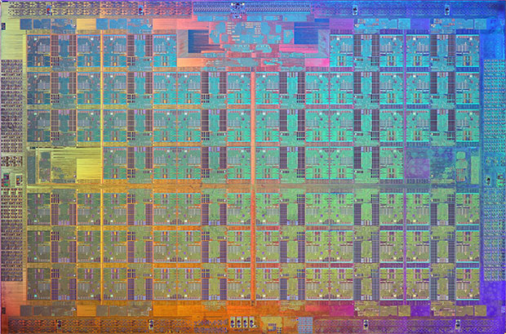
Knights Landing Xeon Phi
[Intel, Micro 2016]

Slide 10
What’s happening?
Fabricated chip has 76 cores
Not expect all to work
Selling based on functional cores
  72, 68, 64
Charge premium for high core counts
  Don’t yield as often, people pay more
https://www.nextplatform.com/2016/08/22/intel-tweaking-xeon-phi-deep-learning/
[Intel, Micro 2016]

Slide 11
Warmup Discussion
Where else do we guard against defects today?
  Where do we accept imperfection today?

Slide 12
Motivation: Probabilities
Given:
  N objects
  P_{g} yield probability
What’s the probability for yield of composite system of N items? [Preclass 2]
  Assume iid faults
  P(N items good) = (P_{g})^{N}

Slide 13
Probabilities
  P_{all_good}(N)= (P_{g})^{N}
P=0.999999
N | P_{all_good}(N)
10⁴
10⁵
10⁶
10⁷

Slide 14
Probabilities
  P_{all_good}(N)= (P_{g})^{N}
P=0.999999
N | P_{all_good}(N)
10⁴ | 0.99
10⁵ | 0.90
10⁶ | 0.37
10⁷ | 0.000045

Slide 15
Simple Implications
As N gets large
  must either increase reliability
  …or start tolerating failures
N
  memory bits
  disk sectors
  wires
  transmitted data bits
  processors
  transistors
  molecules
As devices get smaller, failure rates increase
chemists think P=0.95 is good
As devices get faster, failure rate increases

Slide 16
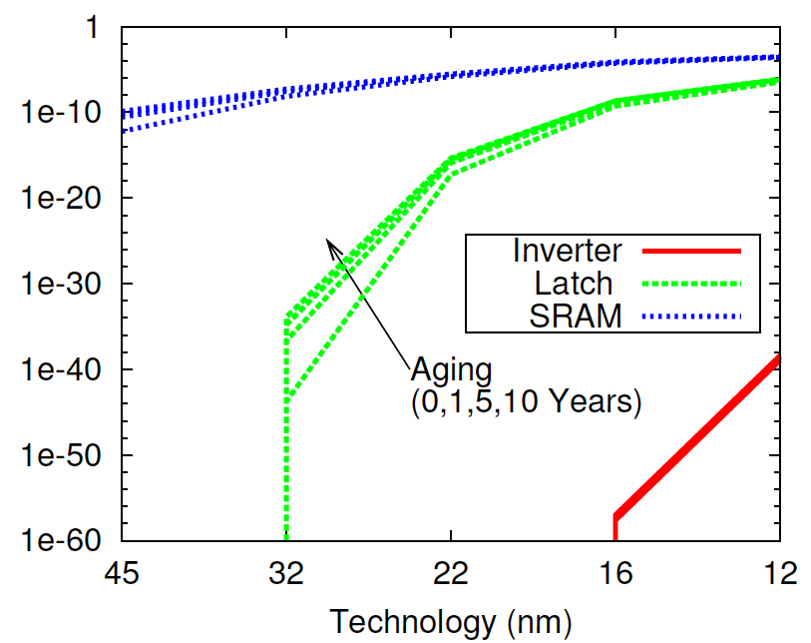
Failure Rate Increases
[Nassif / DATE 2010]

Slide 17
Quality Required for Perfection?
How high must P_{g} be to achieve 90% yield on a collection of 10¹⁰ devices?
[preclass 4]
P_{g}>1-10⁻¹¹

Slide 18
Failure Rate Increases
[Nassif / DATE 2010]

Slide 19
Challenge
Feature size scales down (S)
Capacity (area) → increases (1/S²)
  N increase
Reliability per device goes down
  P_{g} decrease
  P(N items good) = (P_{g})^{N}

Slide 20
Defining Problems

Slide 21
Three Problems
Defects: Manufacturing imperfection
  Occur before operation; persistent
    Shorts, breaks, bad contact
Transient Faults:
  Occur during operation; transient
    node X value flips: crosstalk, ionizing particles, bad timing, tunneling, thermal noise
Lifetime “wear” defects
  Parts become bad during operational lifetime
    Fatigue, electromigration, burnout….
  …slower
    NBTI, Hot Carrier Injection

Slide 22
Shekhar Bokar
Intel Fellow
Micro37 (Dec.2004)

Slide 23
Defect Rate
Device with 10¹¹ elements (100BT)
3 year lifetime = 10⁸ seconds
Accumulating up to 10% defects
10¹⁰ defects in 10⁸ seconds
  1 new defect every 10ms
At 10GHz operation:
  One new defect every 10⁸ cycles
  P_{newdefect}=10⁻¹⁹

Slide 24
First Step to Recover
Admit you have a problem
(observe that there is a failure)

Slide 25
Detection
How do we determine if something wrong?
  Some things easy
    ….won’t start
  Others tricky
    …one and gate computes False & True→True
Observability
  can see effect of problem
  some way of telling if defect/fault present

Slide 26
Detection
Coding
  space of legal values << space of all values
  should only see legal
  e.g. parity, ECC (Error Correcting Codes)
Explicit test (defects, recurring faults)
  ATPG = Automatic Test Pattern Generation
  Signature/BIST=Built-In Self-Test
  POST = Power On Self-Test
Direct/special access
  test ports, scan paths

Slide 27
Coping with defects/faults?
Key idea: redundancy
Detection:
  Use redundancy to detect error
Mitigating: use redundant hardware
  Use spare elements in place of faulty elements (defects)
  Compute multiple times so can discard faulty result (faults)

Slide 28
Defect Tolerance

Slide 29
Three Problems
Defects: Manufacturing imperfection
  Occur before operation; persistent
    Shorts, breaks, bad contact
Transient Faults:
  Occur during operation; transient
    node X value flips: crosstalk, ionizing particles, bad timing, tunneling, thermal noise
Lifetime “wear” defects
  Parts become bad during operational lifetime
    Fatigue, electromigration, burnout….
  …slower
    NBTI, Hot Carrier Injection

Slide 30
Two Models
Disk Drives (defect map)
Memory Chips (perfect chip)

Slide 31
Disk Drives
Expose defects to software
  software model expects defects
    Create table of good (bad) sectors
  manages by masking out in software
    (at the OS level)
    Never allocate a bad sector to a task or file
  yielded capacity varies

Slide 32
Memory Chips
Provide model in hardware of perfect chip
Model of perfect memory at capacity X
Use redundancy in hardware to provide perfect model
Yielded capacity fixed
  discard part if not achieve

Slide 33
Example: Memory
Correct memory:
  N slots
  each slot reliably stores last value written
Millions, billions, etc. of bits…
  have to get them all right?

Slide 34
Failure Rate Increases
[Nassif / DATE 2010]

Slide 35
Memory Defect Tolerance
Idea:
  few bits may fail
  provide more raw bits
  configure so yield what looks like a perfect memory of specified size

Slide 36
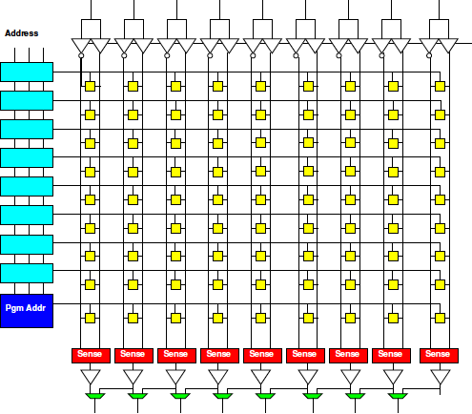
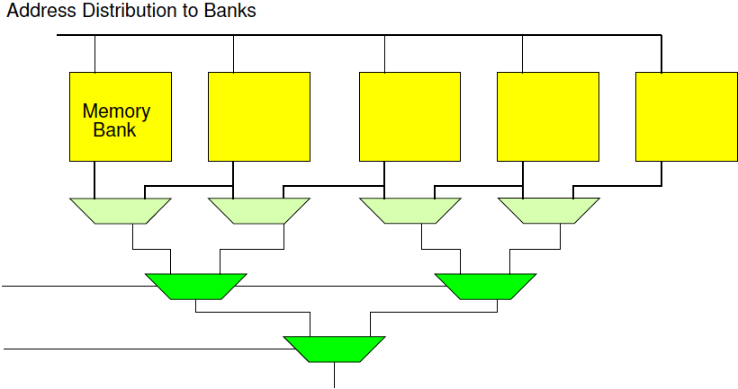
Memory Techniques
Row Redundancy
Column Redundancy
Bank Redundancy

Slide 37
Yield M of N
Preclass 5: Probability of yielding 3 of 5 things?
  Symbolic?
  Numerical for P_{g}=0.9?

Slide 38
Yield M of N
P(M of N) = P(yield N)
  (N choose N-1) P(exactly N-1)
  (N choose N-2) P(exactly N-2)…
  (N choose N-M) P(exactly N-M)…
  [think binomial coefficients]

Slide 39
M of 5 example
1*P⁵ + 5*P⁴(1-P)¹+10P³(1-P)²+10P²(1-P)³+5P¹(1-P)⁴ + 1*(1-P)⁵
Consider P=0.9
  1*P⁵ 0.59 M=5 P(sys)=0.59
  5*P⁴(1-P)¹ 0.33 M=4 P(sys)=0.92
  10P³(1-P)² 0.07 M=3 P(sys)=0.99
  10P²(1-P)³ 0.008
  5P¹(1-P)⁴ 0.00045
  1*(1-P)⁵ 0.00001
Can achieve higher
system yield than
individual components!

Slide 40
Possible Yield of 76 cores@ P=0.9
Processors Yield | Prob Exact | Prob at least
76 | 0.001 | 0.001
75 | 0.004 | 0.005
74 | 0.016 | 0.020
73 | 0.041 | 0.061
72 | 0.079 | 0.140
71 | 0.119 | 0.259
70 | 0.148 | 0.407
69 | 0.156 | 0.562
68 | 0.141 | 0.704
67 | 0.112 | 0.816
66 | 0.079 | 0.895
65 | 0.050 | 0.945
64 | 0.028 | 0.973

Slide 41
Possible Yield of 76 cores@ P=0.9
Processors Yield | Prob at least
76 | 0.001
75 | 0.005
74 | 0.020
73 | 0.061
72 | 0.140
71 | 0.259
70 | 0.407
69 | 0.562
68 | 0.704
67 | 0.816
66 | 0.895
65 | 0.945
64 | 0.973
Out of 100 chips,
how many?
Sell with 72:
Sell with 68:
Sell with 64:
Discard:

Slide 42
Intel Xeon Phi Pricing

Slide 43
Repairable Area
Not all area in a RAM is repairable
  memory bits spare-able
  io, power, ground, control not redundant

Slide 44
Repairable Area
P(yield) = P(non-repair) * P(repair)
P(non-repair) = P^{Nnr}
  N_{nr}<<N_{total}
  P > P_{repair}
    e.g. use coarser feature size
    Differential reliability
P(repair) ~ P(yield M of N)

Slide 45
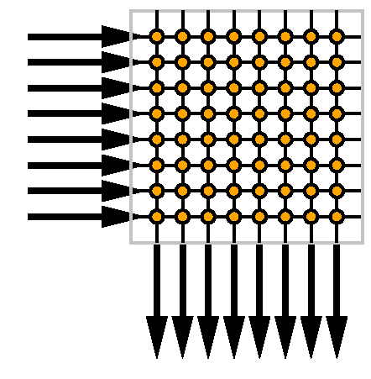
Consider a Crossbar
Allows us to connect any of N things to each other
  E.g.
    N processors
    N memories
    N/2 processors
    N/2 memories

Slide 46
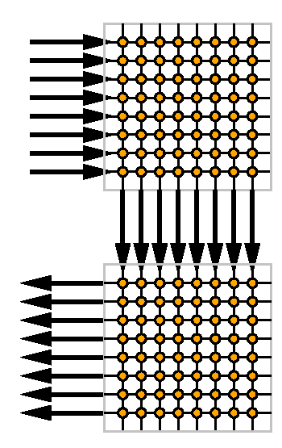
Crossbar Buses and Defects
Two crossbar multibus
Wires may fail
Switches may fail
How tolerate
  Wire failures between
  crossbars?
  Switch failures?

Slide 47
Crossbar Buses and Defects
Two crossbars
Wires may fail
Switches may fail
Provide more wires
  Any wire fault avoidable
    M choose N

Slide 48
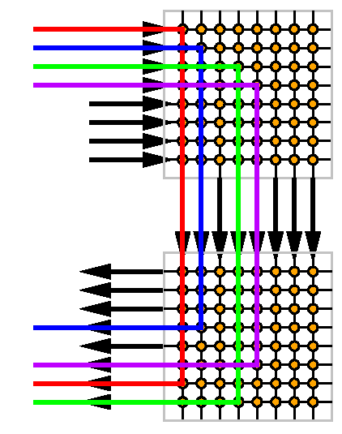
Crossbar Buses and Defects
Two crossbars
Wires may fail
Switches may fail
Provide more wires
  Any wire fault avoidable
    M choose N

Slide 49
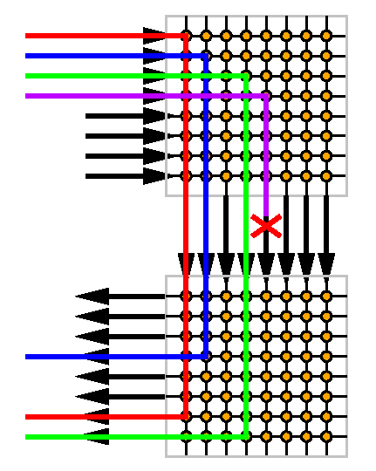
Crossbar Buses and Faults
Two crossbars
Wires may fail
Switches may fail
Provide more wires
  Any wire fault avoidable
    M choose N

Slide 50
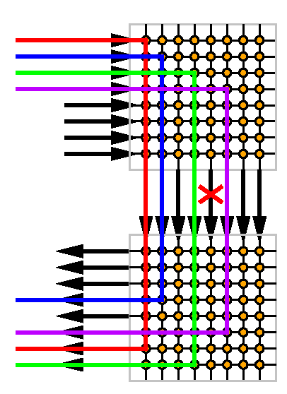
Crossbar Buses and Faults
Two crossbars
Wires may fail
Switches may fail
Provide more wires
  Any wire fault avoidable
    M choose N
  Same idea

Slide 51
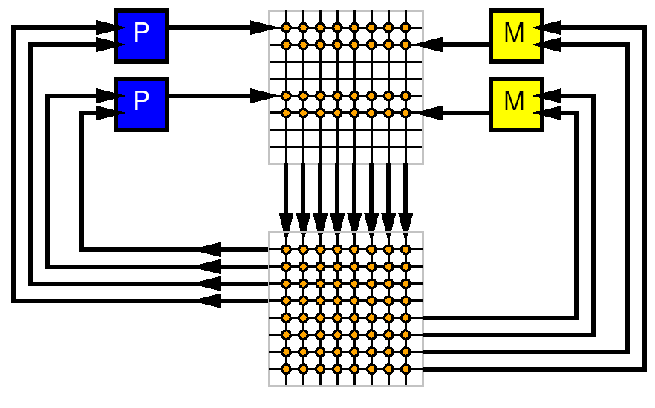
Simple System
P Processors
M Memories
Wires
Memory, Compute, Interconnect

Slide 52
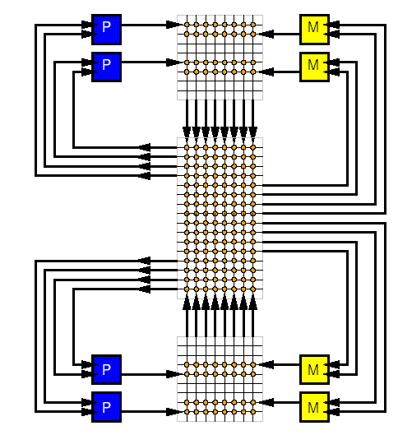
Simple System w/ Spares
P Processors
M Memories
Wires
Provide spare
  Processors
  Memories
  Wires

Slide 53
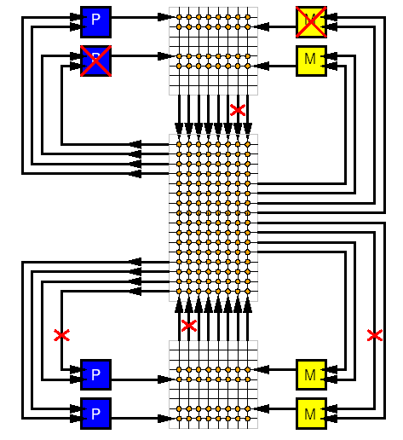
Simple System w/ Defects
P Processors
M Memories
Wires
Provide spare
  Processors
  Memories
  Wires
...and defects

Slide 54
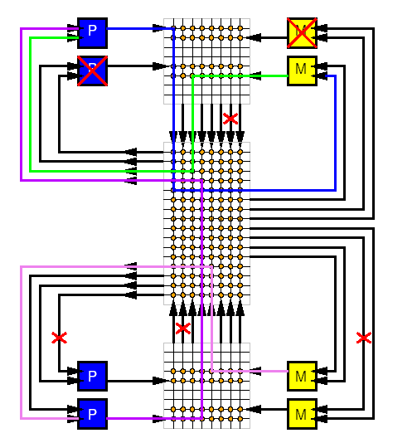
Simple System Repaired
P Processors
M Memories
Wires
Provide spare
  Processors
  Memories
  Wires
Use crossbar to switch together good processors and memories

Slide 55
Simple System Repaired
What are the costs?
  Area
  Energy
  Delay

Slide 56
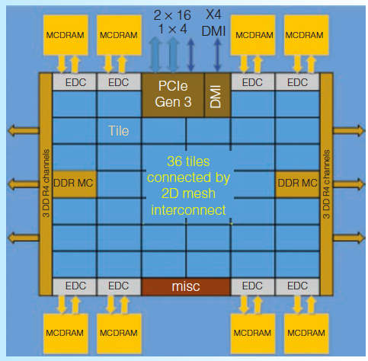
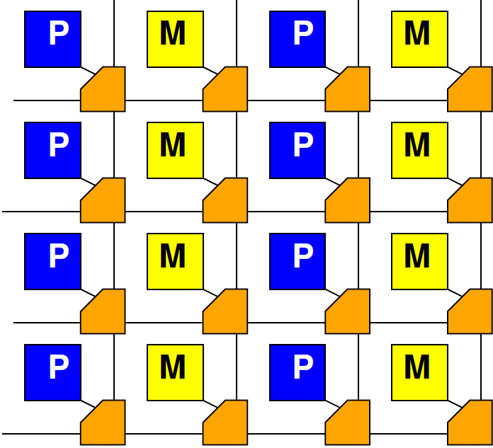
In Practice
Crossbars are inefficient
Use switching networks with
  Locality
  Segmentation
…but basic idea for sparing
is the same

Slide 57
FPGAs

Slide 58
Modern FPGA
Has 10,000 to millions of LUTs
Hundreds to thousands of
  Memory banks
  Multipliers
Reconfigurable interconnect

Slide 59
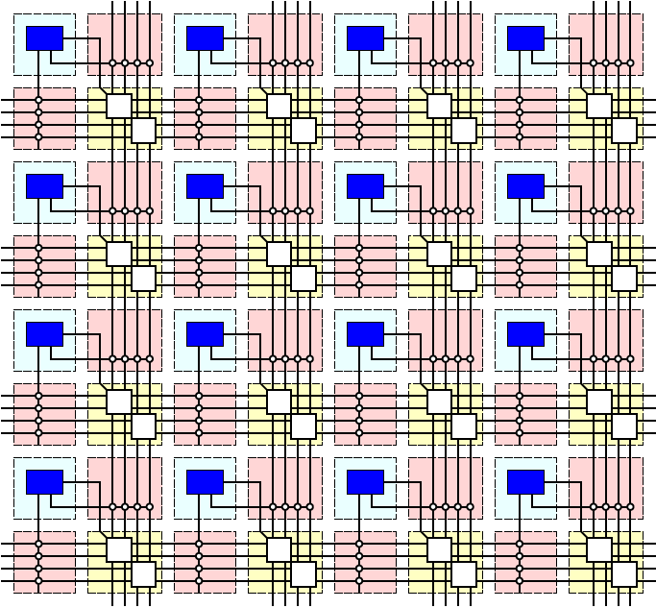
XC7Z020
6-LUTs: 53,200
DSP Blocks: 220
  18x25 multiply,
  48b accumulate
Block RAMs: 140
  36Kb
  Dual port
  Up to 72b wide

Slide 60
Modern FPGA
Has 10,000 to millions of gates
Hundreds to thousands of
  Memory banks
  Multipliers
Reconfigurable interconnect
If a few resources don’t work
  avoid them

Slide 61
Granularity
How do transistors compare between
6-LUT and 64b processor core?
  [qualitative or ballpark]
Yield of 6-LUTs vs. processor cores?
Resources lots per transistor defect?

Slide 62
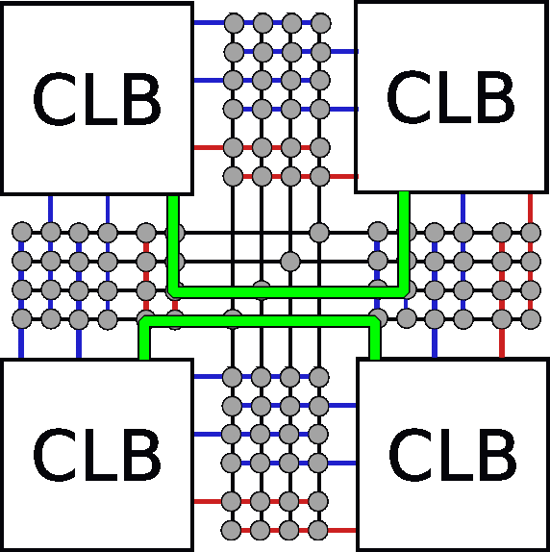
Interconnect Defects
Route around interconnect defects

Slide 63
Defect-Level Viable with FPGAs
Fine-grained repair
Avoiding routing defects
  Tolerates >20% switch defects
[Rubin/unpublished]

Slide 64
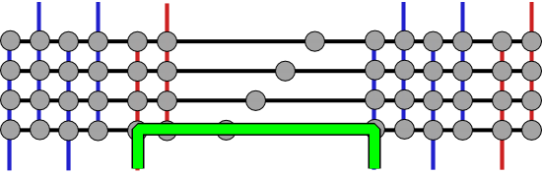
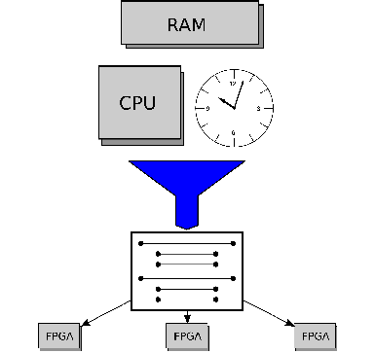
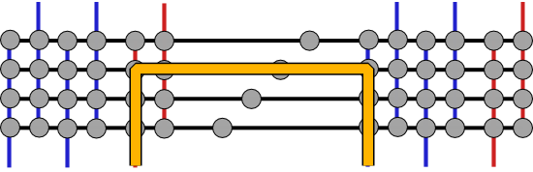
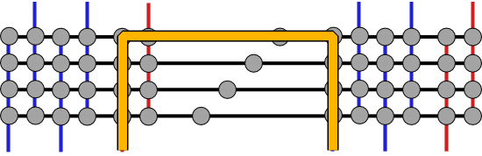
Choose Your own Adventure
Idea: Precompute Alternate mappings
  Still just one bitstream
[Rubin, FPGA 2008]

Slide 65
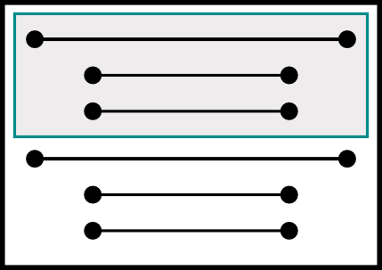
Select Alternatives at Load Time
Examine path
  Configure
  Test
    Good: skip to next net
    Bad: grab next path

Slide 66
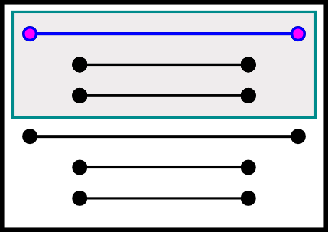
Loading
Examine path
  Configure
  Test
    Good: skip to next net
    Bad: grab next path

Slide 67
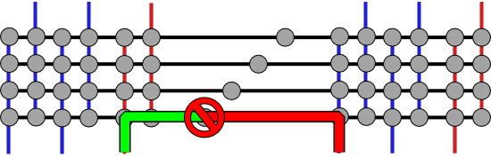
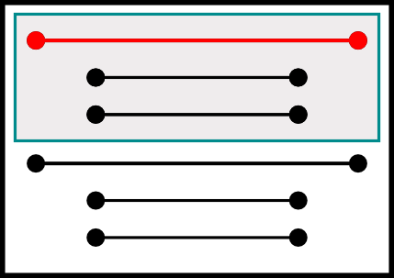
Loading
Examine path
  Configure
  Test
    Good: skip to next net
    Bad: grab next path

Slide 68
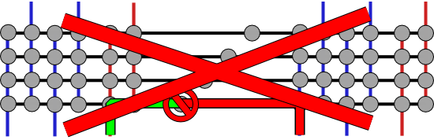
Loading
Examine path
  Configure
  Test
    Good: skip to next net
    Bad: grab next path

Slide 69
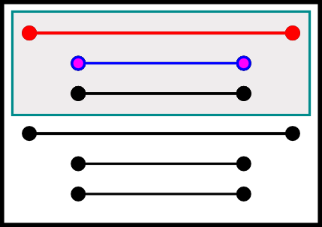
Loading
Examine path
  Configure
  Test
    Good: skip to next net
    Bad: grab next path

Slide 70
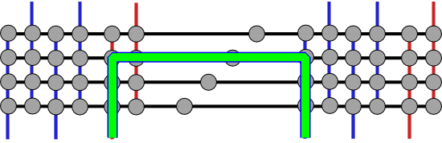
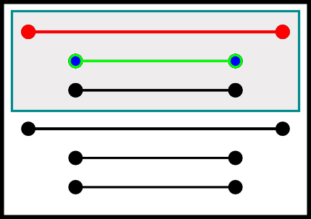
Loading
Examine path
  Configure
  Test
    Good: skip to next net
    Bad: grab next path

Slide 71
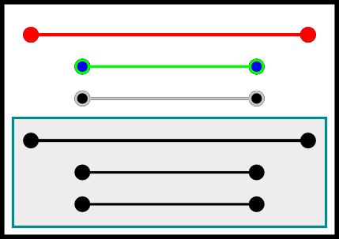
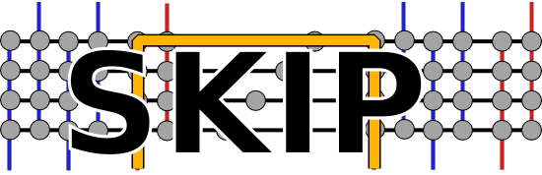
Loading
Examine path
  Configure
  Test
    Good: skip to next net
    Bad: grab next path

Slide 72
FPGAs
Variation and Energy

Slide 73
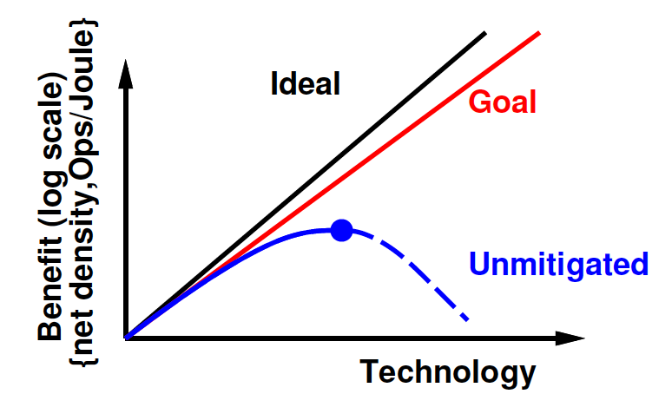
Variation threatens
E/Op reduction
Black nominal
Grey with variation
Min-Energy for multiplication (typically subthreshold)
[Bol et al., IEEE TR VLSI Sys 17(10):1508—1519]

Slide 74
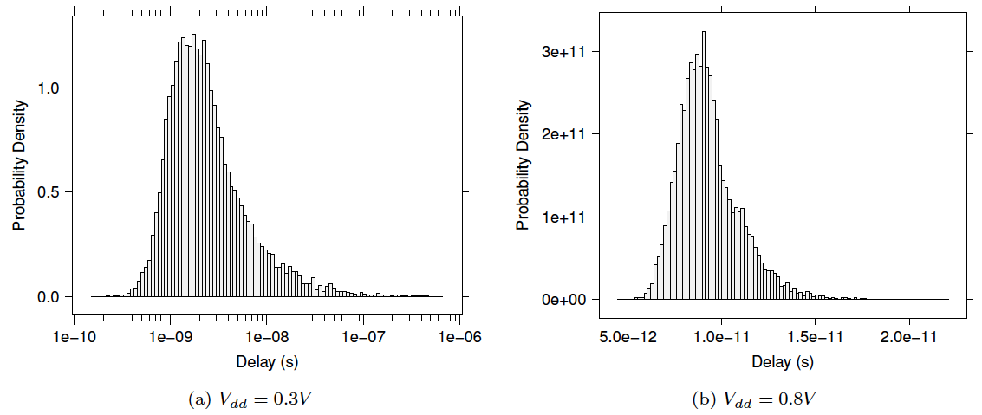
Driven by Tails
PDF
V_{th}
High margins driven by uncommon tails
  Most devices much better
Large device count → sample further into tails
Mehta 2012: 22nm PTM LP – 10,000 samples

Slide 75
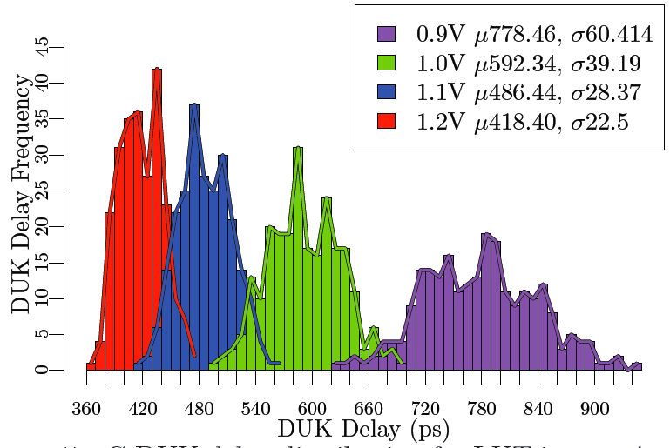
Variation
Modern ICs are like Snowflakes
  Each one is different
[Gojman, FPGA2013]

Slide 76
Driven by Tails
PDF
V_{th}
Given high defect tolerance, what can I do with the devices in the tails?
Mehta 2012: 22nm PTM LP – 10,000 samples

Slide 77
Variation Tolerance
Idea: assign resources, post fabrication to compensate for variations
Opportunity:
  Balance fast paths and slow paths
  Assign slow resources to non-critical paths
  Avoid devices in uncommon tails
  Scale voltage down more aggressively
Fixed design limited to worst-case path
  Must scale voltage up so path meets timing
Paradigm shift: Component-specific mapping

Slide 78
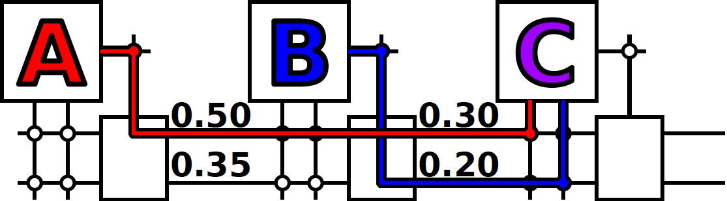
Variation Challenge
Use of high V_{th} resource forces high supply voltage (V_{dd}) to meet timing requirement
Delay: CV/I and I goes as (V_{dd}-V_{th})²

Slide 79
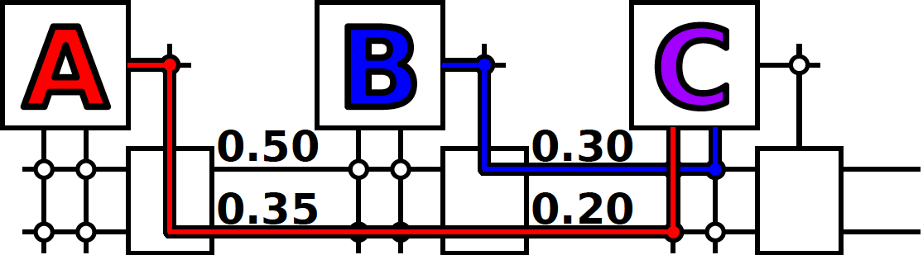
Component-Specific
Avoid high V_{th} resource
Allow lower supply voltage (V_{dd}) to meet timing requirement
Delay: CV/I and I goes as (V_{dd}-V_{th})²

Slide 80
Component-Specific Assignment
Could come out other way
  Best mapping unique to component

Slide 81
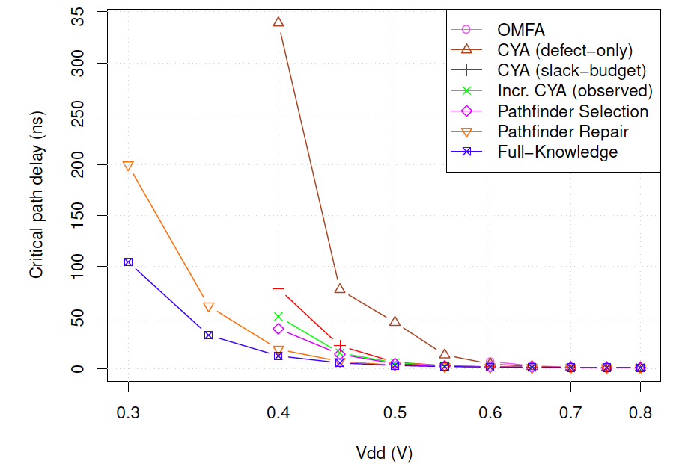
Knowledge Mapping and Voltage-Delay
[Giesen, FPGA 2017]

Slide 82
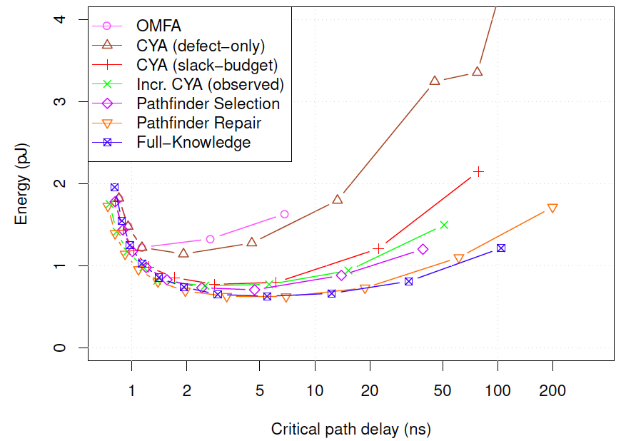
Energy vs. Delay
[Giesen, FPGA 2017]

Slide 83
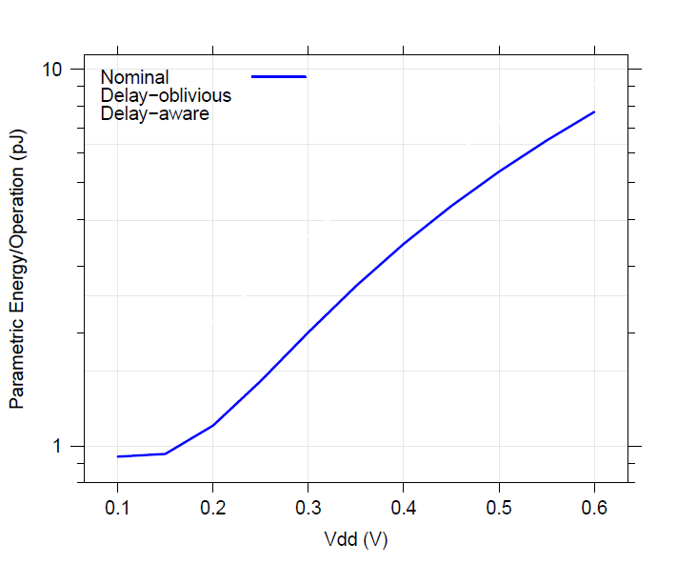
Energy vs V_{dd} (des)
Nominal uses minimum size
[Mehta, FPGA 2012]

Slide 84
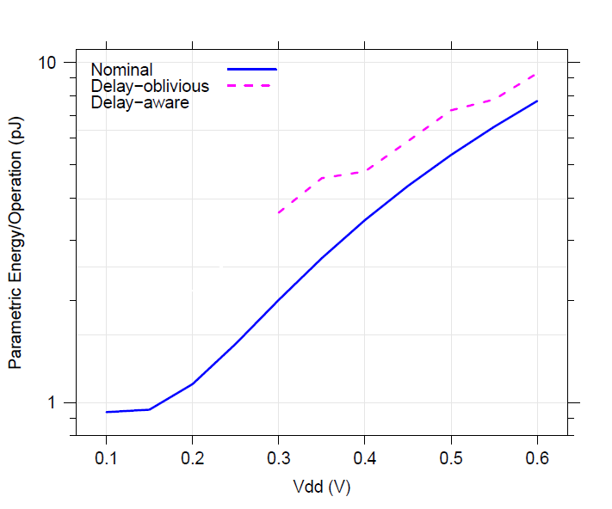
Energy vs V_{dd} (des)
Nominal uses minimum size
Energy
Margin
[Mehta, FPGA 2012]

Slide 85
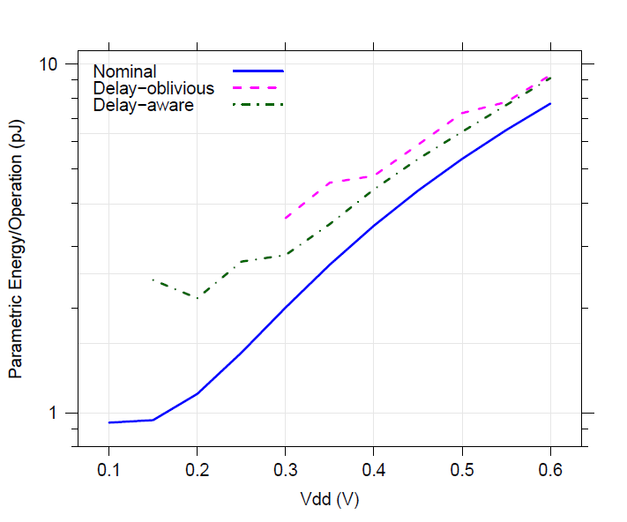
Energy vs V_{dd} (des)
Nominal uses minimum size
Delay-aware routing reduces energy margins
  Smaller sizes
Energy
Savings
(Sizing)
[Mehta, FPGA 2012]

Slide 86
Energy vs V_{dd} (des)
Nominal uses minimum size
Delay-aware routing reduces energy margins
  Smaller sizes
  Lower voltages
Energy
Savings
(Vdd)
[Mehta, FPGA 2012]

Slide 87
Energy vs V_{dd} (des)
Nominal uses minimum size
Delay-aware routing reduces energy margins
  Smaller sizes
  Lower voltages
  Less Leakage
Energy
Savings
(Total)
[Mehta, FPGA 2012]

Slide 88
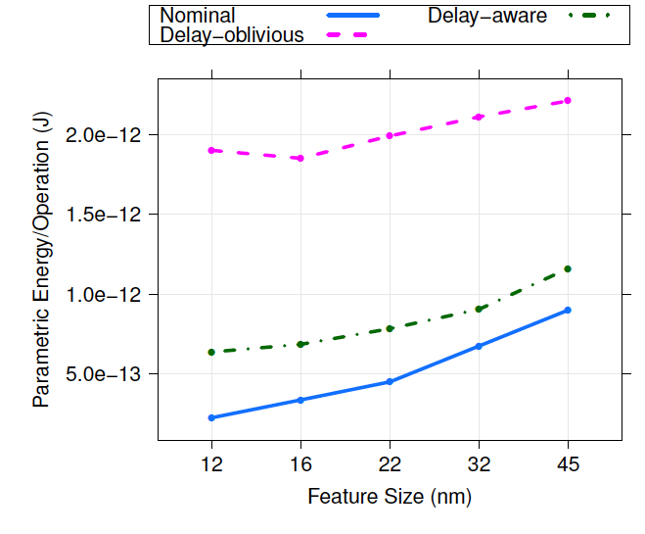
Minimum Energy vs Technology
6
Delay-oblivious scales to 16nm
Delay-aware scales to 12nm at least….
Extend useful life of Silicon technology generation
5
4
Energy Increase
Energy Increase
3
2
Energy Decrease
1
[Mehta PhD thesis 2012 (refined from FPGA 2012)]

Slide 89
Big Ideas
At small feature sizes, not viable to demand perfect fabrication of billions of transistors on a chip
Modern ICs are like snowflakes
  Everyone is different, changes over time
Reconfiguration allows repair
  Finer grain → higher defect rates
  Tolerate variation → lower energy

Slide 90
Admin
Final Project Report
  Due Friday

