Slide 1

ESE532:
System-on-a-Chip Architecture
Day 25: April 19, 2017
Fault Tolerance

Slide 2
Today
Fault Sources
Fault Tolerance
  Memories
  Interconnect
  Compute

Slide 3
Message
At small feature sizes, voltages, and high speed, not viable or economical to demand perfect operation across billions and trillions of operations
Little redundancy can go a long way
For large systems, reliability must be engineered
  …all systems are becoming large

Slide 4
Reminder

Slide 5
Simple Implications: P_{good}=P_{g}^{N}
As N gets large
  must either increase reliability
  …or start tolerating failures
N
  memory bits
  disk sectors
  wires
  transmitted data bits
  processors
  transistors
  molecules
As devices get smaller, failure rates increase
chemists think P=0.95 is good
As devices get faster, failure rate increases

Slide 6
Three Problems
Defects: Manufacturing imperfection
  Occur before operation; persistent
    Shorts, breaks, bad contact
Transient Faults:
  Occur during operation; transient
    node X value flips: crosstalk, ionizing particles, bad timing, tunneling, thermal noise
Lifetime “wear” defects
  Parts become bad during operational lifetime
    Fatigue, electromigration, burnout….
  …slower
    NBTI, Hot Carrier Injection

Slide 7
Faults
Bits, processors, wires
  May fail during operation
Basic Idea same:
  Detect failure using redundancy
  Correct
Now
  Must identify and correct online with the computation

Slide 8
Fault Sources

Slide 9
Transient Sources
Effects
  Thermal noise
  Supply voltage noise
  Timing
  Ionizing particles
    α particle 10⁵ to 10⁶ electrons
      Discharge DRAM cell (multiple)
    Gates with 15—30 electrons
      Even if CMOS restores, takes time

Slide 10
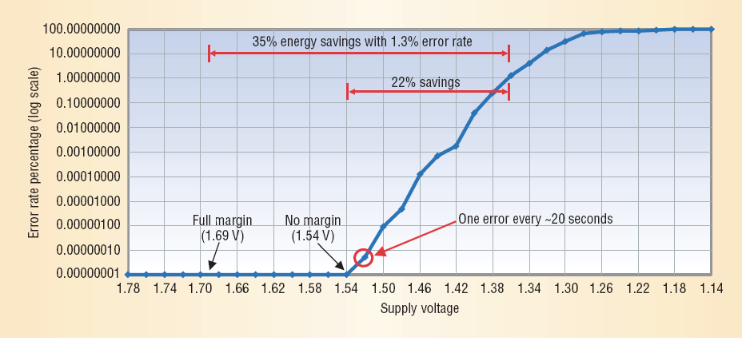
Voltage and Error Rate
[Austin et al.--IEEE Computer, March 2004]

Slide 11
Scaling and Error Rates
Increasing Error Rates
10
2X bit/latch count increase per generation
logic
SEU/bit Norm to 130nm
cache
arrays
1
180
130
90
65
45
32
Technology (nm)
Source: Carter/Intel
11

Slide 12
Errors versus Frequency
V_{CC} & Temperature
F_{CLK} Guardband
Resilient Design
Max TP
Conventional Design
Max TP
[Bowman, ISSCC 2008]

Slide 13
Memory

Slide 14
Simple Memory Example
Problem: bits may lose/change value
  Alpha particle
  Molecule spontaneously switches
Idea:
  Store multiple copies
  Perform majority vote on result

Slide 15
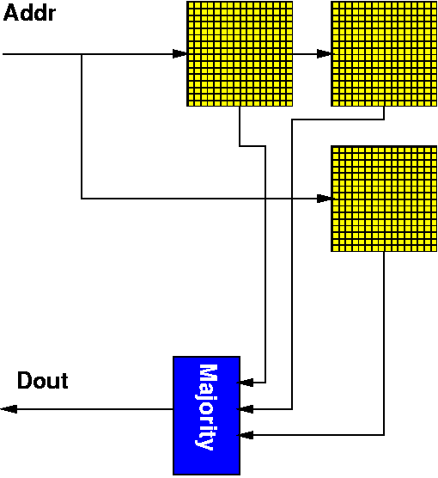
Redundant Memory

Slide 16
Redundant Memory
Like M-choose-N
Only fail if >(N-1)/2 faults
P=0.9
Preclass: P(2 of 3)?

Slide 17
Redundant Memory
Like M-choose-N
Only fail if >(N-1)/2 faults
P=0.9
P(2 of 3)
  All good: (0.9)³ = 0.729
  Any 2 good: 3(0.9)²(0.1)=0.243
  0.971

Slide 18
Redundant Memory
Unsatisfying
  Costs 3x (5x, 7x…) area
  …and energy
How can we do better?
  Less overhead?

Slide 19
Better: Less Overhead
Don’t have to keep N copies
Block data into groups
Add a small number of bits to detect/correct errors

Slide 20
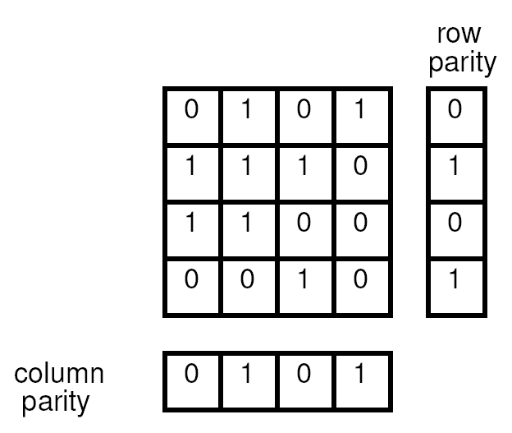
Row/Column Parity
Think of NxN bit block as array
Compute row and column parities
  (total of 2N bits)

Slide 21
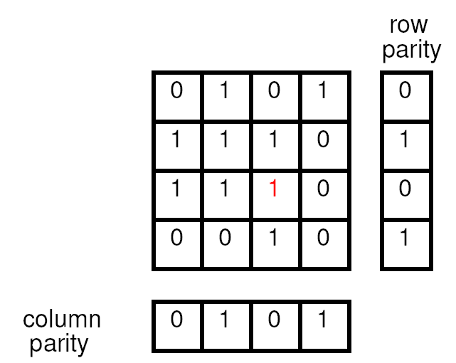
Row/Column Parity
Think of NxN bit block as array
Compute row and column parities
  (total of 2N bits)
Any single bit error

Slide 22
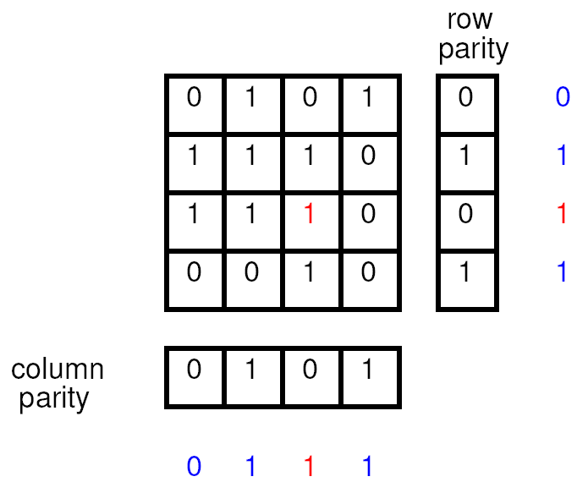
Row/Column Parity
Think of NxN bit block as array
Compute row and column parities
  (total of 2N bits)
Any single bit error
By recomputing parity
  Know which one it is
  Can correct it

Slide 23
Preclass Exercise
Which Block has an error?
What correction do we need?

Slide 24
Row/Column Parity
Simple case is 50% overhead
  Add 8 bits to 16
  Better than 200%
  with 3 copies
  Overhead drop
  with block size
    How scale?
  More expensive
  than used in practice

Slide 25
In Use Today
Conventional DRAM Memory systems
  Use 72b ECC (Error Correcting Code)
  On 64b words [12.5% overhead]
  Correct any single bit error
  Detect multibit errors
CD and flash blocks are ECC coded
  Correct errors in storage/reading
Learn More: ESE 676

Slide 26
Data Storage

Slide 27
CETS ENIAC Cluster
Holds your home directory
…and faculty and research data
Stored on cluster of hard drives
  Crude guess ~ 1000

Slide 28
Preclass 4
Assume 300,000 hour MTBF/disk
Expected number of disk failures/year for cluster of 1000?

Slide 29
RAID
Redundant Array of Inexpensive Disks
Disk drives have ECC on sectors
  At least enough to detect failure
RAID-5 has one parity disk
  Tolerate any single disk failure
    Parity enough to reconstruct when know which disk failed (technical term: Erasure code)
  E.g. 8-of-9 survivability case
  With hot spare, can rebuild data on spare

Slide 30
Interconnect

Slide 31
Gigabit Ethernet
1000BASE-T
CAT-5 cables
Specifies: Bit Error Rate (BER) <10⁻¹⁰
TCP/IP Packet ~ 1500Bytes
  Call is 1250 to make math easy
Probability of packet corruption?
After takes 10 network hops?
Errors in 2 hour movie?

Slide 32
Interconnect
Also uses checksums/ECC
  Guard against data transmission errors
  Environmental noise, crosstalk, trouble sampling data at high rates…
Often just detect error
Recover by requesting retransmission
  E.g. TCP/IP (Internet Protocols)

Slide 33
Interconnect
Also guards against whole path failure
Sender expects acknowledgement
If no acknowledgement will retransmit
If have multiple paths
  …and select well among them
  Can route around any fault in interconnect

Slide 34
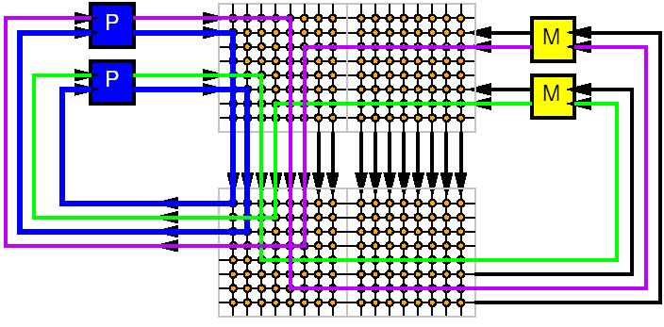
Interconnect Fault Example
Send message
Expect Acknowledgement

Slide 35
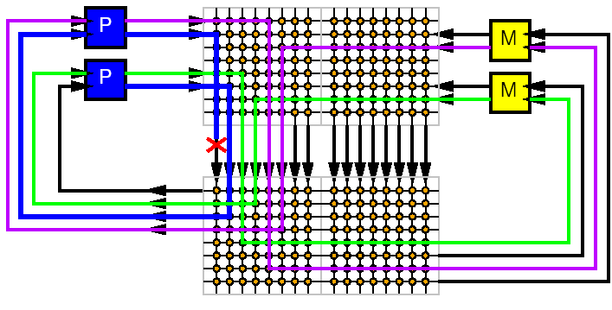
Interconnect Fault Example
Send message
Expect Acknowledgement
If Fail

Slide 36
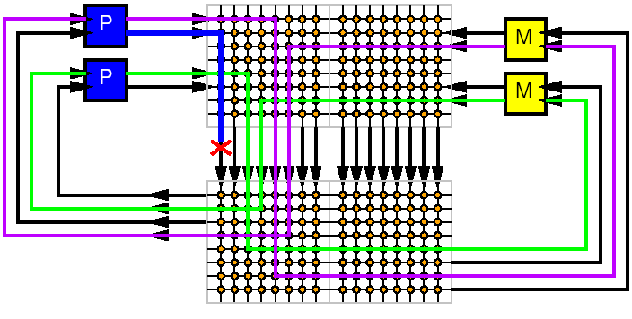
Interconnect Fault Example
Send message
Expect Acknowledgement
If Fail
  No ack

Slide 37
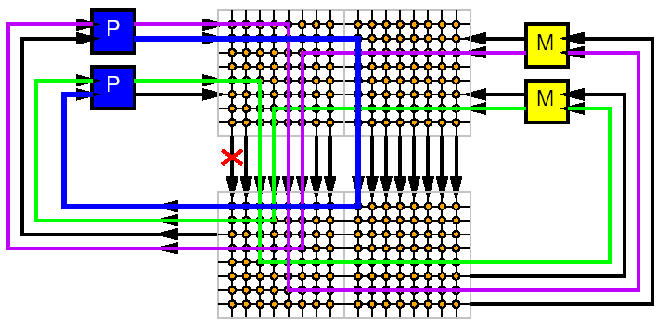
Interconnect Fault Example
If Fail → no ack
  Retry
  Preferably with different resource

Slide 38
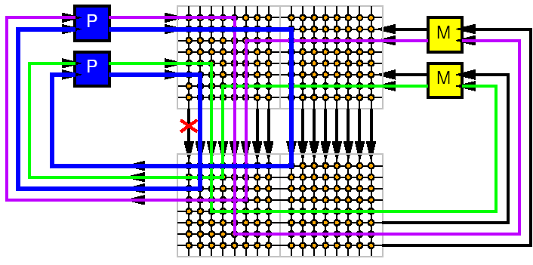
Interconnect Fault Example
If Fail → no ack
  Retry
  Preferably with different resource
Ack signals success

Slide 39
Compute

Slide 40
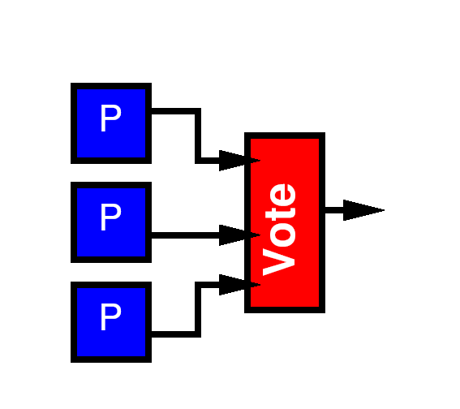
Compute Elements
Simplest thing we can do:
  Compute redundantly
  Vote on answer
  Similar to redundant memory

Slide 41
Compute Elements
Unlike Memory
  State of computation important
  Once a processor makes an error
    All subsequent results may be wrong
Response
  “reset” processors which fail vote
  Go to spare set to replace failing processor

Slide 42
In Use
NASA Space Shuttle
  Uses set of 4 voting processors
Boeing 777
  Uses voting processors
    Uses different architectures for processors
    Uses different software
    Avoid Common-Mode failures
      Design errors in hardware, software

Slide 43
Forward Recovery
Can take this voting idea to gate level
  VonNeuman 1956
Basic gate is a majority gate
  Example 3-input voter
Alternate stages
  Compute
  Voting (restoration)
Number of technical details…
High level bit:
  Requires P_{gate}>0.996
  Can make whole system as reliable as individual gate

Slide 44
Detect / Correct

Slide 45
Correction
Forward error correction with voting
unsatisfying
Paying 3x (5x, 7x, …)
  Area
  Energy

Slide 46
Detect vs. Correct
Detection is cheaper than correction
Redundancy: To handle k-faults
  Voting correction requires 2k+1
    K=1 → 3
  Detection requires k+1
    K=1 → 2
Computation
  E.g.: Sorting (N*log(N)) vs.
  check in sorted order (N)

Slide 47
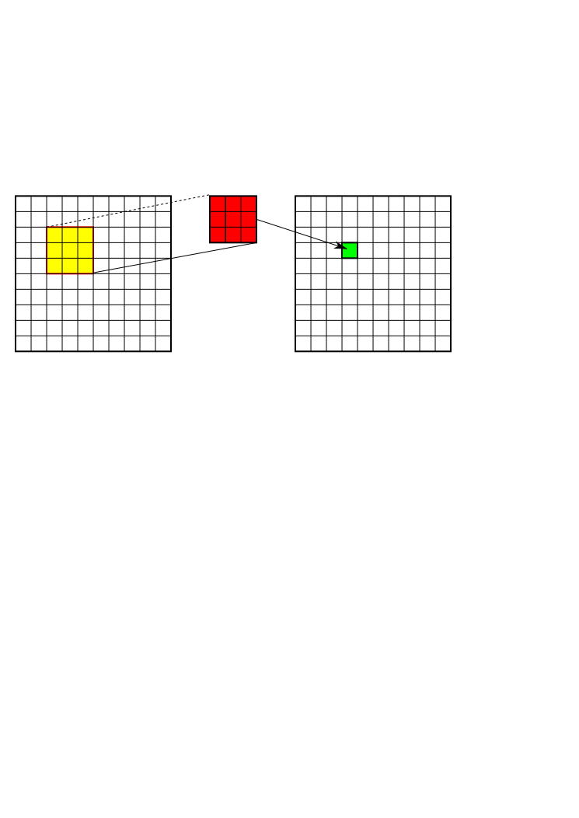
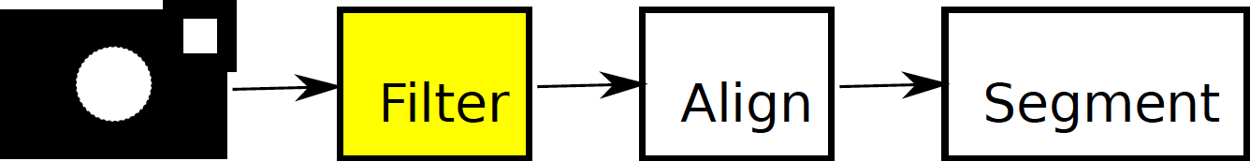
2D Window Filtering
Compute output image as weighted sum of pixels
  Demosaic
  Gaussian filter
Weight of subregion proportional to weight of original
  Except edging effects
E.g. 3x3 window with no zeros
C_{mpy}/C_{add}=10
Check/Compute = 2/99 ~= 2%

Slide 48
Rollback Recovery
Commit state of computation at key points
  to memory (ECC, RAID protected...)
  …reduce to previously solved problem of protecting memory
On faults (lifetime defects)
  recover state from last checkpoint
  like going to last backup….
  …(snapshot)

Slide 49
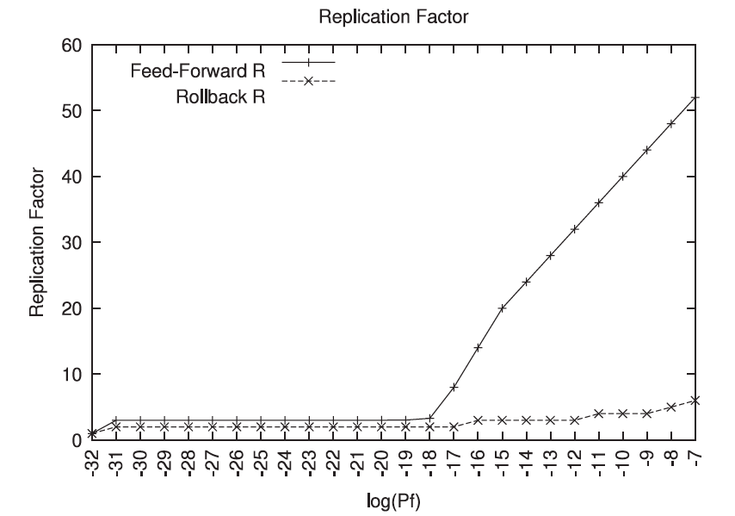
Rollback vs. Forward
[Naeimi, Nanotechnology 2008]

Slide 50
Networking, Data Center

Slide 51
Cloud Providers
How does Google deal with millions of simultaneous user search requests?
What effect of one computer crashing in their cloud?

Slide 52
Google (2008)
Building block 1800 server cluster
In each cluster’s first year, it’s typical that
  1,000 individual machine failures will occur;
  thousands of hard drive failures will occur;
  … and there’s about a 50 percent chance that the cluster will overheat, taking down most of the servers in less than 5 minutes and taking 1 to 2 days to recover.
http://www.datacenterknowledge.com/archives/2008/05/30/failure-rates-in-google-data-centers/

Slide 53
Defect vs. Fault Tolerance
Defect
  Can tolerate large defect rates (10%)
    Use virtually all good components
    Small overhead beyond faulty components
Fault
  Require lower fault rate (e.g. VN <0.4%)
    Overhead to do so can be quite large

Slide 54
Summary
Possible to engineer practical, reliable systems from
  Imperfect fabrication processes (defects)
  Unreliable elements (faults)
We do it today for large scale systems
  Memories (DRAMs, Hard Disks, CDs)
  Internet
  Multiprocessor chips
  Data Centers
…and critical systems
  Space ships, Airplanes
Engineering Questions
  Where invest area/effort?
    Higher yielding components? Tolerating faulty components?

Slide 55
Big Ideas
Left to itself:
  reliability of system << reliability of parts
Can design
  system reliability >> reliability of parts [defects]
  system reliability ~= reliability of parts [faults]
For large systems
  must engineer reliability of system
  …all systems becoming “large”

Slide 56
Admin
Final Project Report
  Due Friday
Collect Zed Boards
  Class Monday 4/24

