Slide 1
ESE532: System-on-a-Chip Architecture
Day 26: April 24, 2017
Security

Slide 2
Today
Security Issues
Memory
Input
Output
Cryptography

Slide 3
Message
SoC Designers need to be concerned about security
Hazards are real, understandable
Avoidable, tricky…
Things that make it easier and harder than general-purpose, best-effort
Consider CIS331, CIS551

Slide 4
Security Issues
What security issues arise for the SoC designer and applications?
What make easier / less of an issue?
What make harder or more important?

Slide 5
Sensationalism
Target data breach
Millions of credit cards; enter through HVAC
Car Hacks
Take over brakes, speed, …
DDoS
Through networks devices/IoT

Slide 6
Potential Security Concerns Arise
Bug free program
with no input
and no output,
might have no security concerns
…but could it do anything?
…uintended outputs?

Slide 7
Security Concern Sources
Bugs – may allow program subversion
Make it do something designer not intend
Inputs – Allow attacker manipulate
Trust inputs?
Cause system to crash?
Poke bug to change data or run code
Outputs – Give information
Limit to intended recipients?
Extract secrets (including keys)

Slide 8
Issues
Confidentiality
Secrets remain secrets
Integrity
Data and code not changed
Only controls as intended
Availability
Continues to perform intended function

Slide 9
SoC Challenge
Embedded systems interact with physical world
Control may cause physical (life-critical) damage
Sensing may make physical information available
Networks components
Exposed to world at large
Attacks, spoofing, monitoring, crash, DoS

Slide 10
SoC Opportunity
Run small, fixed set of software
Few Lines-of-Code (LoC)
Not need to run arbitrary user-supplied code
Handle constrained input
Not arbitrary, unstructured user input?

Slide 11
Bug Rates
Industry average is 15—50 bugs per 1000 LoC
Remained true for decades
Not all exploitable
Google Chrome 380 in 6M LoC~0.06
CVSS>=7
Firefox 395 in 8M LoC~0.05
Cannot assume program is bug free
Especially if it is large
https://security.stackexchange.com/questions/21137/average-number-of-exploitable-bugs-per-thousand-lines-of-code

Slide 12
Raw Bits
Where do we store instructions, stack, heap, integers, floating-point values, pointers?

Slide 13
Memory

Slide 14
Memory Contents
Instructions
Data
Data structures
Pointers
Program call graph
Stack

Slide 15
Memory Contents
Instructions
Data
Data structures
Pointers
Program call graph
Stack
How tell them apart?

Slide 16
Stored Program Processor
Instructions stored in memory
One big, undifferentiated memory
Containing instructions, data, stack, heap…
Powerful
Loading in new programs
Generating new code at runtime
Flexible division of memory space
Dangerous…

Slide 17
C
C allows construction of arbitrary pointers
int *ptr = (int *)0x1000;
ptr[3]=0x0773;
…and references beyond the end of pointers
int data[100];
data[2376]=0x0aa734;
data[-578]=0xffff348c;

Slide 18
Dangerous
Bugs may scribble over memory
Violate integrity of code or data
…or, allow attacker to access or write memory
Pointer that points to unexpected location
Out-of-bounds reference

Slide 19
Very Dangerous
int data[128];
which=read_input();
write_output(data[which]);
What does this allow?

Slide 20
Heartbleed
Attack on SSL
CVE-2014-0160
Could use
User input + lack of bounds checks
To get computers to export secrets
Like cryptography keys

Slide 21
xkcd Heartbleed Explanation
https://xkcd.com/1354/

Slide 22
xkcd Heartbleed Explanation
https://xkcd.com/1354/

Slide 23
xkcd Heartbleed Explanation
https://xkcd.com/1354/

Slide 24
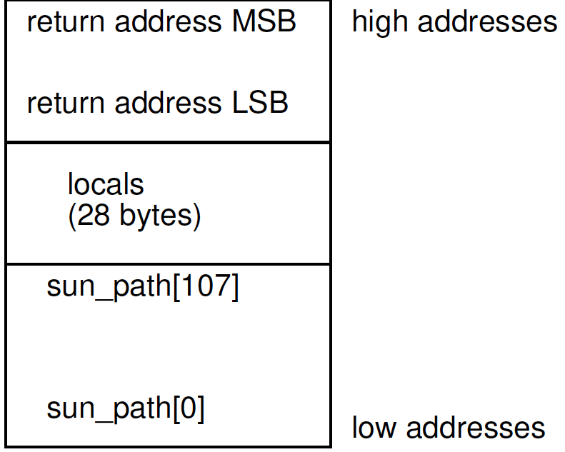
Buffer Attack
int ud_connect(const char *name) {
int fd;
struct sockaddr_un {
sa_family_t sun_family;
char sun_path[108];
} addr;
...
sprintf(addr.sun_path, "%s", name);
...
return fd;
}
What happens if name>108 characters?
> 136?
[Avgerinos, CACM 2014]

Slide 25
Buffer Overflow
Unchecked buffers allow insertion/overwrite of data
Unchecked buffers on stack allow overwrite of data controlling what code you execute
…and maybe even code to execute

Slide 26
http://caspian.paravelsystems.com/pipermail/rivendell-dev/2014-March/020437.html

Slide 27
Defenses
Modern virtual memory systems will set code pages to be unwritable
Can still control which code gets run
Embedded systems without VM don’t have this option
Modern compilers (like gcc) can be instructed to add sanity check code
Stack Guard: Canary data to catch overwrites
Attacker not change canary…

Slide 28
Memory Vulnerability
Raw, undifferentiated memory
Holding code, data, control structures
Accessible from every memory operation
Relying only on absence of out-of-bounds reference bugs to maintain integrity
…enables a host of security vulnerabilities

Slide 29
SoC
Small, differentiated memories in SoC may help
Not live in single, unified address space
Tasks have access to limited, local memory (not everything)
Hardware functions cannot be overwritten

Slide 30
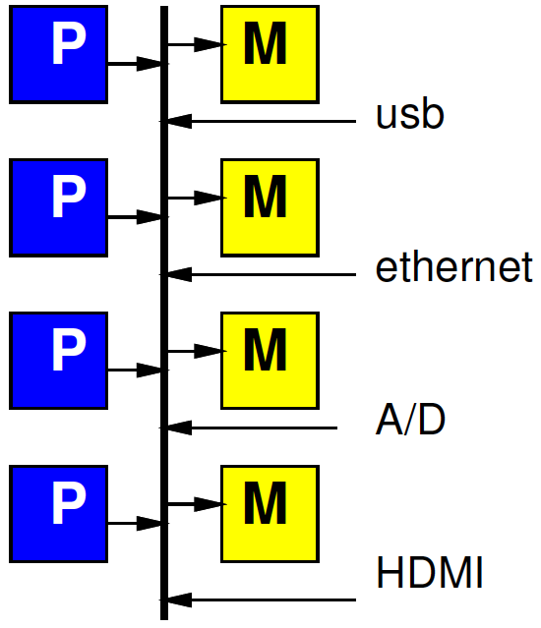
DMA Master
What can a DMA Master do to memory?

Slide 31
DMA
May give USB/firewire/PCI DMA access to memory
Without care can read/write anywhere in memory
Allow malicious peripheral to
Steal data
Compromise integrity

Slide 32
ThunderStrike
Available for: OS X Yosemite v10.10 and v10.10.1,for: MacBook Pro Retina, MacBook Air (Mid 2013 and later), iMac (Late 2013 and later), Mac Pro (Late 2013)
Impact: A malicious Thunderbolt device may be able to affect firmware flashing
Description: Thunderbolt devices could modify the host firmware if connected during an EFI update. This issue was addressed by not loading option ROMs during updates.
CVE-2014-4498 : Trammell Hudson of Two Sigma Investments
https://trmm.net/Thunderstrike_FAQ

Slide 33
Input

Slide 34
Input
Provides an opportunity to poke at system
Exploit vulnerabilities
Directly control system?
Can mislead system
Lie to it

Slide 35
Input and Memory
Memory section illustrates unchecked inputs can exploit vulnerabilities

Slide 36
Input Integrity (xkcd)
https://xkcd.com/327/

Slide 37
Input Data Integrity
Bobby Tables illustrates
Must take care with any inputs that may be used in control
Interpret commands, where branch, specify what operate upon…
As does
data[user_input()]
Heartbleed
Buffer bounds checks

Slide 38
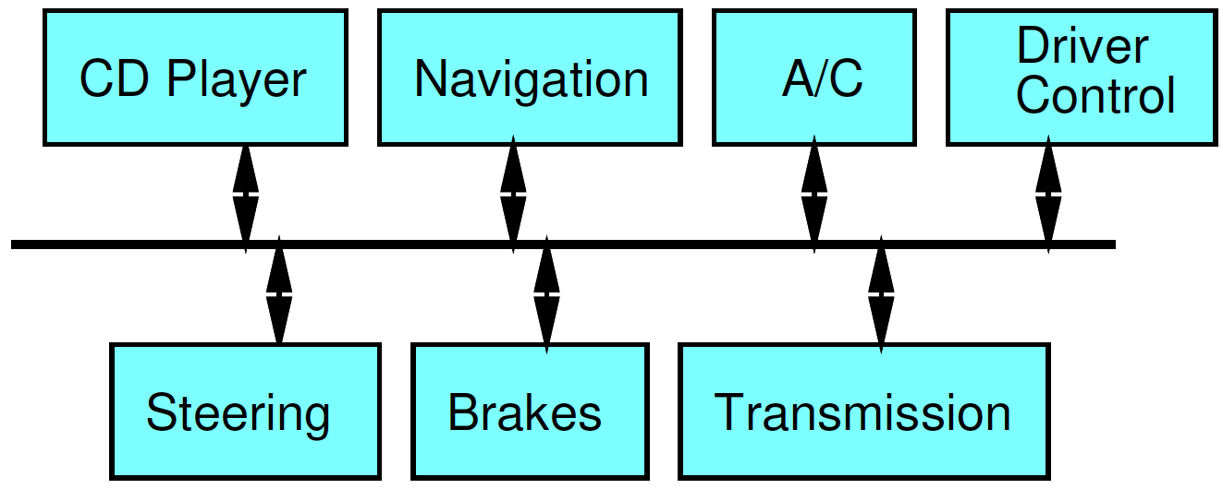
Input Validity
What happens if the CD-player sends a message to the brakes to stop?

Slide 39
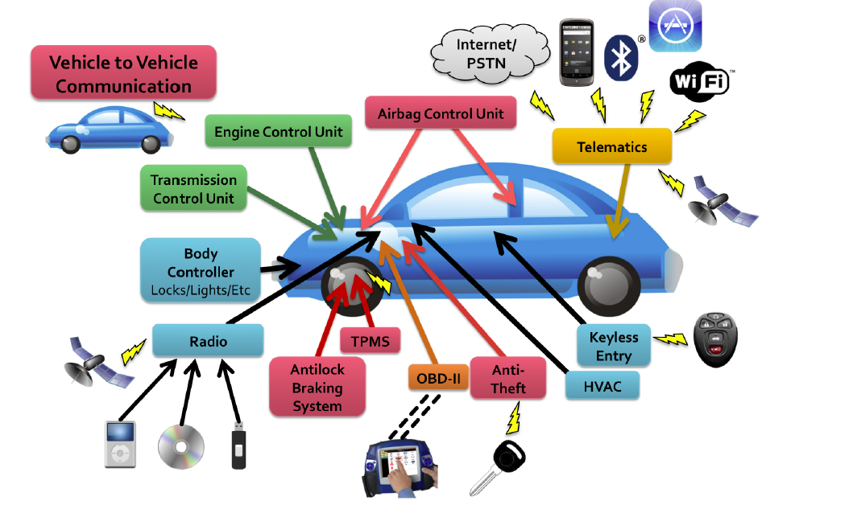
Cars
Modern cars contain many embedded controllers
[Checkoway, Usenix Security 2011]

Slide 40
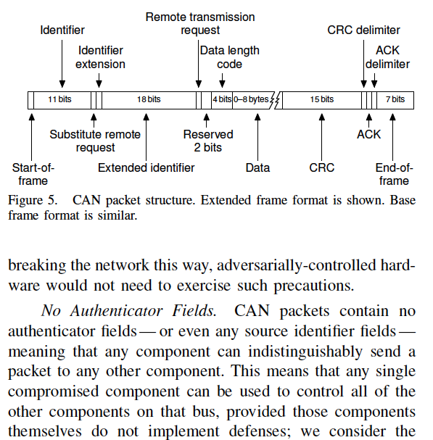
[Koscher, IEEE Security&Privacy 2010]

Slide 41
Result
If you can compromise any unit on the bus (like the MP3 player), can send control messages to any unit

Slide 42
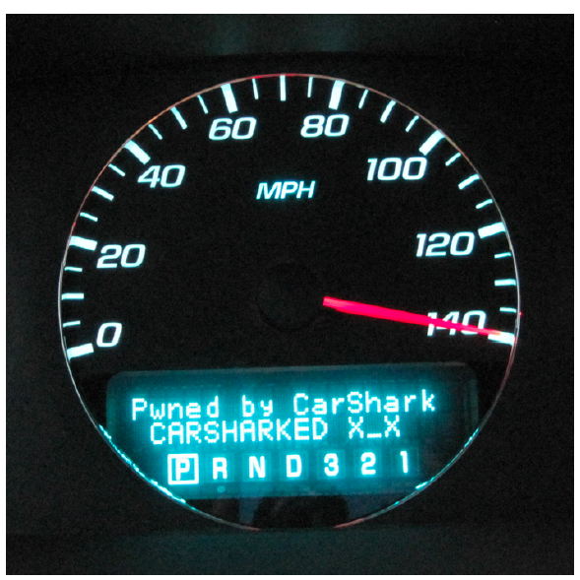
Impact
Were able to control the car
More recent demo 2015 on 60 Minutes
https://news.cs.washington.edu/2015/02/09/watch-uw-cse-and-darpa-hack-a-car-driven-by-60-minutes-leslie-stahl/
[Koscher, IEEE Security&Privacy 2010]

Slide 43
Input Integrity
What could we do to protect against this?

Slide 44
Input Lessons
Need to carefully consider where our inputs come from
and how we know that
If comes from untrustworthy source
Need to validate before use

Slide 45
Output

Slide 46
Output
Who should be able to see the outputs produced?
What outputs is the system producing you may not have intended?
Radio-frequency, power, timing, audio…

Slide 47
AUTHOR: NOAH SHACHTMAN AND DAVID AXE. NOAH SHACHTMAN AND DAVID AXE SECURITY DATE OF PUBLICATION: 10.29.12. 10.29.12 TIME OF PUBLICATION: 4:00 AM. MOST U.S. DRONES OPENLY BROADCAST SECRET VIDEO FEEDS
FOUR YEARS AFTER discovering that militants were tapping into drone video feeds, the U.S. military still hasn’t secured the transmissions of more than half of its fleet of Predator and Reaper drones, Danger Room has learned. The majority of the aircraft still broadcast their classified video streams “in the clear” — without encryption. With a minimal amount of equipment and know-how, militants can see what America’s drones see.
https://www.wired.com/2012/10/hack-proof-drone/

Slide 48
Open Datastreams
…and this is true of most internet connected cameras
Including baby monitors
https://arstechnica.com/security/2015/09/9-baby-monitors-wide-open-to-hacks-that-expose-users-most-private-moments/

Slide 49
Side Channels
Data-dependent behavior may leak information
Timing
Power
Radio Frequency emissions
Ample demonstrations can harvest crypto keys from
Differential power analysis
RF emissions

Slide 50
Timing
How is timing of check related to data?
If attacker can control address alignment of input, how can enhance timing difference?
In demand-fetched memory architecture
for (i=0; i<LEN;i++)
if (passwd[i]!=input[i])
break;

Slide 51
Data Independent
Data independent computation
As we tend to need to do anyway for real-time computations
Can reduce side channel vulnerabilities
E.g.
fetch entire input local before compare
not report failure until entire input scanned
..but not sufficient to address RF, power

Slide 52
Output Lessons
Think about how consumers will authenticate output data
Carry-over from Input integrity
Think carefully about the privacy of output data, and how assure
Watch unintended outputs

Slide 53
Cryptography

Slide 54
Cryptography
Likely need
Encryption/decryption
Privacy
Authentication
Source of randomness
Often a physical random number generator
Some form of identity
Preferably unforgeable

Slide 55
Easy to screw it up
Roll own insecure crypto algorithms
Use weak algorithms or keys
Use insufficiently random data
Leak key-related data
(see memory, output)

Slide 56
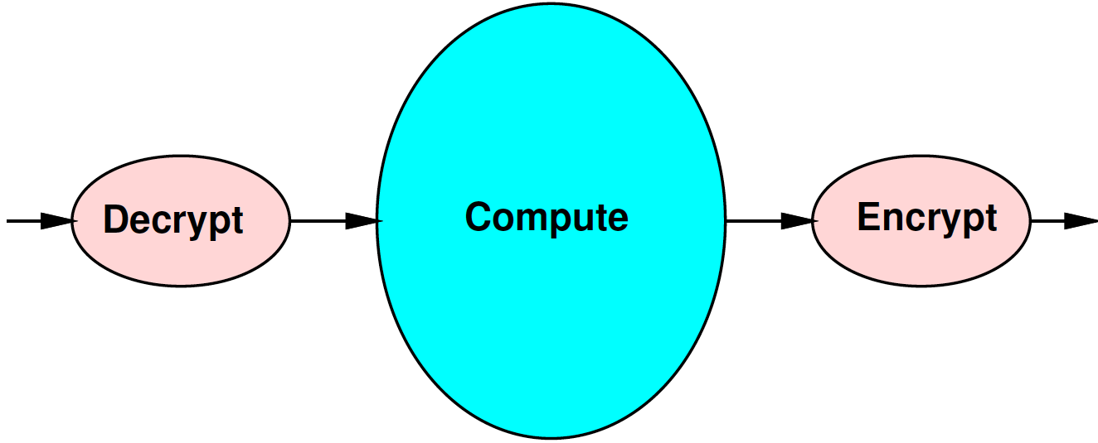
Natural Streaming

Slide 57
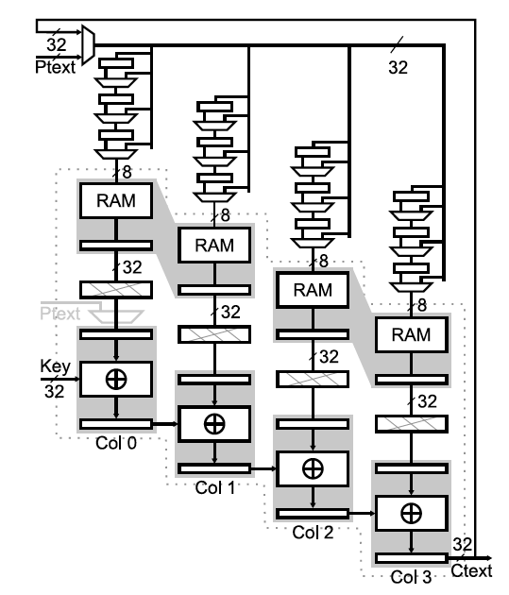
Natural for spatial hardware
[Drimer, FCCM 2008]

Slide 58
Natural for spatial hardware
[Drimer, FCCM 2008]
[Drimer, TRETS 2010]

Slide 59
Big Ideas
SoC Designers need to be concerned about security
Confidentiality, integrity, availability
Important for many applications
Hazards are real, understandable
Avoidable, tricky…

Slide 60
Admin
Collect Zed Boards
Class Monday 4/24
Final: Monday, May 1 9am—11am
One more class on Wednesday

