Slide 1

ESE532:
System-on-a-Chip Architecture
Day 27: April 26, 2017
Wrapup

Slide 2
Today
What was course about
Final
Review w/ Simple Models
Questions/Discussion
Other Courses

Slide 3
Goal
How to design/select/map to SoC to reduce Energy/Area/Delay.

Slide 4
Outcomes
Day 1
Design, optimize, and program a modern System-on-a-Chip.
Analyze, identify bottlenecks, design-space
Decompose into parallel components
Characterize and develop real-time solutions
Implement both hardware and software solutions
Formulate hardware/software tradeoffs, and perform hardware/software codesign

Slide 5
Outcomes
Day 1
Understand the system on a chip from gates to application software, including:
  on-chip memories and communication networks, I/O interfacing, RTL design of accelerators, processors, firmware and OS/infrastructure software.
Understand and estimate key design metrics and requirements including:
  area, latency, throughput, energy, power, predictability, and reliability.

Slide 6
Message for Day
Day 2
Identify the Bottleneck
  May be in compute, I/O, memory, data movement
Focus and reduce/remove bottleneck
  More efficient use of resources
  More resources
Repeat

Slide 7
Abstract Approach
Day 1
Identify requirements, bottlenecks
Decompose Parallel Opportunities
  At extreme, how parallel could make it?
  What forms of parallelism exist?
    Thread-level, data parallel, instruction-level
Design space of mapping
  Choices of where to map, area-time tradeoffs
Map, analyze, refine

Slide 8
SoC Designer
Hardware Building Blocks
Computational blocks
  Adders, multipliers, dividers, ALUs
Registers
Memory blocks
Busses
Multiplexers, Crossbars
DMA Engines
Processors
I/O blocks
  Ethernet, USB, PCI, DDR, Gigabit serial links

Slide 9
Final

Slide 10
Final
Analysis
  Bottleneck
  Amdhal’s Law Speedup
  Computational requirements
  Resource Bounds
  Critical Path
  Latency/throughput
Model/estimate speedup, area, energy, yield
From Code
Forms of Parallelism
Dataflow, SIMD, VLIW, hardware pipeline, threads
Map/schedule task graph to (multiple) target substrates
Memory assignment and movement
Area-time points

Slide 11
Final
Like midterm
  Content
  Style
  Closed book, notes
  Calculators allowed (encouraged)
Monday, May 1 9am—11am
  Towne 303 (here)
  2 hours (standard final exam period)

Slide 12
Review

Slide 13
Sequential Computation
Computation requires a collection of operations
  Arithmetic
  Logical
  Data storage/retrieval

Slide 14
Computations in C
Express computations in a programming language, such as C
Can execute computation in many different ways
  Sequential, parallel, spatial hardware
while(true) {
for (i=0;i<16;i++)
y[i]=a[i]*b[i];
z[0]=y[0];
for (i=1;i<16;i++)
z[i]=z[i-1]+y[i];
}

Slide 15
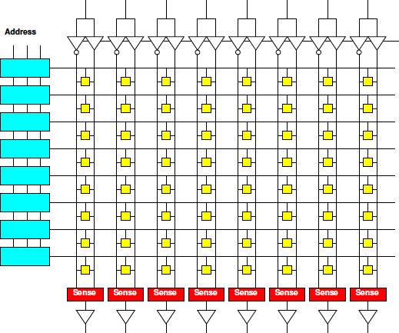
Memory Characteristics
Small memories
  Fast
  Low energy
  Not dense
    (high area per bit)
Large memories
  Slow
  High energy
  Dense (less area per bit)

Slide 16
Memory and Compute
Computation involves both arith/logical ops and memory ops

Slide 17
Memory and Compute
Computation involves both arith/logical ops and memory ops
Either can dominate
  Be bottleneck

Slide 18
Memory and Compute
Timing
  T_{mem}=10
  T_{alu}=1
N_{mpy}=
N_{add}=
N_{mem}=
Total Time, T?
while(true) {
for (i=0;i<16;i++)
y[i]=a[i]*b[i];
z[0]=y[0];
for (i=1;i<16;i++)
z[i]=z[i-1]+y[i];
}
(not count loop, indexing costs in this sequence)

Slide 19
Memory and Compute
Where bottleneck?
  T_{mem}=10
  T_{alu}=1
N_{mpy}=16
N_{add}=15
N_{mem}=95
while(true) {
for (i=0;i<16;i++)
y[i]=a[i]*b[i];
z[0]=y[0];
for (i=1;i<16;i++)
z[i]=z[i-1]+y[i];
}

Slide 20
Data Reuse
Reduce memory operations to large memory by storing in
  Registers
  Small memories

Slide 21
Memory and Compute
a,b in large mem
y,z in small mem
  T_{lem}=10
  T_{sem}=1
  T_{alu}=1
N_{mpy}=16
N_{add}=15
N_{lmem}=?
N_{smem}=?
while(true) {
for (i=0;i<16;i++)
y[i]=a[i]*b[i];
z[0]=y[0];
for (i=1;i<16;i++)
z[i]=z[i-1]+y[i];
}

Slide 22
Memory and Compute
a,b in large mem
y,z in small mem
  T_{lem}=10
  T_{sem}=1
  T_{alu}=1
N_{mpy}=16
N_{add}=15
N_{lmem}=32
N_{smem}=63
while(true) {
for (i=0;i<16;i++)
y[i]=a[i]*b[i];
z[0]=y[0];
for (i=1;i<16;i++)
z[i]=z[i-1]+y[i];
}
Performance impact?

Slide 23
Task Parallel
Can run unrelated tasks concurrently
Ideal: T(p) = T(1)/p

Slide 24
Data Parallel
Can run same task on independent data in parallel
Ideal: T(p) = T(1)/p

Slide 25
Data Parallel
What’s data parallel?
while(true) {
for (i=0;i<16;i++)
y[i]=a[i]*b[i];
z[0]=y[0];
for (i=1;i<16;i++)
z[i]=z[i-1]+y[i];
}

Slide 26
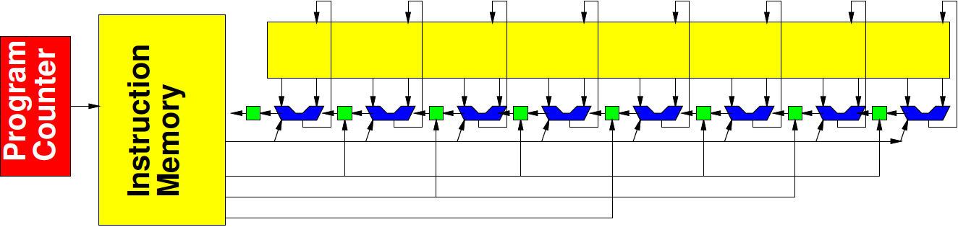
Vector/SIMD
Can perform same operation on a set of data items
Ideal: T(VL) = T(1)/VL
(Vector Length)

Slide 27
Vector/SIMD
Can perform same operation on a set of data items
  Not everything vectorizable

Slide 28
Vector/SIMD
What’s vectorizable?
Speedup vector piece VL=4
  (assume both memory and compute speedup)
Overall speedup
Amdahl’s Law speedup for VL→infintiy?
while(true) {
for (i=0;i<16;i++)
y[i]=a[i]*b[i];
z[0]=y[0];
for (i=1;i<16;i++)
z[i]=z[i-1]+y[i];
}

Slide 29
Dataflow Pipeline
Prod
Consume
With no cycles in flowgraph
  (no feedback)
  (no loop carried dependencies)
Producer and consumer can operate concurrently

Slide 30
Data Flow Pipeline
Producer/consumer here?
Time each
  Assuming T_{mem}=1
while(true) {
for (i=0;i<16;i++)
y[i]=a[i]*b[i];
z[0]=y[0];
for (i=1;i<16;i++)
z[i]=z[i-1]+y[i];
}

Slide 31
Spatial Pipeline
Can build spatial pipeline of hardware operators to compute a dataflow graph
With no feedback: T=1
With feedback loop length L: T=L

Slide 32
Spatial Pipeline
Pipeline taking one a[i], b[i] per cycle?
while(true) {
for (i=0;i<16;i++)
y[i]=a[i]*b[i];
z[0]=y[0];
for (i=1;i<16;i++)
z[i]=z[i-1]+y[i];
}

Slide 33
Spatial Pipeline
Full pipeline taking all 16 a’s, b’s in cycle?
Latency?
while(true) {
for (i=0;i<16;i++)
y[i]=a[i]*b[i];
z[0]=y[0];
for (i=1;i<16;i++)
z[i]=z[i-1]+y[i];
}

Slide 34
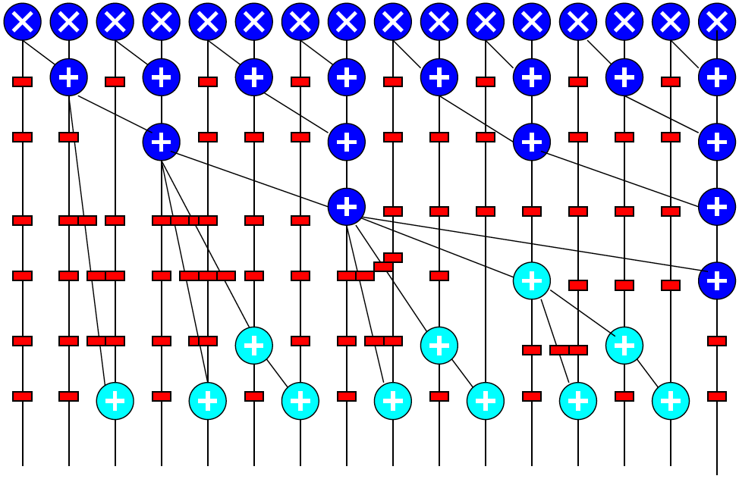
Spatial Pipeline

Slide 35
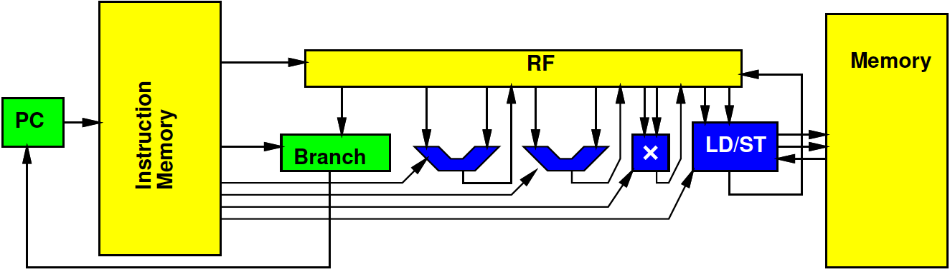
VLIW
Can control datapath to perform multiple, heterogeneous operations per cycle
  Tune parallelism
Op types: A, B, C
  Ops N_{A}, N_{B}, N_{C}
  Number of Hardware Units H_{A}, H_{B}, H_{C}
T_{RB}=max(N_{A}/H_{A}, N_{B}/H_{B}, N_{C}/H_{C},…)<=T_{VLIW}
T_{CP}<=T_{VLIW}

Slide 36
VLIW
VLIW
  1 load/store (a,b)
    Assume single cycle
  1 mpy
  1 add
RB
CP
Schedule
while(true) {
for (i=0;i<16;i++)
y[i]=a[i]*b[i];
z[0]=y[0];
for (i=1;i<16;i++)
z[i]=z[i-1]+y[i];
}

Slide 37
VLIW
VLIW
  4 load/store (a,b)
    Assume single cycle
  2 mpy
  2 add
RB
CP
Schedule
while(true) {
for (i=0;i<16;i++)
y[i]=a[i]*b[i];
z[0]=y[0];
for (i=1;i<16;i++)
z[i]=z[i-1]+y[i];
}

Slide 38
Memory Bottleneck
Memory can end up being bottleneck
Ideal: T(p) = T_{comp}(1)/p+T_{mem}

Slide 39
Memory Bottleneck
Pipeline to perform one multiply per cycle
Memory supplies one data item from large memory (a,b) every 10 cycles
Performance?
  (number of cycles)
while(true) {
for (i=0;i<16;i++)
y[i]=a[i]*b[i];
z[0]=y[0];
for (i=1;i<16;i++)
z[i]=z[i-1]+y[i];
}

Slide 40
Memory Bottleneck
Memory can end up being bottleneck
Ideal: T(p) = T_{comp}(1)/p+T_{mem}/Membw

Slide 41
Memory Bottleneck
Invest in higher bandwidth
  Wider memory
  More memory banks
Exploit data reuse
  Smaller memories may have more bandwidth
  Smaller memories are additional banks
    More bandwidth

Slide 42
Communication
Once parallel, communication may be bottleneck
Ideal (like VLIW):
  T<=max(T_{comp}/p,T_{mem}/membw,T_{comm}/netbw)

Slide 43
Area
Can model area of various solutions
  Sum of component areas
  (watch interconnect)
Cost proportional A/P_{chip}
Without sparing
  P_{chip} = (P_{mm})^{A}
Sparing
  Pmofn

Slide 44
Multi-Objective Optimization
Many forms of parallelism
Given fixed area (resources, energy)
  Maximize performance
  Select best architecture
Given fixed performance goal
  Find architecture that achieves
  With minimum area (energy, cost)

Slide 45
Final
Analysis
  Bottleneck
  Amdhal’s Law Speedup
  Computational requirements
  Resource Bounds
  Critical Path
  Latency/throughput
Model/estimate speedup, area, energy, yield
From Code
Forms of Parallelism
Dataflow, SIMD, VLIW, hardware pipeline, threads
Map/schedule task graph to (multiple) target substrates
Memory assignment and movement
Area-time points

Slide 46
Question/Discussion

Slide 47
Other Courses

Slide 48
Distinction
CIS240, 371, 501
ESE532
Best Effort Computing
  Run as fast as you can
Binary compatible
ISA separation
Shared memory parallelism
Caching – automatic memory management
Superscalar
Pipelined processor
Hardware-Software codesign
  Willing to recompile, maybe rewrite code
  Define/refine hardware
Real-Time
  Guarantee meet deadline
Non shared-memory models

Slide 49
Circuits and Computer Engineering
ESE350
Embedded Systems
μ-controller architectures, Interfacing, ADC, sensor and actuator control, ROS, network protocols
ESE370
Circuit Level Modeling & Optimization of Dig. Systems
Transistor models, CMOS logic, delay, scaling, energy, interconnects, flip-flops, noise, T-lines, RAM design
ESE319
Electronics
Diode & Transistor Circuits, Single Stage & Diff. Amplifiers, Filters, Oscillators
or
ESE419 (572)
Analog Integrated Circuits
MOSFET circuits, Ampl. Stages, I-Mirrors, Op-Amps, Feedback, Stability, Root Locus, Cascode Ampl.
ESE532
SoC Architecture
Hardware/Software
Codesign,
Parallelism, Analysis, Real-Time
ESE570
Digital Integrated Circuits
MOSFET Trans Models, Inverter switching, MOS Logic, Memories, Implementation methods, Layout.
ESE578
RF Integrated
Circuits Design
μ-wave Eng overview, T-line, Smith-chart, S-parameters, matching, passive devices, small signal amplifier, LNA and PA, mixed signal on chip
CIS541
Embedded Cyber Physical Systems
Life-Critical, Real-Time,
Analysis,
Implementations
Validation/verification
Digital
ESE672
Integrated Communication Circuits
Receivers, Low-noise amplifiers, mixers, oscillators, phase lock loops, power amplifiers
Embedded
(uP/uC)
Analog
Notes:
Simple Story

Slide 50
Other Courses
Security: CIS331, CIS551
Networking: ESE407, CIS553
GPGPU (graphics focus): CIS565

Slide 51
Message
Any interesting, challenging computation will require both
hardware and software
SoC powerful implementation platform
  Target pre-existing
  Design customized for problem
  Exploit heterogeneous parallelism
Understand and systematically remove bottlenecks
  Compute, memory, communicate, I/O

Slide 52
Admin
Return Zed Boards → Detkin
Final: Monday, May 1 9am—11am
  Towne 303 (here)

