Slide 1

ESE532:
System-on-a-Chip Architecture
Day 4: January 25, 2017
Data-Level Parallelism

Slide 2
Today
Data-level Parallelism
For Parallel Decomposition
Architectures
Concepts
NEON

Slide 3
Message
Data Parallelism easy basis for decomposition
Data Parallel architectures can be compact – pack more computations onto a die

Slide 4
Preclass 1
300 news articles
Count total occurrences of a string
How can we exploit data-level parallelism on task?
How much parallelism can we exploit?

Slide 5
Parallel Decomposition

Slide 6
Data Parallel
Data-level parallelism can serve as an organizing principle for parallel task decomposition
Run computation on independent data in parallel

Slide 7
Exploit
Can exploit with
  Threads
  Instruction-level Parallelism
  Fine-grained Data-Level Parallelism

Slide 8
Thread Exploit DP
How exploit threads for data-parallel text search?

Slide 9
SPMD
Single Program Multiple Data
Only need to write code once
Get to use many times

Slide 10
ILP Exploit DP
How exploit ILP for DP?
Instruction
Memory
Address
ALU
ALU
+

Slide 11
Pipeline Exploit
How exploit hardware pipeline for text search?

Slide 12
Common Examples
What are common examples of DLP?
  Signal Processing
  Simulation
  Numerical Linear Algebra
  Graphics
  Image Processing
  Optimization
  Other?

Slide 13
Hardware Architectures

Slide 14
Idea
If we’re going to perform the same operations on different data,
exploit that to reduce area, energy
Reduced area means can have more computation on a fixed-size die.

Slide 15
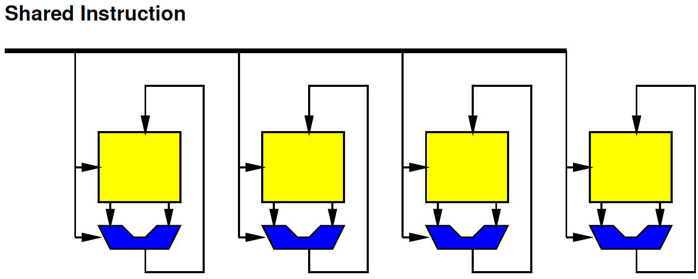
SIMD
Single Instruction Multiple Data

Slide 16
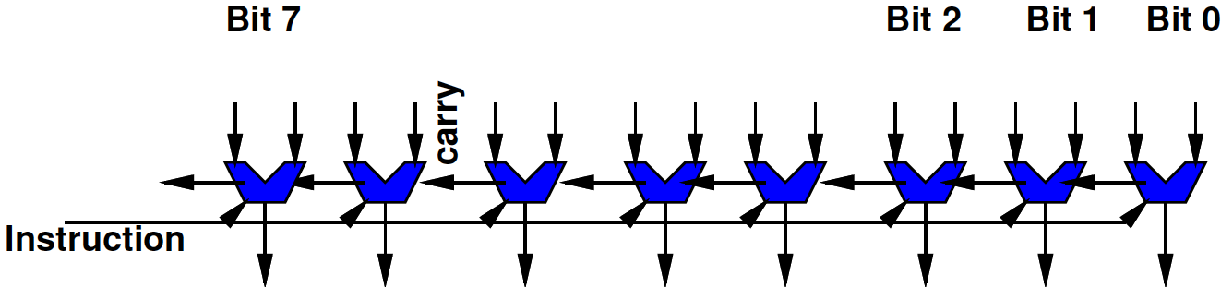
W-bit ALU as SIMD
Familiar idea
A W-bit ALU (W=8, 16, 32, 64, …) is SIMD
Each bit of ALU works on separate bits
  Performing the same operation on it
    Trivial to see bitwise AND, OR, XOR
    Also true for ADD (each bit performing Full Adder)
Share one instruction across all ALU bits

Slide 17
ALU Bit Slice

Slide 18
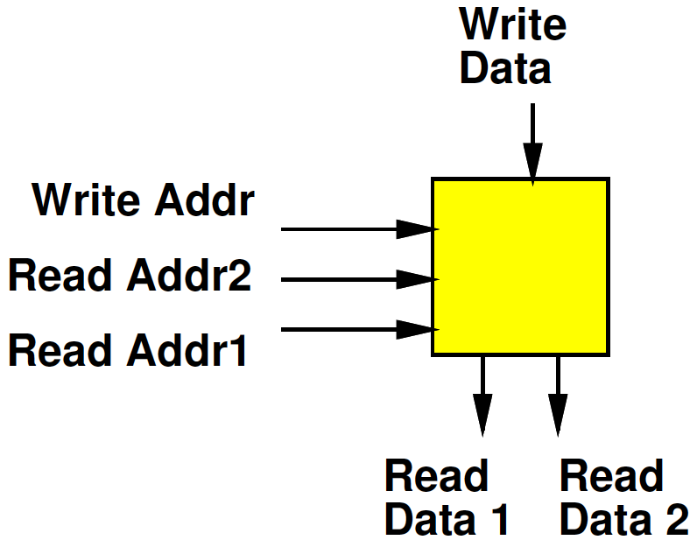
Register File
Small Memory
Usually with multiple ports
  Ability to perform multiple reads and writes simultaneously
Small
  To make it fast (small memories fast)
  Multiple ports are expensive

Slide 19
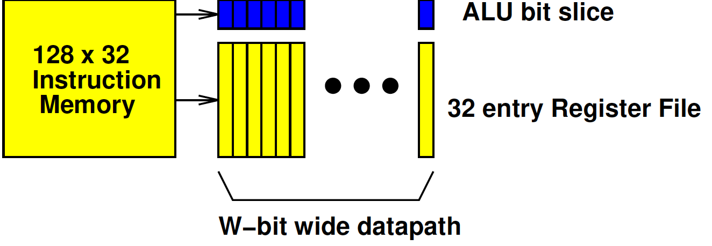
Preclass 2
Area W=16?
Area W=128?
Number in 10⁸
  W=16
  W=128
Perfect Pack Ratio?

Slide 20
Preclass 2
W for single datapath in 10⁸?
Perfect 16b pack ratio?
Compare W=128 perfect pack ratio?

Slide 21
ALU vs. SIMD ?
What’s different between
  128b wide ALU
  SIMD datapath supporting eight 16b ALU operations

Slide 22
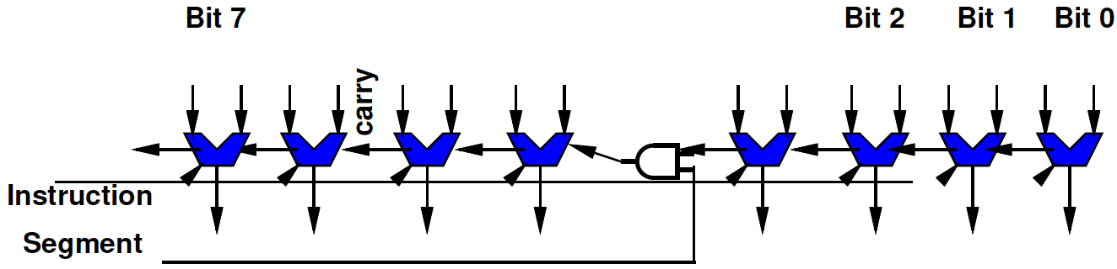
Segmented Datapath
Relatively easy (few additional gates) to convert a wide datapath into one supporting a set of smaller operations
  Just need to squash the carry at points

Slide 23
Segmented Datapath
Relatively easy (few additional gates) to convert a wide datapath into one supporting a set of smaller operations
  Just need to squash the carry at points
But need to keep instructions (description) small
  So typically have limited, homogeneous widths supported

Slide 24
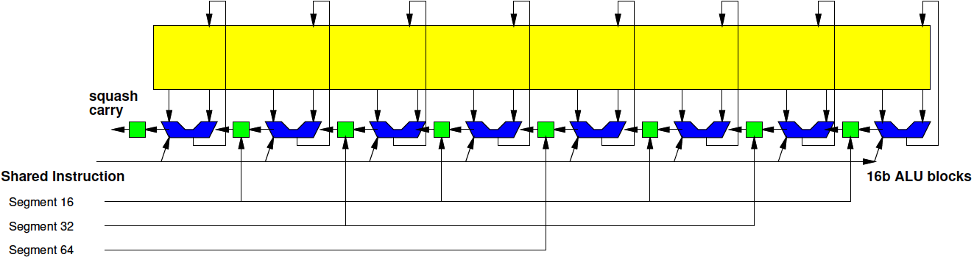
Segmented 128b Datapath
1x128b, 2x64b, 4x32b, 8x16b

Slide 25
Terminology: Vector Lane
Each of the separate segments called a Vector Lane
For 16b data, this provides 8 vector lanes

Slide 26
Opportunity
Don’t need 64b variables for lots of things
Natural data sizes?
  Audio samples?
  Input from A/D?
  Video Pixels?
  X, Y coordinates for 4K x 4K image?

Slide 27
Vector Computation
Easy to map to SIMD flow if can express computation as operation on vectors
  Vector Add
  Vector Multiply
  Dot Product

Slide 28
Concepts

Slide 29
Vector Register File
Need to be able to feed the SIMD compute units
  Not be bottlenecked on data movement to the SIMD ALU
Wide RF to supply
With wide path to memory

Slide 30
Point-wise Vector Operations
Easy – just like wide-word operations
(now with segmentation)

Slide 31
Point-wise Vector Operations
…but alignment matters.
If not aligned, need to perform data movement operations to get aligned

Slide 32
Vector Length
May not match physical hardware length
What happens when
  Vector length > hardware SIMD operators?
  Vector length < hardware SIMD operators?
  Vector length % hdw operators !=0
    E.g. vector length 20, for 8 hdw operators

Slide 33
Skipping Elements?
How does this work with datapath?
for (i=0;i<64;i=i+2)
  c[i]=a[i]+b[i]

Slide 34
Stride
Stride: the distance between vector elements used
for (i=0;i<64;i=i+2)
  c[i]=a[i]+b[i]
Accessing data with stride=2

Slide 35
Load/Store
Strided load/stores
  Some architectures will provide strided memory access that compact when read into register file
Scatter/gather
  Some architectures will provide memory operations to grab data from different places to construct a dense vector

Slide 36
Conditionals?
What happens if want to do something different?
For (i=0;i<8;i++)
  if (a[i]<b[i])
    d[i]=a[i]+c[i]
  else
    d[i]=b[i]+c[i]

Slide 37
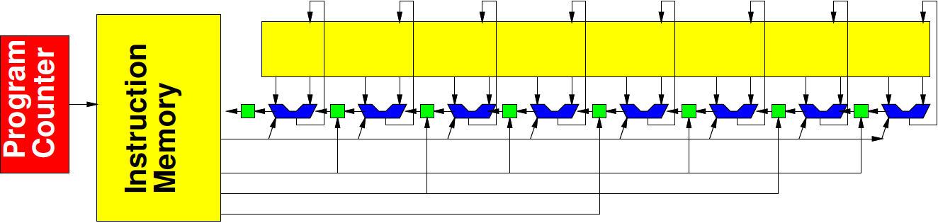
Conditionals
Only have one Program Counter
  Cannot implement conditional via branching

Slide 38
Conditionals
Only have one instruction
  Cannot perform separate operations on each ALU in datapath

Slide 39
Conditionals
Only have one Program Counter
  Cannot implement conditional via branching
Only have one instruction
  Cannot perform separate operations on each ALU in datapath
Must perform an invariant operation sequence

Slide 40
Invariant Operation
If (a[i]<b[i])
  then d[i]=a[i]+c[i]
  else d[i]=b[i]+c[i]
What’s in each register as go through sequence?
T1[i]=a[i]<b[i]
T2[i]=-T1[i]
T3[i]=~(T2[i])
T2[i]=a[i] & T2[i]
T3[i]=b[i] & T3[i]
d[i]=c[i] + T2[i]
d[i]=c[i] + T3[i]

Slide 41
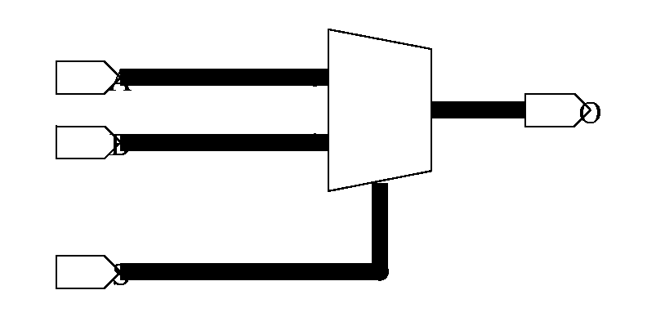
If→Mux Conversion
Can always transform into a data independent sequence
Often convenient to think of IF’s as Multiplexers
If (cond)
  o=a
else
  o=b

Slide 42
Predicated Operation
Many architectures will provide a predicated operation
Only perform operation when predicate matches instruction
p[i]=a[i]<b[i]
p[i]: d[i]=c[i] + a[i]
~p[i]: d[i]=c[i] + b[i]

Slide 43
Predicated Operation
What does this do to instructions must be issued?
What does this do to efficiency?
  Useful operations performed per cycle
p[i]=a[i]<b[i]
p[i]: d[i]=c[i] + a[i]
~p[i]: d[i]=c[i] + b[i]

Slide 44
Nested Conditionals
What happens with nested conditionals?

Slide 45
Dot Product
What happens when need a dot product?
res=0;
for (i=0;i<N;i++)
  res+=a[i]*b[i]

Slide 46
Reduction
Common operations where want to perform a combining operation to reduce a vector to a scalar
  Sum values in vector
  AND, OR
Reduce Operation

Slide 47
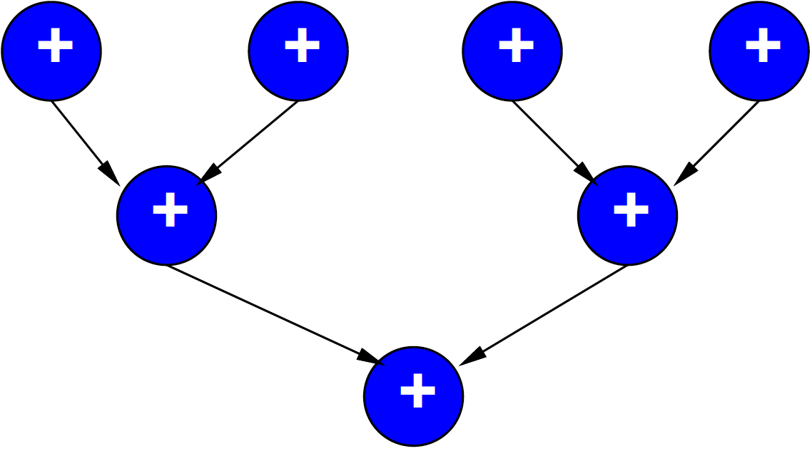
Reduce Tree
Efficiently handled with reduce tree

Slide 48
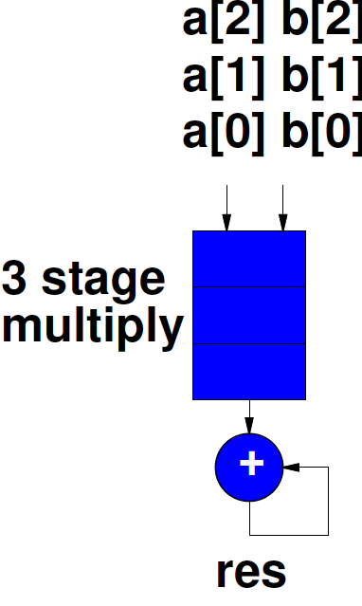
Reduce in Pipeline
Comes almost for free in pipeline

Slide 49
Vector Reduce Instruction
Usually include support for vector reduce operation
  Doesn’t need to add much to delay
  Maybe even faster than performing larger operation
    8 16x16 multiplies with sum reduce
    less complex than one 128x128 multiply
    …can exploit datapath of larger operation

Slide 50
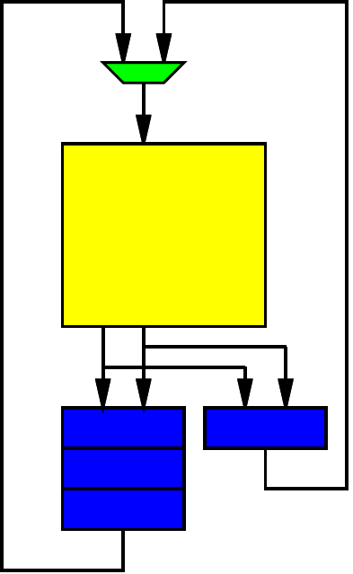
Dot Product Revisited
for (i=0;i<N;i++)
  res+=a[i]*b[i]
a in R0—R4
b in R4—R7
With 3 cycle pipelined multiply
What happens if try to implement dot product as:
  MPY R0, R4, R14
  ADD R14, R15, R15
  MPY R1, R5, R14
  ADD R14, R15, R15
  …

Slide 51
Dot Product Revisited
for (i=0;i<N;i++)
  res+=a[i]*b[i]
a in R0—R4
b in R4—R7
How should order (reformulate) instructions exploiting data-level parallelism?

Slide 52
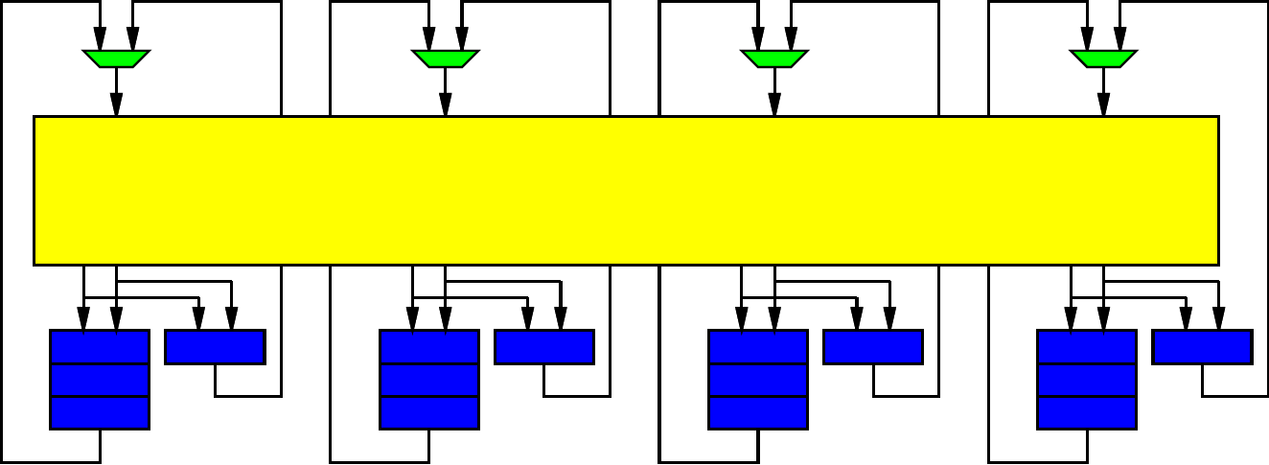
Pipelined Vector Units
Will get both pipelining and parallel vector lanes
Exploit data-level parallelism for both

Slide 53
Neon

Slide 54
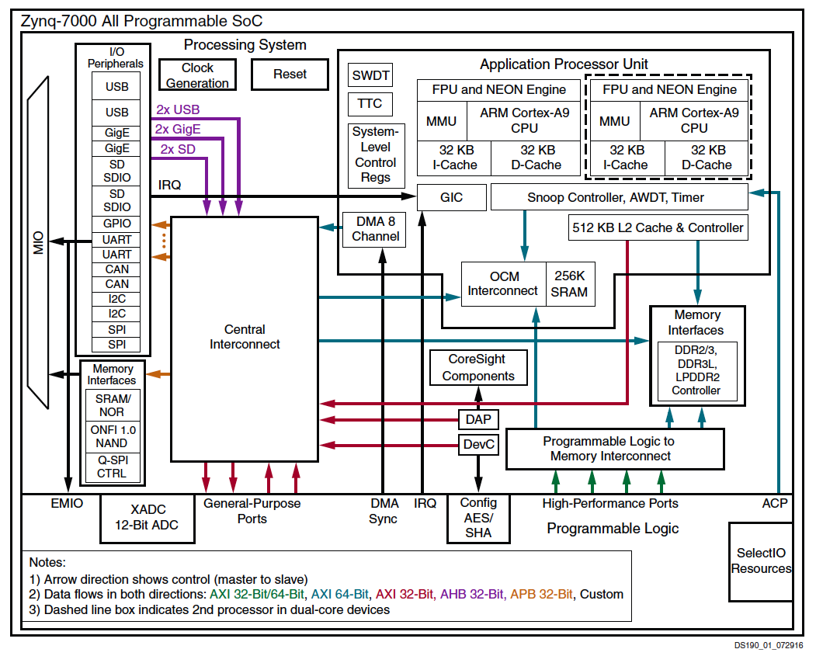

Slide 55
Neon Vector
128b wide register file, 16 registers
Support
  2x64b
  4x32b (also Single-Precision Float)
  8x16b
  16x8b

Slide 56
Sample Instructions
VADD – basic vector
VCEQ – compare equal
  Sets to all 0s or 1s, useful for masking
VMIN – avoid using if’s
VMLA – accumulating multiply
VPADAL – maybe useful for reduce
VEXT – for “shifting” vector alignment
VLDn – deinterleaving load

Slide 57
Neon Notes
Didn’t see
  Vector-wide reduce operation
  Conditionals within vector lanes
Do need to think about operations being pipelined within lanes

Slide 58
Big Ideas
Data Parallelism easy basis for decomposition
Data Parallel architectures can be compact – pack more computations onto a chip
  SIMD, Pipelined
  Benefit by sharing (instructions)
  Performance can be brittle
    Drop from peak as mismatch

Slide 59
Admin
Reading for Day 5 on web
Talk on Thursday by Ed Lee (UCB)
  3pm in Wu and Chen
HW2 due Friday
HW3 out (soon…)
  Different partners

