Slide 1
ESE532: System-on-a-Chip Architecture
Day 5: January 30, 2017
Dataflow Process Model

Slide 2
Today
Dataflow Process Model
Motivation
Issues
Abstraction
Aspirational Recommended Approach

Slide 3
Message
Parallelism can be natural
Discipline to avoid common pitfalls
Maintain determinism
…as much as possible
Identify rich potential parallelism
Abstract out implementation details
Admit to many implementations

Slide 4
Process
Abstraction of a processor
Looks like each process is running on a separate processor
Has own state, including
Program Counter (PC)
Memory
Input/output
May not actually run on processor
Could be specialized hardware block

Slide 5
Thread
Has a separate locus of control (PC)
May share memory
Run in common address space with other threads
For today – no shared memory
(technically no threads)

Slide 6
FIFO
First In First Out
Delivers inputs to outputs in order
Data presence
Consumer knows when data available
Back Pressure
Producer knows when at capacity
Typically stalls
Decouples producer and consumer
Hardware: maybe even different clocks

Slide 7
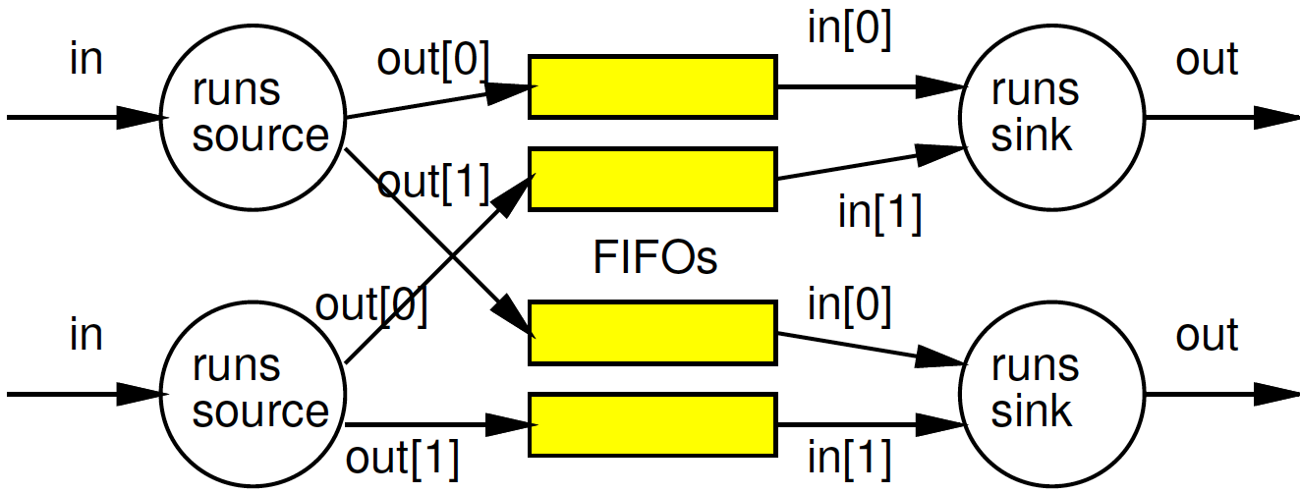
Preclass 1
Value of separate processes?

Slide 8
Preclass 2
Compute Data Parallel GCD
Why challenge for SIMD implementation?
What benefit get from multiple processes (processors) running Data Parallel GCD?
while(a!=b)
a=max(a,b)-min(a,b)
a=min(a,b)
return(a);

Slide 9
Preclass 3
How long to process each input?
Correlation in delays?
What benefit from FIFO and processes?

Slide 10
Process
Processes allow expression of independent control
Convenient for things that advance independently
Performance optimization resource utilization

Slide 11
Issues
Communication – how move data between processes?
Synchronization – how define how they advance relative to each other?
Determinism – for the same inputs, do we get the same outputs?

Slide 12
Today’s Stand
Communication – FIFO-like channels
Synchronization – dataflow with FIFOs
Determinism – how to achieve
…until you must give it up.

Slide 13
Dataflow Process Model

Slide 14
Operation/Operator
Operation – logic computation to be performed
A process that communicates through dataflow inputs and outputs
Operator – physical block that performs an Operation

Slide 15
Dataflow / Control Flow
Dataflow
Program is a graph of operations
Operation consumes tokens and produces tokens
All operations run concurrently
All processes
Control flow (e.g. C)
Program is a sequence of operations
Operation reads inputs and writes outputs into common store
One operation runs at a time
defines successor

Slide 16
Token
Data value with presence indication
May be conceptual
Only exist in high-level model
Not kept around at runtime
Or may be physically represented
One bit represents presence/absence of data

Slide 17
Stream
Logical abstraction of a persistent point-to-point communication link between operators
Has a (single) source and sink
Carries data presence / flow control
Provides in-order (FIFO) delivery of data from source to sink
stream

Slide 18
Streams
Captures communications structure
Explicit producer→consumer link up
Abstract communications
Physical resources or implementation
Delay from source to sink

Slide 19
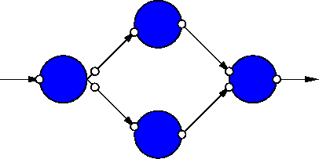
Dataflow Process Network
Collection of Operators
Connected by Streams
Communicating with Data Tokens

Slide 20
Dataflow Abstracts Timing
Doesn’t say
on which cycle calculation occurs
Does say
What order operations occur in
How data interacts
i.e. which inputs get mixed together
Permits
Scheduling on different # and types of resources
Operators with variable delay [examples?]
Variable delay in interconnect [examples?]

Slide 21
Operations
Can be implemented on different operators with different characteristics
Small or large processor
Hardware unit
Different levels of internal
Data-level parallelism
Instruction-level parallelism
May itself be described as
Dataflow process network, sequential, hardware register transfer language

Slide 22
Examples
Operators with Variable Delay
Cached memory or computation
Shift-and-add multiply
Iterative divide or square-root
Variable delay interconnect
Shared bus
Distance changes
Wireless, longer/shorter cables
Computation placed on different cores

Slide 23
Clock Independent Semantics
Interconnect
Takes n-clocks

Slide 24
Semantics
Need to implement semantics
i.e. get same result as if computed as indicated
But can implement any way we want
That preserves the semantics
Exploit freedom of implementation

Slide 25
Dataflow Variants

Slide 26
Synchronous Dataflow (SDF)
Particular, restricted form of dataflow
Each operation
Consumes a fixed number of input tokens
Produces a fixed number of output tokens
When full set of inputs are available
Can produce output
Can fire any (all) operations with inputs available at any point in time

Slide 27
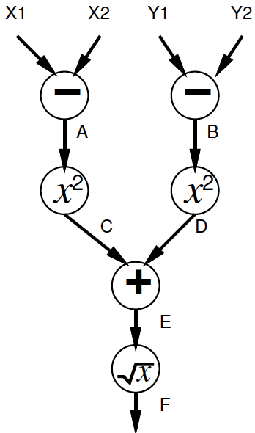
Synchronous Dataflow
+
+
×k
×k
×k
×k

Slide 28
SDF: Execution Semantics
while (true)
Pick up any operator
If operation has full set of inputs
Compute operation
Produce outputs
Send outputs to consumers

Slide 29
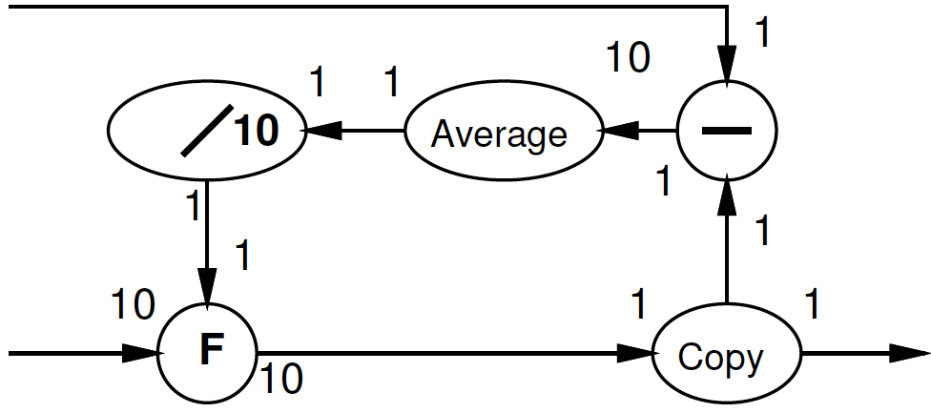
Multirate Synchronous Dataflow
Rates can be different
Allow lower frequency operations
Communicates rates to tools
Use in scheduling, provisioning
Rates must be constant
Data independent
2
decimate
1

Slide 30
SDF
Can validate flows to check legal
Like KCL → token flow must be conserved
No node should
be starved of tokens
Collect tokens
Schedule operations onto processing elements
Provisioning of operators
Provide real-time guarantees
Compute required depth of all buffers
Model restrictions → analysis power
Simulink is SDF model

Slide 31
SDF: good/bad graphs
1
1
2
1
1
1
1
1
1
1
1
1

Slide 32
SDF: good/bad graphs
1
1
1
1
1
2
2
2
2
1
1
1
1
1
1
1
1
1

Slide 33
Dynamic Rates?
When might static rates be limiting? (prevent useful optimizations?)
Compress/decompress
Lossless
Even Run-Length-Encoding
Filtering
Discard all packets from spamRus
Anything data dependent

Slide 34
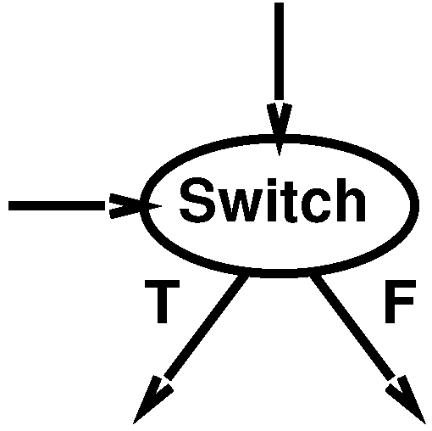
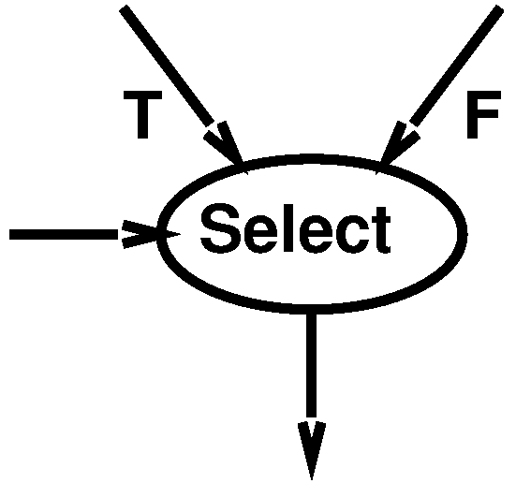
Data Dependence
Add Two Operators
Switch
Select

Slide 35
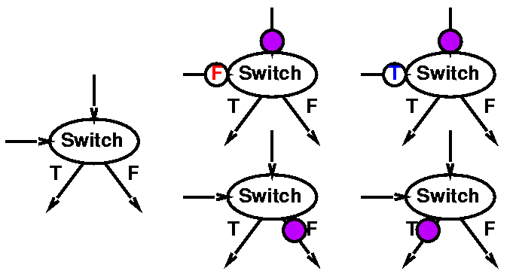
Switch

Slide 36
Filtering Example
spamRus?
discard
dup
switch

Slide 37
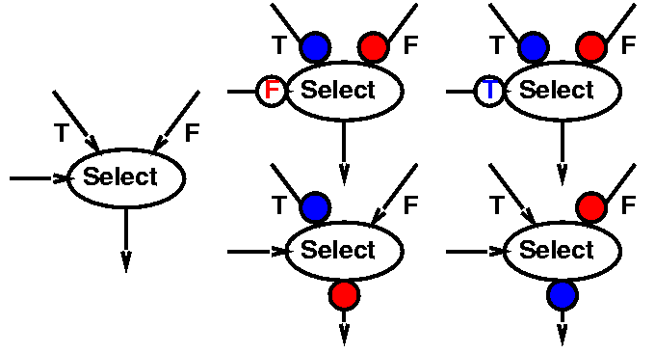
Select

Slide 38
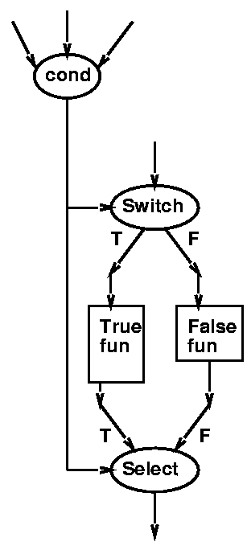
Constructing If-Then-Else

Slide 39
In-Order Merge
Task: Merge to ordered streams in order onto a single output stream
Key step in merge sort
Use to illustrate switch/select

Slide 40
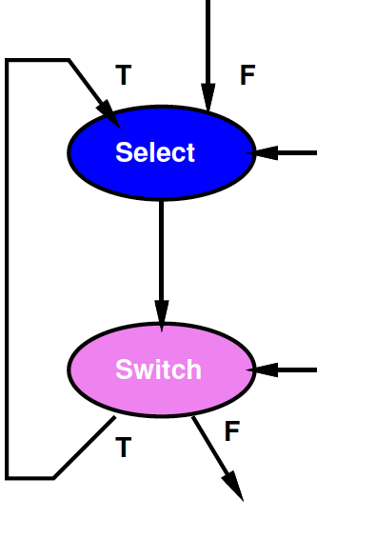
Idiom to Selectively Consume Input
Hold onto current head on loop
Shown left here
With T-side control

Slide 41
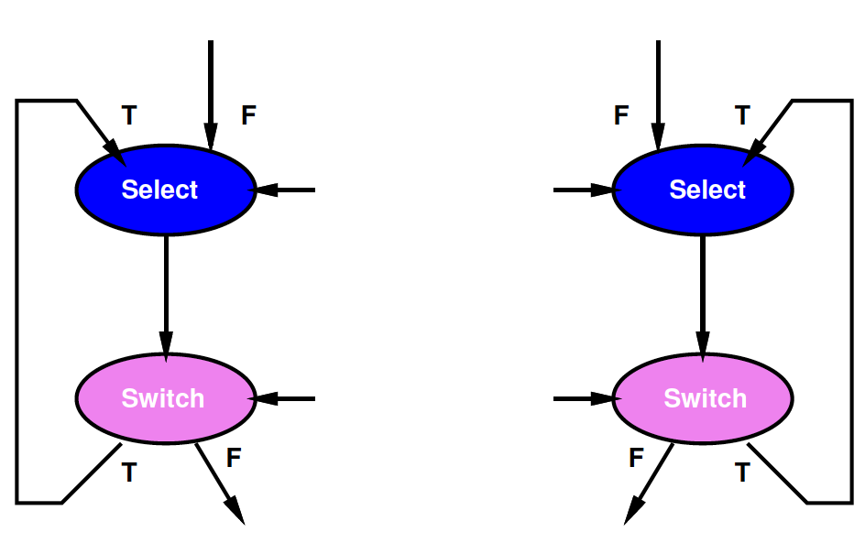
In-Order Merge
Use one for each of the two input streams

Slide 42
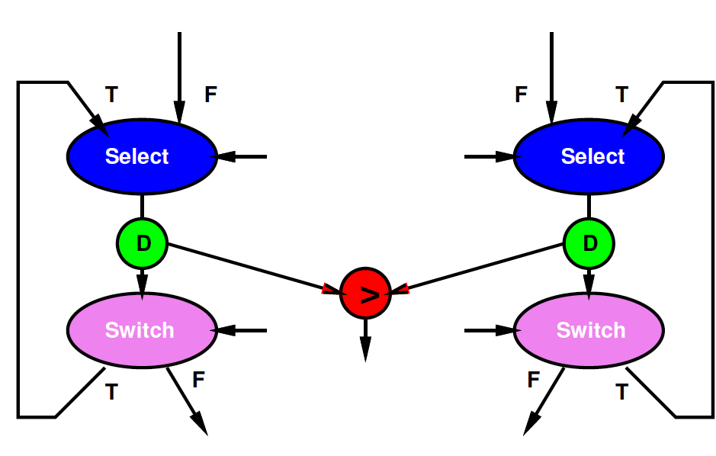
In-Order Merge
Perform Comparison

Slide 43
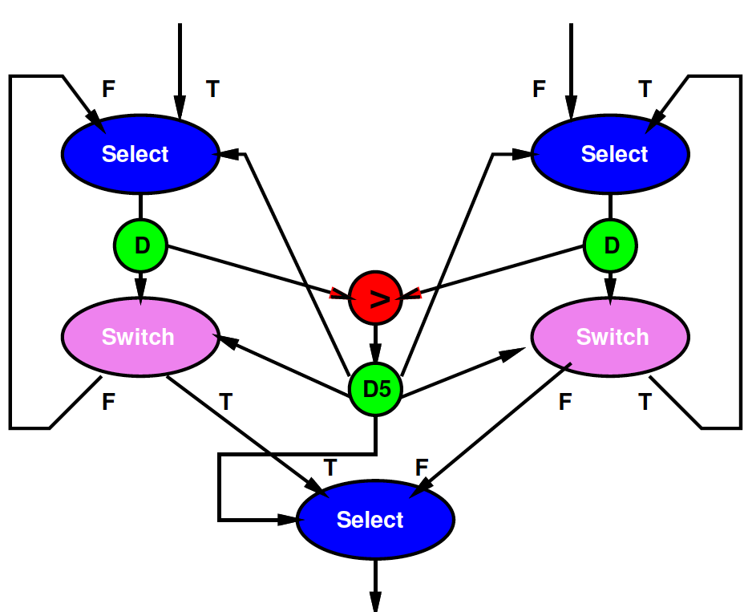
In-Order Merge
Act on result of comparison

Slide 44
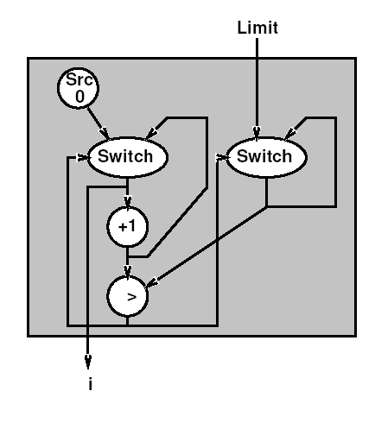
Looping
for (i=0;i<Limit;i++)

Slide 45
Universal
Once we add switch and select, the dataflow model is as powerful as any other
E.g. can do anything we could do in C
“Turing Complete” in formal CS terms

Slide 46
Dynamic Challenges
In general, cannot say
If a graph is well formed
Will not deadlock
How many tokens may have to buffer in stream
Will not bufferlock
deadlock on finite buffer size
When not deadlock on unbounded buffer
Right proportion of operators for computation
More powerful model → weaker analysis
Larger burden to guarantee correctness

Slide 47
Deterministic
As described so far,
Timing-independent
Always gets same answer
Regardless of operator and stream delays
Execution time can be data and implementation dependent

Slide 48
No Peaking
Key to determinism: behavior doesn’t depend on timing
Cannot ask if a token is present
If (not_empty(in))
Out.put(3);
Else
Out.put(2);

Slide 49
When peaking necessary?
What are cases where we need the ability to ask if a data item is present?
Preclass 1
User Input
Server

Slide 50
When Peak Optimization?
What are cases where asking about data presence might allow performance optimization?
Process data as soon as arrives

Slide 51
Peaking
Removed model restriction (no peaking)
Gained expressive power
Can grab data as shows up
Weaken our guarantees
Possible to get non-deterministic behavior

Slide 52
Data-Dependent Parallelism
Sequential code
With malloc(), new()
Size of data determines memory footprint, size of structures
Amount of computation performed
Here process graph may want to match data structure
Add a process spawn

Slide 53
Data-Dependent Parallelism
Where might benefit having data-dependent parallelism?
Searching variable number of targets
Simulation

Slide 54
Data-Independent Parallelism
What happens if we cannot spawn?
Why likely to be less important for a particular SoC target?

Slide 55
Aspirational Approach

Slide 56
Approach (1)
Identify natural parallelism
Convert to streaming flow
Initially leave operators software
Focus on correctness
Identify flow rates, computation per operator, parallelism needed
Refine operators
Decompose further parallelism?
E.g. SIMD changes making now
model potential hardware

Slide 57
Approach (2)
Refine coordination as necessary for implementation
Map operators and streams to resources
Provision hardware
Scheduling: Map operations to operators
Memories, interconnect
Profile and tune

Slide 58
Big Ideas
Capture gross parallel structure with Process Network
Use dataflow synchronization for determinism
Abstract out timing of implementations
Give freedom to optimize implementation for performance
Minimally use non-determinism as necessary

Slide 59
Admin
Reading for Day 6 on web
HW3 due Friday
Expanded feedback incl. HW2

