Slide 1
ESE532: System-on-a-Chip Architecture
Day 6: February 1, 2017
Process and Threads

Slide 2
Today
Dataflow Process Model
Finish Models
Aspirational Recommended Approach
Threads
Hazards
Discipline

Slide 3
Message
Abstract the problem agnostic from implementation
Map based on
Computational demand
Platform
Use restricted patterns to avoid shared-memory pitfalls

Slide 4
Dataflow Variants

Slide 5
Synchronous Dataflow (SDF)
Particular, restricted form of dataflow
Each operation
Consumes a fixed number of input tokens
Produces a fixed number of output tokens
When full set of inputs are available
Can produce output
Can fire any (all) operations with inputs available at any point in time

Slide 6
Dynamic Dataflow
(Less) restricted form of dataflow
Each operation
Conditionally consume input based on data value
Conditionally produce output based on data value
When full set of inputs are available
Can (optionally) produce output
Can fire any (all) operations with data-specified necessary inputs available at any point in time

Slide 7
No Peaking
Key to determinism: behavior doesn’t depend on timing
Cannot ask if a token is present
If (not_empty(in))
Out.put(3);
Else
Out.put(2);

Slide 8
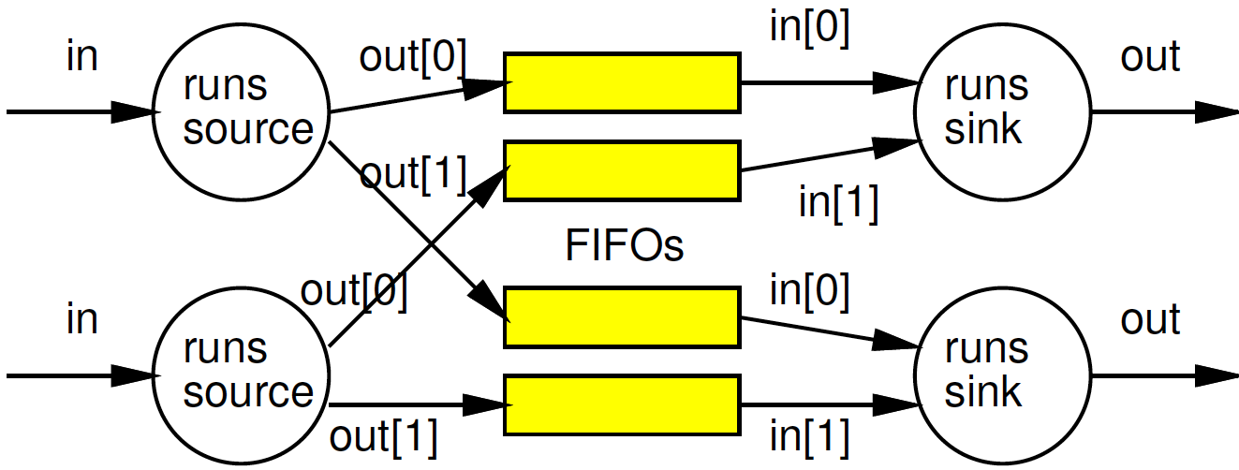
When peaking necessary?
What are cases where we need the ability to ask if a data item is present?

Slide 9
When Peak Optimization?
What are cases where asking about data presence might allow performance optimization?

Slide 10
Peaking
Removed model restriction (no peaking)
Gained expressive power
Can grab data as shows up
Weaken our guarantees
Possible to get non-deterministic behavior

Slide 11
Process Network Roundup
Model | Deterministic Result | Deterministic Timing | Turing Complete
SDF+fixed-delay operators | Y | Y | N
SDF+variable delay operators | Y | N | N
DDF no peak | Y | N | Y
DDF w/ peak | N | N | Y

Slide 12
Aspirational Approach

Slide 13
Approach (1)
Identify natural parallelism
Convert to streaming flow
Initially leave operators software
Focus on correctness
Identify flow rates, computation per operator, parallelism needed
Refine operators
Decompose further parallelism?
E.g. SIMD changes making hw3
model potential hardware

Slide 14
Approach (2)
Refine coordination as necessary for implementation
Map operators and streams to resources
Provision hardware
Scheduling: Map operations to operators
Memories, interconnect
Profile and tune

Slide 15
Approach
Process Network agnostic to operator implementation
Implementation explores
Operator mappings
What fixed SoC provides
Where might allocate hardware for novel SoC
Memory allocation
Isolated memories→communication explicit
Communication mappings

Slide 16
Preclass 1a
Throughput for 1:1 mapping of processes to SPs?
Possibly we didn’t know throughputs initially – map and measure

Slide 17
Preclass 1b
Refine: better mapping to 3 SPs?
Throughput?

Slide 18
Preclass 1c
1/20
(SIMD)
Mapping 1 SIMD and 1 SP?
Throughput?

Slide 19
Approach
Once have base process network (ideally), we have reduced to working in this mapping space
Spend our time (in this class)
Enriching and elaborating this mapping space

Slide 20
Threads

Slide 21
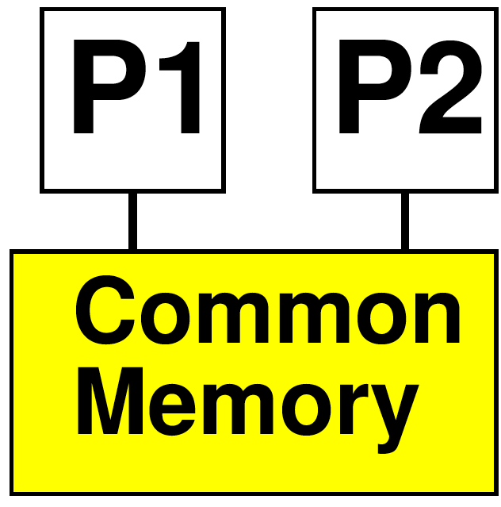
Thread
Has a separate locus of control (PC)
May share memory
Run in common address space with other threads
Now: look at shared memory

Slide 22
Issues
Communication – how move data between processes?
Synchronization – how define how they advance relative to each other?
Determinism – for the same inputs, do we get the same outputs?

Slide 23
Issues
Communication – read/write in common address space
Synchronization – get to choose
Semaphores, locks, barriers, data presence
Determinism – not unless you’re very careful

Slide 24
Shared Memory
Good
Sharing easy to express
Data movement implicit
Bad
Easy to introduced unwanted non-determinism
Expensive abstraction to support
Hardware, energy
Harder to understand and control communication
Latency, throughput…

Slide 25
What to watch for
Thread 1:
Do stuff
M[123]=12
Do more stuff
A=M[123]*2
Thread 2:
Do different stuff
M[123]=0
Do other stuff
What value does A hold?

Slide 26
Preclass 2a
P1:
for (i=0;i<N/2;i++)
v=f(i);
h[v]=h[v]+1;
P2:
for (i=N/2+1;i<N;i++)
v=f(i);
h[v]=h[v]+1;
What can go wrong here?

Slide 27
Preclass 2b
P1:
for (i=0;i<N/2;i++)
v=f(i);
h[v]=h[v]+1;
P2:
for (i=N/2+1;i<N;i++)
v=f(i);
h[v]=h[v]+1;
How might we avoid hazard?

Slide 28
Disciplines
Don’t really share
Exploit actual sharing in limited ways
Privatize
Local memory not really shared
Server thread to sequentialize access to shared state (how use histogram?)
Use data presence
Buffer
Explicitly – presence variable and check

Slide 29
Disciplines
Read-Only sharing OK
Barrier
Force rendezvous at point before continue
Like a clock edge in a circuit

Slide 30
Expression and Implementation not 1:1
Examples
Pure DPN implemented on shared-memory processors
Private memory, implement buffers in SM
Single threaded DP with conditionals
Implement in multiple threads
SDF with many tasks
Implement schedule of operations on single instruction stream

Slide 31
SDF in single thread
While(input)
A=Astep(in());
B=Bstep(A);
C=Cstep(B);

Slide 32
Multiple Ways to Decompose
Searching for 2 targets strings in a single document
Run on 2 processor
How decompose and map?
Resource implications?
Data access implications?

Slide 33
Approach
Identify design space of mappings
Decomposition, hardware mapping
Analyze which meet our platform restrictions (are most efficient)
Experiment as necessary

Slide 34
Big Ideas
Abstract the problem agnostic from implementation
Map based on
Computational demand
Platform
Seldom 1:1 → rich options to explore
Use restricted patterns to avoid shared-memory pitfalls

Slide 35
Admin
Reading for Day 7 on web
HW3 due Friday
HW4 coming…

