Slide 1

ESE532:
System-on-a-Chip Architecture
Day 7: February 6, 2017
Memory

Slide 2
Today
Memory
Memory Bottleneck
Memory Scaling
DRAM
Memory Organization
Data Reuse

Slide 3
Message
Memory bandwidth and latency can be bottlenecks
Minimize data movement
Exploit small, local memories
Exploit data reuse

Slide 4
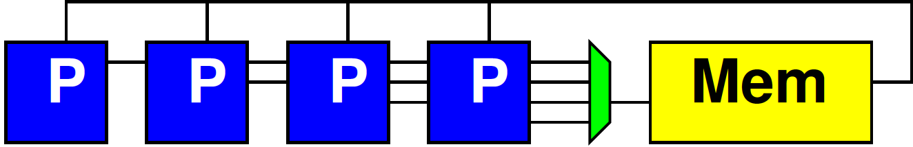
Preclass 1
N processors
Each: 1 read, 10 cycle, 1 write
Memory: 1 read or write per cycle
How many processors can support?

Slide 5
Bottleneck
Sequential access to a common memory can become the bottleneck

Slide 6
Memory Scaling

Slide 7
On-Chip Delay
Delay is proportional to distance travelled
Make a wire twice the length
  Takes twice the latency to traverse
  (can pipeline)
Modern chips
  Run at 100s of MHz to GHz
  Take 10s of ns to cross the chip
What does this say about placement of computations and memories?

Slide 8
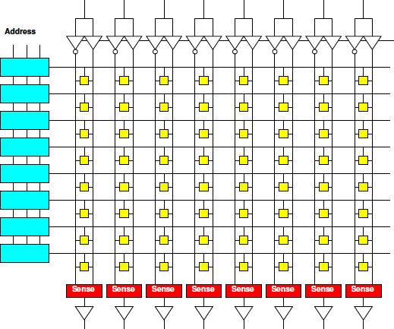
Memory Block
Linear wire delay with distance
Assume constant area/memory bit
N-bit memory, arranged in square
Width?
Depth?
Delay
scale
N?
width
depth

Slide 9
Memory Block Bandwidth
N-bit memory, arranged in square
Bits/cycle
scale with N?

Slide 10
Memory Block Energy
Assume read full width,
  Energy scales with N
    Activate sqrt(N) wires
    Each wire sqrt(N)
    long
  Or, energy/bit
  scales as sqrt(N)
Larger memories
cost more energy

Slide 11
Memory Block Density
Address, sense amplifies are large
Scale slower than bit area
  Bits scale N
  Address sqrt(N)*log(N)
  Sense amps sqrt(N)
Large memories
pay less per bit
  denser

Slide 12
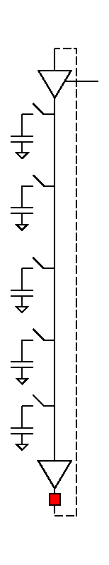
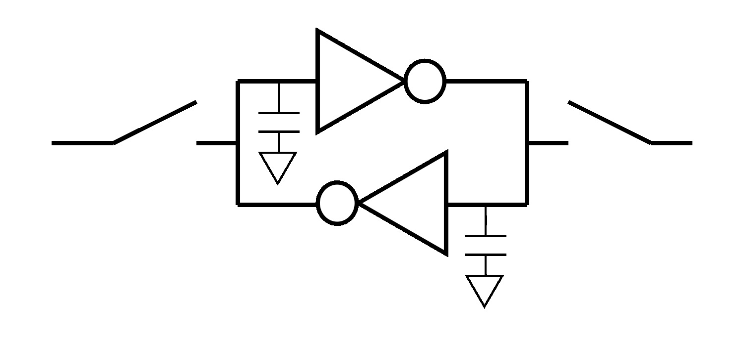
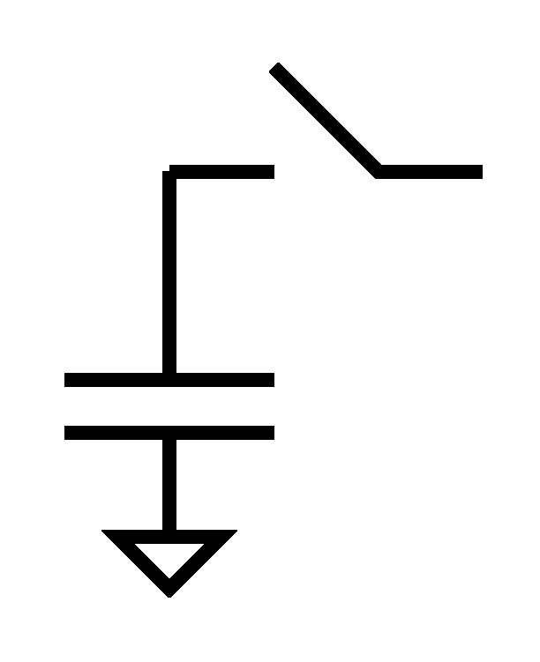
Dynamic RAM
Goes a step further
Share refresh/restoration logic as well
Minimal storage is a capacitor
“Feature” DRAM process is ability to make capacitors efficiently
Denser, but slower

Slide 13
Memory Scaling
Small memories are fast
  Large memories are slow
Small memories low energy
  Large memories high energy
Large memories dense
  Small memories cost
  more area per bit
Combining:
  Dense memories
  are slow

Slide 14
Wide Memory
Relatively easy to have a wide memory
As long as we share the address
SIMD-like
  One address to select
  wide word or bits
Efficient if all read
together

Slide 15
Preclass 2a
256b wide memory read/write in cycle
N processors
Random 32b read; 10 cycle; 32b write
How many processors can support?

Slide 16
Preclass 2b
256b wide memory read/write in cycle
N processors
Local memory (>=1024b)
FIFO 32b read; 10 cycle; 32b write
How exploit wide memory transfer?
How many processors can support?

Slide 17
Lesson
Cheaper to access wide/contiguous blocks memory
  In hardware
  From the architectures built
Can achieve higher bandwidth on large block data transfer
  Than random access of small data items

Slide 18
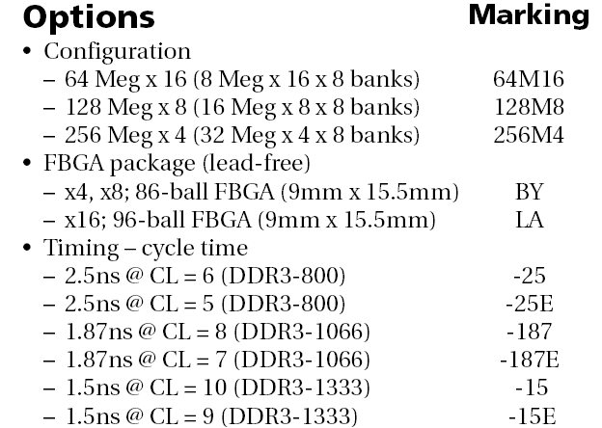
DRAM
1GB DDR3 SDRAM from Micron
  http://www.micron.com/products/dram/ddr3/
  96 pin pakage
  16b datapath IO
  Operate at 500+MHz
  37.5ns random access latency

Slide 19
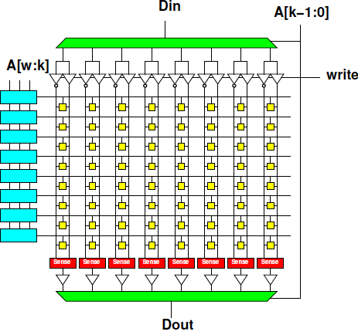
Memory Access Timing
RAS/CAS access
  Address
  Row fetch
  Column select
  writeback/refresh
Optimization for access within a row

Slide 20
Memory Access Timing
RAS/CAS access
  Address
  Row fetch
  Column select
    Can repeat
  writeback/refresh
Row
1024b—8192b
Faster to access within row

Slide 21
DRAM
1GB DDR3 SDRAM from Micron
  http://www.micron.com/products/dram/ddr3/
  96 pin pakage
  16b datapath IO
  Operate at 500+MHz
  37.5ns random access latency

Slide 22
DRAM Streaming
Reading row
is 15ns
16b @ 500MHz
1024b row
1024/16
  64 words
  per row
How supply 16b/2ns

Slide 23
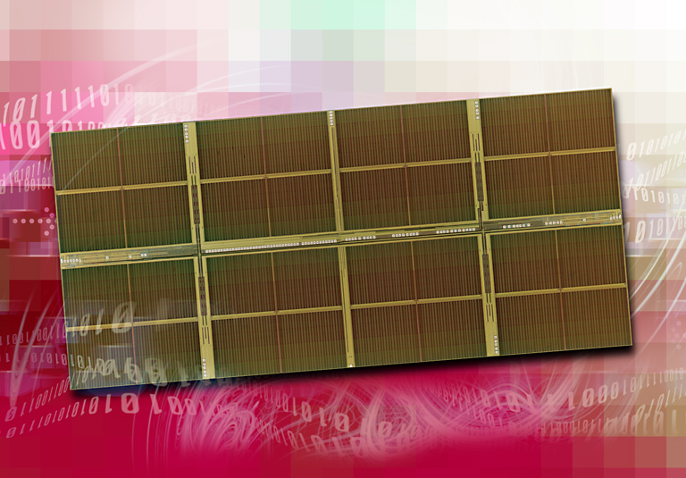
1 Gigabit DDR2 SDRAM
[Source: http://www.elpida.com/en/news/2004/11-18.html]

Slide 24
DRAM
Latency is large (10s of ns)
Throughput can be high (GB/s)
  If accessed sequentially
  If exploit wide word block transfers
Throughput low on random accesses

Slide 25
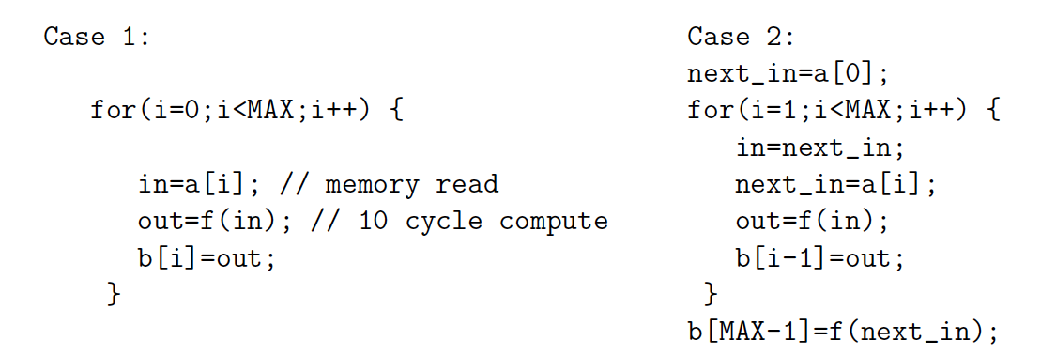
Preclass 4
10 cycle latency to memory
Throughput in each case?

Slide 26
Lesson
Long memory latency can impact throughput
  When must wait on it
  When part of a cyclic dependency
Pipeline memory access when possible
  exploit higher bandwidth of memory
  (compared to 1/latency)

Slide 27
Memory Organization

Slide 28
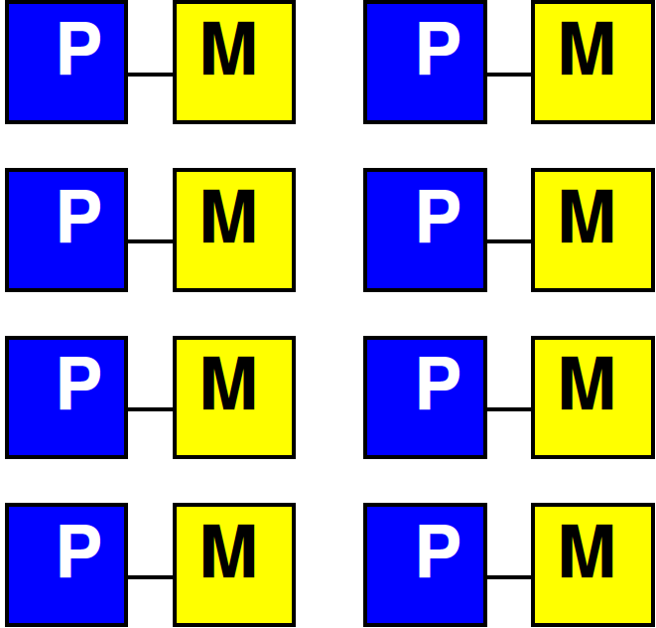
Local Memories
Cheapest way to get low latency and high bandwidth
  Small memories local to compute

Slide 29
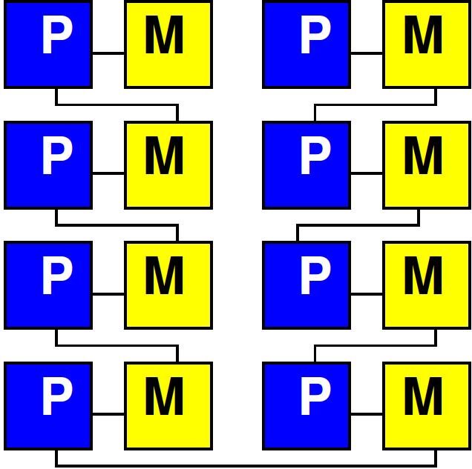
Like Preclass 2b
N processors
Local memory
FIFO 32b read; 10 cycle; 32b write
FIFO memories local to each processor pair
How many processors can these memories support?

Slide 30
Local Memories
Given a choice, to the extent we can get away with it
  Want small memories local to compute
    Bandwidth scales with compute
    Latency remains small

Slide 31
Bandwidth to Shared
High bandwidth is easier to engineer than low latency
  Wide-word demonstrated
  Banking
    Decompose memory into independent banks
    Route requests to appropriate bank

Slide 32
Independent Bank Access
Impact on: Bandwidth, Latency, Area?

Slide 33
Independent Bank Access
Compare same capacity, single memory with 4x wide (same bw) output: area, latency

Slide 34
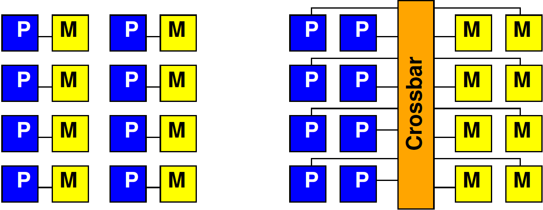
Compare Local and Shared
Compare banked, shared and local
  Latency, area ?

Slide 35
Data Reuse

Slide 36
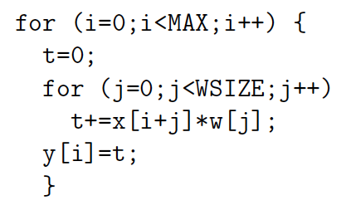
Preclass 5ab
How many reads to x[] and w[]?
How many distinct x[], w[] read?

Slide 37
Preclass 5c
How use local memory to reduce to 5b?
How much local memory need?

Slide 38
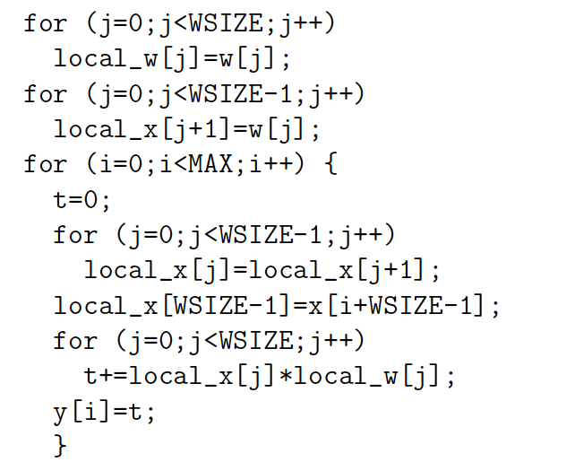
Preclass 5

Slide 39
Lesson
Data can often be reused
  Keep data needed for computation in
    Closer, smaller (faster, less energy) memories
  Reduces bandwidth required from large (shared) memories
Reuse hint: value used multiple times
  Or value produced/consumed

Slide 40
Enhancing Reuse
Computations can often be (re-)organized around data reuse
Parallel decomposition can often be driven by data locality
  Extreme case: processors own data
    Send data to processor for comptuation

Slide 41
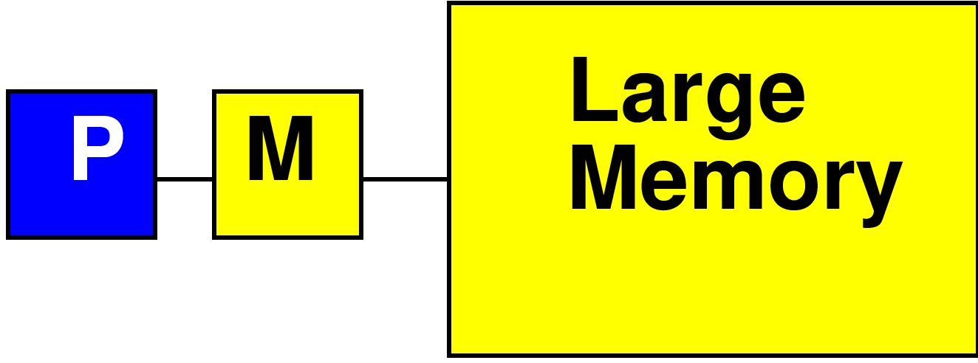
Processor Data Caches
Traditional Processor Data Caches are a heuristic instance of this
  Add a small memory local to the processor
    It is fast, low latency
  Store anything fetched from large/remote/shared memory in local memory
    Hoping for reuse in near future
  On every fetch, check local memory before go to large memory

Slide 42
Processor Data Caches
Demands more than a small memory
  Need to sparsely store address/data mappings from large memory
  Makes more area/delay/energy expensive than just a simple memory of capacity
Don’t need explicit data movement
Cannot control when data moved/saved
  Bad for determinism

Slide 43
Memory Organization
Architecture contains
  Large memories
    For density, necessary sharing
  Small memories local to compute
    For high bandwidth, low latency, low energy
Need to move data
  Among memories
    Large to small and back
    Among small

Slide 44
Big Ideas
Memory bandwidth and latency can be bottlenecks
Exploit small, local memories
  Easy bandwidth, low latency, energy
Exploit data reuse
  Keep in small memories
Minimize data movement
  Small, local memories keep distance short
  Minimally move into small memories

Slide 45
Admin
Reading for Day 8 from Zynq book
HW4 due Friday

