Slide 1
ESE532: System-on-a-Chip Architecture
Day 8: February 8, 2017
Data Movement
(Interconnect, DMA)

Slide 2
Today
Interconnect Infrastructure
Data Movement Threads
Peripherals
DMA

Slide 3
Message
Need to move data
Shared interconnect to make physical connections
Useful to move data as separate thread of control
Dedicating a processor is inefficient
Useful to have dedicated data-movement hardware: DMA

Slide 4
Memory and I/O Organization
Architecture contains
Large memories
For density, necessary sharing
Small memories local to compute
For high bandwidth, low latency, low energy
Peripherals for I/O
Need to move data
Among memories and I/O
Large to small and back
Among small
From Inputs, To Outputs

Slide 5
How move data?
Abstractly, using stream links.
Connect stream between producer and consumer.
Ideally: dedicated wires

Slide 6
Dedicated Wires?
Why might we not be able to have dedicated wires?

Slide 7
Making Connections
Cannot always be dedicated wires
Programmable
Wires take up area
Don’t always have enough traffic to consume the bandwidth of point-to-point wire
May need to serialize use of resource
E.g. one memory read per cycle
Source or destination may be sequentialized on hardware

Slide 8
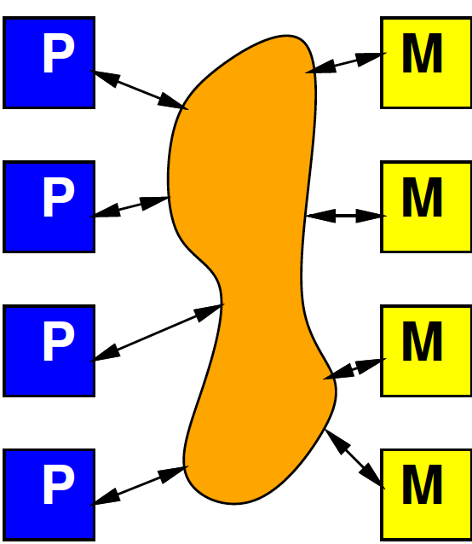
Model
Programmable, possibly shared interconnect

Slide 9
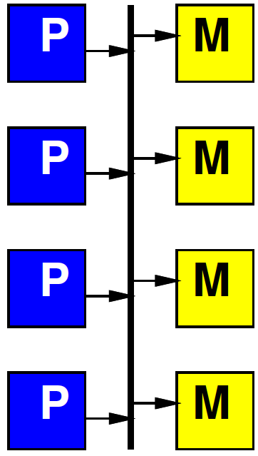
Simple Realization
Shared Bus
Write to bus with address of destination
When address match, take value off bus
Pros?
Cons?

Slide 10
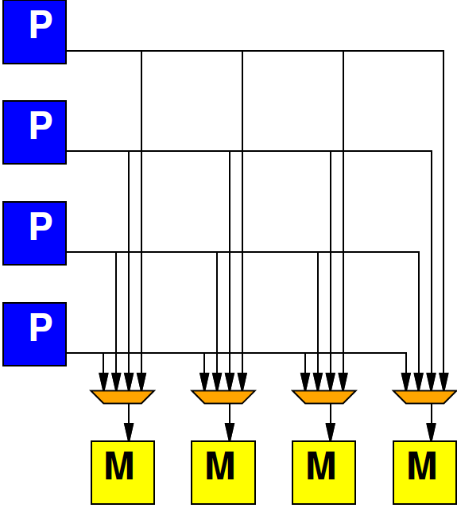
Alternate: Crossbar
Provide programmable connection between all sources and destinations
Any destination can be connected to any single source

Slide 11
Crossbar

Slide 12
Preclass 1
K-input, O-output, W-bit wide Crossbar
How many 2-input muxes?

Slide 13
Crossbar
Provides high bandwidth
Minimal blocking
Costs large amounts of area
Grows fast with inputs, outputs

Slide 14
General Interconnect
Generally, want to be able to parameterize designs
Here: tune area-bandwidth
Control how much bandwidth provide

Slide 15
Interconnect
How might get design points between bus and crossbar?

Slide 16
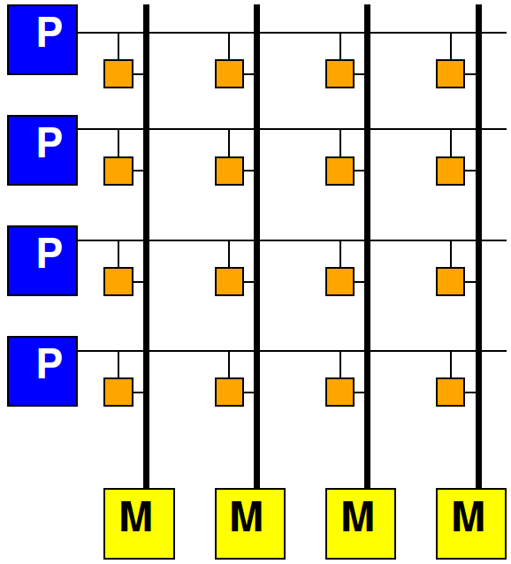
Multiple Busses
Think of crossbar as one bus per output
Simple bus is one bus total
In between,
How many simultaneous busses support?

Slide 17
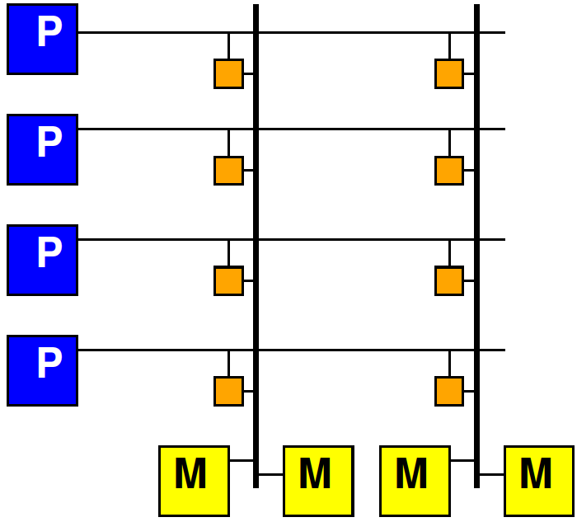
Share Crossbar Outputs
Group set of outputs together on a bus

Slide 18
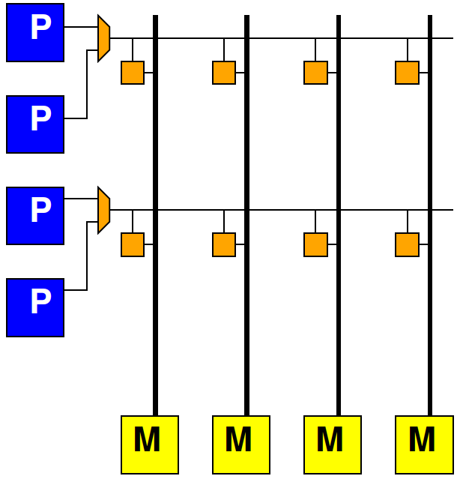
Share Crossbar Inputs
Group number of inputs together on an input port to crossbar

Slide 19
Locality in Interconnect
How allow physically local items to be closer?

Slide 20
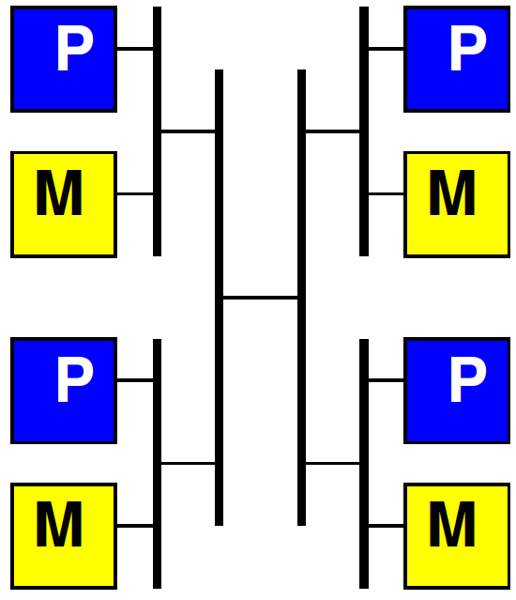
Hierarchical Busses

Slide 21
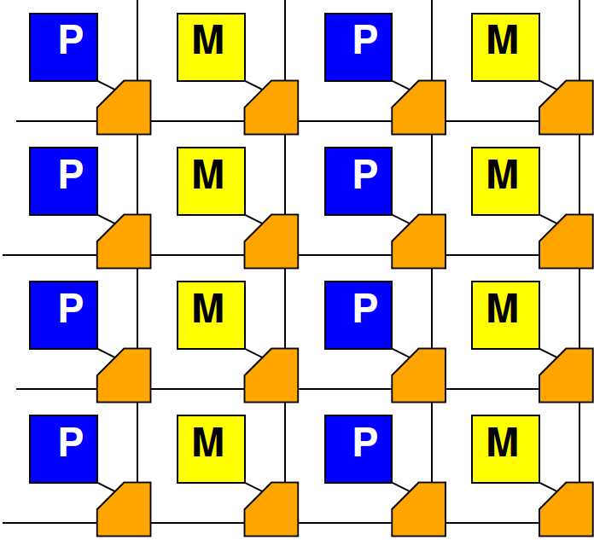
Mesh

Slide 22
Interconnect
Will need an infrastructure for programmable connections
Rich design space to tune area-bandwidth-locality
Will explore more later in course

Slide 23
Masters and Slaves
Regardless of form, potentially have two kinds of entities on interconnect
Master – can initiate requests
E.g. processor that can perform a read or write
Slaves – can only respond to requests
E.g. memory that can return the read data from a read requset

Slide 24
Long Latency Memory Operations

Slide 25
Last Time
Large memories are slow
Latency increases with memory size
Distant memories are high latency
Multiple clock-cycles to cross chip
Off-chip memories even higher latency

Slide 26
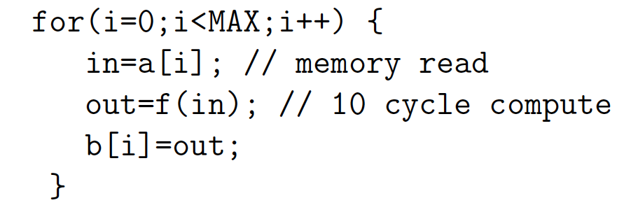
Day 7, Preclass 4
10 cycle latency to memory
If must wait for data return, latency can degrade throughput
10 cycle latency + 10 op + (assorted)
More than 20 cycles / result

Slide 27
Preclass 2
Throughput using 3 threads?

Slide 28
Fetch (Write) Threads
Potentially useful to move data in separate thread
Especially when
Long (potentially variable) latency to data source (memory)
Useful to split request/response

Slide 29
Peripherals

Slide 30
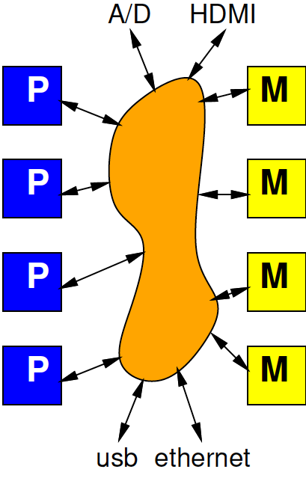
Input and Output
Typical SoC has I/O with external world
Sensors
Actuators
Keyboard/mouse, display
Communications
Also accessible from interconnect

Slide 31
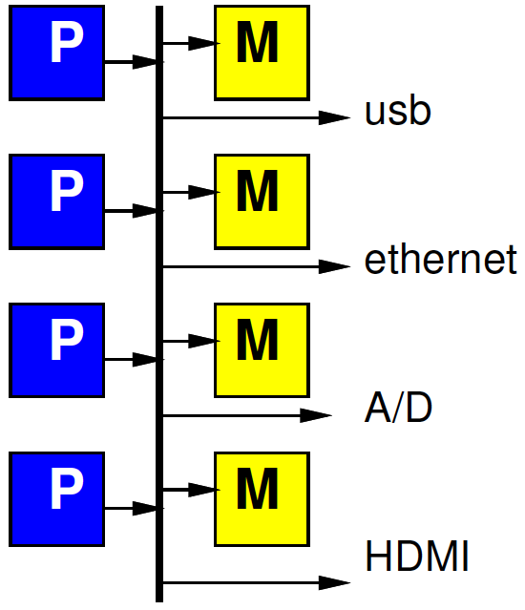
Simple Peripheral Model
Peripherals are slave devices
Masters can read input data
Masters can write output data
To move data, master (e.g. processor) initiates

Slide 32
Simple Model Implications
What implication to processor grabbing/moving each input (output) value?

Slide 33
Timing Demands
Must read each input before overwritten
Must write each output within real-time window
Must guarantee processor scheduled to service each I/O at appropriate frequency
How many cycles between inputs for 1Gb/s network and 32b, 1GHz processor?

Slide 34
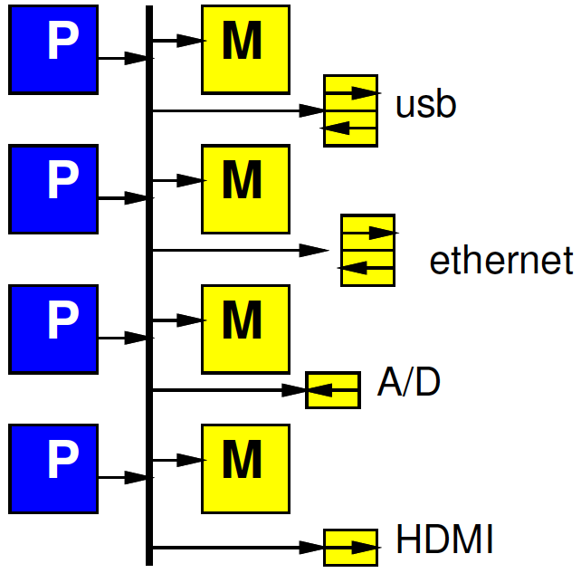
Refine Model
Give each peripheral local FIFO
Processor must still move data
How does this change requirements and impact?

Slide 35
DMA

Slide 36
Preclass 3
How much hardware to support fetch thread:
Counter bits?
Registers?
Comparators?
Other gates?
Compare to MicroBlaze
(minimum config 630 6-LUTs)

Slide 37
Observe
Modest hardware can serve as data movement thread
Much less hardware than a processor
Offload work from processors
Small hardware allow peripherals to be master devices on interconnect

Slide 38
DMA
Direct Memory Access (DMA)
Peripheral as Master
Can write directly into (read from) memory
Saves processor from copying
Reduces demand to schedule processor to service

Slide 39
DMA Engine
Data Movement Thread
Specialized Processor that moves data
Act independently
Implement data movement
Can build to move data between memories (Slave devices)
E.g., Implement P1, P3 in Preclass 3

Slide 40
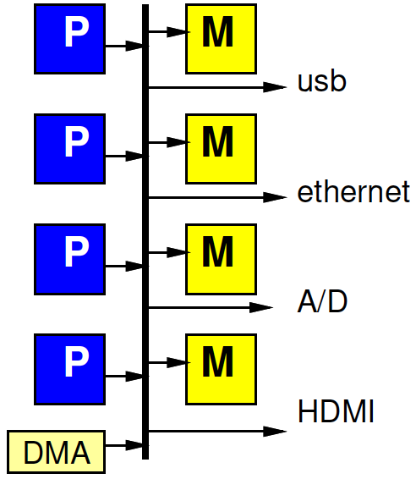
DMA Engine

Slide 41
Programmable DMA Engine
What copy from?
Where copy to?
Stride?
How much?
What size data?
Loop?
Transfer Rate?

Slide 42
Multithreaded DMA Engine
One copy task not necessarily saturate bandwidth of DMA Engine
Share engine performing many transfers (channels)
Separate transfer state for each
Hence thread
Swap among threads
E.g., round-robin

Slide 43
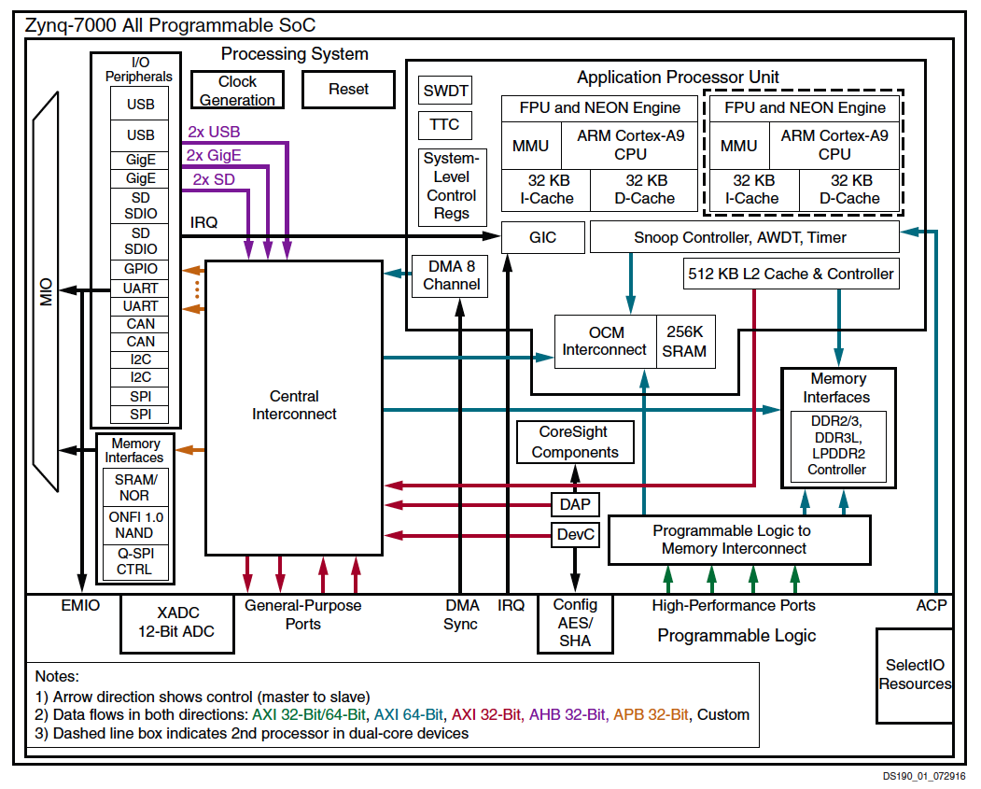

Slide 44
Hardwired and Programmable
Zynq has hardwired DMA engine
Can also add data movement engines (Data Movers) in FPGA fabric

Slide 45
Big Ideas
Need to move data
Shared Interconnect to make physical connections – can tune area/bw/locality
Useful to
move data as separate thread of control
Have dedicated data-movement hardware: DMA

Slide 46
Admin
Reading for Day 9 on web
HW4 due Friday

