Slide 1
ESE532: System-on-a-Chip Architecture
Day 9: February 13, 2017
Spatial Computations

Slide 2
Today
Accelerator Pipelines
FPGAs
Zynq Computational Capacity

Slide 3
Message
Custom accelerators efficient for large computations
Exploit Instruction-level parallelism
Run many low-level operations in parallel
Field Programmable Gate Arrays (FPGAs)
Allow post-fabrication configuration of custom accelerator pipelines
Can offer high computational capacity

Slide 4
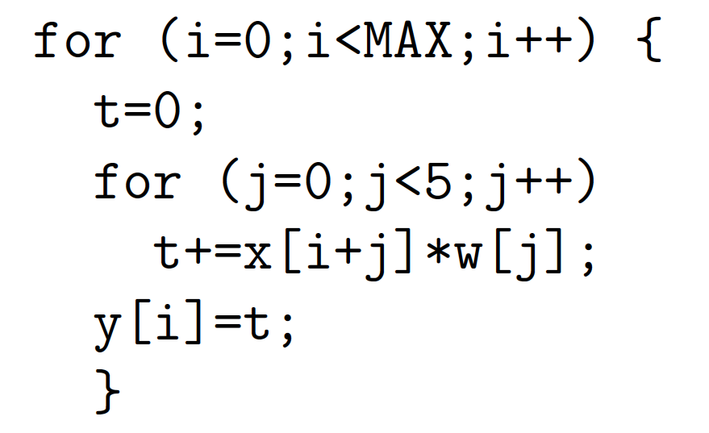
Preclass 1
Spatial pipeline?

Slide 5
Preclass 1
Adders/cycle?
Multipliers/cycle?
Pipeline Depth?

Slide 6
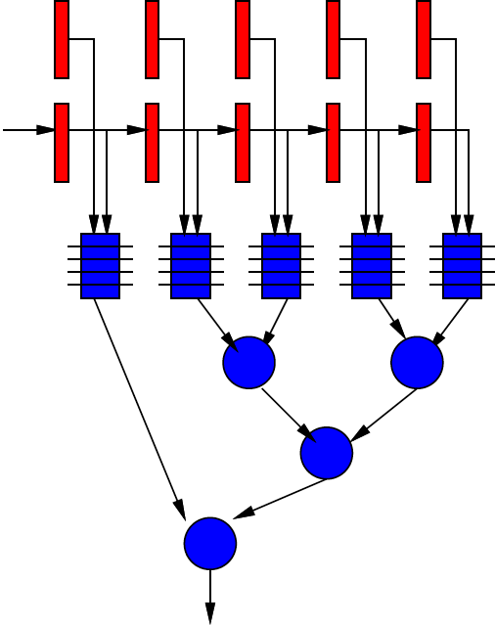
Spatial Pipeline

Slide 7
Spatial Pipeline
Can compute equivalent of tens of “instructions” in a cycle
Wire up primitive operators
No indirection through RF, memory
Pipeline for operator latencies
Any dataflow graph of computational operations

Slide 8
Operators
Can assemble any custom operators
Ones may not have in generic processor
Processor
Add, bitwise-xor/and/or, multiply
Maybe: floating-point add, multiply
Less likely
Square-root, exponent, cosine, encryption (AES) step, polynomial evaluate, log-number-system

Slide 9
Accelerators
Compression/decompression
Encryption/decryption
Encoding (ECC, Checksum)
Discrete Cosine Transform (DCT)
Sorter
Taylor Series Approximation of function
Transistor evaluator
Tensor or Neural Network evaluator

Slide 10
Integration System Architectures
Instruction Augmentation
Streaming Dataflow Operators

Slide 11
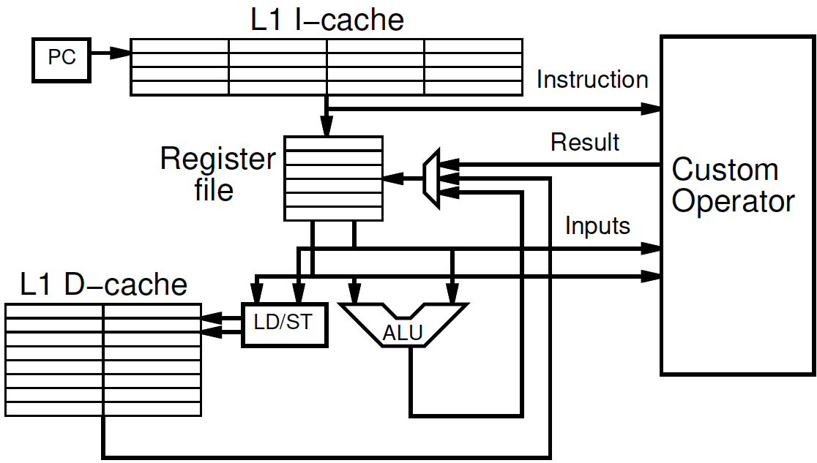
Instruction Augmentation

Slide 12
Instruction Augmentation
Looks like additional instructions
Issue from processor
Examples
Floating-point
SIMD

Slide 13
Streaming Dataflow
Replace operator with custom accelerator
Stream data to/from it
Maybe dedicated path
Operates from memory
Maybe DMA

Slide 14
Streaming Dataflow Example

Slide 15
Application-Specific SoCs
For dedicated applications may build custom hardware for accelerators
Layout VLSI, fab unique chips
ESE370, 570
Tensillica – custom instructions
Video-encoder – include custom DCT, motion-estimation engines

Slide 16
Customizable Accelerators
With post-fabrication configurability can exploit without unique fabrication
Need programmable substrate that allows us to wire-up computations

Slide 17
Field-Programmable Gate Arrays
FPGAs

Slide 18
FPGA
Idea: Can wire up programmable gates in the “field”
After fabrication
At your desk
When part “boots”
Like a “Gate Array”
But not hardwired

Slide 19
Gate Array
Idea: Provide a collection of uncommitted gates
Create your “custom” logic by wiring together the gates
Less layout and masks than full custom
Since only wiring together pre-fab gates
→ lower cost (fewer masks)
→ lower manufacturing delay

Slide 20
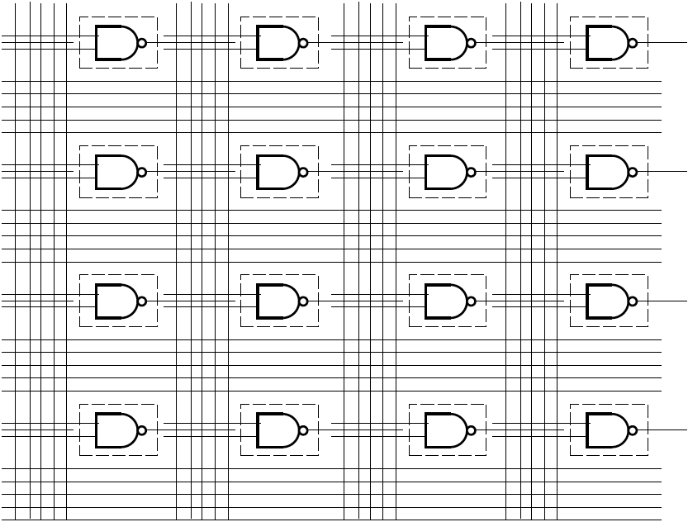
Gate Array

Slide 21
GA→FPGA
Remove the need to even fabricate the wiring mask
Make “customization” soft
Key trick:
Use reprogrammable configuration bits
Typically: static-RAM bits
Like SRAM cells or latches
Hold a configuration value

Slide 22
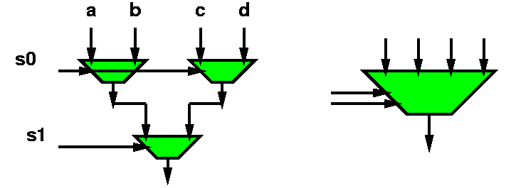
Mux with configuration bits = programmable gate
bool mux4(bool a, b, c, d, s0, s1) {
return(mux2( mux2(a,b,s0),
mux2(c,d,s0),
s1));
}

Slide 23
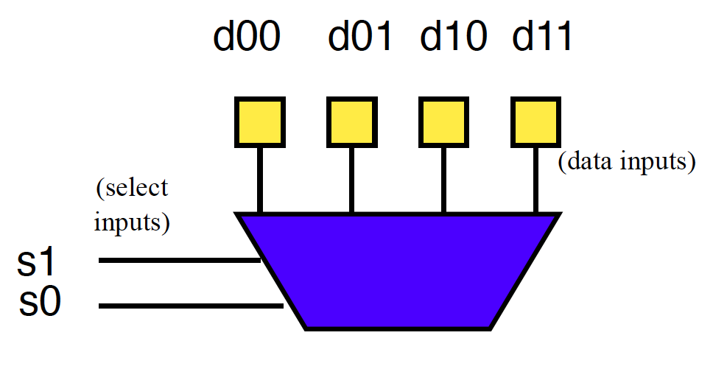
Preclass 2a
How do we program to behave as and2?

Slide 24
Mux as Logic
bool and2(bool x, y)
{return (mux4(false,false,false,true,x,y));}

Slide 25
Preclass 2b
How do we program to behave as xor2?

Slide 26
Mux as Logic
bool and2(bool x, y)
{return (mux4(false,false,false,true,x,y));}
bool xor2(bool x, y)
{return (mux4(false,true,true,false,x,y));}
Just by “configuring” data into this mux4,
Can select any two input function

Slide 27
LUT – LookUp Table
When use a mux as programmable gate
Call it a LookUp Table (LUT)
Implementing the Truth Table for small # of inputs
# of inputs =k (need mux-2^{k})
Just lookup the output result in the table

Slide 28
Preclass 3
How do we program full adder?

Slide 29
FPGA
Programmable gates + wiring
(both built from muxes w/ config. bits)
Can wire up any collection of gates
Like a gate array

Slide 30
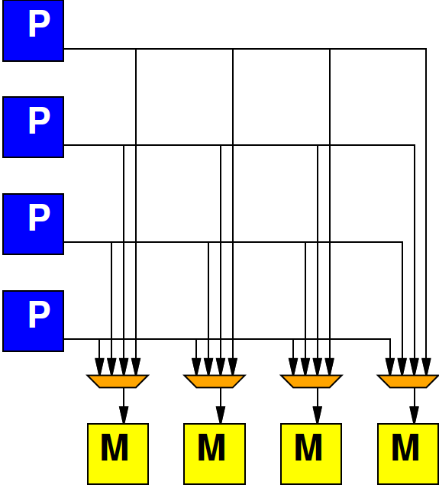
Crossbar Interconnect
How did we say the crossbar interconnect scaled?

Slide 31
Crossbar Interconnect
Crossbar interconnect is too expensive
And not necessary
Want
To be able to wire up gates
Economical with wires and muxes
…and configuration bits
Exploit locality (keep wires short)

Slide 32
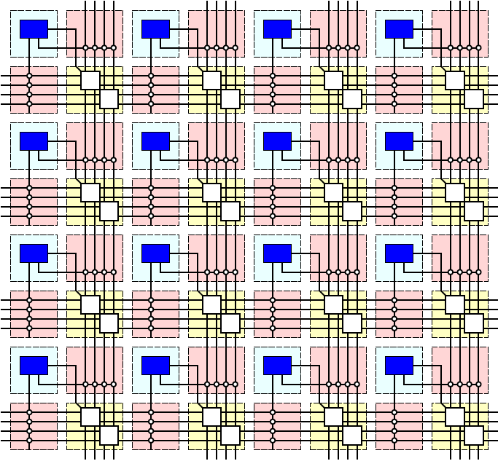
Simple FPGA

Slide 33
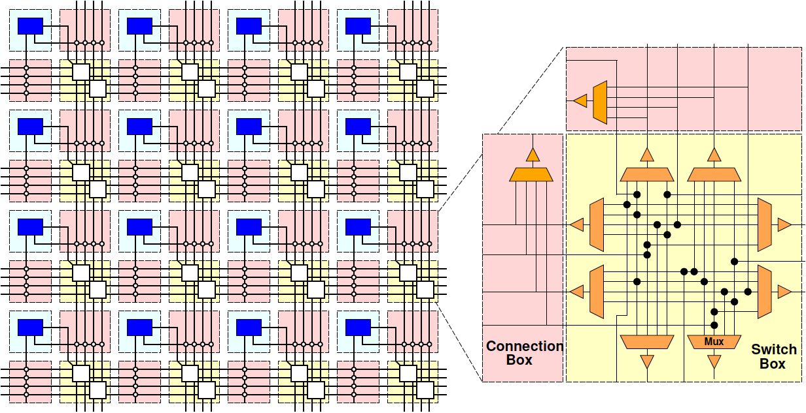
Simple FPGA

Slide 34
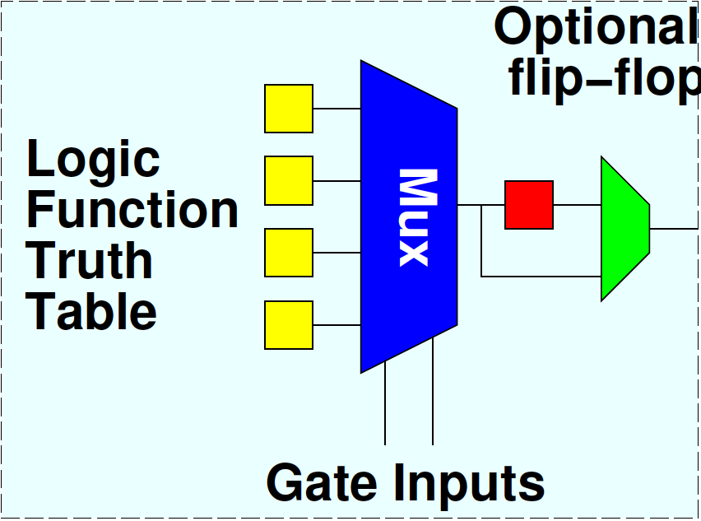
Flip-Flops
Want to be able to pipeline logic
…and generally hold state
E.g. implement window shift register in preclass 1
Add optional flip-flop on each gate

Slide 35
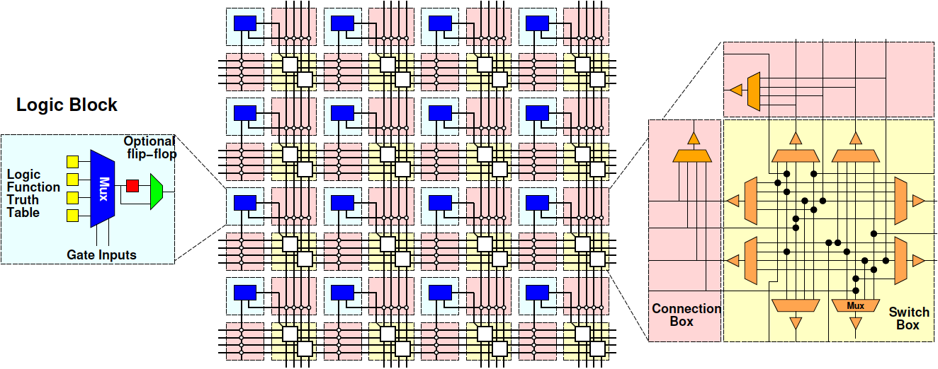
Simple FPGA

Slide 36
FPGA Design
Raises many architectural design questions
How big (many inputs) should the gates have?
Are LUTs really the right thing…
How rich is the interconnect?
Wires/channel
Wire length
Switching options

Slide 37
Modern FPGAs
Logic Blocks
hardwired fast-carry logic
Can implement adder bit in single “LUT”
Speed optimized: 6-LUTs
Energy, Cost optimization: 4-LUTs
Clusters many LUTs into a tile
Interconnect
Mesh, segments of length 4 and longer

Slide 38
Instruction View
FPGA: collection of bit-processing units
Must do the same thing on every cycle
Each BPU unit can do its own thing
Has own (configured) instruction
SIMD: collection of bit-processing units
Can do a different thing on every cycle
All BPU must do the same thing on a cycle
Single broadcast instruction to all BPUs

Slide 39
FPGA vs. SIMD Instruction Architecture
 | Each cycle | Each BPU
FPGA | same | unique
SIMD | unique | same
FPGAs: instructions do not change on cycle-by-cycle basis
SIMD: instructions shared across all units on a cycle

Slide 40
More than LUTs
Should there be more than LUTs in the “array” fabric?
What else might we want?

Slide 41
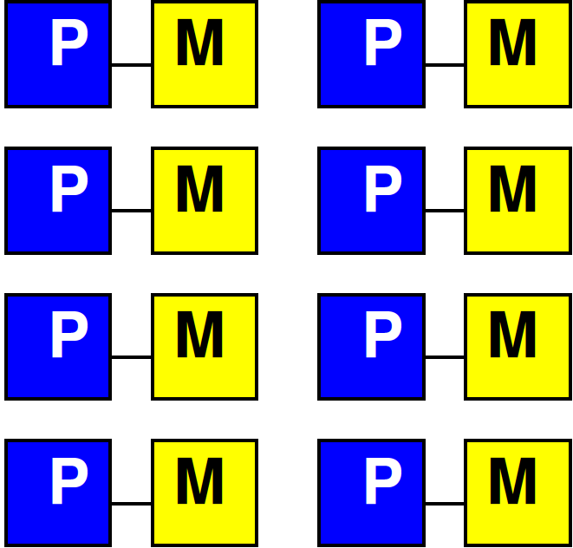
Embedded Memory
One flip-flop per LUT doesn’t store state densely
Want memory close to logic

Slide 42
Embed Memory in Array
Replace logic clusters
Convenient to replace columns
Since area of memory may not match area of logic cluster

Slide 43
Embedded Memory in FPGA
Logic
Cluster
Memory
Bank
Memory
Frequency

Slide 44
Hardwired Multipliers
Can build multipliers out of LUTs
Just as can implement multiplies on processor out of adds
But, custom multiplier is smaller than LUT-configured multiplier
…and multipliers common in signal processing, scientific/engineering compute

Slide 45
Multiplier Integration
Integrate like memories
Replace columns

Slide 46
More FPGA Architecture Design Questions
Size of Memories? Multipliers?
Mix of LUTs, Memories, Multipliers?
Add processors? Floating-point?
Other hardwired blocks?
How manage configuration?

Slide 47
Zynq

Slide 48
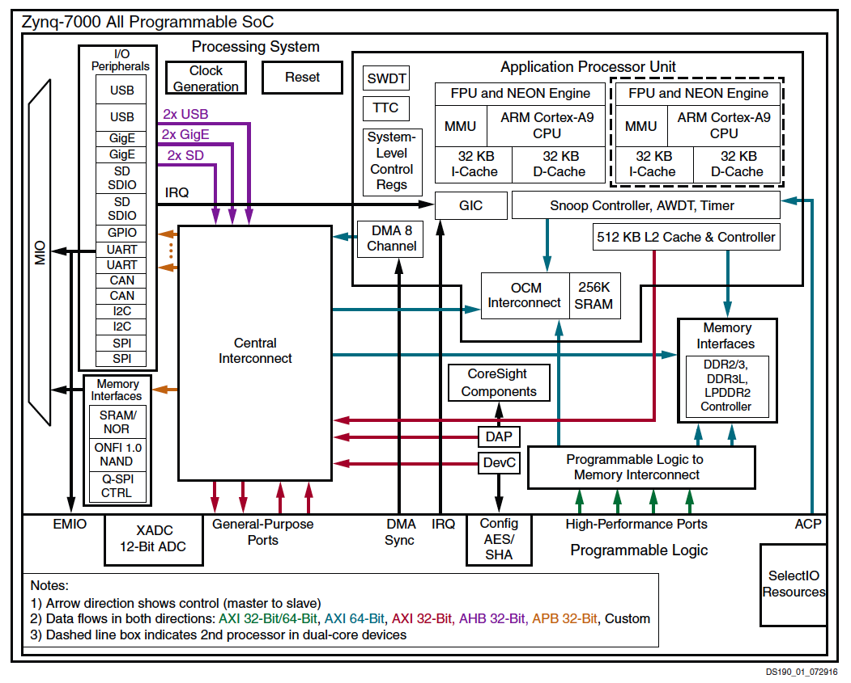

Slide 49
XC7Z020
6-LUTs: 53,200
DSP Blocks: 220
18x25 multiply, 48b accumulate
Block RAMs: 140
36Kb
Dual port
Up to 72b wide

Slide 50
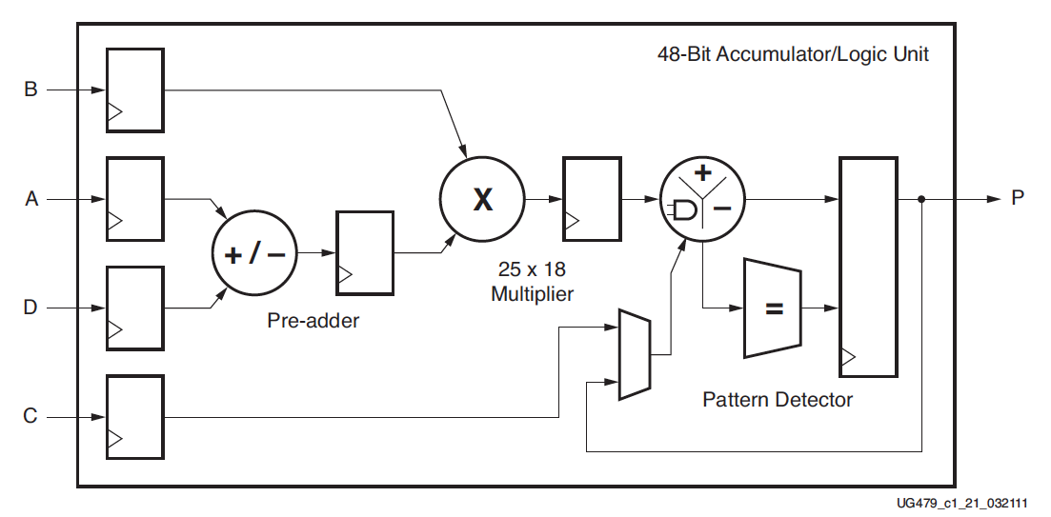
DSP48
Xilinx UG479 DSP48E1 User’s Guide

Slide 51
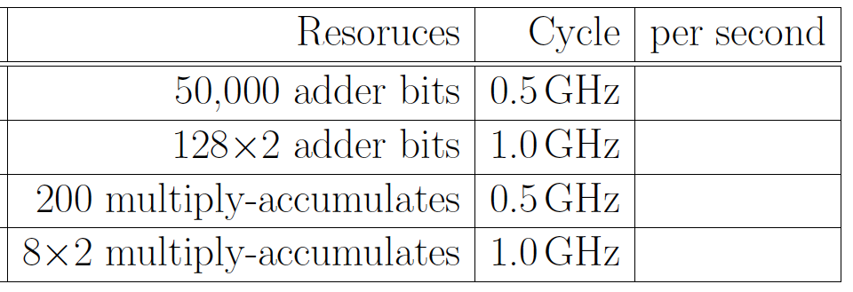
Preclass 4

Slide 52
Compute Capacity
How compare between ARM/NEON and FPGA array?
Adder-bits/second?
Multiply-accumulators/second?

Slide 53
Capacity → Density
Says Zynq has high computational capacity in FPGA
More broadly
FPGA can have more compute/area than processor
E.g., more adder bits in some fixed area
SIMD can have more compute/area than processor
How wide SIMD can you exploit?

Slide 54
FPGA Potential
FPGA Array has high raw capacity
Exploitable when computation has high regularity
Uses the same computation over-and-over
High throughput on a computation
Build customized accelerator pipeline to match the computation
Low-hanging fruit
Operator/function takes most of the compute time

Slide 55
90/10 Rule (of Thumb)
Observation that code is not used uniformly
90% of the time is spent in 10% of the code
Knuth: 50% of the time in 2% of the code
Opportunity
Build custom datapath in FPGA (hardware) for that 10% (or 2%) of the code

Slide 56
Big Ideas
Custom accelerators efficient for large computations
Exploit Instruction-level parallelism
Run many low-level operations in parallel
Field Programmable Gate Arrays (FPGAs)
Allow post-fabrication configuration of custom accelerator pipelines
Can offer high computational capacity

Slide 57
Admin
Reading for Day 10 on canvas
HW5 due Friday

