Slide 1

ESE534:
Computer Organization
Day 16: March 24, 2010
Component-Specific Mapping

Slide 2
Previously
Increasing variation with scaling (Day 8)
Row sparing in memories (Day 12, HW6)
Disk-drive model for mapping out defects in software (Day 12)
PLAs for logic (last time)
LUTs + Interconnect (Day 14)

Slide 3
Today
Defect and Variation Tolerance
for Compute and Interconnect
High defect rates and extreme variation
Nanoscale chips are like snowflakes
  ➔ Each one is unique.
Application mapping tailored to the component

Slide 4
Agenda
nanoPLA
  Introduction
  Tolerating crosspoint defects
  Tolerating extreme V_{th} variation
FPGA
  Tolerating defects
  Lightweight, load-time defect avoidance

Slide 5
nanoPLA
Architecture

Slide 6
NanoPLA Plane
Smallest unit of computation
Built Bottom-Up from nanowires
Diode-Programmable region
  Memory cell area == Wire crossing area
  Molecular
  Amorphous Si
Stochastic FET restore region
  Core-shell nanowires with doped region

Slide 7
NanoPLA Block

Slide 8
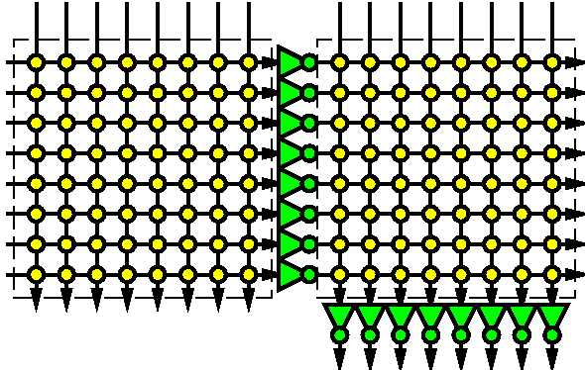
NanoPLA Block
Logically same behavior as PLA
  Selectively invert input.
  And Plane
  Or Plane

Slide 9
NanoPLA Block Circuit Diagram

Slide 10
NanoPLA Block Circuit Diagram

Slide 11
NanoPLA Block Circuit Diagram

Slide 12
NanoPLA Block Circuit Diagram
Invert

Slide 13
NanoPLA Block Circuit Diagram
Invert

Slide 14
NanoPLA Block Circuit Diagram
Invert
OR

Slide 15
NanoPLA Block Circuit Diagram
NAND-Term

Slide 16
NanoPLA

Slide 17
NanoPLA
Tiled programmable logic blocks
Manhattan routing
  Through blocks
  No separate switching network
Nanoscale-density
  Compute
  Interconnect

Slide 18
nanoPLA
Tolerating non-Programmable Crosspoint

Slide 19
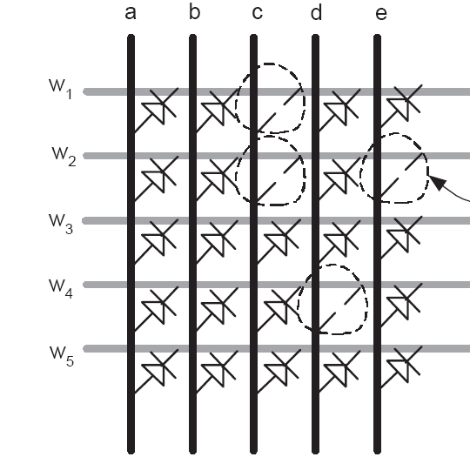
Crosspoint Defects
Crosspoint junctions may be nonprogrammable
  E.g. the first 8x8 from Hewlett-Packard had 85% programmable crosspoints
Preclass:
  100 junctions
  5% stuck-open rate
  P_{xpoint}=0.95
  P_{row} ?

Slide 20
Crosspoint Defects
Using P_{row} just calculated.
How many perfect wires can we expect (on average) in an array of 100 wires?
How will row sparing work here?
What kind of overhead would row sparing require?

Slide 21
Idea 1: Don’t need all junctions
F=a+b+e
Can use wire w₄
Even though has missing crosspoints
Preclass 2:
  F require 3 good crosspoints
  P_{good}?

Slide 22
Idea 2: Have many wires to choose from
F=a+b+e
Cannot use w₂
Can use any of the rest
Probability of at least one match is very high
Preclass 3
  Use P_{good} from Preclass 2
  P(1 of 5)=?
Notes:
1-(1-0.85)⁵>99.99%

Slide 23
Mapping Entire Array
Need to map all 100 functions
Assuming P_{1-of-5} from previous, what’s the probability can find a match for all 100?
In practice have 100 to choose from not 5
What can we do if cannot find a match?

Slide 24
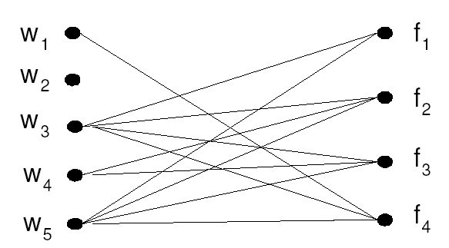
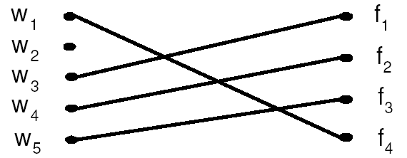
Crosspoint Defects
Tolerate by matching nanowire junction programmability with pterm needs
Naeimi/DeHon, FPT2004
Design and Test of Computers, July-August 2005

Slide 25
Crosspoint
Defect Rate Impact
Toronto20 benchmark circuits
  Typical 10k “gate” logic designs

Slide 26
Matching Lesson
Can use almost all wires
  @ 5% defects, need no extra wires
…despite the fact that almost all wires are imperfect
  P_{row} from preclass 1
Trick is to figure out where an imperfect wire is “good enough”

Slide 27
nanoPLA
Tolerating Extreme V_{th} Variation

Slide 28
Challenge
High variation of V_{th} means some devices leak faster than others evaluate!

Slide 29

Preclass 4
From: http://en.wikipedia.org/wiki/File:Standard_deviation_diagram.svg
Sampling nanowires from a distribution
What range of nanowire V_{th}’s must we tolerate?
4c: In array of 100 nanowires, what is the probability that there is one nanowire nσ above mean and one nσ below?
  σ = 1?
  σ = 2?
  σ = 3?

Slide 30
Preclass
Problem 4d: How many σ out should we expect in a collection of 100 arrays?
Problem 5:
  I(Von,V_{th}=V_{th}+nσ) = ?
  I(Voff,V_{th}=V_{th}-nσ) = ?
What is σ/V_{th} given in example?
Notes:
+-3σ
.21νΑ
1νΑ

Slide 31
Challenge
High variation of V_{th} means some devices leak faster than others evaluate!

Slide 32
NanoPLA Physical Variation
Predominantly Random Variation
Due to Bottom-up manufacturing process
Variation in:
  Dopant fluctuations
  NanoWire alignment
  NanoWire dimensions
  Number of state-holding elements / junction
Variation in Vth, R and C
  Independent Gaussian distributions

Slide 33
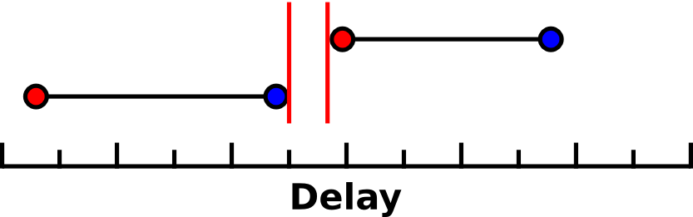
NanoPLA Defect Model

Slide 34
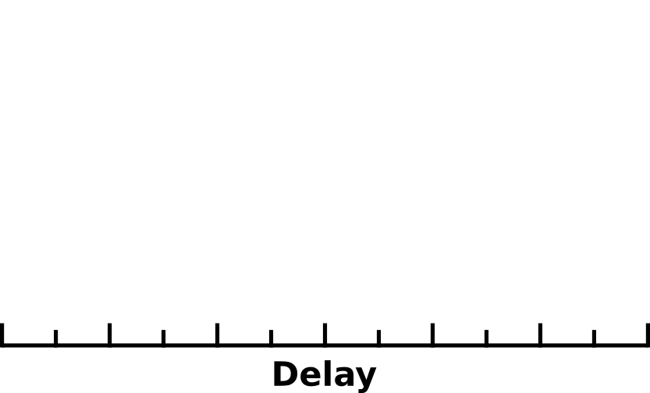
Defect Model

Slide 35
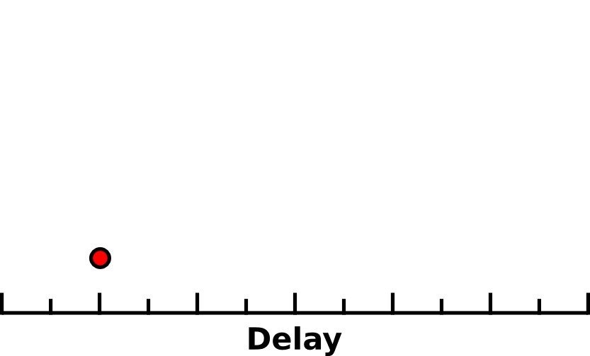
Defect Model
ON
τSwitch

Slide 36
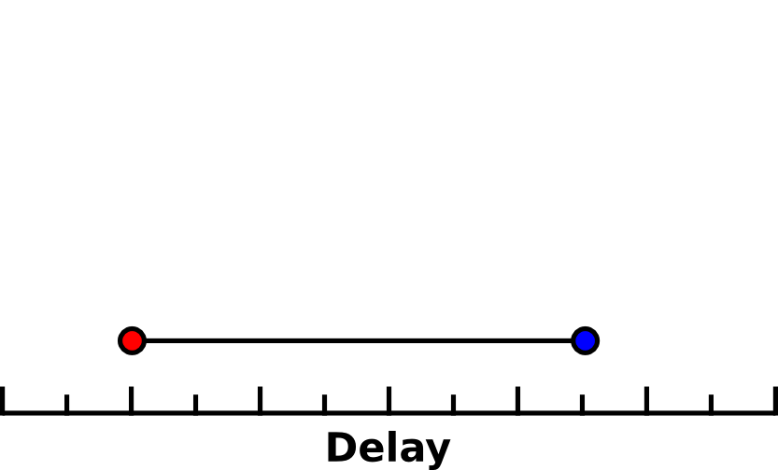
Defect Model
OFF
τSwitch
τLeak

Slide 37
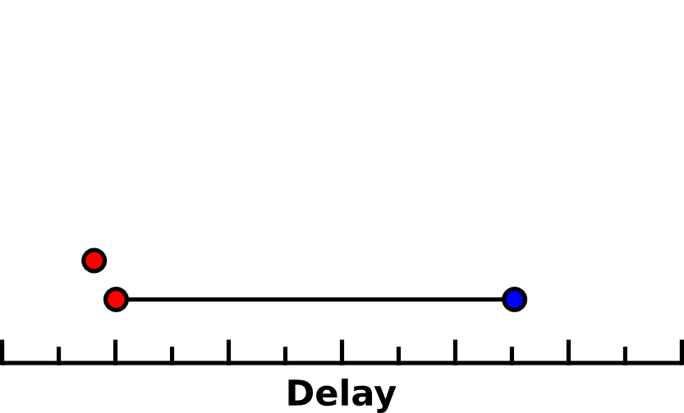
Defect Model
ON
τSwitch
τLeak

Slide 38
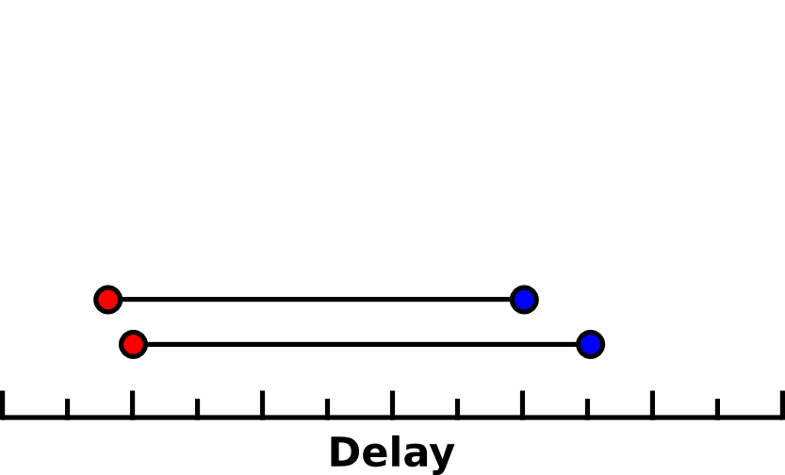
Defect Model
OFF
τSwitch
τLeak

Slide 39
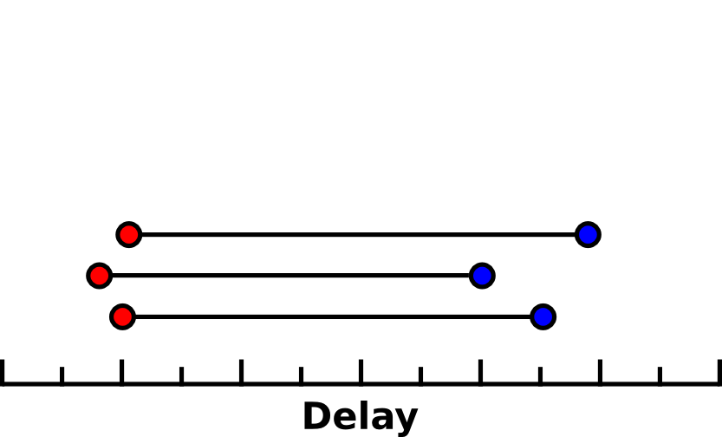
Defect Model
τSwitch
τLeak

Slide 40
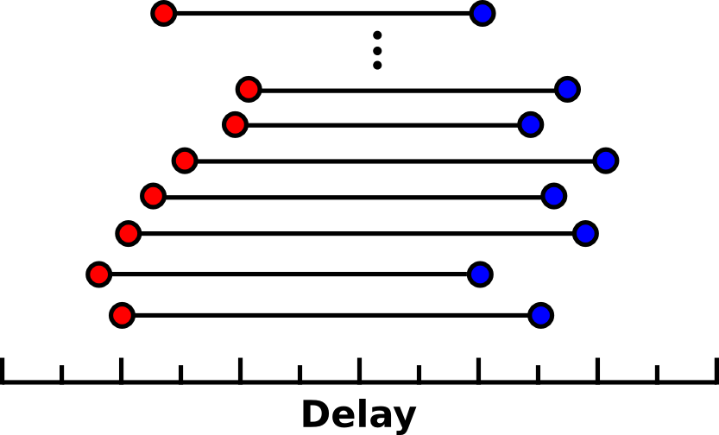
Defect Model
τSwitch
τLeak
Operating Region

Slide 41
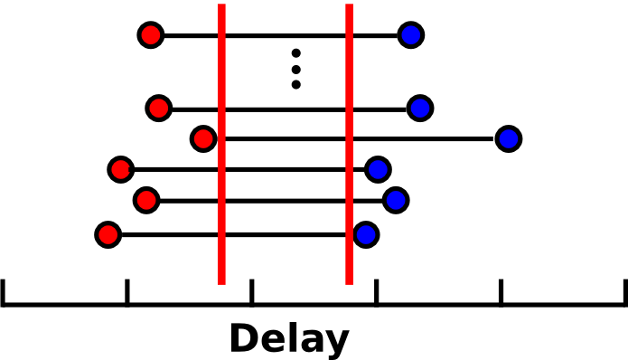
Defect Model
τSwitch of one NAND-term > τLeak of another NAND-term
τTarget
To keep leakage power low, demand two orders of magnitude separation
100·Max(τSwitch) ≤ Min(τLeak)

Slide 42

Variation-Oblivious Mapping

Slide 43
Variation-Oblivious Mapping
Perform Detailed Mapping Oblivious to the Characteristics of the underlying Resources.
l
l

Slide 44
Variation-Oblivious Mapping
Perform Detailed Mapping Oblivious to the Characteristics of the underlying Resources.
SPLA at 38% Variation
l
l

Slide 45
Variation-Oblivious Mapping
Perform Detailed Mapping Oblivious to the Characteristics of the underlying Resources.
SPLA at 38% Variation
l
l
Defective Mapping: 100·Max(τSwitch) ≤ Min(τLeak) not met

Slide 46
Timing Model
τSwitch ≈
τLeak ≈

Slide 47
Timing Model
τSwitch ≈ Ron
τLeak ≈ Roff

Slide 48
Timing Model
τSwitch ≈ Ron ∙ ΣFanout(Cout)
τLeak ≈ Roff ∙ ΣFanout(Cout)

Slide 49
Timing Model
τSwitch ≈ Ron ∙ ΣFanout(Cout)
τLeak ≈ Roff ∙ ΣFanout(Cout)

Slide 50
Timing Model
τSwitch ≈ Ron ∙ ΣFanout(Cout)
τLeak ≈ Roff ∙ ΣFanout(Cout)
Vdd

Slide 51
Timing Model
0
τSwitch ≈ Ron ∙ ΣFanout(Cout)
τLeak ≈ Roff ∙ ΣFanout(Cout)
Vdd

Slide 52
Timing Model
0
τSwitch ≈ Ron ∙ ΣFanout(Cout)
τLeak ≈ Roff ∙ ΣFanout(Cout)
Vdd

Slide 53
Primary Source of Variation

Slide 54
Primary Source of Variation

Slide 55
Primary Source of Variation

Slide 56
Primary Source of Variation

Slide 57
Primary Source of Variation
Linear Change in Ron
Exponential Change in Roff
Vth Variation
Roff variation dominates
all other physical variation

Slide 58
Preventing Overlap
  -How to avoid overlap problem?
  -Mark leakiest defective
  -Perform Variation Oblivious mapping

Slide 59
Defect-Avoiding Algorithm
  -Mark leakiest resources as defective
  -Perform Variation-Oblivious mapping on remaining resources
SPLA at 38% Variation
Works but discards 48% of resources, 167% wider channels leading to high delay, energy and area

Slide 60
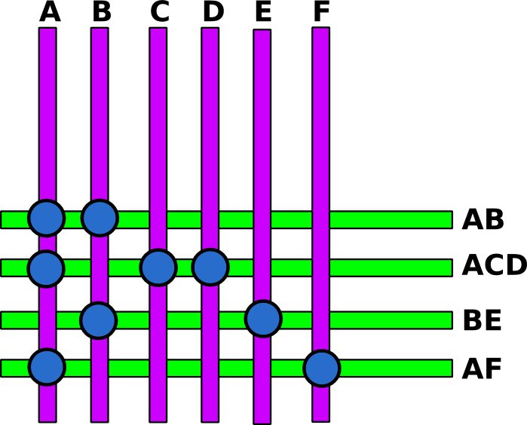
Logical Variation: Variation in Fanout
τLeak ≈ Roff ∙ ΣFanout(Cout)
Fanout comes from netlist
Map:
AB+ACD+BE+AF

Slide 61
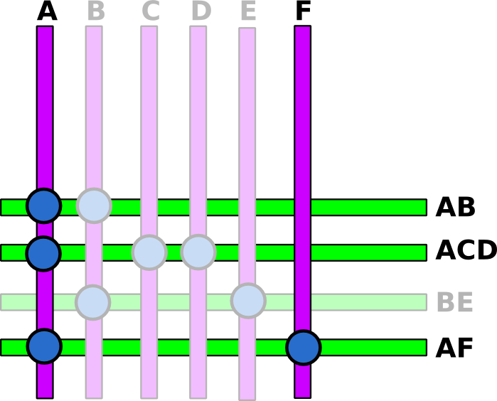
Logical Variation: Variation in Fanout
A has fanout 3:
AB, ACD,AF
F has fanout 1:
AF
Even at nominal, A sees
3 times more load than F
τLeak ≈ Roff ∙ ΣFanout(Cout)

Slide 62
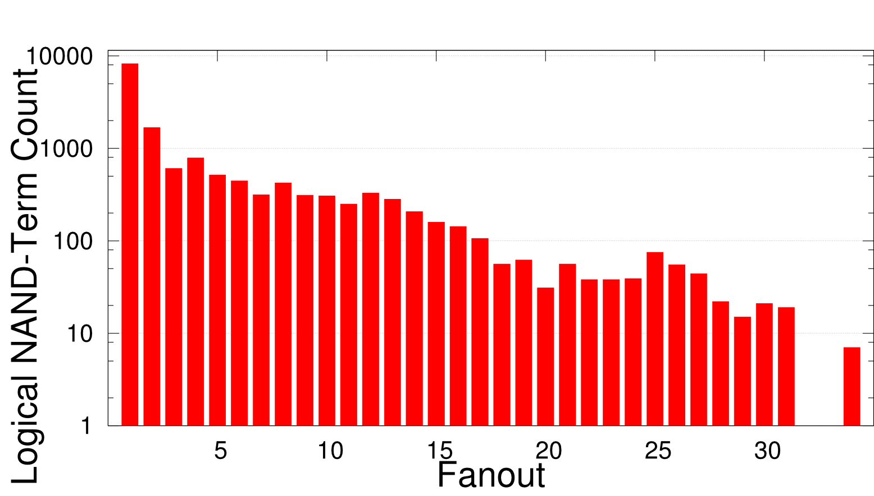
Logical Variation: Variation in Fanout
Typical Fanout Distribution

Slide 63
Defect-Avoiding Toy Example
Step 1 Discard Leaky Resources
Estimated τLeak
Logical Fanout
Roff Resistance
1
320
10
20
15
150
1
300
3
100
30

Slide 64
Defect-Avoiding Toy Example
Step 2 Match Functions to Resources
Estimated τLeak
Logical Fanout
Roff Resistance
1
320
320
10
20
15
150
1500
1
300
4500
3
100
100
30
900

Slide 65
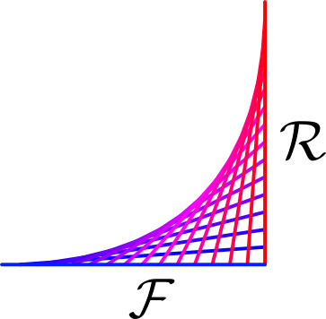
VMATCH

Slide 66
VMATCH
Logical Variation + Physical Variation >> Variation
Variation-Aware Mapping Algorithm
Uses logical variation (fanout variation) to counteract physical variation (Roff variation)
  Matches high-fanout term with low Roff NAND-Term and vice versa.

Slide 67
VMATCH Toy Example
Step 1 Sort
Logical Fanout
Roff Resistance
1
320
10
20
15
150
1
300
3
100
30

Slide 68
VMATCH Toy Example
Step 2 Match High Fanout with Low Roff
Estimated τLeak
Logical Fanout
Roff Resistance
15
20
300
320
10
30
300
3
100
300
1500
1
150
150
4500
1
300
300
100
320
320
900

Slide 69
VMATCH Results
SPLA at 38% Variation
Only requires 3% extra resources

Slide 70
Experiments
5nm
Simulated NanoPLA using 5nm pitch wires, 5nm transistor channel length
Modeled variation up to ITRS predicted 38% for technology
5nm
Implemented Variation-Oblivious, Defect-Avoiding and VMATCH Algorithms on NPR
Routed Toronto 20 Benchmark on 100 Monte Carlo generated chips.

Slide 71
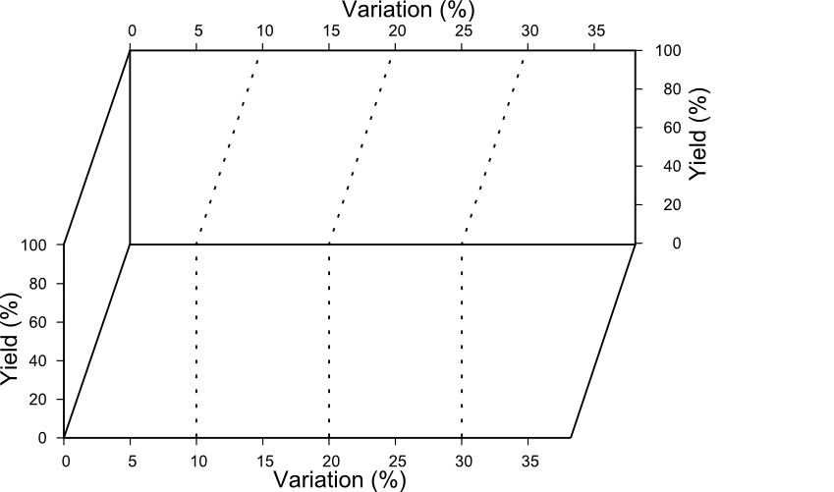
Achievable Yield
Maximum variation that achieves 100% yield SPLA on 100 Chips

Slide 72
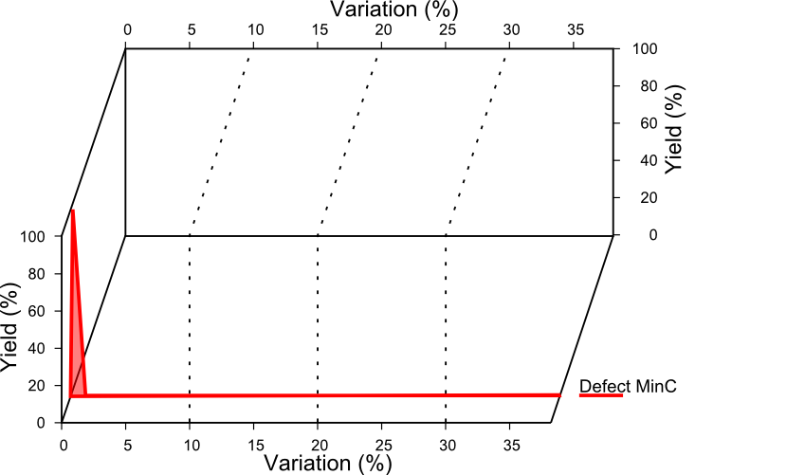
Achievable Yield
Maximum variation that achieves 100% yield SPLA on 100 Chips

Slide 73
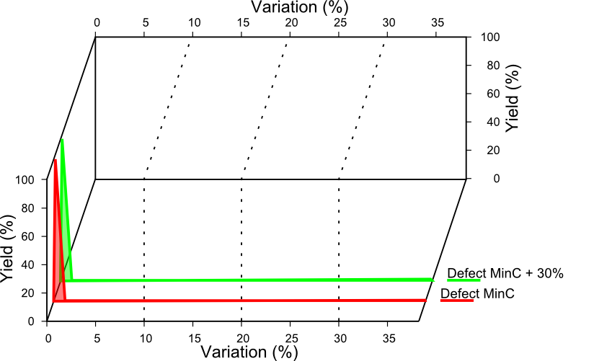
Achievable Yield
Maximum variation that achieves 100% yield SPLA on 100 Chips

Slide 74
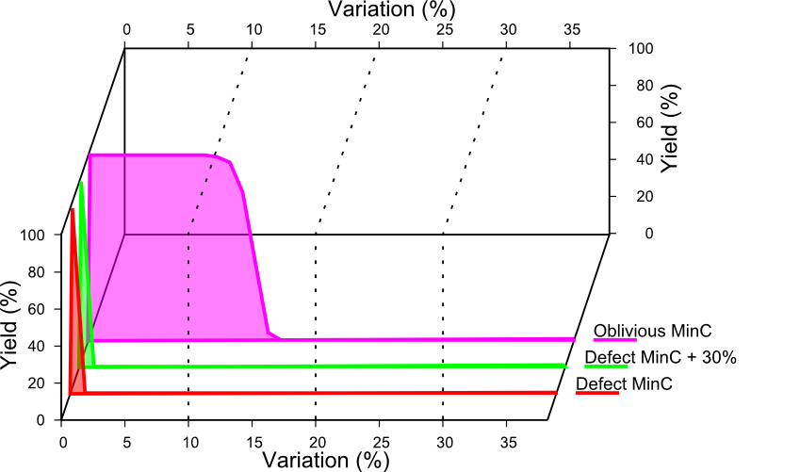
Achievable Yield
Maximum variation that achieves 100% yield SPLA on 100 Chips

Slide 75
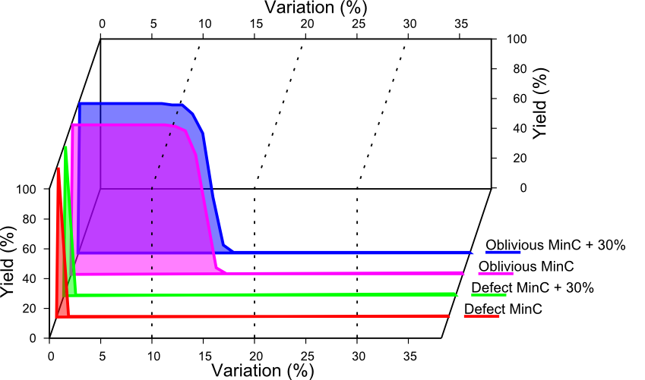
Achievable Yield
Maximum variation that achieves 100% yield SPLA on 100 Chips

Slide 76
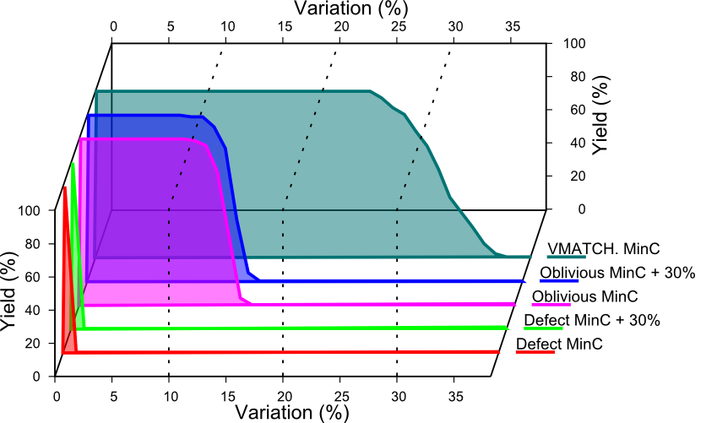
Achievable Yield
Maximum variation that achieves 100% yield SPLA on 100 Chips

Slide 77
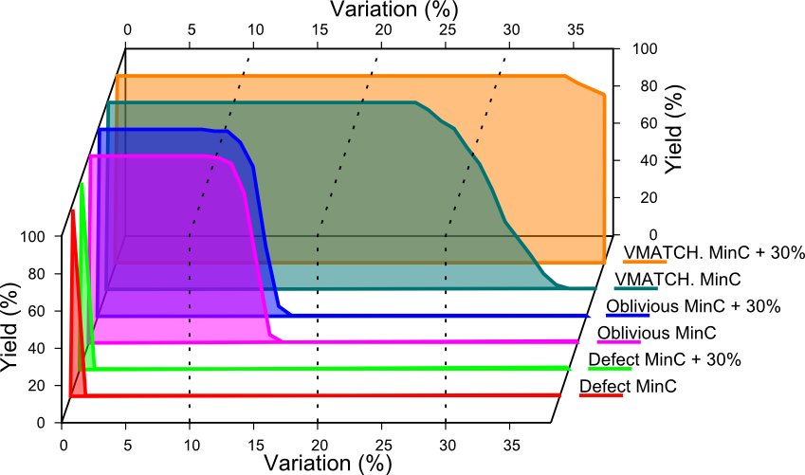
Achievable Yield
Maximum variation that achieves 100% yield SPLA on 100 Chips

Slide 78
Matching Lesson 2
Can keep yield high
  @ 38% variation, small amount of extra wires
…despite the fact that Roff varies over 12 orders of magnitude
Trick is to match the logical variation to the physical variation to reduce both

Slide 79
FPGA Defects
Full Knowledge

Slide 80
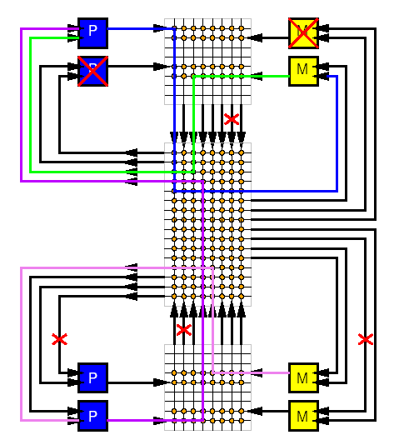
Problem
At high defect rates, some resources will be unusable
Resources
  LUTs
  FFs
  Interconnection links
Full crossbars are
too expensive

Slide 81
Opportunity
Avoid defective elements during mapping
  Don’t place logic in defective LUT
    Like disk-drive model where we don’t allocate a defective sector to hold data
  Route to avoid defective interconnect

Slide 82
Avoid Defective LUT
x
x
x
x
[Lach et al. / FPGA 1998]

Slide 83
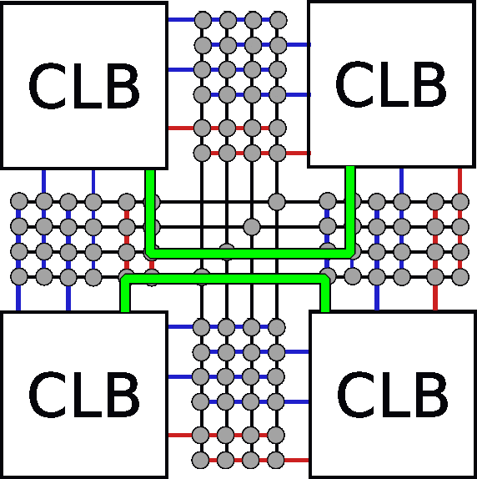
Avoid Defective Interconnect

Slide 84
Example
Collect 4 numbers between 1 and 81

Slide 85
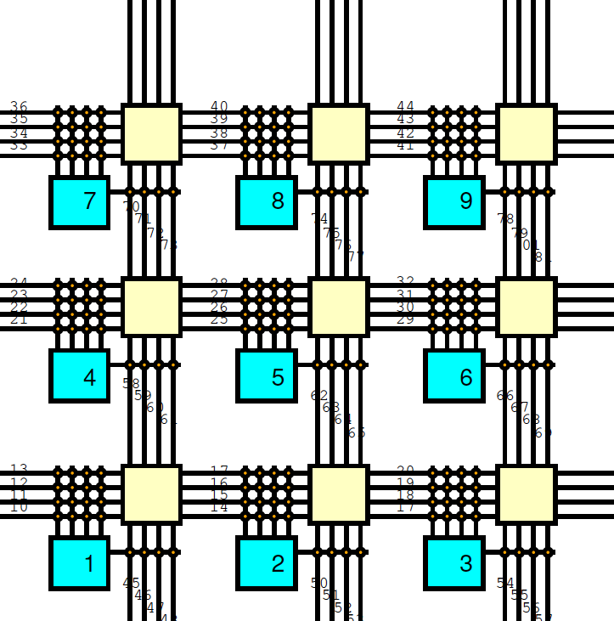
Defects on Mesh
Draw on board for mapping on next slide.

Slide 86
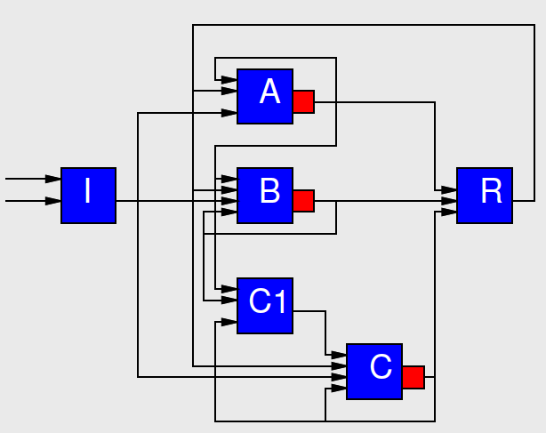
Class Exercise
Map this circuit to the defective LUT mesh, avoiding defects.

Slide 87
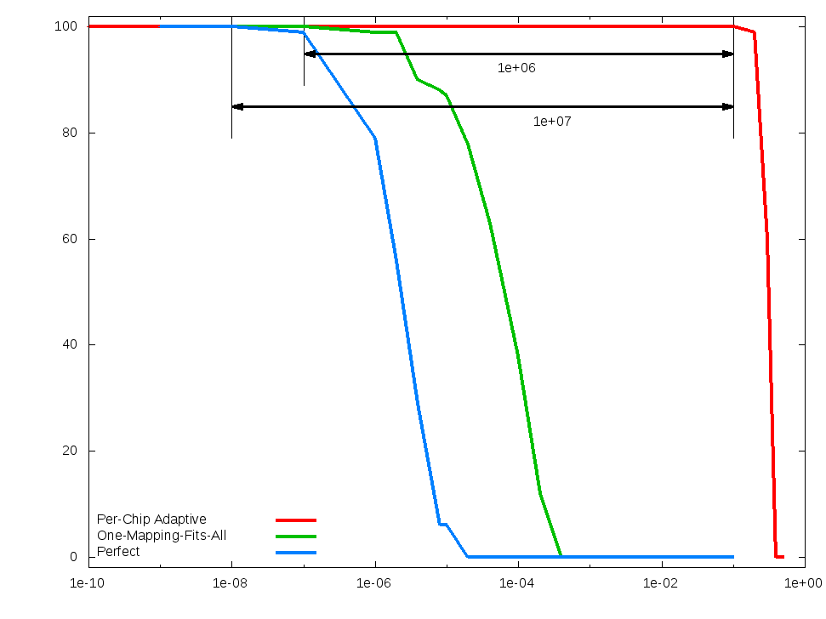
Full Knowledge Interconnect Defect Tolerance
87
Penn ESE534 Spring2010 -- DeHon

Slide 88
FPGA Routing Defects
Pre-computed Alternatives
Lightweight Defect Tolerance
Choose Your own Adventure
88
Penn ESE534 Spring2010 -- DeHon

Slide 89
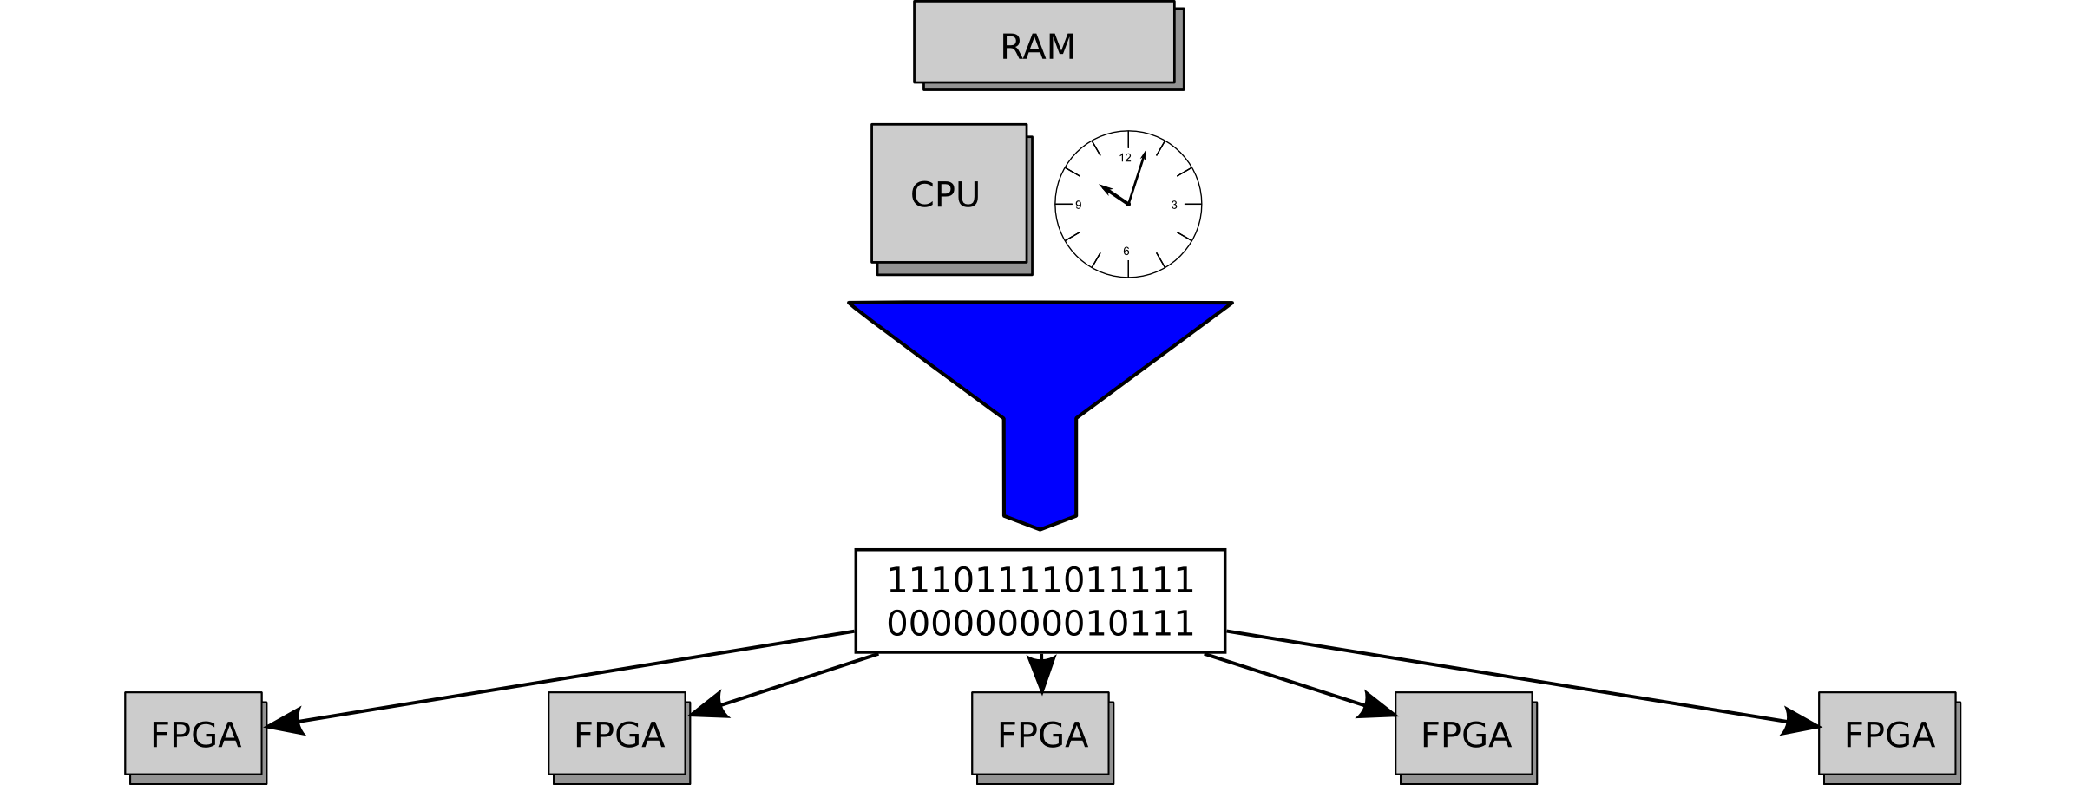
Traditional Bitstream
Notes:
Make each bs a little different
The way we do it now, we spend a lot of time prepparing the bitstream so that we don't have to spend much time on each chip
Bad is that it doesn't let us avoid deffects
Label things for the single bitstream case
Make the chips spotty, see if we can make them look sick with different deffects
“maybe mention the feedback from the chip”

Slide 90
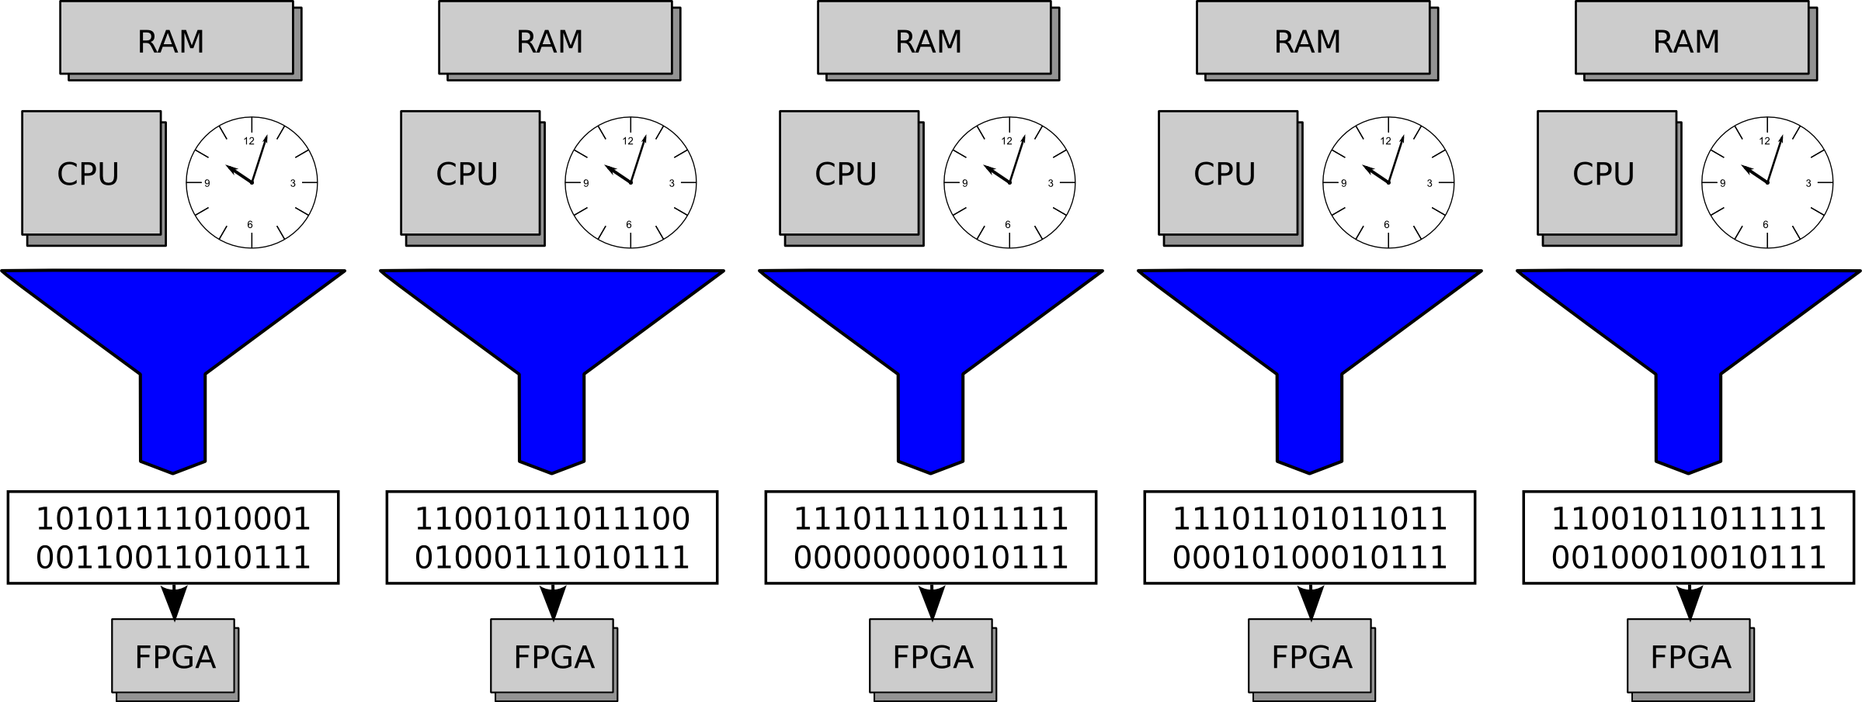
Full Knowledge
Notes:
Make each bs a little different
The way we do it now, we spend a lot of time prepparing the bitstream so that we don't have to spend much time on each chip
Bad is that it doesn't let us avoid deffects
Label things for the single bitstream case
Make the chips spotty, see if we can make them look sick with different deffects
“maybe mention the feedback from the chip”

Slide 91
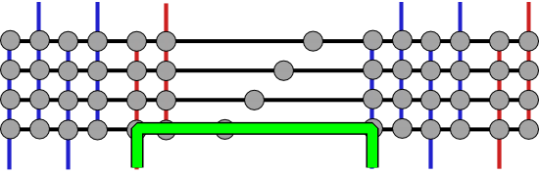
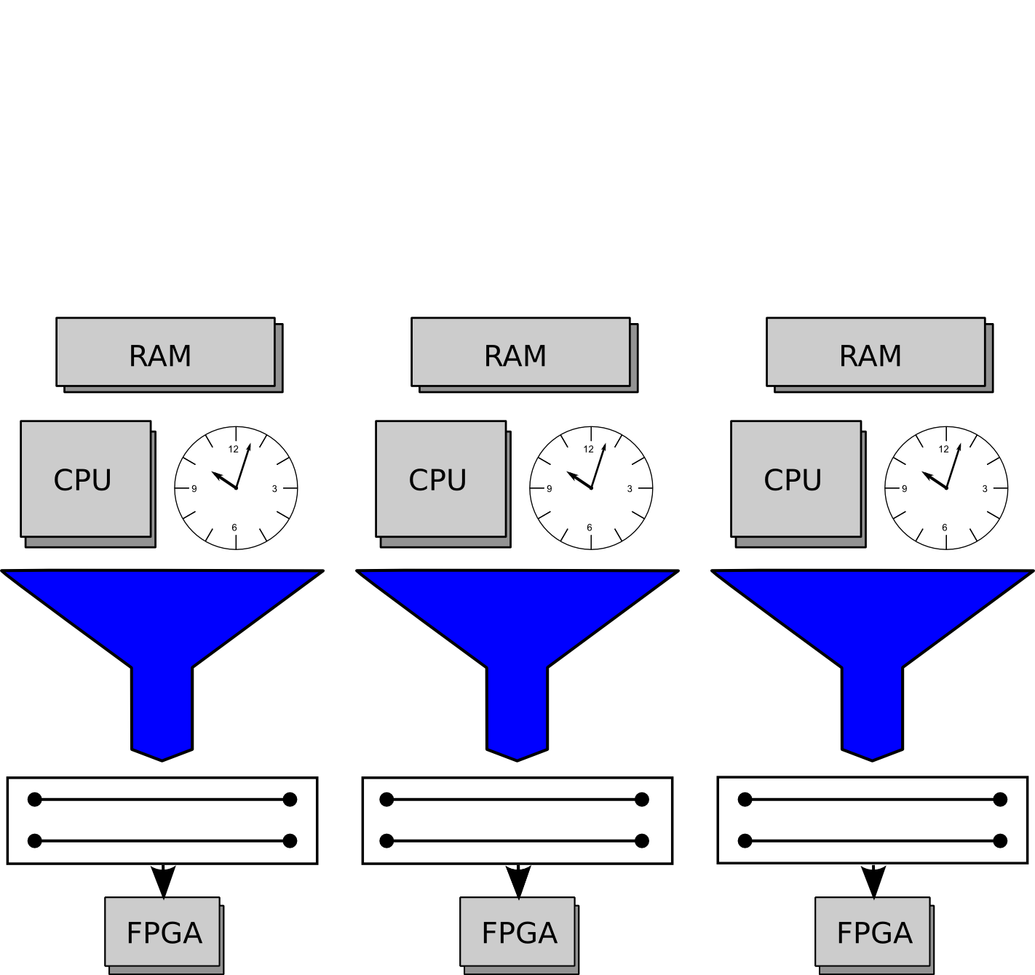
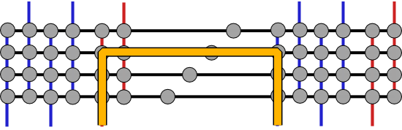
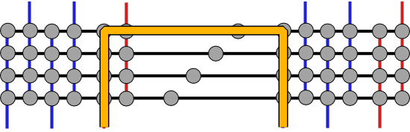
Choose Your own Adventure
Bitstream with alternatives
  Still just one bitstream

Slide 92
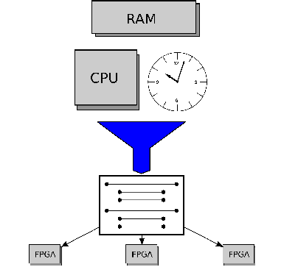
Choose Your own Adventure
Bitstream with alternatives
  Still just one bitstream

Slide 93
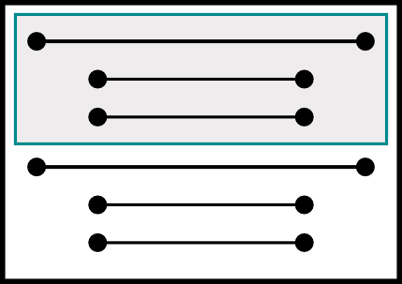
Loading
Examine path
  Configure
  Test
    Good: skip to next net
    Bad: grab next path

Slide 94
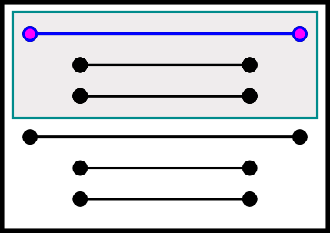
Loading
Examine path
  Configure
  Test
    Good: skip to next net
    Bad: grab next path

Slide 95
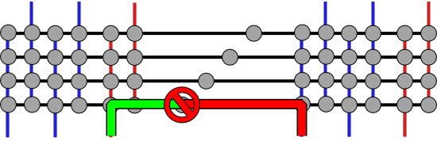
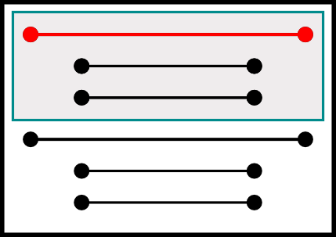
Loading
Examine path
  Configure
  Test
    Good: skip to next net
    Bad: grab next path

Slide 96
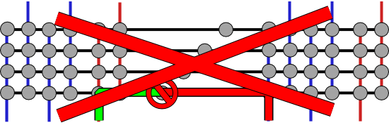
Loading
Examine path
  Configure
  Test
    Good: skip to next net
    Bad: grab next path

Slide 97
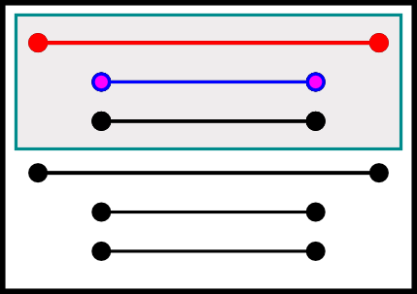
Loading
Examine path
  Configure
  Test
    Good: skip to next net
    Bad: grab next path

Slide 98
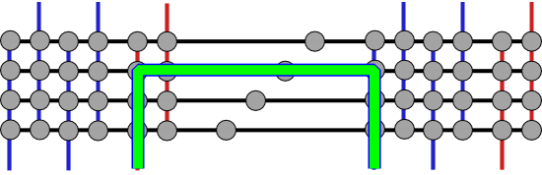
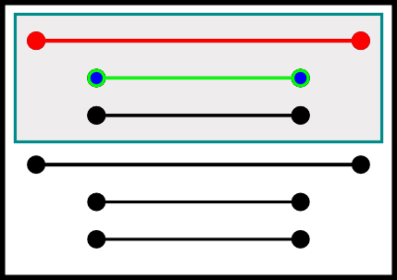
Loading
Examine path
  Configure
  Test
    Good: skip to next net
    Bad: grab next path

Slide 99
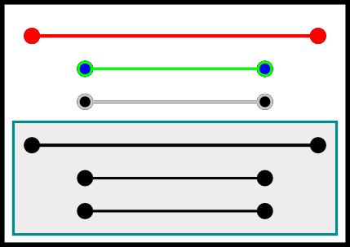
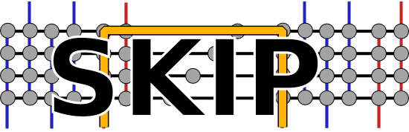
Loading
Examine path
  Configure
  Test
    Good: skip to next net
    Bad: grab next path

Slide 100
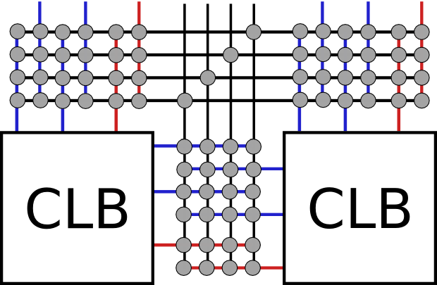
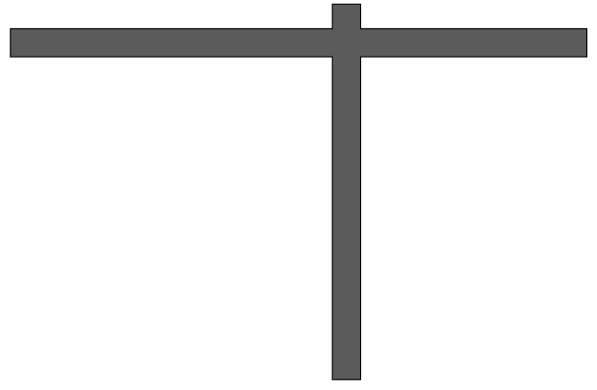




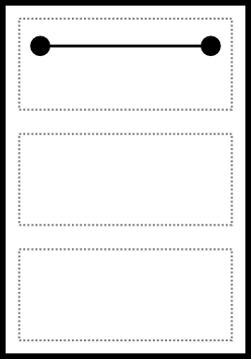
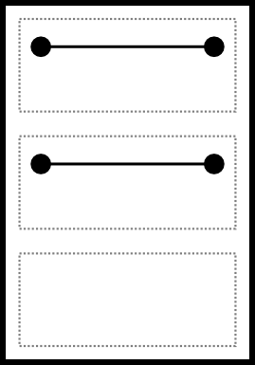

Primary Routing
Mask extra resources for later
Normal routing

Slide 101


Prepare for Alternatives
Mask used resources

Slide 102







Generate Bitstream
Favorite shortest path search

Slide 103


Slide 104



Slide 105


Slide 106
Admin
Homework 7 due Monday
No office hours today (André away)
Reading for Monday on web
  Classic paper on Rent’s Rule

Slide 107
Big Ideas
[MSB Ideas]
Nanoscale Integrated Circuits are like snowflakes – each unique
Cannot expect perfect ICs
  …or even perfect building blocks
But even defective components are often “good enough”
Post-fabrication matching allows us to assign functions based on capabilities

Slide 108
Big Ideas
[MSB-1 Ideas]
Matching in nanoPLA
  5% crosspoint non-programmable defects
  σ=38% variation in V_{th}
Defect-aware routing in FPGAs
  10% switch and segment defects with full knowledge
  1% with pre-computed alternatives

