Slide 1

ESE535:
Electronic Design Automation
Day 1: January 14, 2015
Introduction
Complete questionnaire

Slide 2
Warmup Poll
How many of you have:
  Drawn geometry for transistors and wires
  Sized transistors
  Placed logic and/or memory cells
  Selected the individual gates
  Specified the bit encoding for an FSM
  Designed a bit-slice for an Adder or ALU
  Written RTL Verilog or VHDL
  Written Behavioral Verilog, VHDL, etc. and compiled to hardware?
  Written SystemC or Bluespec System Verilog?
  Compiled C to gates?

Slide 3
Modern Design Challenge
How do we design modern computational systems?
  billions of devices
  used in everything
  billion dollar businesses
  rapidly advancing technology
  more “effects” to address
  rapidly developing applications and uses
  short product cycles
  extreme time-to-market pressures

Slide 4
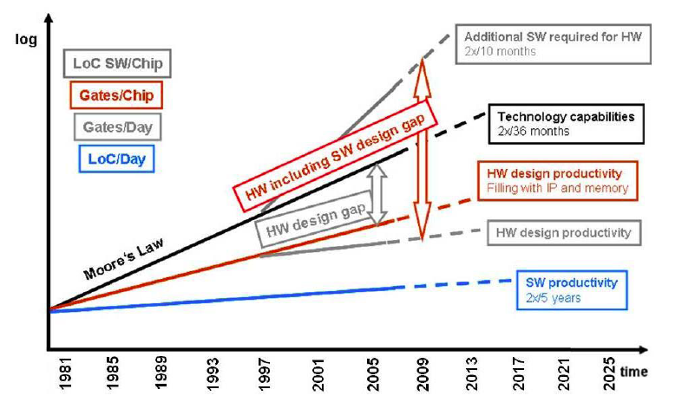
Productivity Gap
Source: ITRS2009, 2011 Design Chapter

Slide 5
The Productivity Gap
Source: Newton (UCB/GSRC)

Slide 6
Bottleneck
Human brain power is the bottleneck
  to producing new designs
  to creating new things
    (applications of technology)
  to making money

Slide 7
Avoiding the Bottleneck
How do we unburden the human?
  Take details away from him/her
    raise the level of abstraction at which human specifies computation
  Pick up the slack
    machine take over the details

Slide 8
Design Productivity by Approach
GATES/WEEK
(Dataquest)
DOMAIN
SPECIFIC
8K - 12K
BEHAVIORAL
2K - 10K
RTL
1K - 2K
a
0
d
q
100 - 200
GATE
b
1
s
clk
TRANSISTOR
10 - 20
Source: Keutzer (UCB EE 244)

Slide 9
To Design, Implement, Verify 10M transistors
Staff Months
62.5
Beh
125
625
RTL
6250
a
0
d
q
b
1
s
clk
Power
62,500
Delay
Area
Source: Keutzer (UCB EE 244)

Slide 10
Central Questions
How do we make the machine fill in the details (elaborate the design)?
How well can it solve this problem?
How fast can it solve this problem?

Slide 11
Outline
Intro/Setup
Instructor
The Problem
Decomposition
Costs
Not Solved
This Class

Slide 12
Instructor
VLSI/CAD user + Novel Tech. consumer
  Architect, Computer Designer
  Spatial designs: FPGAs, Reconfigurable
  Hybrid: Multicontext FPGAs, P+FPGA
  Nanoscale: CNT, NW-based, NEMS
  Avoid tedium (impatient)
Analyze Architectures
  necessary to explore
  costs different (esp. in new technologies)
Mapping as part of runtime?
  Variation, wear, reliability, changing dataset??
Requirements of Computation
Notes:
Story
Started doing VLSI designs (like many of you).
Ultimately, frustrated by the tedium. I liked designing things and
building them, but hated doing low-level details and all the time
it took to get a design done.
Led me to do two things: 1) push for higher level designs (synthesis,
FSMs, place and route) and 2) use FPGAs for prototyping.
Ultimately, FPGAs became interesting of their own right to me,
and began trying to understand how to design arrays. Questions
arose about tradeoffs (large/smaller LUTs, more/less wires…).
Only way to answer is to map designs --> can’t do may by hand (back to the human limit) …. So necessary to automate mapping to explore architecture.
Why did I have to map designs to answer these questions?
Lead to question: can we characterize our tasks better so can precisely
say how much resources required, rather than having a large “design-specific” variation?

Slide 13
Problem
Map from a problem specification down to an efficient implementation on a particular computational substrate.
What is
  a specification
  a substrate
  have to do during mapping

Slide 14
Problem: Specification
Recall: basic tenant of CS theory
  we can specify computations precisely
  Universal languages/building blocks exist
    Turing machines
    nand gates
EEs:
  Can build any function out of nand gates
  Any FSM out of gates + registers
    FSM = Finite State Machine

Slide 15
Specifications
netlist
logic gates
Finite-State Machine (FSM)
programming language
  C, C++, Lisp, Java, block diagram
DSL (domain specific)
  MATLAB, Snort
RTL
  Register Transfer Level
  (e.g. subsets of Verilog, VHDL)
behavioral
dataflow graph
layout
SPICE netlist

Slide 16
Substrate
“full” custom VLSI
Standard cell
metal-only gate-array
FPGA
Processor (scalar, VLIW, Vector)
Array of Processors (SoC, {multi,many}core)
billiard balls
Nanowire PLA
molecules
DNA

Slide 17
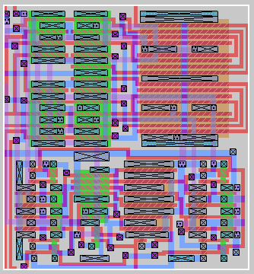
Full Custom
Get to define all layers
Use any geometry you like
Only rules are process design rules
ESE570

Slide 18
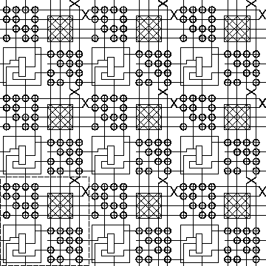
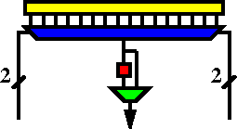
FPGA
K-LUT (typical k=4)
Compute block
w/ optional
output Flip-Flop
ESE171, CIS371

Slide 19
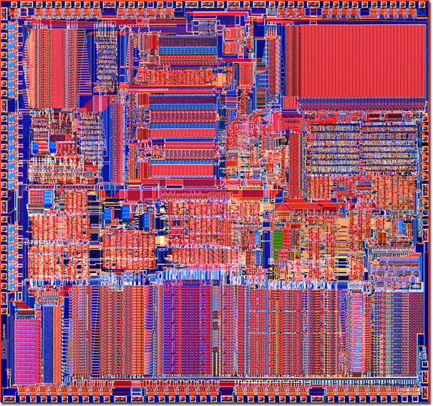
Standard Cell

Slide 20
Standard Cell Area
inv
nand3
inv
AOI4
nor3
Inv
All cells
uniform
height
Width of
channel
determined
by routing
Cell area

Slide 21
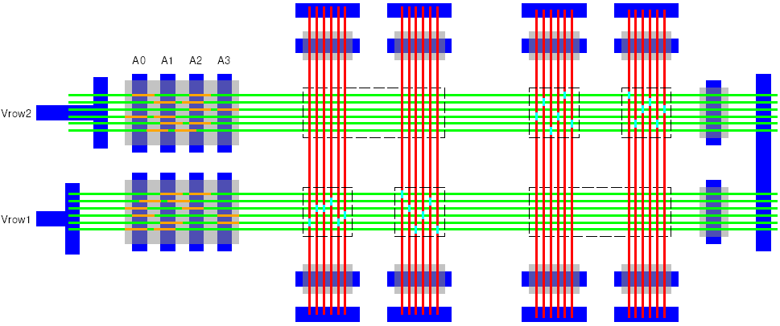
Nanowire PLA

Slide 22
What are we throwing away?
(what does mapping have to recover?)
layout
TR level circuits
logic gates / netlist
FSM
Allocation of functional units and assignment
Cycle-by-cycle timing
Operation sequencing
How task implemented
DSL: MATLAB

Slide 23
Specification not Optimal
Y = a*b*c + a*b*/c + /a*b*c
Multiple representations with the same semantics (computational meaning)
Only have to implement the semantics, not the “unimportant” detail
Exploit freedom to make
  smaller/faster/cooler

Slide 24
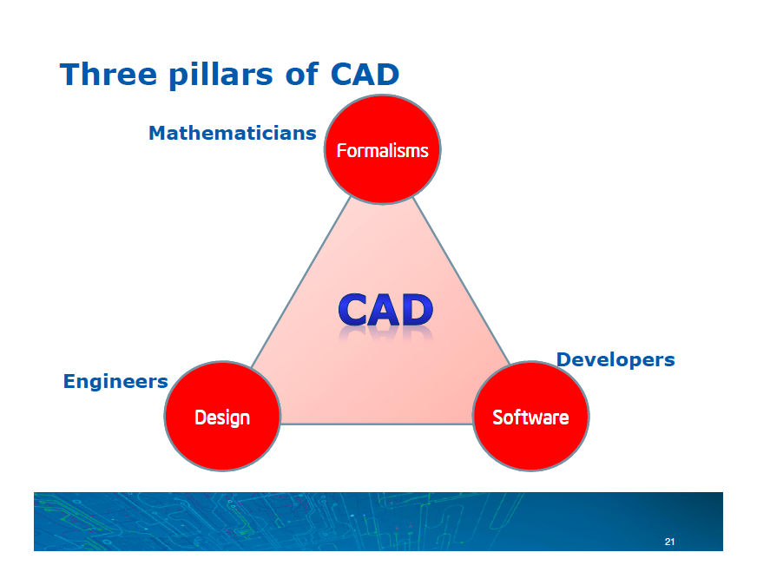
Noel Menesez, Intel Director of Strategic CAD (2014)

Slide 25
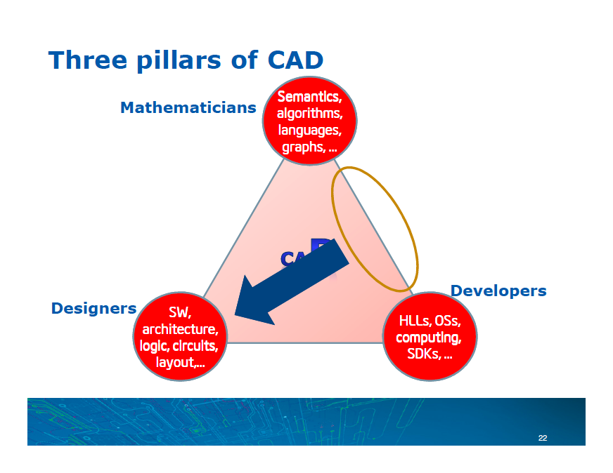
Noel Menesez, Intel Director of Strategic CAD (2014)

Slide 26
Problem Revisited
Map from some “higher” level down to substrate
Fill in details:
  device sizing, placement, wiring, circuits, gate or functional-unit mapping, timing, encoding, data movement, scheduling, resource sharing

Slide 27
Decomposition
Behavioral
(C, MATLAB, …)
Arch. Select
Schedule
RTL
FSM assign
Conventionally, decompose into phases:
  Arch. select, scheduling, assignment -> RTL
  sequential opt. -> logic equations
  logic opt., covering -> gates
  retiming -> gates and registers
  placement-> placed gates
  routing->mapped design
Good abstraction, manage complexity
Two-level,
Multilevel opt.
Covering
Retiming
Gate Netlist
Placement
Routing
Layout
Masks

Slide 28
Easy once decomposed?
All steps are (in general) NP-hard.
  routing
  placement
  partitioning
  covering
  logic optimization
  scheduling
What do we do about NP-hard problems?
  Return to this problem in a few slides…
NP-hard:
Can verify solution in polytime
N, N², N¹⁰⁰
Do not know how to find in polytime
only known e^{N}
if there were a polytime solution
then P=NP

Slide 29
Decomposition
Easier to solve
  only worry about one problem at a time
Less computational work
  smaller problem size
Abstraction hides important objectives
  solving 2 problems optimally in sequence often not give optimal result of simultaneous solution

Slide 30
Mapping and Decomposition
Two important things to get back to
  disentangling problems
  coping with NP-hardness

Slide 31
Costs
Once get (preserve) semantics, trying to minimize the cost of the implementation.
  Otherwise this would be trivial
  (none of the problems would be NP-hard)
What costs?
Typically: EDA [:-)]
  Energy
  Delay (worst-case, expected….)
  Area
Future
  Yield
  Reliability
  Operational Lifetime

Slide 32
Costs
Different cost critera (e.g. E,D,A)
  behave differently under transformations
  lead to tradeoffs among them
    [LUT cover example next slide]
  even have different optimality/hardness
    e.g. optimally solve delay covering in poly time, but not area mapping
      E.g. covering

Slide 33
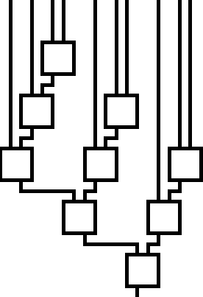
Costs: Area vs. Delay
Example of exploiting freedom of mapping choice.

Slide 34
Costs
Cannot, generally, solve a problem independent of costs
  costs define what is “optimal”
  e.g.
    (A+B)+C vs. A+(B+C)
    [cost=pob. Gate output is high]
    A,B,C independent
    P(A)=P(B)=0.5, P(C)=0.01
    P(A)=0.1, P(B)=P(C)=0.5
Notes:
(A+B)+C
P(A)=P(B)=0.5 P(C)~=0
Cost(A+B)=P(A+B)=P(A)+P(B)-P(A)*P(B)=0.75
Cost((A+B)+C)=P((A+B))+P(C)-P((A+B))*P(C)~=0.75
Total cost both notes ~=1.5
(A+B)+C
P(A)=P(C)=0.5, P(B)~=0
Cost(A+B)~=0.5
Cost((A+B)+C)~=0.75
Total cost ~=1.25

Slide 35
Costs may also simplify problem
Often one cost dominates
  Allow/supports decomposition
  Solve dominant problem/effect first (optimally)
  Cost of other affects negligible
    total solution can’t be far from optimal
  e.g.
    Delay in gates,
    Delay in wires
  Require: formulate problem around relative costs
Simplify problem at cost of generality

Slide 36
Coping with NP-hard Problems
How do we cope with?
simpler sub-problem based on dominant cost or special problem structure
problems exhibit structure
  optimal solutions found in reasonable time in practice
approximation algorithms
  Can get within some bound of optimum
heuristic solutions
high density of good/reasonable solutions?
  Try many … filter for good ones
…makes it a highly experimental discipline

Slide 37
Not a solved problem
Why need to study – not just buy tool from C, M, or S?
NP-hard problems
  almost always solved in suboptimal manner
  or for particular special cases
decomposed in suboptimal ways
quality of solution changes as dominant costs change
  …and relative costs are changing!
new effects and mapping problems crop up with new architectures, substrates

Slide 38
Big Challenge
Rich, challenging, exciting space
Great value
  practical
  theoretical
Worth vigorous study
  fundamental/academic
  pragmatic/commercial

Slide 39
This Class: Student Outcomes
You will learn:
  Freedom exists in design mappings
  and how to exploit
  Formulate & abstract optimization problems
  How to decompose large problems
  Techniques for attacking these problems
  Traditional design objectives (e.g. E,D,A, map time.)
  Canonical representations for problems
  Evaluate the quality of a design mapping
  Implement design automation algorithms

Slide 40
This Class: Technique Toolkit
Dynamic Programming
Linear Programming (LP, ILP)
Graph Algorithms
Greedy Algorithms
Randomization
Search
Heuristics
Approximation Algorithms
SAT

Slide 41
This Class:
Decomposition
Behavioral
(C, MATLAB, …)
Arch. Select
Schedule
RTL
FSM assign
Provisioning
Scheduling
Logic Optimization
Covering/gate-mapping
Partitioning
Placement
Routing
Two-level,
Multilevel opt.
Covering
Retiming
Gate Netlist
Placement
Routing
Layout
Masks

Slide 42
Student Requirements
Reading
Class
Projects
  Will involve programming algorithms
  Roughly weekly
  Cumulative build toward an overall mapping goal
  Choose what you do for final piece
    Last month
  Must do assign/project to pass course
Final Exam

Slide 43
Graduate Class
Assume you are here to learn
  Motivated
  Mature
  Not just doing minimal to get by and get a grade
Not plug-in-numbers and get solution
Things may be underspecified
  Reason
  Ask questions
  State assumptions

Slide 44
Materials
Reading
  Online
    several on canvas
    Rest on Xplore, ACM DL, web
      Linked from syllabus page
  If online, linked to reading page on web;
  I assume you will download/print/read.
  Possible reference texts (on web)
Lecture slides
  I’ll try to link to web page by 10am
    you can print

Slide 45
Today’s Big Ideas
Human time limiter
Leverage: raise abstraction+fill in details
Problems complex (human, machine)
Decomposition necessary evil (?)
Implement semantics
  Exploit freedom to xform to reduce costs
Dominating effects
Problem structure
Optimal solution depend on cost (objective)

Slide 46
Questions?

Slide 47
Administrivia
Next Lecture W 1/21 (Monday MLK)
  Reading on canvas
Return Info sheets
Feedback – every lecture – return@end
Web page
  http://www.seas.upenn.edu/~ese535/
  Policies on web page
    READ THIS (you are responsible for knowing)
  Syllabus linked off page (reading, assign)
  Note Piazza group

