Slide 1

ESE535:
Electronic Design Automation
Day 11: February 25, 2015
Placement
(Intro, Constructive)

Slide 2
Today
Behavioral
(C, MATLAB, …)
Arch. Select
Schedule
RTL
FSM assign
2D Placement Problem
Partitioning→Placement
Quadrisection
Refinement
Two-level,
Multilevel opt.
Covering
Retiming
Gate Netlist
Placement
Routing
Layout
Masks

Slide 3
Placement
Problem: Pick locations for all building blocks
  minimizing energy, delay, area
  really:
    minimize wire length
    minimize channel density

Slide 4
Bad Placement
How bad can it be?
  Area
  Delay
  Energy

Slide 5
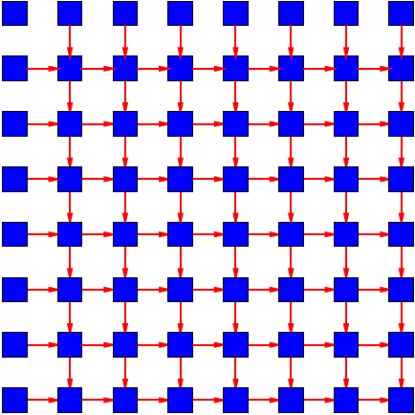
Preclass Channel Widths
Channel Width for Problem 1?

Slide 6
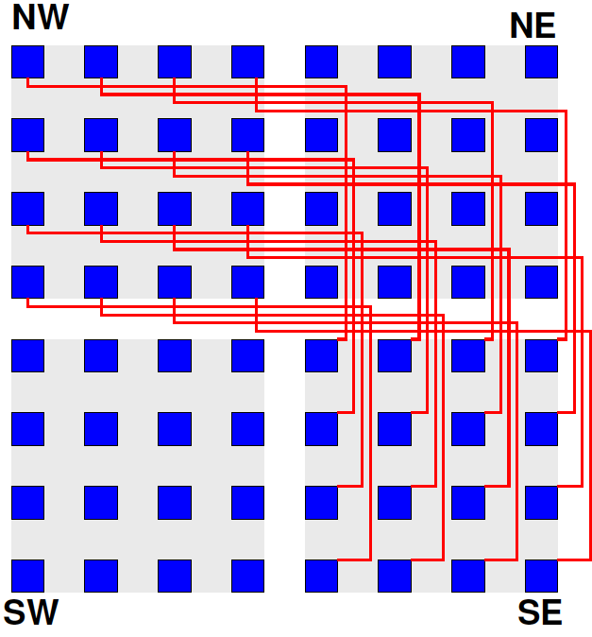
Preclass Channel Widths
Channel Width for Problem 2?

Slide 7
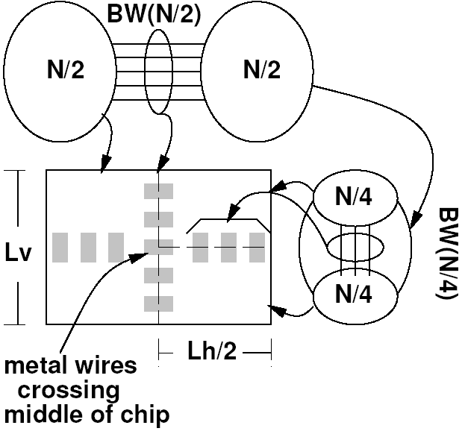
Bad: Area
All wires cross bisection
O(N²) area
good: O(N)

Slide 8
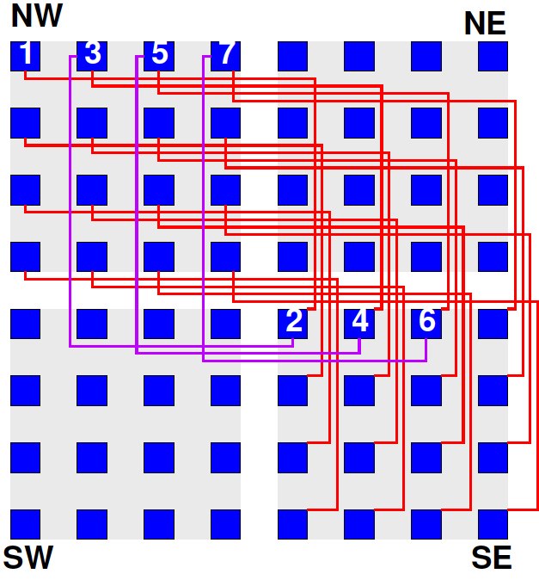
Delay
How bad can
delay be?

Slide 9
Delay
How good can
delay be?

Slide 10
Bad: Delay
All critical path wires cross chip
Delay =O(|PATH|*2*L_{side})
  [and L_{side} is O(N)]
good: O(|PATH|* L_{g})
compare 10ps gates
to many nanoseconds
to cross chip

Slide 11
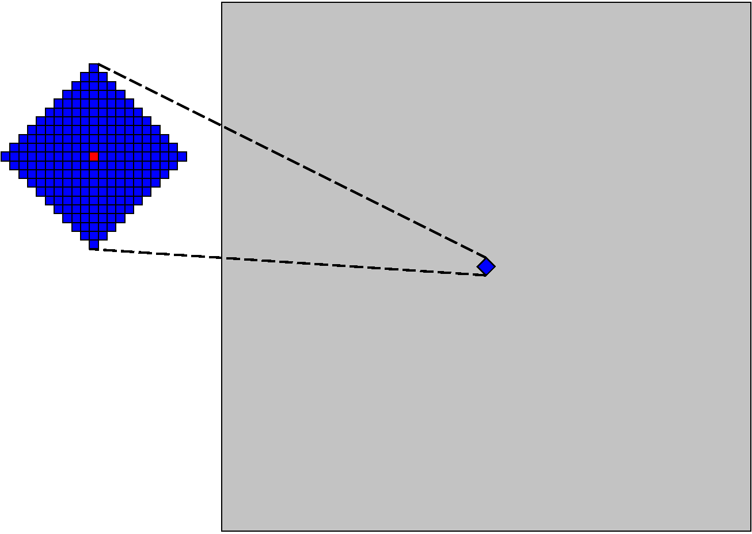
Clock Cycle Radius
Radius of logic can reach in one cycle (45 nm)
  1 Cycle Radius = 10
    Few hundred PEs
  Chip side 1,000 PE
    million PEs
  100s of cycles to cross

Slide 12
Bad: Energy
All wires cross chip:
  O(L_{side}) long → O(L_{side}) capacitance per wire
    Recall Area→O(N²)
    So L_{side} → O(N)
  ×O(N) wires → O(N²) capacitance
Good:
  O(1) long wires → O(N) capacitance

Slide 13
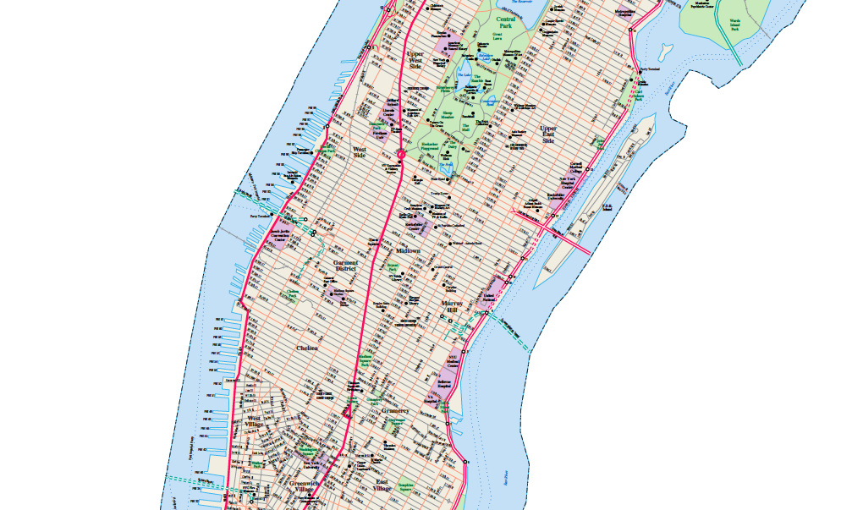
Manhattan

Slide 14
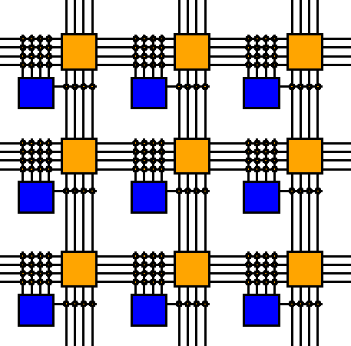
Manhattan Distance
Horizontal and Vertical Routing: Manhattan distance
  |X_{i}-X_{j}|+|Y_{i}-Y_{j}|
Contrast:
Euclidean distance

Slide 15
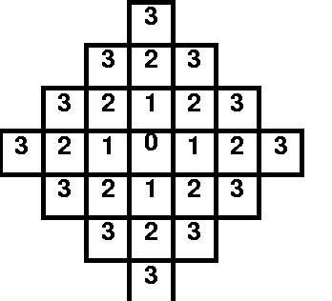
Distance
Can we place everything close?

Slide 16
Illustration
Consider a complete tree
  nand2’s, no fanout
  N nodes
Logical circuit depth?
Circuit Area?
Side Length?
Average wire length between nand gates? (lower bound)

Slide 17
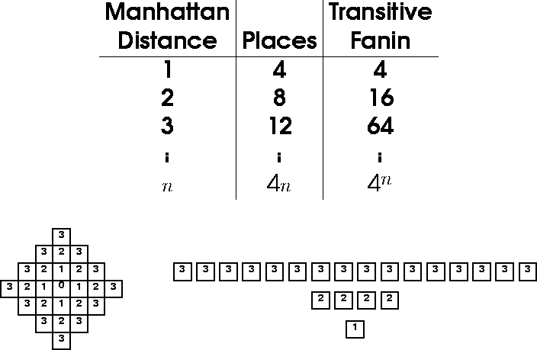
“Closeness”
Try placing “everything” close

Slide 18

Preclass 5
2400 unit side, 4 unit × unit gates
Wire length lower bound?

Slide 19
Generalizing Preclass 5
What’s minimum length for longest wires?
?

Slide 20
Generalizing
Interconnect Lengths
P>0.5
Side is √(N)
IO crossing it is N^{p}
What’s minimum length for longest wires?
Implication:
  Wire lengths grow at least as fast as N^{(p-0.5)}
?

Slide 21
Generalizing
Interconnect Lengths
Large cut widths
  imply long wires
?

Slide 22
Placement Problem Characteristics
Familiar
  NP Complete
  local, greedy not work
  greedy gets stuck in local minima

Slide 23
Constructive Placement

Slide 24
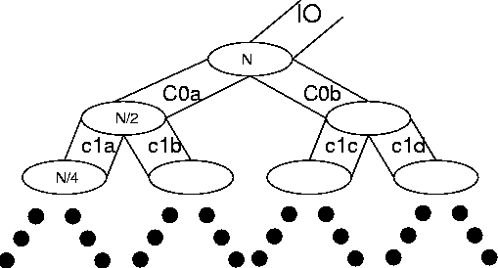
Basic Idea
Partition (bisect) to define halves of chip
  minimize wire crossing
Recurse to refine
When get down to single component, done

Slide 25
Adequate?
Does recursive bisection capture the primary constraints of two-dimensional placement?

Slide 26
Problems
Greedy, top-down cuts
  maybe better pay cost early?
Two-dimensional problem
  (often) no real cost difference between H and V cuts
Interaction between subtrees
  not modeled by recursive bisect

Slide 27
Example
Think of this (right) as logical graph.
Assume we find the “right” bisection (shown)
Where do A and B go?
How does recursive partitioning enforce/encourage this?
A
BA

Slide 28
Interaction

Slide 29
Example
Ideal split
(not typical)
“Equivalent” split
ignoring external constraints
Practically -- makes all H
cuts also be V cuts

Slide 30
Interaction

Slide 31
Problem
Need to keep track of where things are
  outside of current partition
  include costs induced by above
…but don’t necessarily know where things are
  still solving problem

Slide 32
Improvement: Ordered
Order operations
Keep track of existing solution
Use to constrain or pass costs to next subproblem
A
B

Slide 33
Improvement: Ordered
Order operations
Keep track of existing solution
Use to constrain or pass costs to next subproblem
Flow cut
  use existing in src/sink
  A nets = src, B nets = sink
S
A
B
T

Slide 34
Improvement: Ordered
Order operations
Keep track of existing solution
Use to constrain or pass costs to next subproblem
Flow cut
  use existing in src/sink
  A nets = src, B nets = sink
FM: start with fixed,
unmovable nets for
side-biased inputs
S
A
B
T

Slide 35
Improvement: Constrain
Partition once
Constrain movement within existing partitions
Account for both H and V crossings
Partition next
  (simultaneously work parallel problems)
  easy modification to FM

Slide 36
Constrain Partition
C
A
D
B
Solve AB and CD concurrently.

Slide 37
Improvement: Quadrisect
Solve more of problem at once
Quadrisection:
  partition into 4 bins simultaneously
  keep track of costs all around

Slide 38
Quadrisect
Modify FM to work on multiple buckets
k-way has:
  k(k-1) buckets
  |from|×|to|
  quad→ 12
reformulate gains
update still O(1)

Slide 39
Quadrisect
Cases (15):
  (1 partition) → 4
  (2 part) → 6 = (4 choose 2)
  (3 part) → 4 = (4 choose 3)
  (4 part) → 1

Slide 40
Recurse
Keep outside constraints
  (cost effects)
Problem?
  Don’t know detail place
What can we do?
  Model as at center of unrefined region

Slide 41
Option: Terminal Propagation
Abstract inputs as terminals
Partition based upon
Represent cost effects on placement/refinement decisions

Slide 42
Option: Refine
Keep refined placement
Use in cost estimates

Slide 43
Problem
Still have ordering problem
What is the problem?
Earlier subproblems solved
with weak constraints from later
  (cruder placement estimates)
Solved previous case by flattening
Why might not be satisfied with that?
In extreme give up divide and conquer
Alternative?

Slide 44
Iterate
After solve later problems
“Relax” solution
Solve earlier problems again with refined placements (cost estimates)
Repeat until converge

Slide 45
Iteration/Cycling
General technique to deal with
phase-ordering problem
  what order do we perform transformations, make decisions?
  How get accurate information to everyone
Still basically greedy

Slide 46
Refinement
Relax using overlapping windows
Deal with edging effects
Huang&Kahng claim
10-15% improve
  cycle
  overlap

Slide 47
Possible Refinement
Allow unbalanced cuts
  most things still work
  just distort refinement groups
  allowing unbalance using FM quadrisection looks a bit tricky
  gives another 5-10% improvement

Slide 48
Runtime
Each gain update still O(1)
  (bigger constants)
  so, FM partition pass still O(N)
O(1) iterations expected
assume O(1) overlaps exploited
O(log(N)) levels
Total: O(N log(N))
  very fast compared to typical annealing
    (annealing next time)

Slide 49
Quality: Area
Gordian-L: Analytic global placer
DOMINO: network flow detail
[Huang&Kahng/ISPD1997]

Slide 50
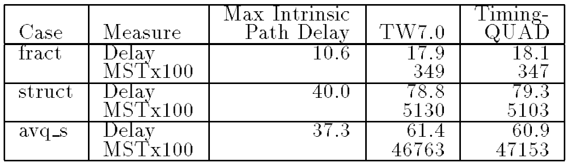
Quality: Delay
Weight edges based on criticality
  Periodic, interleaved timing analysis

Slide 51
Uses
Good by self
Starting point for simulated annealing
  speed convergence
With synthesis (both high level and logic)
  get a quick estimate of physical effects
  (play role in estimation/refinement at larger level)
Early/fast placement
  before willing to spend time looking for best
For fast placement where time matters
  FPGAs, online placement?

Slide 52
Summary
Partition to minimize cut size
Additional constraints to do well
  Improving constant factors
Quadrisection
Keep track of estimated placement
Relax/iterate/Refine

Slide 53
Big Ideas:
Potential dominance of interconnect
Divide-and-conquer
Successive Refinement
Phase ordering: estimate/relax/iterate

Slide 54
Admin
Reading for Monday
  Online (JSTOR): classic paper on
  Simulated Annealing

