Slide 1

ESE535:
Electronic Design Automation
Day 12: March 2, 2015
Placement II
(Simulated Annealing)

Slide 2
Preclass
Squared wirelength for top placement?
Squared wirelength for bottom placement?
Number of swaps?
Squared wirelength after swap for each of these cases?
  Sample from class
  (everyone assigned 1 or 2)

Slide 3
Preclass Lesson
Why can’t we find an improving swap?

Slide 4
Today
Behavioral
(C, MATLAB, …)
Arch. Select
Schedule
RTL
FSM assign
Placement
Improving Quality
  Cost functions
  Avoiding local minima
Technique:
  Simulated Annealing
Two-level,
Multilevel opt.
Covering
Retiming
Gate Netlist
Placement
Routing
Layout
Masks

Slide 5
Simulated Annealing
Physically motivated approach
Physical world has similar problems
  objects/atoms seeking minimum cost arrangement
  at high temperature (energy) can move around
    E.g. it melts
  at low temperature, no free energy to move
  cool quickly→freeze in defects (weak structure)
    glass
  cool slowly→ allow to find minimum cost
    crystal

Slide 6
Key Benefit
Avoid Local Minima
  Allowed to take locally non-improving moves in order to avoid being stuck

Slide 7
Simulated Annealing
At high temperature can move around
  not trapped to only make “improving” moves
  free energy from “temperature” allows exploration of non-minimum states
  avoid being trapped in local minima
As temperature lowers
  less energy available to take big, non-minimizing moves
  more local / greedy moves

Slide 8
Design Optimization
Components:
“Energy” (Cost) function to minimize
  represent entire state, drives system forward
Moves
  local rearrangement/transformation of solution
Cooling schedule
  initial temperature
  temperature steps (sequence)
  time at each temperature

Slide 9
Basic Algorithm Sketch
Pick an initial solution
Set temperature (T) to initial value
while (T>T_{min})
  for time at T
    pick a move at random
    compute Δcost
    if less than zero, accept
    else if (random()<e^{-Δcost/T}), accept
  update T

Slide 10
Cost Function
Can be very general
  Combine area, timing, energy, routability…
Desirable characteristics:
  drive entire solution in right direction
    reward every good move
  cheap to compute delta costs
    e.g. FM
    Ideally O(1)

Slide 11
Bad Cost Functions
Not reward every move:
  size < threshold ?
  Anything using max
    channel width
    critical path delay
    How apply to example at right?
Expensive update cost
  rerun router on every move
  rerun static timing analysis
    E.g. recalculate critical path delay

Slide 12
Example Cost Functions
bb_{x}
Total Wire Length
  Linear, quadratic…
Σ Bounding Box (semi-perimeter)
  Surrogate for routed net length
Σ (e^{channel_density})
  Dominate by largest density → approximate max
  Rewards improvement in non-maximum channel
  But reward is larger for denser channels
  Can be computed incrementally
bb_{y}

Slide 13
Cost Functions in Use
Next few slides will look at cost functions in use by VPR
  Versatile Placement and Routing
  Widely used, open-source placement and routing tool for FPGAs
  From Univ. of Toronto
  Now part of VTR (Verilog-to-Routing) suite
More complicated than earlier examples
  We’ll try to make sense of components

Slide 14
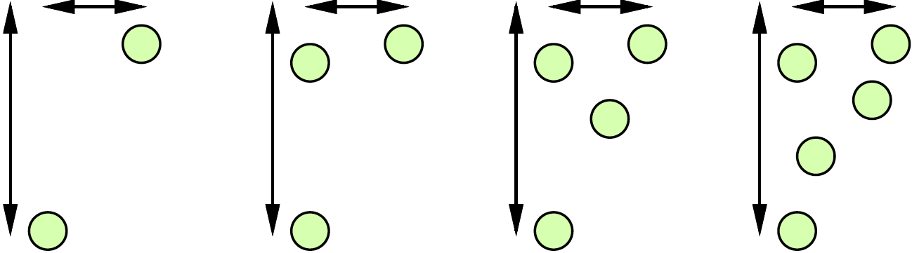
Bounding Box
Why might not be satisfied with bounding box?
  Should these all contribute same cost?
      2, 3, 4, or 5 terminals on same net

Slide 15
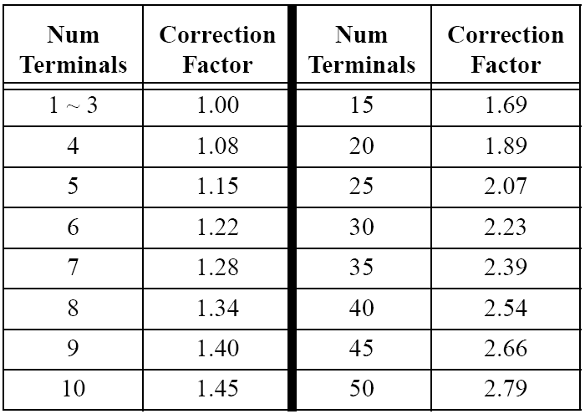
Example: VPR Wire Costs
VPR Bounding Box
Swartz, Betz, & Rose
FPGA 1998
Original table:
Cheng ICCAD 1994

Slide 16
Example: VPR Timing Costs
Criticality(e)=1-Slack(e)/Dmax
TCost(e)=Delay(e)*Criticality(e)^{CriticalityExp}
Keep all edge Criticalities in a table
Recompute Net Criticality
at each Temperature
Marquardt, Betz, & Rose
FPGA2000

Slide 17
Different Costs
How might we deal with multiple costs?
  E.g. Wire cost and Timing costs ?

Slide 18
VPR Balance
Wire and Time Cost
Anneal Cost is weighted linear sum of Wire and Time
Marquardt, Betz, & Rose FPGA2000

Slide 19
Basic Algorithm Sketch (review)
Pick an initial solution
Set temperature (T) to initial value
while (T>T_{min})
  for time at T
    pick a move at random
    compute Δcost
    if less than zero, accept
    else if (random()<e^{-Δcost/T}), accept
  update T

Slide 20
Moves
Swap two cells
  Within some distance limit? (ex. to come)
Swap regions
  …rows, columns, subtrees, cluster
Rotate cell (when feasible)
Flip (mirror) cell
Permute cell inputs (equivalent inputs)

Slide 21
Legality Constraints
Examples:
  Limit on number of LUTs/PE (position)
  Limit on number of Inputs/cluster (region)
Options:
  Force all moves to be legal
    Force initial placement to be legal
    Illegal moves rejected
  Allow illegal placement/moves
    Set cost function to make undesirable
    Make less desirable (more costly) over time

Slide 22
Basic Algorithm Sketch (review)
Pick an initial solution
Set temperature (T) to initial value
while (T>T_{min})
  for time at T
    pick a move at random
    compute Δcost
    if less than zero, accept
    else if (random()<e^{-Δcost/T}), accept
  update T

Slide 23
Initial Solution
Random
Spectral Placement
Constructive Placement
  Fast placers start at lower temperature; assume constructive got global right.
    But may be stuck in minima region defined by constructive placement

Slide 24
Basic Algorithm Sketch (review)
Pick an initial solution
Set temperature (T) to initial value
while (T>T_{min})
  for time at T
    pick a move at random
    compute Δcost
    if less than zero, accept
    else if (random()<e^{-Δcost/T}), accept
  update T

Slide 25
Details
Initial Temperature
  T₀=-Δavg/ln(P_{accept})
  e^{-Δcost/T}
  e^{-Δcost/T0}=e^{-Δcost/(-Δavg/ln(Paccept))}
  Average move → e^{ln(Paccept)}
    Accepted with Probability P_{accept}
When P_{accept}=1, moves randomize

Slide 26
Details
Cooling schedule: options
  fixed ratio: T=λT
    (e.g. λ=0.85)
  temperature dependent
  function of both temperature and acceptance rate
    example to come
Time at each temperature: options
  fixed number of moves?
  fixed number of rejected moves?
  fixed fraction of rejected moves?

Slide 27
VPR Cooling Schedule
Moves at Temperature = cN^{4/3}
Temperature Update
  Tnew=Told×γ
  Idea: advance slowly
  in good α range
  α is measured
  acceptance rate
Betz, Rose, & Marquardt
Kluwer 1999

Slide 28
Basic Algorithm Sketch
Pick an initial solution
Set temperature (T) to initial value
while (T>T_{min})
  for time at T
    pick a move at random
    compute Δcost
    if less than zero, accept
    else if (random()<e^{-Δcost/T}), accept
  update T
What happens
when T→0 ?

Slide 29
Range Limit
Want to tune so accepting 44% of the moves – Lam and Delosme DAC 1988
VPR
  Define Rlimit – defines maximum Δx and Δy accepted
  Tune Rlimit to maintain acceptance rate
  Rlimit^{new}=Rlimit^{old}×(1-0.44+α)
    α is measured acceptance rate

Slide 30
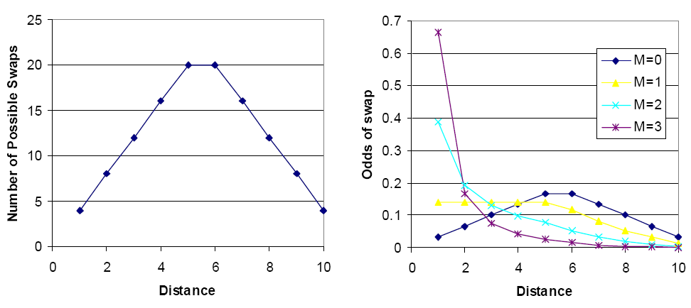
Range Limiting?
Eguro alternate [DAC 2005]
  define P=D^{-M}
  Tune M to control α

Slide 31
Range Limiting
Distance is
P_{swap}=D^{-M}
M adjusted
For 44% accept
Eguro, Hauck, & Sharma DAC 2005

Slide 32
Recall: VPR Timing Costs
Criticality(e)=1-Slack(e)/Dmax
TCost(e)=Delay(e)*Criticality(e)^{CriticalityExp}
Keep all edge criticalities in a table
Recompute Net Criticality
at each Temperature
Why might be a problem?
Marquardt, Betz, & Rose
FPGA2000

Slide 33
Changing Criticality
Consider: Initial Critical Path D→E→F
  Secondary Path A→B→C
A
B
C
D
E
F

Slide 34
Changing Criticality
A
B
C
D
E
F
After moves
A
B
C
D
E
F

Slide 35
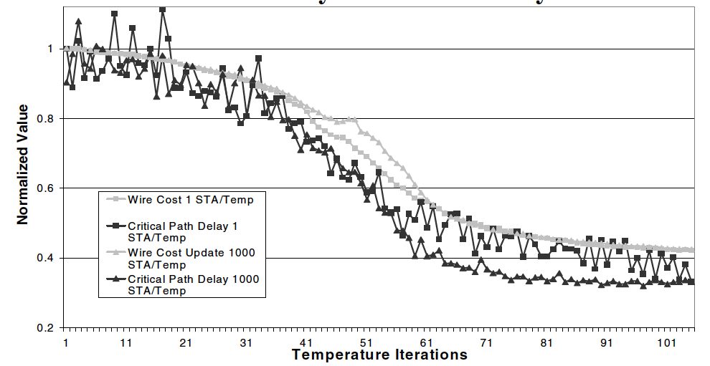
Stale Criticality
Criticality becomes stale during moves
Eguro & Hauck DAC 2008

Slide 36
Basic Algorithm Sketch (review)
Pick an initial solution
Set temperature (T) to initial value
while (T>T_{min})
  for time at T
    pick a move at random
    compute Δcost
    if less than zero, accept
    else if (random()<e^{-Δcost/T}), accept
  update T

Slide 37
Variant: “Rejectionless”
Order moves by cost
  compare FM
Pick random number first
Use random to define range of move costs will currently accept
Pick randomly within this range
Idea: never pick a costly move which will be rejected

Slide 38
Simulated Annealing Theory
If stay long enough at each cooling stage
  will achieve tight error bound
If cool long enough
  will find optimum
…but is it any less work than exhaustive exploration?
  Good to have a continuum….

Slide 39
Practice
Good results
  ultimately, what most commercial tools use...what vpr uses…
Slow convergence
Tricky to pick schedules to accelerate convergence
  Too slow → runs too long
  Too fast → freezes prematurely→local min
  → low quality

Slide 40
Pragmatic Approach
Good way to find out what optimization is possible
  Run for long time and cool slowly
  If can slow down cooling and get improvement
    Demonstration haven’t found optimum, yet
Once know good result this way
  Can try to accelerate convergence
  w/out sacrificing quality

Slide 41

Big “Hammer”
Costly, but general
Works for most all problems
  (part, placement, route, retime, schedule…)
Can have hybrid/mixed cost functions
  as long as weight to single potential
  (e.g. wire/time from VPR)
With care, can attack multiple levels
  place and route
Ignores structure of problem
  resignation to finding/understanding structure

Slide 42
Summary
Simulated Annealing
  use randomness to explore space
  accept “bad” moves to avoid local minima
  decrease tolerance over time
General purpose solution
  costly in runtime

Slide 43
Big Ideas:
Use randomness to explore large
(non-convex) space
  Sample various parts of space
  Avoid becoming trapped in local minimum
Technique
  Simulated Annealing

Slide 44
Admin
Reading for Wednesday online
Assignment 6 due Thursday

