Slide 1

ESE535:
Electronic Design Automation
Day 13: March 3, 2015
Routing 1

Slide 2
Today
Behavioral
(C, MATLAB, …)
Arch. Select
Schedule
RTL
FSM assign
Routing Cases
Routing Problem
Decomposition
Channel Routing
Variations
  Over-the-cell
Two-level,
Multilevel opt.
Covering
Retiming
Gate Netlist
Placement
Routing
Layout
Masks

Slide 3
Routing Problem
Once know where blocks live (placement),
How do we connect them up?
  i.e. where do the wires go?
In such a way as to:
  Fit in fixed resources
  Minimize resource requirements
      (channel width → area)

Slide 4
Routing Cases
Gate Array
Standard Cell
Full Custom

Slide 5
Gate Array
Fixed Grid
Fixed row and column width
Must fit into prefab channel capacity
Resource-constrainted routing

Slide 6
Gate Array
What freedom can we exploit in routing?

Slide 7
Gate Array
Opportunities
  Choice in paths
  Exploit freedom to:
    Meet channel limits
    Minimize channel width

Slide 8
Gate Array
What other paths could the red wire take?
T
S

Slide 9
Gate Array
Opportunities
  Choice in paths
  Exploit freedom to:
    Meet channel limits
    Minimize channel width

Slide 10
Gate Array
Opportunities
  Choice in paths
  Exploit freedom to:
    Meet channel limits
    Minimize channel width

Slide 11
Semicustom Array
Float channel widths as needed
How do we optimize area in this case?

Slide 12
Semicustom Array
Float Channel widths as needed
Area
  minimize total channel widths
  A=H*V
  H=Σ H_{i}
  V=Σ V_{i}

Slide 13
Row-based Standard Cell
Variable size
  Cells
  Channels
Primary route within row
  Minimize tracks in channel
Vertical feed throughs

Slide 14
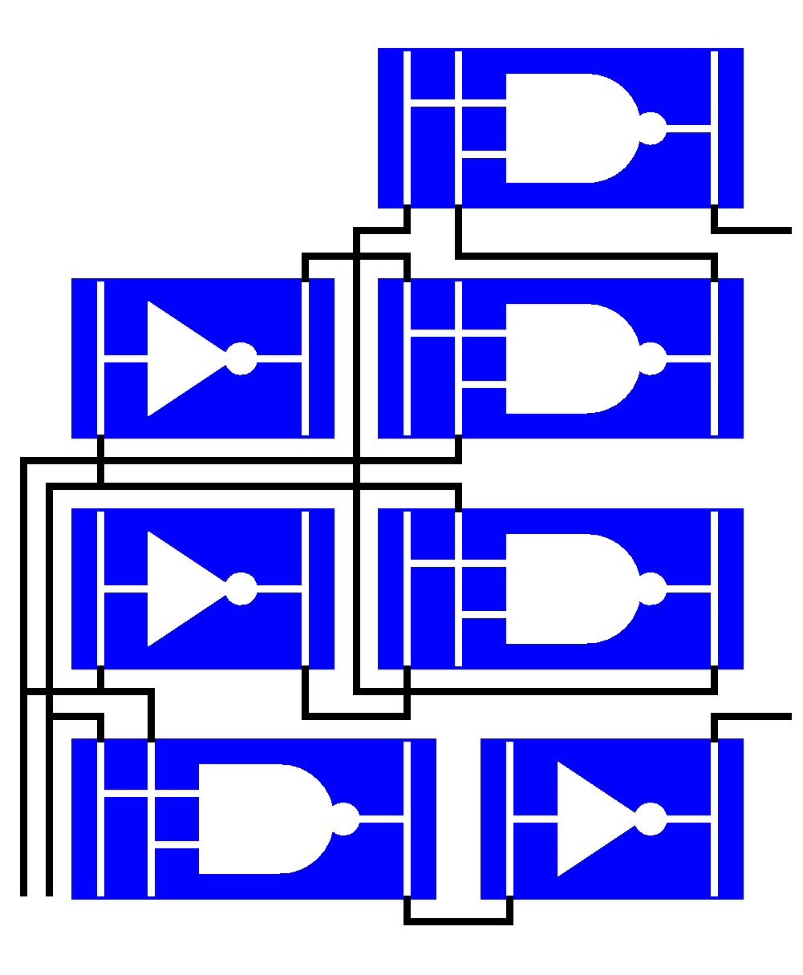
Standard Cell Gates
IOs on one or both sides
Design in Feed-thru

Slide 15
Full Custom / Macroblock
Allow arbitrary geometry
  Place larger cells
    E.g. memory
  Datapath blocks
Less regular, but still have channels…

Slide 16
Routing Decomposed

Slide 17
Phased Routing
After placement…
Slice (macroblock case)
  And order channels
Global Route
  Which channels to use
  (suitable approach Monday after break)
Channel Route
  Today
Switchbox Route

Slide 18
Macroblock→Channel Route
5
Slice into pieces
Route each as channel
Significance of numbers?
3
4
2
1

Slide 19
Macroblock→Channel Route
5
Slice into pieces
Route each as channel
If work inside out
  Can expand channels as needed
  Complete in one pass
3
4
2
1

Slide 20
Not all Assemblies Sliceable
No horizontal or vertical slice will separate
Prevents ordering that allows us to route in one pass

Slide 21
Switchbox Routing
Box with 3 or 4 sides fixed
Contrast channel routing with only 2 sides fixed

Slide 22
Gate Array → Channel
Global route first
  Decide which path each signal takes
  Sequence of channels
  Minimize congestion
    Wires per channel segment

Slide 23
Gate Array → Channel
Then Channel route each resulting channel
Horizontal
Channel
Vertical Channel

Slide 24
Std.Cell → Channel Route
Plan feed through
Channel route each row

Slide 25
Channel Routing
Key subproblem in all variants
Pseudo 1D problem
Given: set of terminals on one or both sides of channel
Assign to tracks to minimize channel width
K L M C M N N O
A C C D E E M F

Slide 26
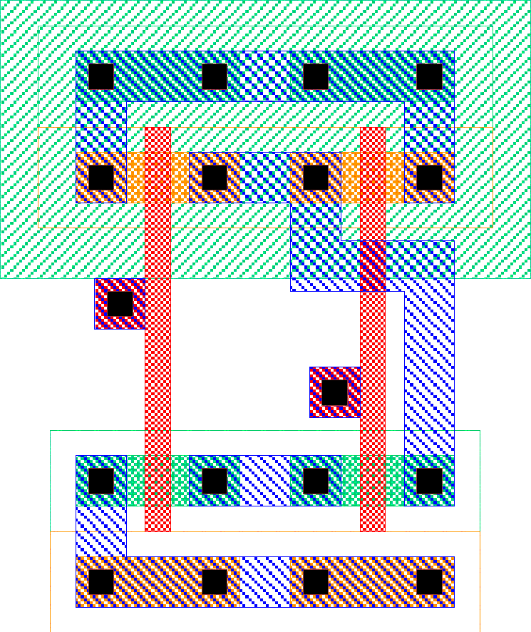
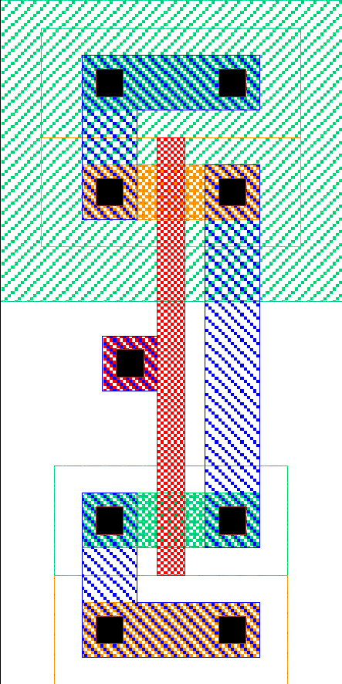
Standard Cell Area
nand3
All cells
uniform
height
Width of
channel
determined
by routing

Slide 27
Channel Abstraction
K L M C M N N O
A C C D E E M F
nand3
All cells
uniform
height
Width of
channel
determined
by routing
K
L
M
M
M

Slide 28
Switchbox Route
[since don’t go any further with this, not clear worth showing]
A B D E
Terminals on 4 sides
Link up terminal
G
D
F
H
A
H
C
E
A C F B

Slide 29
Channel Routing

Slide 30
Trivial Channel Routing
Assign every net its own track
  Channel width > N (single output functions)
  Chip bisection ∝N → chip area N²

Slide 31
Trivial Channel Routing
How can we do better?
  What do we want to exploit?

Slide 32
Sharing Tracks
Want to Minimize tracks used
Trick is to share tracks

Slide 33
Not that Easy
With Two sides
  Even assigning one track/signal may not be sufficient
A
B
C
B
C
D

Slide 34
Not that Easy
With Two sides
  Even assigning one track/signal may not be sufficient
A
Bad assignment
Overlap:
A,B
B,C
B
C
B
C
D

Slide 35
Not that Easy
With Two sides
  Even assigning one track/signal may not be sufficient
A
Valid assignment avoids overlap
B
C
B
C
D

Slide 36
Not that Easy
With Two sides
  Even assigning one track/signal may not be sufficient
A
i.e. there are vertical
constraints on ordering
B
C
B
C
D

Slide 37
Vertical Constraints
For vertically aligned pins:
  With single “vertical” routing layer
  Cannot have distinct top pins on a lower track than bottom pins
    Leads to vertical overlap
  Produces constraint that top wire be higher track than lower
  Combine across all top/bottom pairs
    Leads to a Vertical Constraint Graph (VCG)

Slide 38
VCG Example
A
B
C
A
B
D
C
B
C
D

Slide 39
Channel Routing Complexity
With Vertical Constraints
  Problem becomes NP-complete
Without Vertical Constraints
  Can be solved optimally
  Tracks = maximum channel density
  Greedy algorithm

Slide 40
No Vertical Constraints
Good for:
Single-sided channel
  (no top and bottom pins)
Three layers for routing
  Two vertical channels allow top and bottom pins to cross
  May not be best way to use 3 layers…

Slide 41
Left-Edge Algorithm
Sort nets on leftmost end position
Start next lowest track; end=0
While there are unrouted nets with lowest left position > end of this track
  Select unrouted net with lowest left position > end
  Place selected net on this track
  Update end position on this track to be end position of selected net
If nets remain, return to step 2
Greedy, optimal.

Slide 42
Example: Left-Edge
Note: nets (shown as
letters here) show up
as numbers in
conv. channel
routing file formats.
Top: a b g b c d f
Bottom: g d f e a c e
Nets:
  a:1—5
  b:2—4
  c:5—6
  d:2—6
  e:4—7
  f:3—7
  g:1—3

Slide 43
Example: Left-Edge
Top: a b g b c d f
Bottom: g d f e a c e
Nets:
  a:1—5
  b:2—4
  c:5—6
  d:2—6
  e:4—7
  f:3—7
  g:1—3
Sort Left Edge:
  a:1—5
  g:1—3
  b:2—4
  d:2—6
  f:3—7
  e:4—7
  c:5—6

Slide 44
Example: Left-Edge
Top: a b g b c d f
Bottom: g d f e a c e
Sort Left Edge:
  a:1—5
  g:1—3
  b:2—4
  d:2—6
  f:3—7
  e:4—7
  c:5—6
Track 0:
  End 0
  Add a:1—5
  End 5

Slide 45
Example: Left-Edge
Top: a b g b c d f
Bottom: g d f e a c e
Sort Left Edge:
  g:1—3
  b:2—4
  d:2—6
  f:3—7
  e:4—7
  c:5—6
Track 0: a:1—5
Track 1:
  End 0
  g:1—3
  End 3
  e: 4—7
  End 7

Slide 46
Example: Left-Edge
Top: a b g b c d f
Bottom: g d f e a c e
Sort Left Edge:
  b:2—4
  d:2—6
  f:3—7
  c:5—6
Track 0: a:1—5
Track 1: g:1—3, e:4—7
Track 2:
  End 0
  b:2—4
  End 4
  c:5—6
  End 6

Slide 47
Example: Left-Edge
Top: a b g b c d f
Bottom: g d f e a c e
Sort Left Edge:
  d:2—6
  f:3—7
Track 0: a:1—5
Track 1: g:1—3, 4:e—7
Track 2: b:2—4, c:5—6
Track 3: d:2—6
Track 4: f:3—7

Slide 48
Example: Left-Edge
Top: a b g b c d f
Bottom: g d f e a c e
Track 0: a:1—5
Track 1: g:1—3, e:4—7
Track 2: b:2—4, c:5—6
Track 3: d:2—6
Track 4: f:3—7

Slide 49
Constrained Left-Edge
Construct VCG
Sort nets on leftmost end position
Start new track; end=0
While there are nets that have
  No descendents in VCG
  And left edge > end
    Place net on track and update end
    Delete net from list, VCG
If there are still nets left to route, return to 2

Slide 50
Example: Constrained Left-Edge
b
Top: a b g b c d f
Bottom: g d f e a c e
Nets:
  a:1—5
  b:2—4
  c:5—6
  d:2—6
  e:4—7
  f:3—7
  g:1—3
Vertical Constraints
[draw board]
  a→g
  b→d
  g→f
  b→e
  c→a
  d→c
  f→e
d
c
a
g
f
e

Slide 51
Example: …
Track 0:
  e:4—7
Track 1:
  f:3—7
Track 2:
  g:1—3
Track 3:
  a:1—5
Track 4:
  c:5—6
Track 5:
  d:2—6
Track 6:
  b:2—4
b
Top: a b g b c d f
Bottom: g d f e a c e
Sort Left Edge:
  a:1—5
  g:1—3
  b:2—4
  d:2—6
  f:3—7
  e:4—7
  c:5—6
d
c
a
g
f
e

Slide 52
Vertical Constraints
Also give a lower bound on routed channel width
  Channel width >= channel density
  Channel width >= height of VCG graph

Slide 53
Example: Left-Edge
Top: a b g b c d f
Bottom: g d f e a c e
Nets:
  a:1—5
  b:2—4
  c:5—6
  d:2—6
  e:4—7
  f:3—7
  g:1—3

Slide 54
Example 2: …
a
Top: a a a b e d g c
Bottom: b c d e f g f f
Sort Left Edge:
  b:1—4
  a:1—3
  c:2—8
  d:3—6
  e:4—5
  f:5—8
  c:6—7
b
c
d
e
g
f

Slide 55
Example 2: …
a
b
c
d
e
g
Top: a a a b e d g c
Bottom: b c d e f g f f
Sort Left Edge:
  b:1—4
  a:1—3
  c:2—8
  d:3—6
  e:4—5
  f:5—8
  g:6—7
f
Track 0: f
Track 1: c
Track 2: e, g
Track 3: b
Track 4: d
Track 5: a

Slide 56
VCG Cycles
Top: a a b
Bottom: b c a
VCG:
a
c
b

Slide 57
VCG Cycles
No channel ordering satisfies VCG
Must relax artificial constraint of single horizontal track per signal
Dogleg: split horizontal run into multiple track segments
In general, can reduce track requirements
a
c
b

Slide 58
Dogleg Cycle Elimination
Top: a a b
Bottom: b c a
VCG:
Top: a1 a1/a2 b
Bottom: b c a2
VCG:
a1
a
b
c
b
a2
c

Slide 59
Dogleg Cycle Elimination
Top: a1 a1/a2 b
Bottom: b c a2 VCG:
a1
b
a2
c

Slide 60
Dogleg Algorithm
Break net into segments at pin positions
Build VCG based on segments
Run constrained on segments rather than full wires

Slide 61
Dogleg Example (no cycle)
Top: 1 1 2 - 2 3
Bottom: 2 3 - 3 4 4
1 1 2a/2b – 2b 3b
2a 3a – 3a/b 4 4
1
3
2
1
3b
2b
4
3a
2a
4
[note: switch to numbers for terminals]

Slide 62
No Dogleg
Top: 1 1 2 - 2 3
Bottom: 2 3 - 3 4 4
1
3
2
4

Slide 63
With Dogleg
Top: 1 1 2a/2b – 2b 3b
Bottom: 2a 3a – 3a/b 4 4
1
3b
2b
3a
2a
4

Slide 64
Doglegs
Exploiting dogleg
  Introduces more freedom
  Can reduce track requirements
    Reduces height of VCG
In general, any unused vertical track could support some dogleg

Slide 65
Channel Abstraction
K L M C M N N O
A C C D E E M F
nand3
All cells
uniform
height
Width of
channel
determined
by routing
K
L
M
M
M

Slide 66
Doglegs
Exploiting dogleg
  Introduces more freedom
  Can reduce track requirements
In general, any unused vertical track could support some dogleg
  How select which signal uses track for dogleg?
    Creates a larger optimization problem
  Might support multiple?

Slide 67
Other Freedoms
Swap equivalent pins
  E.g. nand inputs equivalent
Mirror cells
  if allowed electrically
Choose among cell instances
  Permute pins
A B C
B A C
A B C
C B A
A C B

Slide 68
Exploit Freedom To
Reduce channel density
Reduce/Eliminate vertical constraints
  Cycles
  VCG height
1 2
2 1
3 2
1 4
3 2
1 4

Slide 69
Over The Cell
Limit cell to lower metal
  Maybe only up to M1
Can route over with higher metal

Slide 70
Example: OTC
Top: 0 1 6 1 2 3 5
Bottom: 6 3 5 4 0 2 4

Slide 71
Over The Cell
Compute maximal independent set
  To find nets can be routed in 1 layer (planar) over cell
  MIS can be computed in O(n²) time with dynamic programming
Then route residual connections in channel
Works on 2-metal if only M1 in cell
  Feedthrus in M1
1
2
3
2
4
3
4
1

Slide 72
Multilayer
With 3 layer
  Can run channel over cells
  Put Terminals in center of cell

Slide 73
Standard Cell Area
nand3
All cells
uniform
height
Width of
channel
determined
by routing

Slide 74
Channel Over Cell

Slide 75
Route Over Cells
If channel width < cell height
  Routing completely on top of cells
If channel width > cell height
  Cell area completely hidden under routing channel
  More typical case
    Especially for large rows

Slide 76
Summary
Decompose Routing
Channel Routing
Left-Edge
Vertical Constraints
Exploiting Freedom
  Dogleg, pin swapping
Routing over logic

Slide 77
Big Ideas
Decompose Problem
  Divide and conquer
Interrelation of components
Structure: special case can solve optimally
Technique: Greedy algorithm
Use greedy as starting point for more general algorithm

Slide 78
Admin
Next week Spring Break
Reading for Monday after break online
Andre out week after break
  Monday: Guest lecture
  Wednesday: No class (no midterm)
Assign 7, 8 on routing out

