Slide 1

ESE535:
Electronic Design Automation
Day 14: March 16, 2015
Routing 2
(Pathfinder)

Slide 2
Today
Behavioral
(C, MATLAB, …)
Arch. Select
Schedule
RTL
FSM assign
Routing
  Pathfinder
    graph based
    global routing
    simultaneous global/detail
Two-level,
Multilevel opt.
Covering
Retiming
Gate Netlist
Placement
Routing
Layout
Masks

Slide 3
Global Routing
Problem: Find sequence of channels for all routes
  minimizing channel sizes
  minimize max channel size
  meeting channel capacity limits

Slide 4
Global→Graph
Graph Problem on routes through regions
w

Slide 5
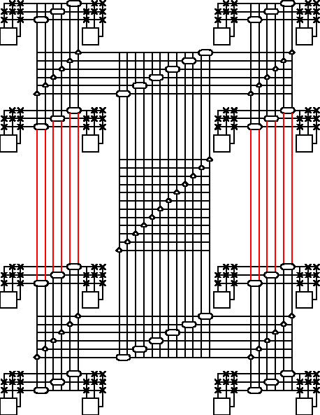
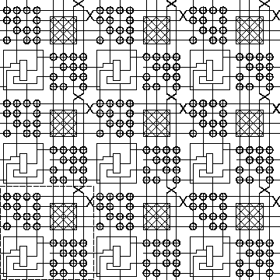
Global/Detail
With limited switching (e.g. FPGA)
  can represent routing graph exactly

Slide 6
Global/Detail

Slide 7
Routing in Graph
Find {shortest,available} path between source and sink
  search problem (e.g. BFS, A*)

Slide 8
Breadth First Search (BFS)
Start at source src
Put src node in priority queue with cost 0
  Priority queue orders by cost
While (not found sink)
  Pop least cost node from queue
    Get: current_node, current_cost
  Is this sink? → found
  For each outgoing edge from current_node
    Push destination onto queue
    with cost current_cost+edge_cost

Slide 9
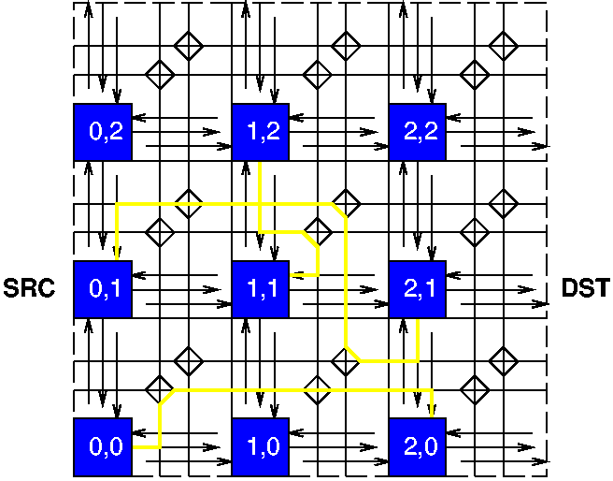
Search Animation

Slide 10
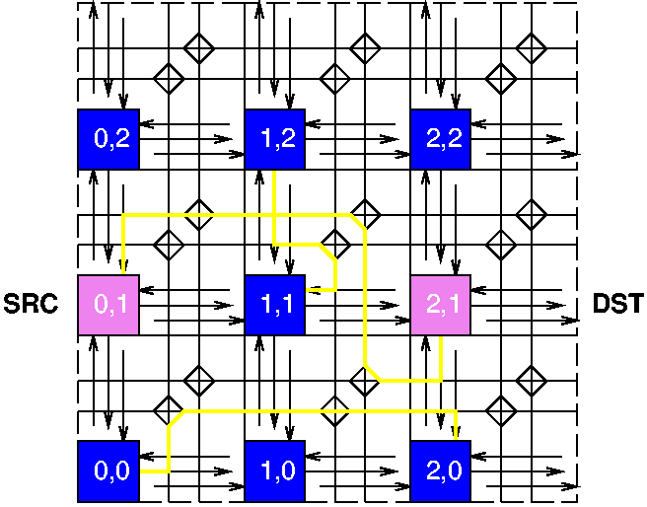
Search Animation
Not possible to
use minimum
Manhattan
distance route.
Why?

Slide 11
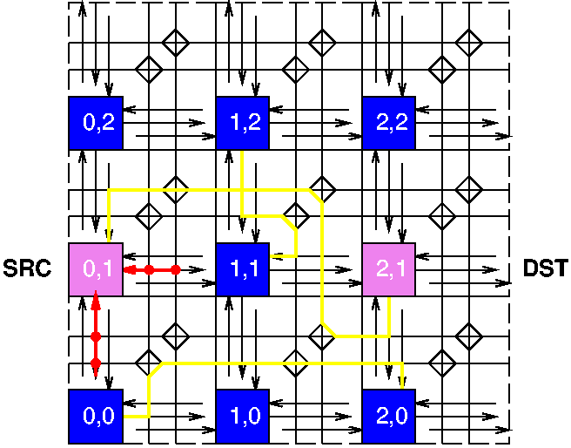
Search Animation

Slide 12
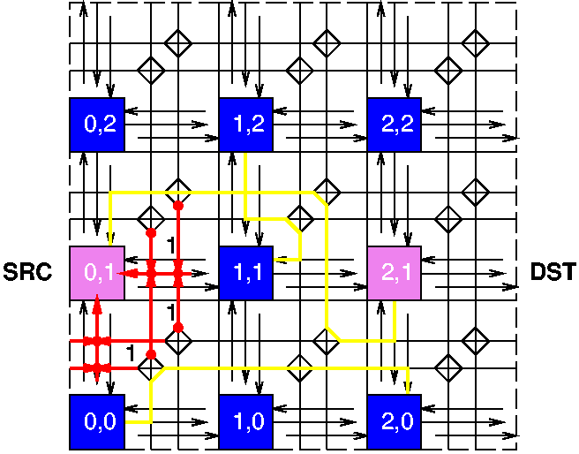
Search Animation

Slide 13
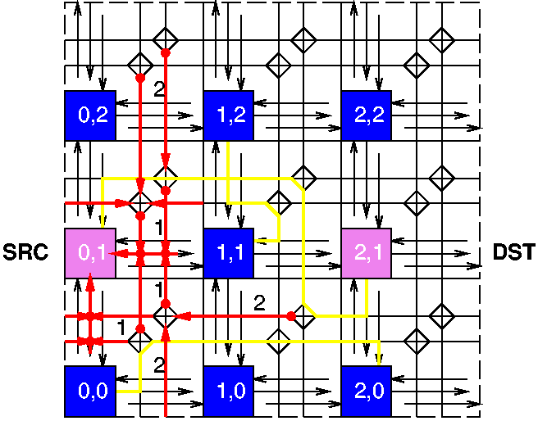
Search Animation

Slide 14
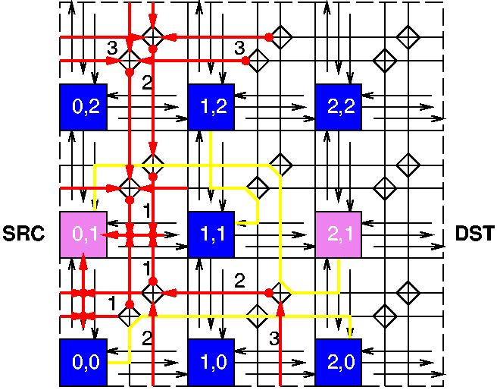
Search Animation

Slide 15
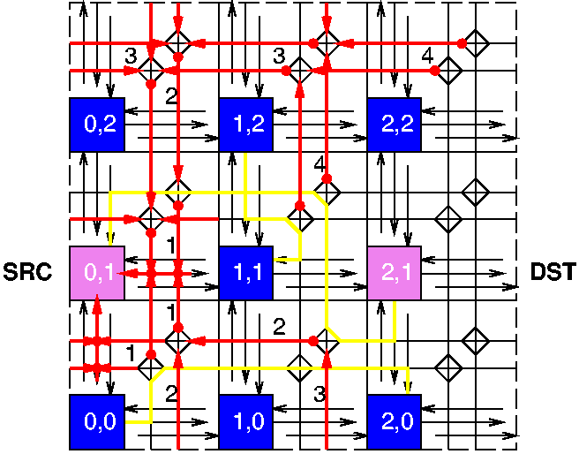
Search Animation

Slide 16
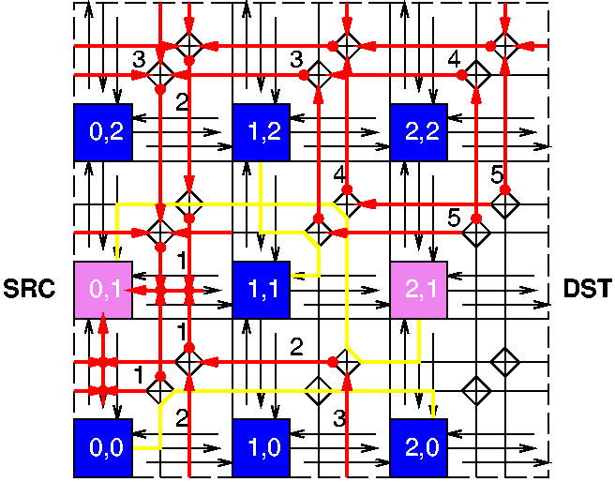
Search Animation

Slide 17
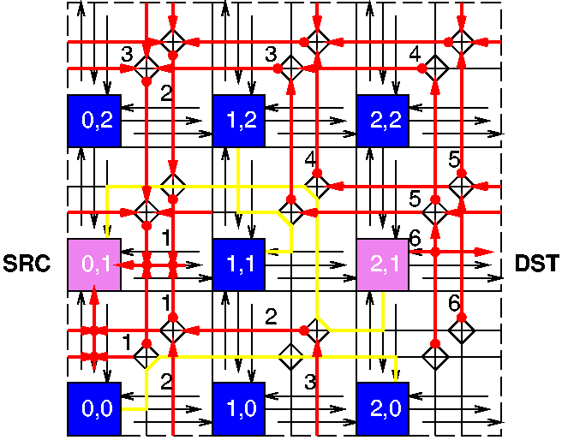
Search Animation

Slide 18
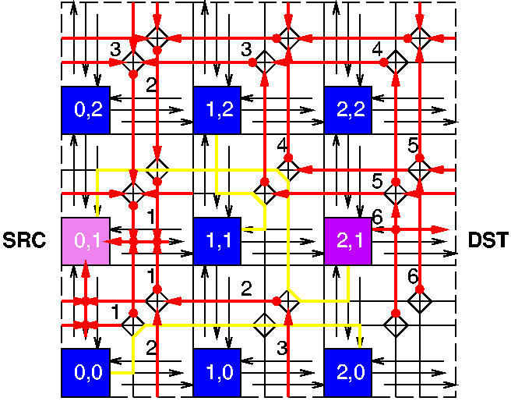
Search Animation

Slide 19
Search Animation

Slide 20
Easy?
Finding a path is moderately easy
What’s hard?
Can I just iterate and pick paths?
  Does greedy selection work?

Slide 21
Example
s1
s2
s3
All links capacity 1
s_{i} →d_{i}
d1
d2
d3

Slide 22
Challenge
s1
s2
s3
Satisfy all routes simultaneously
Routes share potential resources
Greedy/iterative
  not know who will need which resources
    E.g. consider routing s3->d3 then s2->d2 then s1->d1
  i.e. resource/path choice looks arbitrary
  …but earlier decisions limit flexibility for later
    like scheduling
  order effects result
d1
d2
d3

Slide 23
Negotiated Congestion
Idea:
  try once
  see where we run into problems
  undo problematic/blocking allocation
    rip-up
  use that information to redirect/update costs on subsequent trials
    retry

Slide 24
Negotiated Congestion
Here
  route signals
  allow overuse
  identify overuse and encourage signals to avoid
    reroute signals based on overuse/past congestion

Slide 25
Basic Algorithm
Route signals along minimum cost path
If congestion/overuse
  assign higher cost to congested resources
    Makes problem a shortest path search
    Allows us to adapt costs/search to problem
Repeat until done

Slide 26
Key Idea
Congested paths/resources become expensive
When there is freedom
  future routes with freedom to avoid congestion
  will avoid the congestion
When there is less freedom
  must take congested routes
Routes that must use congested will,
others will chose uncongested paths

Slide 27
Cost Function (1)
PathCost=Σ (link costs)
LinkCost = base × f(#routes using, time)
Base cost of resource
  E.g. delay of resource
  Encourage minimum resource usage
    (minimum length path, if possible)
  minimizing delay = minimizing resources
Congestion
  penalizes (over) sharing
  increase sharing penalty over time
3+1+4=8
s1
1
s2
1
s3
2
3
1
4
3
1
1
1
3
1
2
1
4
d1
d2
4
d3

Slide 28
Example
(first order congestion)
FUTURE: maybe label circles
So they can callout.
s1
1
s2
1
s3
1
1
2
3
1
4
3
1
1
1
Capacity
3
1
1
1
1
1
1
1
1
2
1
4
Base costs (delays)
d1
d2
4
d3
What is preferred path for s1→d1, s2→d2, s3→d3?

Slide 29
Example
(first order congestion)
s1
1
s2
1
s3
1
1
1
1
1
1
1
1
1
1
2
3
1
4
3
1
1
1
Capacity
3
1
1
1
1
1
1
2
1
4
Base costs (delays)
d1
d2
4
d3
All, individual routes prefer middle; create congestion.

Slide 30
Example
(first order congestion)
s1
1
s2
1
s3
1
1
1
1
1
1
1
1
1
1
2
3
1
4
3
1
1
1
Capacity
3
1
1
1
1
1
1
2
1
4
Base costs (delays)
d1
d2
4
d3
If make congestion expensive:
e.g. cost(congest)=2^{users} What happens when
reroute s1→d1?

Slide 31
Example
(first order congestion)
s1
1
s2
1
s3
1
1
2
3
1
4
3
1
1
1
Capacity
3
1
1
1
2
1
4
Base costs (delays)
d1
d2
4
d3
Reroute, avoid congestion.

Slide 32
Example (need for history)
s1
s2
s3
s4
1
1
1
2
2
1
1
1
1
1
Capacity
1
1
1
2
2
2
1
Base costs (delays)
d1
d2
d3
d4
Need to redirect uncongested paths.

Slide 33
Example (need for history)
s1
s2
s3
s4
Imagine partially routed.
1
1
1
2
2
1
1
Where do we route s3→d3?
1
1
1
1
What happens when
we reroute?
1
1
1
2
2
2
1
1
d1
d2
d3
d4

Slide 34
Example (need for history)
s1
s2
s3
s4
Local congestion alone
won’t drive in right
directions.
Both paths equal cost
…neither resolves problem.
1
1
1
2
2
1
1
1
1
1
1
1
1
1
2
2
2
1
1
May ping-pong back
and forth.
(can imagine longer
chain like this)
d1
d2
d3
d4
Cannot route s3→d3

Slide 35
Cost Function (2)
Cost = (base + history)*f(#resources,time)
History
  avoid resources with history of congestion
  E.g. add 1 to history every time resource is congested

Slide 36
Example (need for history)
S3→d3 and s4→d4
initially ping-pong
s1
s2
s3
s4
1
1
1
2
2
1
How does history help?
Builds up congestion history on
path 3 and 4
1
1
1
1
1
1
1
2
2
2
Eventually makes path 3 and 4
more expensive than path 1;
…resolves conflict…
1
d1
d2
d3
d4
➔ Adaptive cost scheme.

Slide 37
Delay

Slide 38
What about delay?
Existing formulation uses delay to reduces resources, but doesn’t directly treat
How do we want to optimize delay?
Want:
  prioritize critical path elements for shorter delay
  allow nodes with slack to take longer paths

Slide 39
Integrate Delay into Cost Function
Cost=
  (1-W(edge))*delay + W(edge) *congest
  congest as before
    (base+history)*f(#signals,time)
W(edge) = Slack(edge)/D_{max}
  0 for edge on critical path
  >0 for paths with slack
Use W(edge) to order routes
Update critical path and W each round

Slide 40
Cost Function (Delay)
Cost=
  (1-W(edge))*delay + W(edge) *congest
  congest as before
    (base+history)*f(#signals,time)
W(edge) = Slack(edge)/D_{max}
What happens if multiple slack 0 nets contend for edge?
W(edge)=Max(minW,Slack(edge)/D_{max})
  minW > 0

Slide 41
Problem
Are nanoseconds and congestion comparable?
How normalize/weight so can add together?

Slide 42
VPR
If doesn’t uncongest,
weight congestion more
Cost=
  (1-W(e))×delay + W(e)×PF^{(iter)}×congest
  PF=Pressure Factor Multiplier
Eventually congest dominates delay
What might go wrong?

Slide 43
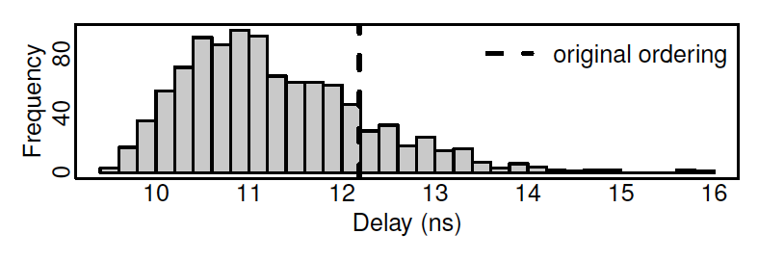
VPR Pressure Factor
Converges quickly
But may “freeze” with higher delay than necessary
Netlist Shuffle experiment
[Rubin / FPGA 2011]

Slide 44
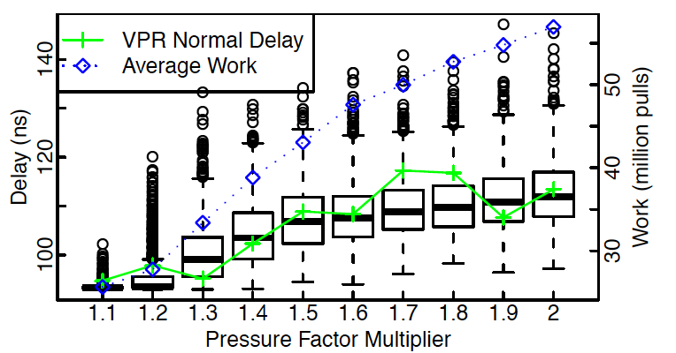
VPR Pressure Factor Tuning
  (1-W(e))×delay + W(e)×PF^{(iter)}×congest
[Raphael Rubin 2010]

Slide 45
Alternate Delay Approach
Believe Pathfinder can resolve congestion
Pathfinder has trouble mixing delay and congestion
Idea: Turn delay problem into congestion problem
  Reject paths that are too long
  All signals compete only for resources that will allow them to meet their timing goals

Slide 46
Outlaw Long Paths
Issue: Critical path may go through multiple gates
  Contain more than one gate→gate path
  How allocate slack among paths?
Target 12
Gate 1
Manhattan hop 1

Slide 47
Outlaw Long Paths
Issue: Critical path may go through multiple gates
  Contain more than one gate→gate path
  How allocate slack among paths?
Target 12
Gate 1
Manhattan hop 1

Slide 48
Outlaw Long Paths
Issue: Critical path may go through multiple gates
  Contain more than one gate→gate path
  How allocate slack among paths?
Target 12
Gate 1
Manhattan hop 1
1
2
3
4
5
6
7
8
9
Total Slack?

Slide 49
Slack Budgeting
Divide slack among the paths
  Slack of 3
  Example: give slack 1 to first link
  2 to second
1
2
3
4
5
6
7
8
9
[So / FPGA 2008]

Slide 50
Slack Budgeting
Divide slack among the paths
Each net now has delay target
Reject any path exceeding delay target
Reduce to congestion negotiation
5
6
[So / FPGA 2008]

Slide 51
Slack Budgeting
Can often find lower delay routes that VPR
Takes 10x as long
  Mostly in slack budgeting
Solution depends on slack budget
  Not exploiting full freedom to re-allocate slack among links
[So / FPGA 2008]

Slide 52
Delay Target Routing
Similar high-level idea
Just set target for Pathfinder cost
  Rather than allowing to float

Slide 53
Delay Target
Cost=
  (1-W(edge))*delay + W(edge) *congest
W(edge) = Slack(edge)/D_{target}
  Previously: denominate was D_{max}
Compute Slack based on D_{target}
  can be negative
W(edge)=Max(minW,Slack(edge)/D_{target})
  minW > 0

Slide 54
Delay Target Routing
Does allow slack to be used on any of the gate→gate connections on path
  …but not being that deliberate/efficient about the allocation
Doesn’t require time for slack allocation

Slide 55
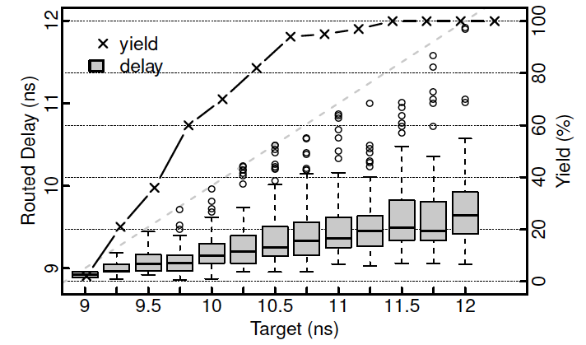
Delay Target Routing
[Rubin / FPGA 2011]

Slide 56
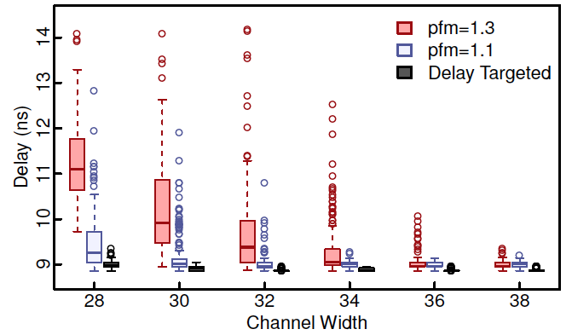
Delay Target Routing
Less sensitive to initial conditions
[Rubin / FPGA 2011]

Slide 57
Run Time?
Route |E| edges
Each path search O(|E_{graph}|) worst case
  …generally less
Iterations?

Slide 58
Quality and Runtime Experiment
For Synthetic netlists on HSRA
  Expect to be worst-case problems
Congestion only
  Quality = # channels
Number of individual route trials limited (measured) as multiple of nets in design
  (not measuring work per route trial)

Slide 59
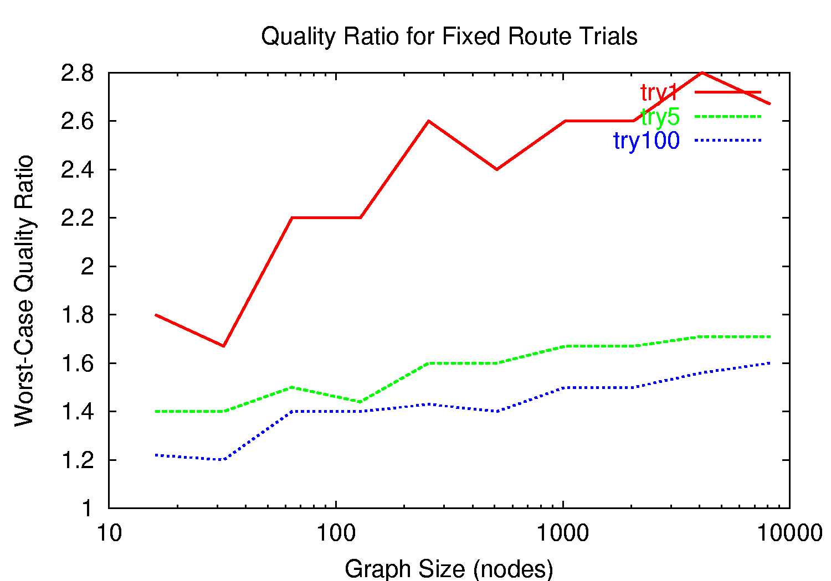
Quality: fixed runtime

Slide 60
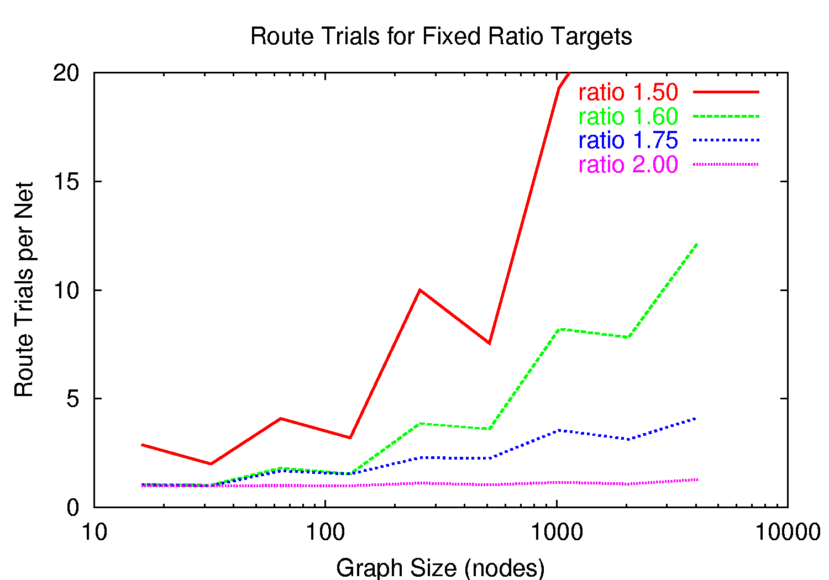
Quality Target

Slide 61
Conclusions?
Iterations increases with N
Quality degrade as we scale?

Slide 62
Techniques to Accelerate
(already in use in data just shown)

Slide 63
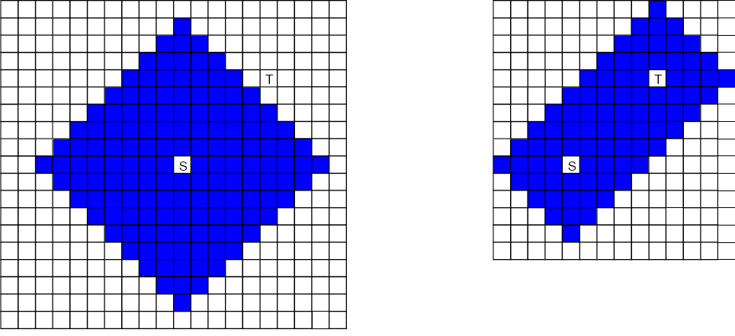
Inefficient?
What is inefficient about
this search?
How might we do better?

Slide 64
Inefficient?
What if we only searched
for minimum length paths?
How would we do that?
Downside?

Slide 65
Recall Search Example
Not possible to
use minimum
Manhattan
distance route.

Slide 66
Only Search Minimum Length

Slide 67
Minimum Search
What is the minimum
we need to search
(if uncongested)?
What would that
search look like?

Slide 68
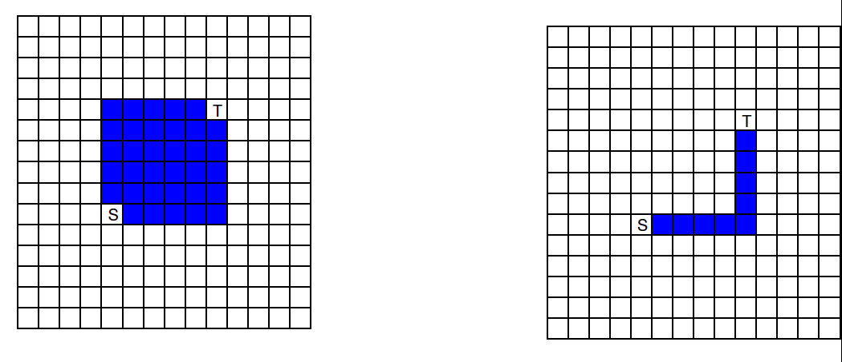
BFS vs. DFS

Slide 69
Search Ordering
Default: breadth first search for shortest
  O(total-paths)
Alternately: use A*:
  estimated costs/path length, prune candidates earlier
  can be more depth first
    (search promising paths as long as know can’t be worse)

Slide 70
BFS → A*
Start at source
Put src node in priority queue with cost 0
  Priority queue orders by cost
  Cost = Σ (path so far) + min path to dest
While (not found sink)
  Pop least cost node from queue
    Get: current_node, current_cost
  Is this sink? → found
  For each outgoing edge
    Push destination onto queue
    with cost current_cost+edge_cost
Maybe show a
parameter here
for tuning how greedy?

Slide 71
BFS vs. A*

Slide 72
Single-side, Directed (A*)
Only expand search windows as
prove necessary to have longer route.

Slide 73
Search: one-side vs. two-sides
One-side vs. Two-sides

Slide 74
Searching
In general:
  greedy/depth first searching
    find a path faster
    may be more expensive
      (not least delay, congest cost)
  tradeoff by weighting
    estimated delay on remaining path vs. cost to this point
    control greediness of router
  More greedy is faster at cost of less optimal paths (wider channels)
    40% W → 10x time reduction [Tessier/thesis’98]

Slide 75
Searching
Use A* like search
  Always expanded (deepen) along shortest …as long as can prove no other path will dominate
  Uncongested: takes O(path-length) time
  Worst-case reduces to breadth-first
    O(total-paths)

Slide 76
Summary
Finding short path easy/well known
Complication: need to route set of signals
  who gets which path?
  Arbitrary decisions earlier limit options later
Idea: iterate/relax using congestion history
  update path costs based on congestion
    Cost adaptive to route
  reroute with new costs
Accommodate delay and congestion

Slide 77
Big Ideas
Exploit freedom
Technique:
  Graph algorithms (BFS, DFS)
  Search techniques: A*
  Iterative improvement/relaxation
  Adaptive cost refinement

Slide 78
Admin
Assignment 4 due Wednesday
Reading for Wednesday on web
Spring Break next week
Reading for Monday after break
  On Blackboard

