Slide 1
ESE535: Electronic Design Automation
Day 15: March 23, 2015
Dataflow

Slide 2
Previously
A1
A3
A5
A7
A8
A9
A10
A11
A12
A13
A2
A4
A6
B2
B1
B3
B10
B11
B4
B5
B6
Scheduling of concurrent operations
B7
B8
B9

Slide 3
Want to See
Abstract compute model
natural for parallelism and hardware
Describe computation abstracted from implementation
Defines correctness

Slide 4
Today
Behavioral
(C, MATLAB, …)
Arch. Select
Schedule
RTL
FSM assign
Dataflow
SDF
Single rate
Multirate
Dynamic Dataflow
Expression
Two-level,
Multilevel opt.
Covering
Retiming
Gate Netlist
Placement
Routing
Layout
Masks

Slide 5
Parallelism Motivation

Slide 6
Producer-Consumer Parallelism
Stock
predictions
encrypt
Can run concurrently
Just let consumer know when producer sending data

Slide 7
Pipeline Parallelism
ME
DCT
VQ
code
Can potentially all run in parallel
Like physical pipeline
Useful to think about stream of data between operators

Slide 8
DAG Parallelism
Decode
video
Check/decode
block
synchronize
Decode
audio
Doesn’t need to be linear pipeline
Synchronize inputs

Slide 9
Graphs with Feedback
+
+
×k
×k
×k
×k
In general may hold state
Very natural for many tasks

Slide 10
Definitions

Slide 11
Operation/Operator
Operation – logic computation to be performed
Operator – physical block that performs an Operation

Slide 12
Dataflow / Control Flow
Dataflow
Program is a graph of operations
Operation consumes tokens and produces tokens
All operations run concurrently
Control flow (e.g. C)
Program is a sequence of operations
Operation reads inputs and writes outputs into common store
One operation runs at a time
defines successor

Slide 13
Token
Data value with presence indication
May be conceptual
Only exist in high-level model
Not kept around at runtime
Or may be physically represented
One bit represents presence/absence of data

Slide 14
Token Examples?
What are familiar cases where data may come with presence tokens?
Network packets
Memory references from processor
Variable latency depending on cache presence
Start bit on serial communication

Slide 15
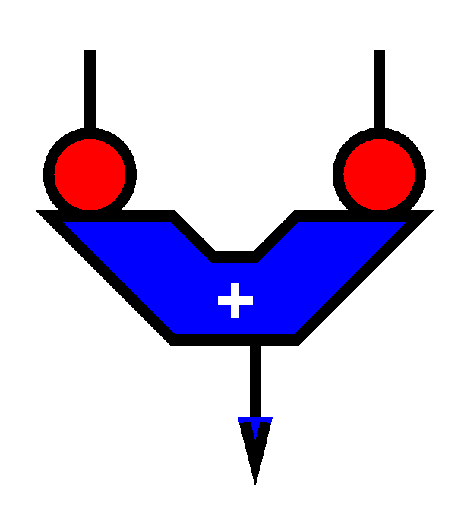
Operation
Takes in one or more inputs
Computes on the inputs
Produces results
Logically self-timed
“Fires” only when input set present
Signals availability of output

Slide 16
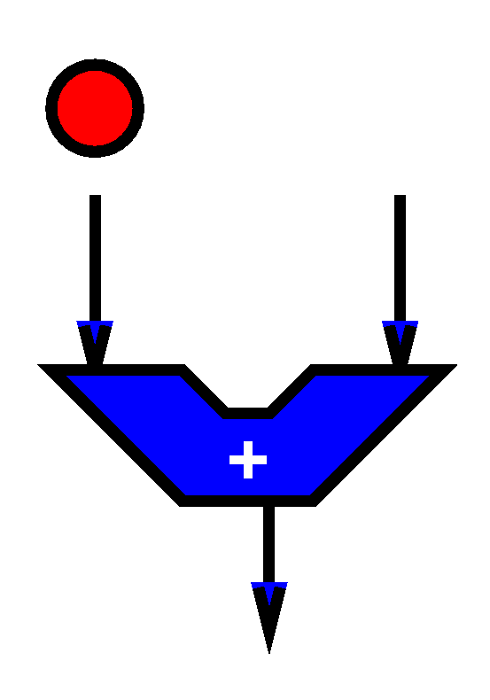
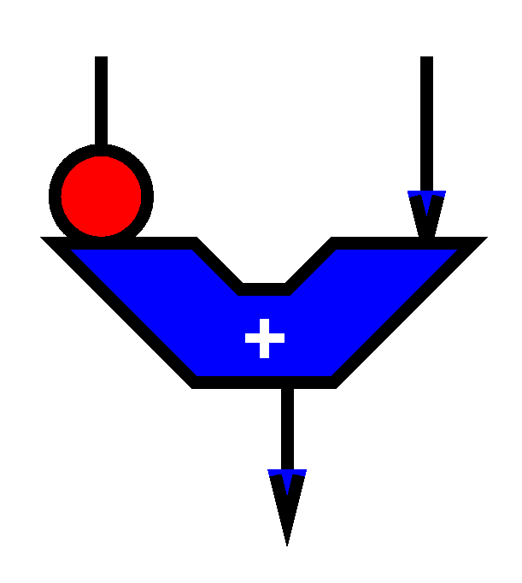
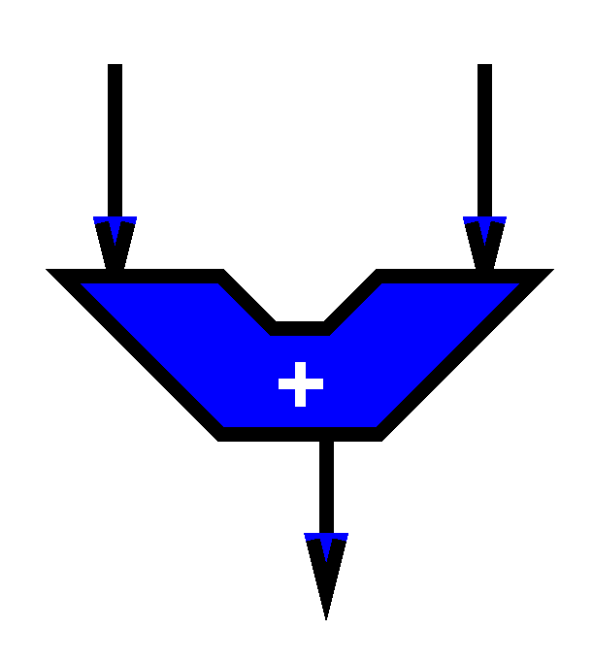
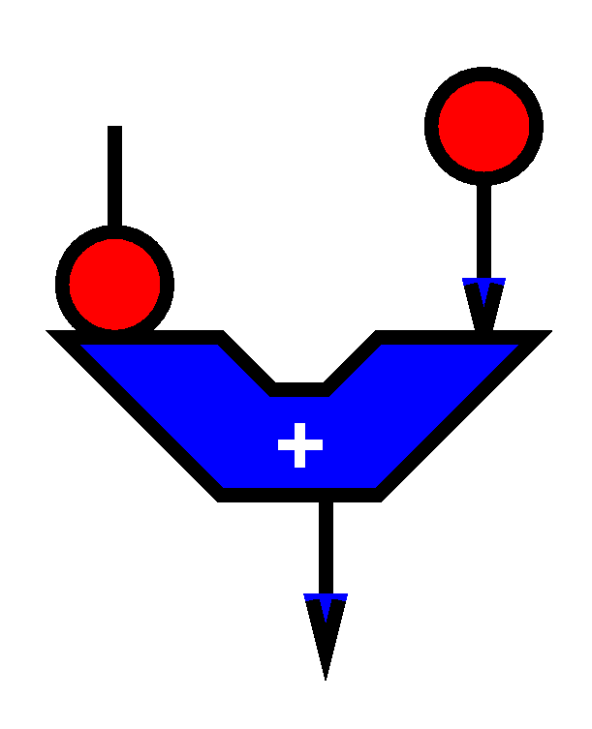
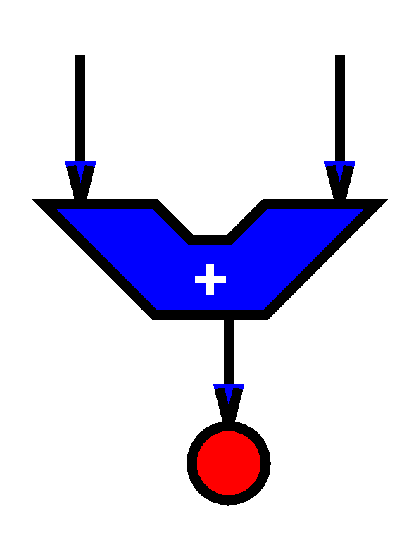

Slide 17
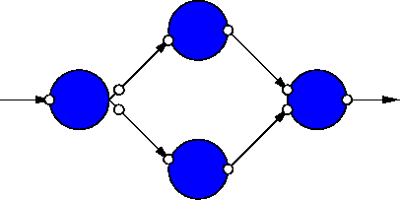
Dataflow Graph
Represents
computation sub-blocks
linkage
Abstractly
controlled by data presence

Slide 18
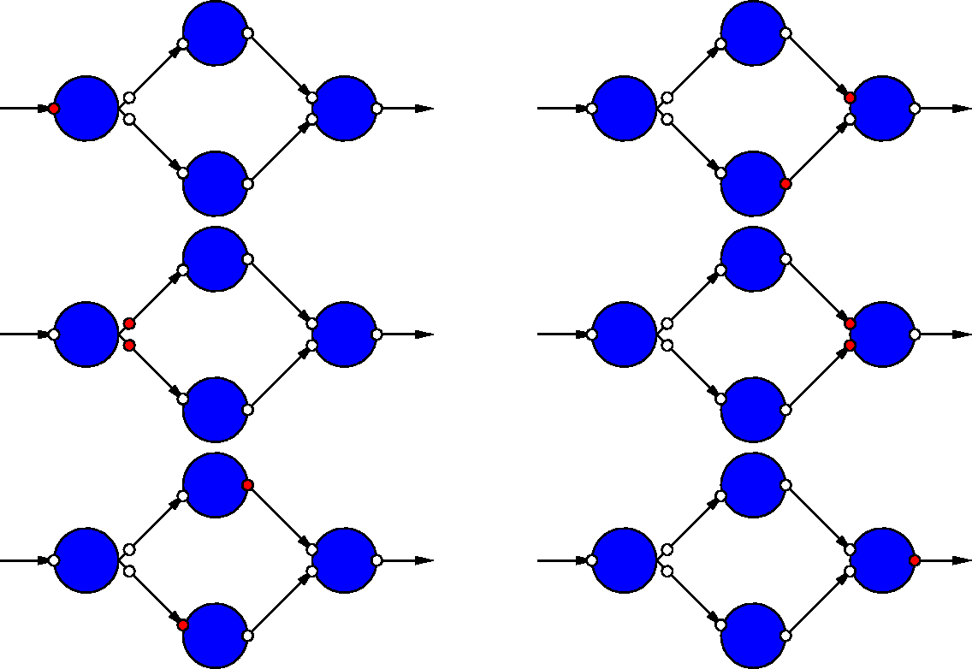
Dataflow Graph Example

Slide 19
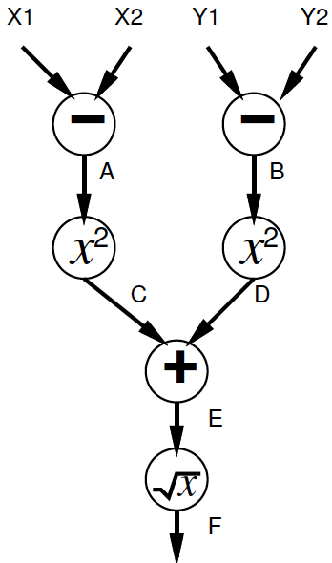
In-Class Dataflow Example

Slide 20
Stream
Logical abstraction of a persistent point-to-point communication link
Has a (single) source and sink
Carries data presence / flow control
Provides in-order (FIFO) delivery of data from source to sink
stream

Slide 21
Streams
Captures communications structure
Explicit producer→consumer link up
Abstract communications
Physical resources or implementation
Delay from source to sink

Slide 22
Register Transfer Level (RTL)
Behavioral
(C, MATLAB, …)
Arch. Select
Schedule
RTL
FSM assign
Describe computation as logic and registers
Equations (logic) define values to be clocked into next register
Typically what you right in VHDL, Verilog
Two-level,
Multilevel opt.
Covering
Retiming
Gate Netlist
Placement
Routing
Layout
Masks

Slide 23
Dataflow Abstracts Timing
Doesn’t say
on which cycle calculation occurs [contrast RTL]
Does say
What order operations occur in
How data interacts
i.e. which inputs get mixed together
Permits
Scheduling on different # of resources
Operators with variable delay [examples?]
Variable delay in interconnect [examples?]

Slide 24
Examples
Operators with Variable Delay
Cached memory or computation
Shift-and-add multiply
Iterative divide or square-root
Variable delay interconnect
Shared bus
Distance changes
Wireless, longer/shorter cables
Computation placed on different cores?

Slide 25
Difference: Dataflow Graph/Pipeline

Slide 26
Clock Independent Semantics
Interconnect
Takes n-clocks

Slide 27
Semantics
Need to implement semantics
i.e. get same result as if computed as indicated
But can implement any way we want
That preserves the semantics
Exploit freedom of implementation

Slide 28
Dataflow Variants

Slide 29
Synchronous Dataflow (SDF)
Particular, restricted form of dataflow
Each operation
Consumes a fixed number of input tokens
Produces a fixed number of output tokens
When full set of inputs are available
Can produce output
Can fire any (all) operations with inputs available at any point in time

Slide 30
Synchronous Dataflow
+
+
×k
×k
×k
×k

Slide 31
SDF: Execution Semantics
while (true)
Pick up any operator
If operation has full set of inputs
Compute operation
Produce outputs
Send outputs to consumers

Slide 32
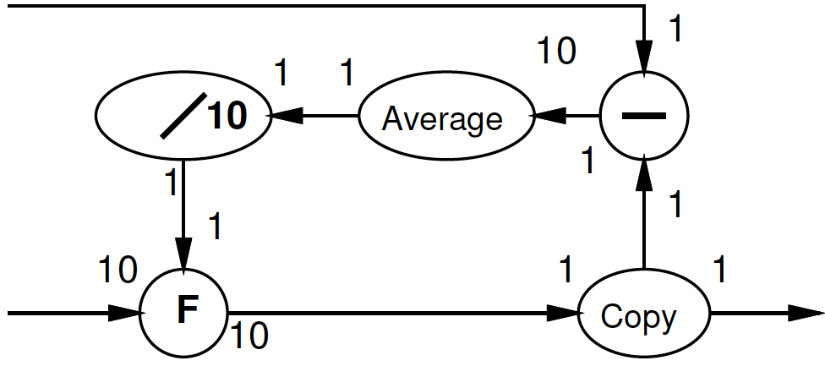
Multirate Synchronous Dataflow
Rates can be different
Allow lower frequency operations
Communicates rates to CAD
Something not clear in RTL
Use in scheduling, provisioning
Rates must be constant
Data independent
2
decimate
1

Slide 33
SDF
Can validate flows to check legal
Like KCL → token flow must be conserved
No node should
be starved of tokens
Collect tokens
Schedule operations onto processing elements
Provisioning of operators
Provide real-time guarantees
Simulink is SDF model

Slide 34
SDF: good/bad graphs
1
1
2
1
1
1
1
1
1
1
1
1

Slide 35
SDF: good/bad graphs
1
1
1
1
1
2
2
2
2
1
1
1
1
1
1
1
1
1

Slide 36
Dynamic Rates?
When might static rates be limiting? (prevent useful optimizations?)
Compress/decompress
Lossless
Even Run-Length-Encoding
Filtering
Discard all packets from spamRus
Anything data dependent

Slide 37
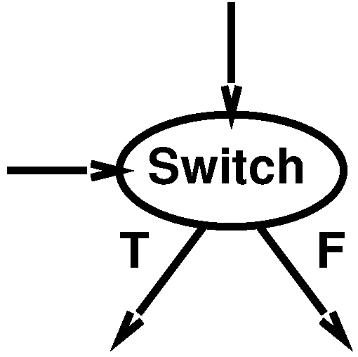
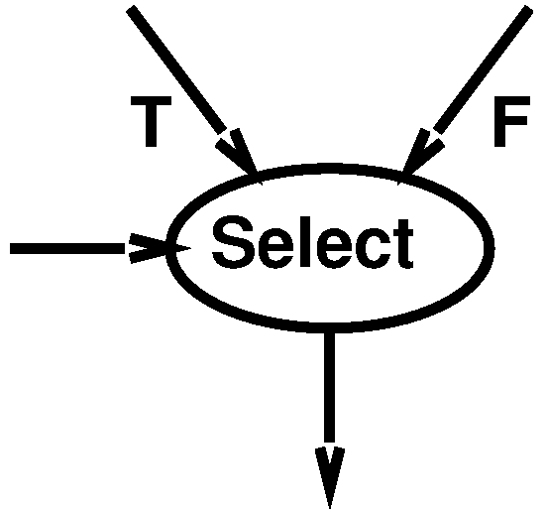
Data Dependence
Add Two Operators
Switch
Select

Slide 38
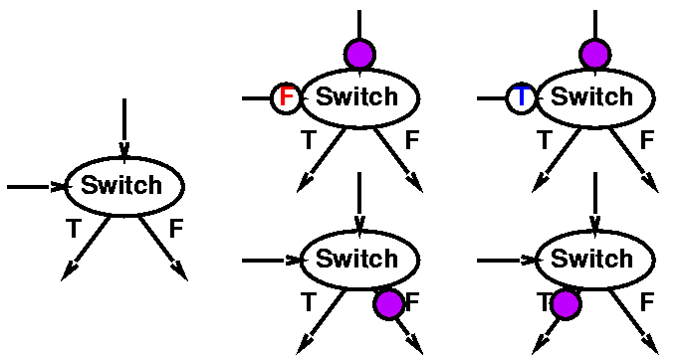
Switch

Slide 39
Filtering Example
spamRus?
discard
dup
switch

Slide 40
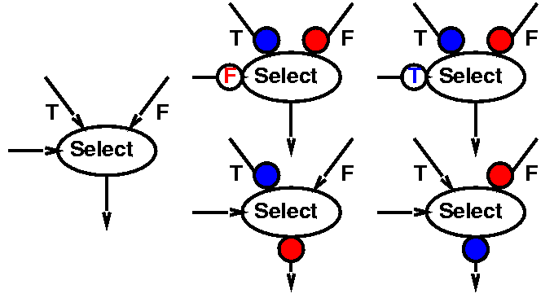
Select

Slide 41
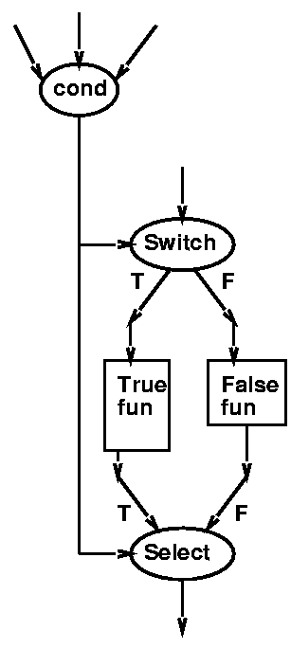
Constructing If-Then-Else

Slide 42
In-Order Merge
Task: Merge to ordered streams in order onto a single output stream
Key step in merge sort
Use to illustrate switch/select

Slide 43
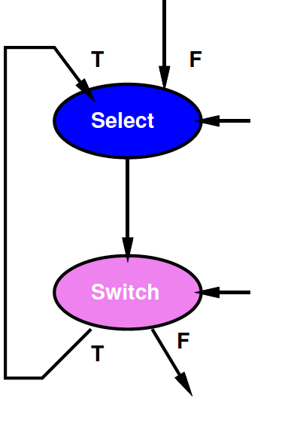
Idiom to Selectively Consume Input
Hold onto current head on loop
Shown left here
With T-side control

Slide 44
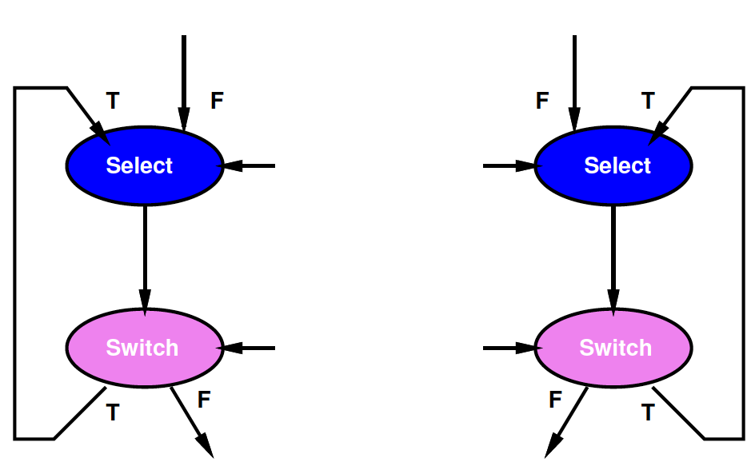
In-Order Merge
Use one for each of the two input streams

Slide 45
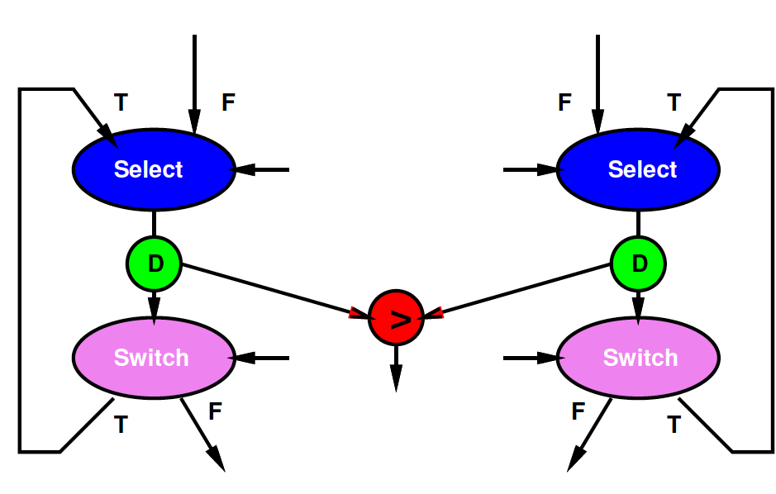
In-Order Merge
Perform Comparison

Slide 46
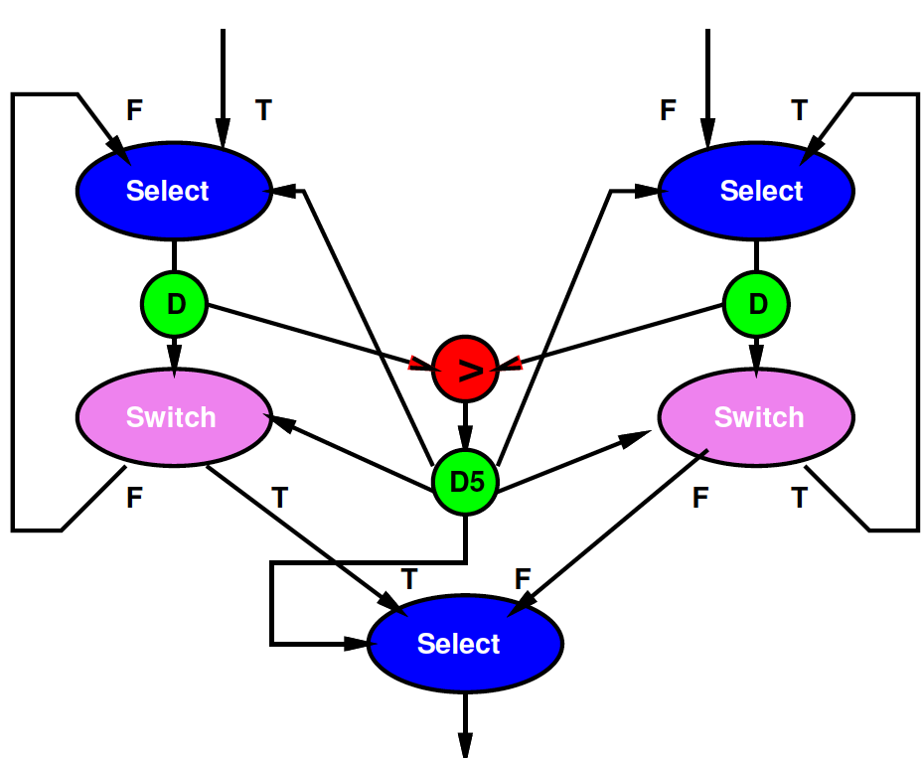
In-Order Merge
Act on result of comparison

Slide 47
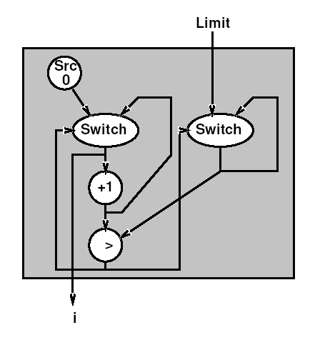
Looping
for (i=0;i<Limit;i++)

Slide 48
Universal
Once we add switch and select, the dataflow model is as powerful as any other
E.g. can do anything we could do in C
“Turing Complete” in formal CS terms

Slide 49
Dynamic Challenges
In general, cannot say
If a graph is well formed
Will not deadlock
How many tokens may have to buffer in stream
Right proportion of operators for computation

Slide 50
Expression (Time Permitting)
How would we capture this in a Programming Language?

Slide 51
Expression
Could express operations in C/Java
Each is own thread
Link together with Streams
E.g. SystemC

Slide 52
C Example
while (!(eos(stream_a) && !(eos(stream_b))
A=stream_a.read();
B=stream_b.read();
Out=(a+b)*(a-b);
stream_out.write(Out);

Slide 53
Connecting up Dataflow
stream stream1=new stream();
operation prod=new stock(stream1);
operation cons=new encrypt(stream1);
Stock
predictions
encrypt

Slide 54
What have we gained?
Ability to capture more freedom that exists
Freedom we can use to reduce costs
A1: Model for expressing freedom that exists in the computation
Higher-level than an implementation
Perhaps as a useful intermediate
A2: Model allows freedom for implementations (or instances) to take variable time?

Slide 55
Summary
Dataflow Models
Simple pipelines
DAGs
SDF (single, multi)-rate
Dynamic Dataflow
Allow
express parallelism
freedom of implementation

Slide 56
Big Ideas:
Dataflow
Natural model for capturing computations
Communicates useful information for optimization
Linkage, operator usage rates
Abstract representations
Leave freedom to implementation

Slide 57
Admin
HW7
Reading for Wednesday on Canvas
HW8 Thursday

