Slide 1

ESE535:
Electronic Design Automation
Day 16: March 25, 2015
C→RTL

Slide 2
Today
Behavioral
(C, MATLAB, …)
Arch. Select
Schedule
See how get from a language (C)
to dataflow
Basic translation
  Straight-line code
  Memory
  Basic Blocks
  Control Flow
  Looping
Optimization
  If-conversion
  Hyperblocks
  Common Optimizations
  Pipelining
  Unrolling
RTL
FSM assign
Two-level,
Multilevel opt.
Covering
Retiming
Gate Netlist
Placement
Routing
Layout
Masks

Slide 3
Design Productivity by Approach
Day 1
GATES/WEEK
(Dataquest)
DOMAIN
SPECIFIC
8K - 12K
BEHAVIORAL
2K - 10K
RTL
1K - 2K
a
0
d
q
100 - 200
GATE
b
1
s
clk
TRANSISTOR
10 - 20
Source: Keutzer (UCB EE 244)

Slide 4
C Primitives
Arithmetic Operators
Unary Minus (Negation) -a
Addition (Sum) a + b
Subtraction (Difference) a - b
Multiplication (Product) a * b
Division (Quotient) a / b
Modulus (Remainder) a % b
Things might have a hardware operator for…

Slide 5
C Primitives
Bitwise Operators
Bitwise Left Shift a << b
Bitwise Right Shift a >> b
Bitwise One's Complement ~a
Bitwise AND a & b
Bitwise OR a | b
Bitwise XOR a ^ b
Things might have a hardware operator for…

Slide 6
C Primitives
Comparison Operators
Less Than a < b
Less Than or Equal To a <= b
Greater Than a > b
Greater Than or Equal To a >= b
Not Equal To a != b
Equal To a == b
Logical Negation !a
Logical AND a && b
Logical OR a || b
Things might have a hardware operator for…

Slide 7
Expressions: combine operators
a*x+b
a
x
b
*
+
A connected set of operators
→ Graph of operators

Slide 8
Expressions: combine operators
a*x+b
a*x*x+b*x+c
a*(x+b)*x+c
((a+10)*b < 100)
A connected set of operators
→ Graph of operators

Slide 9
C Assignment
Basic assignment statement is:
Location = expression
f=a*x+b
a
x
b
*
+
f

Slide 10
Straight-line code
a sequence of assignments
What does this mean?
  g=a*x;
  h=b+g;
  i=h*x;
  j=i+c;
a
x
b
c
*
g
+
h
*
i
+
j

Slide 11
Variable Reuse
Variables (locations) define flow between computations
Locations (variables) are reusable
  t=a*x;
  r=t*x;
  t=b*x;
  r=r+t;
  r=r+c;

Slide 12
Variable Reuse
Variables (locations) define flow between computations
Locations (variables) are reusable
  t=a*x; t=a*x;
  r=t*x; r=t*x;
  t=b*x; t=b*x;
  r=r+t; r=r+t;
  r=r+c; r=r+c;
Sequential assignment semantics tell us which definition goes with which use.
  Use gets most recent preceding definition.

Slide 13
Dataflow
Can turn sequential assignments into dataflow graph through def→use connections
  t=a*x; t=a*x;
  r=t*x; r=t*x;
  t=b*x; t=b*x;
  r=r+t; r=r+t;
  r=r+c; r=r+c;
a
x
b
c
*
*
*
+
+

Slide 14
Dataflow Height
t=a*x; t=a*x;
  r=t*x; r=t*x;
  t=b*x; t=b*x;
  r=r+t; r=r+t;
  r=r+c; r=r+c;
Height (delay) of DF graph may be less than # sequential instructions.
a
x
b
c
*
*
*
+
+

Slide 15
Lecture Checkpoint
Happy with
  Straight-line code
  Variables
Graph for preclass f
Next topic: Memory

Slide 16
C Memory Model
One big linear address space of locations
Most recent definition to location is value
Sequential flow of statements
New value
000
001
Addr
002
004
005
006
007
008
009
010
011
Current value

Slide 17
C Memory Operations
Read/Use
a=*p;
a=p[0]
a=p[c*10+d]
Write/Def
*p=2*a+b;
p[0]=23;
p[c*10+d]=a*x+b;

Slide 18
Memory Operation Challenge
Memory is just a set of location
But memory expressions can refer to variable locations
  Does *q and *p refer to same location?
  p[0] and p[c*10+d]?
  *p and q[c*10+d]?
  p[f(a)] and p[g(b)] ?

Slide 19
Pitfall
P[i]=23
r=10+P[i]
P[j]=17
s=P[j]*12
Value of r and s?
Could do:
P[i]=23; P[j]=17;
r=10+P[i]; s=P[j]*12
….unless i==j
Value of r and s?

Slide 20
C Pointer Pitfalls
*p=23
r=10+*p;
*q=17
s=*q*12;
Similar limit if p==q

Slide 21
C Memory/Pointer Sequentialization
Must preserve ordering of memory operations
  A read cannot be moved before write to memory which may redefine the location of the read
    Conservative: any write to memory
    Sophisticated analysis may allow us to prove independence of read and write
  Writes which may redefine the same location cannot be reordered

Slide 22
Consequence
Expressions and operations through variables (whose address is never taken) can be executed at any time
  Just preserve the dataflow
Memory assignments must execute in strict order
  Ideally: partial order
  Conservatively: strict sequential order of C

Slide 23
Forcing Sequencing
Demands we introduce some discipline for deciding when operations occur
  Could be a FSM
  Could be an explicit dataflow token
  Callahan uses control register
Other uses for timing control
  Control
  Variable delay blocks
  Looping

Slide 24
Scheduled Memory Operations
Source: Callahan

Slide 25
Control

Slide 26
Conditions
If (cond)
  DoA
Else
  DoB
While (cond)
  DoBody
No longer straightline code
Code selectively executed
Data determines which computation to perform

Slide 27
Basic Blocks
Sequence of operations with
  Single entry point
  Once enter execute all operations in block
  Set of exits at end
begin:
x=y;
y++;
z=y;
t=z>20;
brfalse t, finish
y=4
finish:
x=x*y
end:
BB0:
x=y;
y++;
z=y;
t=z>20
br(t,BB1,BB2)
BB1:
y=4;
br BB2
BB2:
x=x*y;
Basic Blocks?

Slide 28
Basic Blocks
Sequence of operations with
  Single entry point
  Once enter execute all operations in block
  Set of exits at end
Can dataflow schedule operations within a basic block
  As long as preserve memory ordering

Slide 29
Connecting Basic Blocks
Connect up basic blocks by routing control flow token
  May enter from several places
  May leave to one of several places

Slide 30
Connecting Basic Blocks
Connect up basic blocks by routing control flow token
  May enter from several places
  May leave to one of several places
BB0
begin:
x=y;
y++;
z=y;
t=z>20;
brfalse t, finish
y=4
finish:
x=x*y
end:
BB0:
x=y;
y++;
z=y;
t=z>20
br(t,BB1,BB2)
BB1:
y=4;
br BB2
BB1
BB2
BB2:
x=x*y;

Slide 31
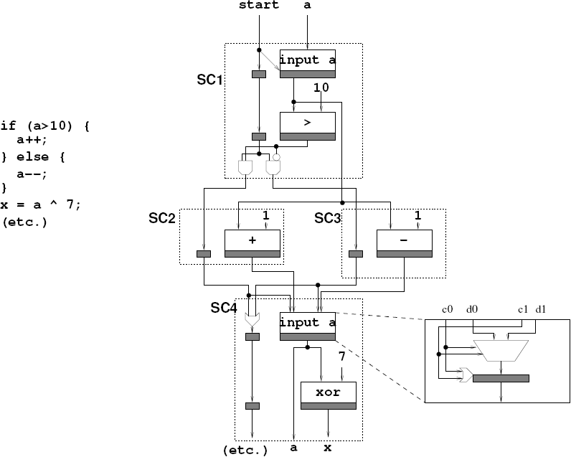
Basic Blocks for if/then/else
Source: Callahan

Slide 32
Loops
sum=0;
i=0;
sum=0;
for (i=0;i<imax;i++)
  sum+=i;
r=sum<<2;
i<imax
sum+=i;
i=i+1;
r=sum<<2;

Slide 33
Lecture Checkpoint
Happy with
  Straight-line code
  Variables
  Memory
  Control
Q: Satisfied with implementation this is producing?

Slide 34
Beyond Basic Blocks
Basic blocks tend to be limiting
Runs of straight-line code are not long
For good hardware implementation
  Want more parallelism

Slide 35
Simple Control Flow
If (cond) { … } else { …}
Assignments become conditional
In simplest cases (no memory ops),
can treat as dataflow node
cond
then
else
select

Slide 36
Simple Conditionals
if (a>b)
c=b*c;
else
c=a*c;
a>b
b*c
a*c
c

Slide 37
Simple Conditionals
v=a;
if (b>a)
v=b;
If not assigned, value flows from before assignment
b>a
b
a
v

Slide 38
Simple Conditionals
a
max=a;
min=a;
if (a>b)
{min=b;
c=1;}
else
{max=b;
c=0;}
May (re)define many values on each branch.
a>b
b
1
0
min
max
c

Slide 39
Preclass G
Finish drawing graph for preclass g

Slide 40
Recall: Basic Blocks for if/then/else
Source: Callahan

Slide 41
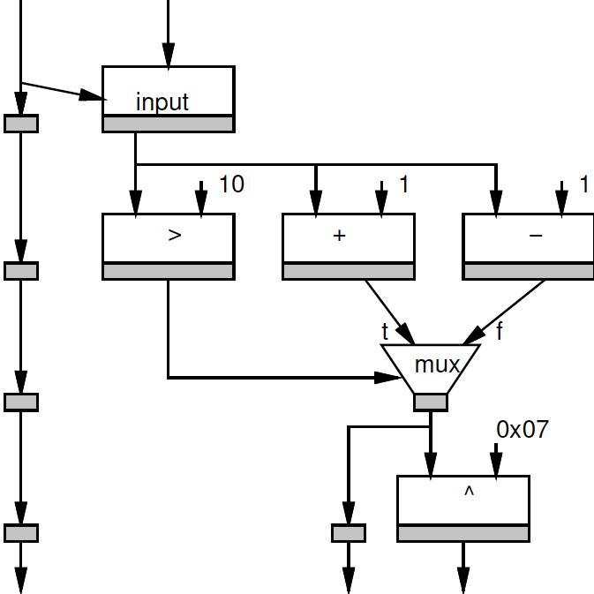
Mux Converted
if (a>10)
a++;
else;
a—
x=a^0x07

Slide 42
Height Reduction
Mux converted version has shorter path (lower latency)
Why?

Slide 43
Height Reduction
Mux converted version has shorter path (lower latency)
Can execute condition in parallel with then and else clauses

Slide 44
Mux Conversion and Memory
What might go wrong if we mux-converted the following:
If (cond)
  *a=0
Else
  *b=0

Slide 45
Mux Conversion and Memory
What might go wrong if we mux-converted the following:
If (cond)
  *a=0
Else
  *b=0
Don’t want memory operations in non-taken branch to occur.

Slide 46
Mux Conversion and Memory
If (cond)
  *a=0
Else
  *b=0
Don’t want memory operations in non-taken branch to occur.
Conclude: cannot mux-convert blocks with branches (without additional care)

Slide 47
Hyperblocks
Can convert if/then/else into dataflow
  If/mux-conversion
Hyperblock
  Single entry point
  No internal branches
  Internal control flow provided by mux conversion
  May exit at multiple points
a>b
b*c
a*c
c

Slide 48
Basic Blocks → Hyperblock
Source: Callahan

Slide 49
Hyperblock Benefits
More code → typically more parallelism
  Shorter critical path
Optimization opportunities
  Reduce work in common flow path
  Move logic for uncommon case out of path
    Makes smaller faster

Slide 50
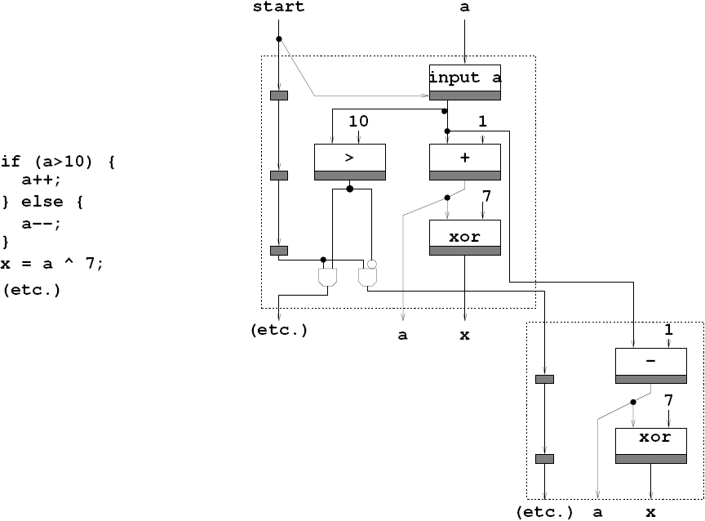
Common Case Height Reduction
Source: Callahan

Slide 51
Common-Case Flow Optimization
Source: Callahan

Slide 52
Optimizations
Constant propagation: a=10; b=c[a];
Copy propagation: a=b; c=a+d; → c=b+d;
Constant folding: c[10*10+4]; → c[104];
Identity Simplification: c=1*a+0; → c=a;
Strength Reduction: c=b*2; → c=b<<1;
Dead code elimination
Common Subexpression Elimination:
  C[x*100+y]=A[x*100+y]+B[x*100+y]
  t=x*100+y; C[t]=A[t]+B[t];
Operator sizing: for (i=0; i<100; i++) b[i]=(a&0xff+i);

Slide 53
Additional Concerns?
What are we still not satisfied with?
Parallelism in hyperblock
  Especially if memory sequentialized
    Disambiguate memories?
    Allow multiple memory banks?
Only one hyperblock active at a time
  Share hardware between blocks?
Data only used from one side of mux
  Share hardware between sides?
Most logic in hyperblock idle?
  Couldn’t we pipeline execution?

Slide 54
Pipelining
i<MAX
x
i
for (i=0;i<MAX;i++)
  o[i]=(a*x[i]+b)*x[i]+c;
If know memory operations independent
read
+
a
*
b
+
*
c
+
o
write

Slide 55
Unrolling
Put several (all?) executions of loop into straight-line code in the body.
for (i=0;i<MAX;i++)
  o[i]=(a*x[i]+b)*x[i]+c;
for (i=0;i<MAX;i+=2)
  o[i]=(a*x[i]+b)*x[i]+c;
  o[i+1]=(a*x[i+1]+b)*x[i+1]+c;

Slide 56
Unrolling
If MAX=4:
  o[0]=(a*x[0]+b)*x[0]+c;
  o[1]=(a*x[1]+b)*x[1]+c;
  o[2]=(a*x[2]+b)*x[2]+c;
  o[3]=(a*x[3]+b)*x[3]+c;
for (i=0;i<MAX;i++)
  o[i]=(a*x[i]+b)*x[i]+c;
for (i=0;i<MAX;i+=2)
  o[i]=(a*x[i]+b)*x[i]+c;
  o[i+1]=(a*x[i+1]+b)*x[i+1]+c;

Slide 57
Unrolling
If MAX=4:
  o[0]=(a*x[0]+b)*x[0]+c;
  o[1]=(a*x[1]+b)*x[1]+c;
  o[2]=(a*x[2]+b)*x[2]+c;
  o[3]=(a*x[3]+b)*x[3]+c;
  Benefits?
for (i=0;i<MAX;i++)
  o[i]=(a*x[i]+b)*x[i]+c;
for (i=0;i<MAX;i+=2)
  o[i]=(a*x[i]+b)*x[i]+c;
  o[i+1]=(a*x[i+1]+b)*x[i+1]+c;

Slide 58
Unrolling
If MAX=4:
  o[0]=(a*x[0]+b)*x[0]+c;
  o[1]=(a*x[1]+b)*x[1]+c;
  o[2]=(a*x[2]+b)*x[2]+c;
  o[3]=(a*x[3]+b)*x[3]+c;
  Create larger basic block.
  More scheduling freedom.
  More parallelism.
for (i=0;i<MAX;i++)
  o[i]=(a*x[i]+b)*x[i]+c;
for (i=0;i<MAX;i+=2)
  o[i]=(a*x[i]+b)*x[i]+c;
  o[i+1]=(a*x[i+1]+b)*x[i+1]+c;

Slide 59
Flow Review

Slide 60
Summary
Language (here C) defines meaning of operations
Dataflow connection of computations
Sequential precedents constraints to preserve
Create basic blocks
Link together
Optimize
  Merge into hyperblocks with if-conversion
  Pipeline, unroll
Result is dataflow graph
  (can schedule to RTL)

Slide 61
Big Ideas:
Semantics
Dataflow
Mux-conversion
Specialization
Common-case optimization

Slide 62
Admin
Project Assignment
HW8
Reading for Monday on web

